Slide 1
Dataset stats
Homo sapiens hg19-male | SCGPM_CUT-RUN-test3_A549-FOSL2-GFP-0.25uL-AY8CK_L1_ACAGTG | 0.82 | 28,523 | 341,514 | 28,368 | 333,938 | 2x25 | 9,995,714 | 6,158,716 | 0.81
Homo sapiens hg19-male | SCGPM_CUT-RUN-test3_A549-FOSL2-GFP-0.25uL-AY8CK_L1_ACAGTG | 0.81 | 30,922 | 425,817 | 30,833 | 419,065 | 2x25-maxFL120 | 3,160,192 | 6,158,716 | 0.26
Homo sapiens hg19-male | SCGPM_CUT-RUN-test3_A549-FOSL2-GFP-0.25uL-AY8CK_L1_ACAGTG | 0.85 | 18,250 | 256,044 | 18,138 | 249,030 | 2x25-minFL150 | 6,173,684 | 6,158,716 | 0.50
Homo sapiens hg19-male | SCGPM_CUT-RUN-test3_A549-FOSL2-GFP-0.5uL-AY8CK_L1_TGACCA | 0.88 | 33,922 | 327,251 | 33,680 | 318,951 | 2x25 | 12,992,012 | 8,519,150 | 0.76
Homo sapiens hg19-male | SCGPM_CUT-RUN-test3_A549-FOSL2-GFP-0.5uL-AY8CK_L1_TGACCA | 0.85 | 40,788 | 423,992 | 40,653 | 416,583 | 2x25-maxFL120 | 4,618,096 | 8,519,150 | 0.27
Homo sapiens hg19-male | SCGPM_CUT-RUN-test3_A549-FOSL2-GFP-0.5uL-AY8CK_L1_TGACCA | 0.92 | 19,867 | 231,779 | 19,705 | 224,004 | 2x25-minFL150 | 7,445,120 | 8,519,150 | 0.44

Slide 2
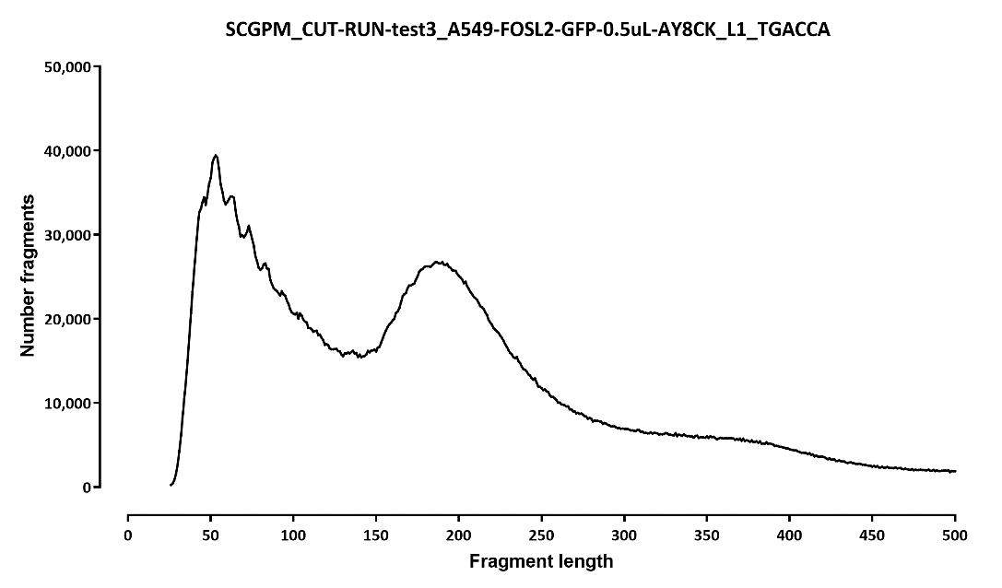
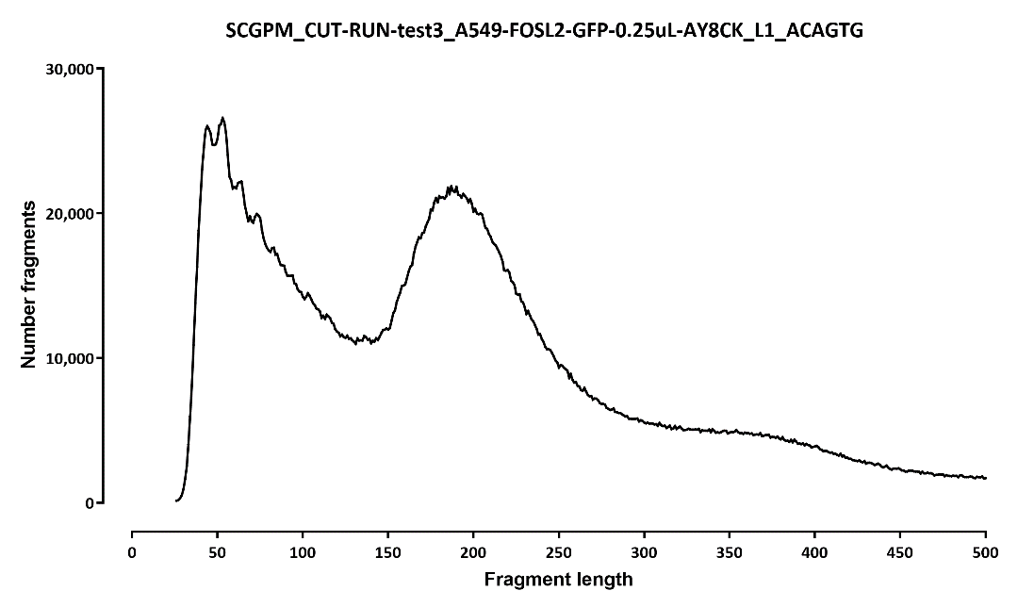
Fragment length distribution:

Slide 3
Overlap with ChIP-seq peaks and CTCF motifs:
 | number peaks |  |  |  |  |  |  |  | fraction
 | ChIP peak |  | no ChIP peak |  |  |  | ChIP peak | no ChIP peak | ChIP peak |  | no ChIP peak
 | motif | no motif | motif | no motif |  |  |  |  | motif | no motif | motif | no motif
A549-FOSL2-HA-ENCFF374ZCG | 18,729 | 14,625 | 0 | 0 |  | A549-FOSL2-HA-ENCFF374ZCG | 1.00 | 0.00 | 0.56 | 0.44 | n/a | n/a
A549-eGFP-FOSL2-Snyder-IDR | 22,880 | 11,950 | 0 | 0 |  | A549-eGFP-FOSL2-Snyder-IDR | 1.00 | 0.00 | 0.66 | 0.34 | n/a | n/a
CUT&RUN-1uL | 14,147 | 8,243 | 6,345 | 14,540 |  | TTAGGC | 0.52 | 0.48 | 0.63 | 0.37 | 0.30 | 0.70
CUT&RUN-1uL.maxFL120bp | 11,350 | 8,977 | 3,963 | 19,271 |  | TTAGGC.maxFL120bp | 0.47 | 0.53 | 0.56 | 0.44 | 0.17 | 0.83
CUT&RUN-1uL.minFL150bp | 11,751 | 7,006 | 3,666 | 8,614 |  | TTAGGC.minFL150bp | 0.60 | 0.40 | 0.63 | 0.37 | 0.30 | 0.70
CUT&RUN-0.25uL | 11,459 | 6,472 | 3,006 | 7,586 |  |  | 0.63 | 0.37 | 0.64 | 0.36 | 0.28 | 0.72
CUT&RUN-0.25uL.maxFL120bp | 9,968 | 7,504 | 2,620 | 10,830 |  |  | 0.57 | 0.43 | 0.57 | 0.43 | 0.19 | 0.81
CUT&RUN-0.25uL.minFL150bp | 8,088 | 5,042 | 1,315 | 3,805 |  |  | 0.72 | 0.28 | 0.62 | 0.38 | 0.26 | 0.74
CUT&RUN-0.5uL | 12,472 | 7,088 | 4,131 | 10,231 |  |  | 0.58 | 0.42 | 0.64 | 0.36 | 0.29 | 0.71
CUT&RUN-0.5uL.maxFL120bp | 11,619 | 8,328 | 4,192 | 16,649 |  |  | 0.49 | 0.51 | 0.58 | 0.42 | 0.20 | 0.80
CUT&RUN-0.5uL.minFL150bp | 8,542 | 5,389 | 1,538 | 4,398 |  |  | 0.70 | 0.30 | 0.61 | 0.39 | 0.26 | 0.74

Slide 4
Overlap with 1ug CUT&RUN
#DataSet: |  | file2_test2_0.25ug-all-reads | file2_test2_0.25ug-maxFL120bp | file2_test2_0.25ug-minFL150bp | file2_test2_0.5ug-all-reads | file2_test2_0.5ug-maxFL120bp | file2_test2_0.5ug-minFL150bp | file2_test2_1ug-all-reads | file2_test2_1ug-maxFL120bp | file2_test2_1ug-minFL150bp
 | Regions | 28368 | 30833 | 18138 | 33680 | 40653 | 19705 | 43029 | 43414 | 30844
test2_0.25ug-all-reads | 28368 | 1.00 | 0.67 | 0.63 | 0.82 | 0.72 | 0.59 | 0.91 | 0.74 | 0.80
test2_0.25ug-maxFL120bp | 30833 | 0.68 | 1.00 | 0.47 | 0.71 | 0.73 | 0.49 | 0.80 | 0.75 | 0.66
test2_0.25ug-minFL150bp | 18138 | 0.98 | 0.70 | 1.00 | 0.90 | 0.76 | 0.76 | 0.96 | 0.78 | 0.91
test2_0.5ug-all-reads | 33680 | 0.69 | 0.59 | 0.49 | 1.00 | 0.69 | 0.58 | 0.85 | 0.69 | 0.73
test2_0.5ug-maxFL120bp | 40653 | 0.56 | 0.55 | 0.39 | 0.64 | 1.00 | 0.42 | 0.71 | 0.66 | 0.57
test2_0.5ug-minFL150bp | 19705 | 0.85 | 0.69 | 0.70 | 0.98 | 0.75 | 1.00 | 0.94 | 0.76 | 0.89
test2_1ug-all-reads | 43029 | 0.60 | 0.53 | 0.41 | 0.66 | 0.61 | 0.43 | 1.00 | 0.65 | 0.71
test2_1ug-maxFL120bp | 43414 | 0.54 | 0.53 | 0.38 | 0.59 | 0.61 | 0.40 | 0.71 | 1.00 | 0.55
test2_1ug-minFL150bp | 30844 | 0.73 | 0.60 | 0.54 | 0.79 | 0.67 | 0.57 | 0.99 | 0.69 | 1.00

Slide 5
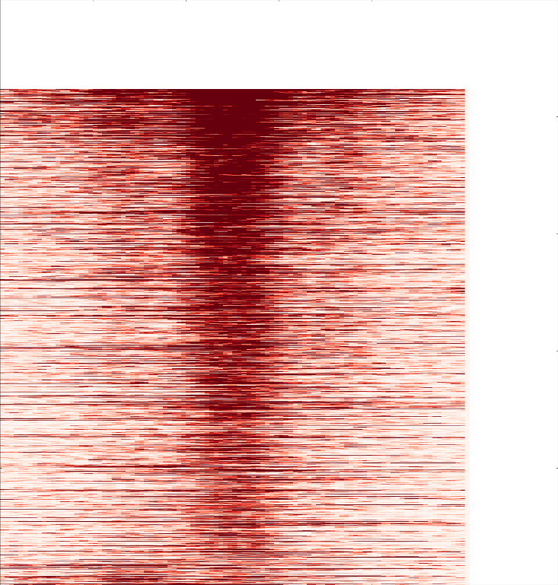
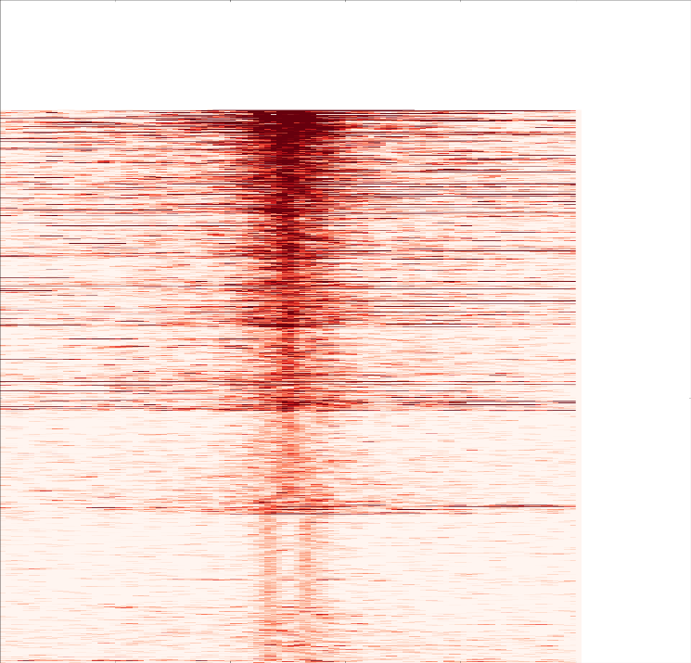
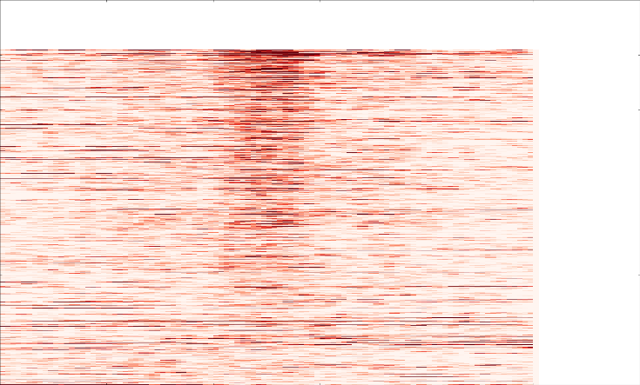
Overlap with ChIP-seq peaks, profile around peaks, FOSL2 , 0.5ug
common sites ChIP-only sites CUT&RUN only sites

Slide 6
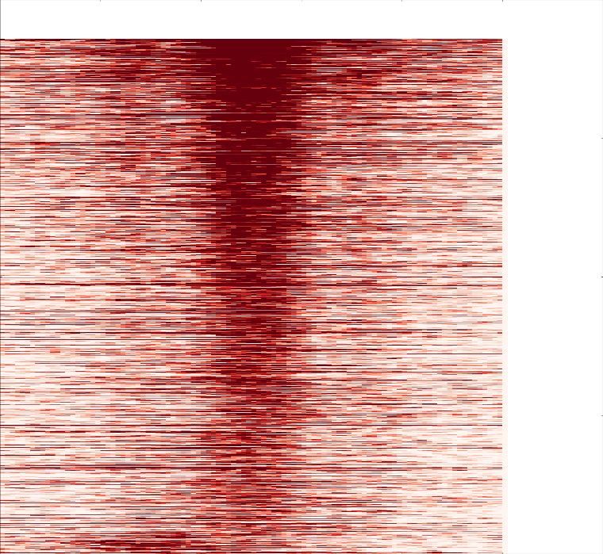
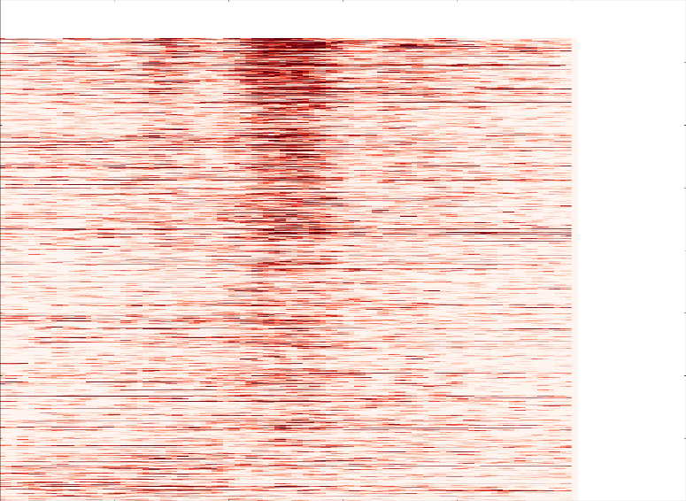
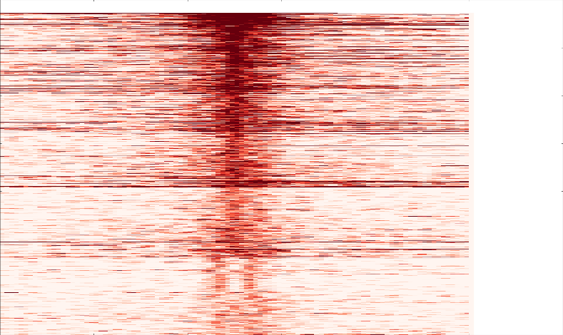
Overlap with ChIP-seq peaks, profile around peaks, FOSL2
common sites ChIP-only sites CUT&RUN only sites

Slide 7
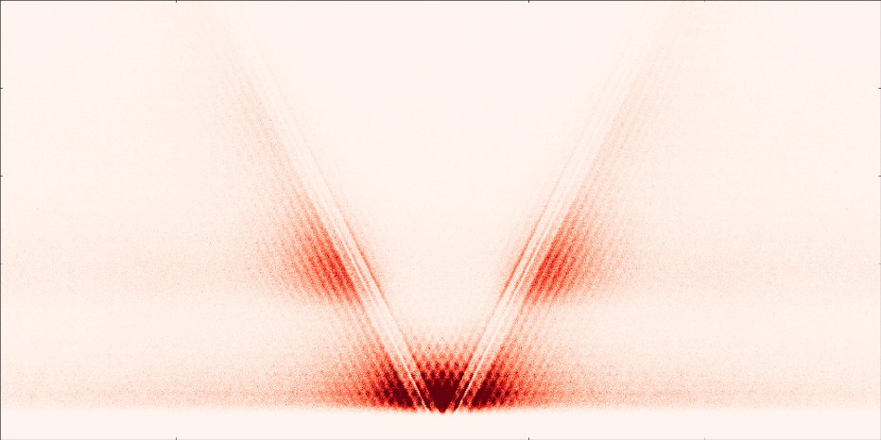
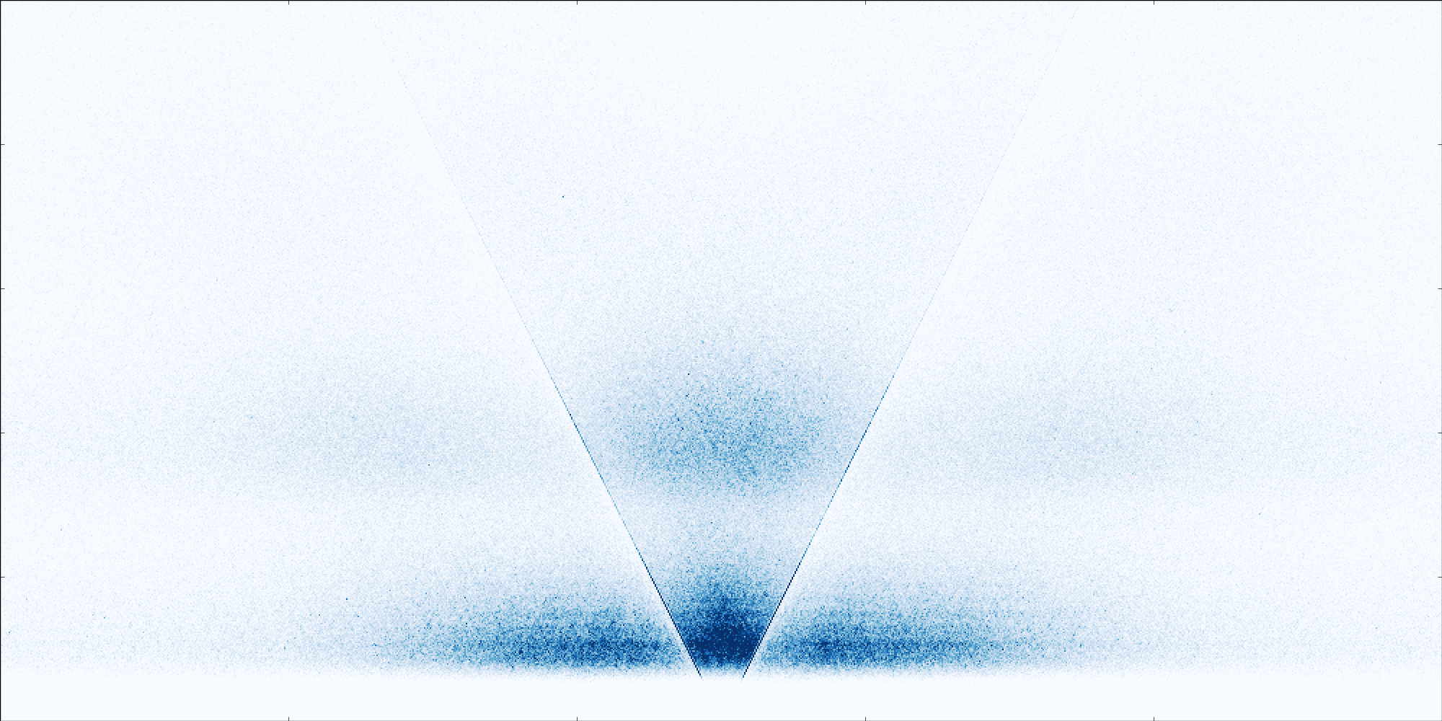
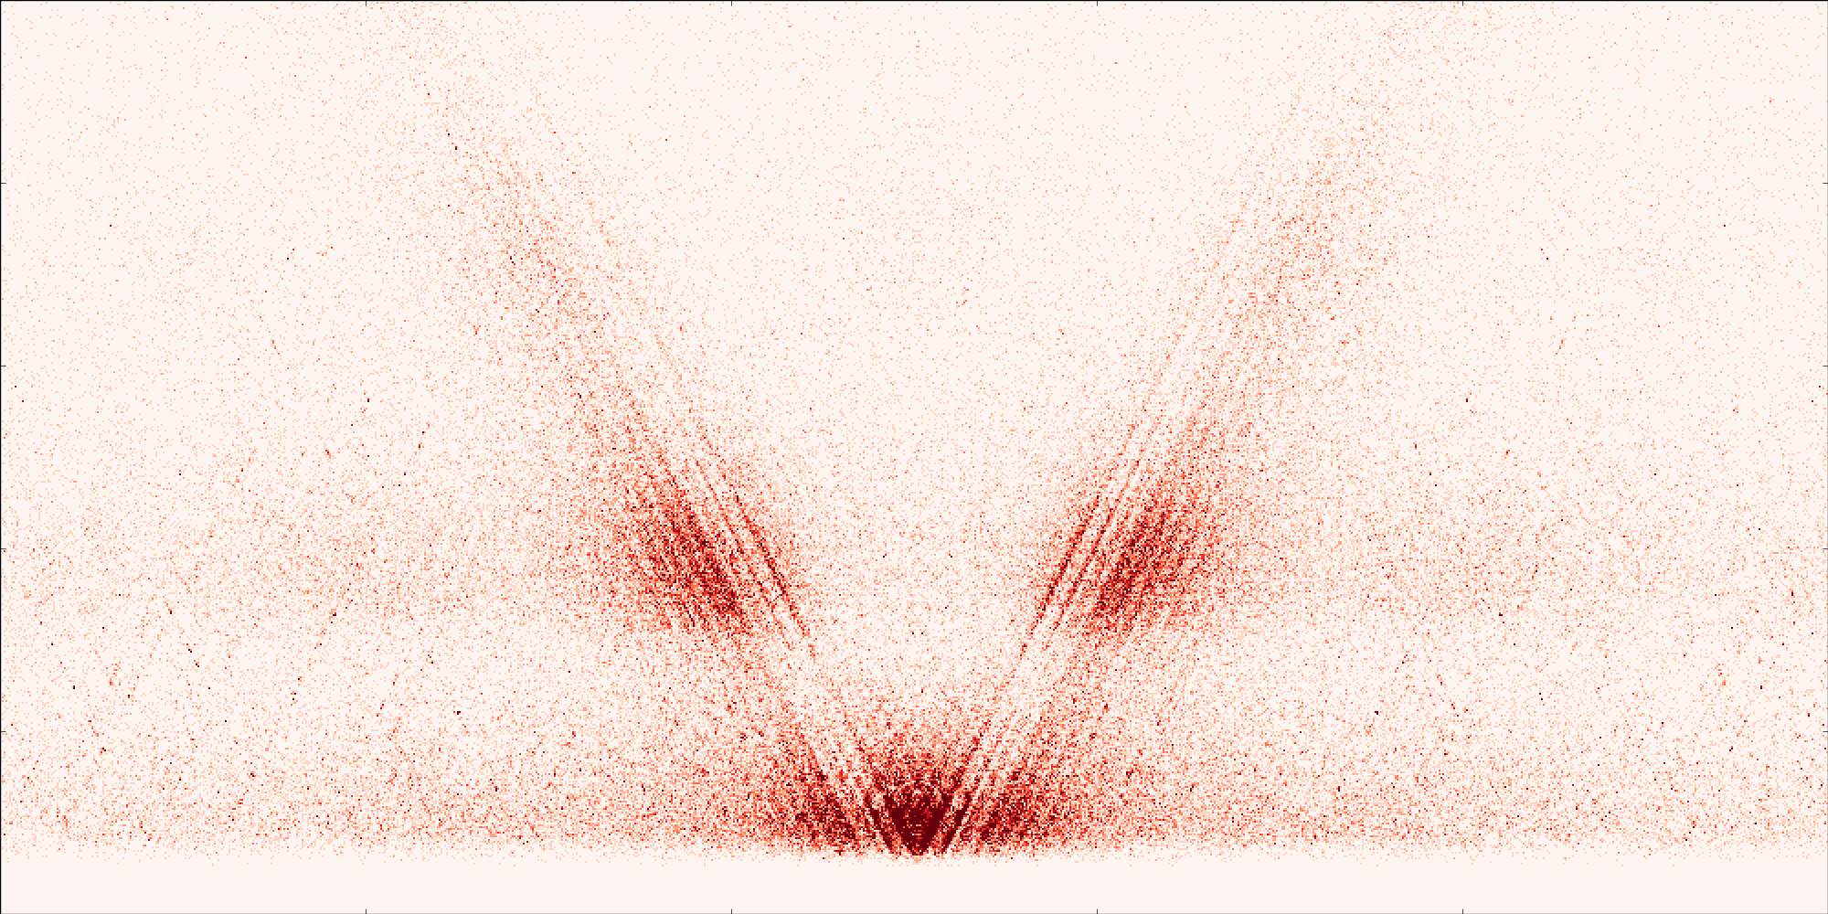

FOSL2, 0.25ug
motif-centered
MACS2 peak call-centered
500
ChIP-common sites
with motif
ChIP-common sites
with motif
0
CUTnRUN-only sites
with motif
CUTnRUN-only sites
no motif
-500 0 500

Slide 8
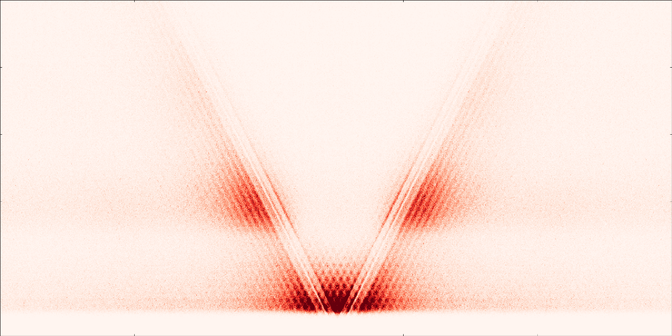

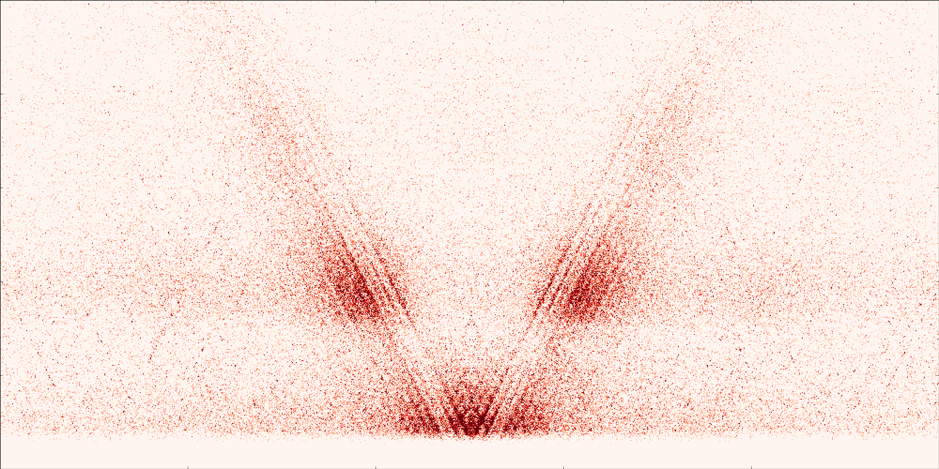

FOSL2, 0.5ug
motif-centered
MACS2 peak call-centered
500
ChIP-common sites
with motif
ChIP-common sites
with motif
0
CUTnRUN-only sites
with motif
CUTnRUN-only sites
no motif
-500 0 500

