Slide 1
Dataset stats
Homo sapiens hg19-male | SCGPM_CUT-RUN-test2_A549-FOSL2-GFP-ATWJL_L1_GCCAAT | 0.83 | 43,275 | 358,158 | 43,029 | 348,547 | 2x25 | 19,882,234 | 11,903,934 | 0.84
Homo sapiens hg19-male | SCGPM_CUT-RUN-test2_A549-FOSL2-GFP-ATWJL_L1_GCCAAT | 0.83 | 43,561 | 422,574 | 43,414 | 412,859 | 2x25-maxFL120 | 5,233,868 | 11,903,934 | 0.22
Homo sapiens hg19-male | SCGPM_CUT-RUN-test2_A549-FOSL2-GFP-ATWJL_L1_GCCAAT | 0.85 | 31,037 | 298,799 | 30,844 | 289,984 | 2x25-minFL150 | 13,105,348 | 11,903,934 | 0.55
Homo sapiens hg19-male | SCGPM_CUT-RUN-test2_A549-H3K4me1-ATWJL_L1_CGATGT | 0.94 | 53,467 | 169,952 | 53,421 | 169,634 | 2x25 | 30,056,250 | 17,187,817 | 0.87
Homo sapiens hg19-male | SCGPM_CUT-RUN-test2_A549-H3K4me1-ATWJL_L1_CGATGT | 0.98 | 3,534 | 14,513 | 3,525 | 14,326 | 2x25-maxFL120 | 2,136,256 | 17,187,817 | 0.06
Homo sapiens hg19-male | SCGPM_CUT-RUN-test2_A549-H3K4me1-ATWJL_L1_CGATGT | 0.94 | 49,537 | 157,670 | 49,489 | 157,370 | 2x25-minFL150 | 26,231,238 | 17,187,817 | 0.76

Slide 2
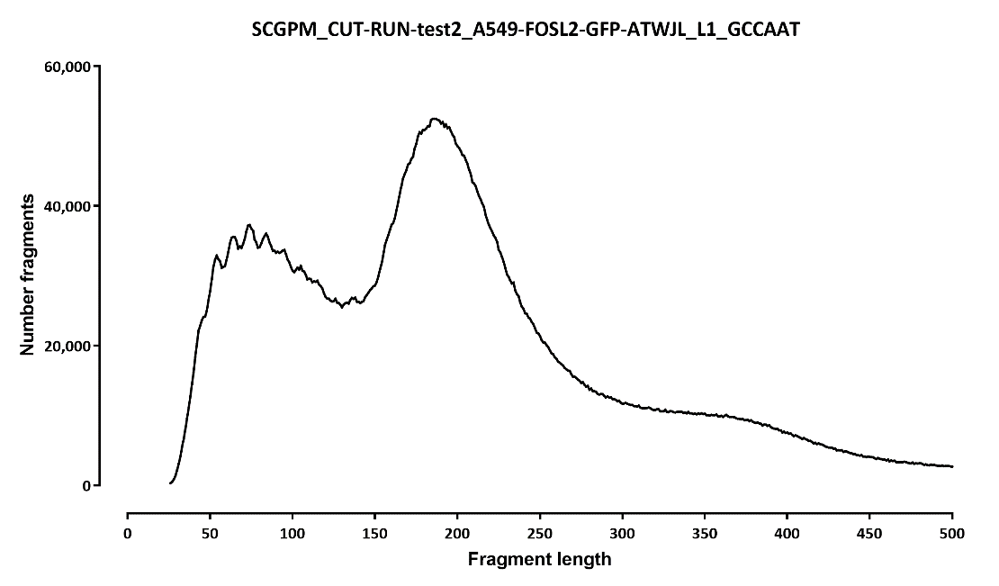
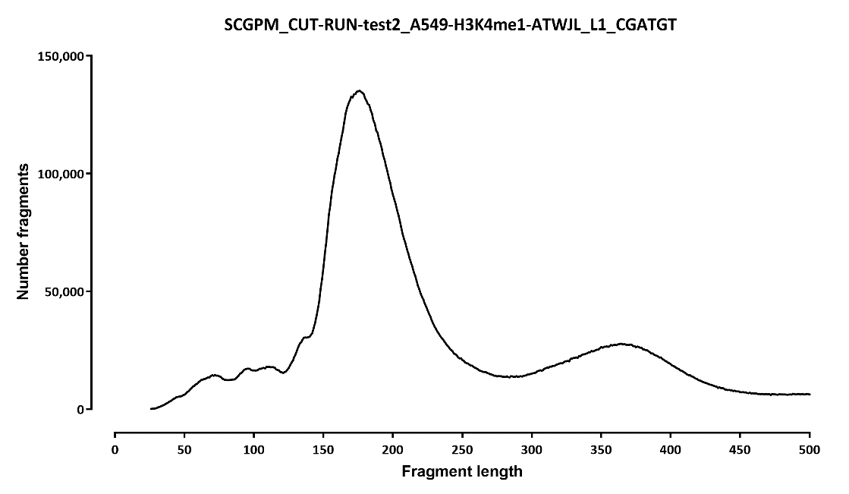
Fragment length distribution:

Slide 3
Overlap with ChIP-seq peaks and CTCF motifs:
 | number peaks |  |  |  |  |  |  |  | fraction
 | ChIP peak |  | no ChIP peak |  |  |  | ChIP peak | no ChIP peak | ChIP peak |  | no ChIP peak
 | motif | no motif | motif | no motif |  |  |  |  | motif | no motif | motif | no motif
A549-FOSL2-HA-ENCFF374ZCG | 18,729 | 14,625 | 0 | 0 |  | A549-FOSL2-HA-ENCFF374ZCG | 1.00 | 0.00 | 0.56 | 0.44 | n/a | n/a
GCCAAT | 14,147 | 8,243 | 6,345 | 14,540 |  | TTAGGC | 0.52 | 0.48 | 0.63 | 0.37 | 0.30 | 0.70
GCCAAT.maxFL120bp | 11,350 | 8,977 | 3,963 | 19,271 |  | TTAGGC.maxFL120bp | 0.47 | 0.53 | 0.56 | 0.44 | 0.17 | 0.83
GCCAAT.minFL150bp | 11,751 | 7,006 | 3,666 | 8,614 |  | TTAGGC.minFL150bp | 0.60 | 0.40 | 0.63 | 0.37 | 0.30 | 0.70

Slide 4
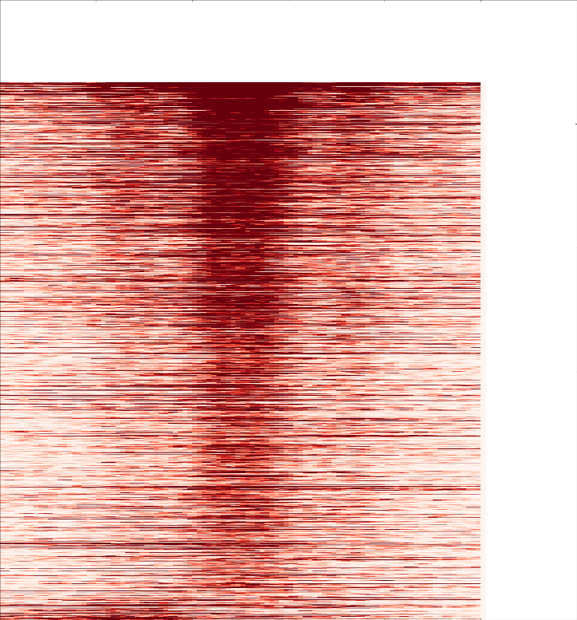
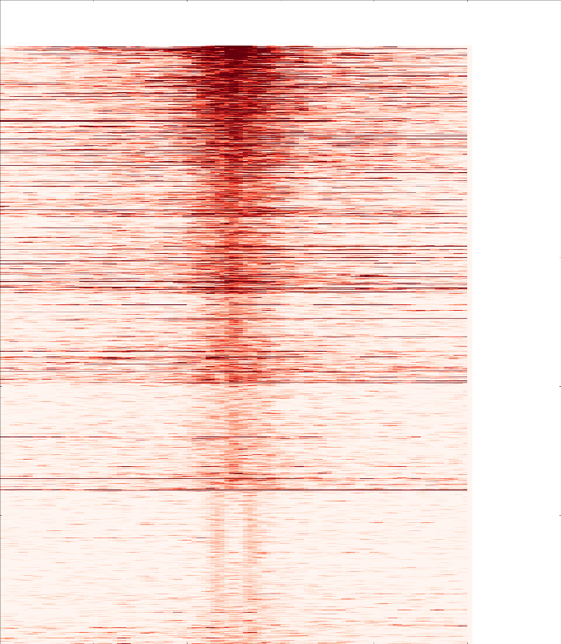
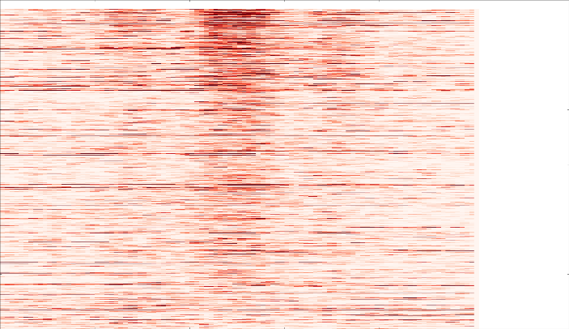
Overlap with ChIP-seq peaks, profile around peaks, FOSL2
common sites ChIP-only sites CUT&RUN only sites

Slide 5
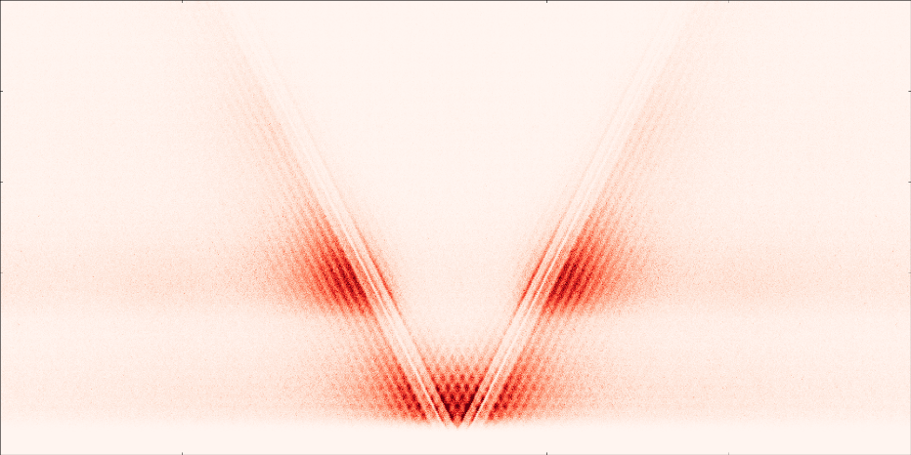
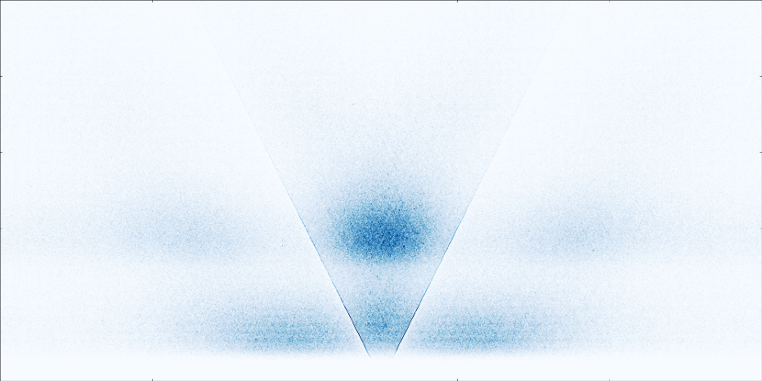
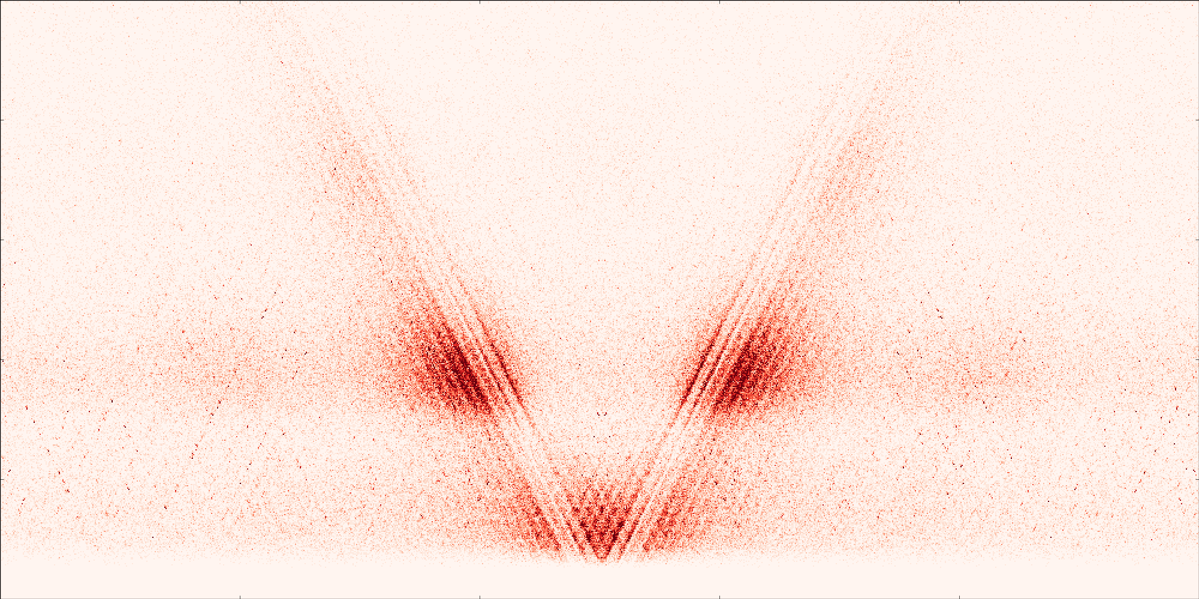

CTCF ACTTGA
motif-centered
MACS2 peak call-centered
500
ChIP-common sites
with motif
ChIP-common sites
with motif
0
CUTnRUN-only sites
with motif
CUTnRUN-only sites
no motif
-500 0 500

Slide 6
Overlap with ChIP-seq peaks and CTCF motifs:
 | number peaks |  |  |  |  |  |  |  | fraction
 | ChIP peak |  | no ChIP peak |  |  |  | ChIP peak | no ChIP peak | ChIP peak |  | no ChIP peak
 | motif | no motif | motif | no motif |  |  |  |  | motif | no motif | motif | no motif
A549-eGFP-FOSL2-Snyder-IDR | 22,880 | 11,950 | 0 | 0 |  | A549-eGFP-FOSL2-Snyder-IDR | 1.00 | 0.00 | 0.66 | 0.34 | n/a | n/a
GCCAAT | 15,090 | 7,938 | 6,278 | 14,845 |  | TTAGGC | 0.52 | 0.48 | 0.66 | 0.34 | 0.30 | 0.70
GCCAAT.maxFL120bp | 11,898 | 8,827 | 3,415 | 19,421 |  | TTAGGC.maxFL120bp | 0.48 | 0.52 | 0.57 | 0.43 | 0.15 | 0.85
GCCAAT.minFL150bp | 12,417 | 6,991 | 3,000 | 8,629 |  | TTAGGC.minFL150bp | 0.63 | 0.37 | 0.64 | 0.36 | 0.26 | 0.74

