Slide 1
MAPPING STATS
# | Exonic: | Intergenic: | Intronic:
Quant-seq_Day-14_neuron_rep1 | 0.75 | 0.09 | 0.16
Quant-seq_Day-14_neuron_rep2 | 0.70 | 0.09 | 0.21
Quant-seq_Day-21_neuron_rep1 | 0.72 | 0.10 | 0.17
Quant-seq_Day-21_neuron_rep2 | 0.57 | 0.11 | 0.32
Quant-seq_Day-28_neuron_rep1 | 0.70 | 0.11 | 0.19
Quant-seq_Day-28_neuron_rep2 | 0.74 | 0.10 | 0.16

Slide 2
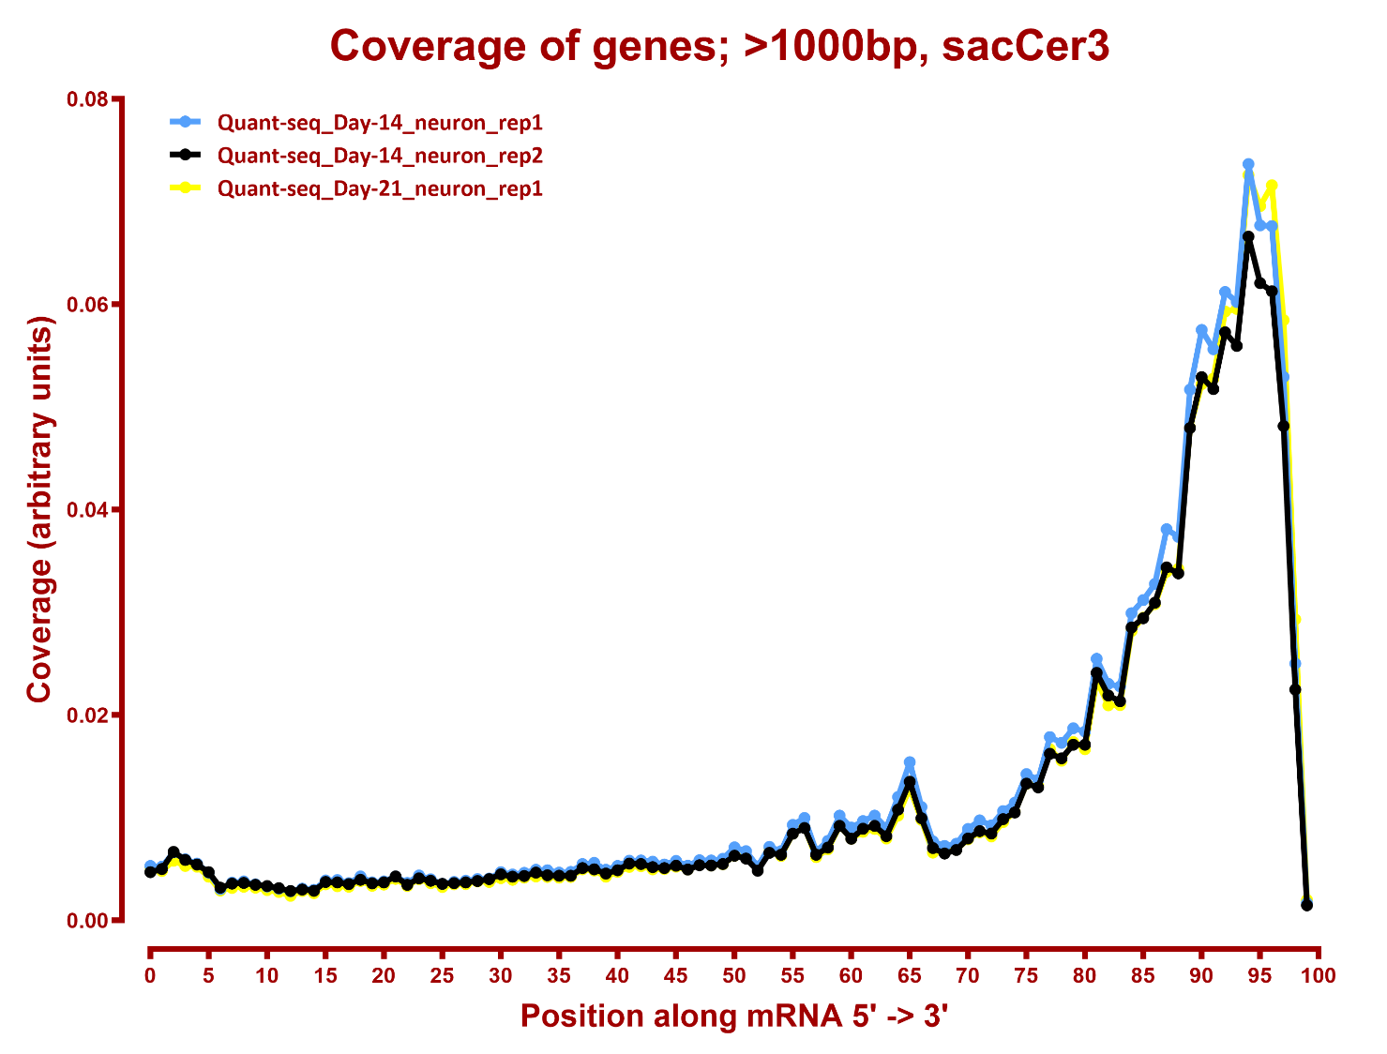
COVERAGE

Slide 3
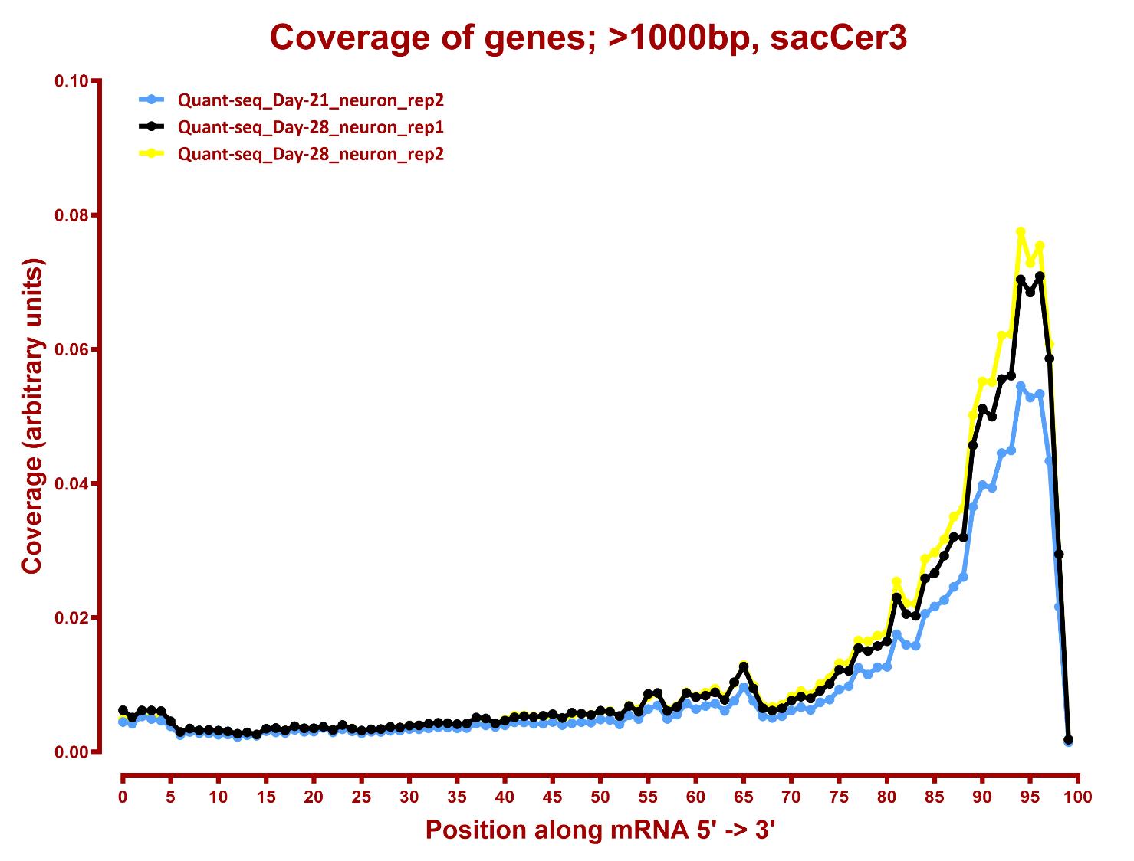

Slide 4
QUANTIFICATION:
-- ran Stringtie on artificial GTF files containing the last 300 bp of each gene/transcript

