Slide 1
Mapping stats

Slide 2
Read distribution
# | Exonic: | Intergenic: | Intronic:
MS119-HDF_NT1 | 0.92 | 0.03 | 0.05
MS120-HDF_NT2 | 0.94 | 0.03 | 0.03
MS121-HDF_NT3 | 0.94 | 0.03 | 0.04
MS122-HDF_TASOR2_1 | 0.94 | 0.02 | 0.04
MS123-HDF_TASOR2_2 | 0.94 | 0.02 | 0.03
MS124-HDF_TASOR2_3 | 0.93 | 0.03 | 0.04
MS125-HDF_TASOR_1 | 0.93 | 0.03 | 0.05
MS126-HDF_TASOR_2 | 0.94 | 0.02 | 0.04
MS127-K562_NT1 | 0.86 | 0.07 | 0.07
MS128-K562_NT2 | 0.86 | 0.07 | 0.07
MS129-K562_NT3 | 0.86 | 0.07 | 0.08
MS130-K562_TASOR2_1 | 0.85 | 0.07 | 0.07
MS131-K562_TASOR2_2 | 0.85 | 0.07 | 0.07
MS132-K562_TASOR2_3 | 0.86 | 0.07 | 0.07
MS133-K562_TASOR_1 | 0.86 | 0.07 | 0.07
MS134-K562_TASOR_2 | 0.86 | 0.07 | 0.07

Slide 3
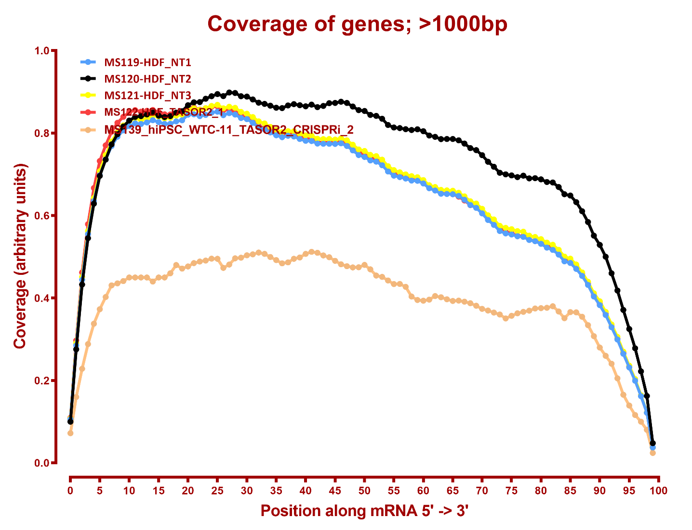
Read coverage

Slide 4
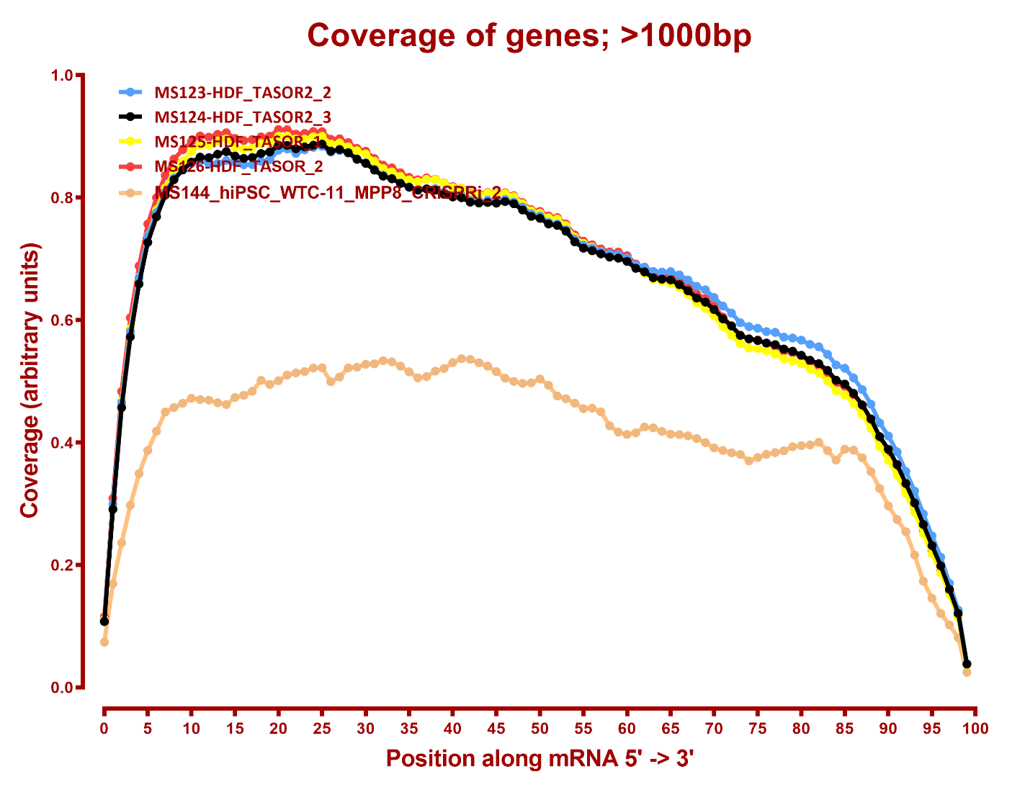
Read coverage

Slide 5
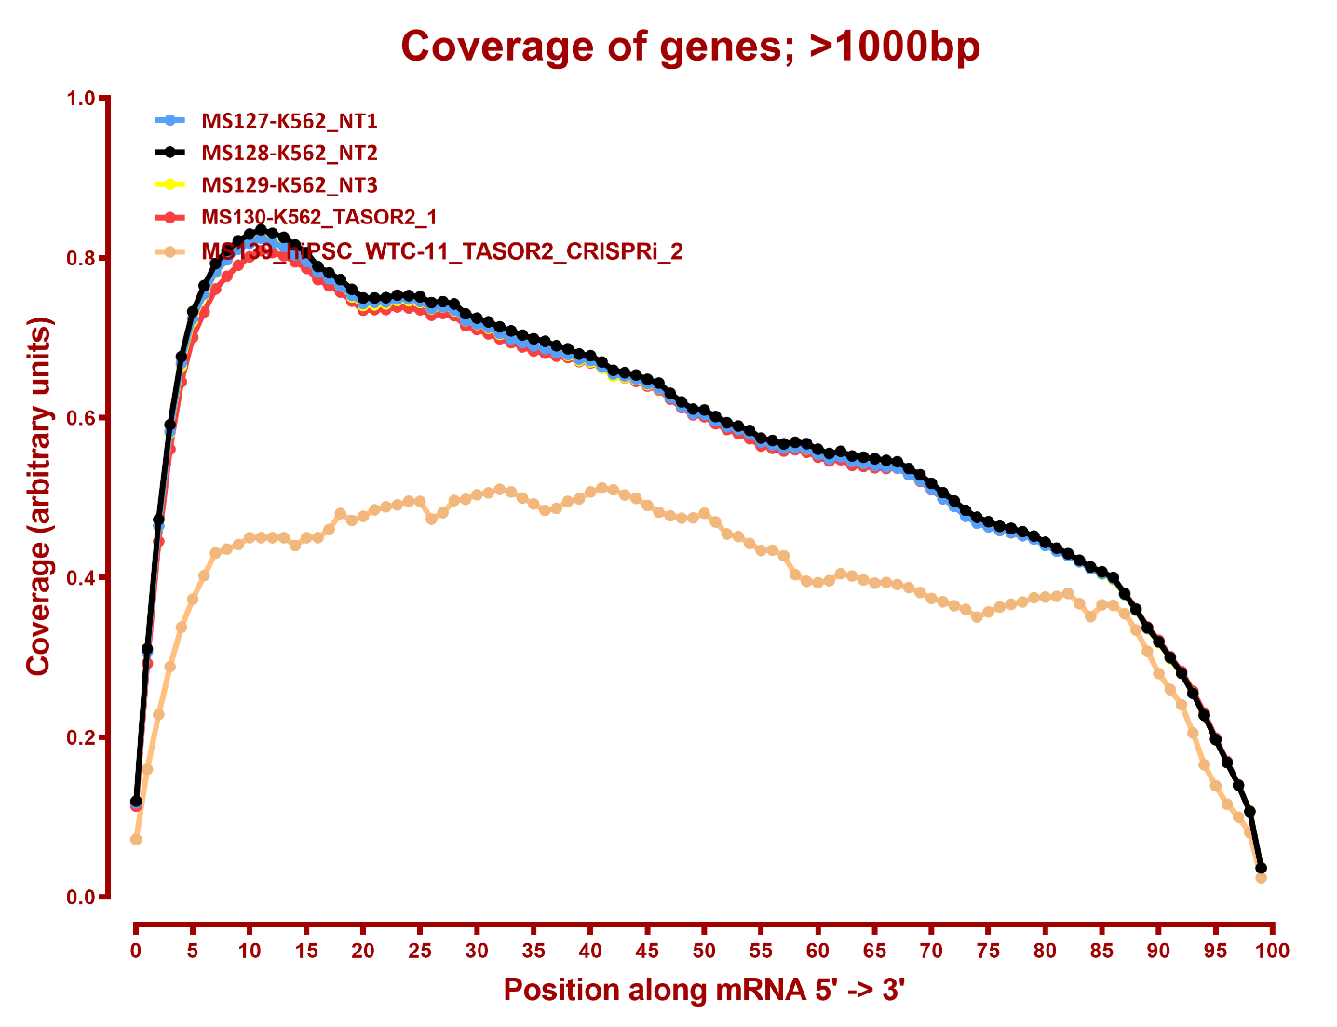
Read coverage

Slide 6
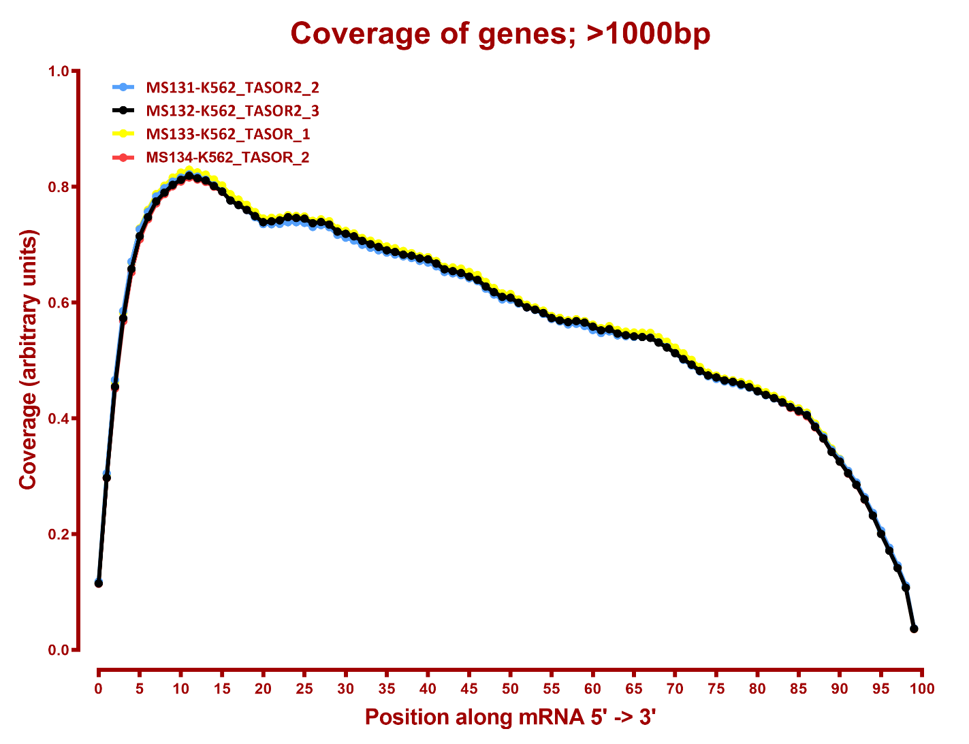
Read coverage

Slide 7
RSEM refSeq T2T
Number differential genes
A | B | p-adj |  | p-val
 |  | up in B vs A | down in B vs A | up in B vs A | down in B vs A
HDF_NT | HDF_TASOR2 | 5 | 6 | 410 | 437
HDF_NT | HDF_TASOR | 673 | 891 | 1,753 | 2,020
HDF_TASOR | HDF_TASOR2 | 961 | 641 | 2,059 | 1,659
K562_NT | K562_TASOR2 | 121 | 18 | 548 | 415
K562_NT | K562_TASOR | 4 | 2 | 520 | 379
K562_TASOR | K562_TASOR2 | 98 | 53 | 484 | 664

Slide 8
RSEM refSeq hg38
Number differential genes
A | B | p-adj |  | p-val
 |  | up in B vs A | down in B vs A | up in B vs A | down in B vs A
HDF_NT | HDF_TASOR2 | 5 | 3 | 339 | 397
HDF_NT | HDF_TASOR | 666 | 910 | 1,635 | 1,952
HDF_TASOR | HDF_TASOR2 | 941 | 639 | 1,956 | 1,628
K562_NT | K562_TASOR2 | 125 | 17 | 524 | 379
K562_NT | K562_TASOR | 4 | 2 | 461 | 316
K562_TASOR | K562_TASOR2 | 106 | 54 | 462 | 618

Slide 9
eXpress refSeq T2T
Number differential genes
A | B | p-adj |  | p-val
 |  | up in B vs A | down in B vs A | up in B vs A | down in B vs A
HDF_NT | HDF_TASOR2 | 8 | 10 | 499 | 586
HDF_NT | HDF_TASOR | 369 | 534 | 1,341 | 1,637
HDF_TASOR | HDF_TASOR2 | 497 | 284 | 1,535 | 1,162
K562_NT | K562_TASOR2 | 59 | 21 | 567 | 455
K562_NT | K562_TASOR | 9 | 4 | 509 | 401
K562_TASOR | K562_TASOR2 | 44 | 24 | 503 | 565

Slide 10
eXpress refSeq hg38
Number differential genes
A | B | p-adj |  | p-val
 |  | up in B vs A | down in B vs A | up in B vs A | down in B vs A
HDF_NT | HDF_TASOR2 | 1 | 4 | 361 | 453
HDF_NT | HDF_TASOR | 439 | 592 | 1,372 | 1,611
HDF_TASOR | HDF_TASOR2 | 572 | 388 | 1,474 | 1,230
K562_NT | K562_TASOR2 | 68 | 12 | 459 | 327
K562_NT | K562_TASOR | 4 | 4 | 452 | 326
K562_TASOR | K562_TASOR2 | 42 | 19 | 394 | 439

Slide 11
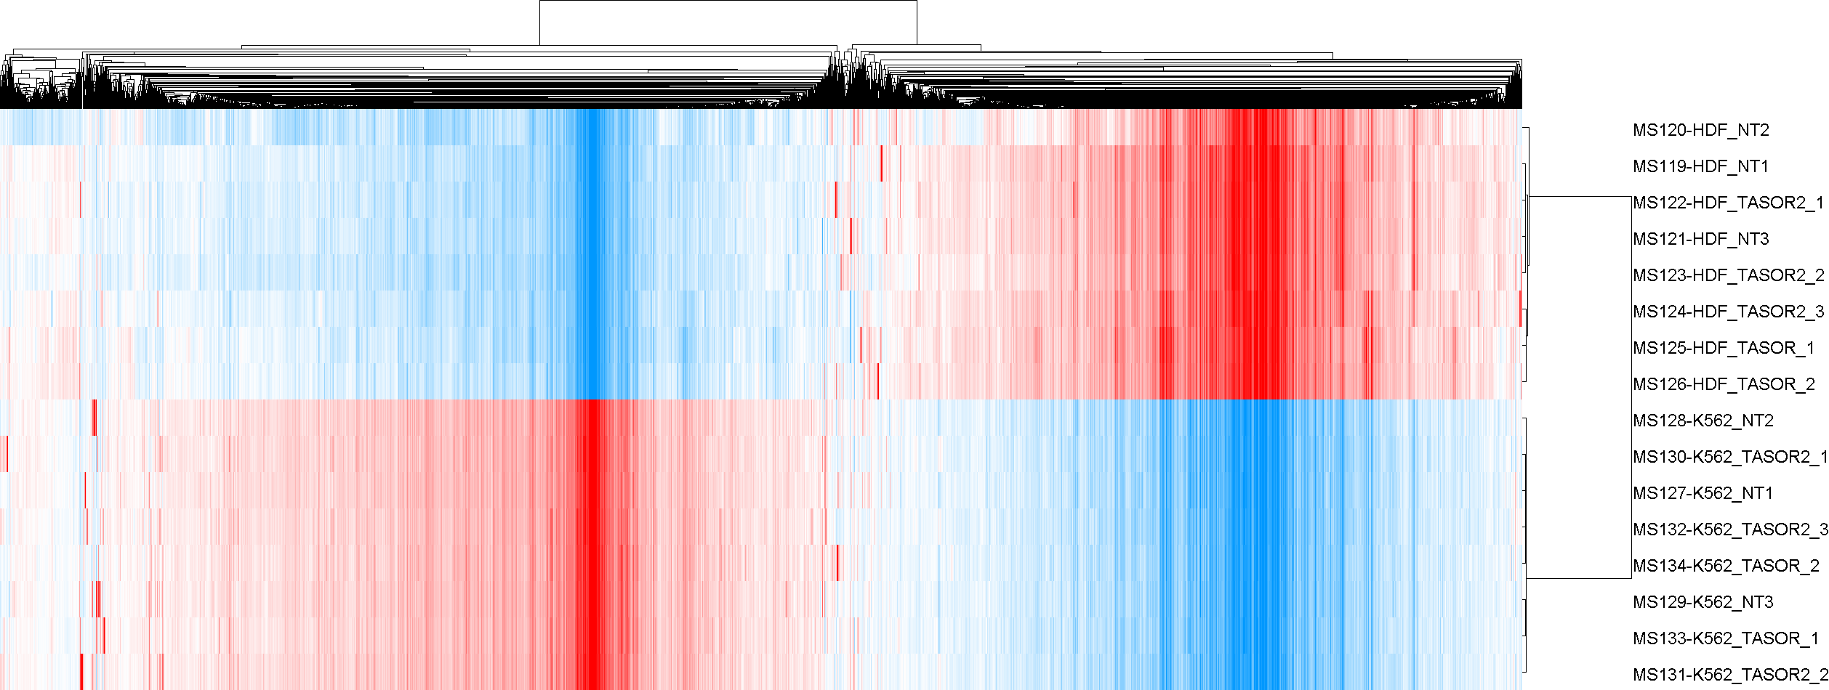
RSEM refSeq T2T

Slide 12
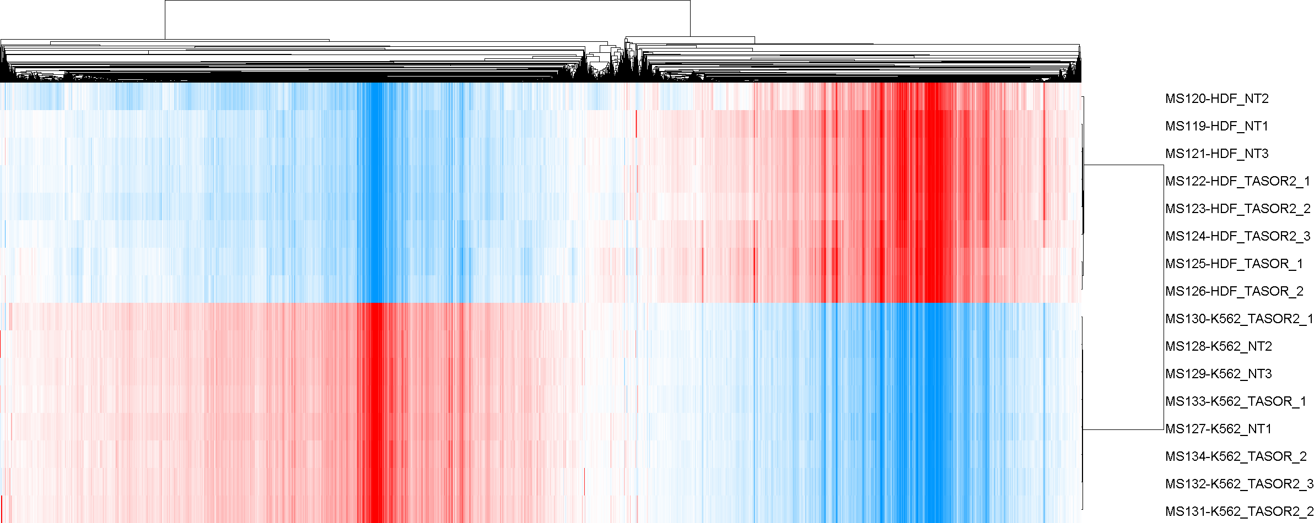
RSEM refSeq hg38

Slide 13
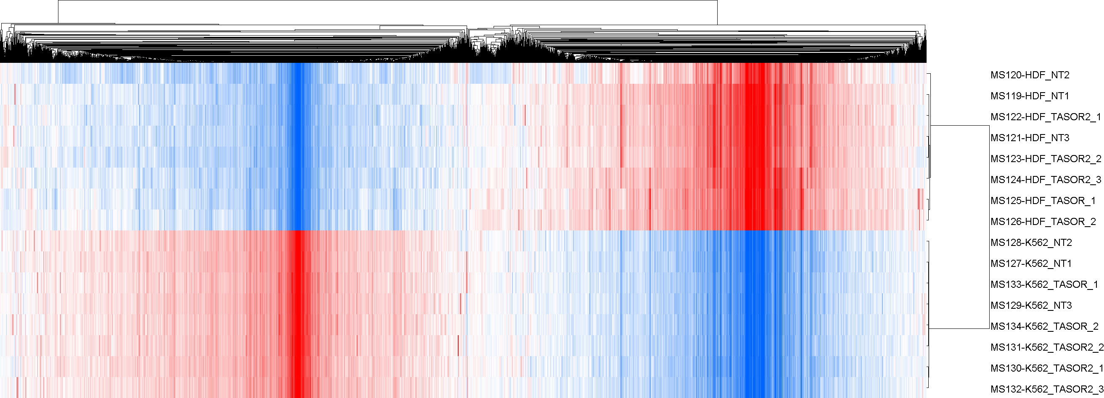
eXpress refSeq T2T

Slide 14
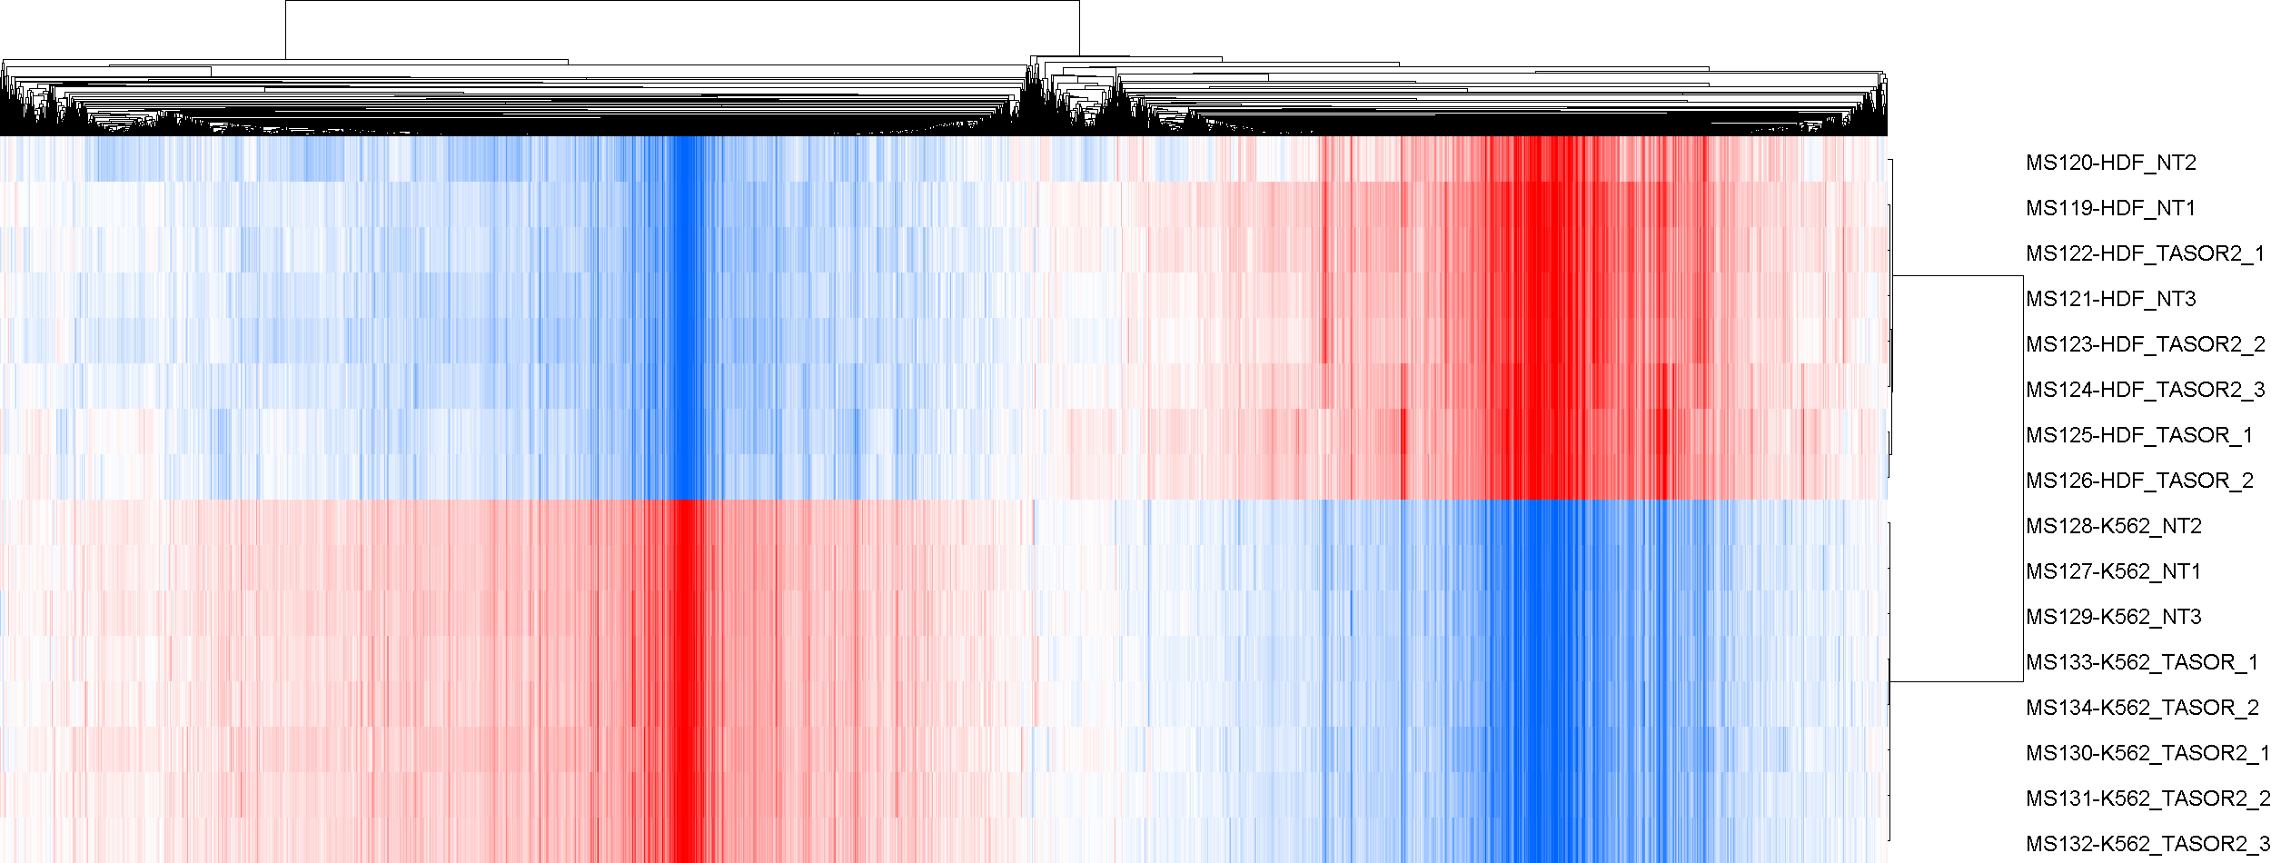
eXpress refSeq hg38

