Slide 1
Mapping stats

Slide 2
Read distribution

Slide 3
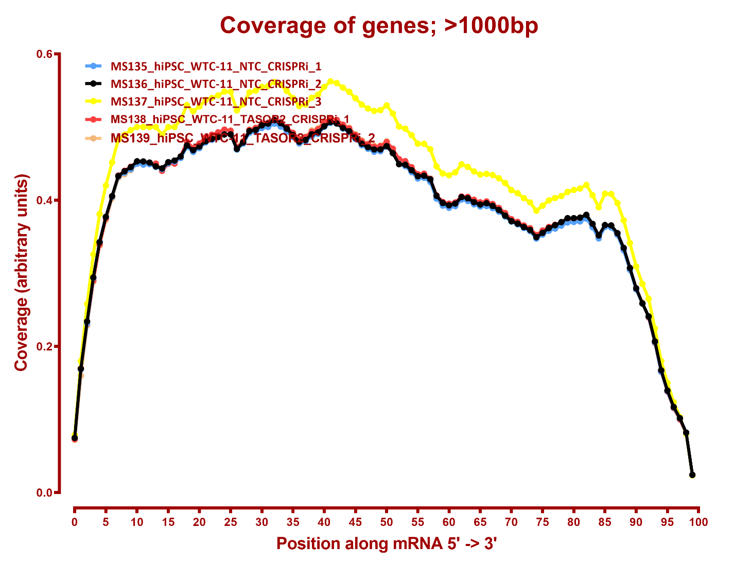
Read coverage

Slide 4
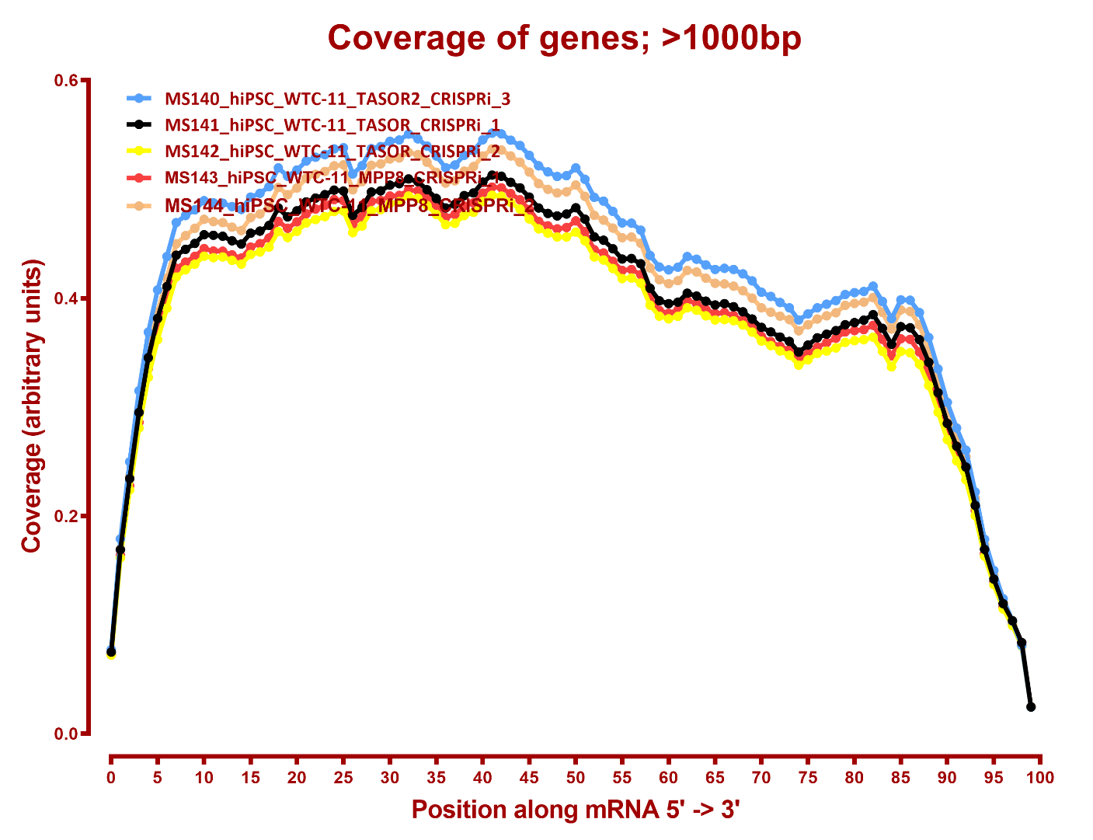
Read coverage

Slide 5
RSEM refSeq T2T
Number differential genes
A | B | p-adj |  | p-val
 |  | up in B vs A | down in B vs A | up in B vs A | down in B vs A
MPP8 | NTC | 399 | 696 | 1,305 | 1,627
MPP8 | TASOR2 | 333 | 574 | 1,177 | 1,409
MPP8 | TASOR | 10 | 26 | 373 | 498
NTC | TASOR2 | 59 | 8 | 395 | 191
NTC | TASOR | 254 | 79 | 821 | 658
TASOR2 | TASOR | 238 | 90 | 792 | 749

Slide 6
RSEM refSeq hg38
Number differential genes
A | B | p-adj |  | p-val
 |  | up in B vs A | down in B vs A | up in B vs A | down in B vs A
MPP8 | NTC | 482 | 706 | 1,338 | 1,569
MPP8 | TASOR2 | 406 | 577 | 1,182 | 1,363
MPP8 | TASOR | 13 | 21 | 385 | 475
NTC | TASOR2 | 59 | 7 | 392 | 180
NTC | TASOR | 209 | 76 | 784 | 625
TASOR2 | TASOR | 199 | 99 | 721 | 718

Slide 7
eXpress refSeq T2T
Number differential genes
A | B | p-adj |  | p-val
 |  | up in B vs A | down in B vs A | up in B vs A | down in B vs A
MPP8 | NTC | 192 | 326 | 1,074 | 1,192
MPP8 | TASOR2 | 155 | 285 | 988 | 1,079
MPP8 | TASOR | 6 | 7 | 481 | 551
NTC | TASOR2 | 22 | 6 | 500 | 346
NTC | TASOR | 148 | 48 | 779 | 645
TASOR2 | TASOR | 149 | 48 | 713 | 723

Slide 8
eXpress refSeq hg38
Number differential genes
A | B | p-adj |  | p-val
 |  | up in B vs A | down in B vs A | up in B vs A | down in B vs A
MPP8 | NTC | 130 | 253 | 803 | 1,016
MPP8 | TASOR2 | 93 | 194 | 735 | 901
MPP8 | TASOR | 6 | 5 | 340 | 352
NTC | TASOR2 | 18 | 5 | 312 | 208
NTC | TASOR | 109 | 26 | 523 | 385
TASOR2 | TASOR | 102 | 24 | 521 | 419

Slide 9
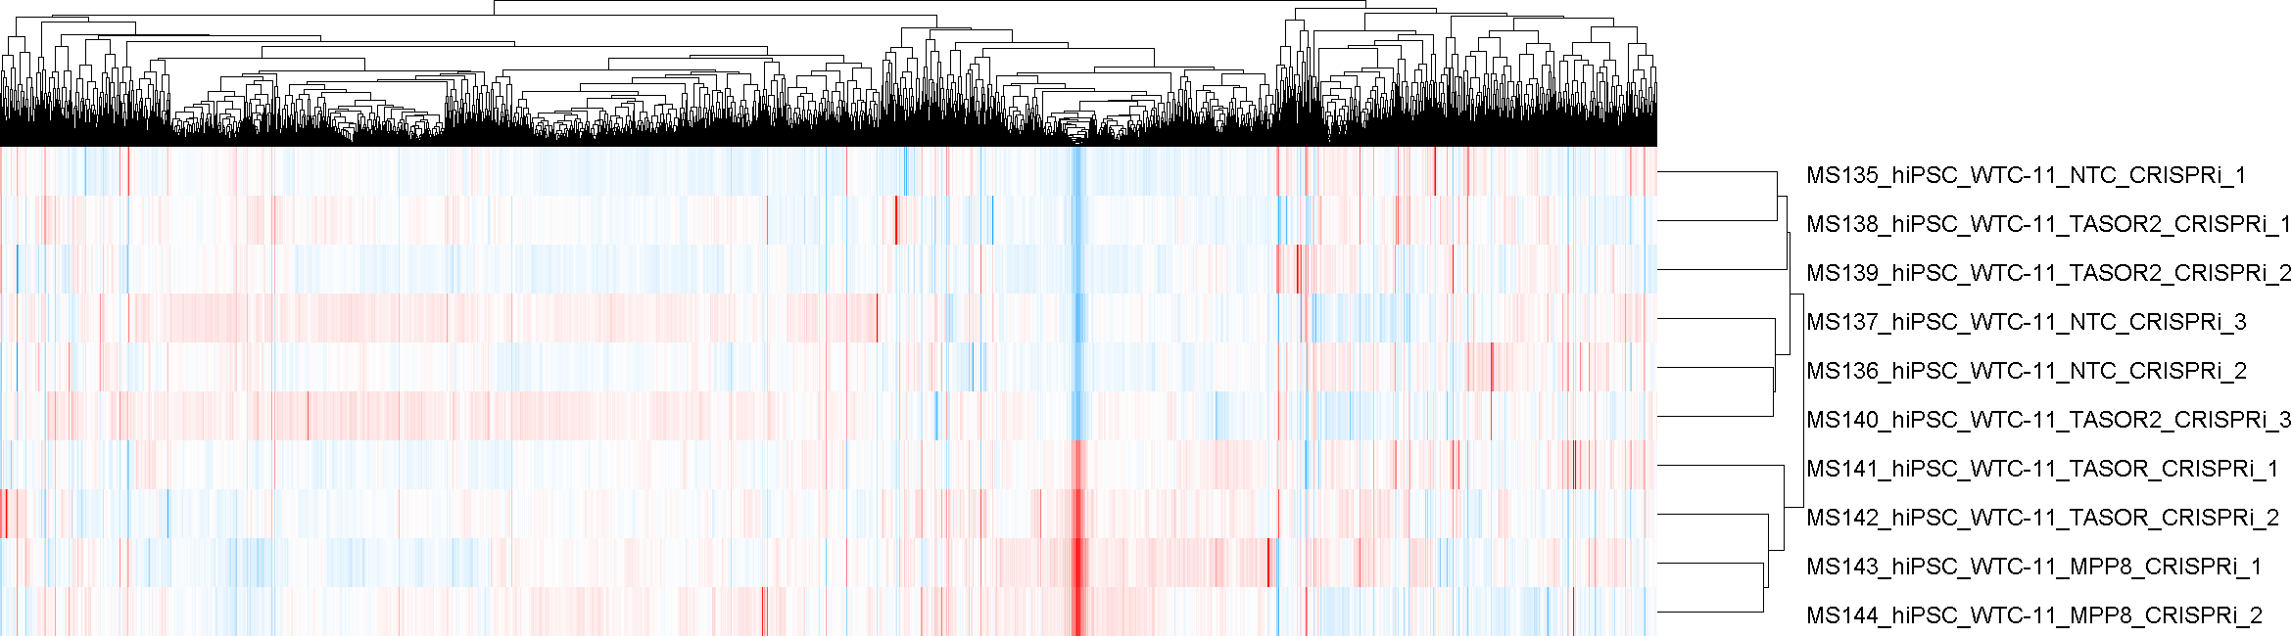
RSEM refSeq T2T

Slide 10
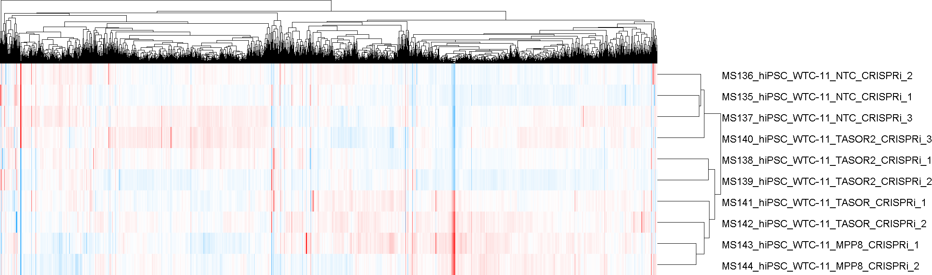
RSEM refSeq hg38

Slide 11
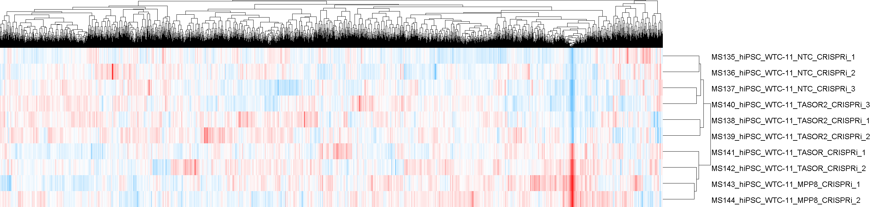
eXpress refSeq T2T

Slide 12
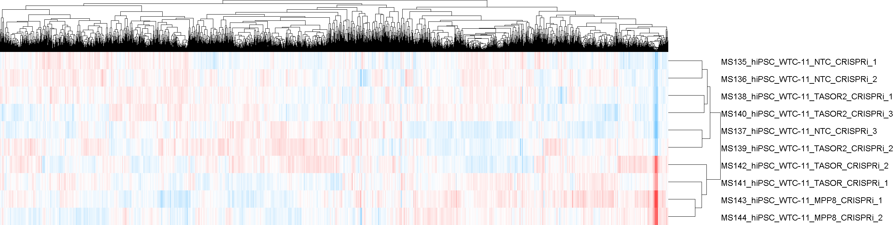
eXpress refSeq hg38

