Slide 1
Mapping stats

Slide 2
Read distribution
# | Exonic: | Intergenic: | Intronic:
RNA-seq_MORC2-KO_rep1-GSM2509513 | 0.83 | 0.09 | 0.08
RNA-seq_MORC2-KO_rep2-GSM2509514 | 0.88 | 0.07 | 0.06
RNA-seq_MPP8-KO_rep1-GSM2509515 | 0.85 | 0.08 | 0.06
RNA-seq_MPP8-KO_rep2-GSM2509516 | 0.83 | 0.10 | 0.07
RNA-seq_TASOR-KO_rep1-GSM2509517 | 0.88 | 0.07 | 0.05
RNA-seq_TASOR-KO_rep2-GSM2509518 | 0.81 | 0.19 | 0.00
RNA-seq_WT_rep1-GSM2509511 | 0.85 | 0.09 | 0.06
RNA-seq_WT_rep2-GSM2509512 | 0.85 | 0.09 | 0.06

Slide 3
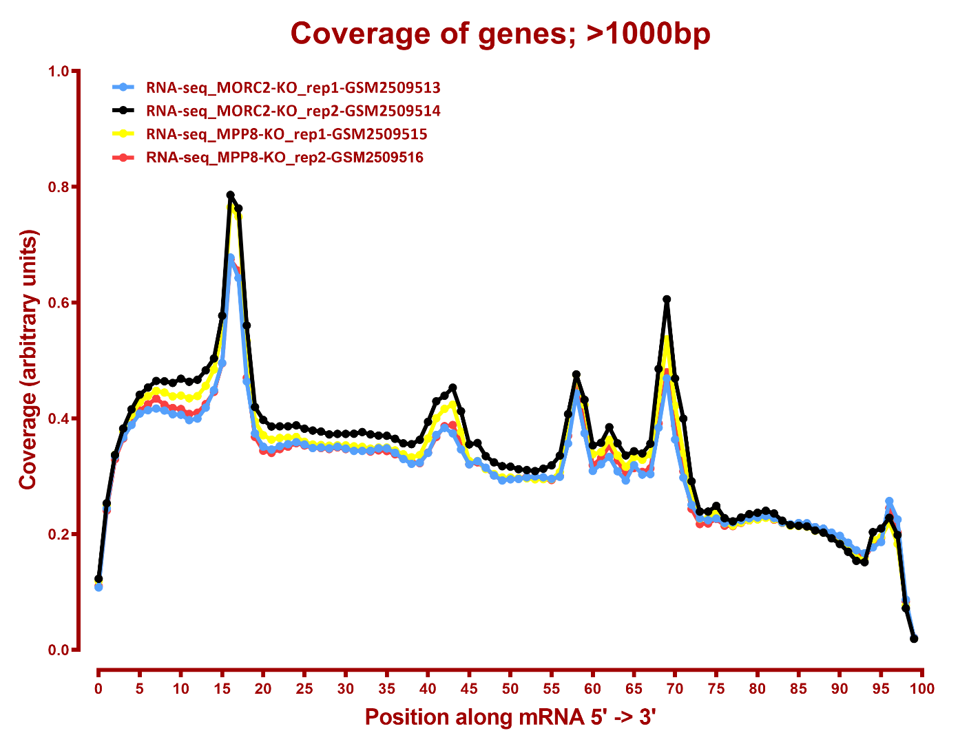
Read coverage

Slide 4
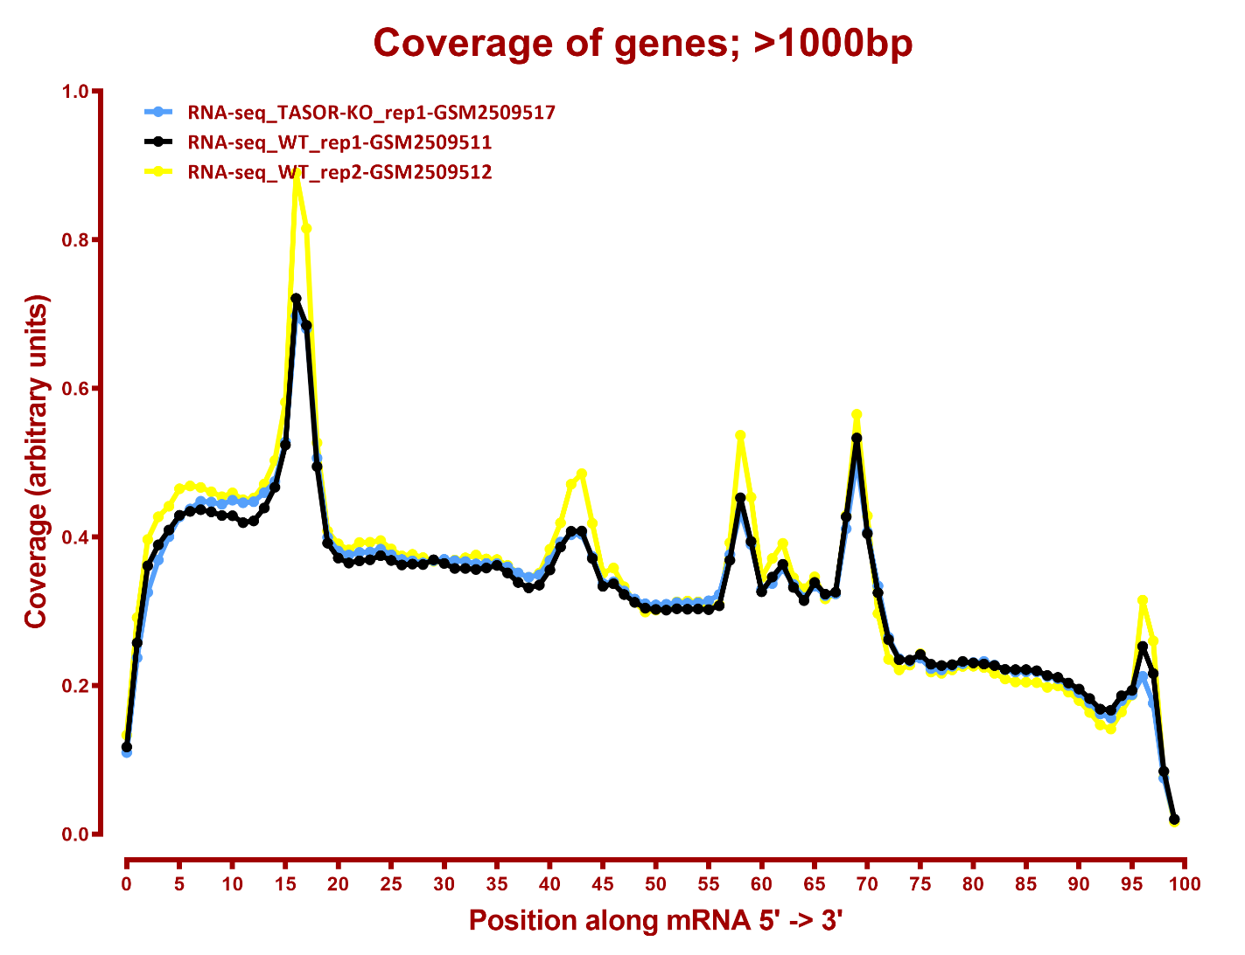
Read coverage

Slide 5
DESeq
Number differential genes
A | B | p-adj |  | p-val
 |  | up in B vs A | down in B vs A | up in B vs A | down in B vs A
MPP8-KO | MORC2-KO | 2 | 3 | 15 | 24
TASOR-KO | MORC2-KO | 3 | 3 | 29 | 16
TASOR-KO | MPP8-KO | 1 | 2 | 31 | 10
WT | MORC2-KO | 1 | 2 | 34 | 33
WT | MPP8-KO | 4 | 2 | 75 | 37
WT | TASOR-KO | 1 | 2 | 24 | 56
Number differential genes, TASOR rep2 excluded
MPP8-KO | MORC2-KO | 8 | 9 | 315 | 358
TASOR-KO | MORC2-KO | 20 | 11 | 525 | 223
TASOR-KO | MPP8-KO | 18 | 3 | 595 | 213
WT | MORC2-KO | 45 | 18 | 582 | 356
WT | MPP8-KO | 103 | 36 | 850 | 681
WT | TASOR-KO | 24 | 33 | 450 | 592

Slide 6
GO enrichment, WT-vs-MORC2 up, p-val
None
GO enrichment, WT-vs-MORC2 down, p-val
None
GO enrichment, WT-vs-TASOR up, p-val
None
GO enrichment, WT-vs-TASOR down, p-val
None

Slide 7
GO enrichment, WT-vs-MPP8 up, p-val
None
GO enrichment, WT-vs-MPP8 down, p-val

Slide 8
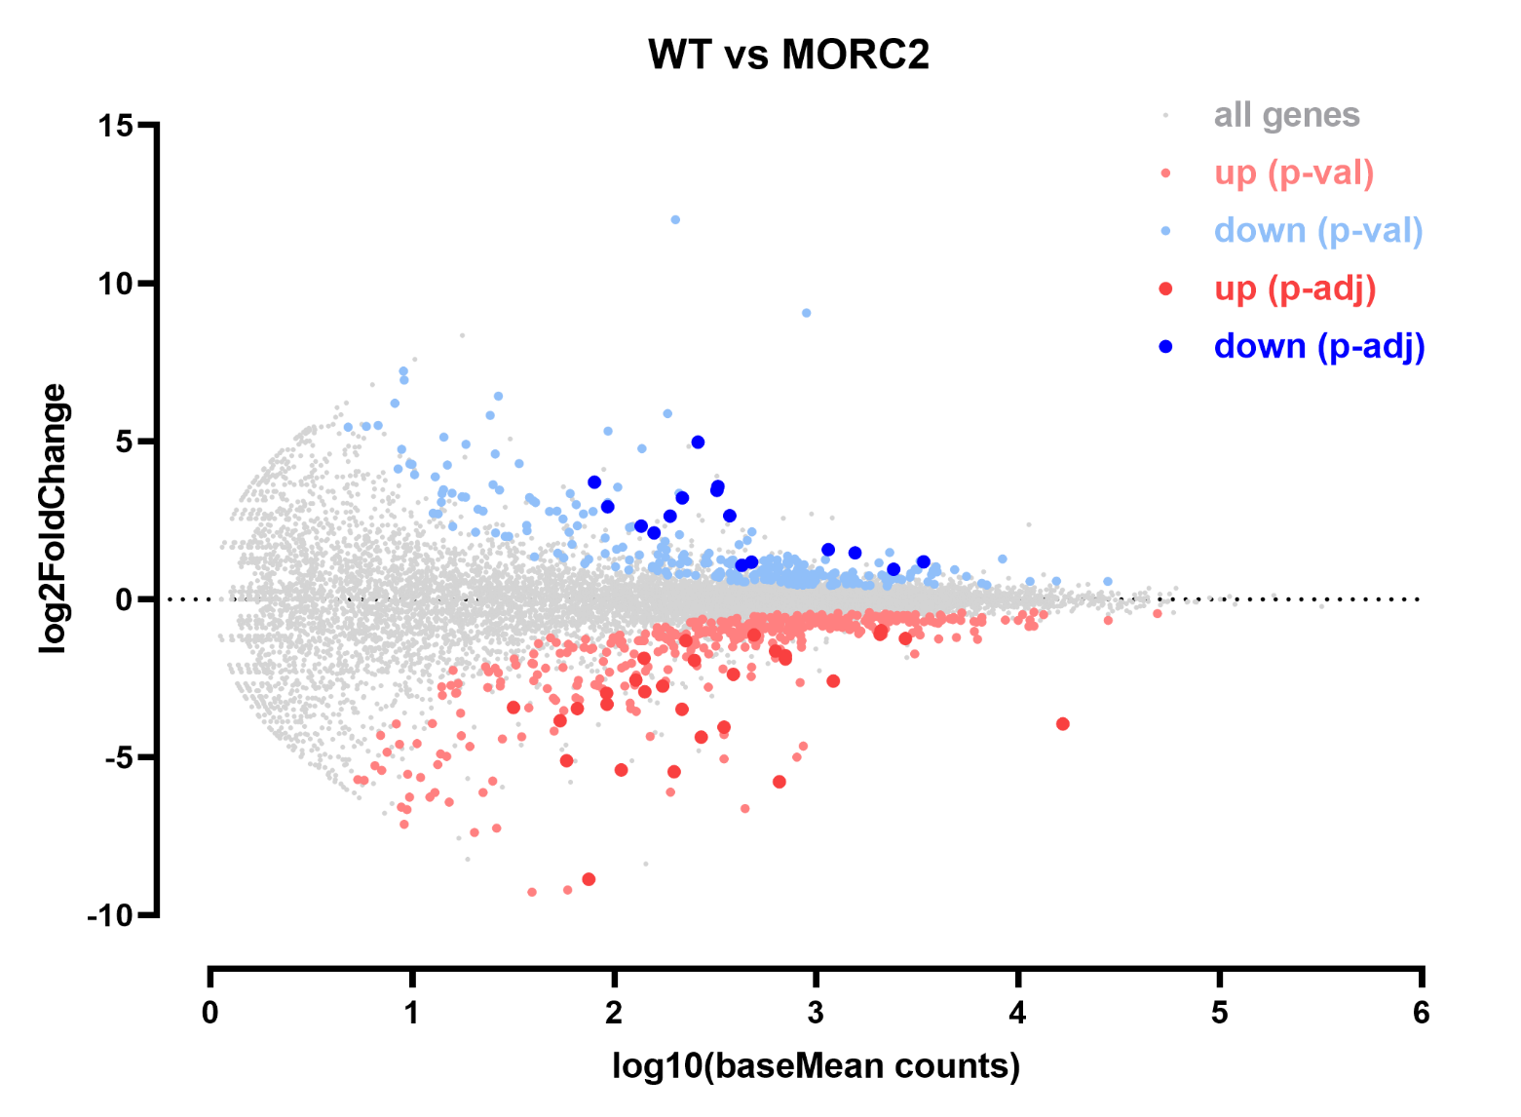

Slide 9
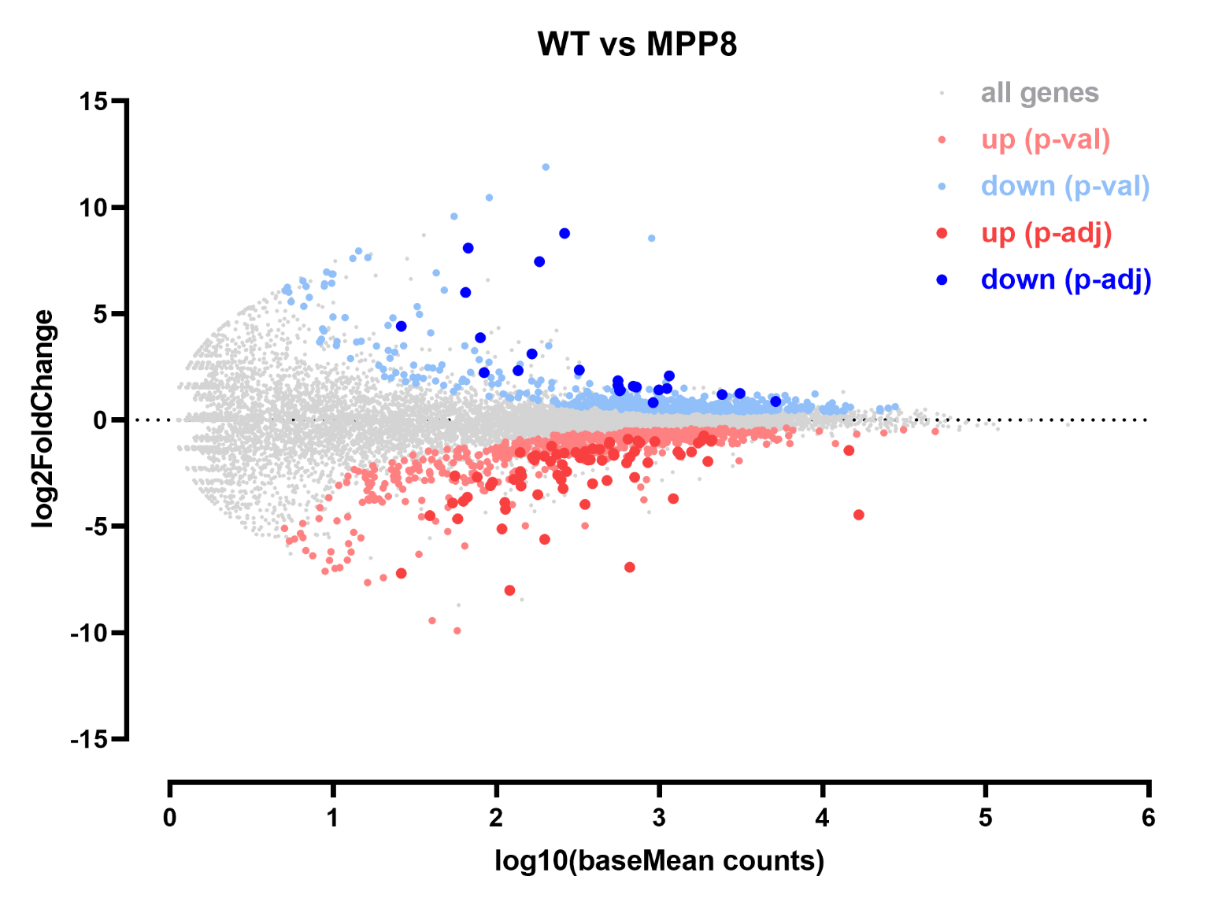

Slide 10
