Slide 1
Mapping stats (1x36mers) (for QC)

Slide 2
Mapping stats (1x36mers) (for QC)

Slide 3
Mapping stats (2x36mers)

Slide 4
Mapping stats (2x36mers)

Slide 5
Mapping stats (2x75mers)

Slide 6
Mapping stats (2x75mers)

Slide 7
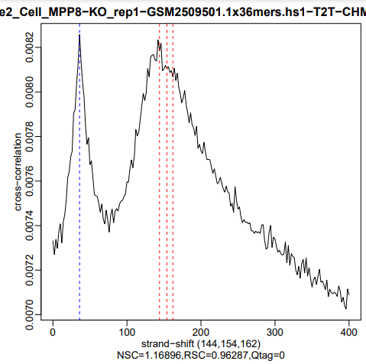
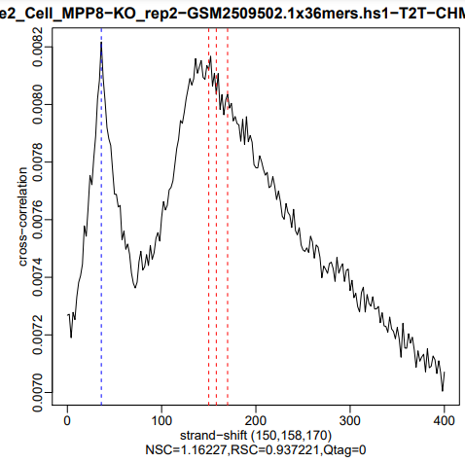
Cross-correlation profiles

Slide 8
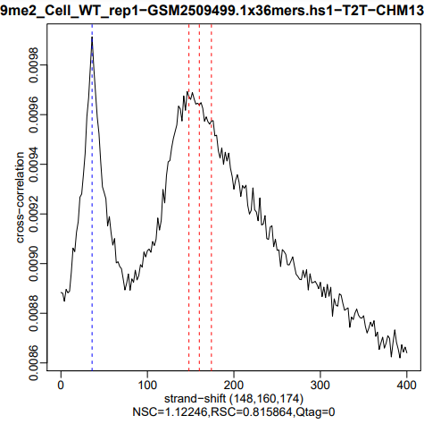
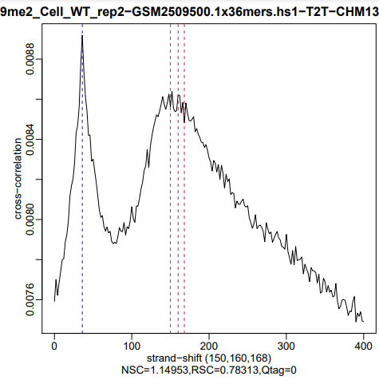

Slide 9
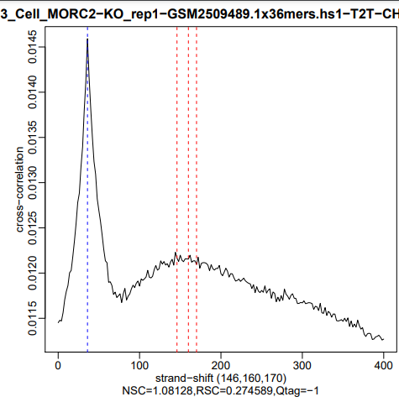
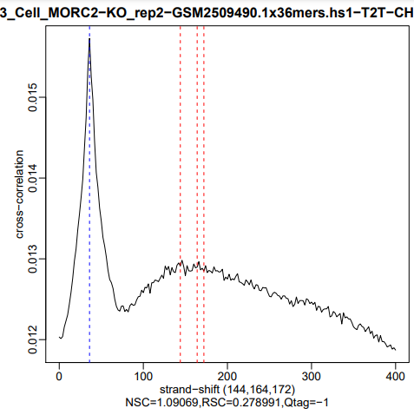

Slide 10
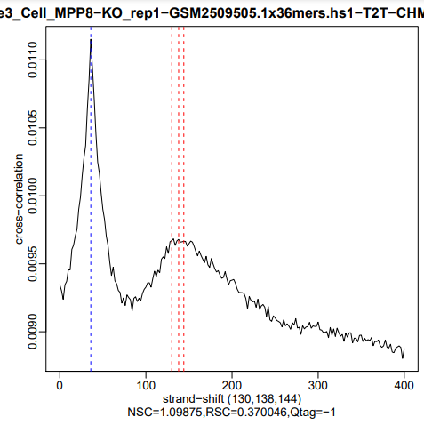
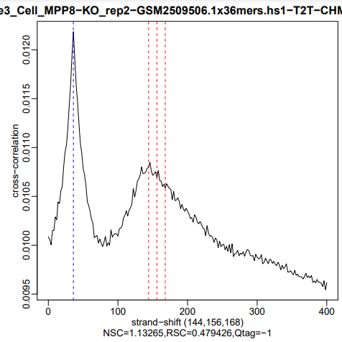

Slide 11
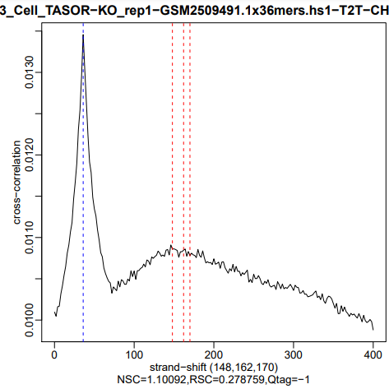
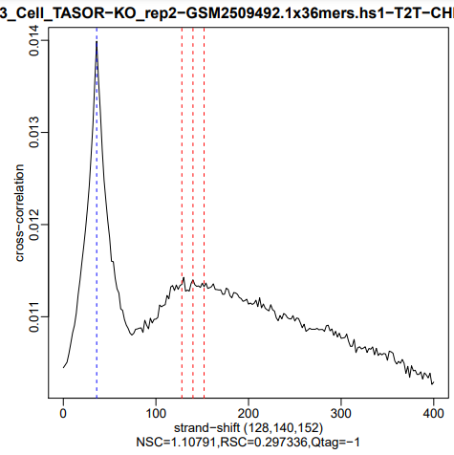

Slide 12
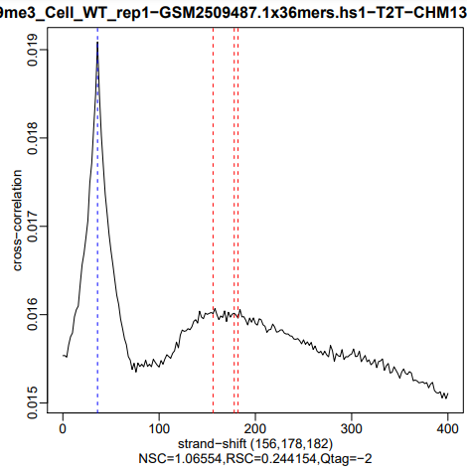
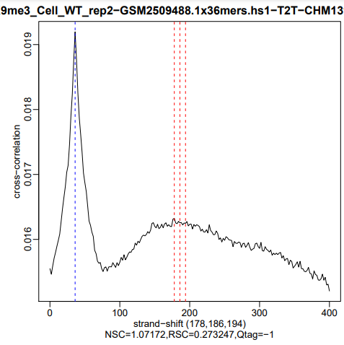

Slide 13
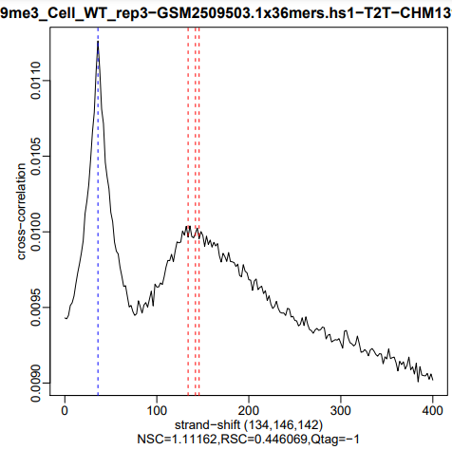
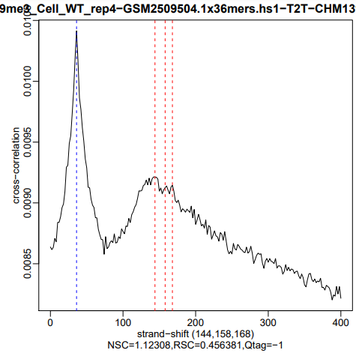

Slide 14
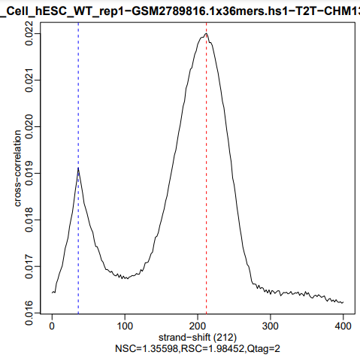
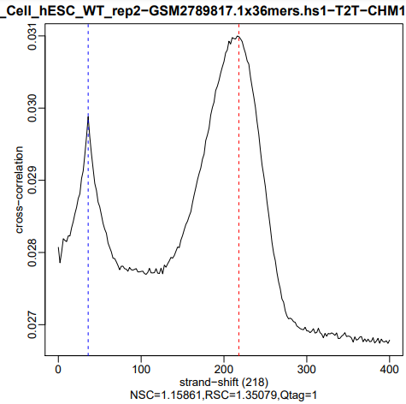

Slide 43
Peak overlap (2x75mers post-IDR)

Slide 44
ChromHMM state overlap

Slide 45
ChromHMM state overlap enrichment

Slide 46
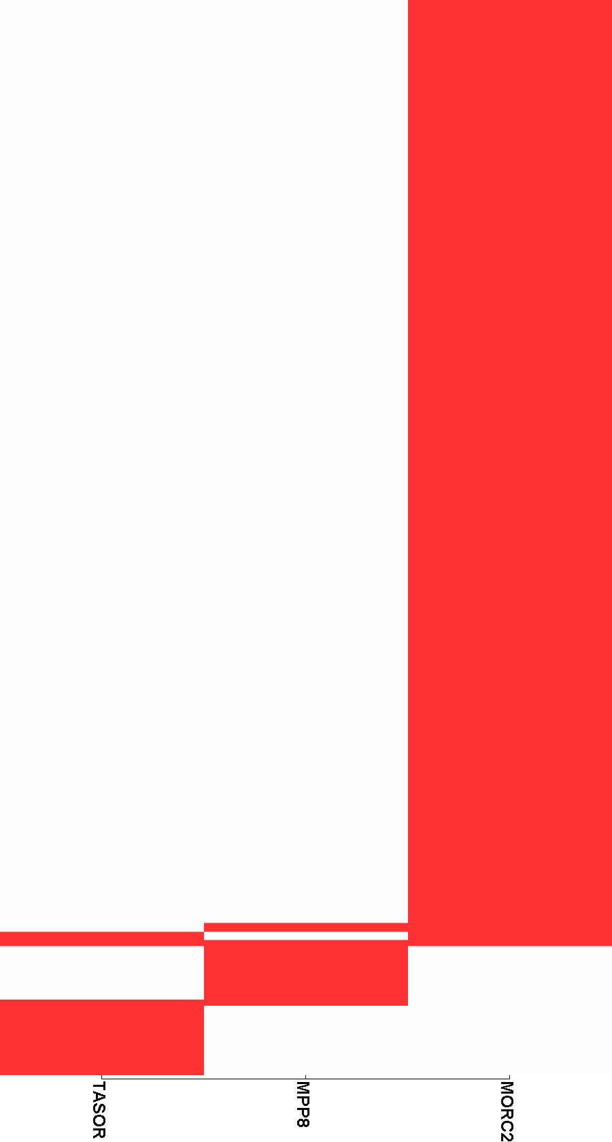
Peak clustering (MORC2, MPP8, TASOR WT only)

Slide 47













Peak clustering (MORC2, MPP8, TASOR WT only)
H3K9me2
MPP8-KO
H3K9me2
WT
H3K9me3
MORC2 KO
H3K9me3
MPP8 KO
H3K9me3
TASOR KO
H3K9me3
WT

Slide 48




Input
hESC
Input
K562

Slide 49










MORC2
hESC
MORC2
MORC2 KO
MORC2 MPP8 KO
MORC2
TASOR KO
MORC2
WT

Slide 50










MPP8
hESC
MPP8
MORC2 KO
MPP8
MPP8 KO
MPP8
TASOR KO
MPP8
WT

Slide 51








Pol2
MORC2 KO
Pol2
MPP8 KO
Pol2
TASOR KO
Pol2
WT

Slide 52








TASOR
MORC2 KO
TASOR
MPP8 KO
TASOR
TASOR KO
TASOR
WT

Slide 53
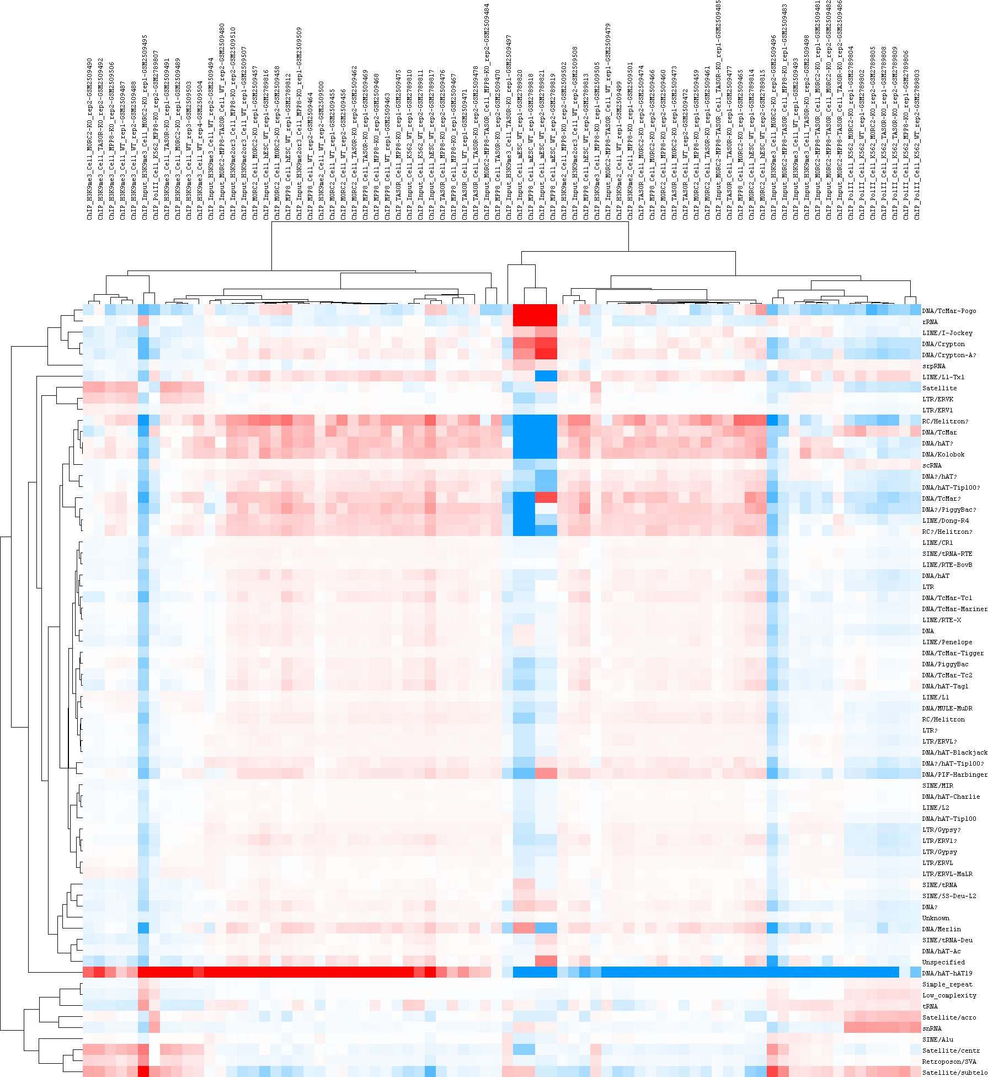
Repeat classes

Slide 54
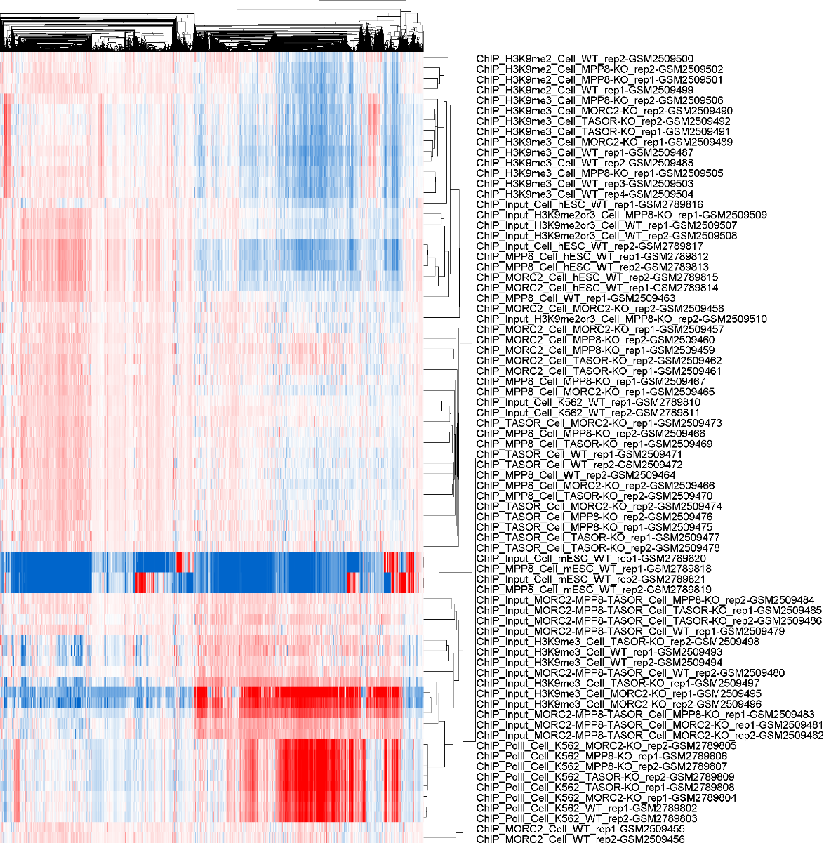
Repeat
families

