Slide 1
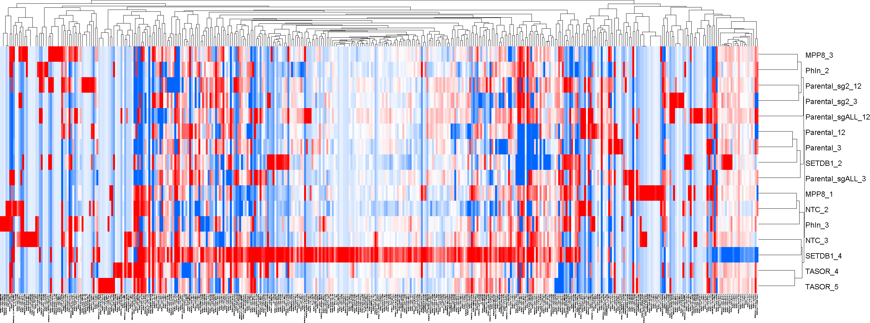
Repeats quantification in repeat space (repBase 23.08 + eXpress TPM), RNA-seq
Note: only 0.5-1% of reads aligned to consensus repeats

Slide 2
Repeats quantification in repeat space (repBase 23.08 + eXpress TPM), hiPSC RNA-seq, L1

Slide 3
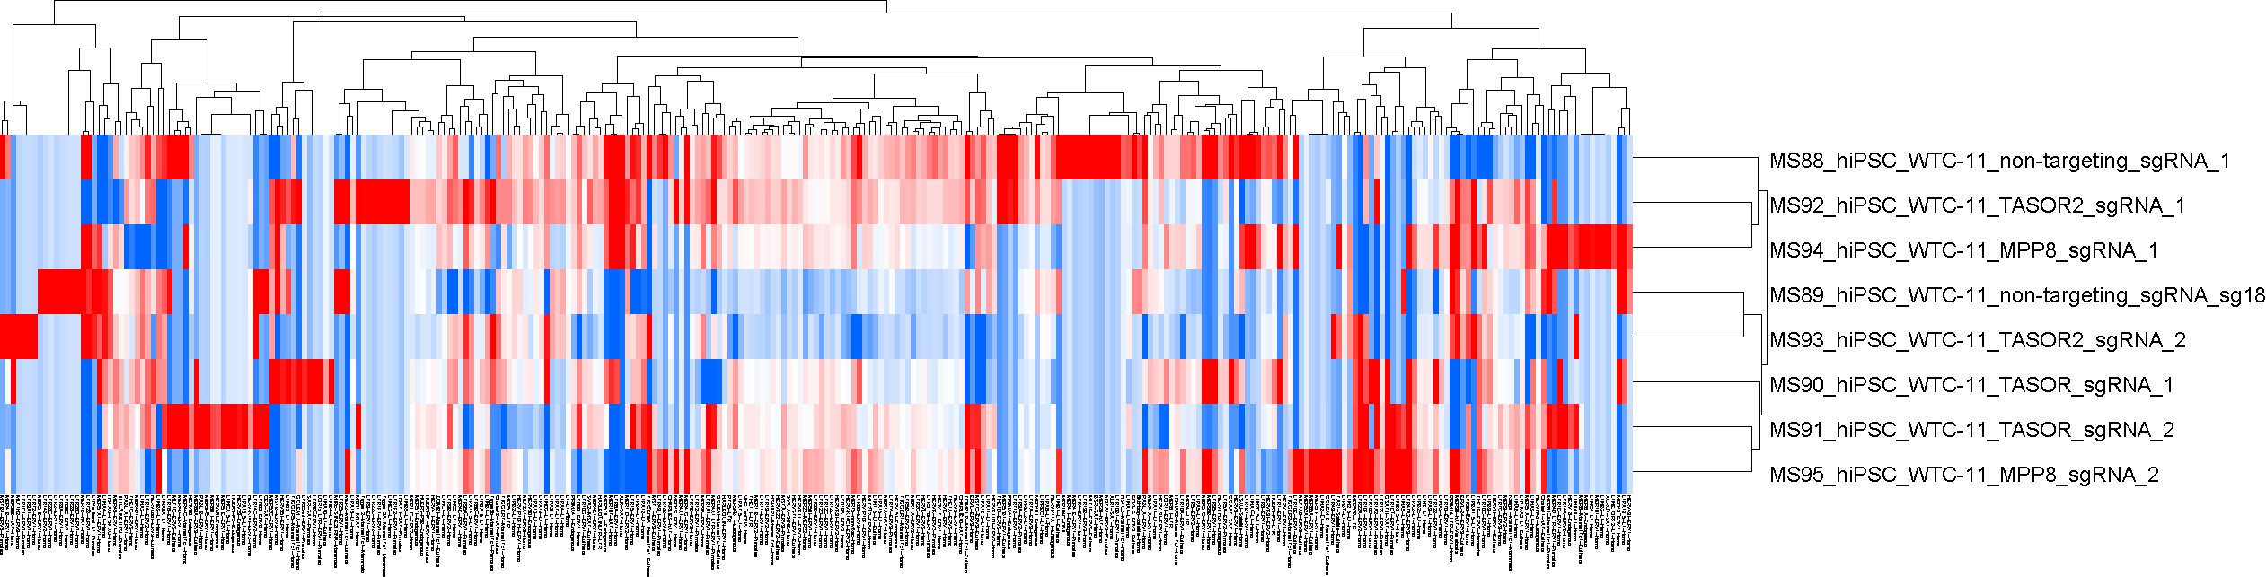
Repeats quantification in repeat space (repBase 23.08 + eXpress TPM), hiPSC RNA-seq

Slide 4
Repeats quantification in repeat space (repBase 23.08 + eXpress TPM), hiPSC RNA-seq, L1

Slide 5
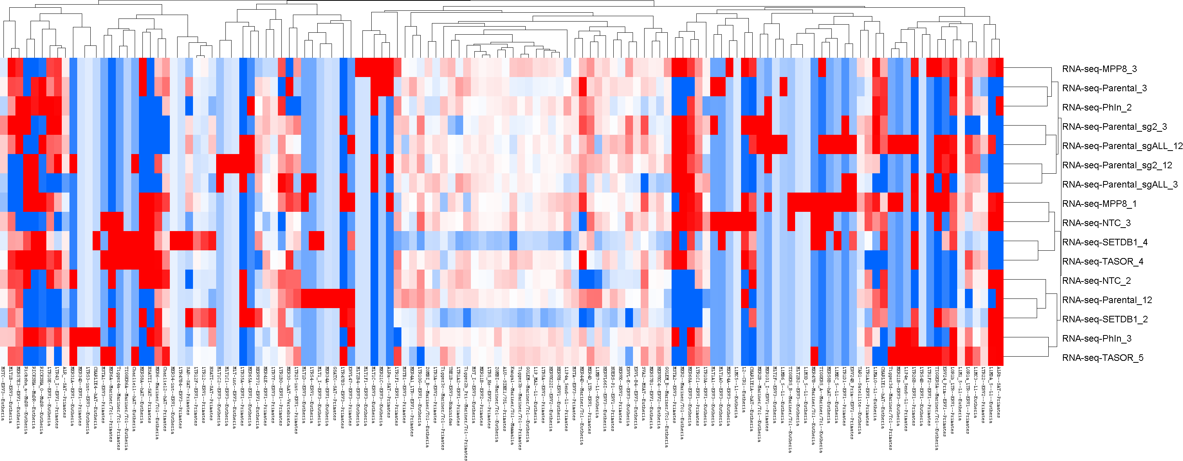
Repeats quantification in repeat space (repBase 23.08 + RPKM), RNA-seq

Slide 6
Repeats quantification in repeat space (repBase 23.08 + RPKM), RNA-seq, L1

Slide 7
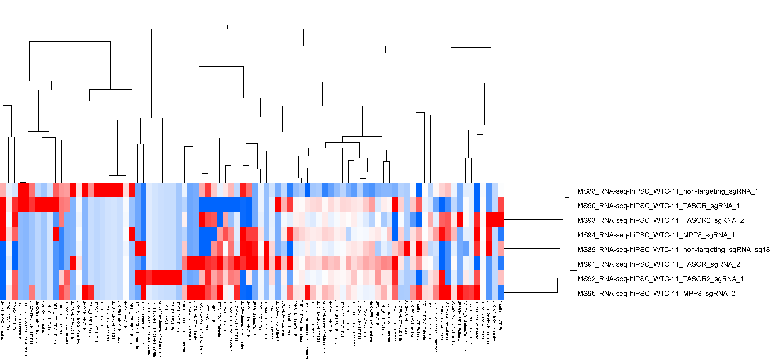
Repeats quantification in repeat space (repBase 23.08 + RPKM), hiPSC RNA-seq

Slide 8
Repeats quantification in repeat space (repBase 23.08 + RPKM), hiPSC RNA-seq, L1

