Slide 1
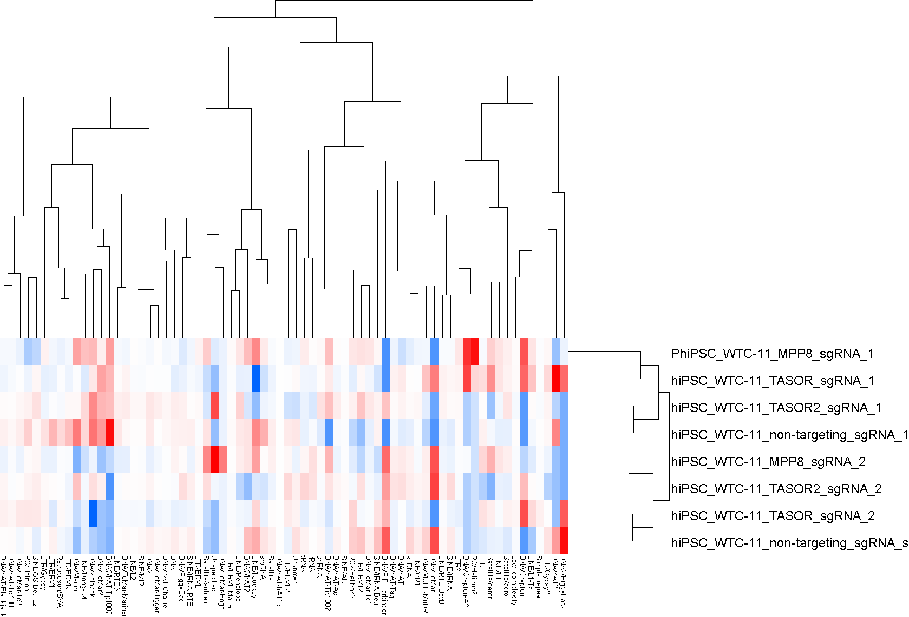
Repeats quantification in genome space, hiPSC RNA-seq

Slide 2
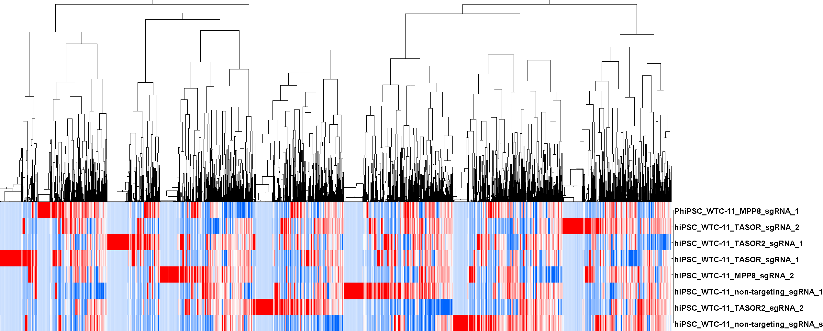
Repeats quantification in genome space, hiPSC RNA-seq

Slide 3
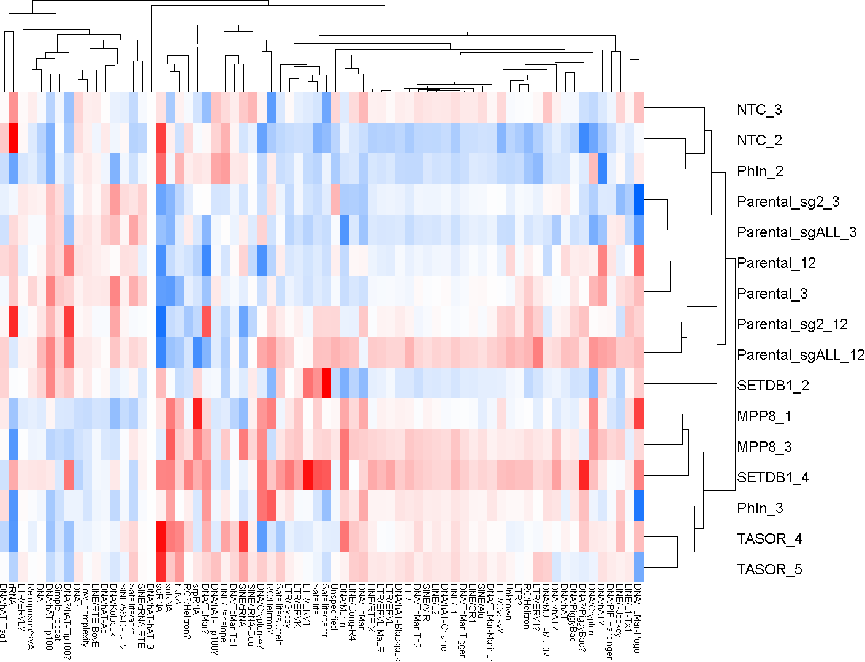
Repeats quantification in genome space, RNA-seq

Slide 4
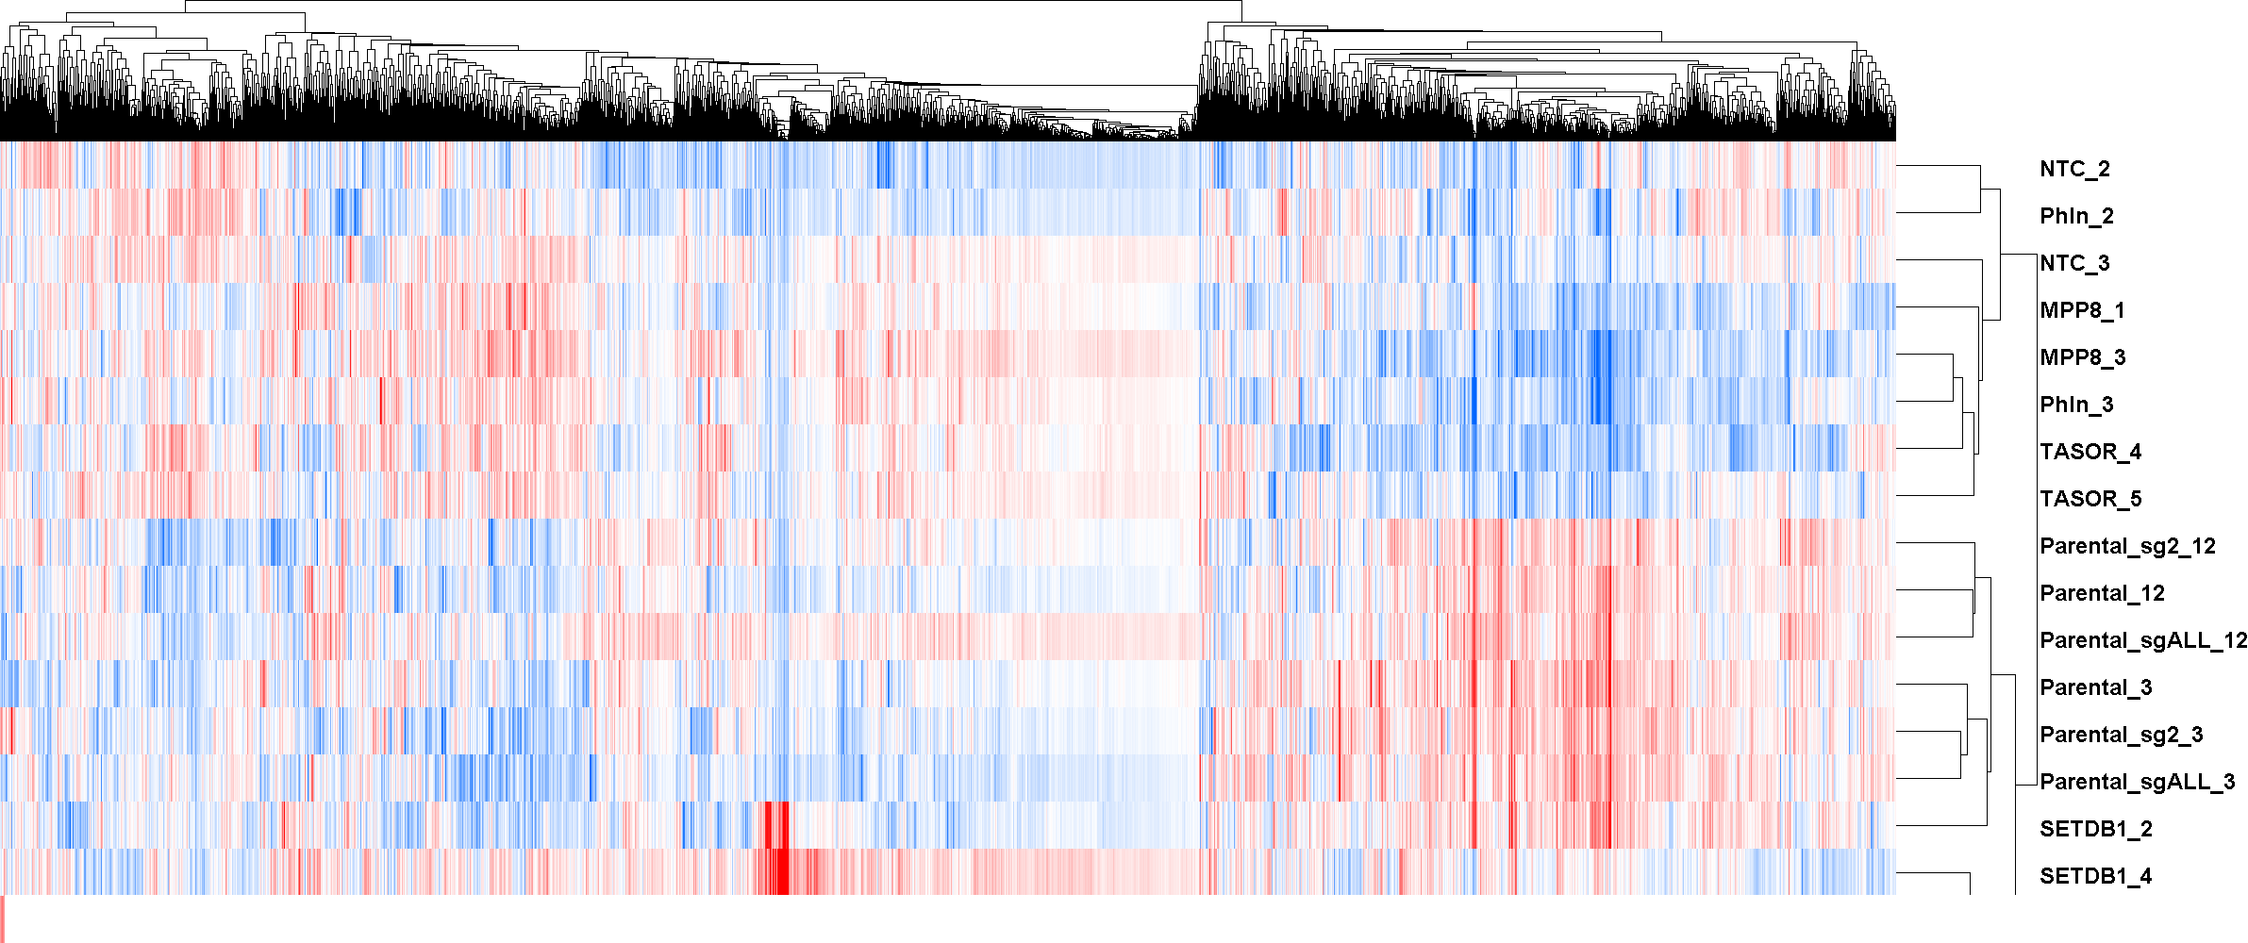
Repeats quantification in genome space, RNA-seq

