Slide 1
Mapping stats

Slide 2
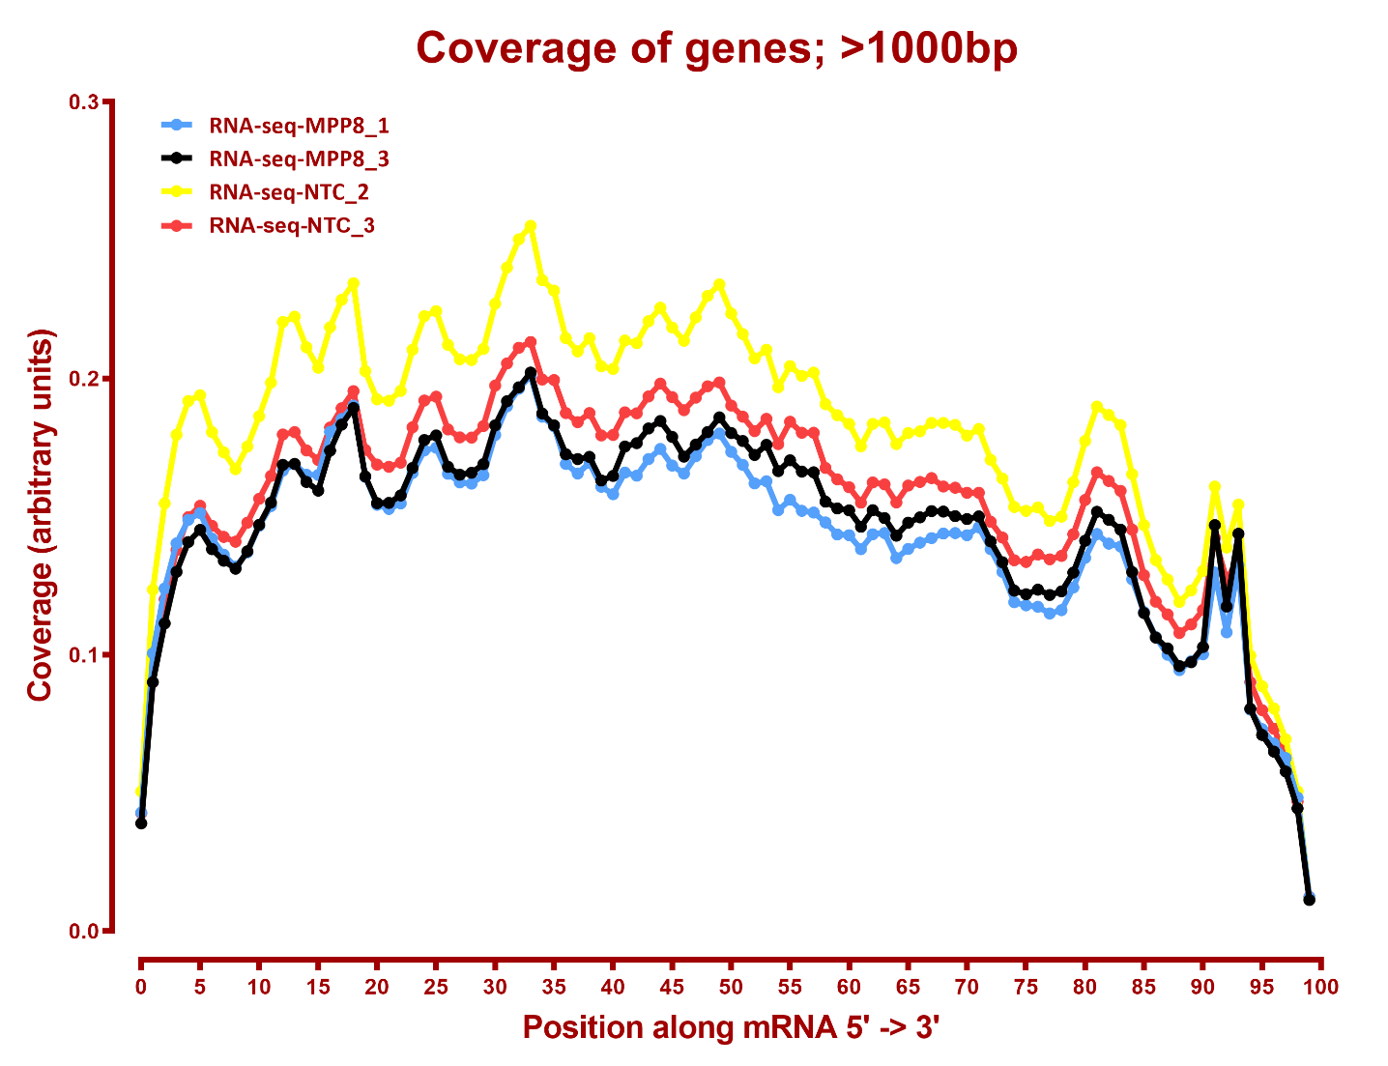
Read distribution

Slide 3
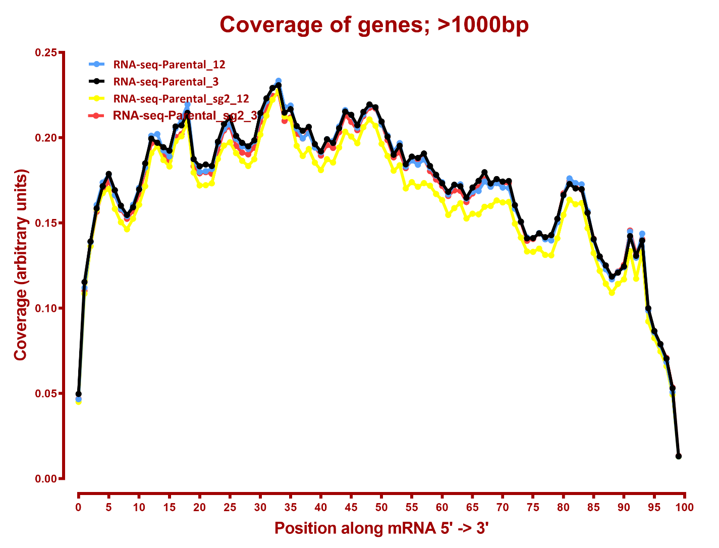
Read coverage

Slide 4
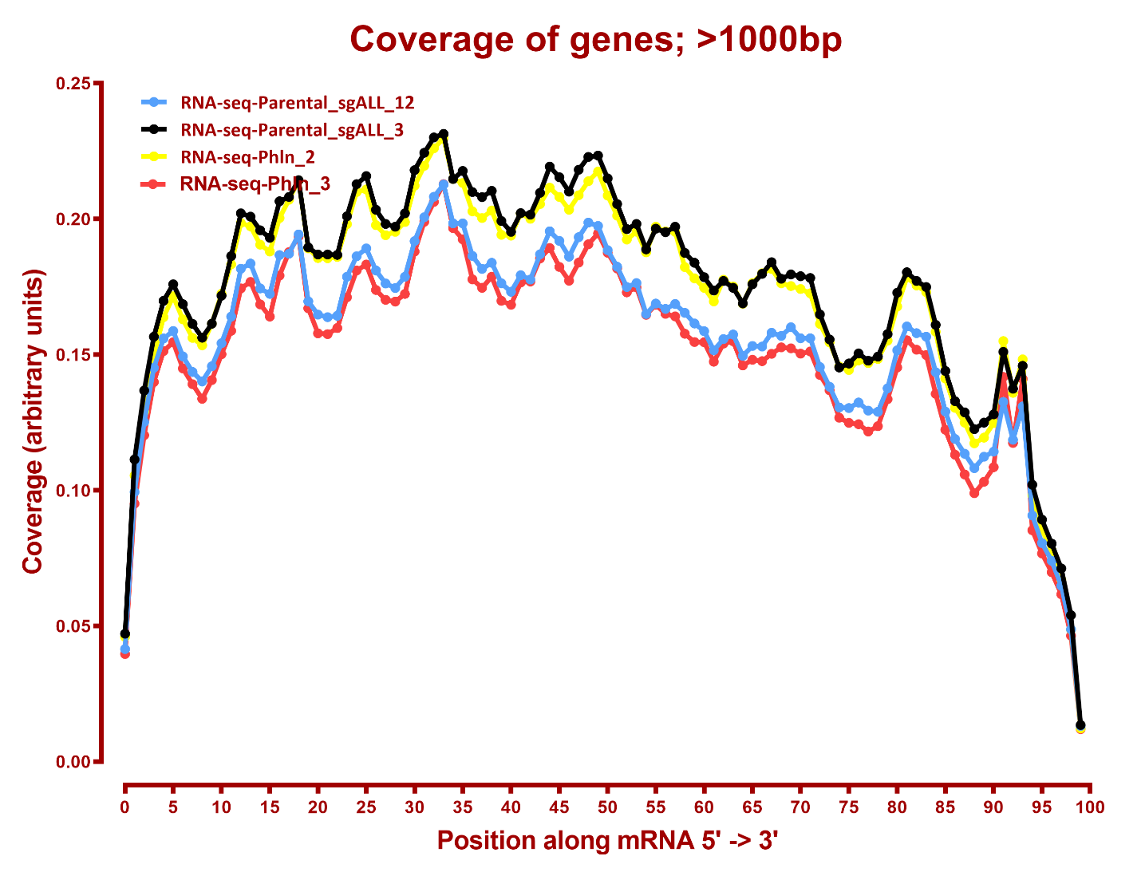
Read coverage

Slide 5
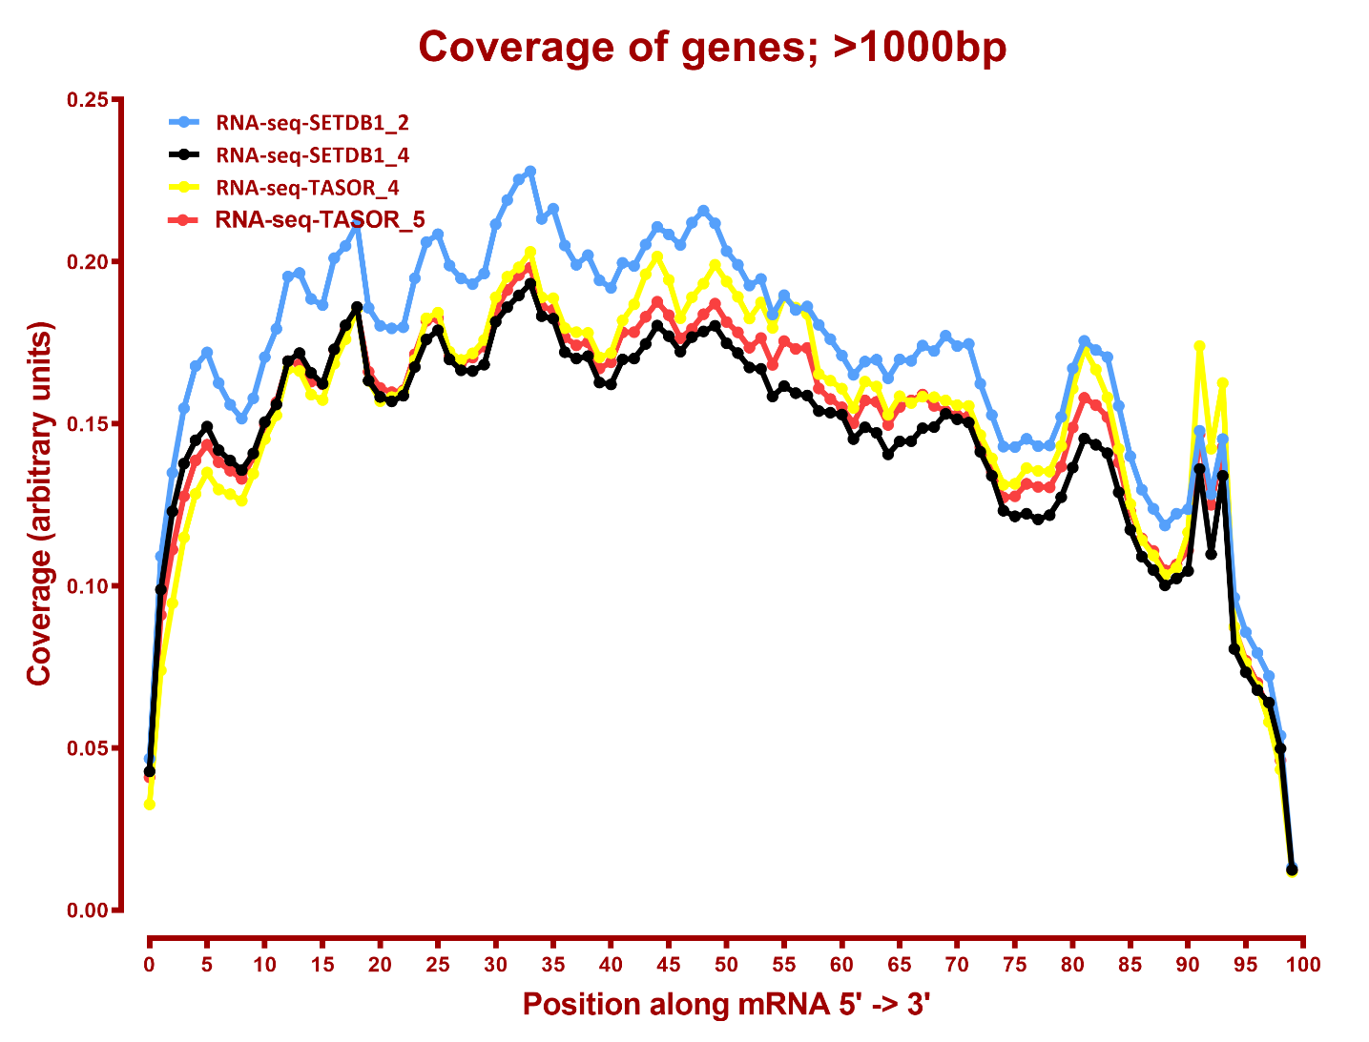
Read coverage

Slide 6
DESeq
Number differential genes
A | B | p-adj |  | p-val
 |  | up in B vs A | down in B vs A | up in B vs A | down in B vs A
MPP8 | NTC | 9 | 8 | 39 | 113
MPP8 | Phln | 5 | 1 | 107 | 29
MPP8 | SETDB1 | 201 | 29 | 680 | 181
MPP8 | TASOR2_Parental | 141 | 51 | 626 | 416
MPP8 | TASOR2_Parental_sg2 | 104 | 18 | 798 | 290
MPP8 | TASOR2_Parental_sgALL | 143 | 40 | 618 | 313
MPP8 | TASOR | 8 | 9 | 63 | 113
NTC | Phln | 3 | 2 | 106 | 14
NTC | SETDB1 | 202 | 29 | 757 | 158
NTC | TASOR2_Parental | 111 | 30 | 531 | 225
NTC | TASOR2_Parental_sg2 | 83 | 12 | 923 | 214
NTC | TASOR2_Parental_sgALL | 121 | 28 | 533 | 185
NTC | TASOR | 4 | 6 | 52 | 39
Phln | SETDB1 | 127 | 29 | 474 | 181
Phln | TASOR | 3 | 10 | 34 | 123
SETDB1 | TASOR | 28 | 184 | 181 | 719
TASOR2_Parental_sg2 | Phln | 9 | 44 | 224 | 524
TASOR2_Parental_sg2 | SETDB1 | 10 | 2 | 133 | 180
TASOR2_Parental_sg2 | TASOR2_Parental_sgALL | 0 | 0 | 9 | 247
TASOR2_Parental_sg2 | TASOR | 13 | 81 | 368 | 977
TASOR2_Parental_sgALL | Phln | 26 | 51 | 227 | 320
TASOR2_Parental_sgALL | SETDB1 | 53 | 8 | 246 | 66
TASOR2_Parental_sgALL | TASOR | 29 | 94 | 275 | 548
TASOR2_Parental | Phln | 30 | 55 | 295 | 325
TASOR2_Parental | SETDB1 | 53 | 7 | 309 | 71
TASOR2_Parental | TASOR2_Parental_sg2 | 0 | 0 | 313 | 10
TASOR2_Parental | TASOR2_Parental_sgALL | 0 | 0 | 12 | 6
TASOR2_Parental | TASOR | 39 | 100 | 376 | 577

Slide 7
GO enrichment, NTC-vs-Phln down, p-adj
None
GO enrichment, NTC-vs-Phln up, p-adj
None

Slide 8
GO enrichment, NTC-vs-SETDB1 down, p-adj
None
GO enrichment, NTC-vs-SETDB1 up, p-adj
N | X | LOD | P | P_adj | attrib ID | attrib name
7 | 28 | 1.507676 | 1.78E-08 | <0.001 | GO:0016339 | calcium-dependent cell-cell adhesion via plasma membrane cell adhesion molecules
8 | 56 | 1.210307 | 1.76E-07 | <0.001 | GO:0007416 | synapse assembly
17 | 143 | 1.126269 | 3.80E-13 | <0.001 | GO:0007156 | homophilic cell adhesion via plasma membrane adhesion molecules
17 | 207 | 0.946912 | 1.51E-10 | <0.001 | GO:0098742 | cell-cell adhesion via plasma-membrane adhesion molecules
25 | 575 | 0.659858 | 5.48E-09 | <0.001 | GO:0098609 | cell-cell adhesion
21 | 630 | 0.530396 | 7.08E-06 | 0.028 | GO:0005509 | calcium ion binding
29 | 960 | 0.495059 | 8.32E-07 | 0.002 | GO:0007155 | cell adhesion
29 | 966 | 0.492118 | 9.44E-07 | 0.002 | GO:0022610 | biological adhesion
74 | 4003 | 0.319073 | 1.21E-06 | 0.003 | GO:0043169 | cation binding
73 | 3942 | 0.31836 | 1.40E-06 | 0.005 | GO:0046872 | metal ion binding
93 | 5819 | 0.264595 | 1.63E-05 | 0.049 | GO:0043167 | ion binding

Slide 9
GO enrichment, NTC-vs-TASOR down, p-adj
None
GO enrichment, NTC-vs-TASOR up, p-adj
None

Slide 10
GO enrichment, NTC-vs-TASOR2_Parental down, p-adj
None
GO enrichment, NTC-vs-TASOR2_Parental up, p-adj
None

Slide 11
GO enrichment, NTC-vs-TASOR2_Parental_sg2 down, p-adj
None
GO enrichment, NTC-vs-TASOR2_Parental_sg2 up, p-adj
None

Slide 12
GO enrichment, NTC-vs-TASOR2_Parental_sgALL down, p-adj
None
GO enrichment, NTC-vs-TASOR2_Parental_sgALL up, p-adj
None

