Slide 1
Mapping stats

Slide 2
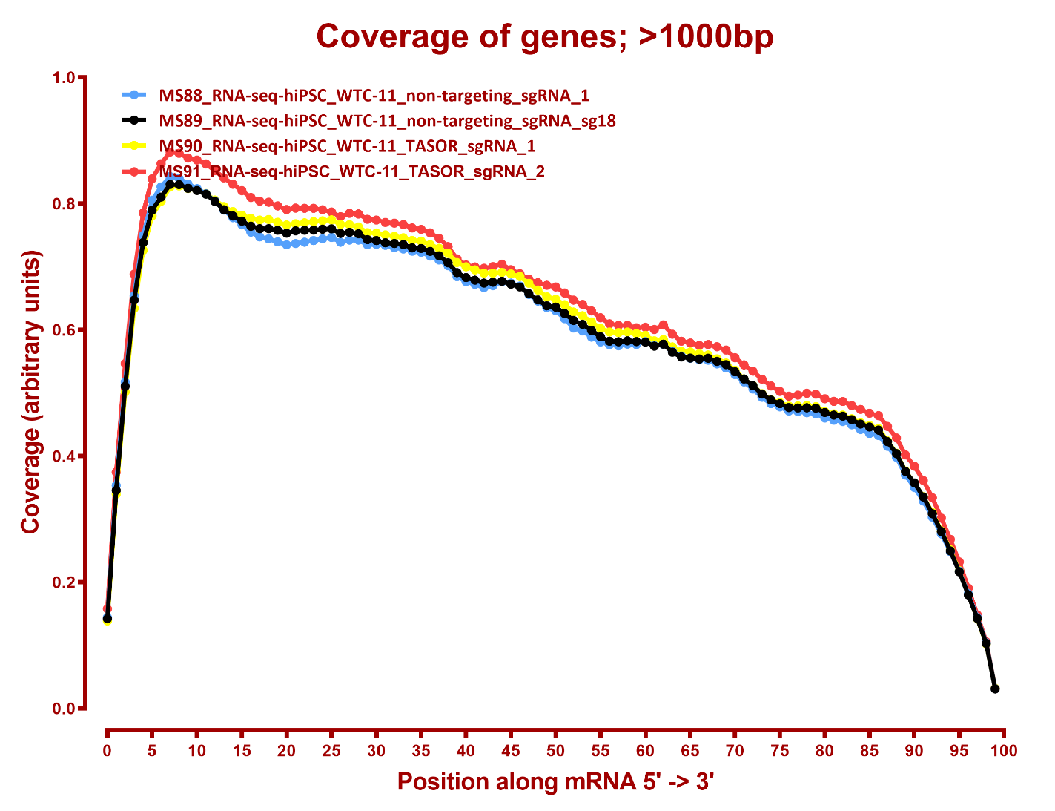
Read distribution

Slide 3
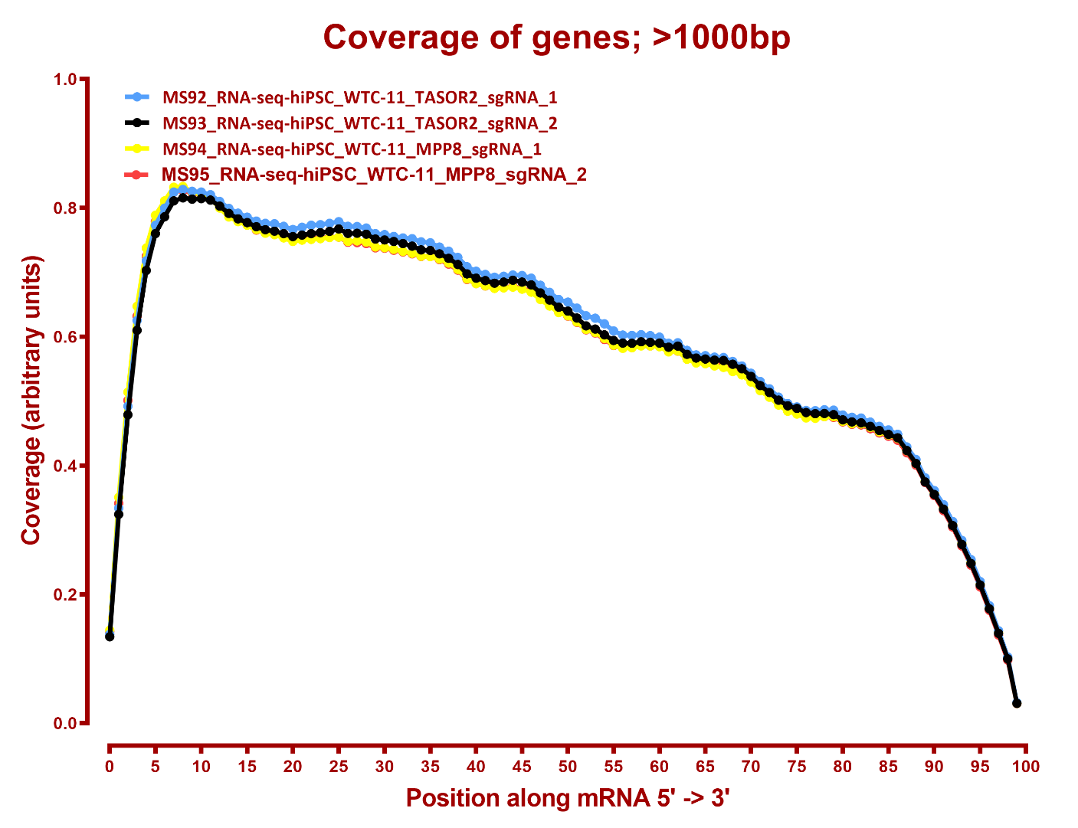
Read coverage

Slide 4
DESeq
Number differential genes
A | B | p-adj |  | p-val
 |  | up in B vs A | down in B vs A | up in B vs A | down in B vs A
MPP8 | TASOR2 | 5 | 123 | 177 | 422
MPP8 | TASOR | 2 | 4 | 162 | 220
NTC | MPP8 | 146 | 131 | 1,004 | 1,349
NTC | TASOR2 | 10 | 26 | 859 | 1,421
NTC | TASOR | 117 | 147 | 1,170 | 1,484
TASOR2 | TASOR | 91 | 8 | 382 | 186

Slide 5
GO enrichment, NTC-vs-MPP8 down, p-adj
None
GO enrichment, NTC-vs-MPP8 up, p-adj
None

Slide 6
GO enrichment, NTC-vs-TASOR down, p-adj
None
GO enrichment, NTC-vs-TASOR up, p-adj
None

Slide 7
GO enrichment, NTC-vs-TASOR2 down, p-adj
None
GO enrichment, NTC-vs-TASOR2 up, p-adj
None

