Slide 1
Mapping stats (first-pass alignment; 2x25mers)

Slide 2
Mapping stats (first-pass alignment; 2x25mers)

Slide 3
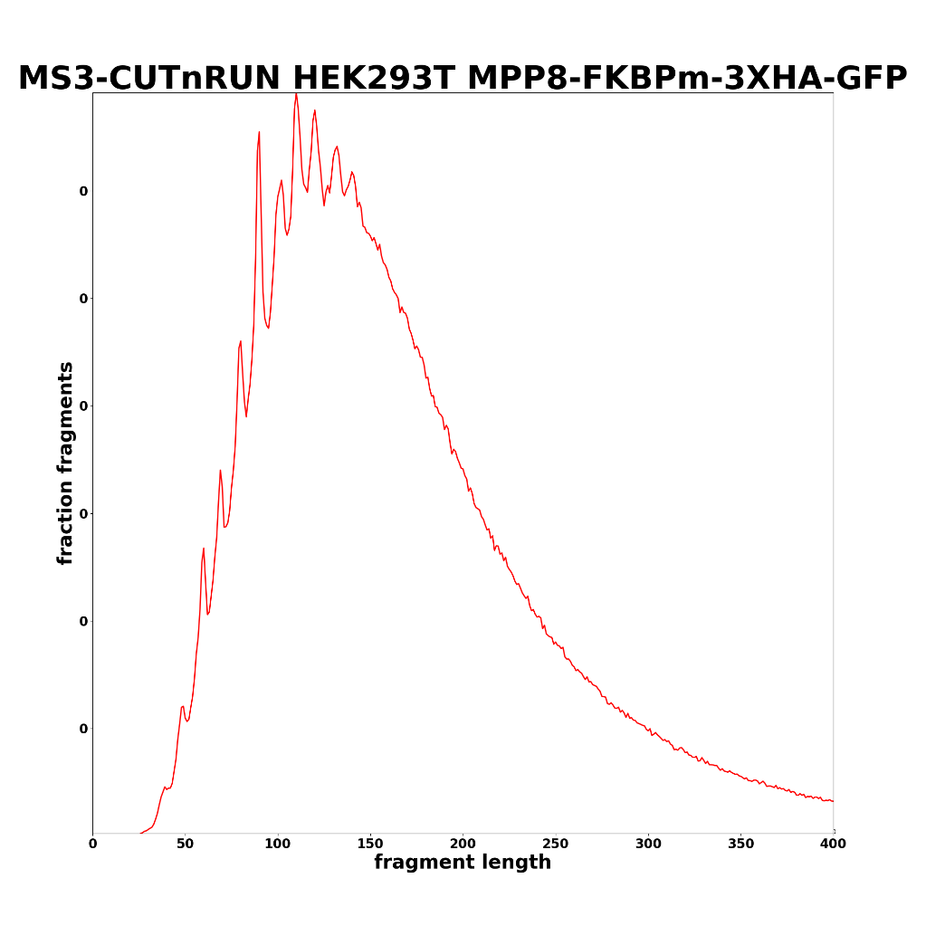
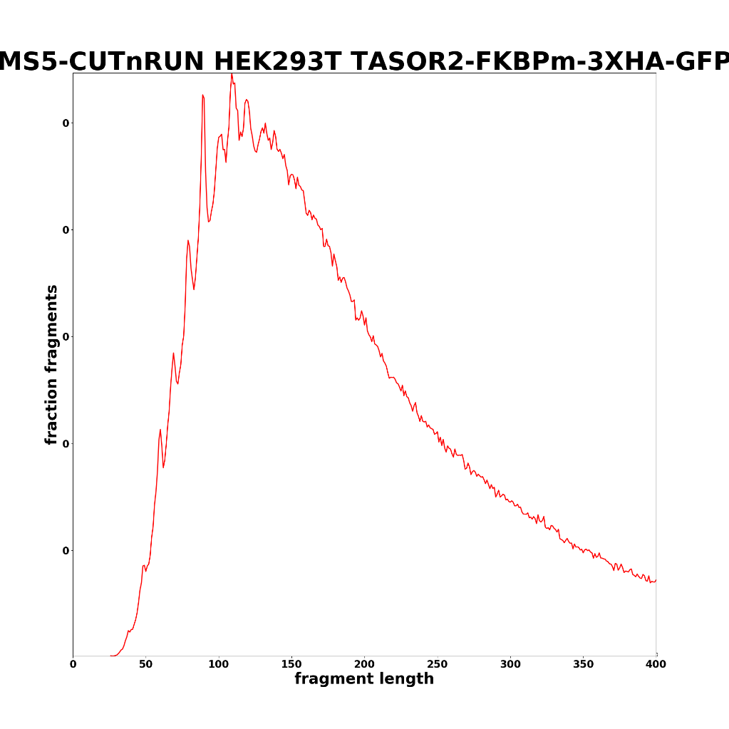
Fragment lengths (some examples)

Slide 4
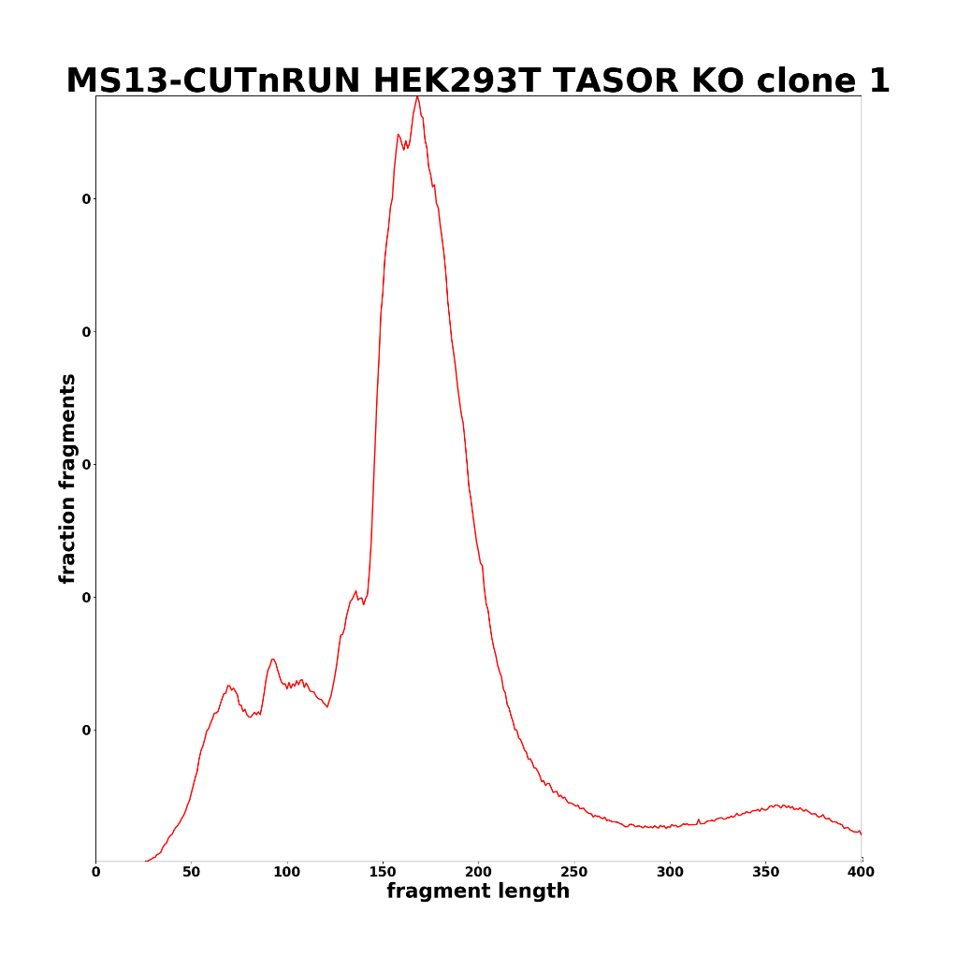
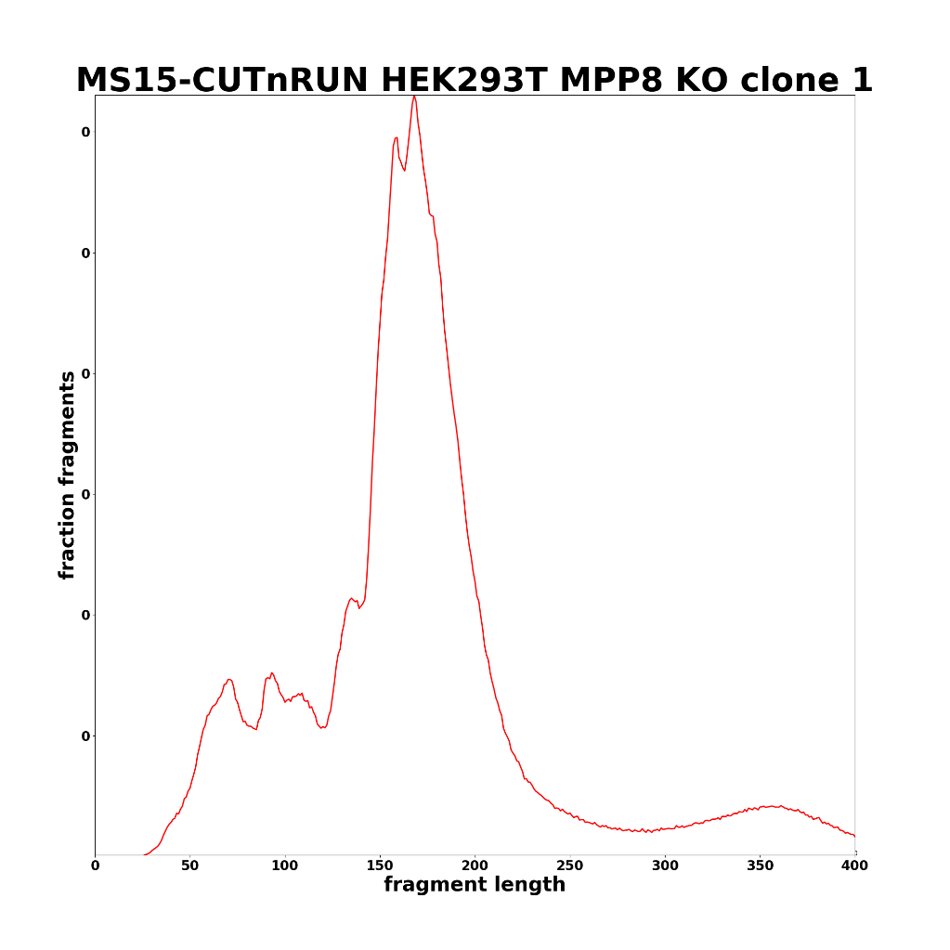

Slide 5
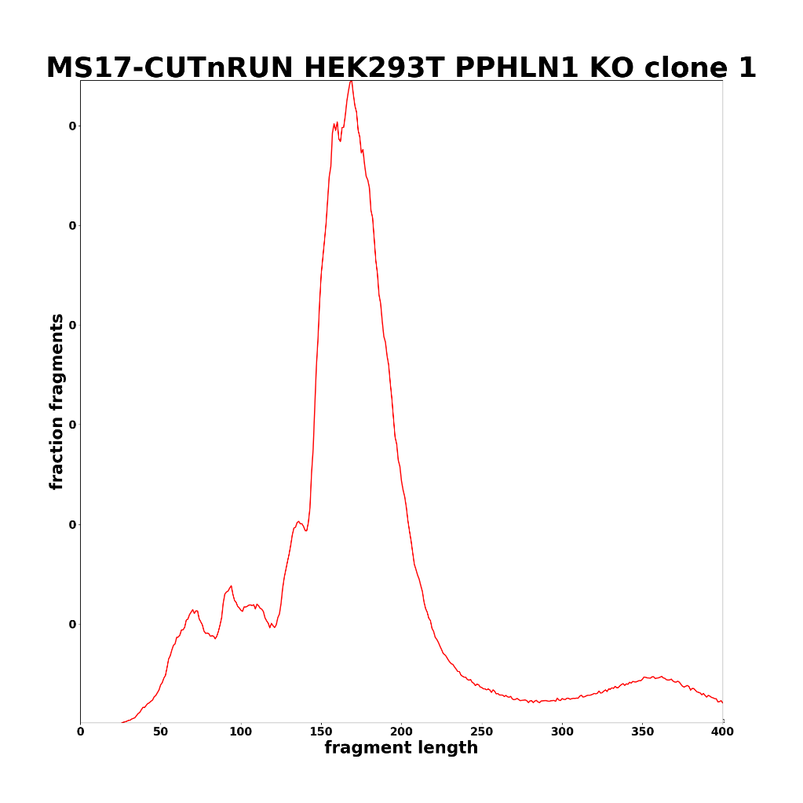
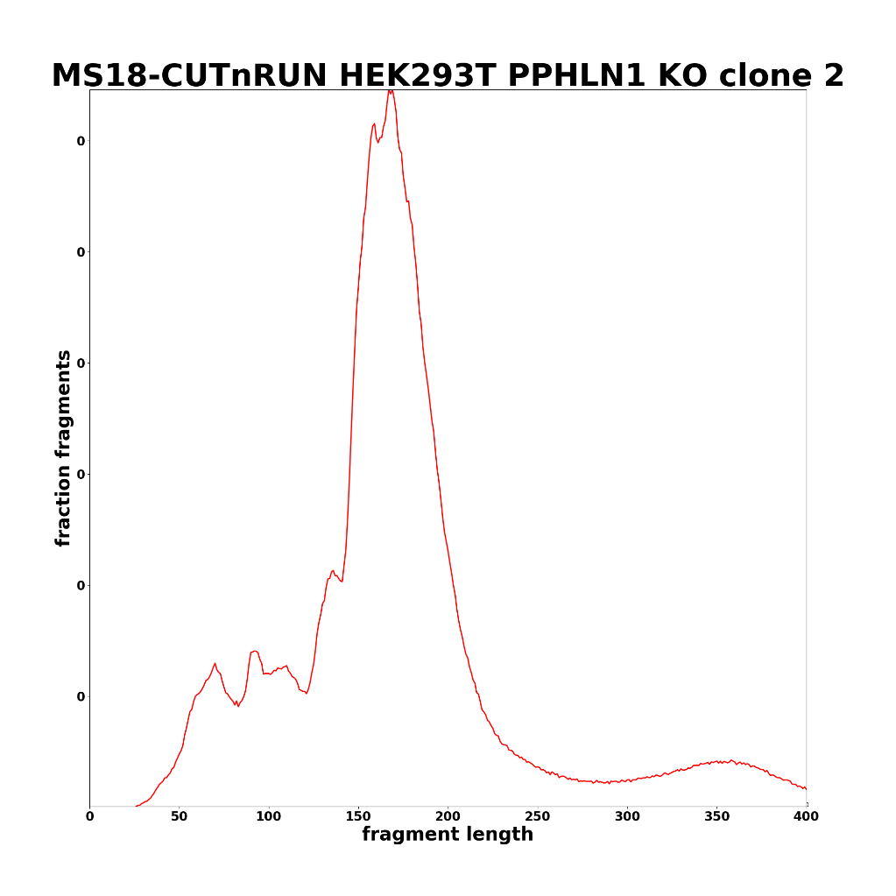

Slide 6
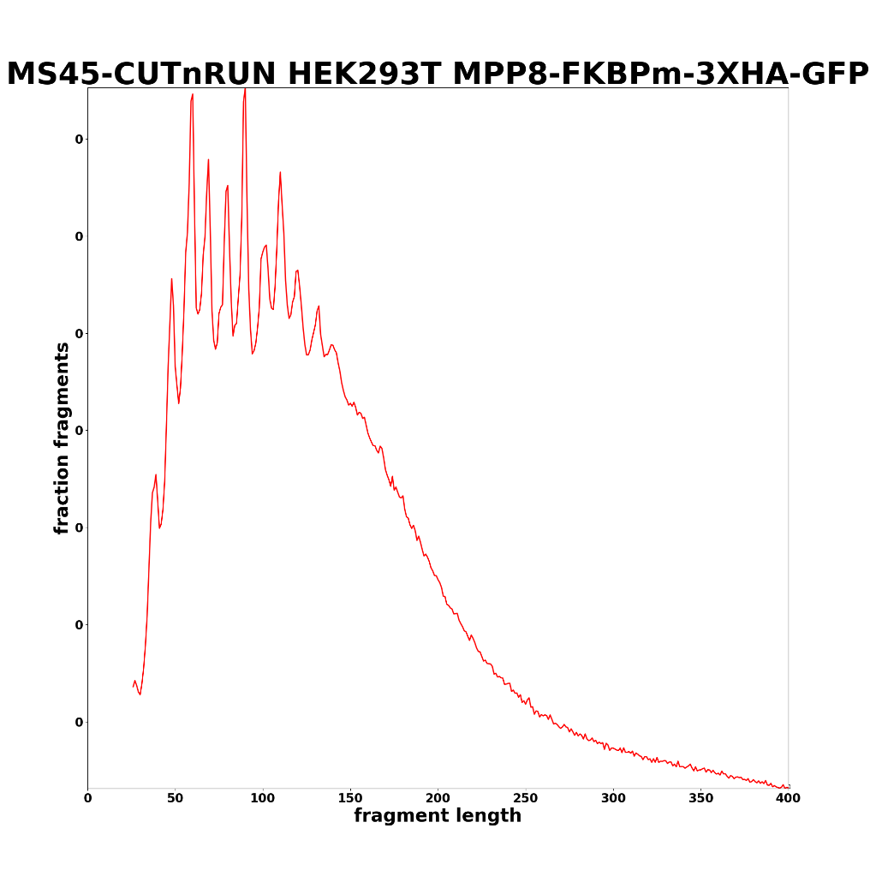
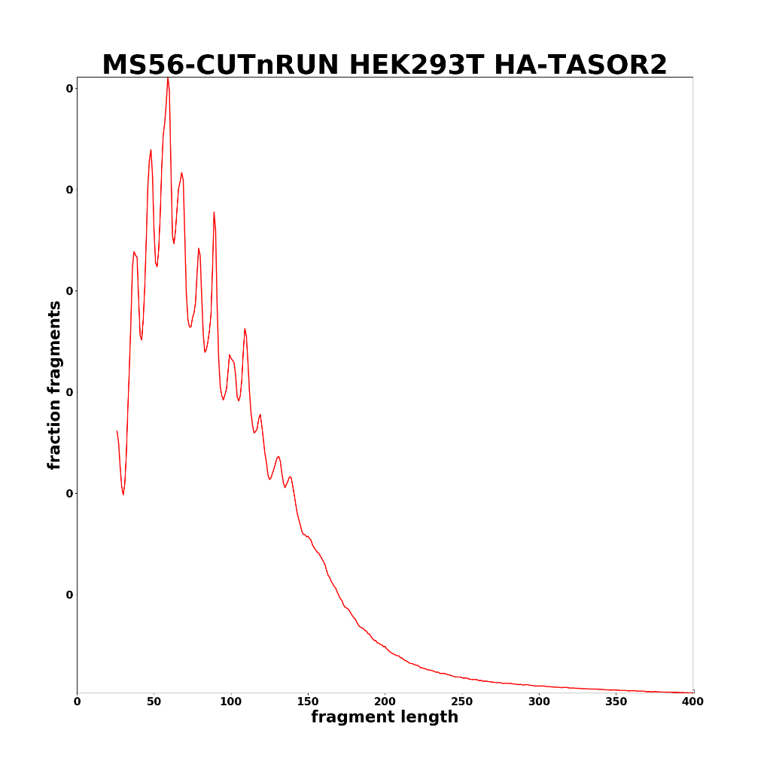

Slide 7
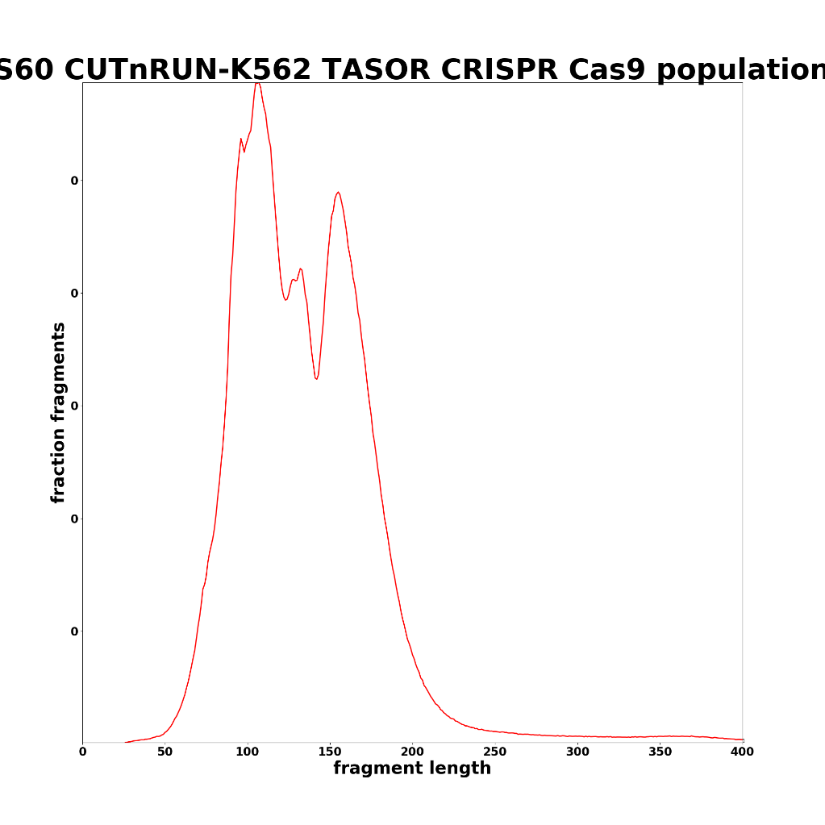
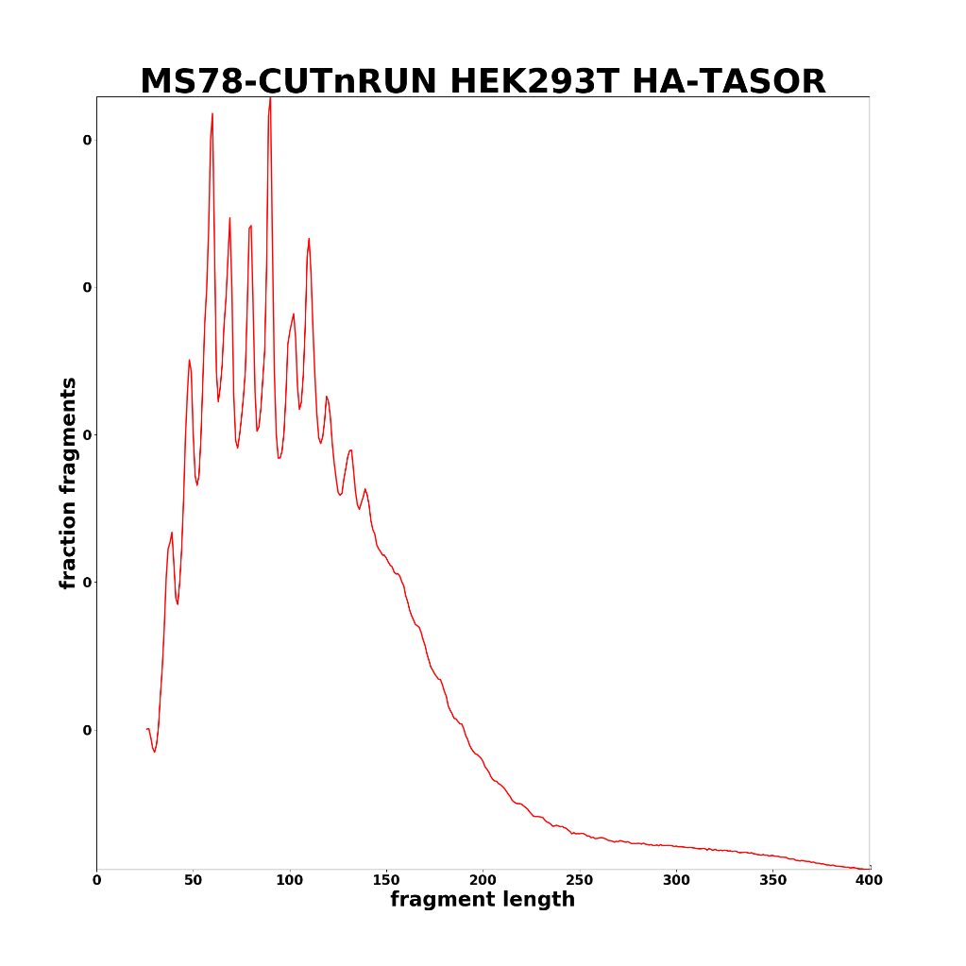

Slide 8
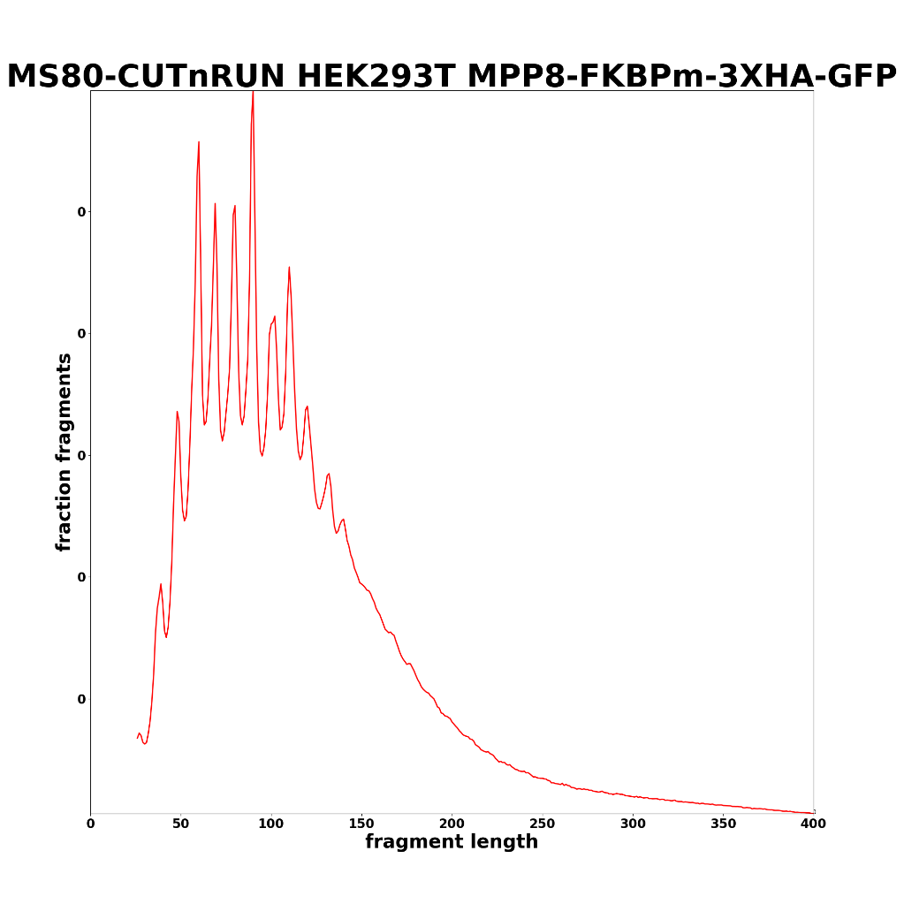
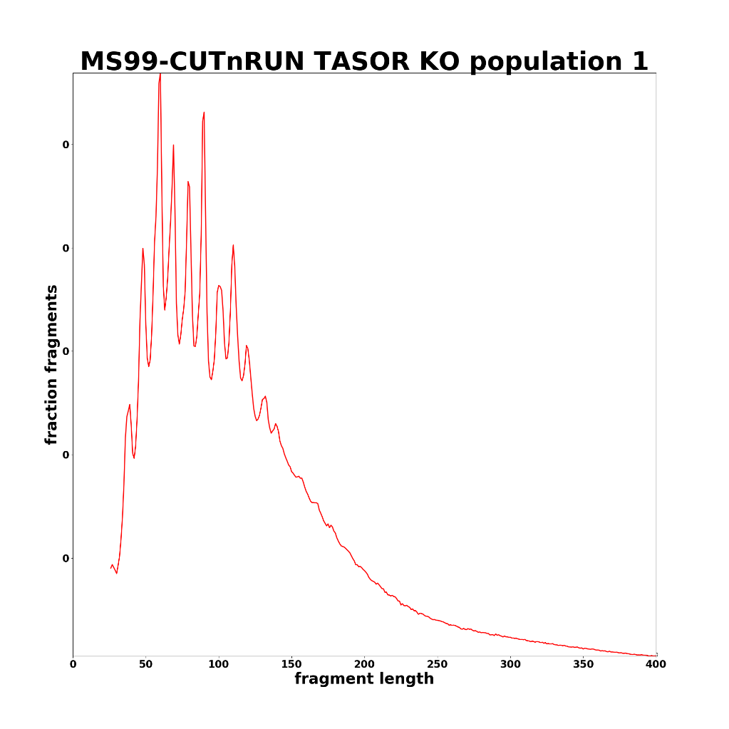

Slide 9
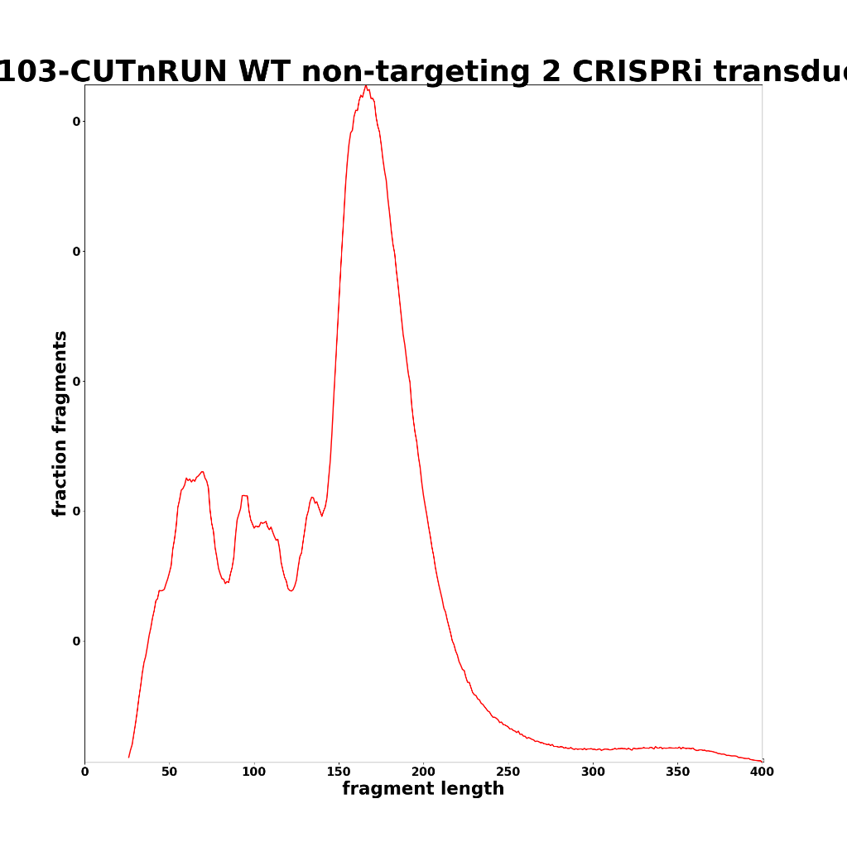
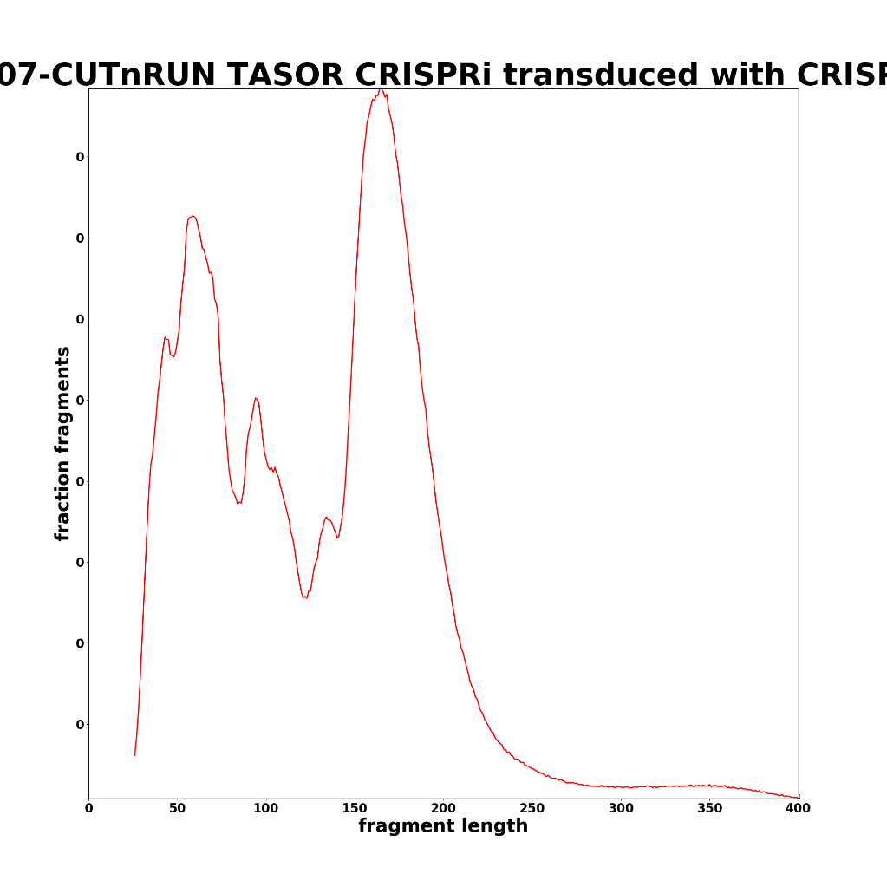

Slide 10
There are still a lot of short fragments in a number of the libraries.
Alignment done subsequently as 2x36mers

Slide 11
Mapping stats (2x36mers)

Slide 12
Mapping stats (2x36mers)

Slide 13
Peak overlap

Slide 14

Peak overlap

Slide 15











Slide 16










Slide 17










Slide 18










Slide 19










