Slide 1
DEMULTIPLEXING:
Total reads: | 564,660
Sample1 | 7,799 |  | Total reads after demultiplexing:
Sample2 | 4,957 |  | 179,778
Sample3 | 7,315
Sample4 | 4,258
Sample5 | 6,762
Sample6 | 7,914
Sample7 | 5,120
Sample8 | 7,666
Sample9 | 7,587
Sample10 | 7,368
Sample11 | 6,185
Sample12 | 6,380
Sample13 | 5,025
Sample14 | 8,302
Sample15 | 5,132
Sample16 | 4,262
Sample17 | 3,668
Sample18 | 3,862
Sample19 | 4,876
Sample20 | 4,982
Sample21 | 7,095
Sample22 | 3,755
Sample23 | 4,934
Sample24 | 8,094
Sample25 | 3,186
Sample26 | 4,825
Sample27 | 9,032
Sample28 | 7,536
Sample29 | 5,208
Sample30 | 6,693
Unfortunately, the index sequences are simply not present in most of the reads
But there are still 5-9K reads

Slide 2
ANNOTATIONS
The next question is what annotation to use, as the different available annotations for the human genome have a different number of isoforms
See further below for more details
I ran it on the three annotations that I have, but we can quickly rerun on anything else

Slide 3
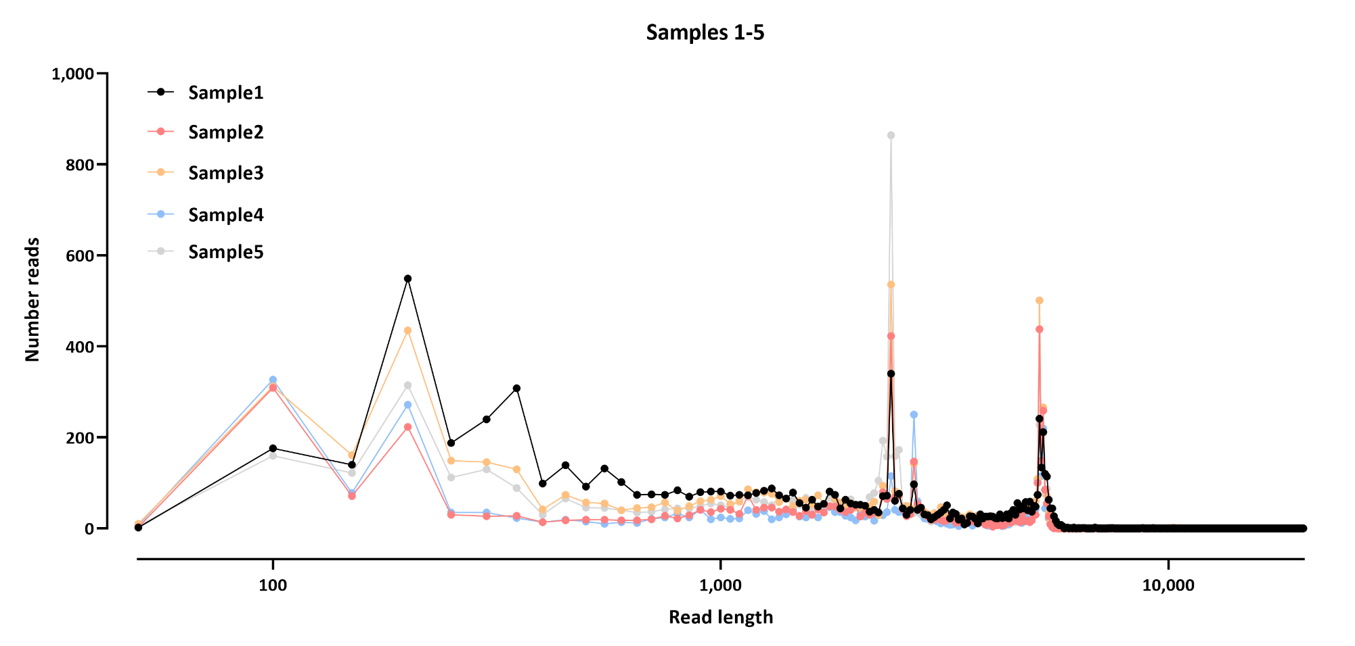
READ LENGTH DISTRIBUTION

Slide 4
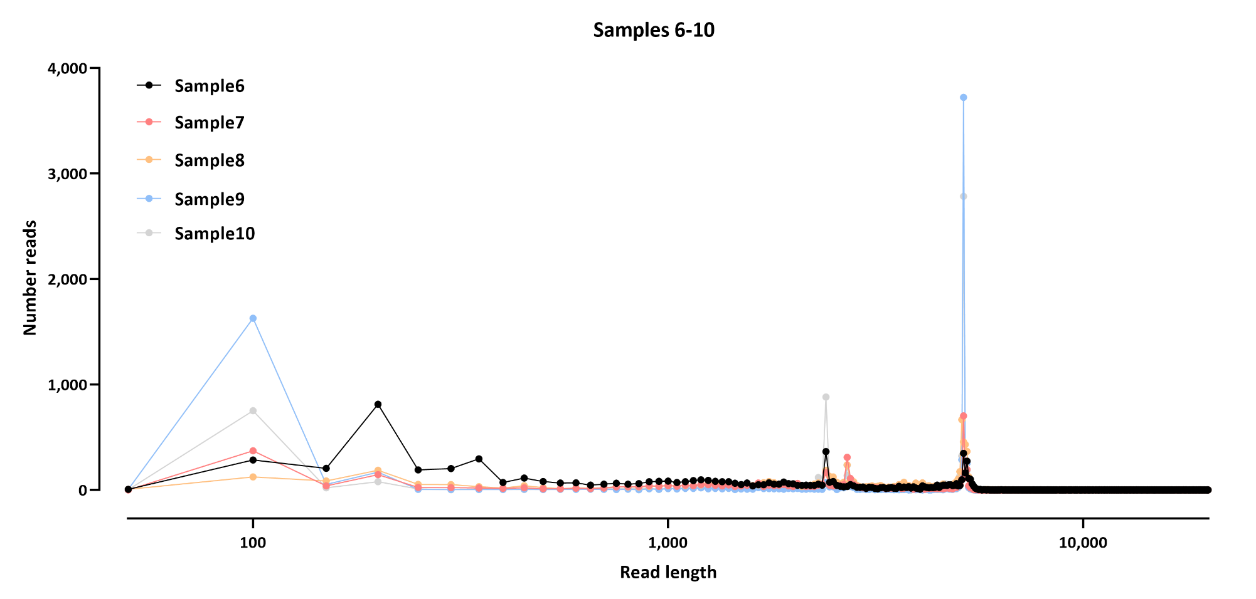
READ LENGTH DISTRIBUTION

Slide 5
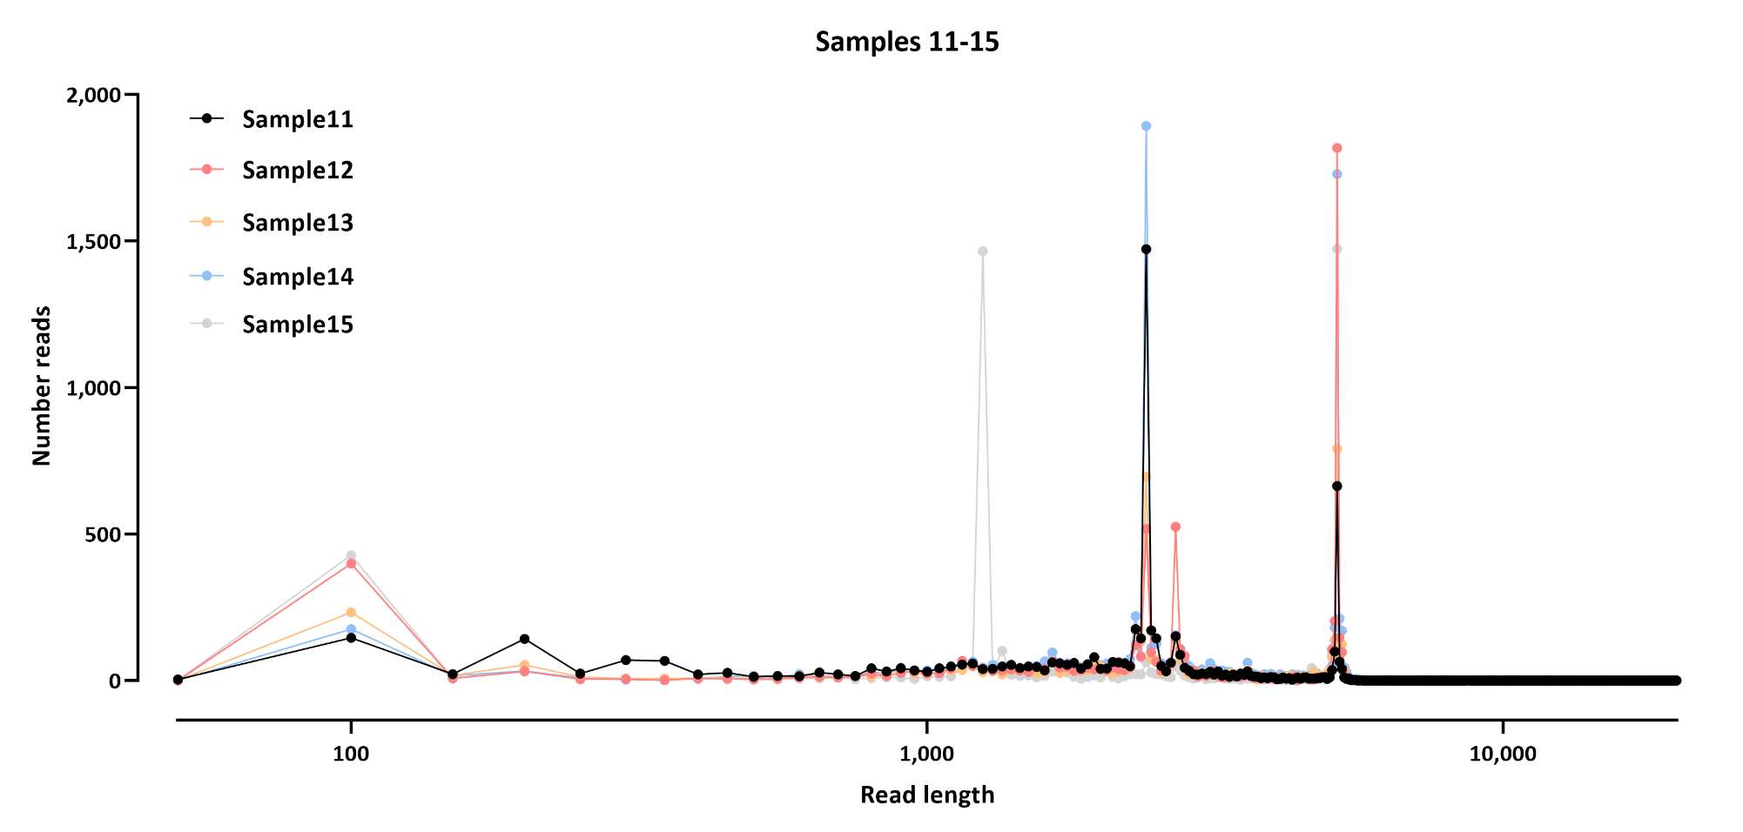
READ LENGTH DISTRIBUTION

Slide 6
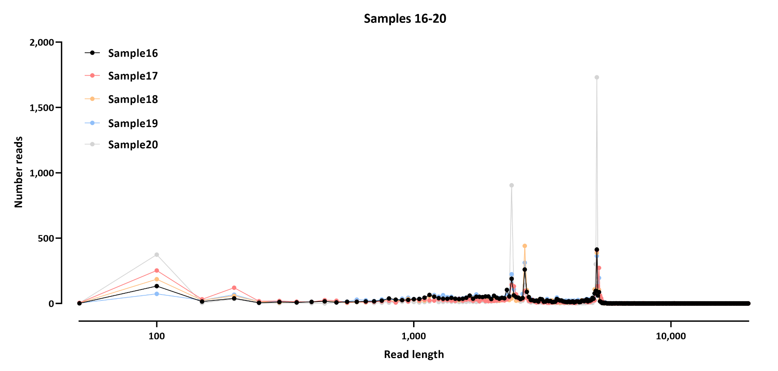
READ LENGTH DISTRIBUTION

Slide 7
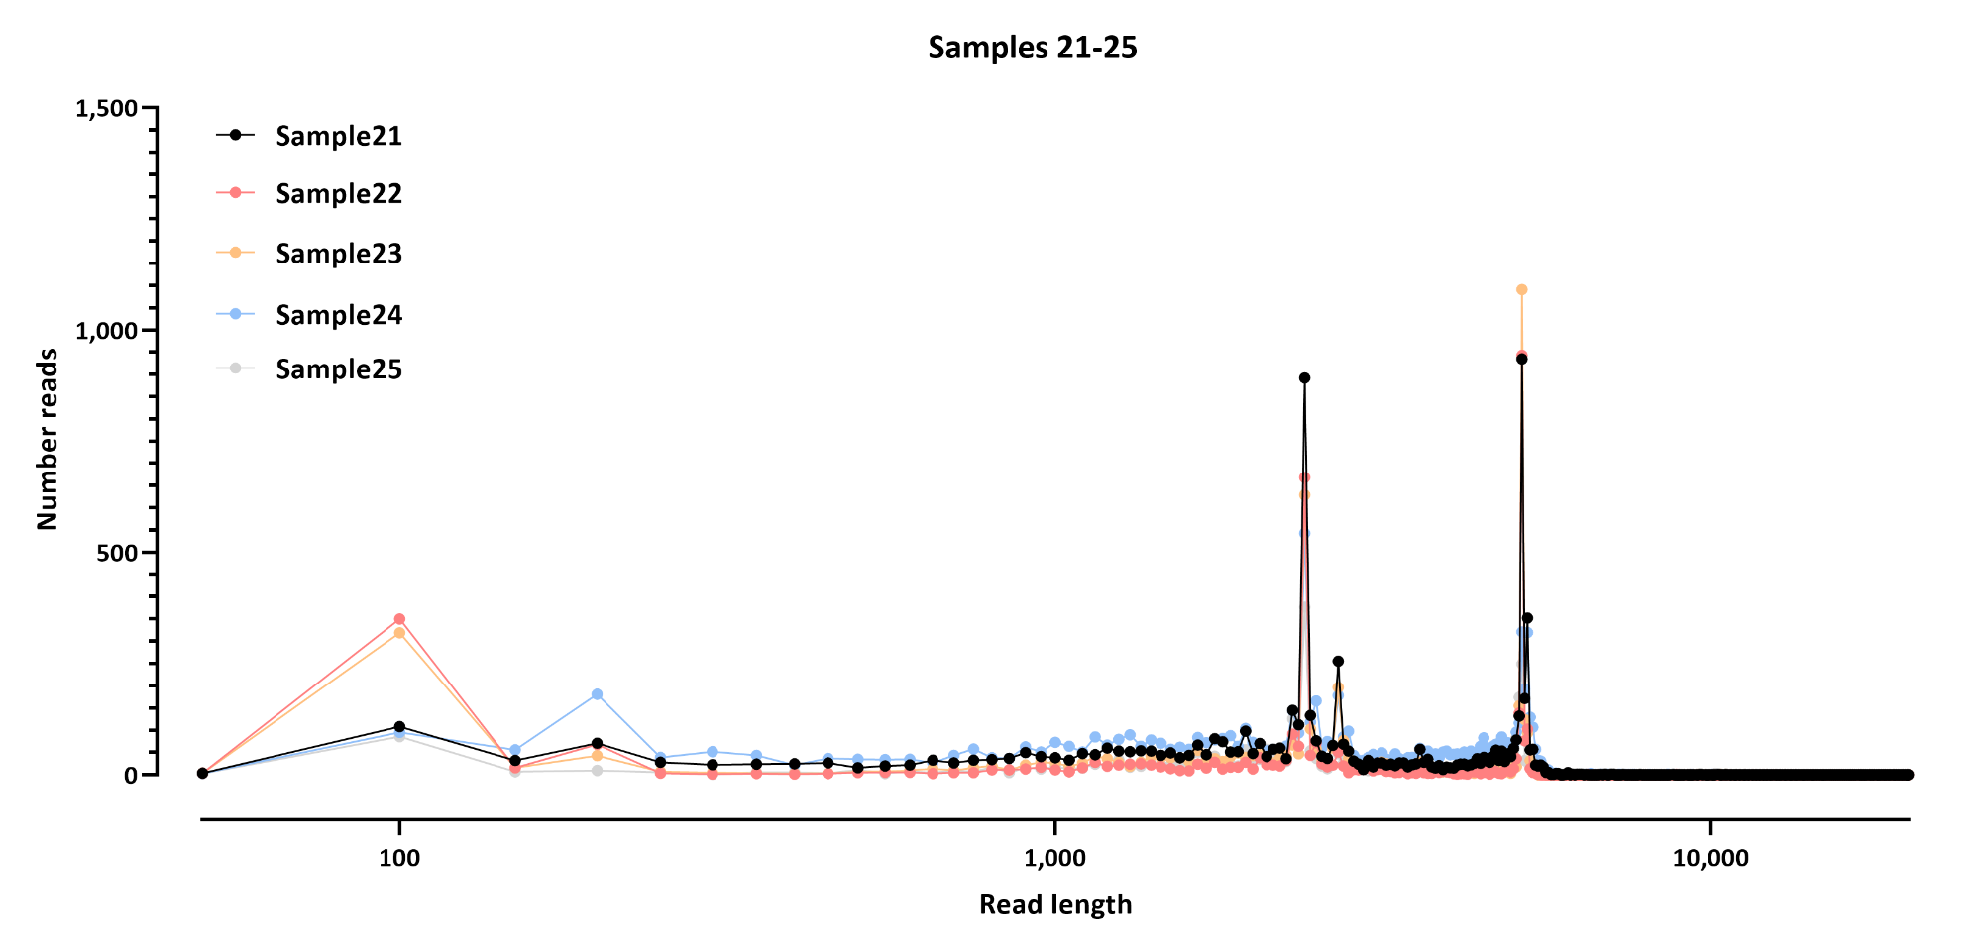
READ LENGTH DISTRIBUTION

Slide 8
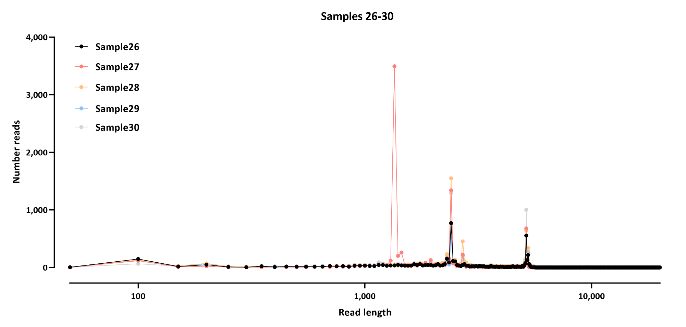
READ LENGTH DISTRIBUTION

Slide 9
CACNA1C ISOFORMS IN GENCODE
Isofrom | transcript length
CACNA1C-201 | 6,616
CACNA1C-202 | 6,968
CACNA1C-203 | 6,634
CACNA1C-204 | 6,655
CACNA1C-205 | 6,535
CACNA1C-206 | 6,535
CACNA1C-207 | 6,511
CACNA1C-208 | 6,511
CACNA1C-209 | 7,377
CACNA1C-210 | 6,571
CACNA1C-211 | 7,482
CACNA1C-212 | 6,568
CACNA1C-213 | 6,562
CACNA1C-214 | 7,590
CACNA1C-215 | 6,568
CACNA1C-216 | 6,595
CACNA1C-217 | 6,511
CACNA1C-218 | 6,511
CACNA1C-219 | 6,529
CACNA1C-220 | 13,433
CACNA1C-221 | 6,568
CACNA1C-222 | 7,590
CACNA1C-223 | 831
CACNA1C-224 | 581
CACNA1C-225 | 6,811
CACNA1C-226 | 592
CACNA1C-227 | 669
CACNA1C-228 | 819
CACNA1C-229 | 545
CACNA1C-230 | 577
CACNA1C-231 | 2,833

Slide 10
CACNA1C ISOFORMS IN REFSEQ 2012
Isofrom | transcript length
CACNA1C_dup9 | 13,531
CACNA1C_dup10 | 13,480
CACNA1C_dup12 | 13,480
CACNA1C_dup17 | 13,504
CACNA1C_dup13 | 13,537
CACNA1C_dup7 | 13,624
CACNA1C_dup18 | 13,564
CACNA1C_dup11 | 13,447
CACNA1C-AS4 | 737
CACNA1C_dup22 | 13,550
CACNA1C_dup2 | 13,480
CACNA1C_dup8 | 13,504
CACNA1C-AS2 | 609
CACNA1C_dup5 | 13,537
CACNA1C_dup14 | 13,660
CACNA1C_dup6 | 13,471
CACNA1C-IT2 | 588
CACNA1C_dup20 | 13,694
CACNA1C | 13,480
CACNA1C_dup19 | 13,480
CACNA1C_dup4 | 13,540
CACNA1C-AS1 | 2,230
CACNA1C_dup1 | 13,498
CACNA1C_dup15 | 13,480
CACNA1C_dup3 | 13,537
CACNA1C-IT3 | 430
CACNA1C_dup21 | 13,550
CACNA1C_dup16 | 13,603

Slide 11
CACNA1C ISOFORMS IN REFSEQ 2022
XM_006719017.2 | 13,531
XM_011521020.2 | 13,606
XM_011521023.3 | 13,517
XM_017019926.2 | 15,497
XM_017019927.2 | 15,392
XM_017019928.2 | 15,179
XM_017019929.2 | 15,122
XM_017019930.2 | 8,375
XM_017019931.2 | 8,291
XM_017019932.2 | 9,236
XM_017019933.2 | 8,180
XM_017019934.2 | 8,171
XM_017019935.2 | 14,918
XM_017019936.2 | 8,153
XM_017019937.2 | 8,153
XM_017019938.2 | 8,153
XM_017019939.2 | 8,147
XM_017019940.2 | 8,120
XM_017019941.2 | 8,114
XM_017019942.2 | 8,096
XM_017019943.2 | 8,096
XM_017019944.2 | 8,096
XM_017019945.2 | 8,096
XM_017019946.2 | 9,056
XM_017019947.2 | 8,096
XM_017019948.2 | 8,096
XM_017019949.2 | 8,096
XM_017019950.2 | 8,090
XM_017019951.2 | 8,087
XM_017019952.2 | 8,063
XM_017019953.1 | 13,531
XM_017019954.1 | 13,531
XM_017019955.2 | 14,918
XR_001749433.1 | 8,374
Isofrom | transcript length
NM_000719.7_2 | 13,744
NM_001129827.2_2 | 13,888
NM_001129829.2_2 | 13,867
NM_001129830.3_2 | 13,849
NM_001129831.2_2 | 13,828
NM_001129832.2_2 | 13,804
NM_001129833.2_2 | 13,801
NM_001129834.2_2 | 13,801
NM_001129835.2_2 | 13,801
NM_001129836.2_2 | 13,795
NM_001129837.2_2 | 13,768
NM_001129838.2_2 | 13,768
NM_001129839.2_2 | 13,762
NM_001129840.2_2 | 13,744
NM_001129841.2_2 | 13,744
NM_001129842.2_2 | 13,744
NM_001129843.2_2 | 13,744
NM_001129844.2_2 | 13,735
NM_001129846.2_2 | 13,711
NM_001167623.2_2 | 13,744
NM_001167624.3_2 | 13,849
NM_001167625.2_2 | 13,924
NM_199460.4_2 | 13,993
NR_045725.1_2 | 2,230
NR_046578.1_2 | 737
NR_046579.1_2 | 609
NR_046768.1_2 | 589
NR_046769.1_2 | 430

Slide 12
ALIGNMENT
Did three different alignments:
BLAT
Minimaps2
GMAP

Slide 13
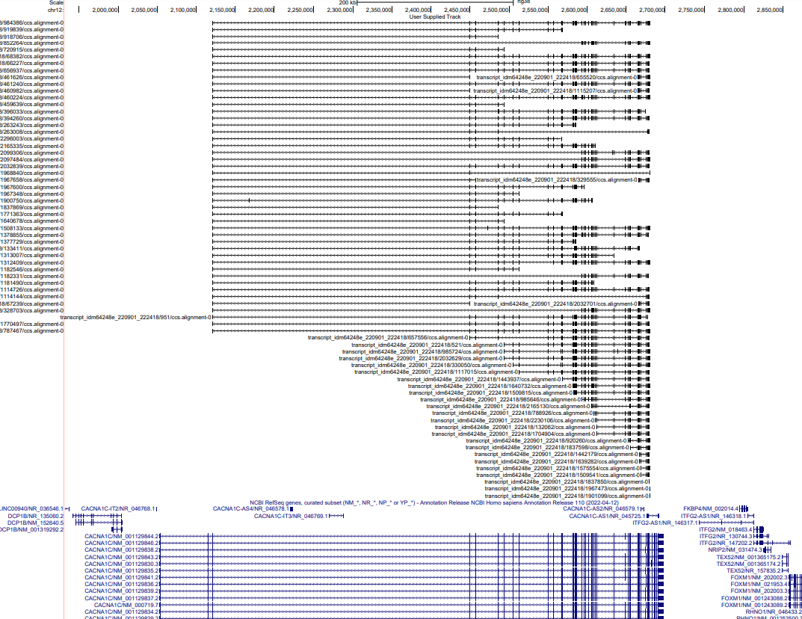
BLAT ALIGNMENT (FIRST 100 READS FROM SAMPLE1)

Slide 14
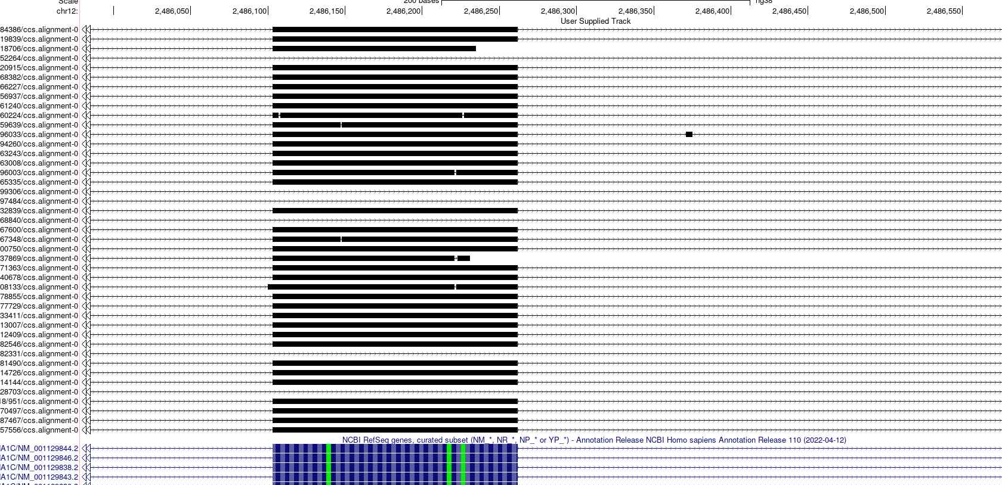
ALIGNMENT ISSUE #1 (BLAT)
BLAT exhibits a tendency to create microexons for this gene

Slide 15
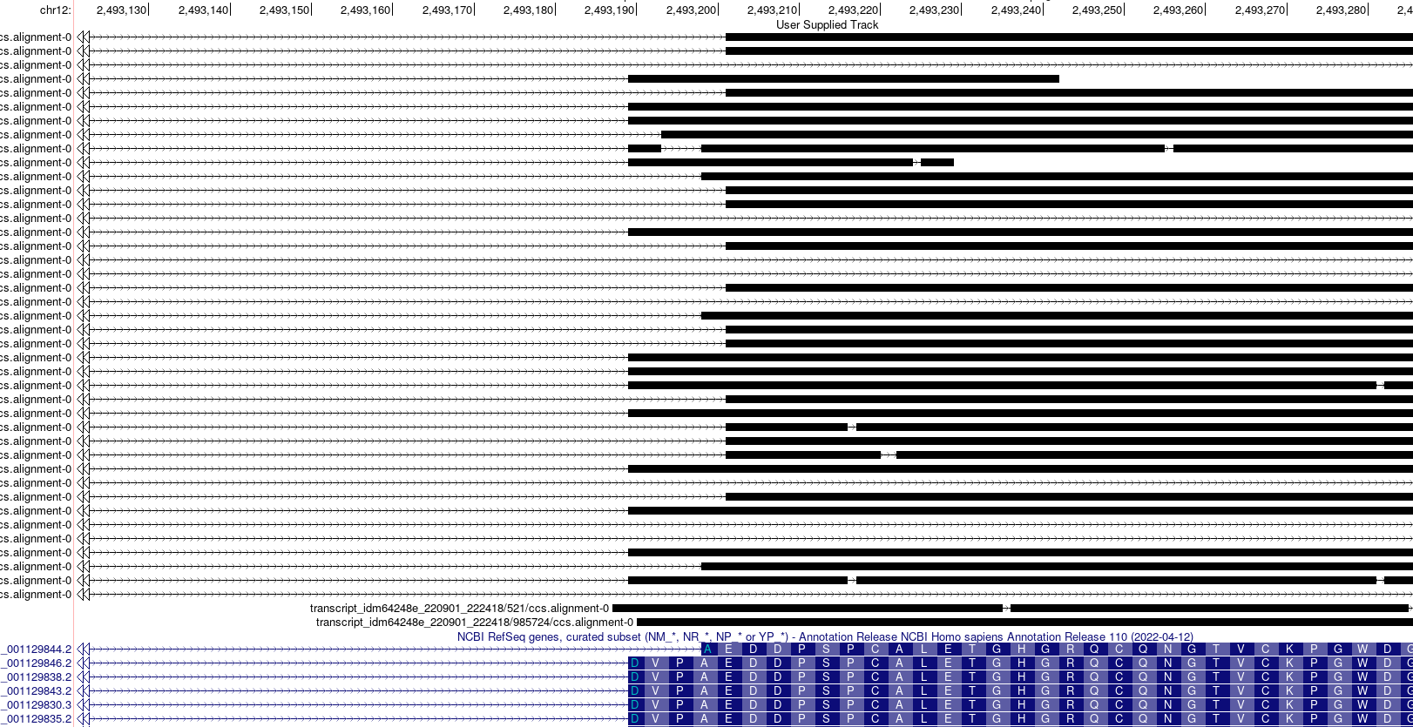
ALIGNMENT ISSUE #2 (BLAT)
Second, there is an alternative 3’ site on this exon, and the alignments don’t get it always right

Slide 16
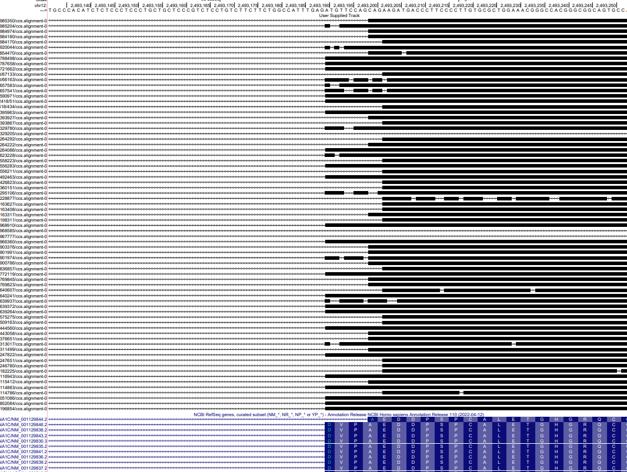
ALIGNMENT ISSUE #2 (MINIMAP2)
Same issue with Minimap (though Minimap does not create spurious microexons, which is a plus)

Slide 17
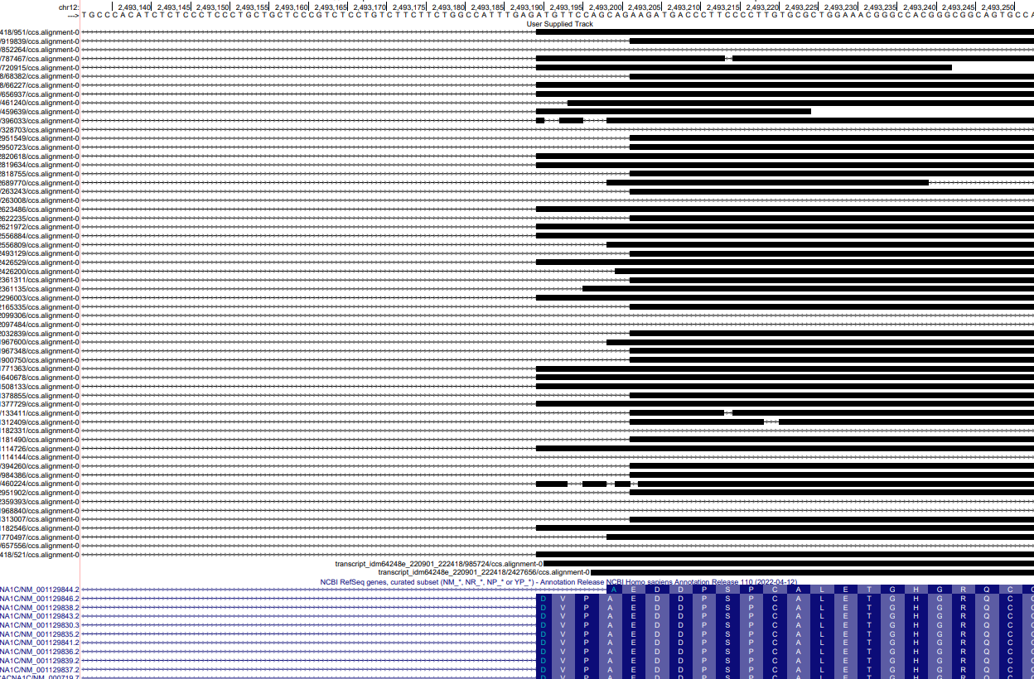
ALIGNMENT ISSUE #2 (GMAP)

Slide 18
QUANTIFICATION SUMMARY:
 |  |  |  | Assigned reads
 |  |  |  | GMAP |  |  | BLAT |  |  | Minimap2
Total reads: | 564,660 |  |  | 2016-11-16-refSeq | 2021-12-08-RefSeq | gencode.v30 | 2016-11-16-refSeq | 2021-12-08-RefSeq | gencode.v30 | 2016-11-16-refSeq | 2021-12-08-RefSeq | gencode.v30
Sample1 | 7,799 |  | Total reads after demultiplexing: | 0.44 | 0.45 | 0.44 | 0.46 | 0.47 | 0.46 | 0.58 | 0.60 | 0.57
Sample2 | 4,957 |  | 179,778 | 0.35 | 0.36 | 0.35 | 0.34 | 0.35 | 0.34 | 0.47 | 0.50 | 0.47
Sample3 | 7,315 |  |  | 0.39 | 0.40 | 0.39 | 0.40 | 0.41 | 0.40 | 0.51 | 0.53 | 0.50
Sample4 | 4,258 |  |  | 0.39 | 0.40 | 0.38 | 0.40 | 0.42 | 0.40 | 0.47 | 0.51 | 0.46
Sample5 | 6,762 |  |  | 0.29 | 0.30 | 0.29 | 0.36 | 0.37 | 0.35 | 0.40 | 0.43 | 0.39
Sample6 | 7,914 |  |  | 0.46 | 0.47 | 0.46 | 0.51 | 0.52 | 0.50 | 0.55 | 0.58 | 0.55
Sample7 | 5,120 |  |  | 0.36 | 0.37 | 0.35 | 0.32 | 0.32 | 0.31 | 0.46 | 0.47 | 0.44
Sample8 | 7,666 |  |  | 0.25 | 0.26 | 0.25 | 0.23 | 0.24 | 0.23 | 0.36 | 0.37 | 0.35
Sample9 | 7,587 |  |  | 0.33 | 0.33 | 0.33 | 0.32 | 0.32 | 0.32 | 0.38 | 0.39 | 0.38
Sample10 | 7,368 |  |  | 0.21 | 0.21 | 0.21 | 0.26 | 0.27 | 0.25 | 0.32 | 0.35 | 0.31
Sample11 | 6,185 |  |  | 0.25 | 0.26 | 0.25 | 0.31 | 0.33 | 0.31 | 0.39 | 0.41 | 0.38
Sample12 | 6,380 |  |  | 0.27 | 0.28 | 0.27 | 0.27 | 0.29 | 0.27 | 0.34 | 0.38 | 0.34
Sample13 | 5,025 |  |  | 0.24 | 0.24 | 0.24 | 0.22 | 0.22 | 0.22 | 0.37 | 0.39 | 0.36
Sample14 | 8,302 |  |  | 0.18 | 0.19 | 0.18 | 0.19 | 0.19 | 0.19 | 0.32 | 0.33 | 0.29
Sample15 | 5,132 |  |  | 0.18 | 0.18 | 0.18 | 0.17 | 0.17 | 0.17 | 0.21 | 0.22 | 0.21
Sample16 | 4,262 |  |  | 0.33 | 0.35 | 0.33 | 0.31 | 0.32 | 0.31 | 0.40 | 0.43 | 0.40
Sample17 | 3,668 |  |  | 0.28 | 0.29 | 0.28 | 0.29 | 0.31 | 0.29 | 0.36 | 0.39 | 0.35
Sample18 | 3,862 |  |  | 0.40 | 0.42 | 0.39 | 0.35 | 0.37 | 0.35 | 0.45 | 0.48 | 0.45
Sample19 | 4,876 |  |  | 0.32 | 0.33 | 0.32 | 0.29 | 0.30 | 0.29 | 0.41 | 0.43 | 0.40
Sample20 | 4,982 |  |  | 0.15 | 0.16 | 0.15 | 0.15 | 0.15 | 0.15 | 0.31 | 0.31 | 0.29
Sample21 | 7,095 |  |  | 0.23 | 0.24 | 0.23 | 0.23 | 0.23 | 0.22 | 0.38 | 0.40 | 0.36
Sample22 | 3,755 |  |  | 0.21 | 0.22 | 0.21 | 0.22 | 0.23 | 0.22 | 0.35 | 0.36 | 0.34
Sample23 | 4,934 |  |  | 0.25 | 0.25 | 0.25 | 0.23 | 0.24 | 0.23 | 0.39 | 0.40 | 0.36
Sample24 | 8,094 |  |  | 0.28 | 0.29 | 0.27 | 0.27 | 0.29 | 0.27 | 0.38 | 0.40 | 0.37
Sample25 | 3,186 |  |  | 0.19 | 0.20 | 0.19 | 0.18 | 0.19 | 0.18 | 0.26 | 0.28 | 0.26
Sample26 | 4,825 |  |  | 0.22 | 0.23 | 0.22 | 0.25 | 0.26 | 0.25 | 0.35 | 0.36 | 0.34
Sample27 | 9,032 |  |  | 0.11 | 0.11 | 0.11 | 0.12 | 0.13 | 0.12 | 0.19 | 0.20 | 0.19
Sample28 | 7,536 |  |  | 0.24 | 0.25 | 0.23 | 0.23 | 0.24 | 0.23 | 0.38 | 0.40 | 0.36
Sample29 | 5,208 |  |  | 0.26 | 0.27 | 0.26 | 0.26 | 0.27 | 0.25 | 0.39 | 0.42 | 0.38
Sample30 | 6,693 |  |  | 0.19 | 0.20 | 0.19 | 0.19 | 0.20 | 0.19 | 0.34 | 0.36 | 0.32

Slide 19
CAVEAT:
Most reads are in fact not uniquely assigned because the gene is very long and the reads do not fully cover it, so if the read does not cover some of the exons that make an isoform unique, then it can only be assigned provisionally to two isoforms.

Slide 20
BACK TO THE PROBLEMATIC EXON:
Most reads are actually lost because of the mess here.
Most transcripts have this exon starting at position 2,493,190, but there are reads mapping to 2,493,196, 2,493,199, and 2,493,202
GENCODE does not have this at all
I made new transcripts with these coordinates and requantified

Slide 21
QUANTIFICATION SUMMARY, NEW ANNOTATIONS
 |  |  |  | Assigned reads
 |  |  |  | GMAP |  |  | BLAT |  |  | Minimap2
Total reads: | 564,660 |  |  | 2016-11-16-refSeq |  | gencode.v30 | 2016-11-16-refSeq |  | gencode.v30 | 2016-11-16-refSeq |  | gencode.v30
Sample1 | 7,799 |  | Total reads after demultiplexing: | 0.45 |  | 0.45 | 0.49 |  | 0.49 | 0.68 |  | 0.68
Sample2 | 4,957 |  | 179,778 | 0.35 |  | 0.35 | 0.37 |  | 0.37 | 0.59 |  | 0.60
Sample3 | 7,315 |  |  | 0.40 |  | 0.40 | 0.43 |  | 0.43 | 0.63 |  | 0.63
Sample4 | 4,258 |  |  | 0.39 |  | 0.39 | 0.45 |  | 0.45 | 0.56 |  | 0.56
Sample5 | 6,762 |  |  | 0.30 |  | 0.30 | 0.44 |  | 0.45 | 0.53 |  | 0.54
Sample6 | 7,914 |  |  | 0.47 |  | 0.47 | 0.57 |  | 0.57 | 0.65 |  | 0.65
Sample7 | 5,120 |  |  | 0.36 |  | 0.36 | 0.33 |  | 0.33 | 0.56 |  | 0.56
Sample8 | 7,666 |  |  | 0.27 |  | 0.26 | 0.25 |  | 0.25 | 0.52 |  | 0.51
Sample9 | 7,587 |  |  | 0.33 |  | 0.33 | 0.34 |  | 0.34 | 0.53 |  | 0.53
Sample10 | 7,368 |  |  | 0.22 |  | 0.22 | 0.33 |  | 0.33 | 0.46 |  | 0.46
Sample11 | 6,185 |  |  | 0.26 |  | 0.26 | 0.43 |  | 0.44 | 0.57 |  | 0.57
Sample12 | 6,380 |  |  | 0.27 |  | 0.27 | 0.33 |  | 0.34 | 0.45 |  | 0.46
Sample13 | 5,025 |  |  | 0.25 |  | 0.24 | 0.24 |  | 0.24 | 0.49 |  | 0.50
Sample14 | 8,302 |  |  | 0.19 |  | 0.19 | 0.23 |  | 0.22 | 0.54 |  | 0.54
Sample15 | 5,132 |  |  | 0.18 |  | 0.18 | 0.17 |  | 0.17 | 0.29 |  | 0.29
Sample16 | 4,262 |  |  | 0.33 |  | 0.33 | 0.33 |  | 0.33 | 0.46 |  | 0.47
Sample17 | 3,668 |  |  | 0.29 |  | 0.29 | 0.33 |  | 0.33 | 0.47 |  | 0.47
Sample18 | 3,862 |  |  | 0.40 |  | 0.40 | 0.38 |  | 0.38 | 0.52 |  | 0.52
Sample19 | 4,876 |  |  | 0.33 |  | 0.33 | 0.31 |  | 0.31 | 0.53 |  | 0.53
Sample20 | 4,982 |  |  | 0.16 |  | 0.16 | 0.18 |  | 0.18 | 0.47 |  | 0.47
Sample21 | 7,095 |  |  | 0.24 |  | 0.24 | 0.25 |  | 0.25 | 0.52 |  | 0.52
Sample22 | 3,755 |  |  | 0.22 |  | 0.22 | 0.25 |  | 0.25 | 0.50 |  | 0.51
Sample23 | 4,934 |  |  | 0.25 |  | 0.25 | 0.26 |  | 0.26 | 0.52 |  | 0.53
Sample24 | 8,094 |  |  | 0.29 |  | 0.29 | 0.30 |  | 0.30 | 0.50 |  | 0.51
Sample25 | 3,186 |  |  | 0.20 |  | 0.20 | 0.23 |  | 0.23 | 0.40 |  | 0.41
Sample26 | 4,825 |  |  | 0.23 |  | 0.23 | 0.34 |  | 0.34 | 0.53 |  | 0.54
Sample27 | 9,032 |  |  | 0.11 |  | 0.11 | 0.16 |  | 0.16 | 0.28 |  | 0.29
Sample28 | 7,536 |  |  | 0.24 |  | 0.24 | 0.27 |  | 0.27 | 0.54 |  | 0.54
Sample29 | 5,208 |  |  | 0.26 |  | 0.26 | 0.27 |  | 0.27 | 0.52 |  | 0.53
Sample30 | 6,693 |  |  | 0.20 |  | 0.20 | 0.24 |  | 0.24 | 0.53 |  | 0.53

