Slide 1
Notes on processing:
- I should have asked for FASTQ, as the BAM was 2x150mers, and did not have the unaligned reads
Thus cross-correlation is not done properly, as it needs to be run on de novo 1x36mers alignments without the second end. And it did indeed turn out to be a problem (see further below)
Peak calling and track generation were done on the supplied BAM files

Slide 2
Datasets stats
Note:
NSC/RSC are not meaningful
because of the mapping issue
Note:
Complexity in the inputs is low

Slide 3
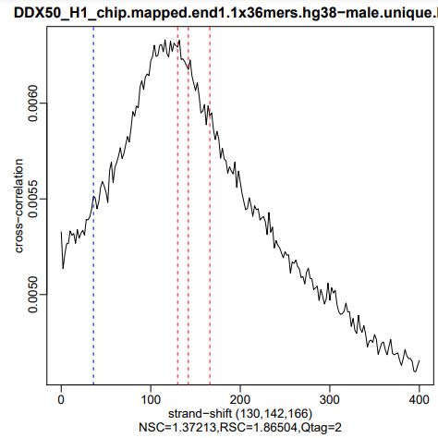
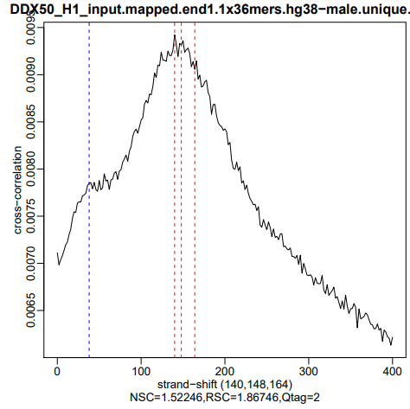
Cross-correlation
All plots are identical to these, which is because of the mapping issue

Slide 4
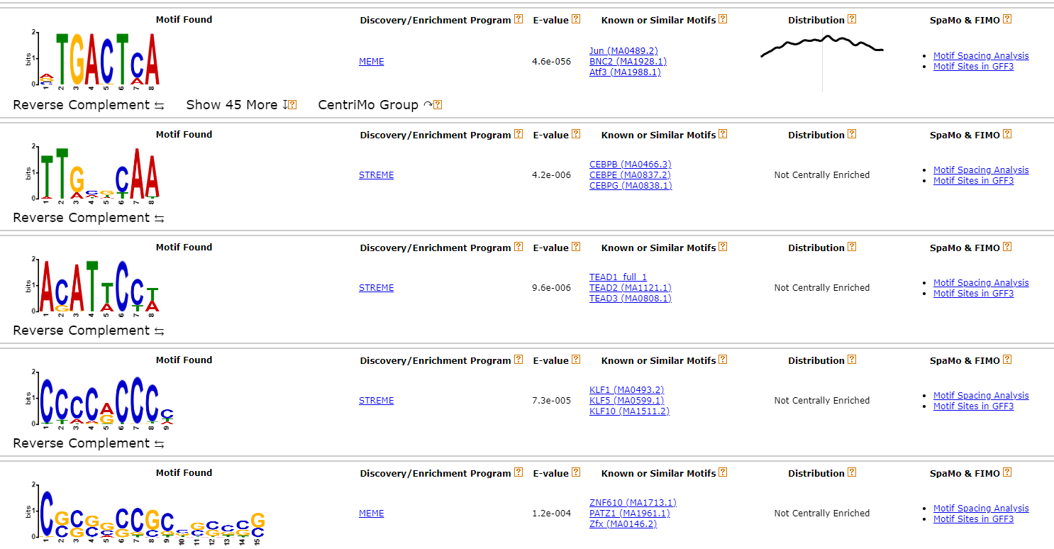
MEME-ChIP on IFI16_D2_chip

Slide 5
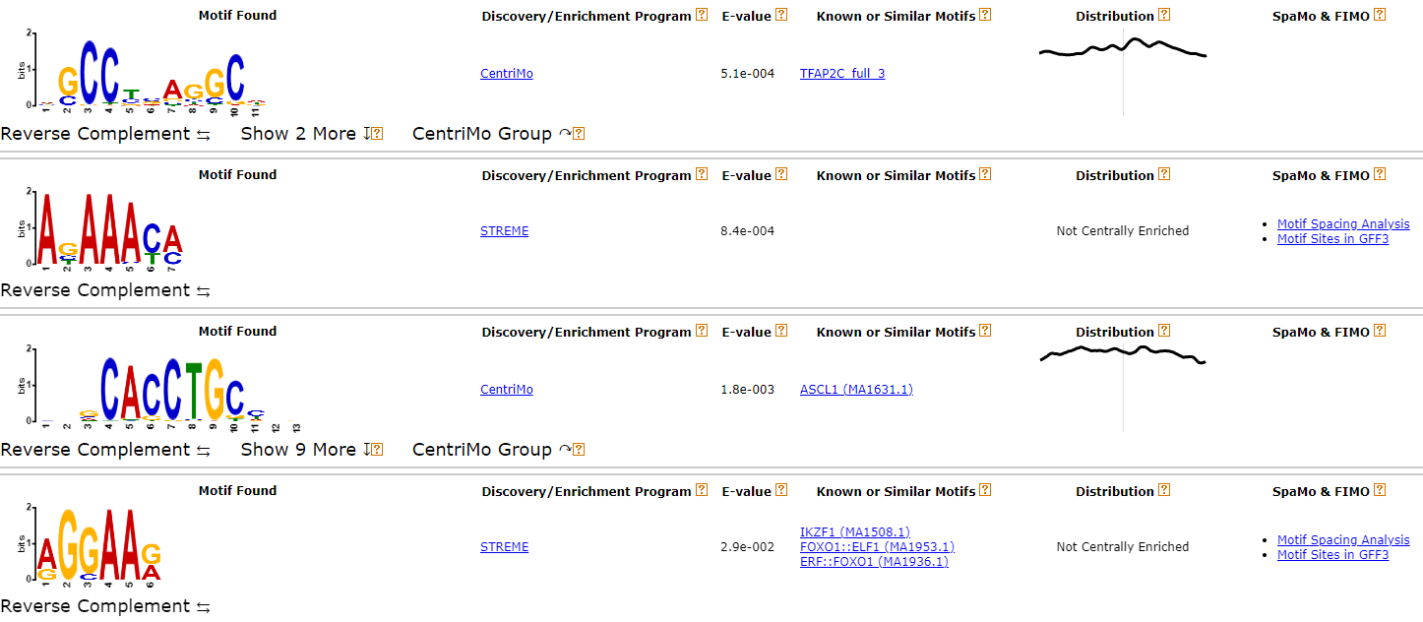

Slide 6
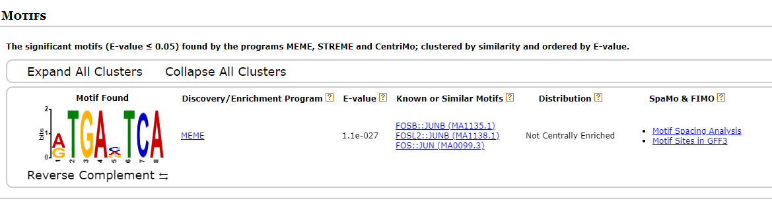
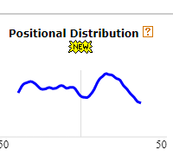
MEME-ChIP on IFI16_D3_chip

Slide 7
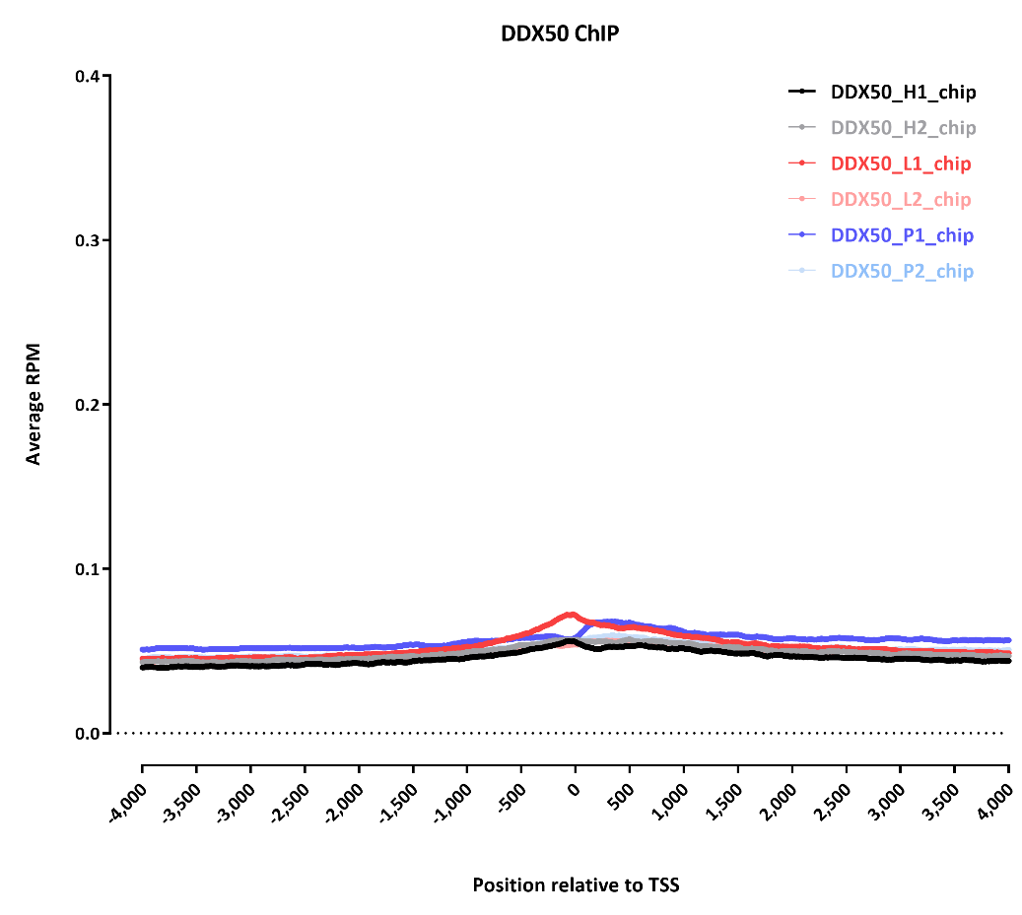
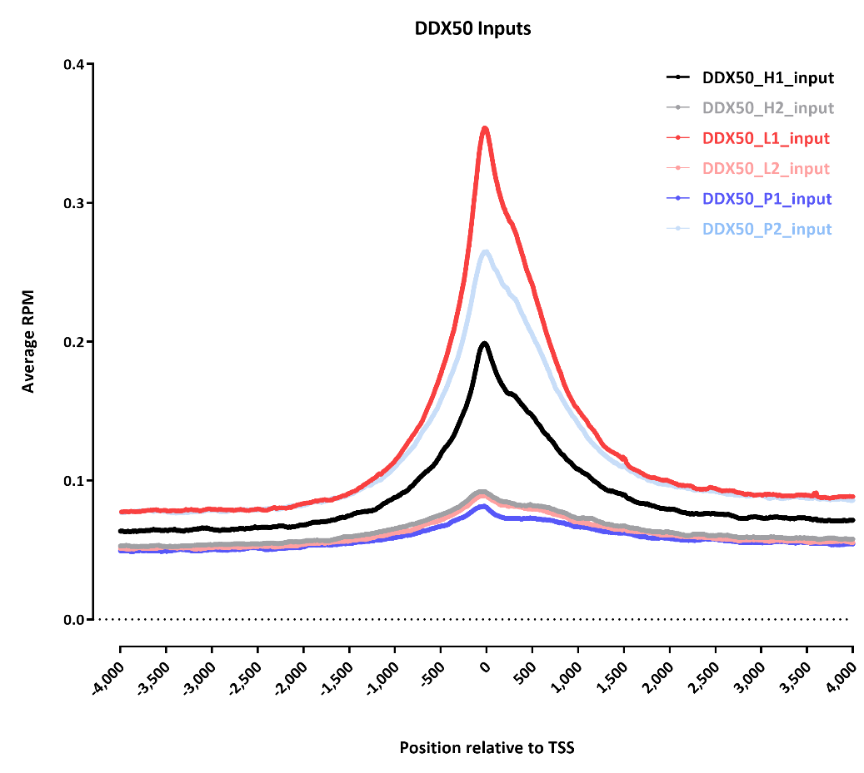
TSS profiles

Slide 8
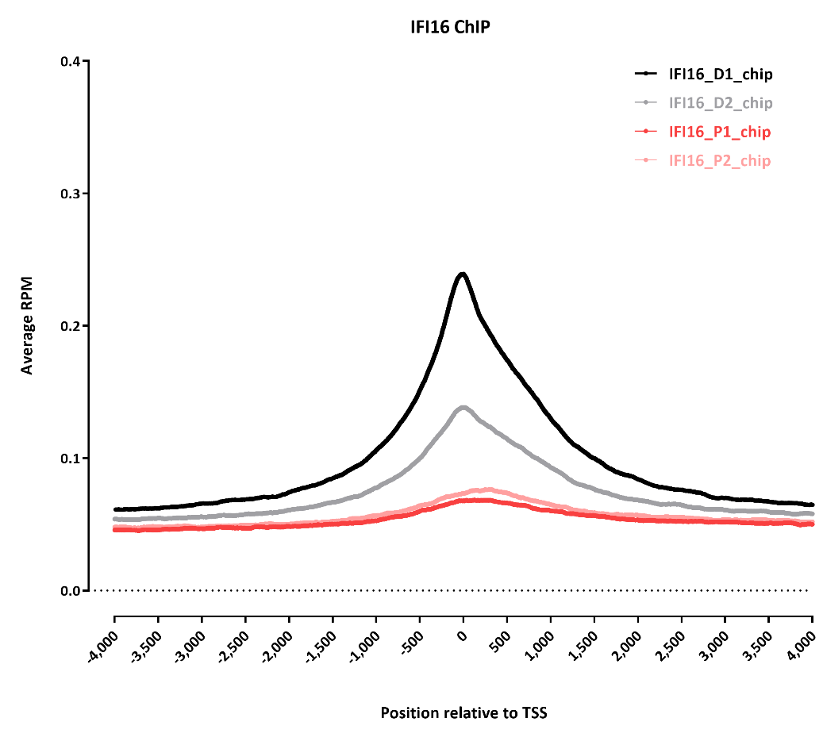
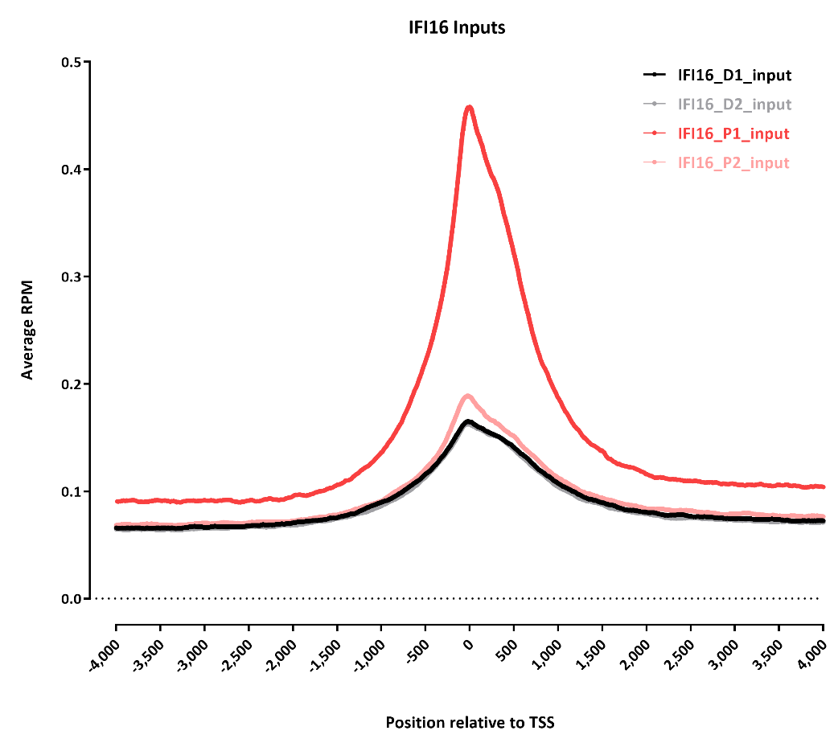
There is a rather strong TSS bias in the inputs

Slide 9
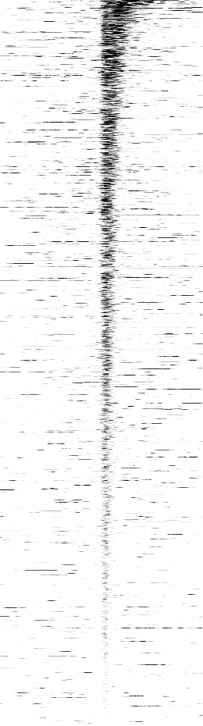







Signal distribution around IFI16_D1_chip peaks
IFI16_D1_chip | IFI16_D1_input | IFI16_D2_chip | IFI16_D2_input | IFI16_P1_chip | IFI16_P1_input | IFI16_P2_chip | IFI16_P2_input
-2.5kb 0 +2.5kb
The asymmetry is weird

Slide 10






DDX50_H1_chip | DDX50_H1_input | DDX50_H2_chip | DDX50_H2_input | DDX50_L1_chip | DDX50_L1_input

Slide 11






DDX50_L2_chip | DDX50_L2_input | DDX50_P1_chip | DDX50_P1_input | DDX50_P2_chip | DDX50_P2_input

Slide 12
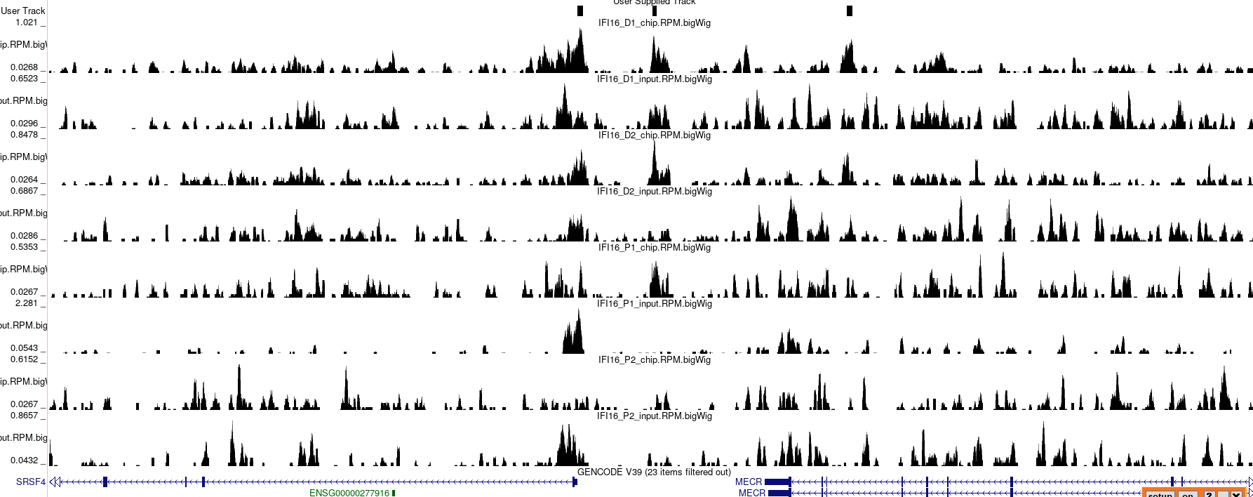
Browser snapshots
These are random peaks

Slide 13
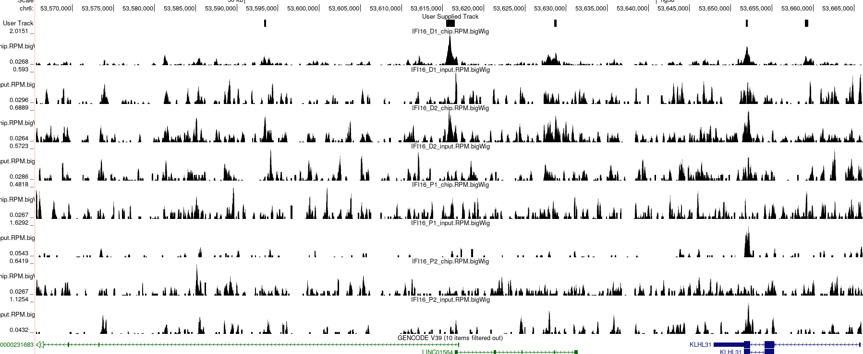
This is one of the strongest peaks

Slide 14
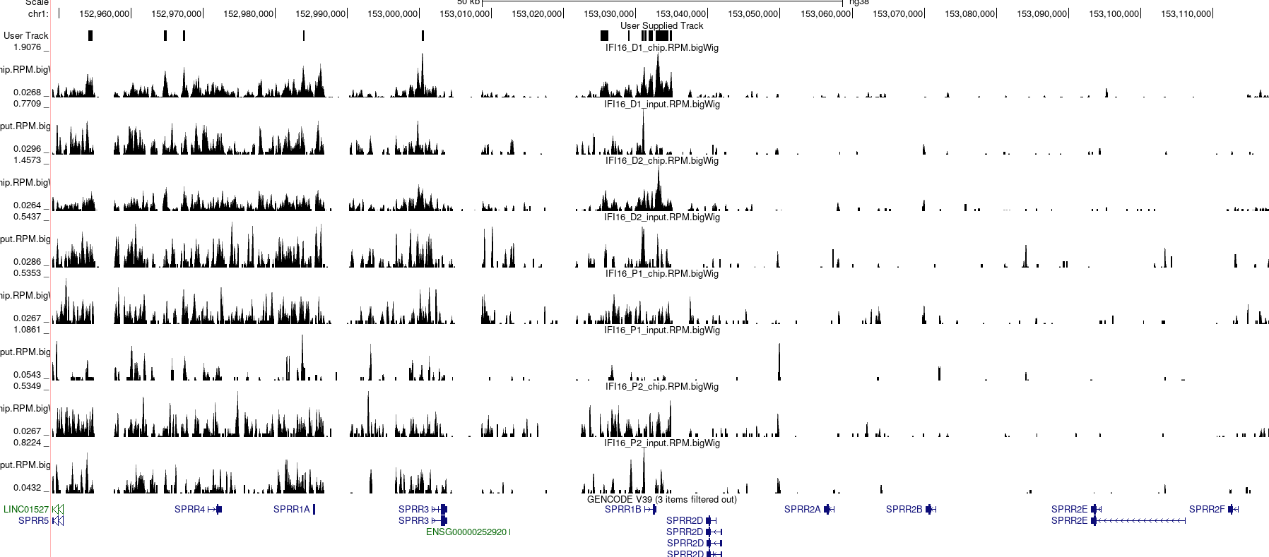
This is one of the strongest peaks

Slide 15
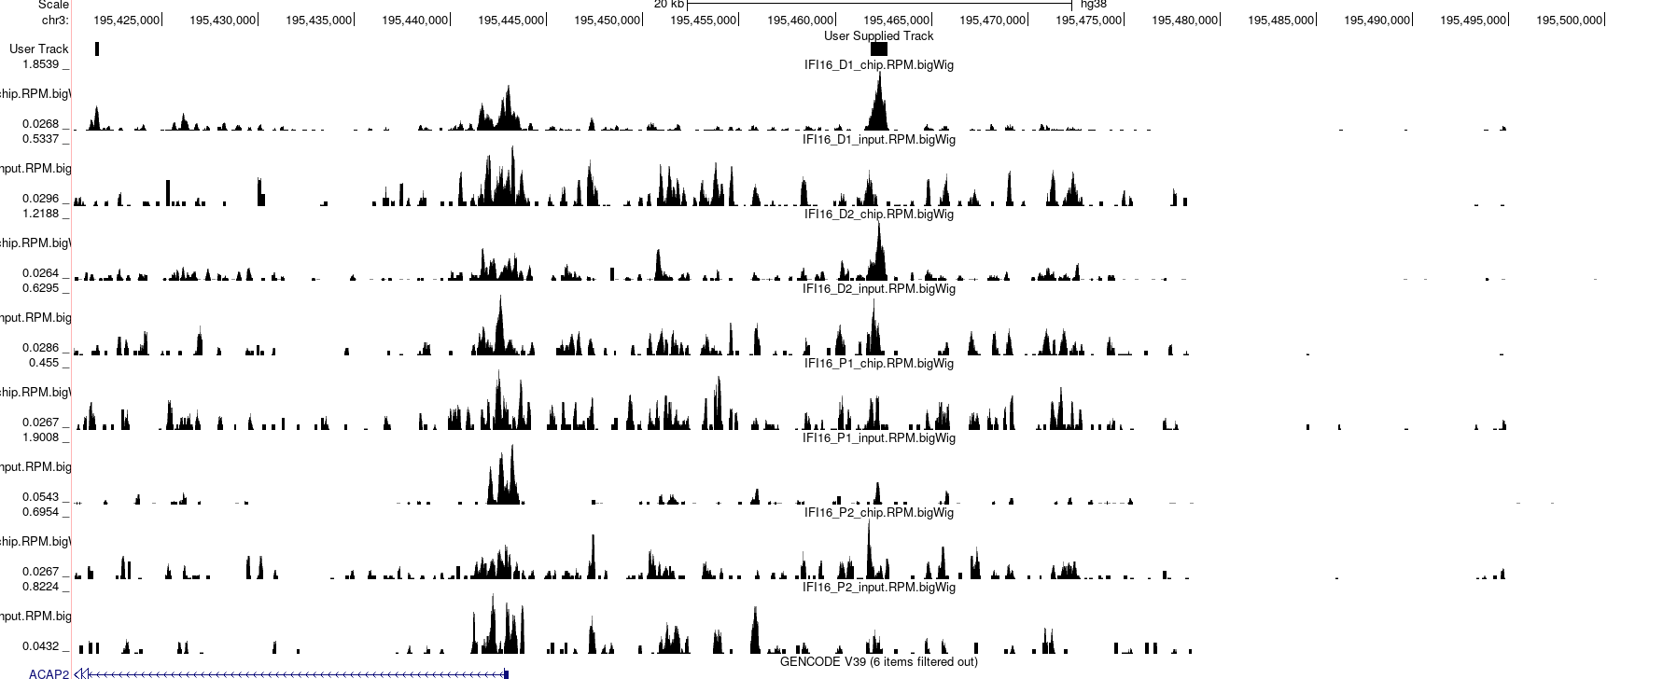
This is one of the strongest peaks

Slide 16
Summary:
Inputs are problematic for all datasets – low complexity and clustered enrichment
DDX50 does not show any enrichment
For one of the IFI16 datasets, peaks are called, another one is weak. But they are still somewhat difficult to distinguish from background
On the other hand it is good that some motifs are returned

