Slide 1
Processing overview
- For transcriptome quantification in transcriptome – eXpress on Bowtie alignments, GENCODE V29
- For genome-space quantification – mapping with STAR, quantification on GENCODE V29 using Stringtie
- Also ran Stringtie on a BAM file from HA
- Comparisons at the gene level only

Slide 2
Dataset stats
Read distribution QC
# | Exonic: | Intergenic: | Intronic:
PPMI-Phase1-IR1.3079.BL.PP0015-7954.5104-SL-1426 | 0.448452 | 0.05425346 | 0.497295
PPMI-Phase1-IR1.3081.BL.PP0015-6659.5104-SL-0416 | 0.506405 | 0.03840683 | 0.455188

Slide 3
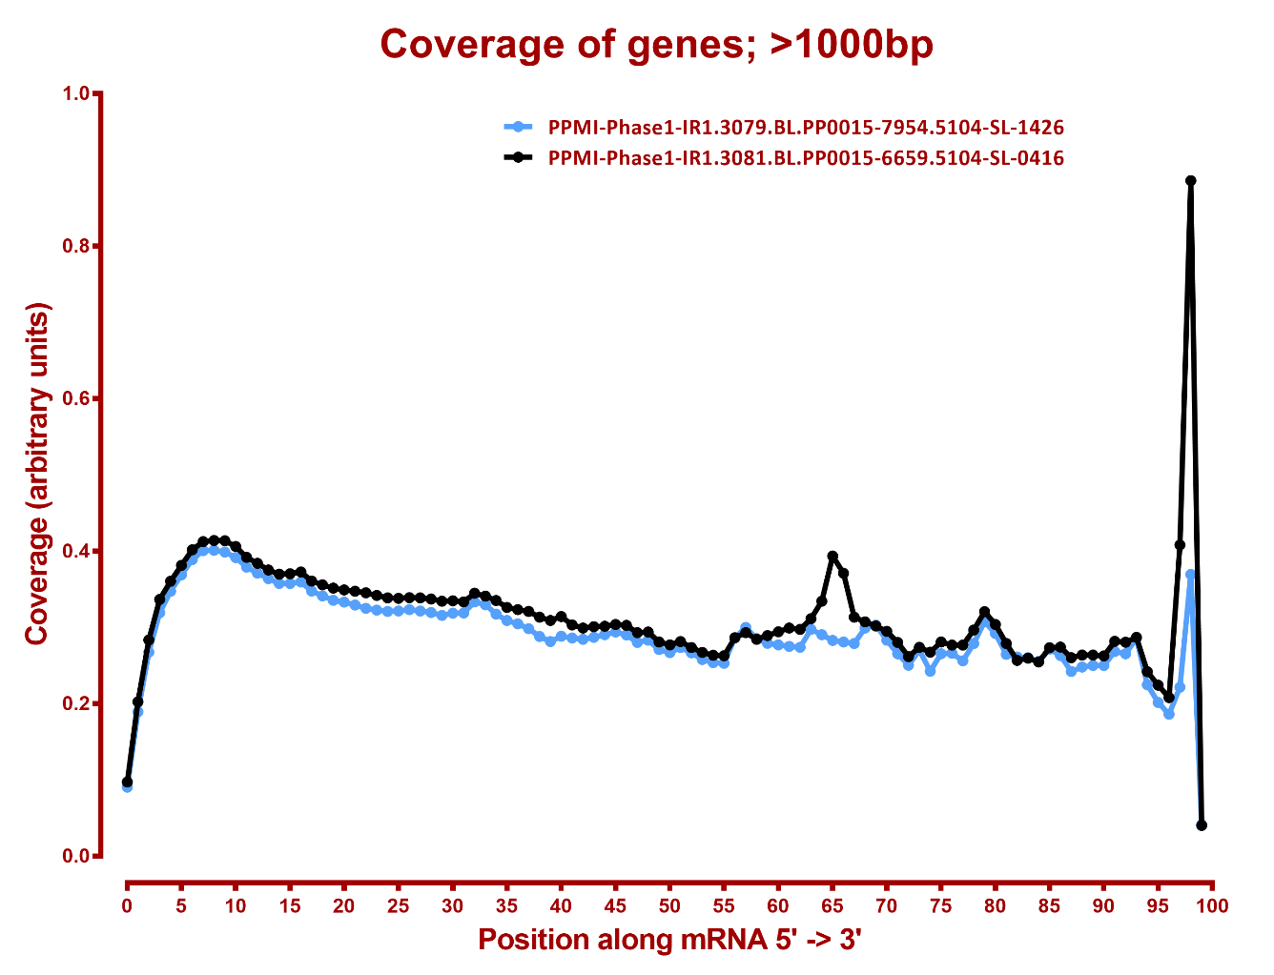
Read coverage QC

Slide 4
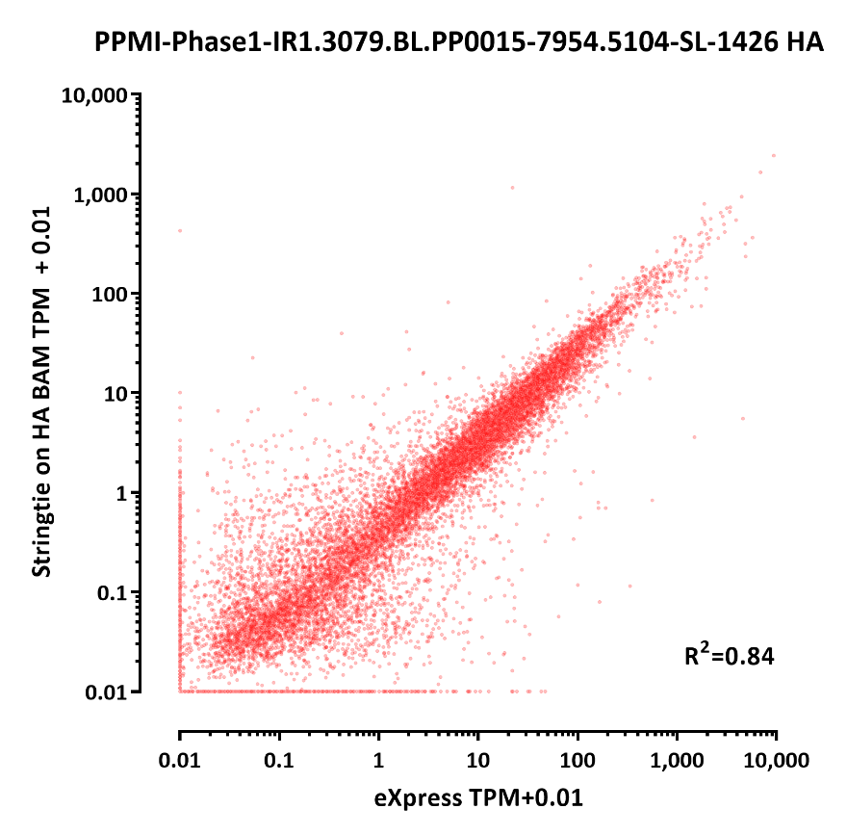
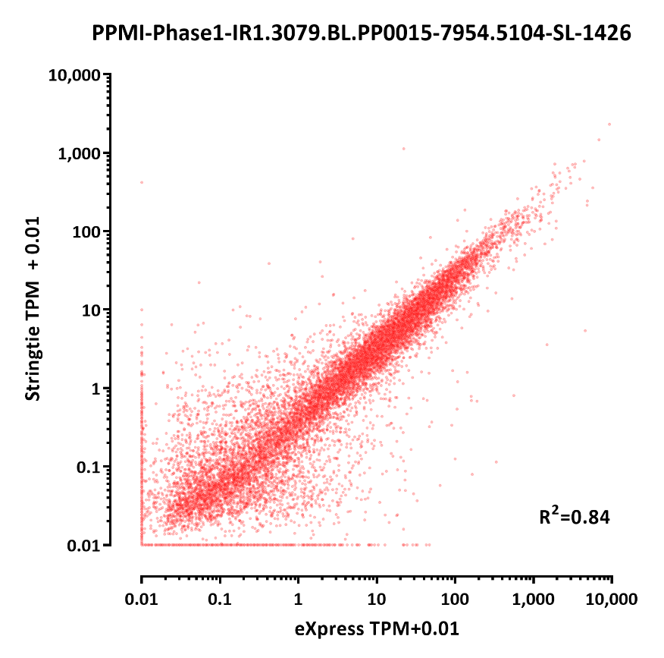
eXpress vs Stringtie, reprocessing , protein coding genes only (n=19,908)

Slide 5
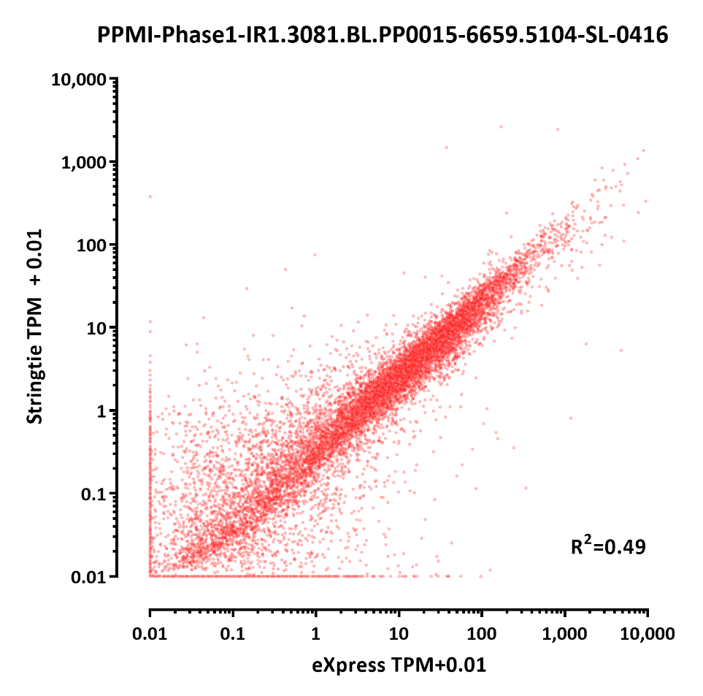
eXpress vs Stringtie, reprocessing, protein coding genes only (n=19,908)

Slide 6
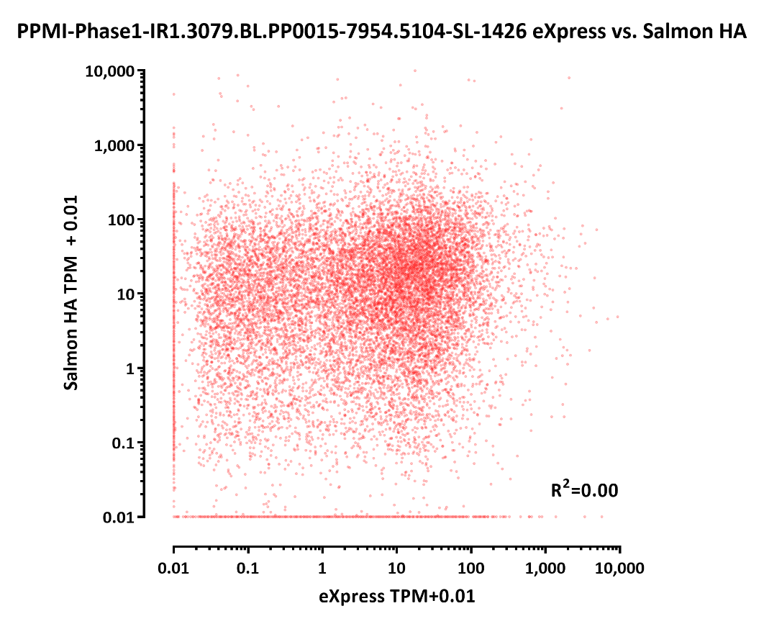
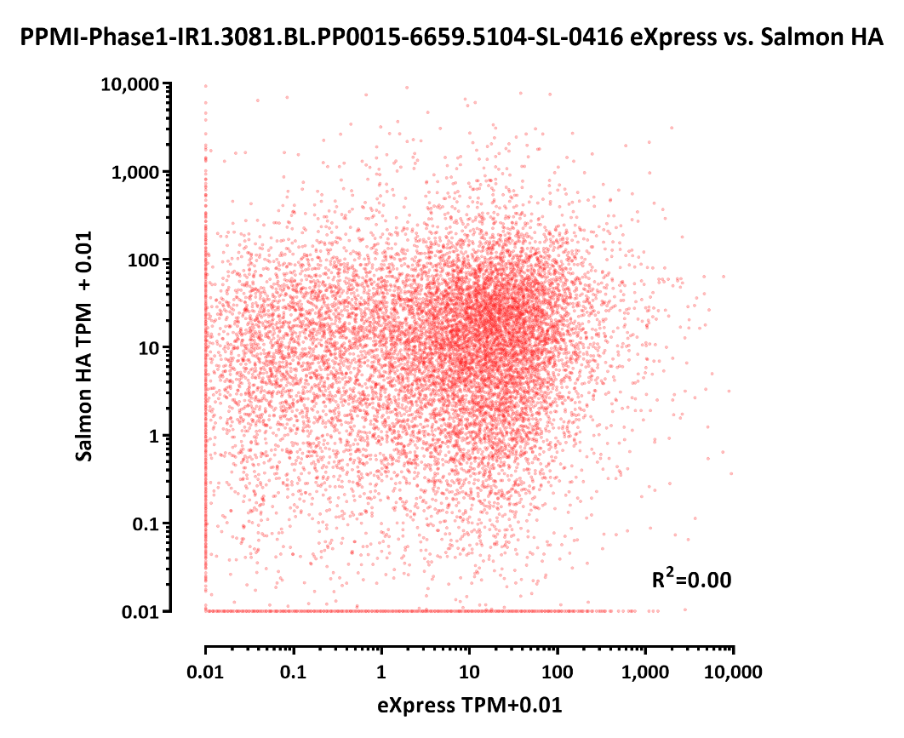
eXpress vs Salmon, protein coding genes only (n=17,726)

Slide 7
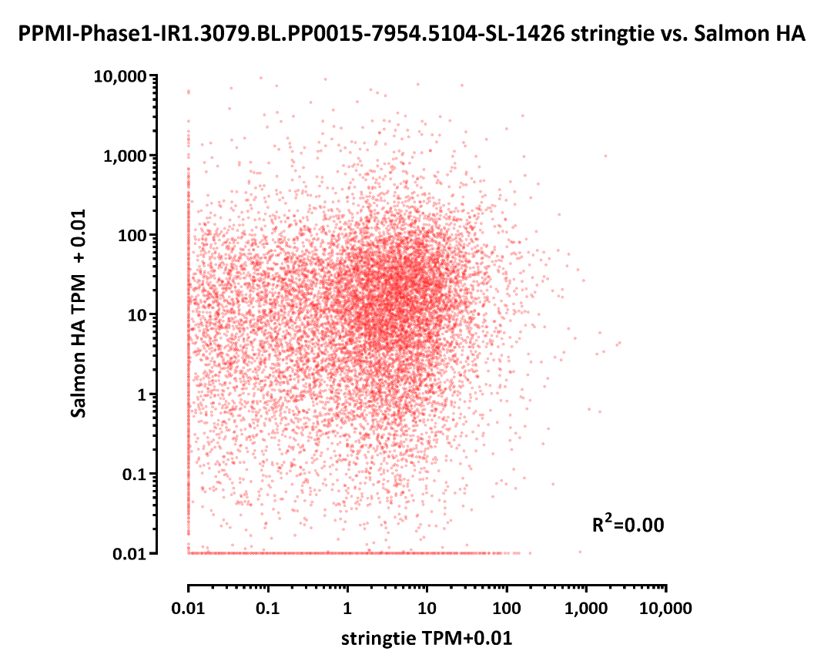
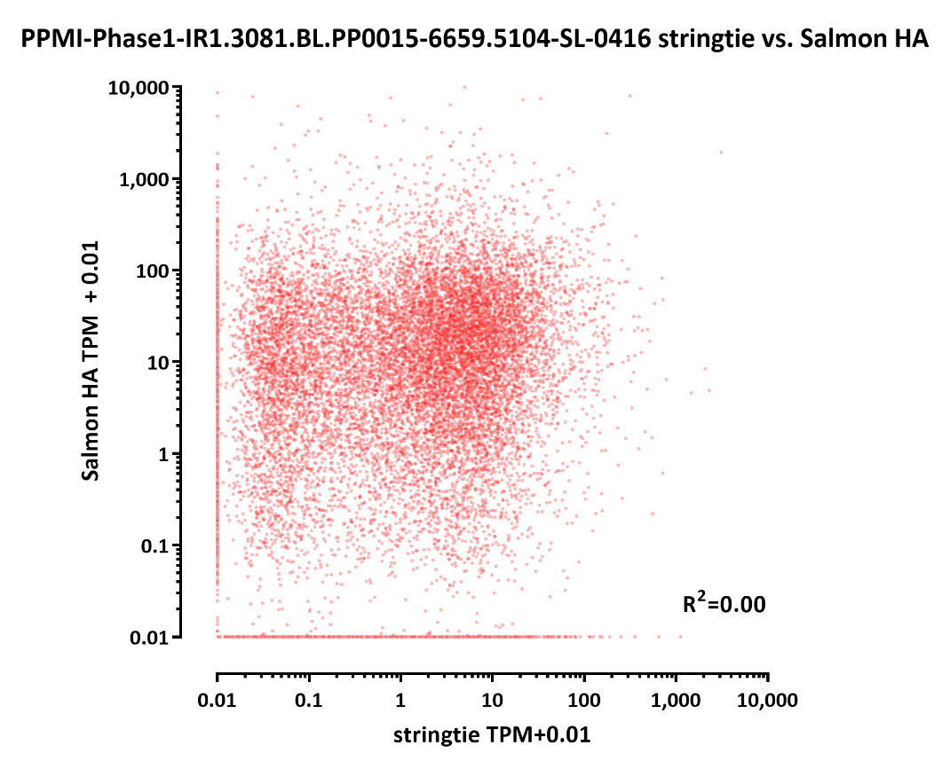
stringtie vs Salmon, protein coding genes only (n=17,726)

Slide 8
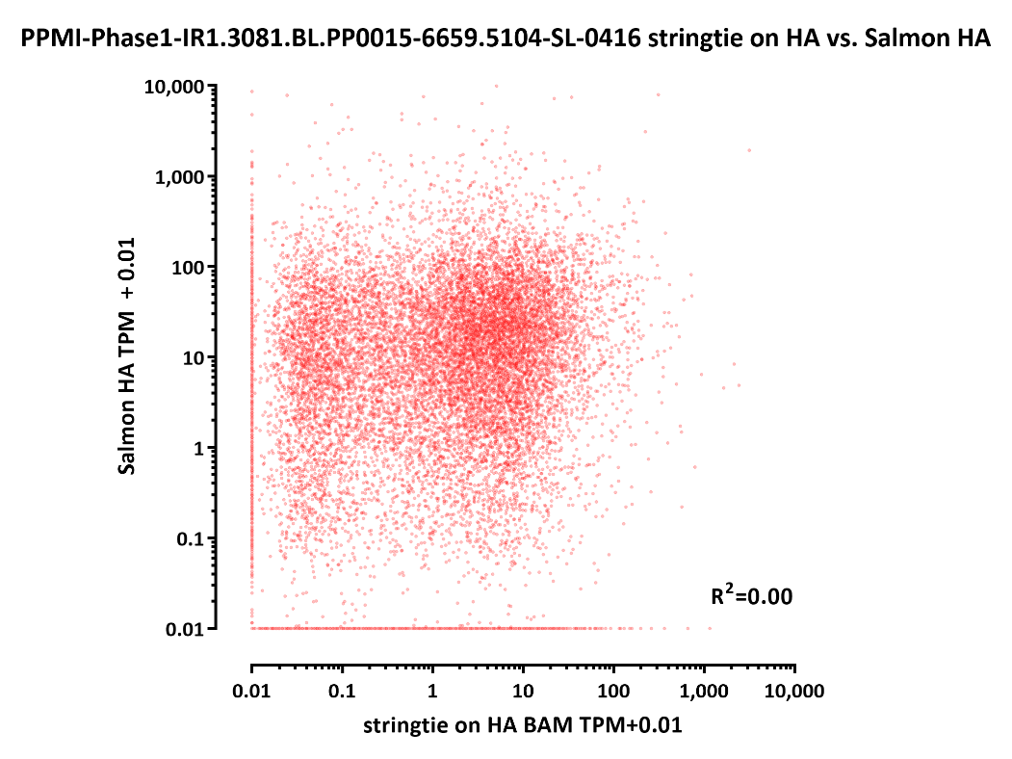
stringtie vs Salmon, protein coding genes only (n=17,726)

