Slide 1
Dataset stats
Species | # | Read Length | Raw fragments | Unique | Complexity | MACS2 NumPeaks | MACS2 RPM | MACS2 PseudoRep NumPeaks | MACS2 RPM | NSC | RSC | QC
hg38_no_haps | FGFR1_LIF-GSM1603268 | 1x50 | 202,601,919 | 118,417,973 | 0.04 | 176 | 6,146 |  |  | 6.527 | 2.203 | 2
hg38_no_haps | FGFR1_RA_Exp2-GSM1603275 | 1x50 | 26,459,306 | 15,571,797 | 0.85 | 745 | 10,546 |  |  | 1.467 | 0.928 | 0
hg38_no_haps | FGFR1_RA-GSM1603271 | 1x50 | 171,546,555 | 55,730,457 | 0.14 | 4 | 22 |  |  | 1.493 | 0.034 | -2
hg38_no_haps | H3.3_RA-GSM1603274 | 1x50 | 187,356,177 | 43,030,732 | 0.05 |  |  |  |  | 2.637 | 0.111 | -2
hg38_no_haps | Nur77_LIF-GSM1603270 | 1x50 | 200,979,400 | 119,703,622 | 0.08 | 4 | 22 |  |  | 10.564 | 1.244 | 1
hg38_no_haps | Nur77_RA-GSM1603273 | 1x50 | 199,297,844 | 99,530,481 | 0.07 | 1 | 3 |  |  | 12.051 | 0.949 | 0
hg38_no_haps | RXRa_LIF-GSM1603269 | 1x50 | 202,874,068 | 126,368,008 | 0.11 | 0 | 0 |  |  | 4.810 | 1.177 | 1
hg38_no_haps | RXRa_RA-GSM1603272 | 1x50 | 197,808,527 | 79,944,508 | 0.04 | 659 | 17,715 |  |  | 1.875 | 0.079 | -2
chrM | FGFR1_LIF-GSM1603268 | 1x50 | 202,601,919 | 7,413 | 0.20
chrM | FGFR1_RA_Exp2-GSM1603275 | 1x50 | 26,459,306 | 1,049 | 0.44
chrM | FGFR1_RA-GSM1603271 | 1x50 | 171,546,555 | 68,630 | 0.38
chrM | H3.3_RA-GSM1603274 | 1x50 | 187,356,177 | 186 | 0.46
chrM | Nur77_LIF-GSM1603270 | 1x50 | 200,979,400 | 7,228 | 0.22
chrM | Nur77_RA-GSM1603273 | 1x50 | 199,297,844 | 744 | 0.31
chrM | RXRa_LIF-GSM1603269 | 1x50 | 202,874,068 | 10,545 | 0.23
chrM | RXRa_RA-GSM1603272 | 1x50 | 197,808,527 | 562 | 0.33
Aligned against the genome as well as against chrM alone
(due to NUMTs, some of chrM is not uniquely mappable)

Slide 2
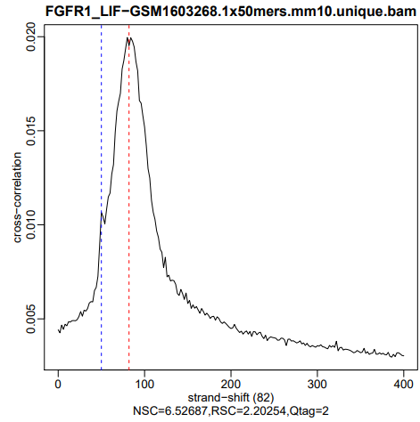
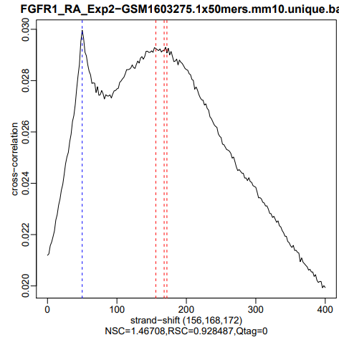
Cross-correlation QC

Slide 3
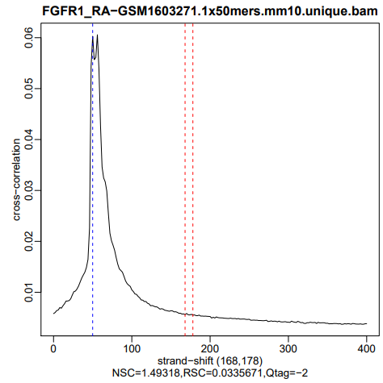
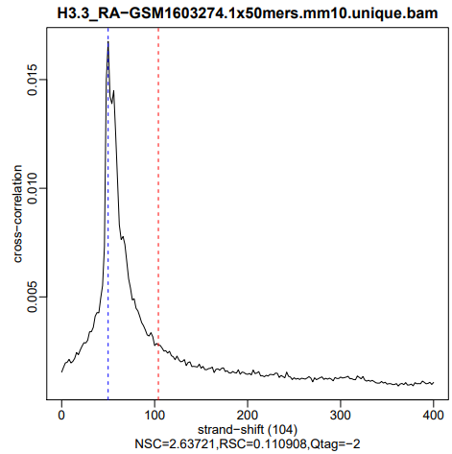

Slide 4
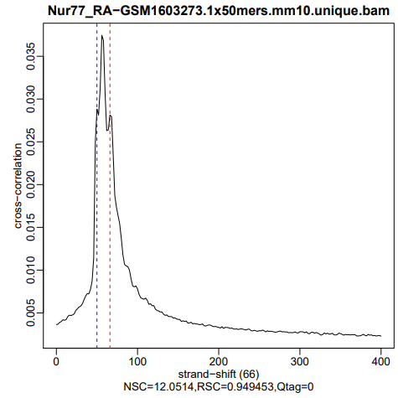
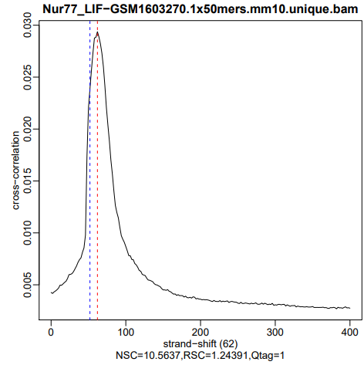

Slide 5
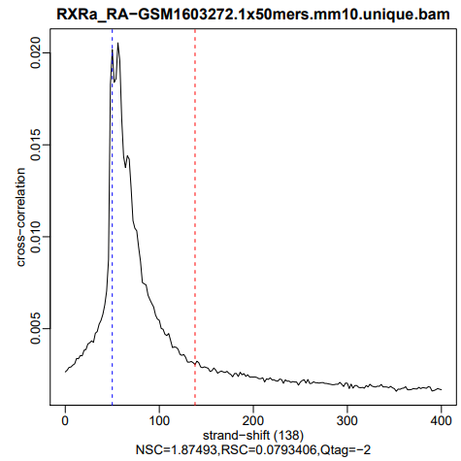
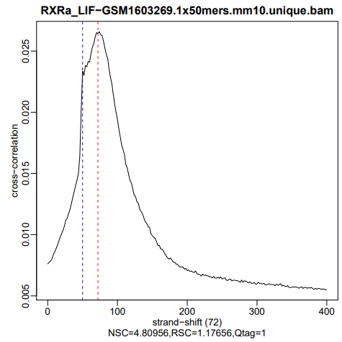

Slide 6
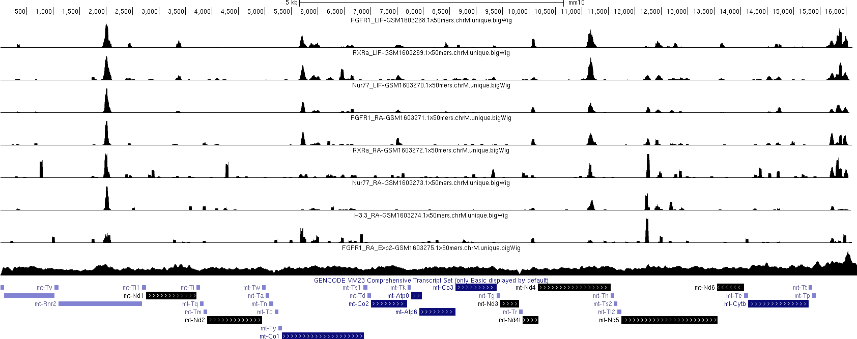
chrM

Slide 7
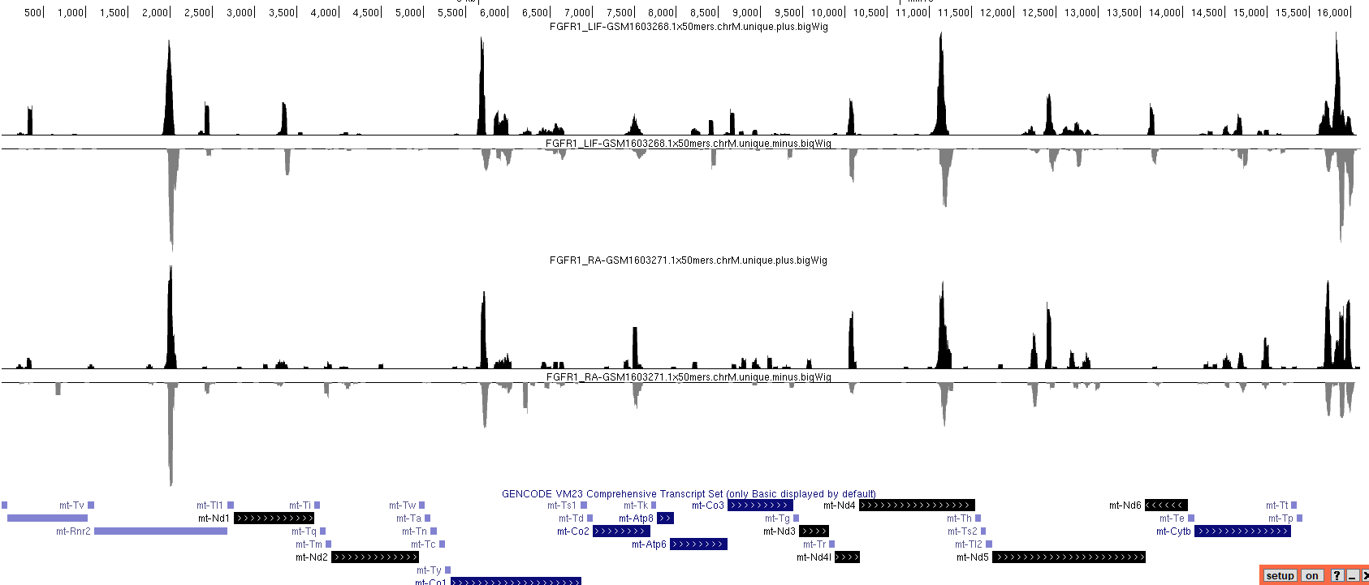
chrM stranded

Slide 8
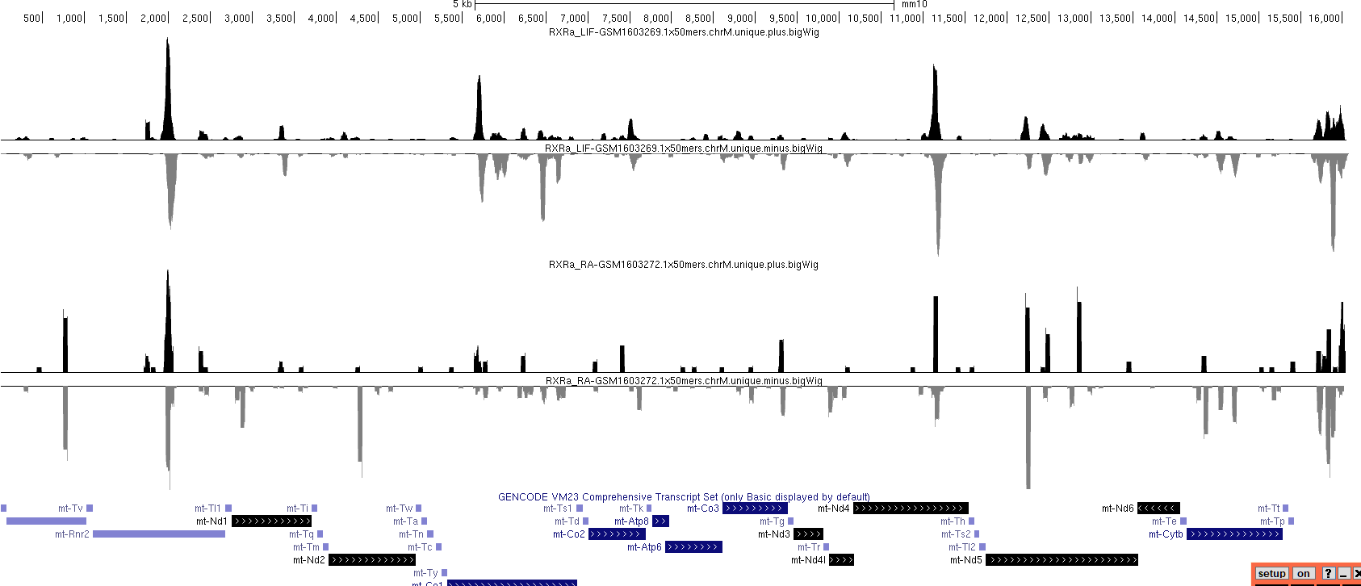

Slide 9
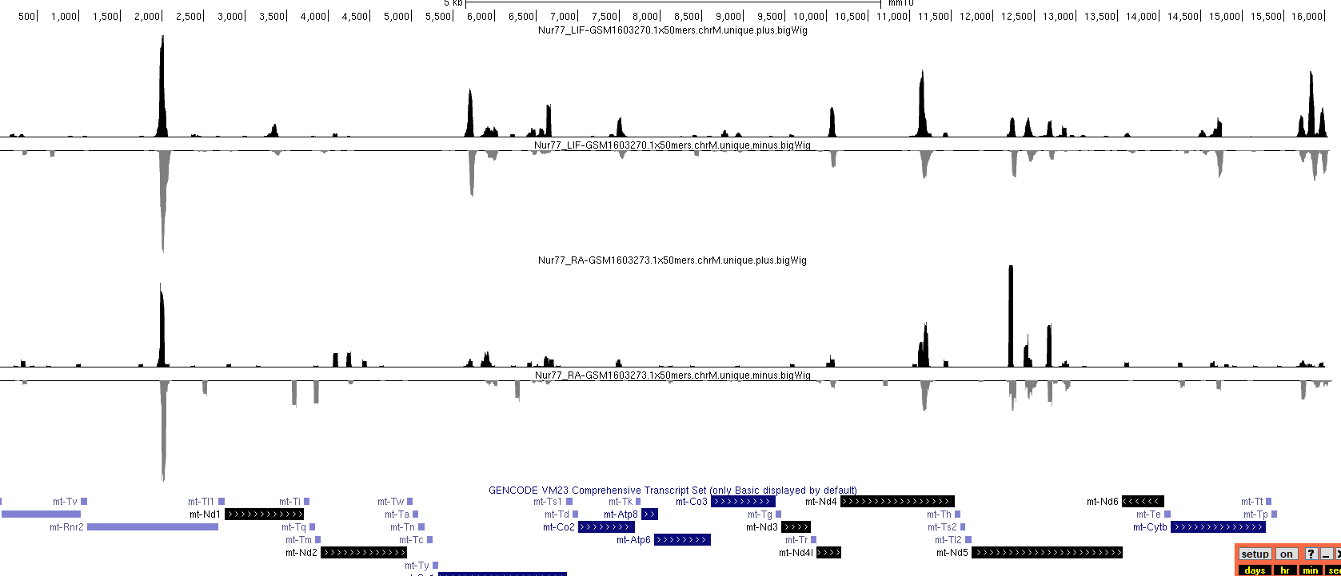

Slide 10
