Slide 1
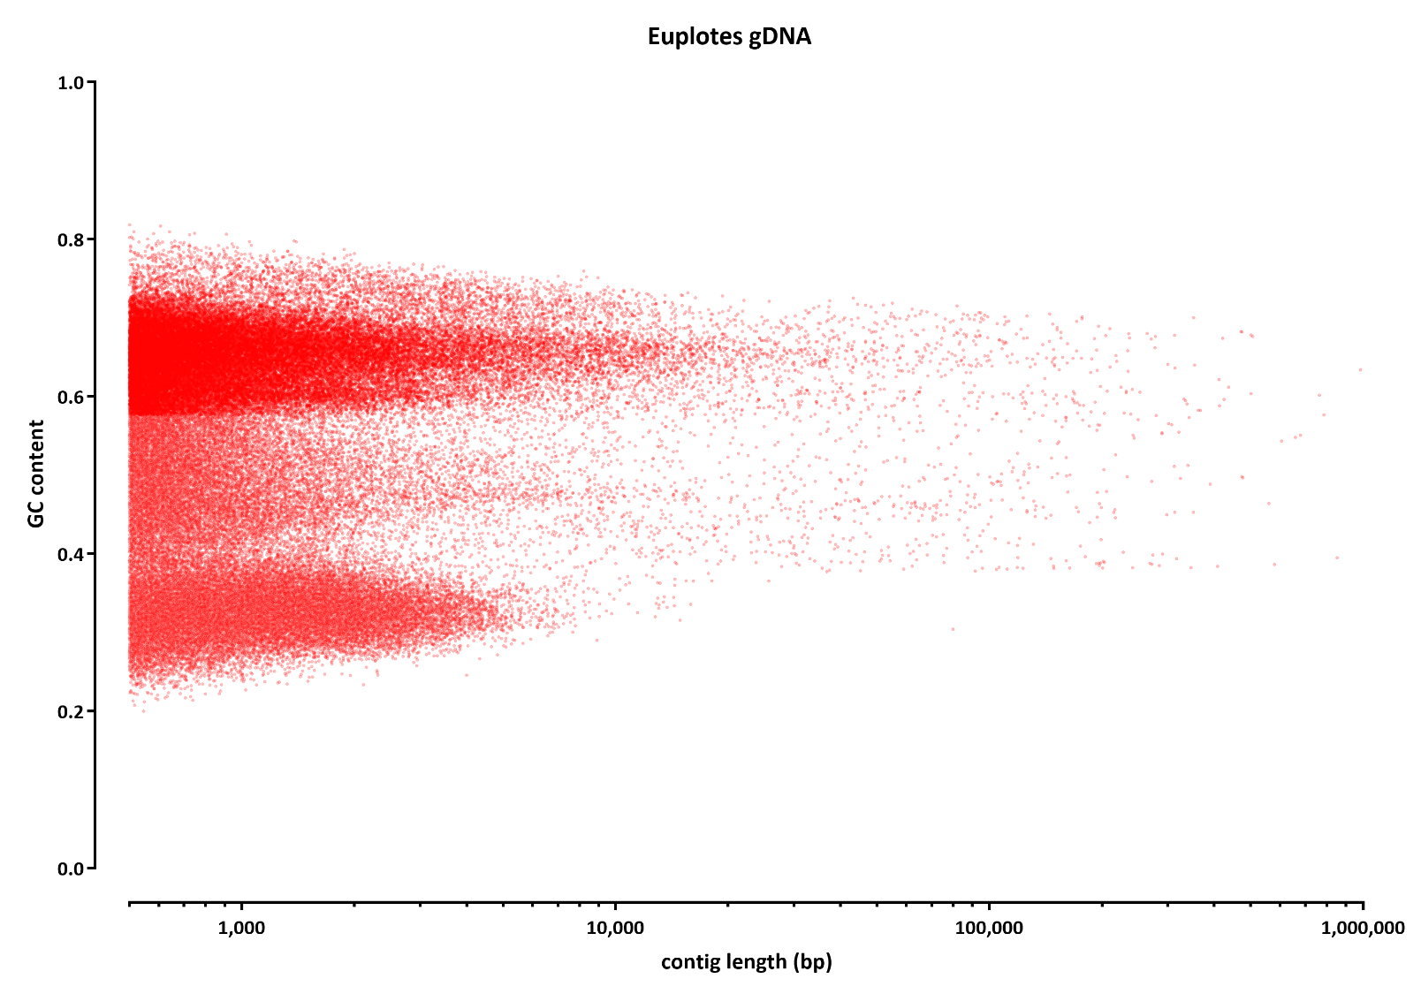

Slide 2
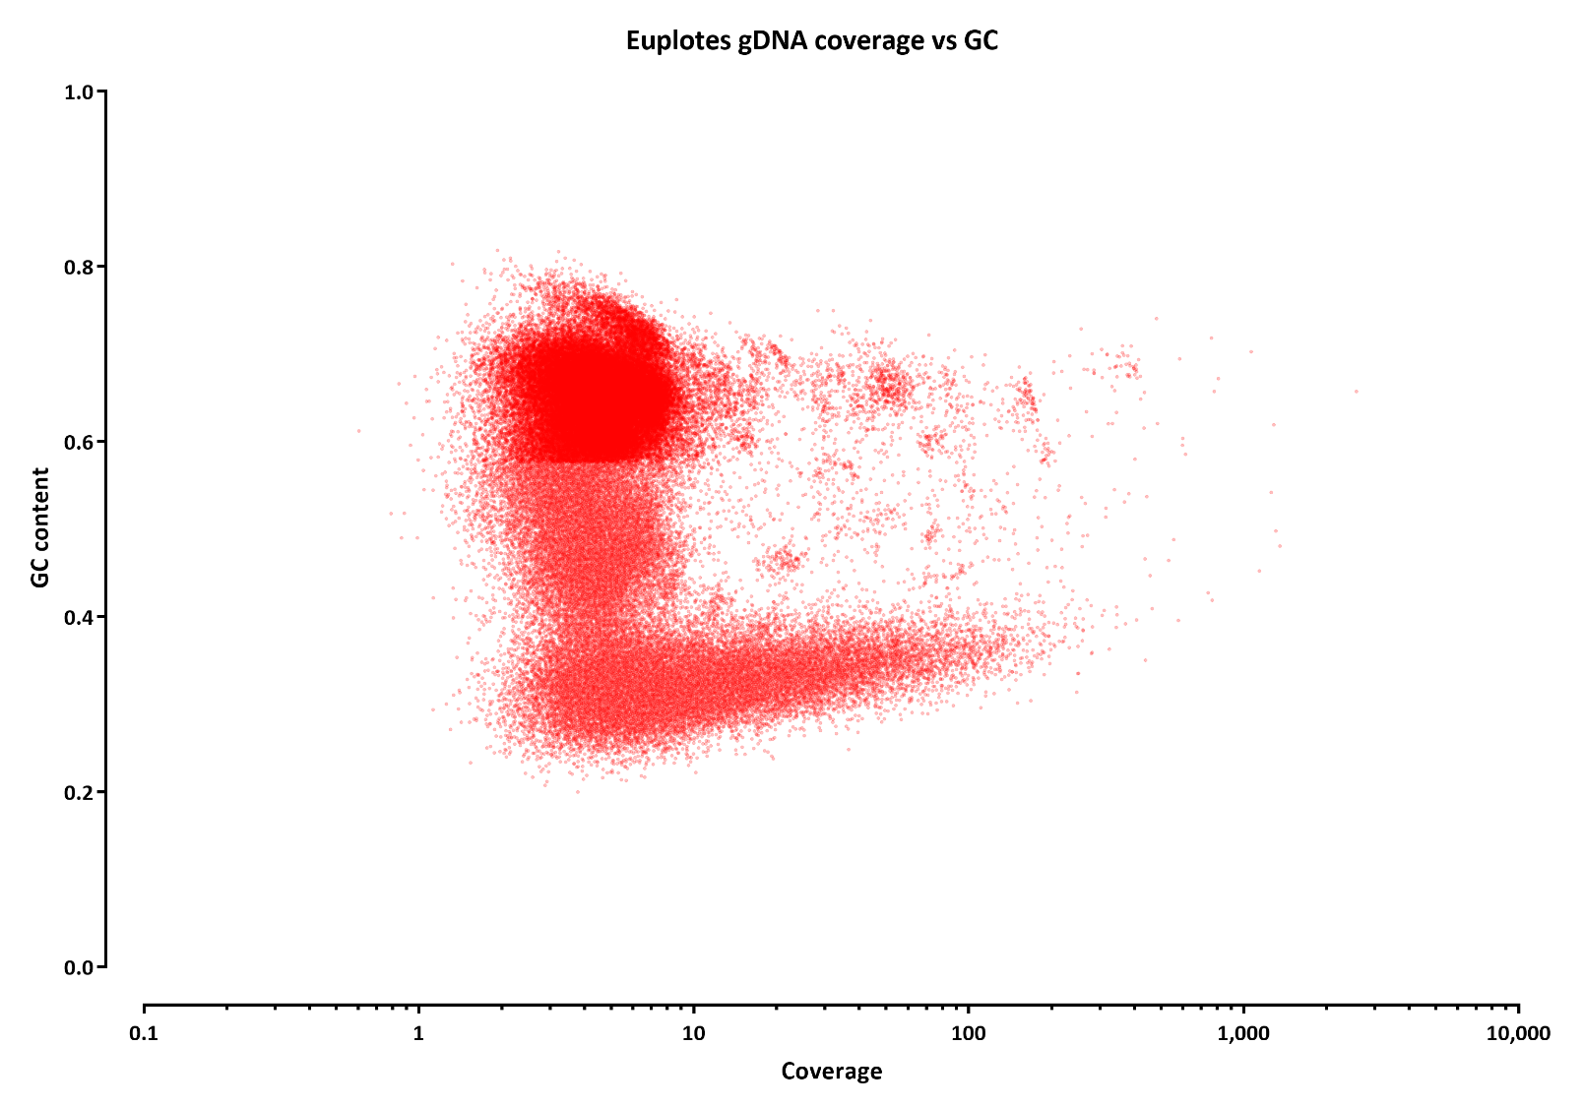

Slide 3
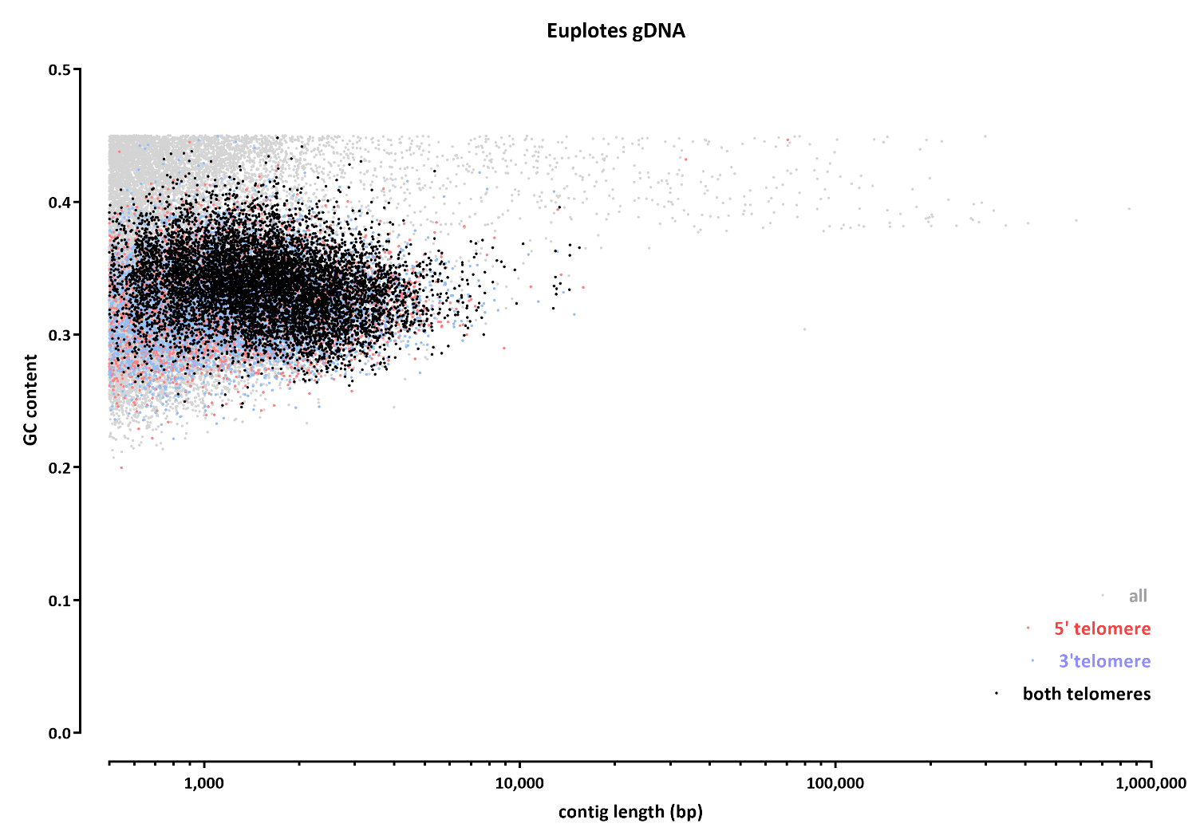
Split contigs at GC% = 45
Those lower than that were assumed to be Euplotes, those higher to be Symbiodinium
Looked for 5’-ccccaaaa-3’ as the telomeric sequence in Euplotes contigs
- 5’ telomere present: 14,252 contigs
3’ telomere present: 14,290 contigs
telomeres present on both ends: 8,521 contigs

