Slide 1
MINI GROUP MEETING
GEORGI K. MARINOV
March 6th 2019

Slide 2
I. GENOME ORGANIZATION IN DINOFLAGELLATES

Slide 3
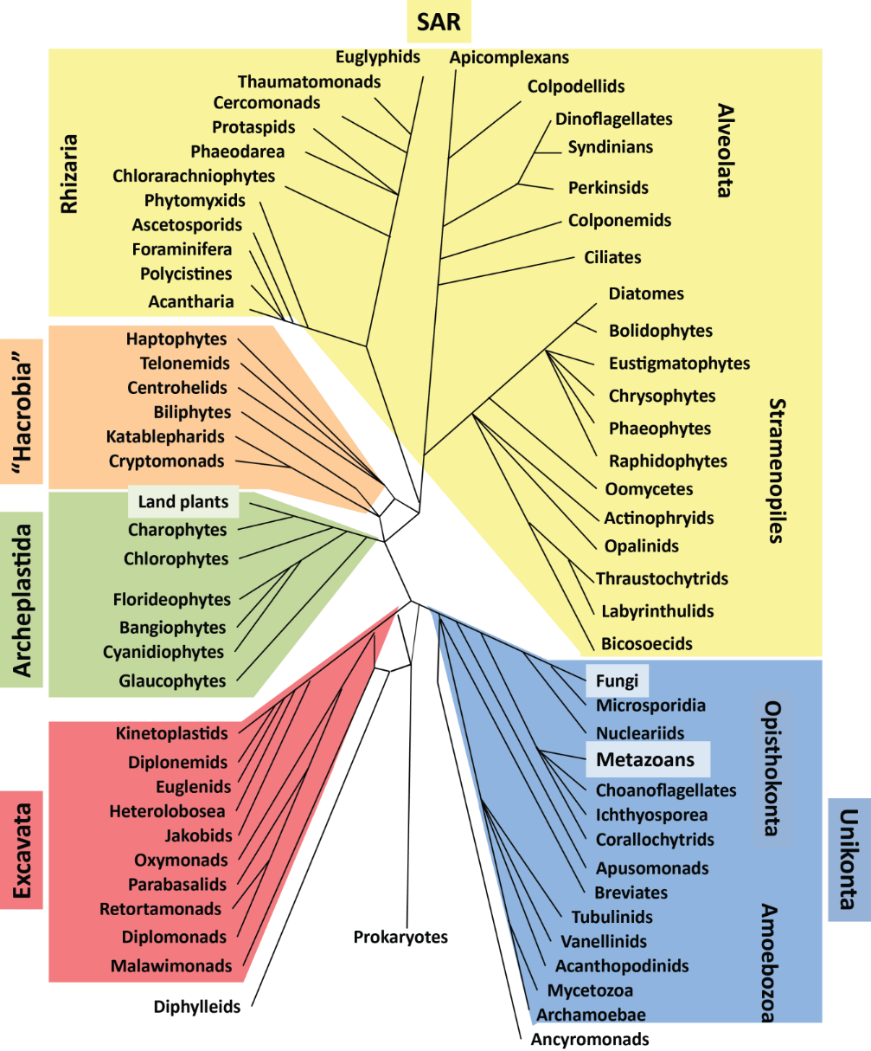
EUKARYOTE DIVERSITY, SHORT VERSION

Slide 4
DINOFLAGELLATES AND THEIR SPECIAL FEATURES
Permanently condensed fibrilar chromosomes
Very low protein-to-DNA ratio (~1/10th of the usual)
Histones are in low abundance, long thought to be completely absent
High percentage of 5-hydroxymethyluracile (up to 40%)
Huge genomes, often with tandem arrays of the same gene
Extremely intron rich (19 introns per gene on average); unique splice sites
Few transcription factors
Gene regulation is hypothesized to happen either at the posttrascriptional level or at the level of the control of chromatin looping

Slide 5
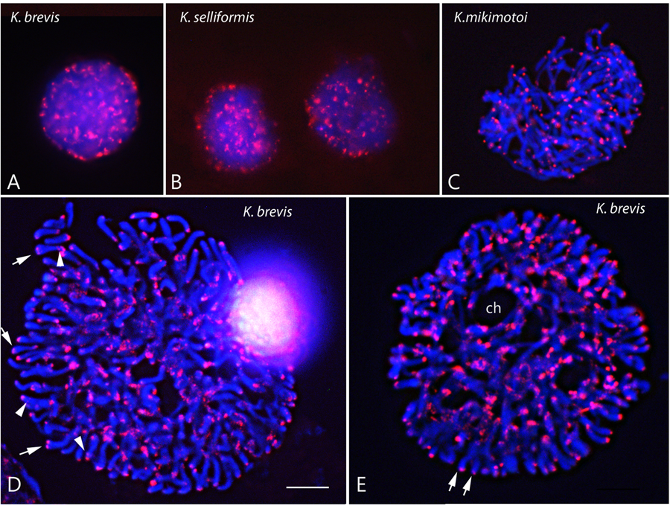
DINOFLAGELLATE CHROMOSOMES
Cuadrado et al. 2019

Slide 6
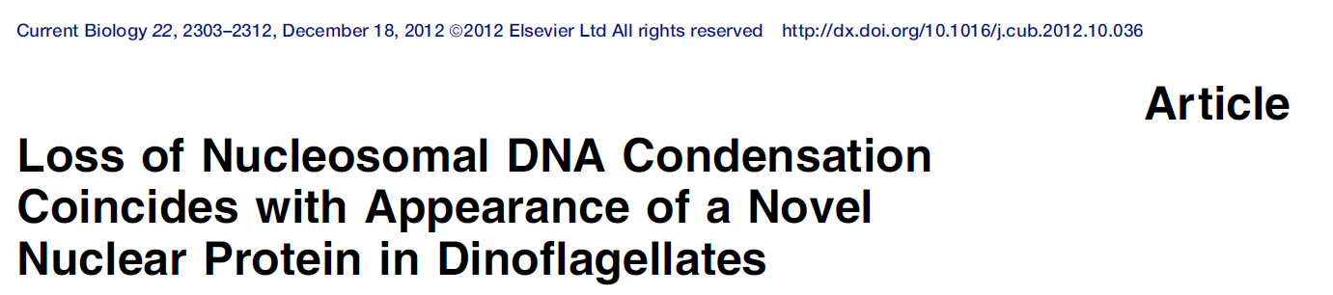
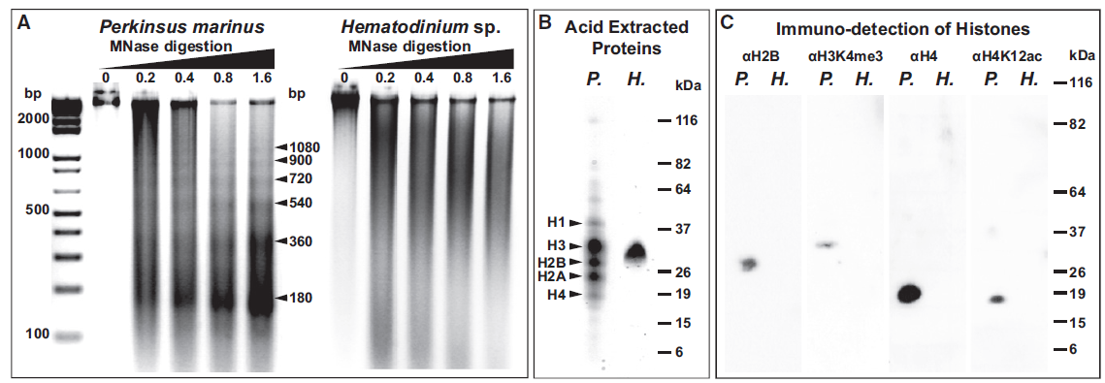
DVNPs (Dinoflagellate Viral Nucleoproteins, unrelated to histones) and HLPs (histone-like proteins) are thought to be the main packaging components

Slide 7
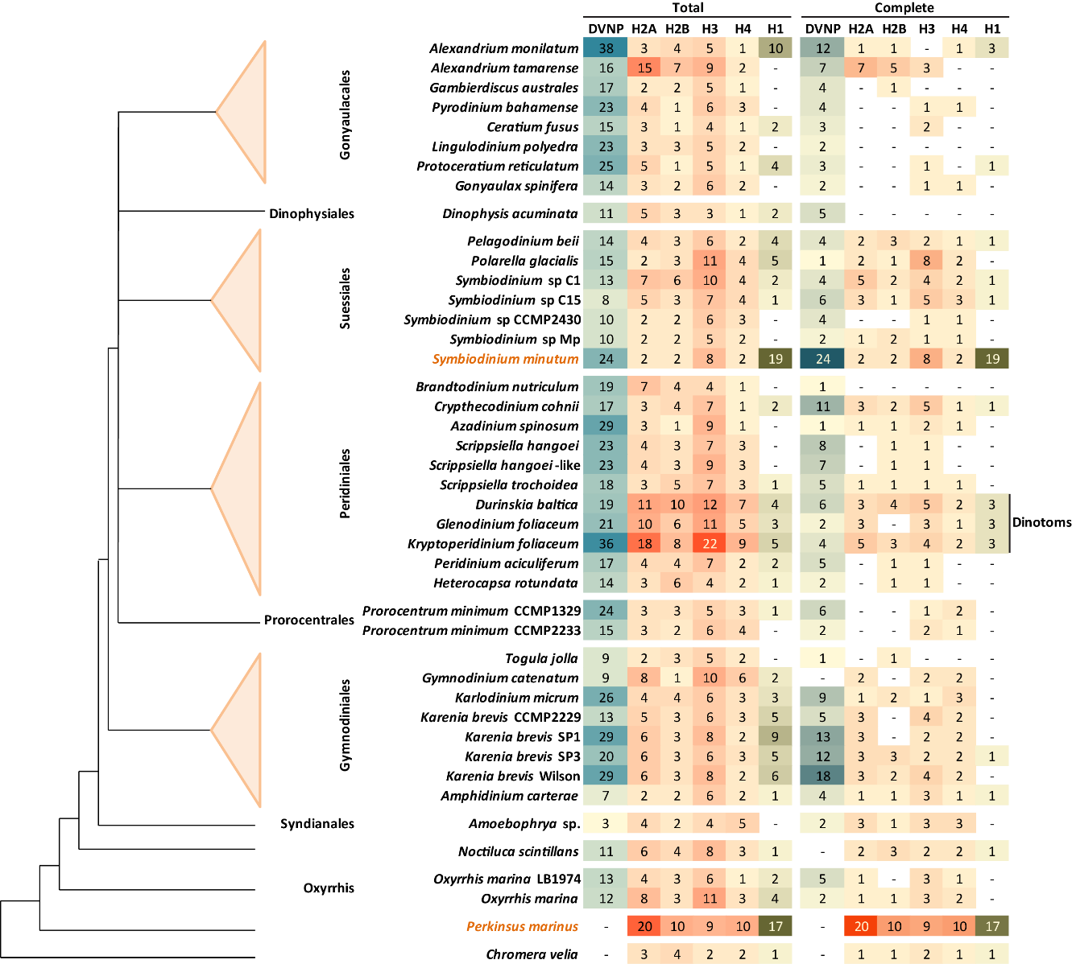
BUT HISTONES ARE PRESENT

Slide 8
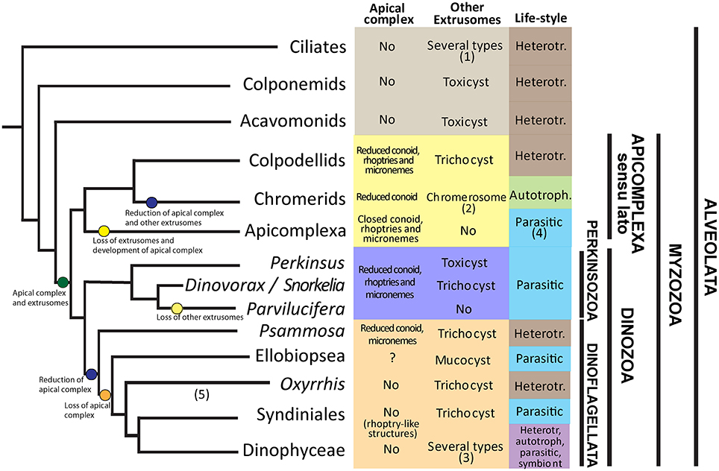
LOSS OF NUCLEOSOMES

Slide 9
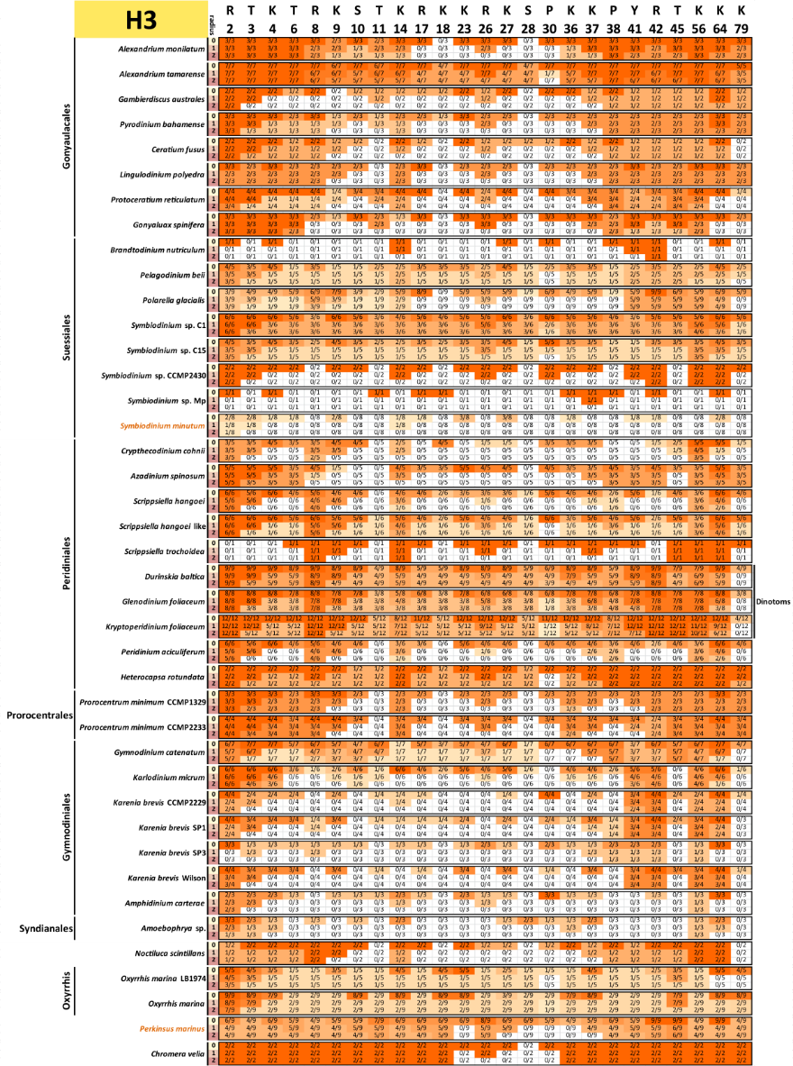

Slide 10
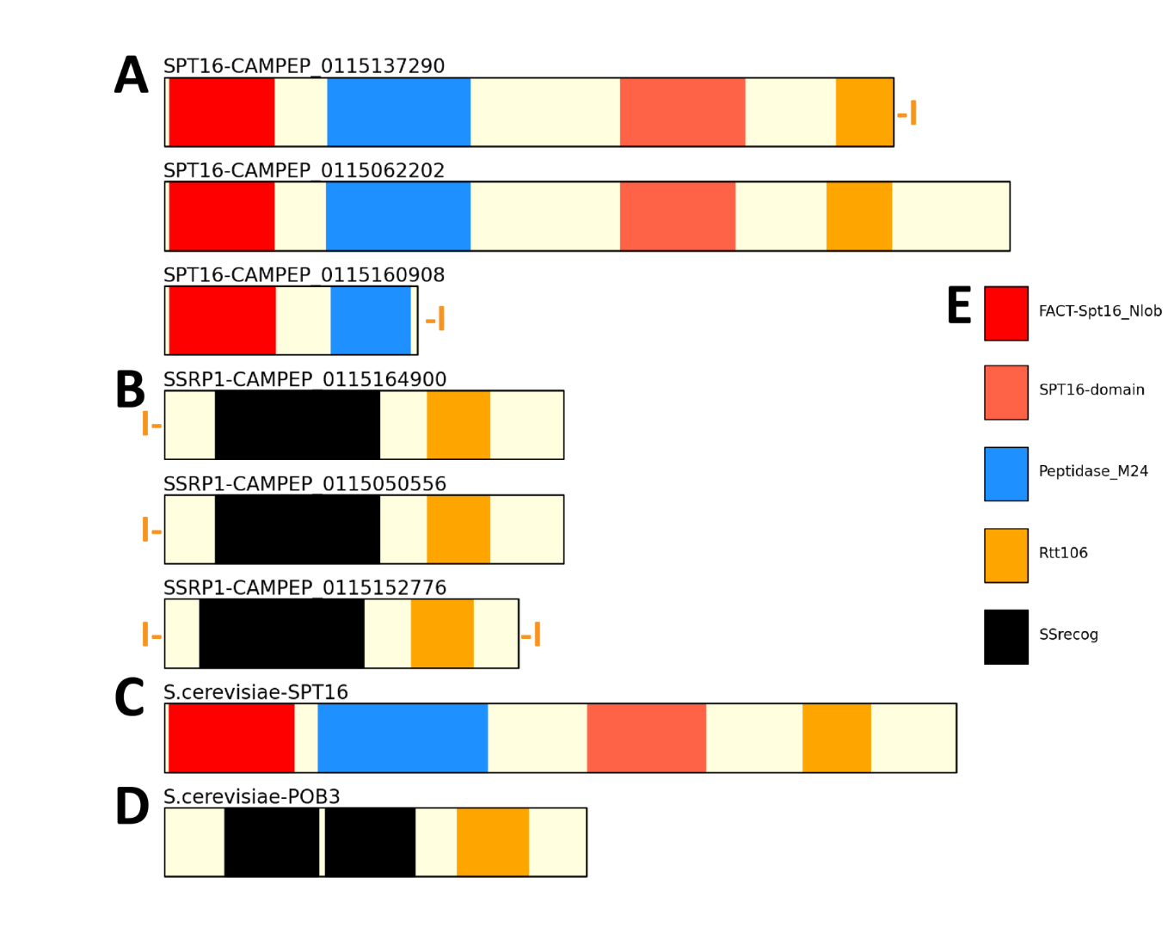
THE FACT COMPLEX IN DINOFLAGELLATES

Slide 11
WHAT WE WANT TO DO
Profile chromatin accessibility (ATAC-seq)
Genome 3D structure (Hi-C)
ChIP-seq against histones
5mC and 5hmU profiling

Slide 12
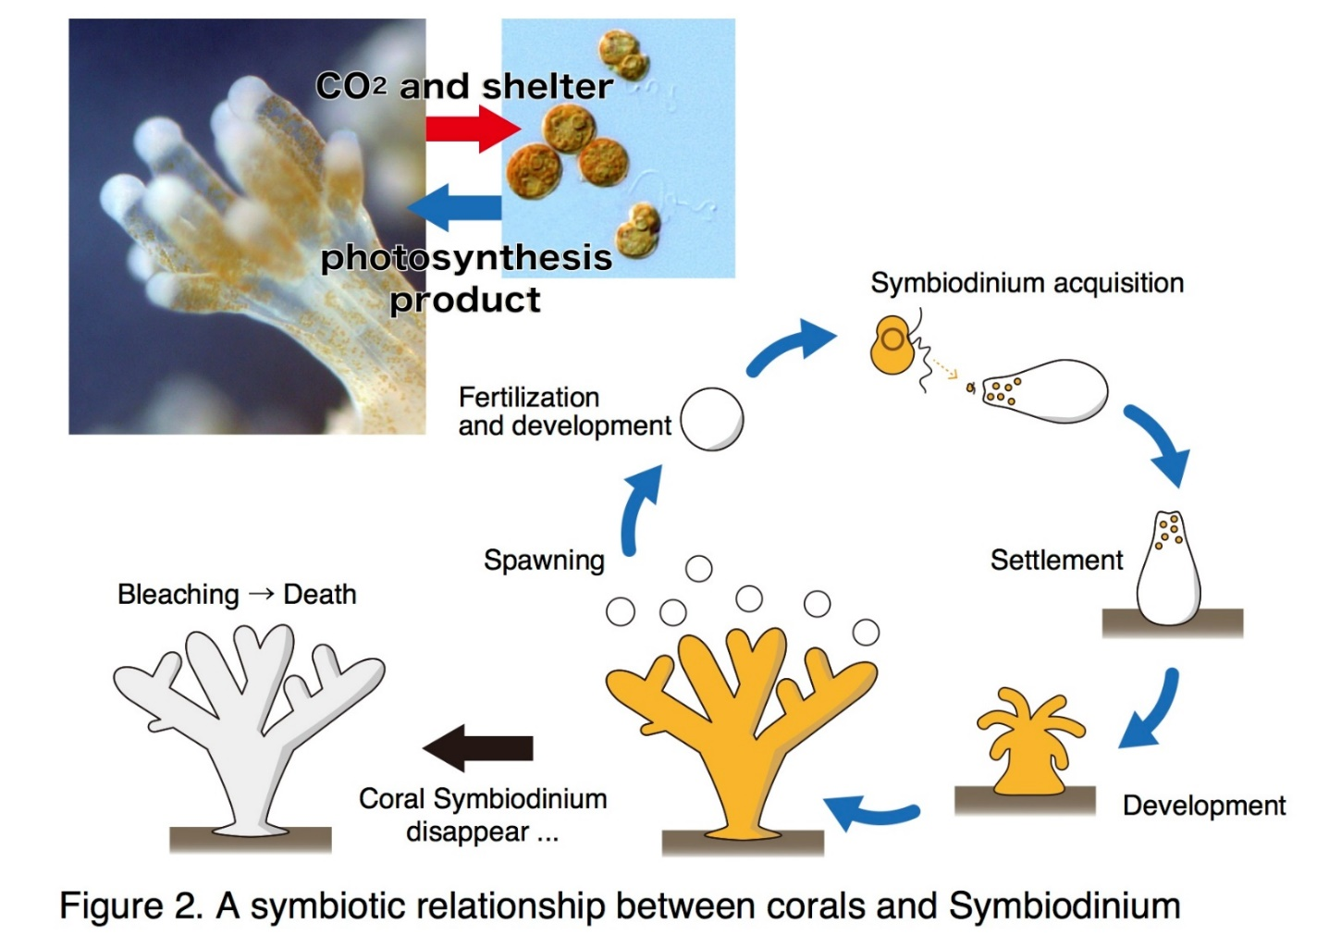
CORAL SYMBIOSIS

Slide 13
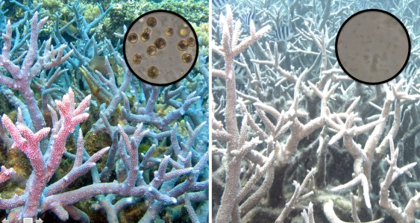
CORAL BLEACHING

Slide 14
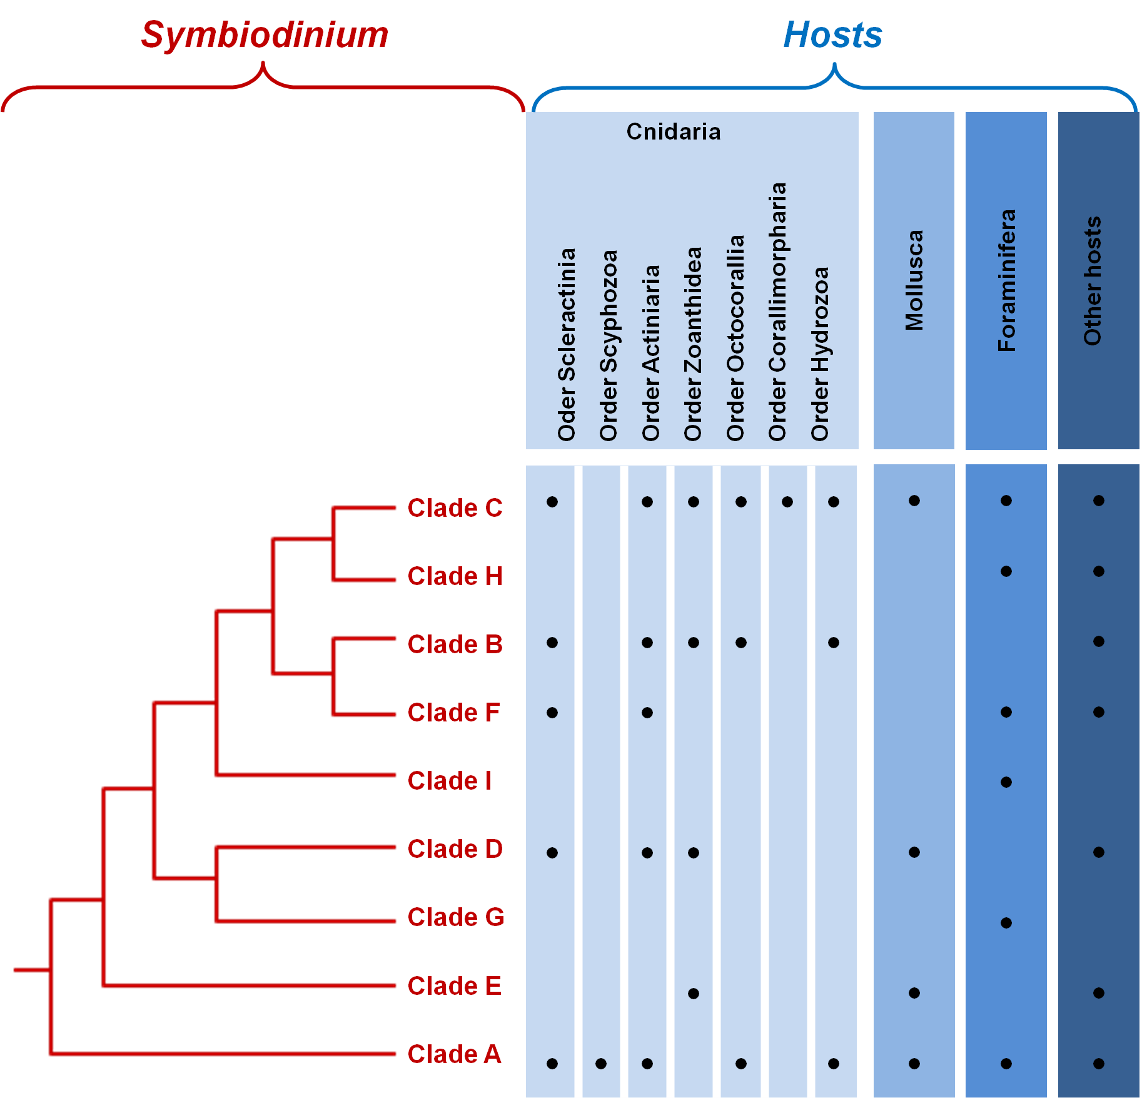

Slide 15
SYMBIODINIUM GENOME ASSEMBLIES
#Contig length | S. kawagutii | S. microadriaticum | S. minutum_Clade_B1
0 | 23412 | 136 | 12051
1,000 | 2611 | 6868 | 2305
10,000 | 1434 | 1039 | 5587
100,000 | 2534 | 1516 | 1956
1,000,000 | 49 | 136 | 0
10,000,000 | 0 | 0 | 0
100,000,000 | 0 | 0 | 0
 | S. kawagutii | S. microadriaticum | S. minutum_Clade_B1
N50 | 125,226 | 573,512 | 380,908
N90 | 31,482 | 145,806 | 109,232

Slide 16

SYMBIODINIUM HI-C
5kb resolution

Slide 17
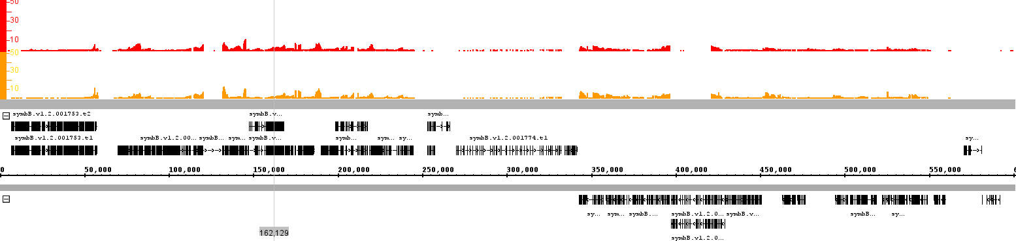

34C 8d RNA-seq
34C 0d RNA-seq
+ strand genes
- strand genes

Slide 18
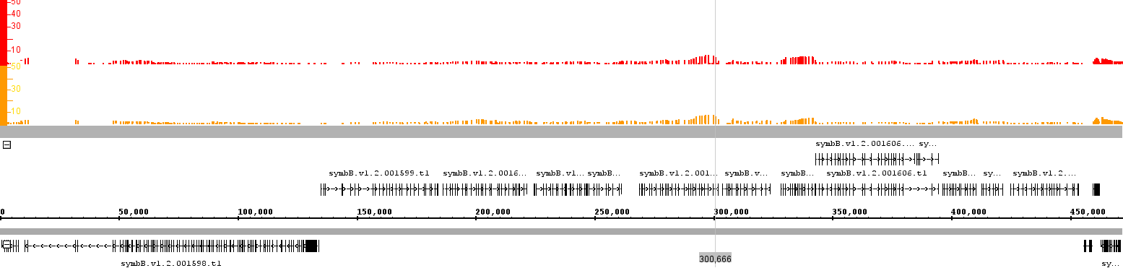
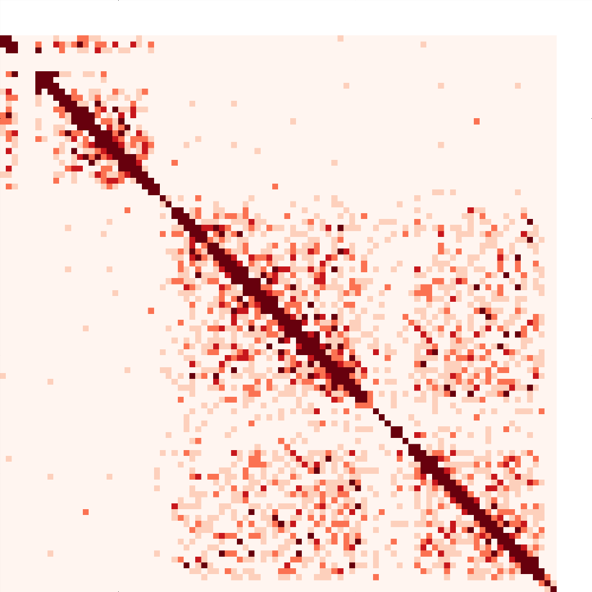
34C 8d RNA-seq
34C 0d RNA-seq
+ strand genes
- strand genes

Slide 19
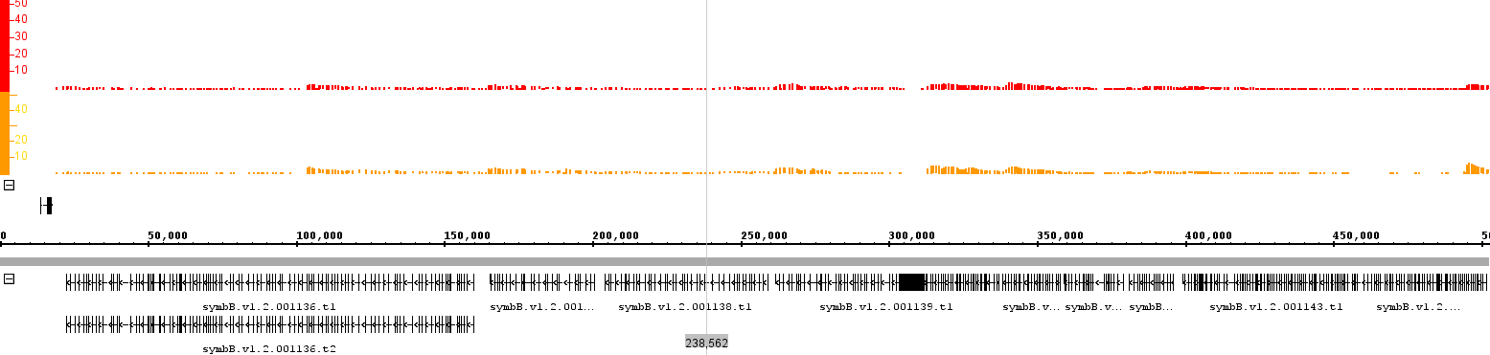

34C 8d RNA-seq
34C 0d RNA-seq
+ strand genes
- strand genes

Slide 20
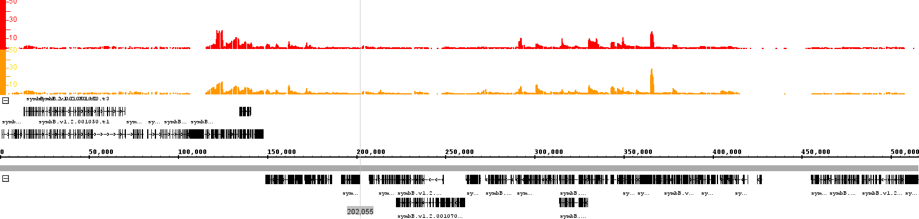
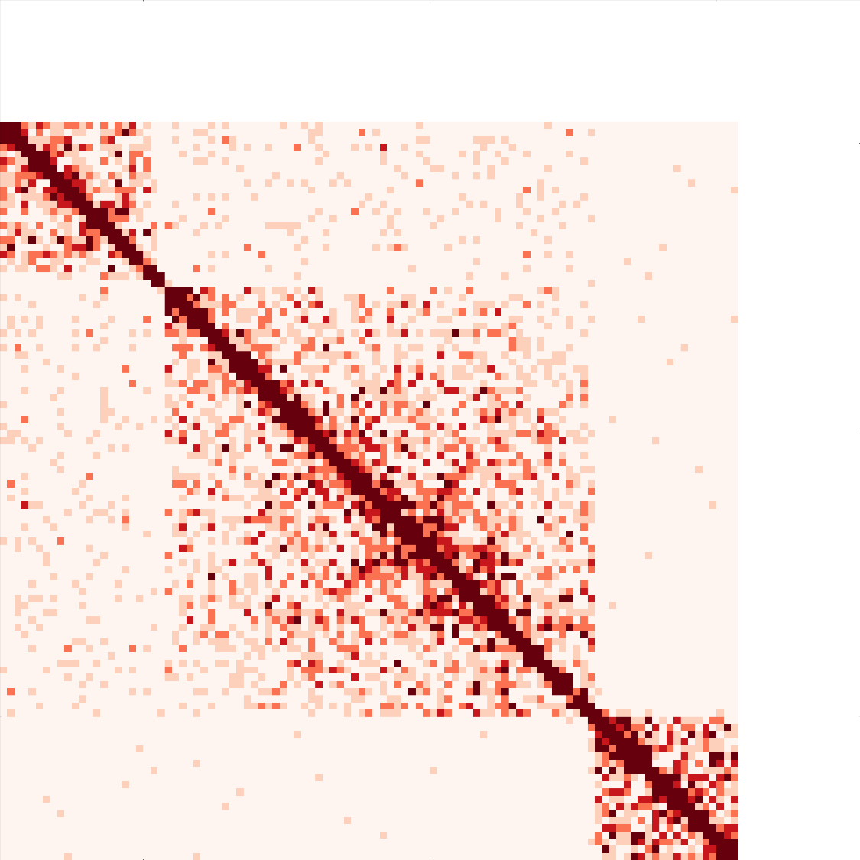
34C 8d RNA-seq
34C 0d RNA-seq
+ strand genes
- strand genes

Slide 21
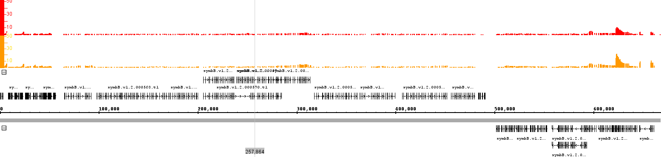
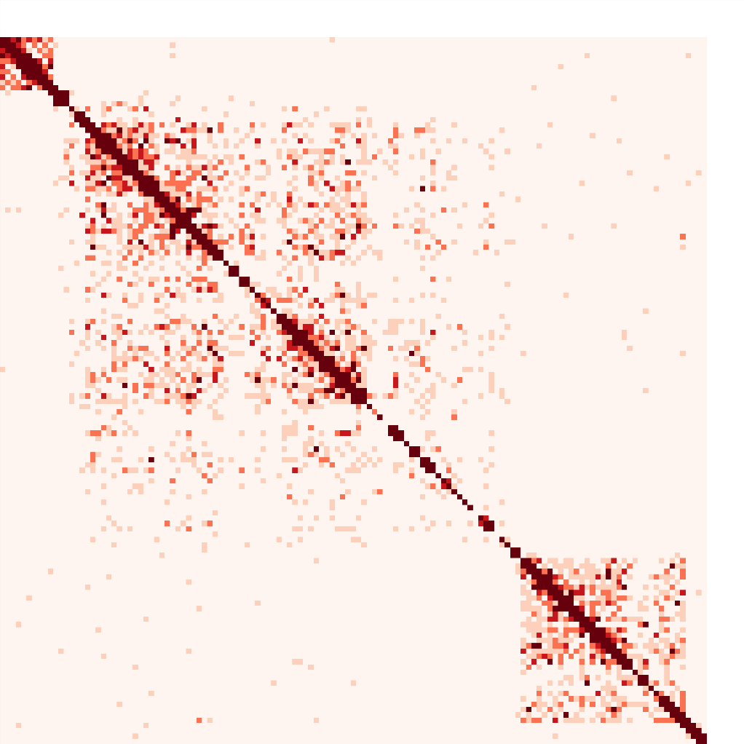
34C 8d RNA-seq
34C 0d RNA-seq
+ strand genes
- strand genes

Slide 22
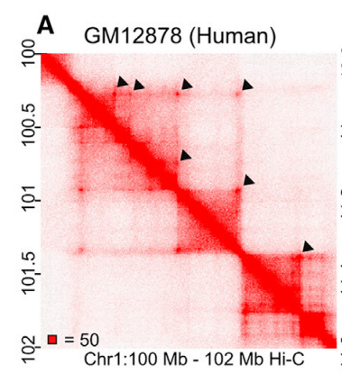
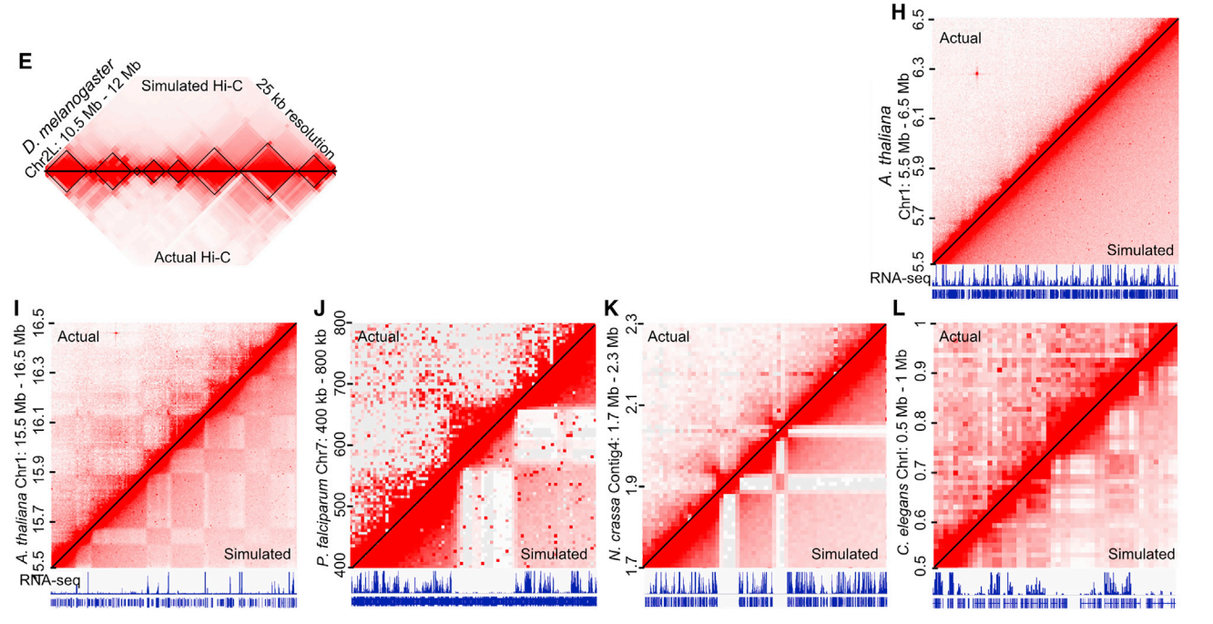
COMPARISON WITH OTHER EUKARYOTES:
from Rawley et al. 2017

Slide 23
CONCLUSIONS
Strong insulation domains are observed in the Symbiodinium genome
These appear to correspond to individual multicistronic gene arrays (with some exceptions)
Clear loop contacts are not immediately obvious
TO DO:
Relationship to epigenetic marks (5mC and dhmU)?
Properly assemble genome with the Hi-C data and nanopore reads
Polymer simulations and chromosome structure modelling
27C vs 34C?

Slide 24
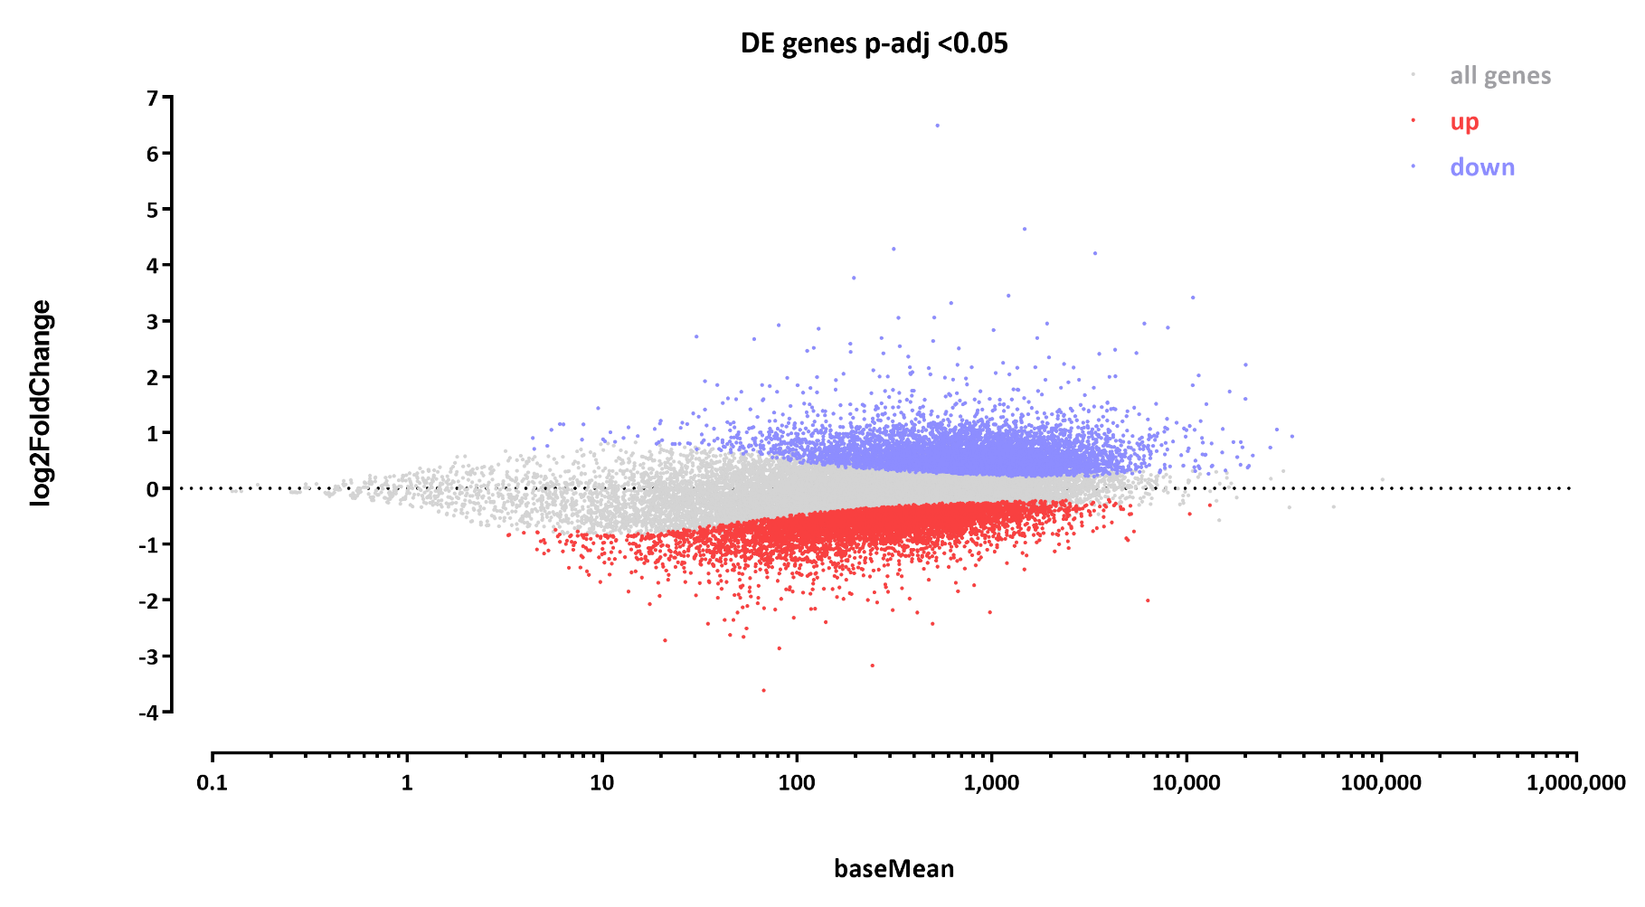
34C VS 27C RNA-SEQ

Slide 25
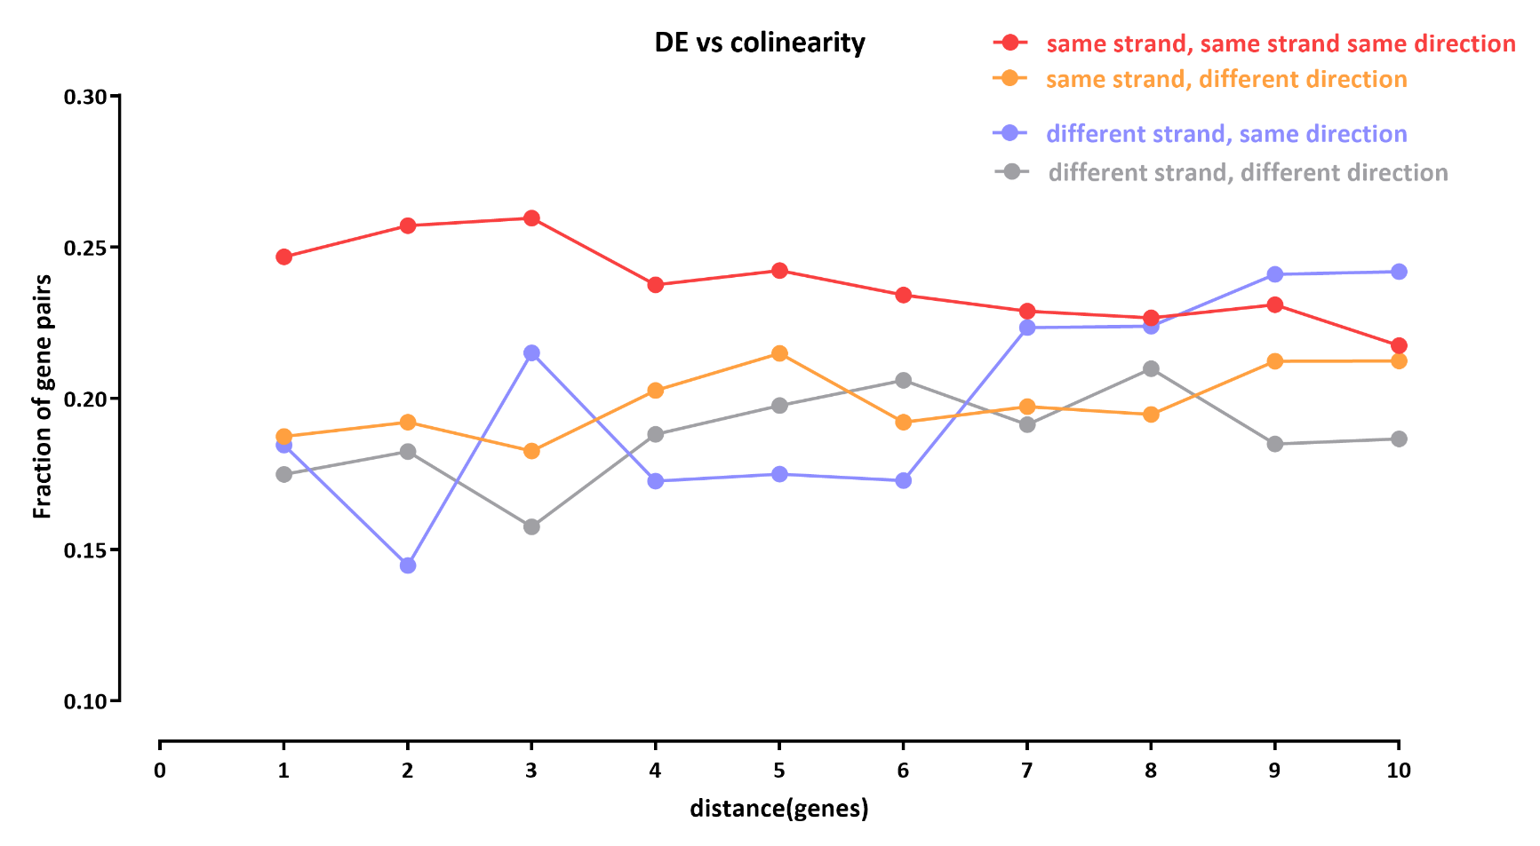
34C VS 27C RNA-SEQ

Slide 26
ACKNOWLEDGEMENTS
Tingting Xiang
Arthur Grossman
Phillip Cleves
John Pringle

Slide 27
II. CLAPP-seq

Slide 28
IDEA AND GOALS
Cross-linking creates a chemical bond between amine groups on proteins and DNA
It is not a peptide bond, so even complete proteinase K digestion should leave a residue on DNA
In principle we should be able to read that residue using nanopore sequencing
This will tell us the exact sites of protein-DNA contacts
Longer-term vision: combine with ChIP and SMAC-seq to get simultaneous measures of contact sites, accessibility, and endogenous methylation on single molecules

Slide 29
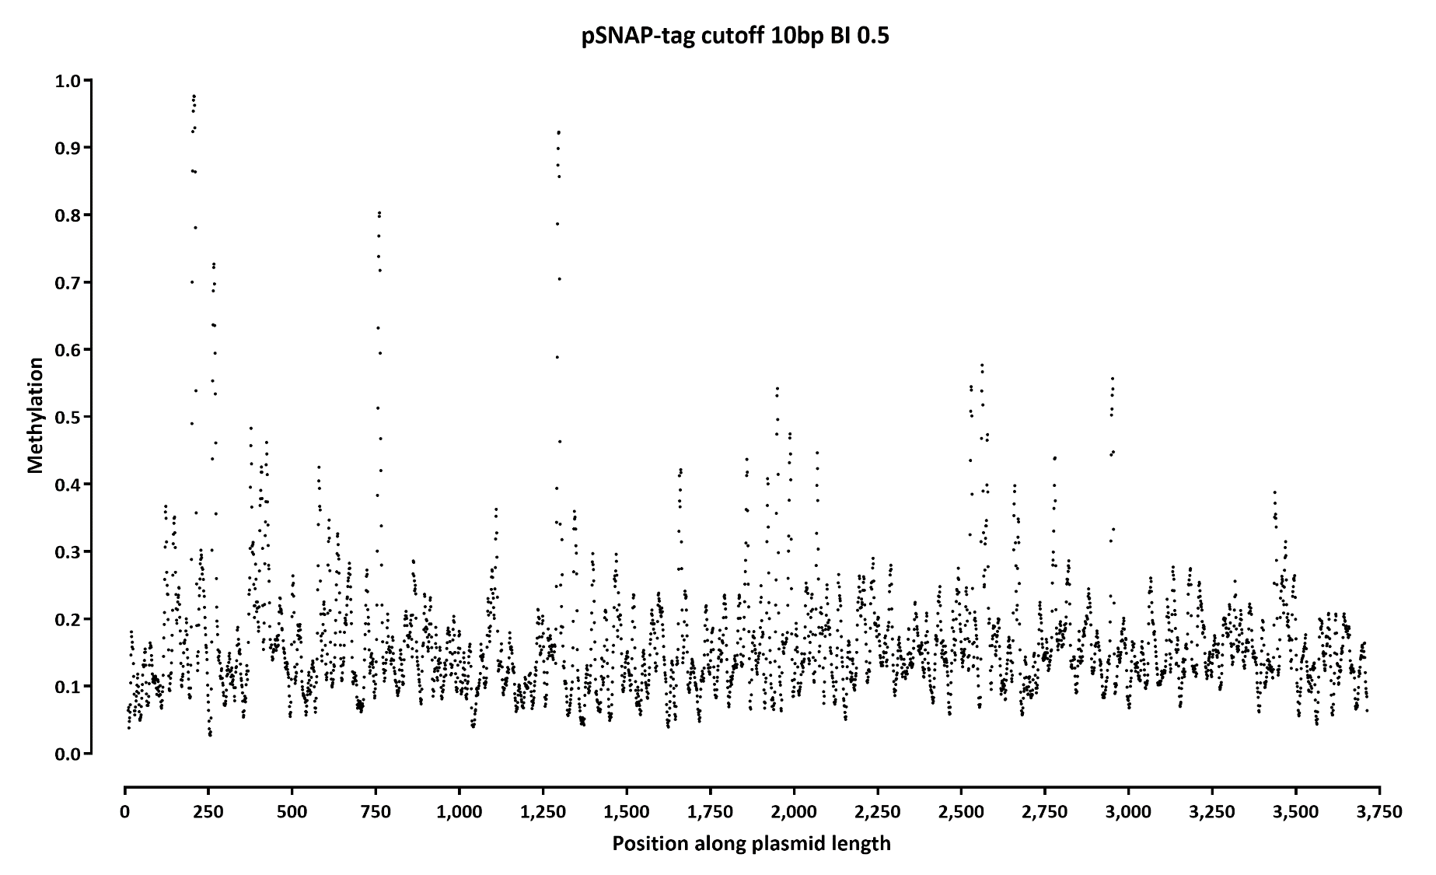
T7 CROSSLINKING TO A PLASMID

Slide 30
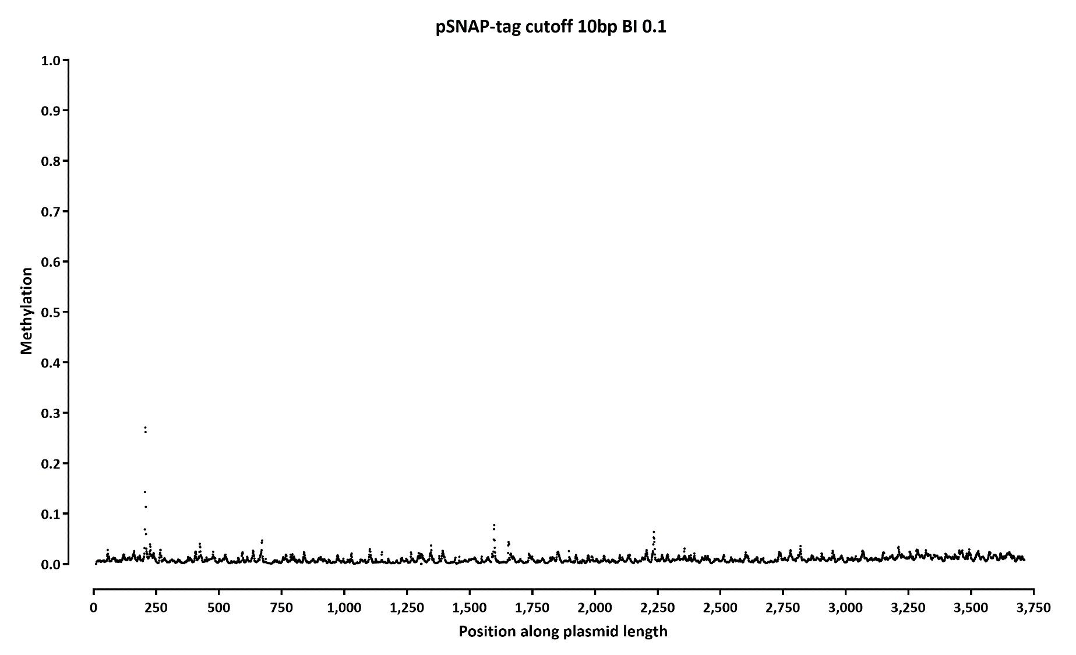

Slide 31
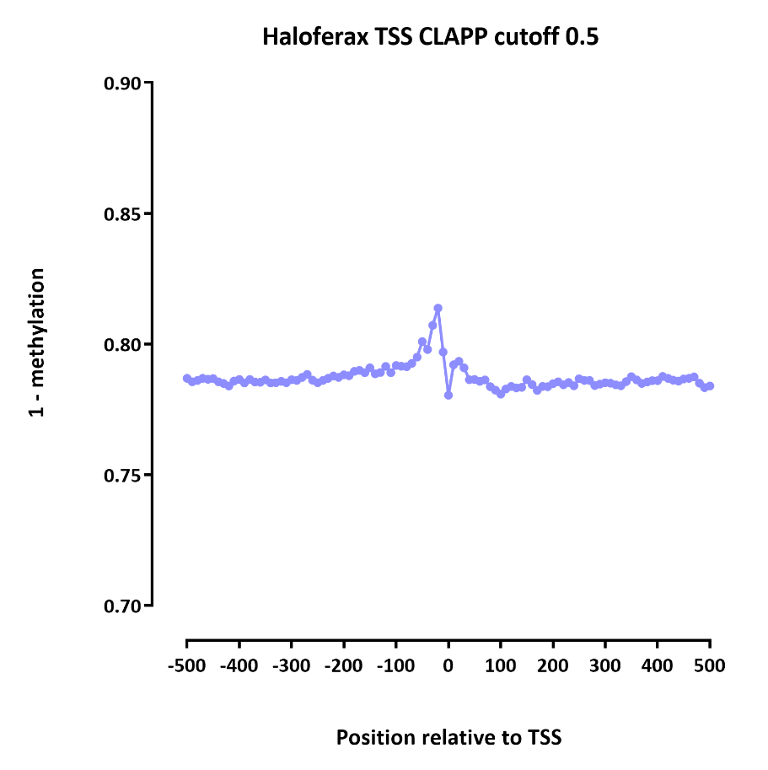
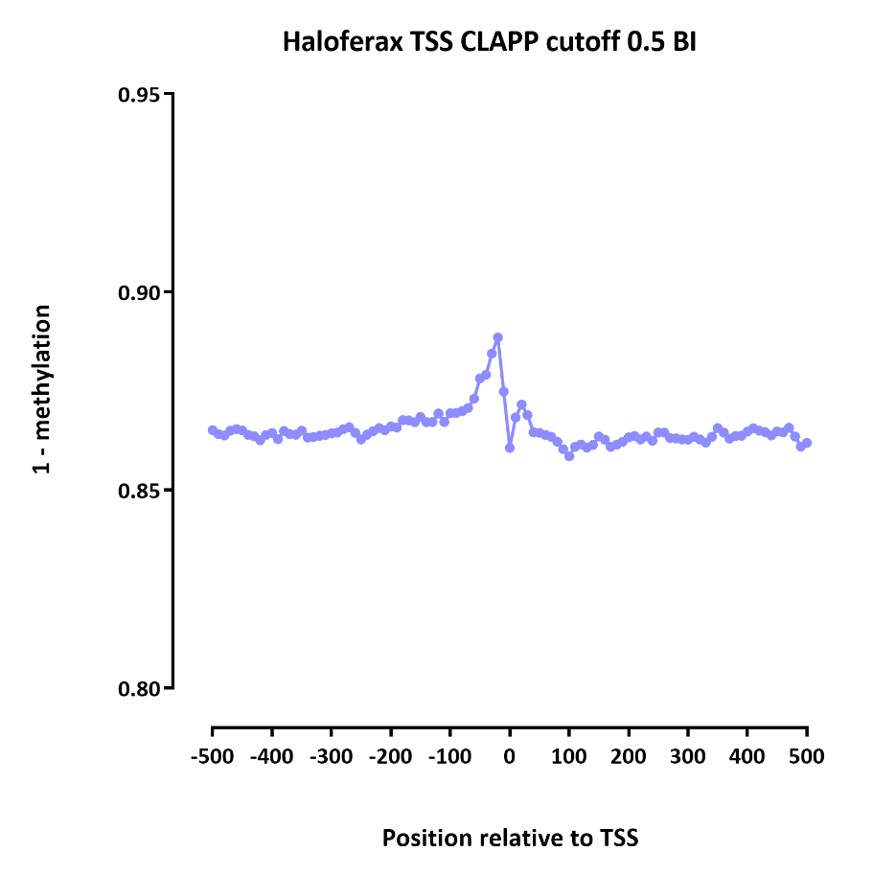
IN ARCHAEA (HALOFERAX)

Slide 32
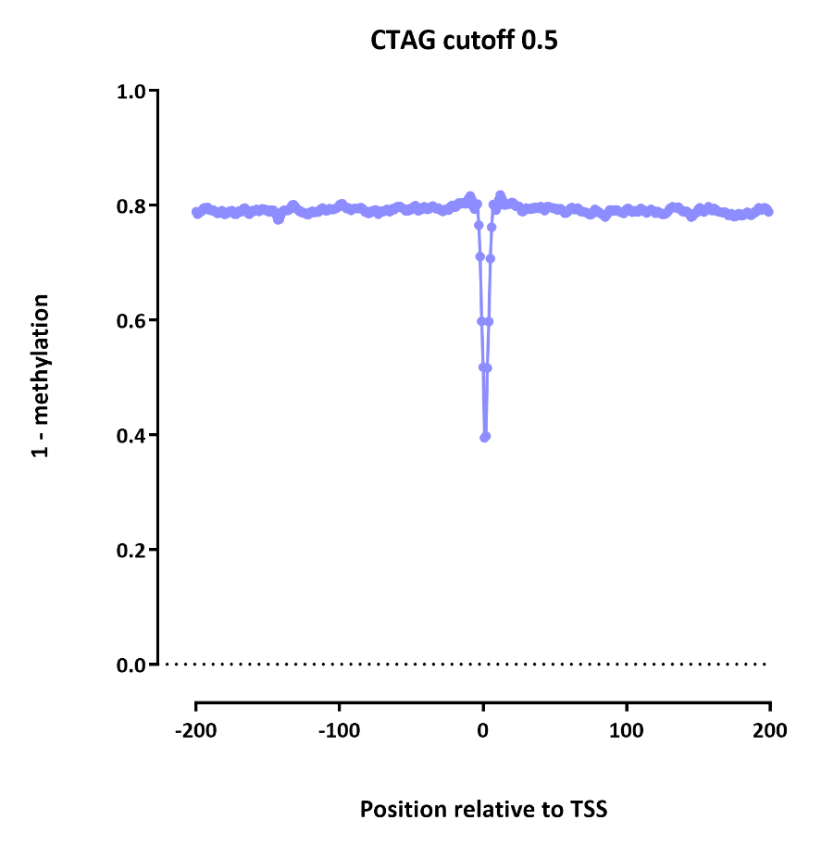
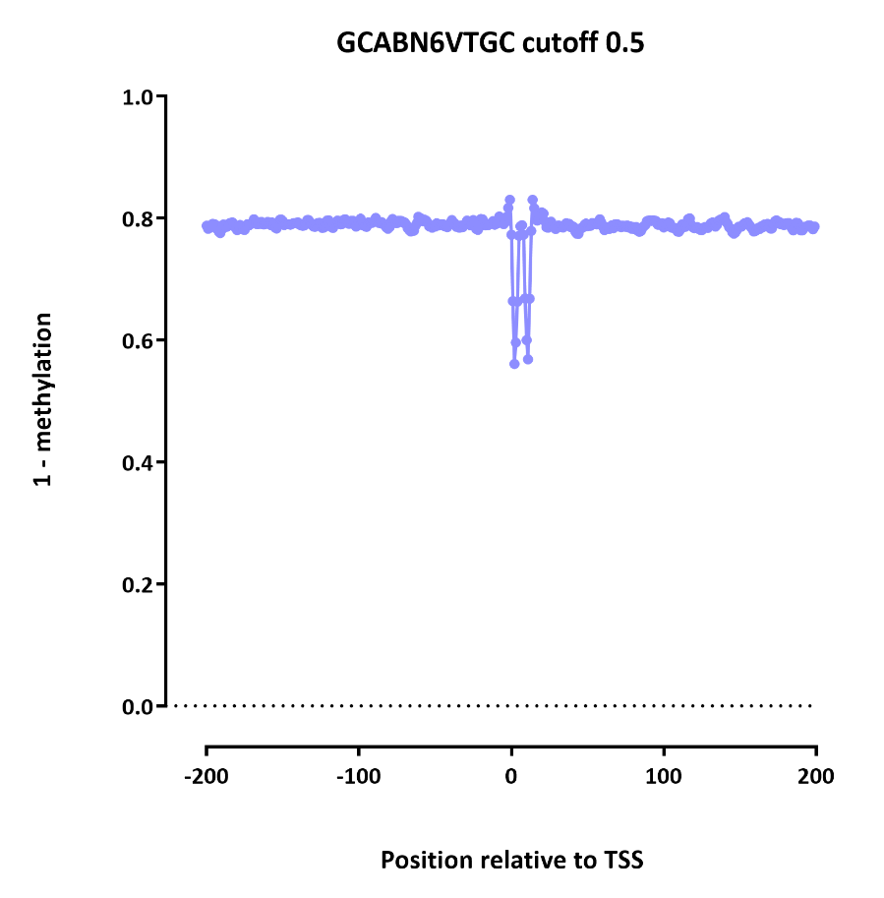
COMPLICATION: ENDOGENOUS METHYLATION

Slide 33
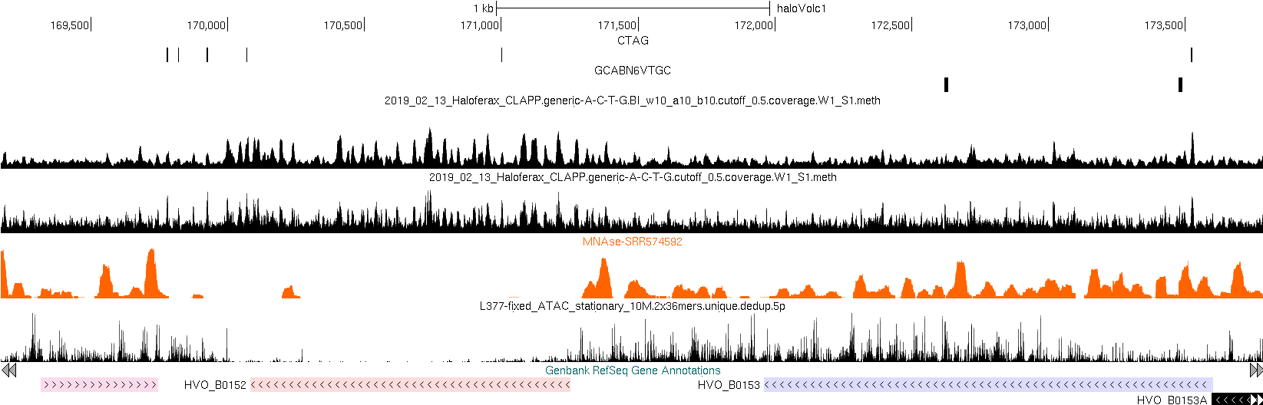
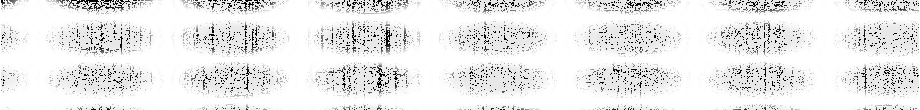
TRANSPOSON

Slide 34
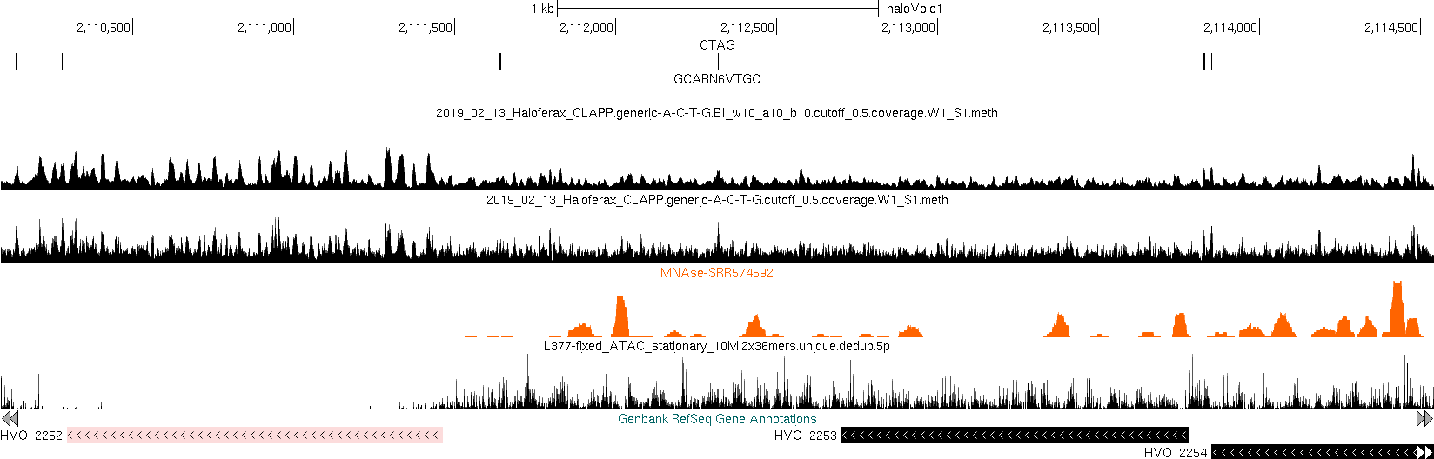
TRANSPOSON

Slide 35
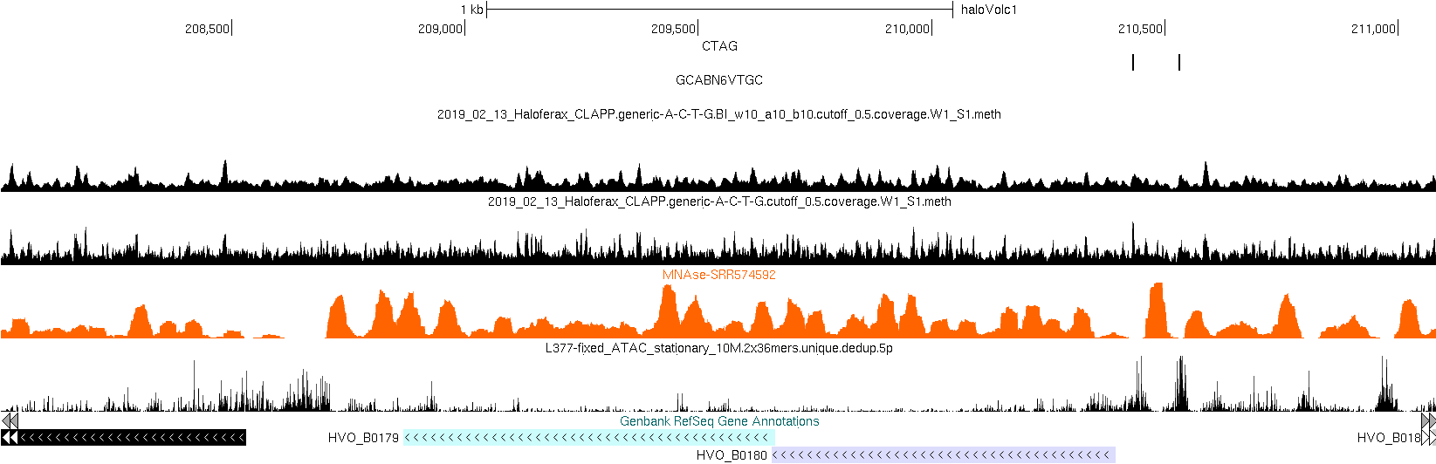


Slide 36
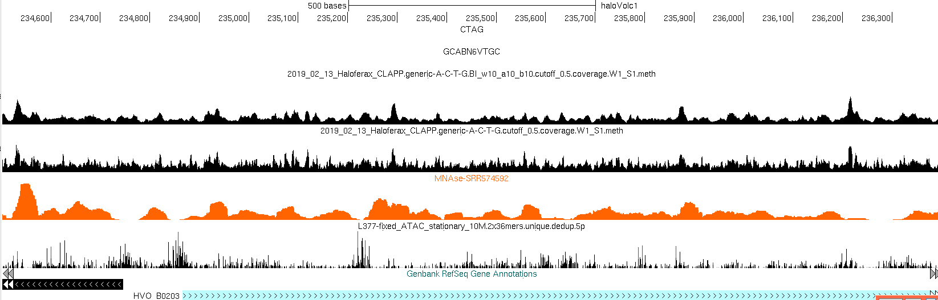


Slide 37
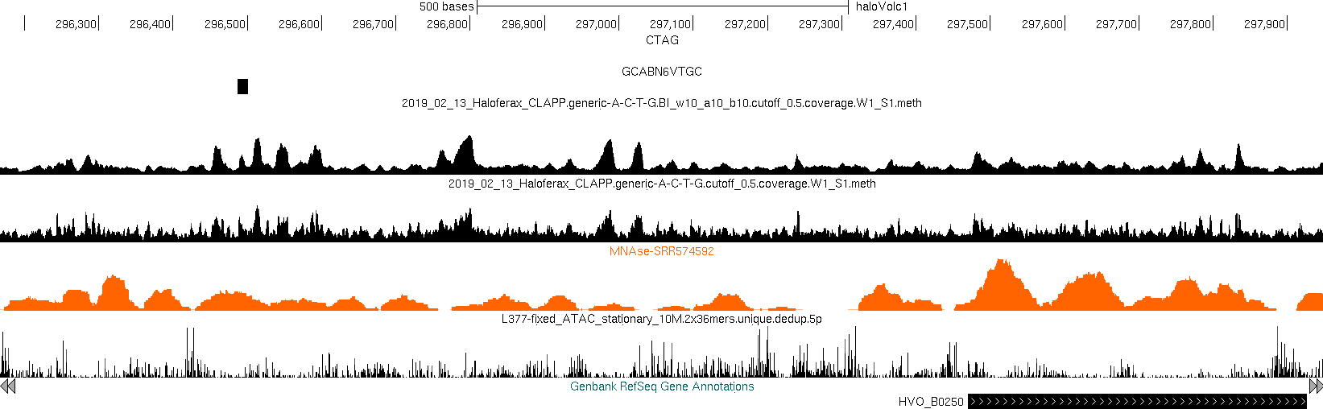


Slide 38
