Slide 1
Dataset stats
# | Exonic: | Intergenic: | Intronic:
L1737-SLAM_4SU_0uM | 0.81 | 0.11 | 0.08
L1738-SLAM_4SU_100uM | 0.83 | 0.09 | 0.08
L1739-SLAM_4SU_1mM | 0.81 | 0.11 | 0.09
L1740-SLAM_4SU_10mM | 0.82 | 0.10 | 0.08
L1741-SLAM_4TU_0uM | 0.80 | 0.11 | 0.09
L1742-SLAM_4TU_100uM | 0.79 | 0.12 | 0.09
L1743-SLAM_4TU_1mM | 0.79 | 0.11 | 0.10
L1744-SLAM_4TU_10mM | 0.80 | 0.11 | 0.09

Slide 2
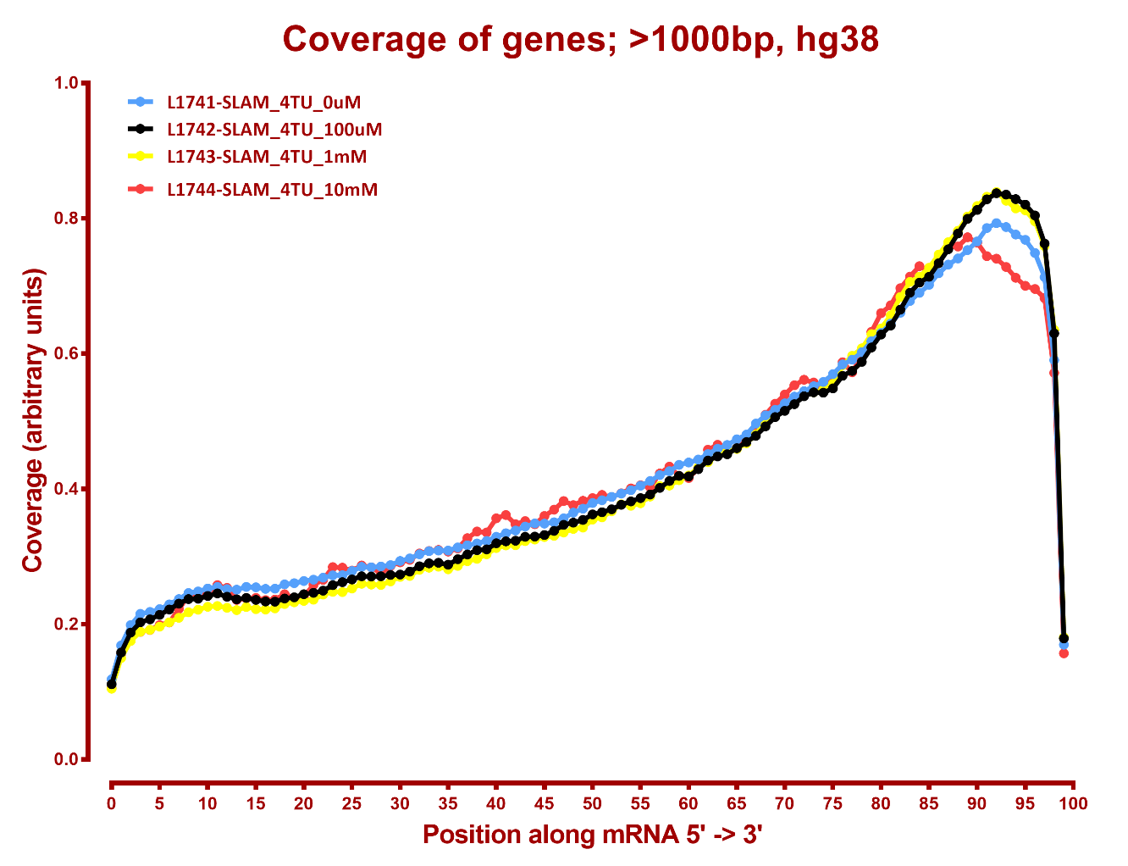
5’-3’ coverage

Slide 3
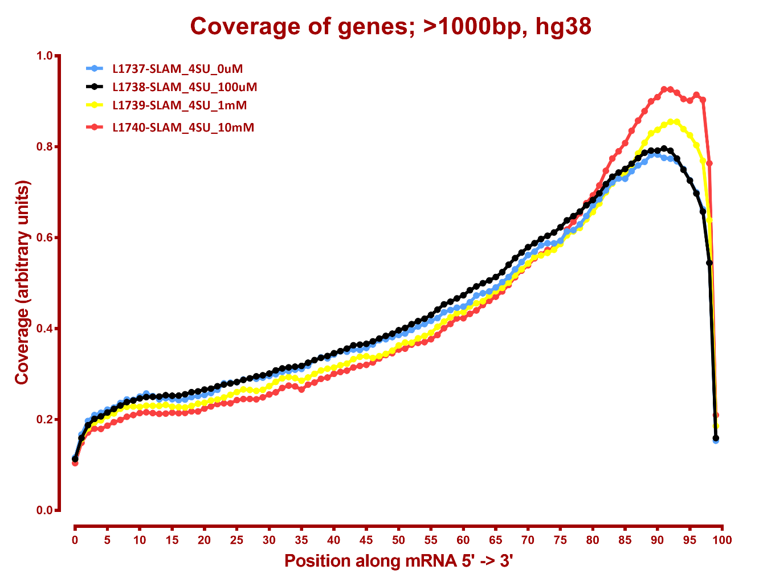
5’-3’ coverage

Slide 4
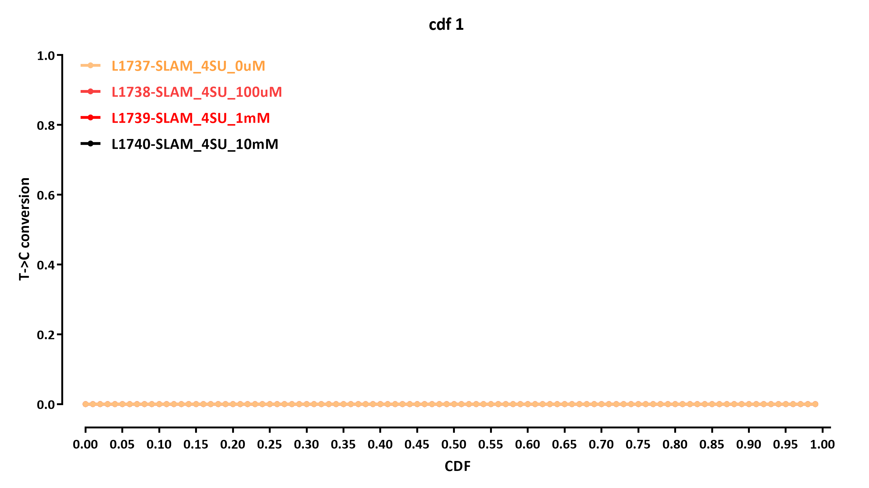
Slamdunk conversion rates

Slide 5


