Slide 1
Assembly summary (“transcripts”):
- Total assembled "transcripts" 65,239
- ORFs >60aa, 6-frame 193,945
- transcripts with ORFs >60aa, 6-frame 48,049
- with PFAM domain, E <= 1E-5:
 |  | # transcripts with PFAM domain
hard filtered transcripts | 6-frame | 20,798
 | longest ORF | 19,576
soft filtered transcripts | 6-frame | 21,778
 | longest ORF | 19,585
transcripts | 6-frame | 21,382
 | longest ORF | 19,583

Slide 2
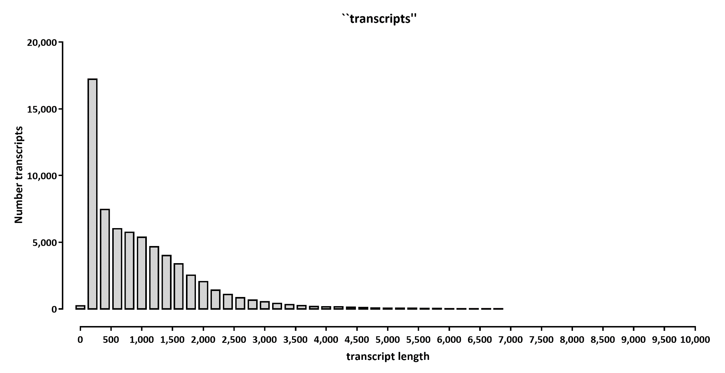

Slide 3
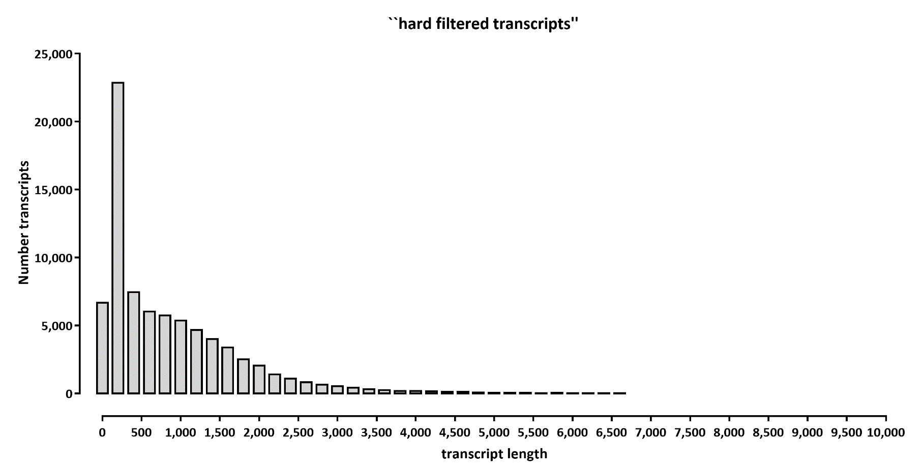

Slide 4
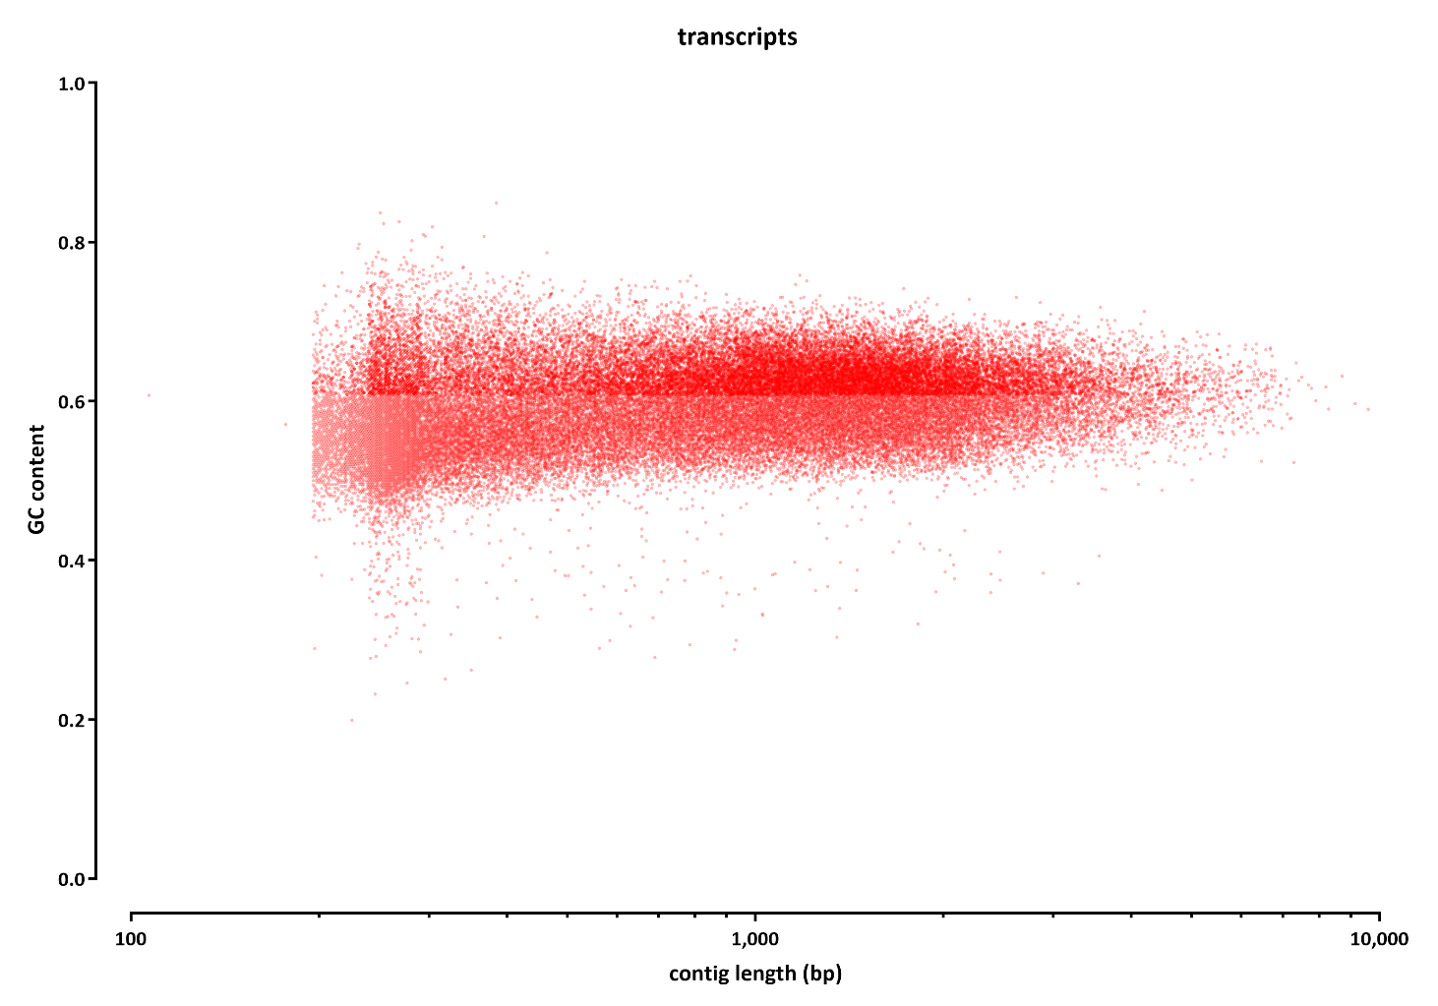

Slide 5
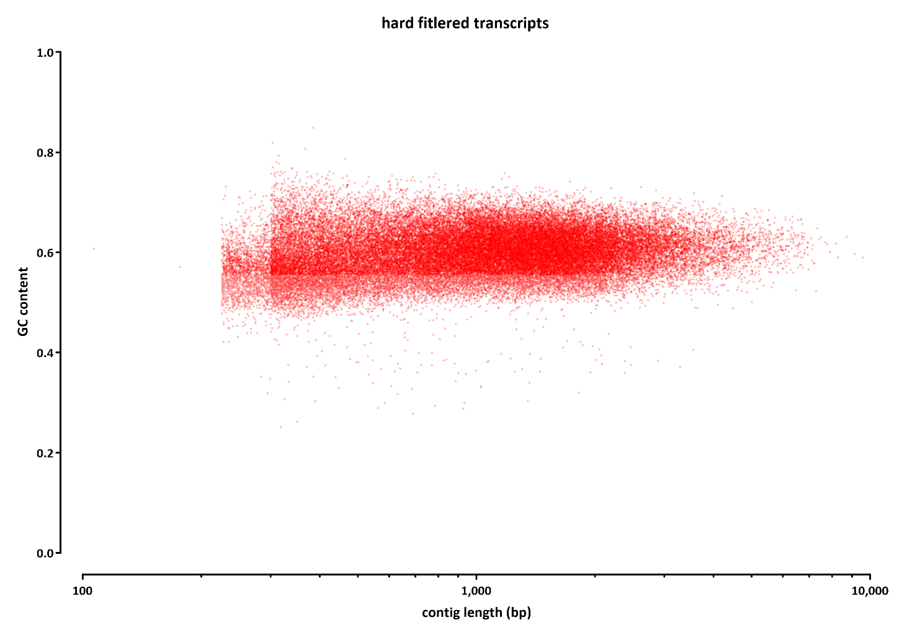

Slide 6
