Slide 1
Summary of what was done
Mapped transcripts to new assembly with GMAP
Note that 2,852 transcripts did not map uniquely to the assembly
Looked for how often genes within the same coexpression module and in different module were:
  on the same chromosome
  on the same chromosome and on the same strand
  within a given distance (in units of genes) from each other

Slide 2
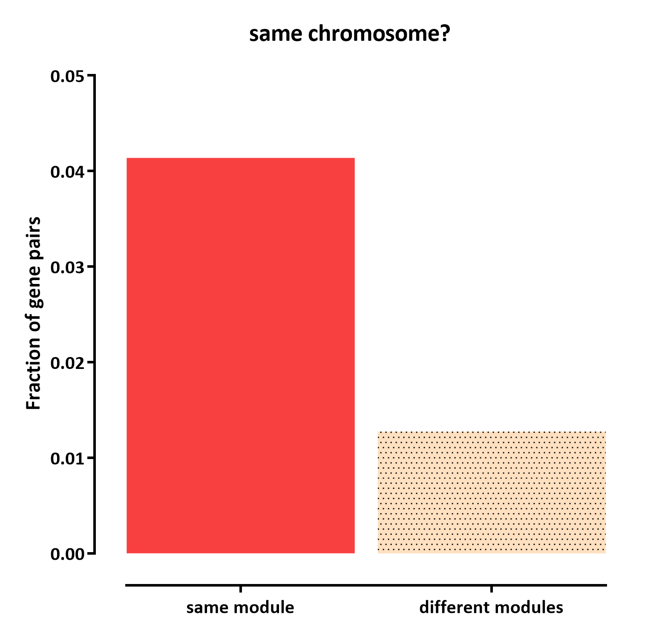
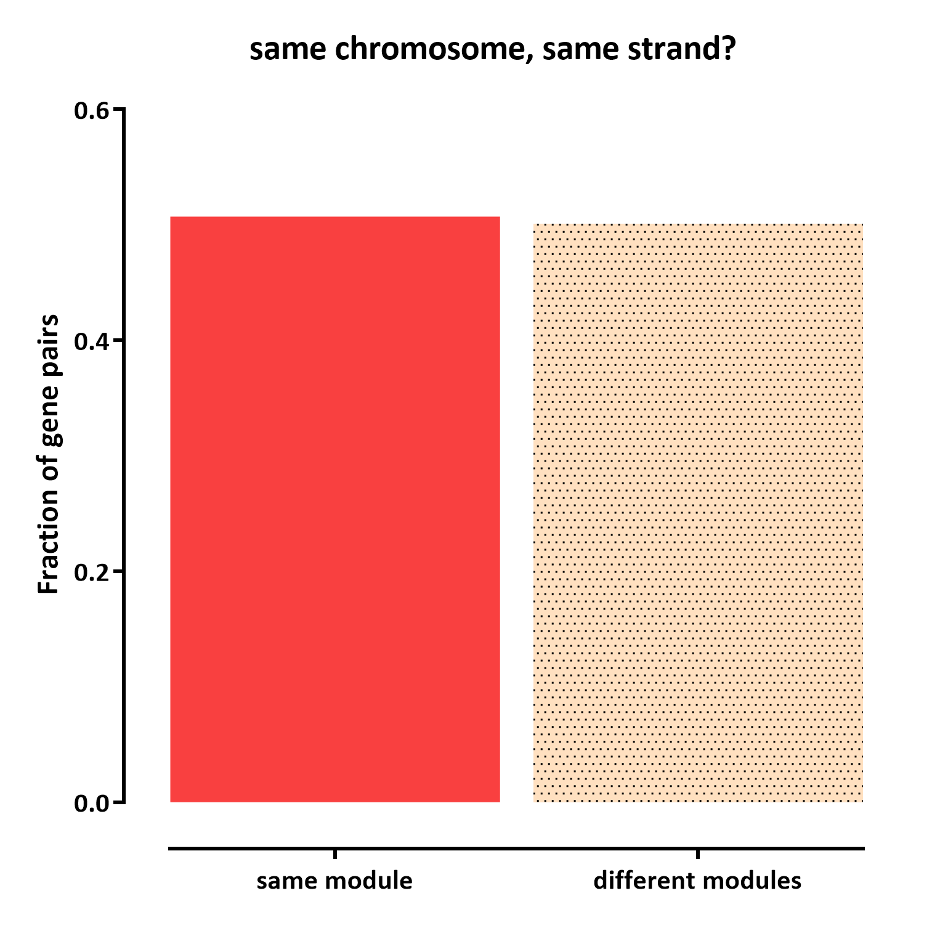
- While there are more genes on the same chromosome within a module, the majority of genes in a given module are not on the same chromosome
- Note that it is possible that we are confounded by partial transcripts, i.e. the same gene but assembled in more than one piece in the transcriptome assembly

Slide 3
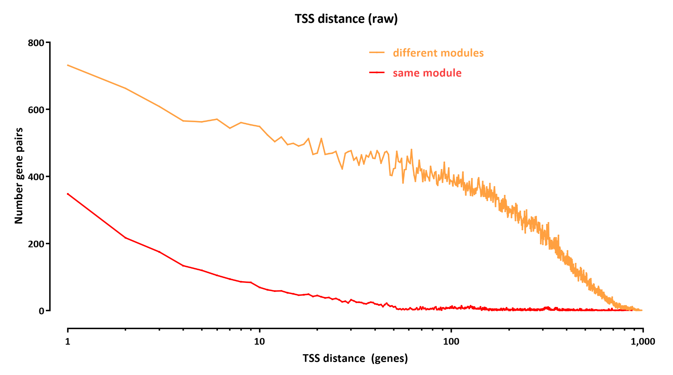

Slide 4
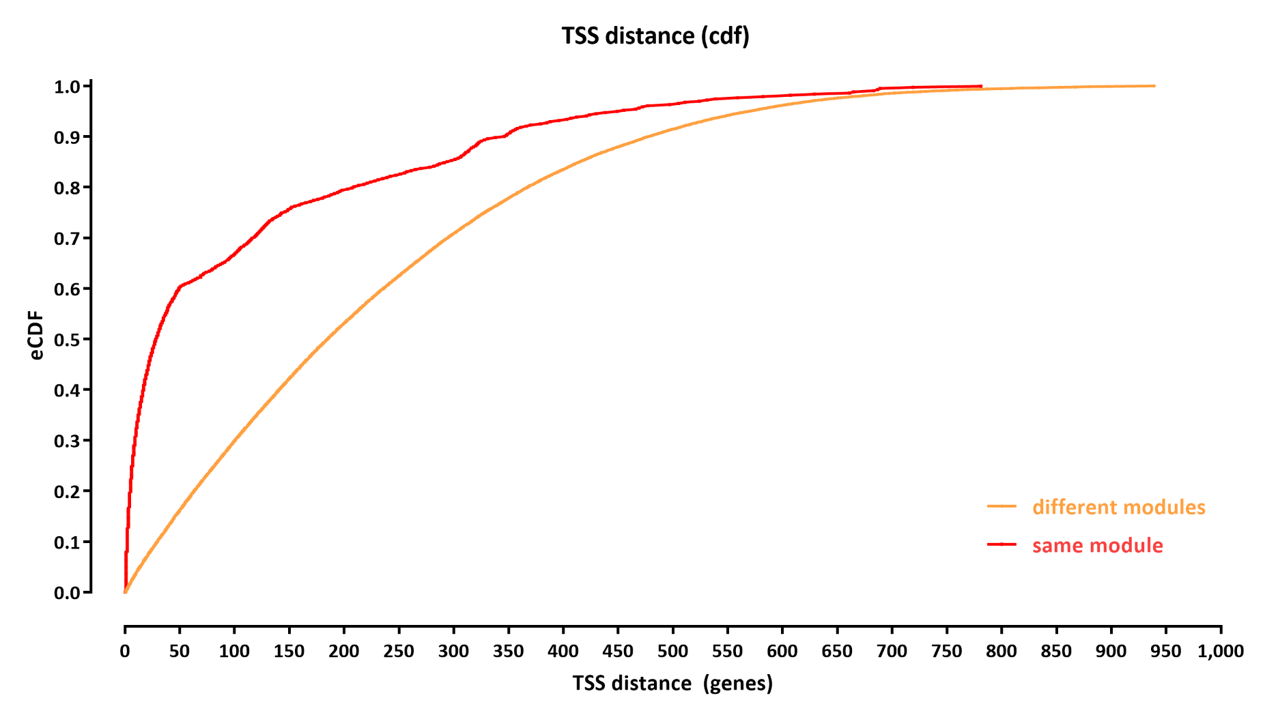

Slide 5
