Slide 1
Mapping stats

Slide 2
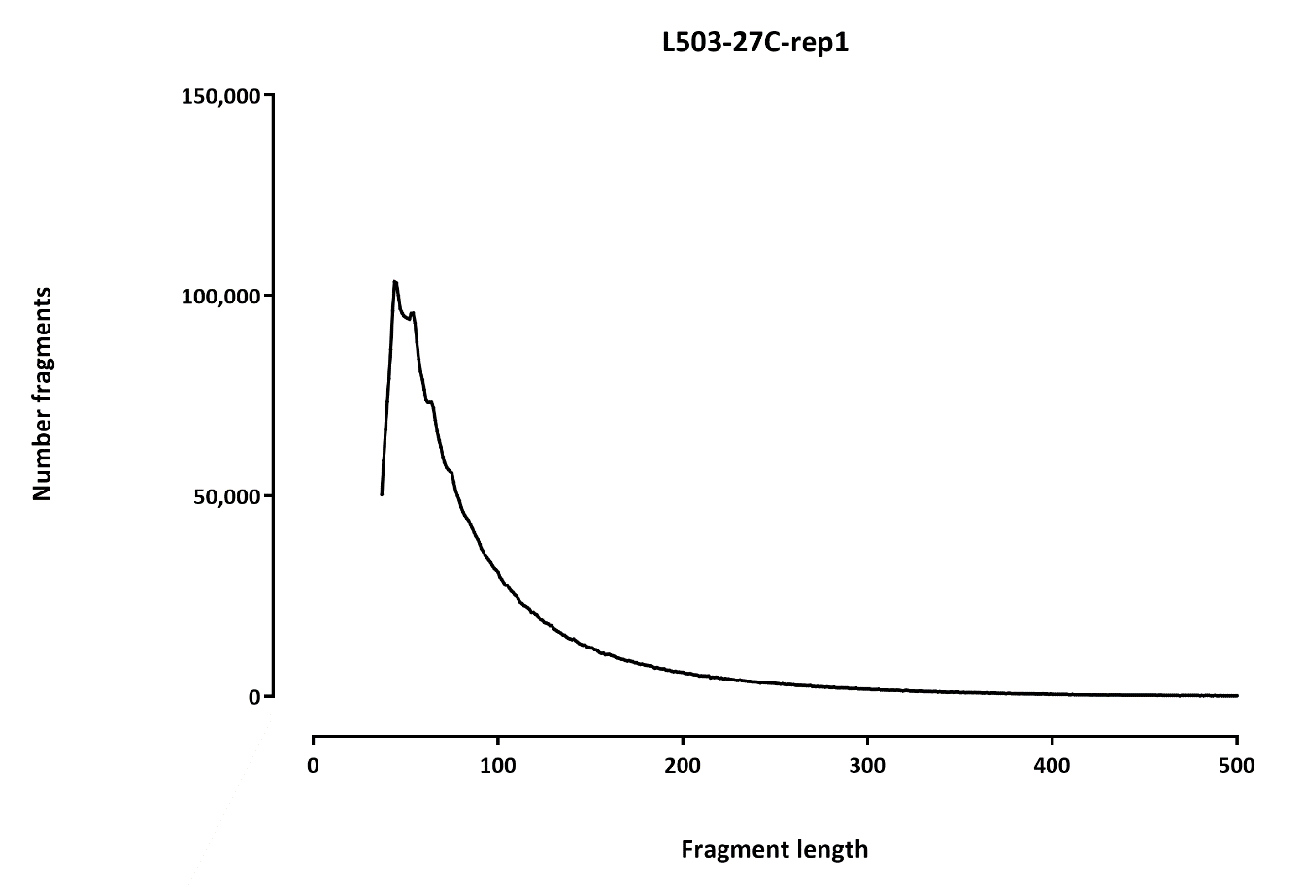

Slide 3
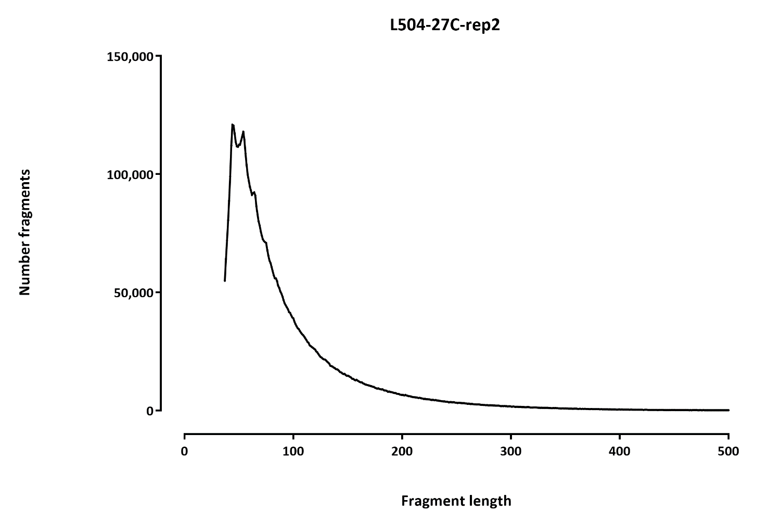

Slide 4
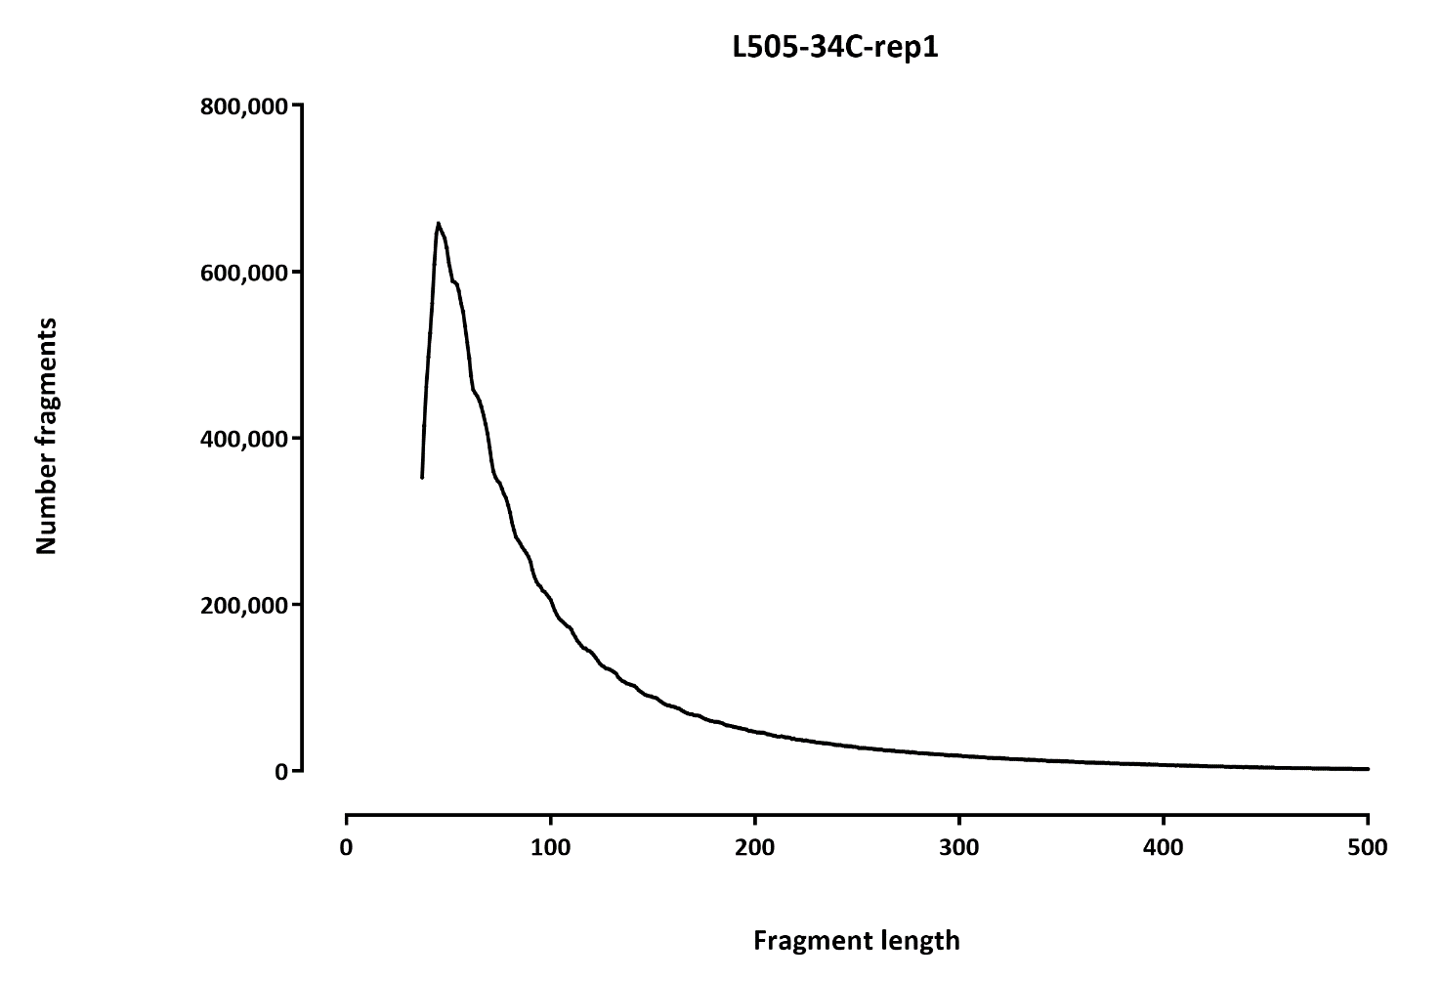

Slide 5
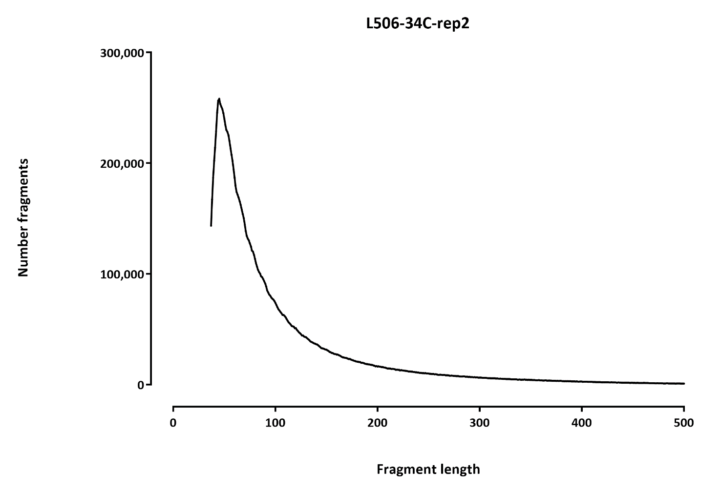

Slide 6
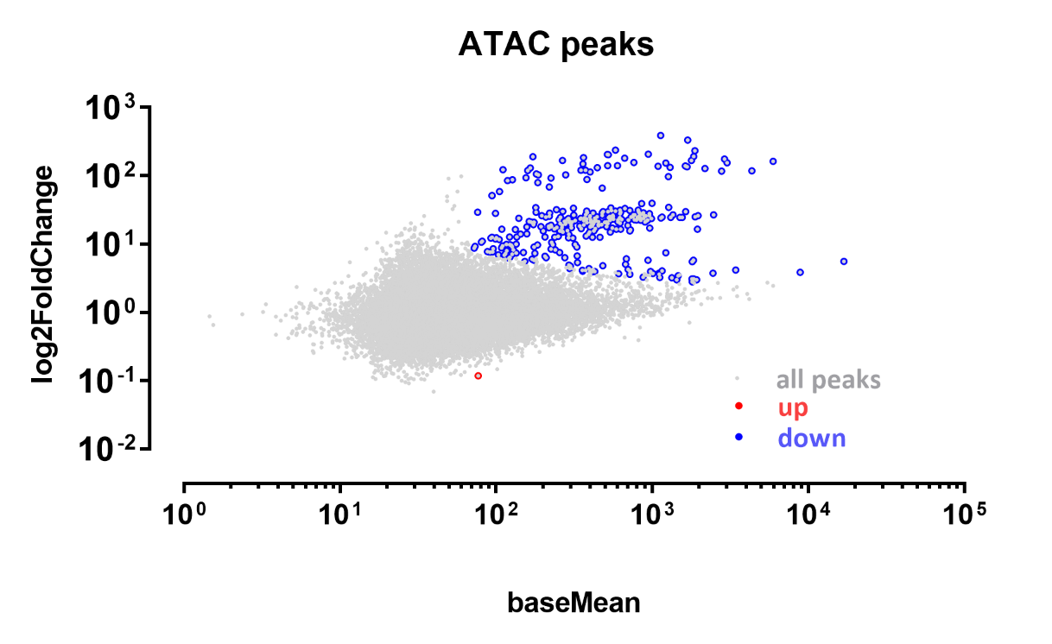
Differential peaks
A | B | p-val |  | p-adj
 |  | up in B vs A | down in B vs A | up in B vs A | down in B vs A
27C | 34C | 372 | 1,395 | 2 | 317

