Slide 1
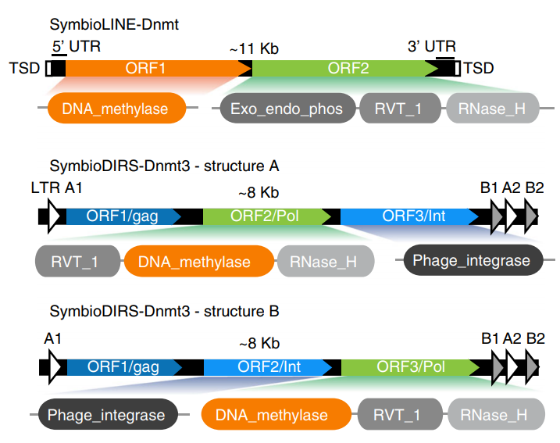
From the published paper:
Split DNMTs into 4 groups:
LINE-DNMTs
DIRS-DNMTs
other_domain_DNMTs
DNMTs with no other annotated domains

Slide 2
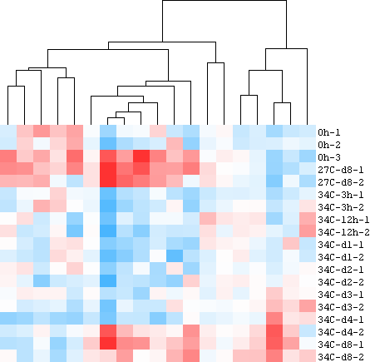
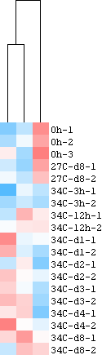
DIRS-DNMTs, >1TPM in at least one sample
DIRS-DNMTs, >1TPM in at least one sample

Slide 3
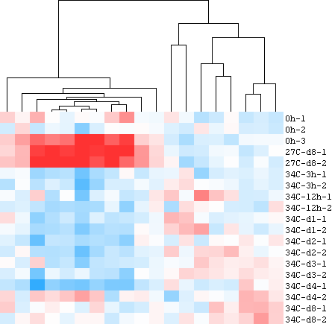
others, >1TPM in at least one sample

Slide 4
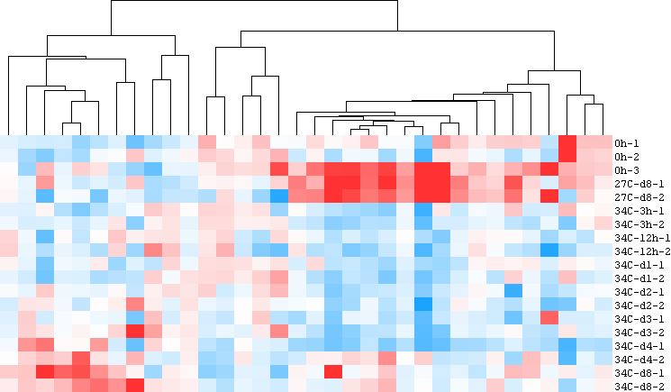
no other domain, >1TPM in at least one sample

Slide 5
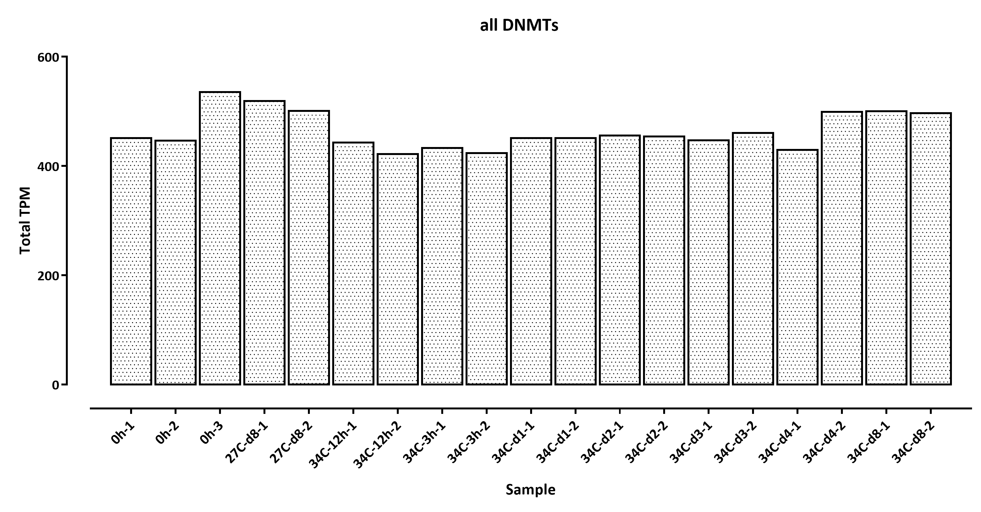
Expression change over all DNMTs

Slide 6
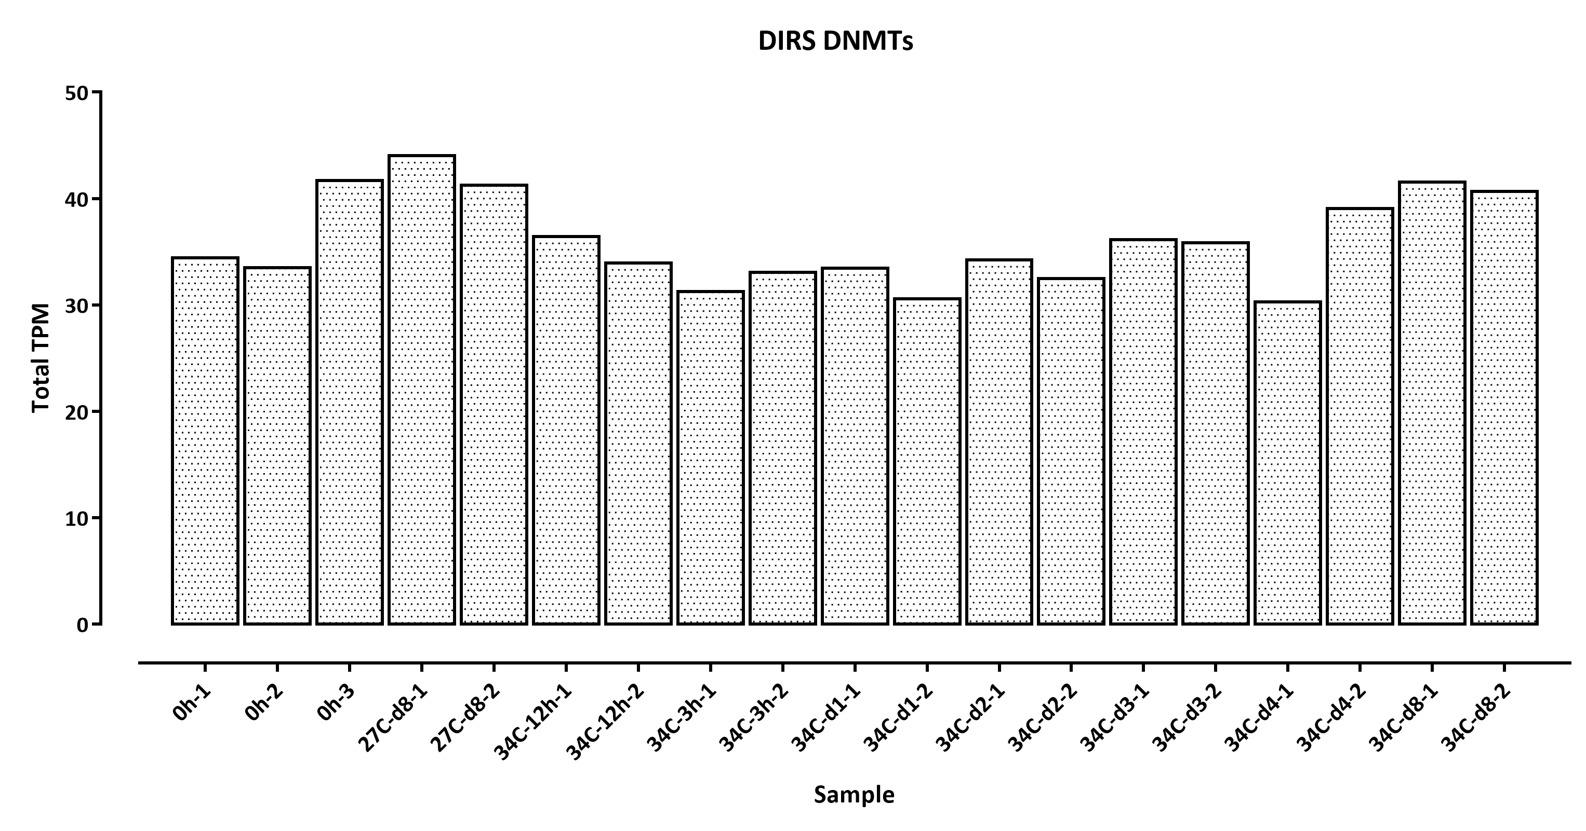

Slide 7
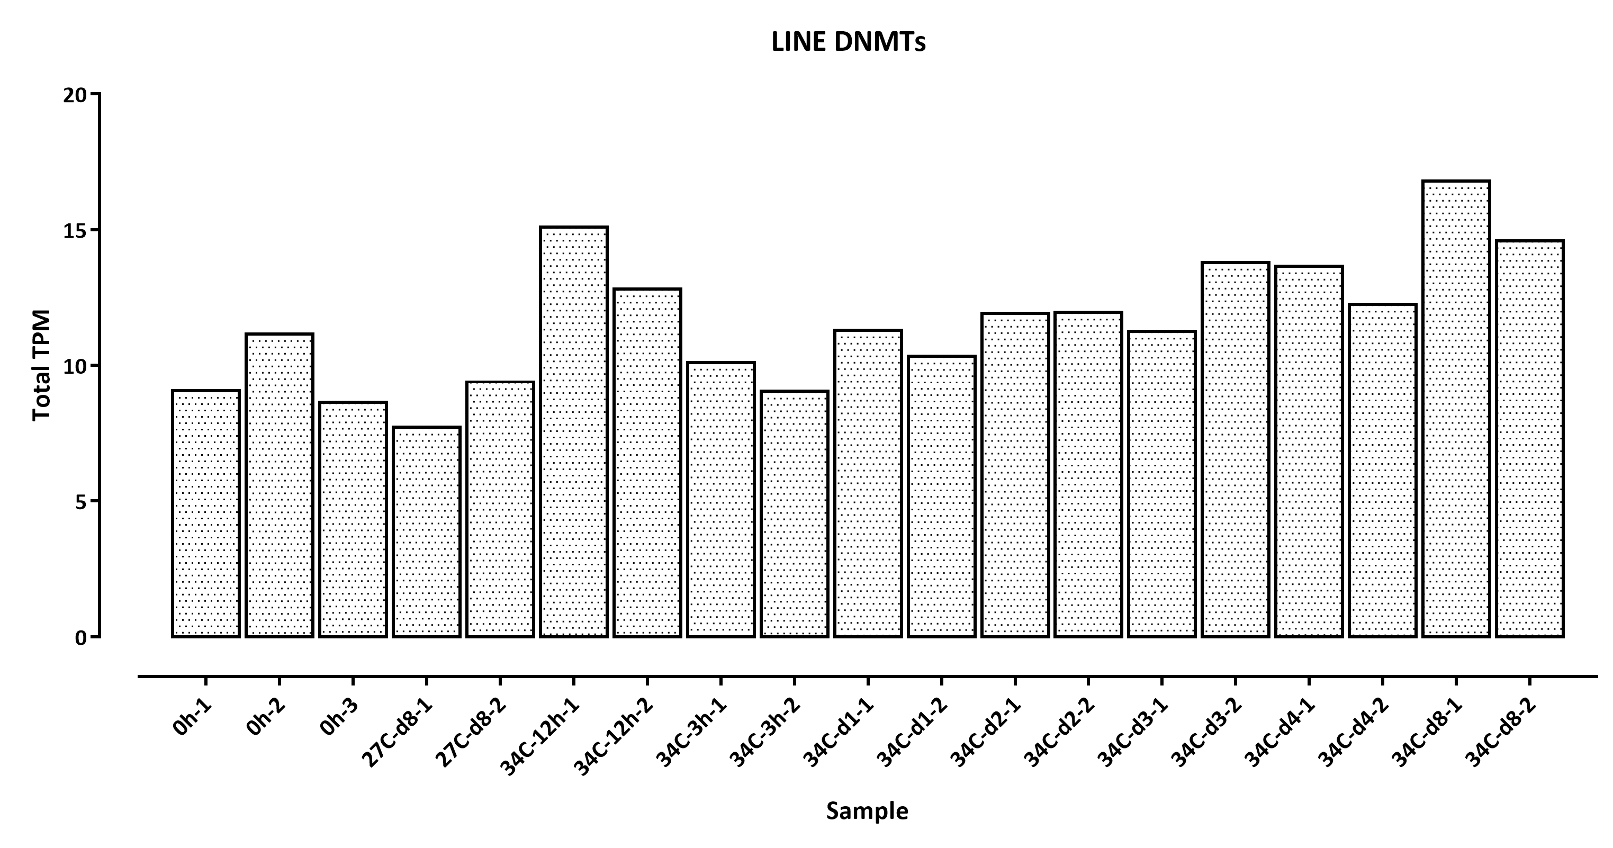

Slide 8
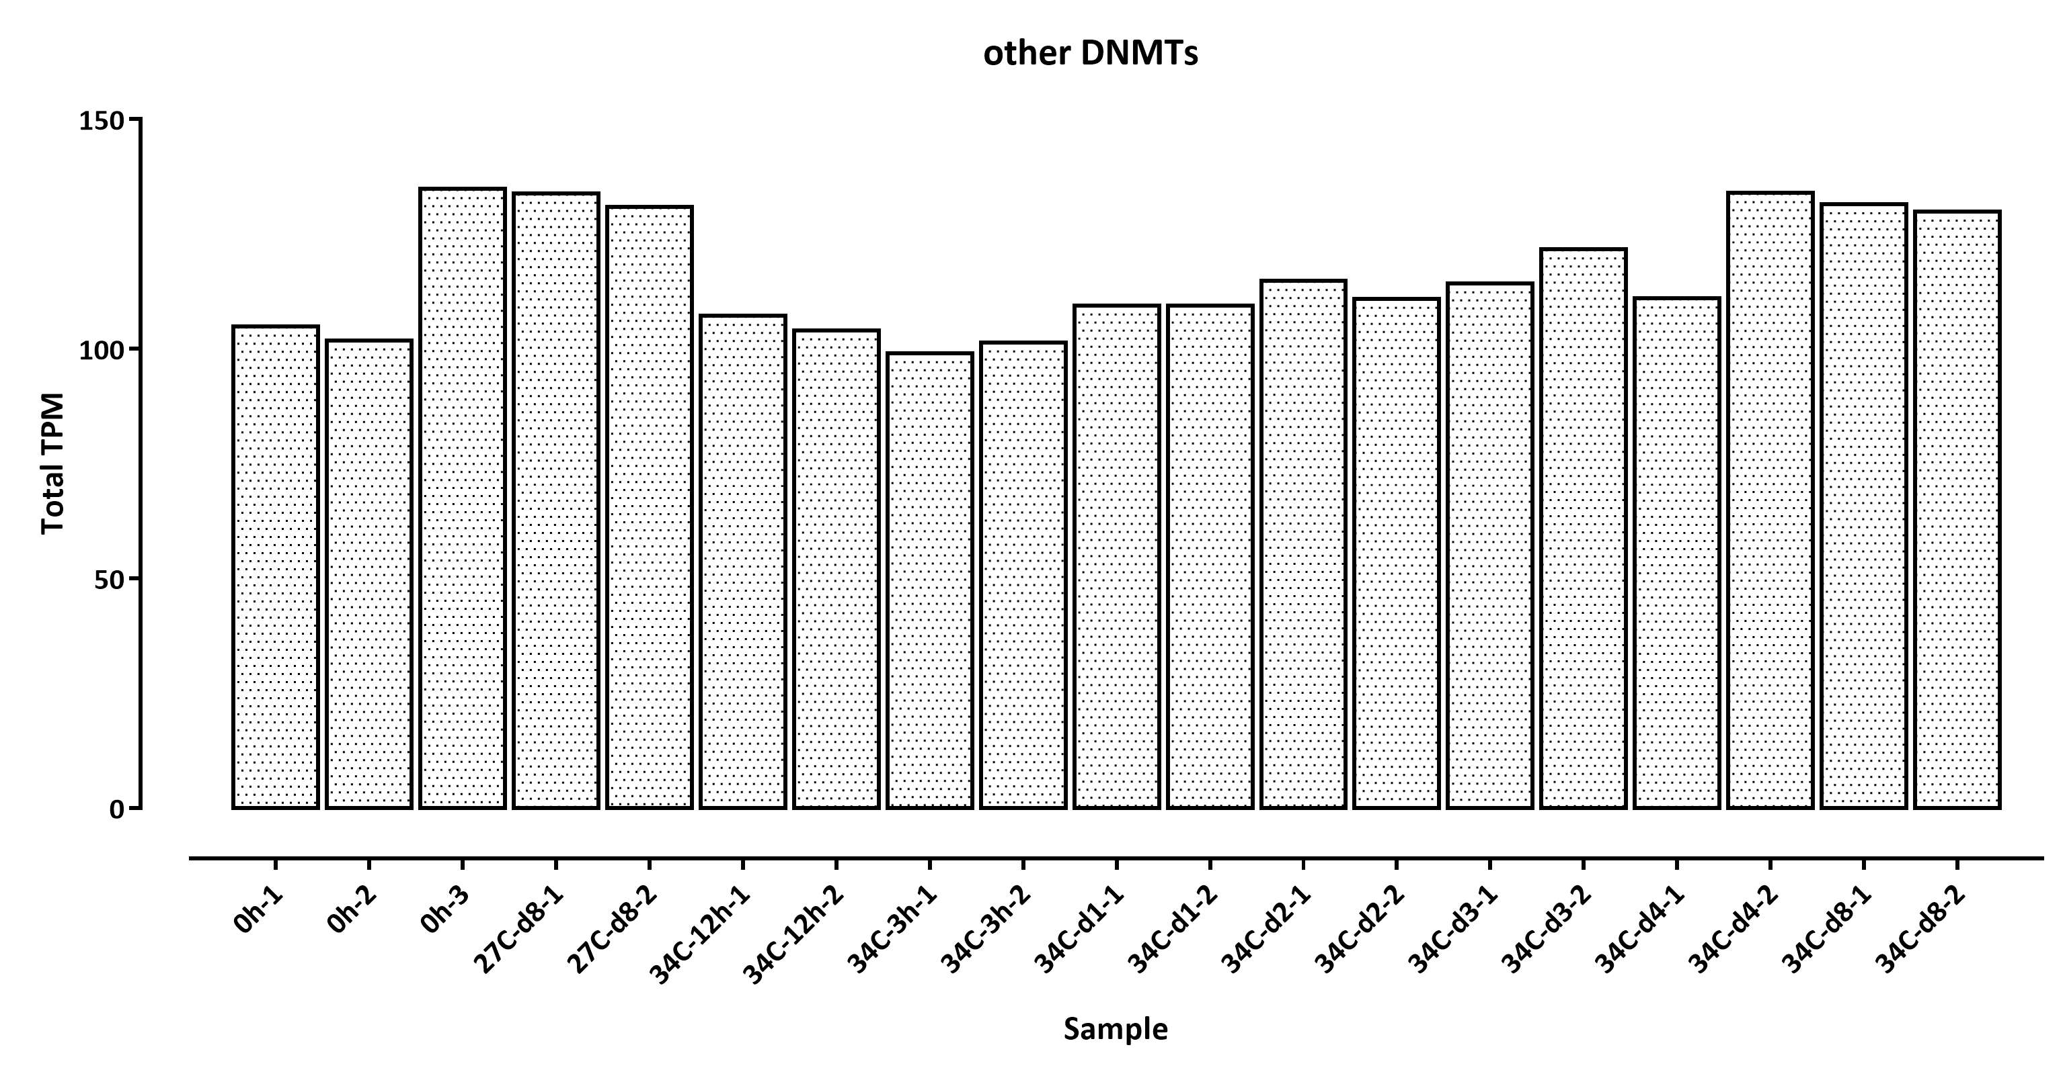

Slide 9
