Slide 1
MAPPING STATS
Library | Raw fragments | Species | 2x36mers unique
 |  |  | Unique reads | Complexity | Fraction aligned
2026-01-03-MS251125L01_exp251028_RPE1_ChIP_1_INPUT_DMSO | 930,257 | dm6 | 105,056 | 0.86 | 0.06
2026-01-03-MS251125L01_exp251028_RPE1_ChIP_1_INPUT_DMSO | 930,257 | hg38 | 1,439,014 | 0.83 | 0.77
2026-01-03-MS251125L02_exp251028_RPE1_ChIP_1_INPUT_TPL | 1,324,465 | dm6 | 127,818 | 0.88 | 0.05
2026-01-03-MS251125L02_exp251028_RPE1_ChIP_1_INPUT_TPL | 1,324,465 | hg38 | 2,078,886 | 0.87 | 0.78
2026-01-03-MS251125L03_exp251111_RPE1_ChIP_2_INPUT_DMSO | 1,014,184 | dm6 | 110,564 | 0.82 | 0.05
2026-01-03-MS251125L03_exp251111_RPE1_ChIP_2_INPUT_DMSO | 1,014,184 | hg38 | 1,565,960 | 0.81 | 0.77
2026-01-03-MS251125L04_exp251111_RPE1_ChIP_2_INPUT_TPL | 1,223,023 | dm6 | 142,802 | 0.85 | 0.06
2026-01-03-MS251125L04_exp251111_RPE1_ChIP_2_INPUT_TPL | 1,223,023 | hg38 | 1,894,526 | 0.84 | 0.77
2026-01-03-MS251125L05_exp251028_RPE1_ChIP_1_ChIP_RNAPII_DMSO | 14,789,394 | dm6 | 1,872,002 | 0.82 | 0.06
2026-01-03-MS251125L05_exp251028_RPE1_ChIP_1_ChIP_RNAPII_DMSO | 14,789,394 | hg38 | 22,895,858 | 0.83 | 0.77
2026-01-03-MS251125L06_exp251028_RPE1_ChIP_1_ChIP_RNAPII_TPL | 11,512,870 | dm6 | 1,289,398 | 0.81 | 0.06
2026-01-03-MS251125L06_exp251028_RPE1_ChIP_1_ChIP_RNAPII_TPL | 11,512,870 | hg38 | 17,196,000 | 0.82 | 0.75
2026-01-03-MS251125L07_exp251028_RPE1_ChIP_1_ChIP_S2P_DMSO | 11,204,377 | dm6 | 1,432,144 | 0.80 | 0.06
2026-01-03-MS251125L07_exp251028_RPE1_ChIP_1_ChIP_S2P_DMSO | 11,204,377 | hg38 | 17,134,508 | 0.80 | 0.76
2026-01-03-MS251125L08_exp251028_RPE1_ChIP_1_ChIP_S2P_TPL | 11,724,369 | dm6 | 2,119,054 | 0.79 | 0.09
2026-01-03-MS251125L08_exp251028_RPE1_ChIP_1_ChIP_S2P_TPL | 11,724,369 | hg38 | 16,648,492 | 0.78 | 0.71
2026-01-03-MS251125L09_exp251111_RPE1_ChIP_2_ChIP_S2P_DMSO | 11,248,866 | dm6 | 1,245,718 | 0.84 | 0.06
2026-01-03-MS251125L09_exp251111_RPE1_ChIP_2_ChIP_S2P_DMSO | 11,248,866 | hg38 | 16,810,892 | 0.84 | 0.75
2026-01-03-MS251125L10_exp251111_RPE1_ChIP_2_ChIP_S2P_TPL | 11,671,219 | dm6 | 2,170,716 | 0.81 | 0.09
2026-01-03-MS251125L10_exp251111_RPE1_ChIP_2_ChIP_S2P_TPL | 11,671,219 | hg38 | 16,396,268 | 0.81 | 0.70
2026-01-03-MS251125L11_exp251111_RPE1_ChIP_2_ChIP_S5P_DMSO | 13,459,803 | dm6 | 1,879,578 | 0.81 | 0.07
2026-01-03-MS251125L11_exp251111_RPE1_ChIP_2_ChIP_S5P_DMSO | 13,459,803 | hg38 | 19,518,790 | 0.80 | 0.73
2026-01-03-MS251125L12_exp251111_RPE1_ChIP_2_ChIP_S5P_TPL | 11,401,091 | dm6 | 2,881,390 | 0.77 | 0.13
2026-01-03-MS251125L12_exp251111_RPE1_ChIP_2_ChIP_S5P_TPL | 11,401,091 | hg38 | 13,724,430 | 0.81 | 0.60

Slide 2
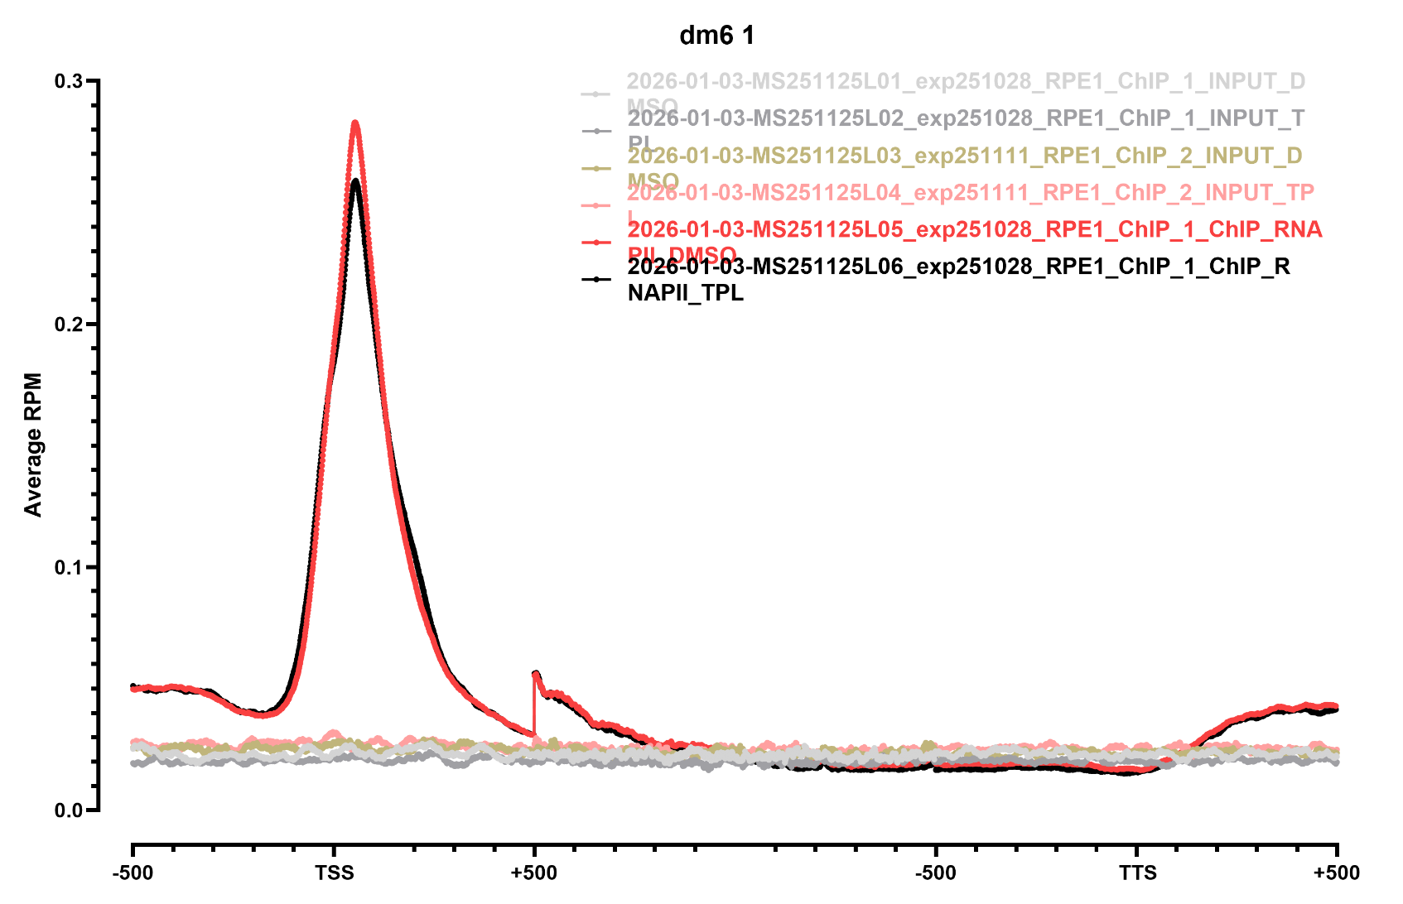
METAGENE PROFILES

Slide 3
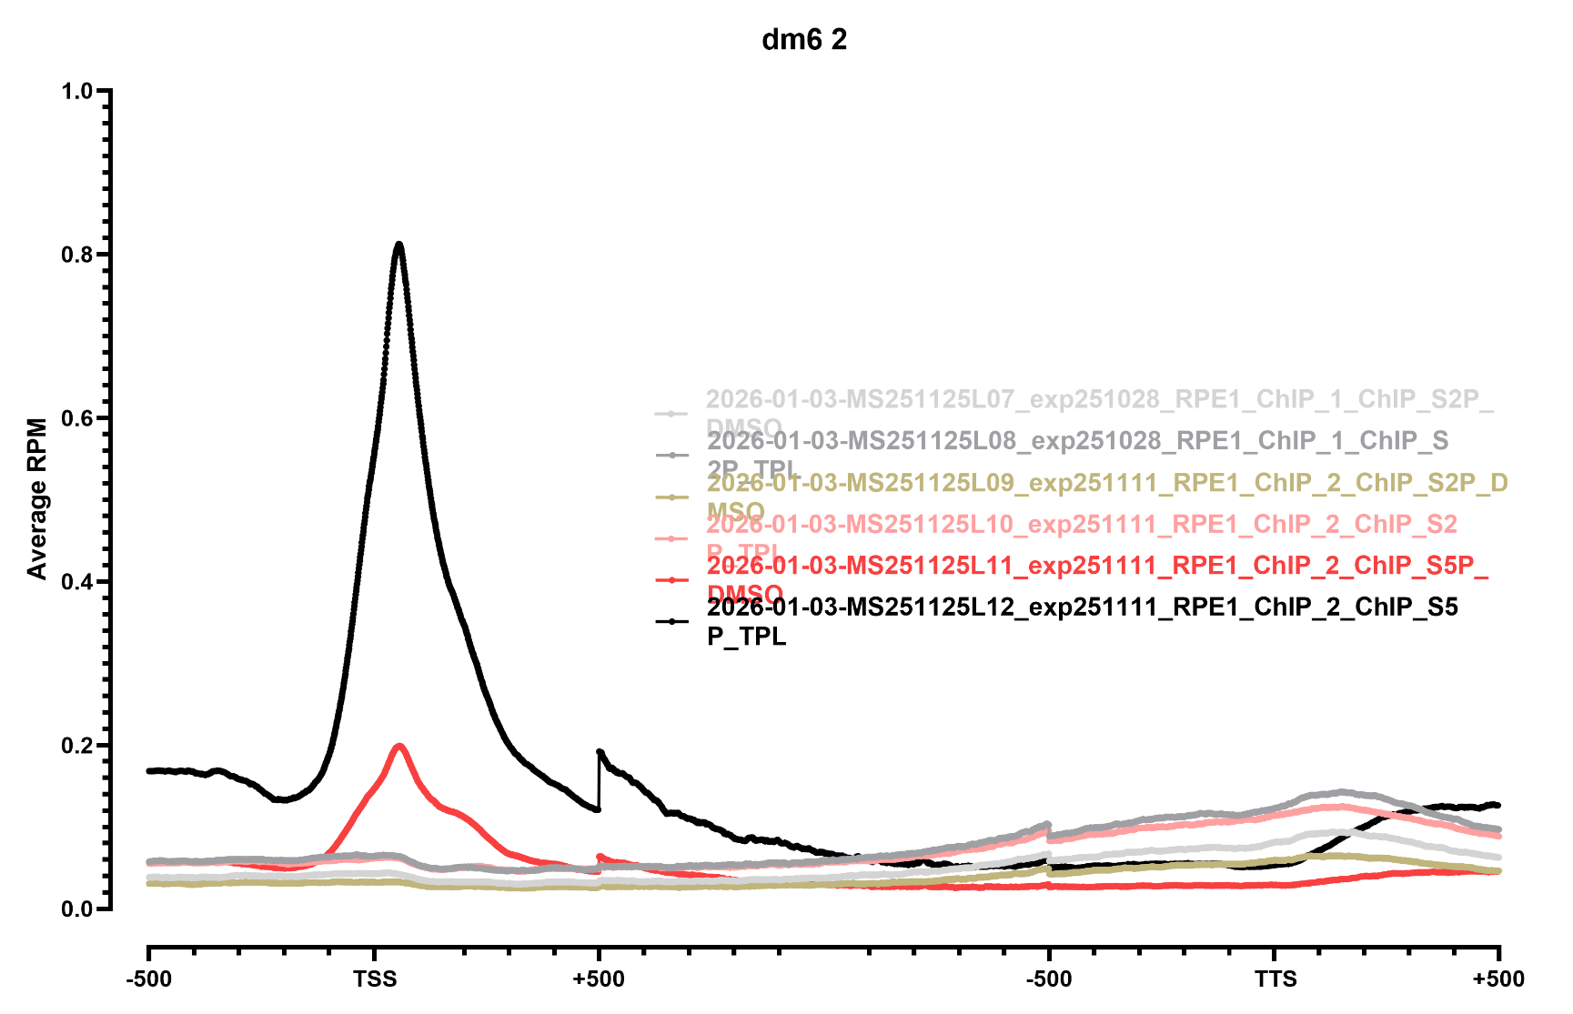
METAGENE PROFILES

Slide 4
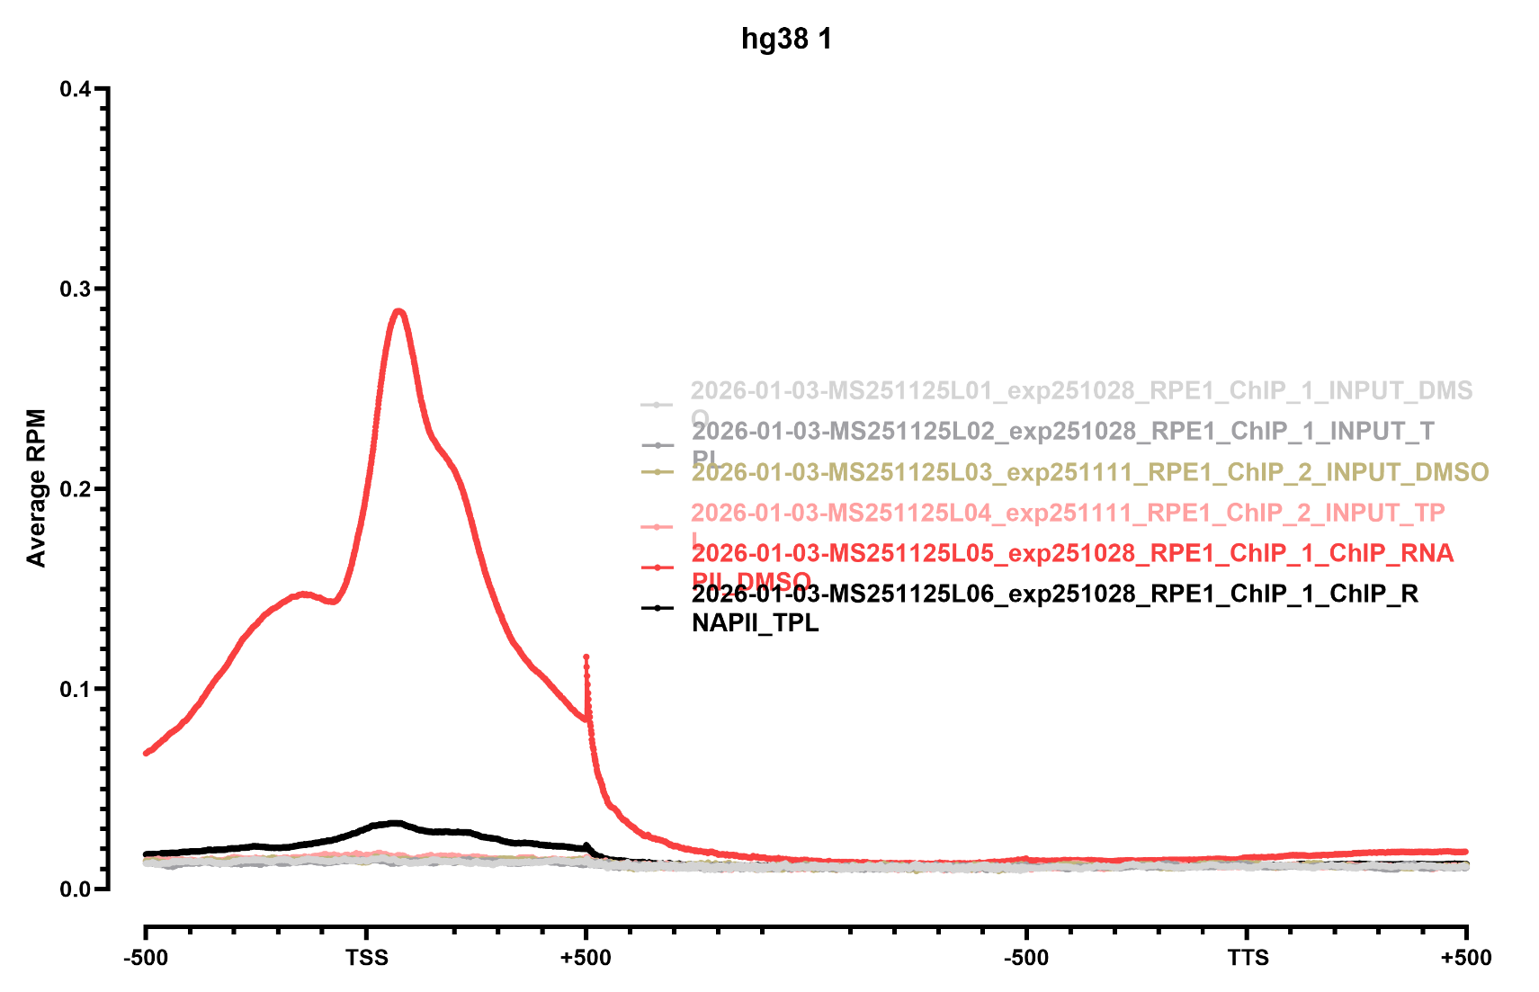
METAGENE PROFILES

Slide 5
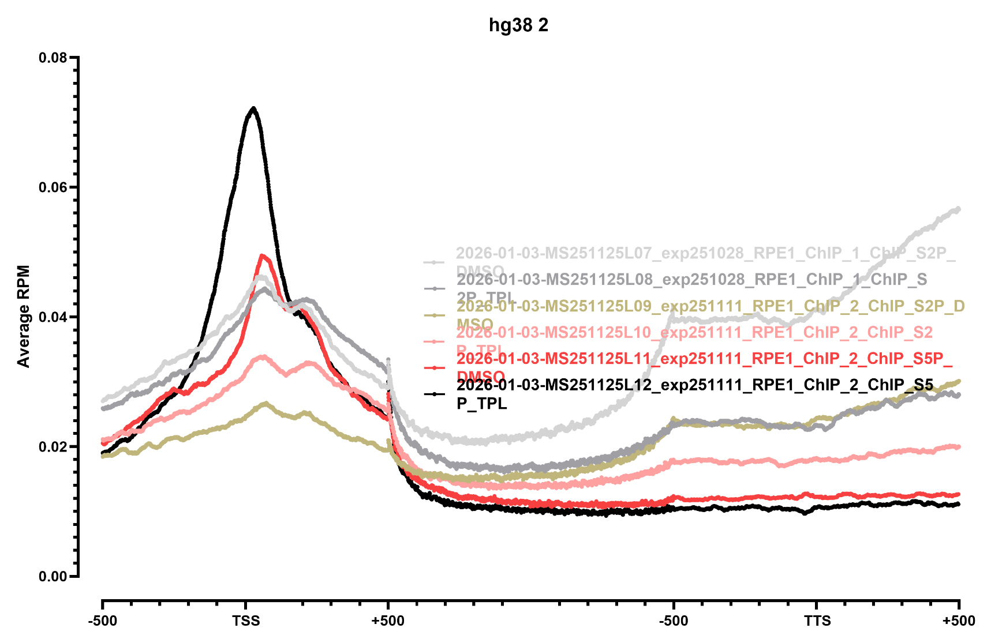
METAGENE PROFILES

