Slide 1
PREVIOUS ASSEMBLIES

Slide 2
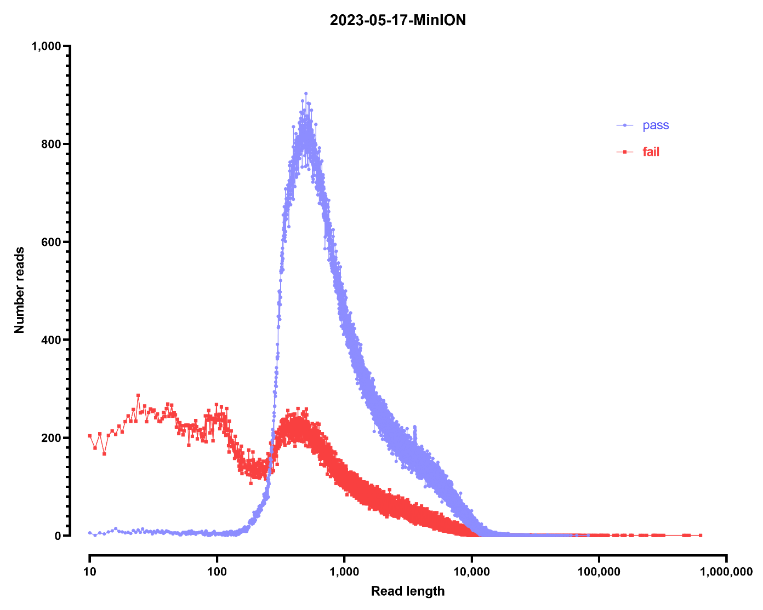
MinION read length distribution
~7 Gbp

Slide 3
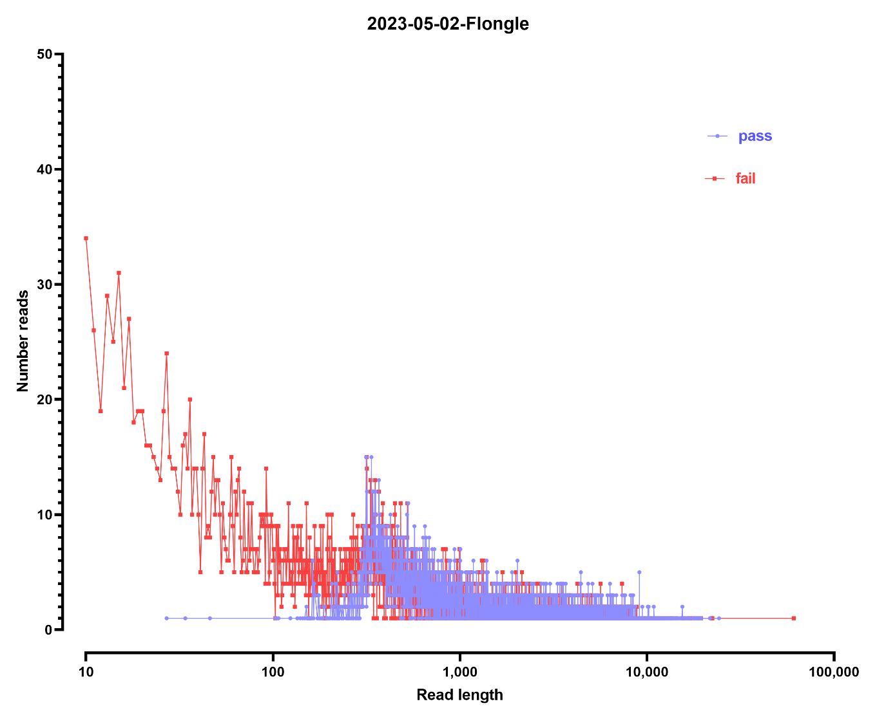
Flongle read length distribution
~60 Mbp

Slide 4
Short read data:
L2789 | yeast_YAC_Matt_1
L2790 | yeast_YAC_Matt_1
230522_NB551514_0056_AHNC33BGXN | 2x38 | 3,736,315
230522_NB551514_0056_AHNC33BGXN | 2x38 | 3,194,013
SPAdes assembly Illumina + ONT
N50 11,250 bp
NODE_1_length_58913_cov_3.402649 58913
NODE_2_length_55548_cov_3.600666 55548
NODE_3_length_43828_cov_3.742916 43828
NODE_4_length_42124_cov_3.727020 42124
NODE_5_length_41786_cov_3.544105 41786
NODE_6_length_39554_cov_2.970320 39554
NODE_7_length_39293_cov_2.902369 39293
NODE_8_length_38432_cov_3.002448 38432
NODE_9_length_38014_cov_3.463258 38014
NODE_10_length_36870_cov_2.472840 36870
This is weird – there is so much nanopore data…
SPAdes assembly Illumina only:
N50 3,068 bp
NODE_1_length_21614_cov_6.438580 21614
NODE_2_length_16447_cov_5.123797 16447
NODE_3_length_14171_cov_4.914274 14171

Slide 5
Shasta 0.10.1 assembly, ONT only
N50 4,167 bp
wtdbg-2.5 assembly, ONT only
N50 31,354 bp
NECAT assembly, ONT only
N50 954,962 bp
bctg00000019 30247
bctg00000020 25288
bctg00000021 13832
bctg00000022 968
bctg00000018 111478
bctg00000016 271877
bctg00000017 217462
bctg00000015 277415
bctg00000012 401330
bctg00000014 331861
bctg00000013 399974
bctg00000011 429026
bctg00000009 524798
bctg00000010 477224
bctg00000008 579349
bctg00000007 679205
bctg00000006 779327
bctg00000004 954962
bctg00000005 939887
bctg00000002 1085228
bctg00000003 1053385
bctg00000001 1529316
bctg00000000 1873469

Slide 6
NECAT assembly, ONT only; BLAST results:
bctg00000019 30247 mitochondrion
bctg00000020 25288 Expression vector pSB229
bctg00000021 13832 mitochondrion
bctg00000022 968 chrIV
bctg00000018 111478 mitochondrion
The rest is too large to run with the online BLAST tool

Slide 7
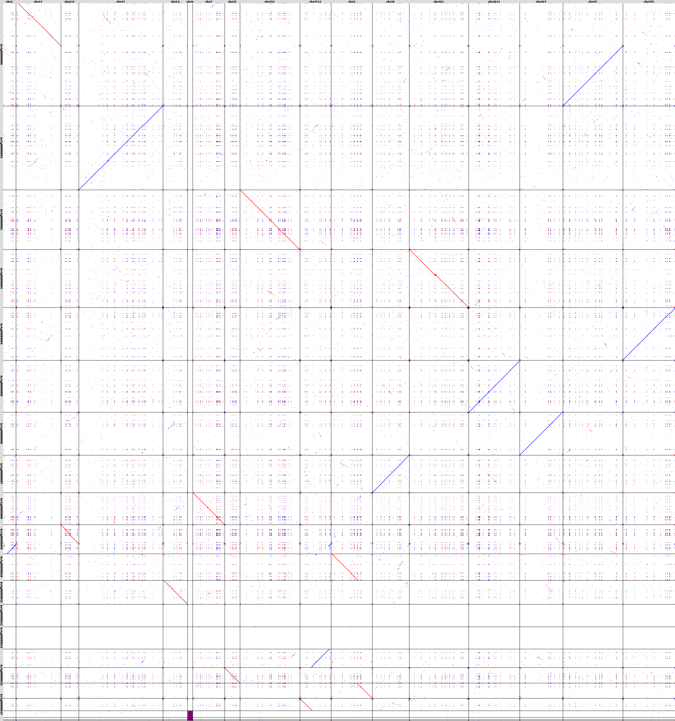
NECAT assembly, ONT only; whole genome alignment against sacCer3
I II III IV IXM V VI VII VIII X XI XII XIII XIV XV XVI
0 1 2 3 4 5 6 7 8 9 10 11 12 13 14 15 16 17

Slide 8
WITH UPDATED NOVASEQ DATA

Slide 9
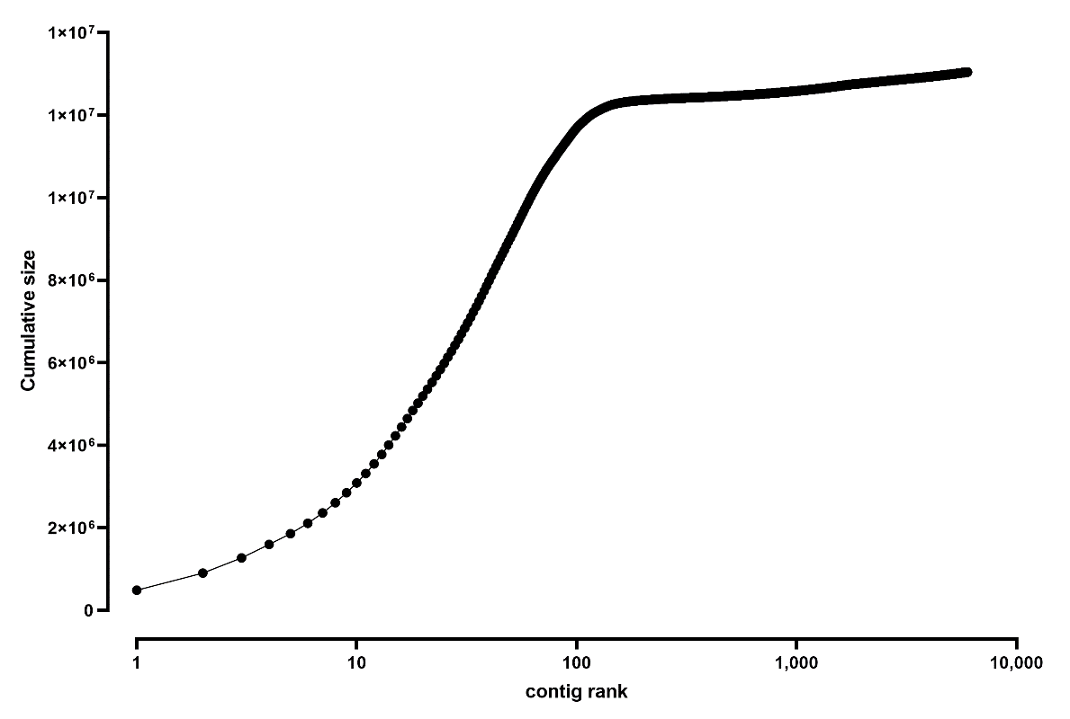
Short read data:
L2789 | yeast_YAC_Matt_1
L2790 | yeast_YAC_Matt_1
230522_NB551514_0056_AHNC33BGXN | 2x38 | 3,736,315
230522_NB551514_0056_AHNC33BGXN | 2x38 | 3,194,013
CKDL230018741-1A_225KKJLT3_L2 2x150 80,916,164
SPAdes assembly Illumina + ONT
N50 141,094 bp
NODE_1_length_485139_cov_304.603745 485139
NODE_2_length_416600_cov_271.966767 416600
NODE_3_length_369332_cov_266.547291 369332
NODE_4_length_323787_cov_274.668778 323787
NODE_5_length_260118_cov_255.803113 260118
NODE_6_length_255486_cov_267.614961 255486
NODE_7_length_250130_cov_272.256015 250130
NODE_8_length_248254_cov_322.828513 248254
NODE_9_length_239762_cov_268.664903 239762
NODE_10_length_235827_cov_706.113321 235827

Slide 10
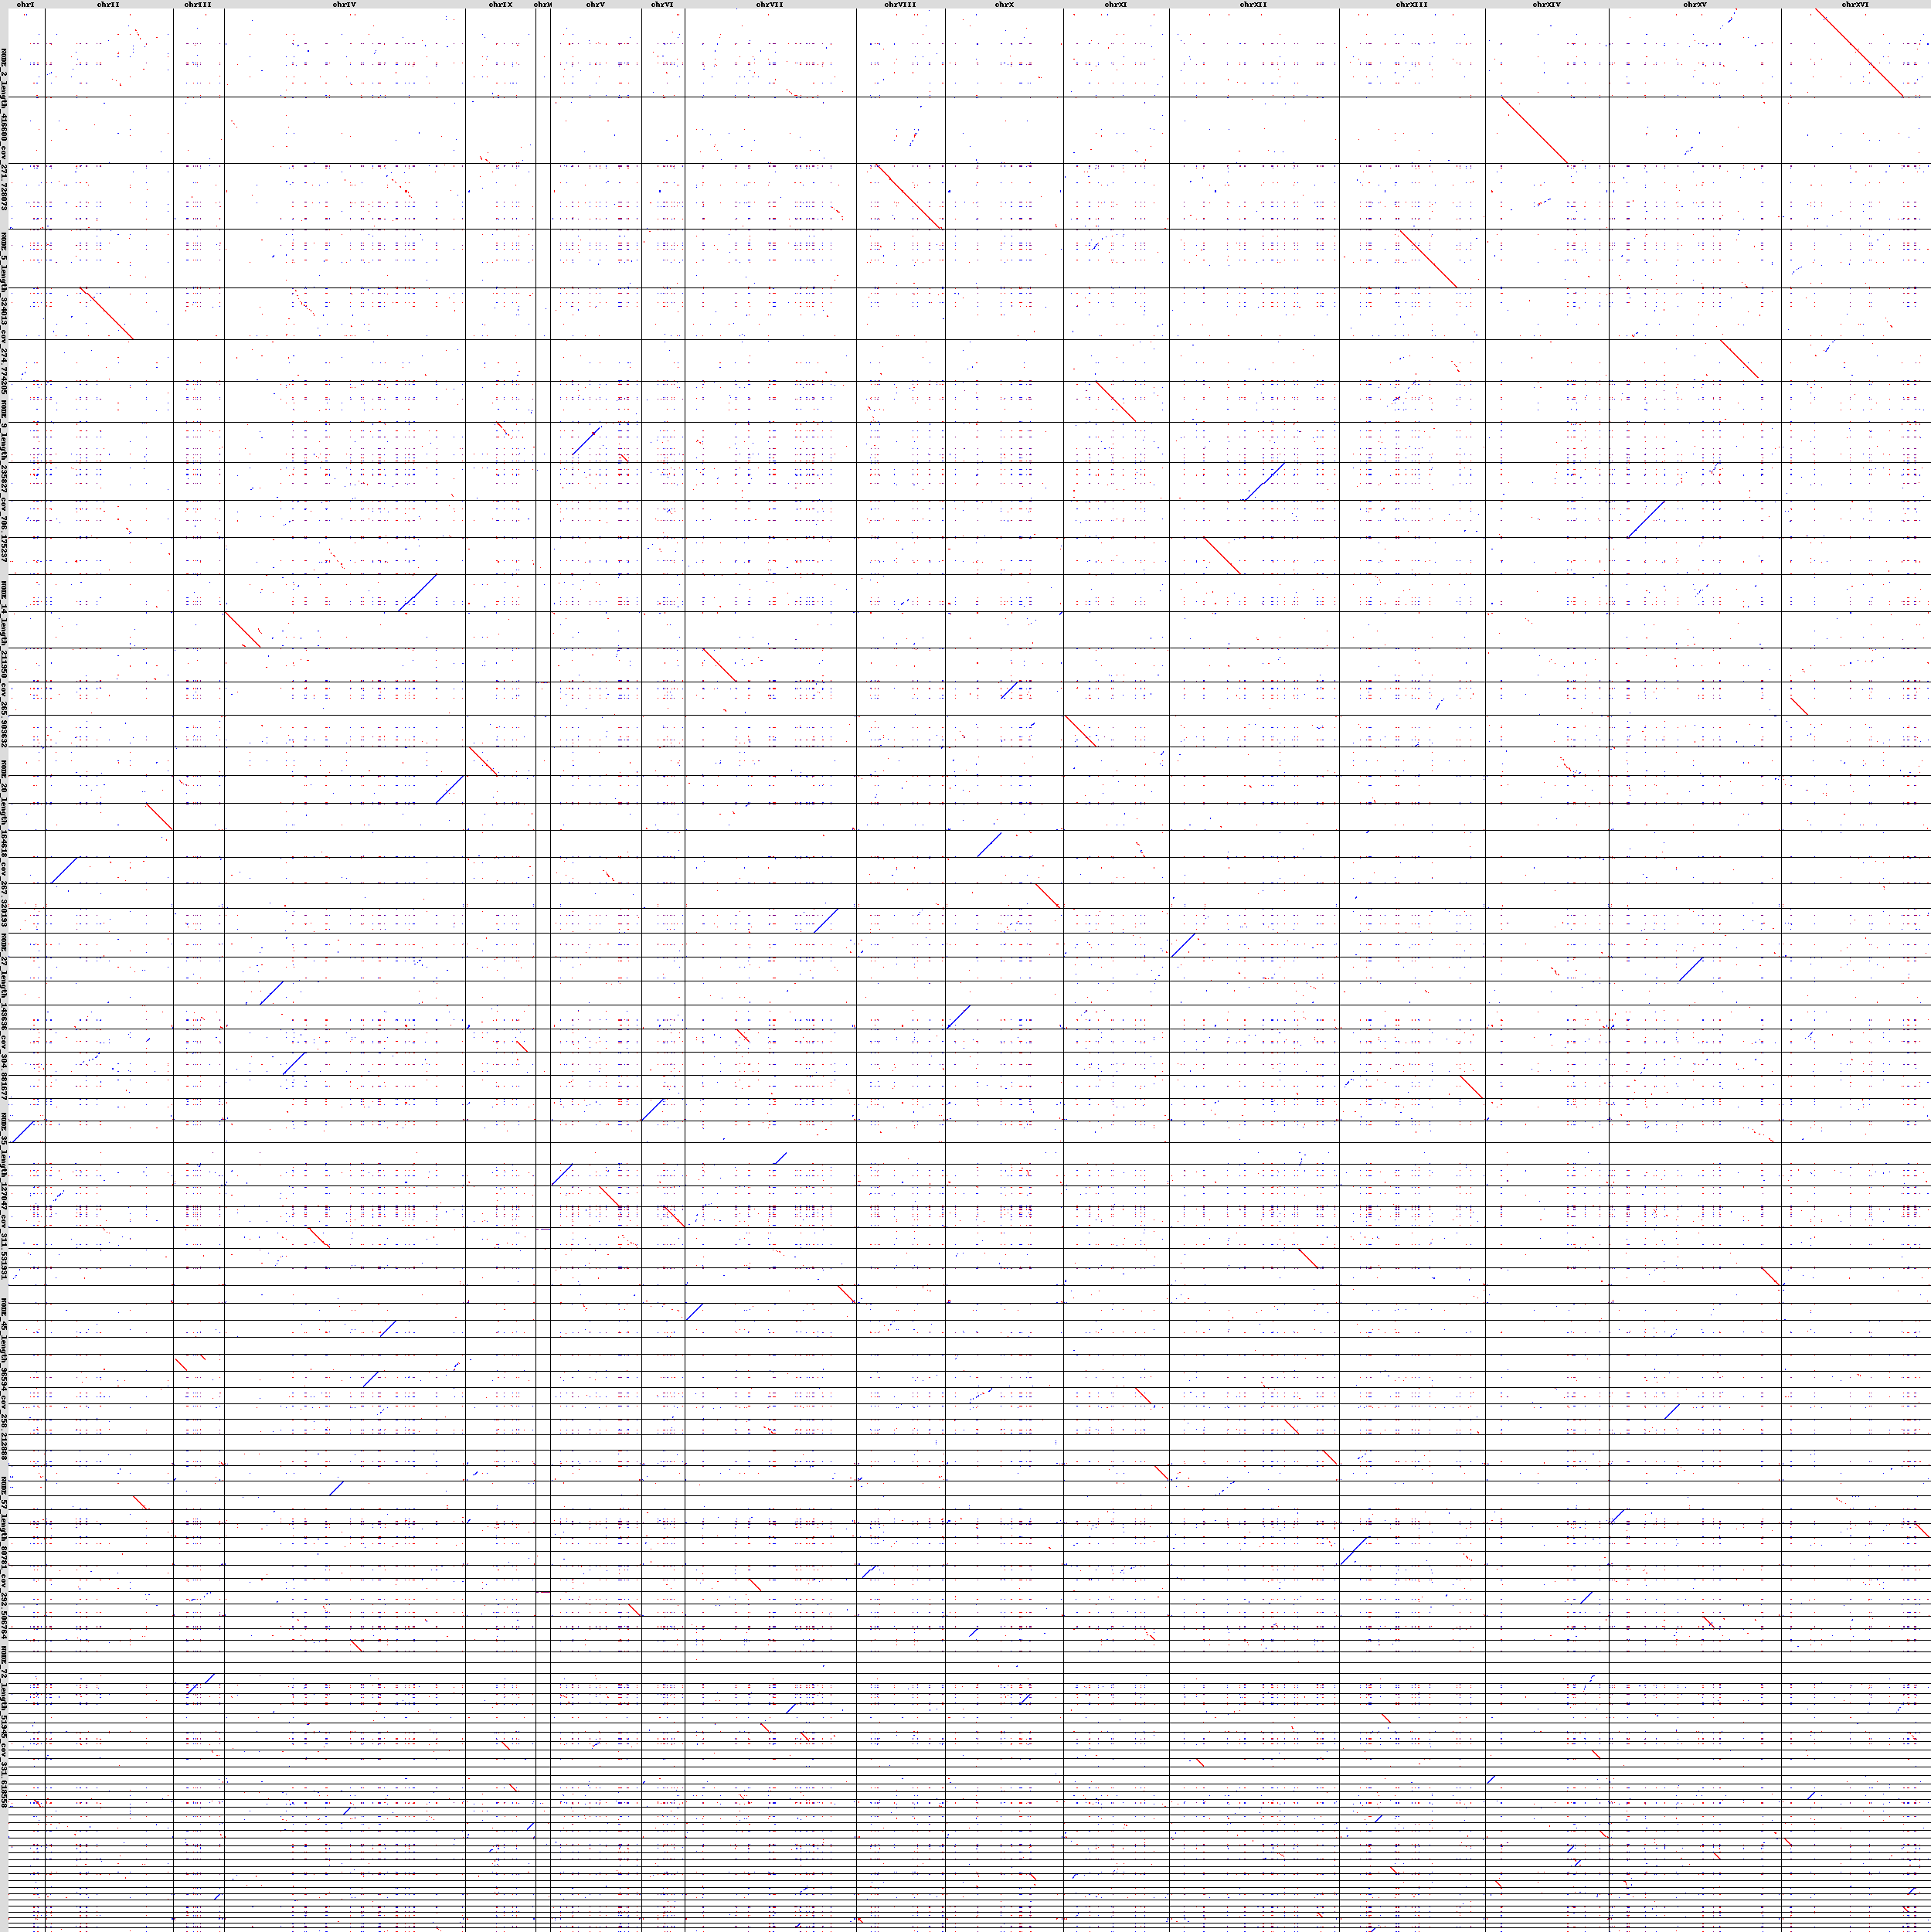
whole genome alignment against sacCer3

Slide 11
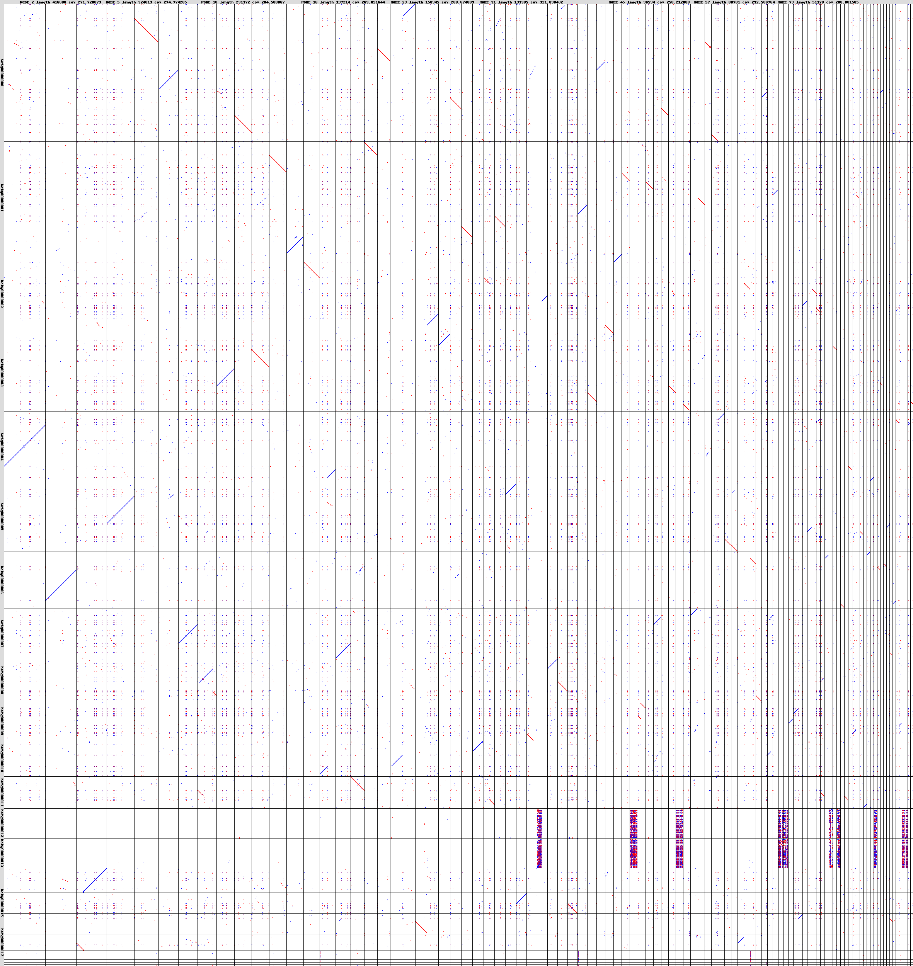
whole genome alignment against the NECAT assembly

Slide 12
SPAdes assembly Illumina only:
N50 34,470
NODE_1_length_125259_cov_264.502819 125259
NODE_2_length_124980_cov_278.791355 124980
NODE_3_length_121603_cov_269.775266 121603
NODE_4_length_112055_cov_339.881679 112055
NODE_5_length_110676_cov_244.957739 110676
NODE_6_length_107579_cov_260.590715 107579
NODE_7_length_102685_cov_251.435847 102685
NODE_8_length_96069_cov_264.200669 96069
NODE_9_length_95322_cov_265.567815 95322
NODE_10_length_94610_cov_259.480429 94610

Slide 13
SPAdes assembly Illumina + ONT + NECAT as trusted contigs
N50 361,639 bp
NODE_1_length_635429_cov_535.230310 635429
NODE_2_length_591528_cov_339.146962 591528
NODE_3_length_578907_cov_567.743736 578907
NODE_4_length_577267_cov_388.173784 577267
NODE_5_length_519707_cov_493.958617 519707
NODE_6_length_518279_cov_313.443229 518279
NODE_7_length_491309_cov_276.163712 491309
NODE_8_length_471186_cov_277.625418 471186
NODE_9_length_427514_cov_309.102679 427514
NODE_10_length_412351_cov_326.292513 412351
NODE_11_length_397030_cov_285.063425 397030
NODE_12_length_375451_cov_279.093658 375451
NODE_13_length_369321_cov_267.150369 369321
NODE_14_length_361639_cov_274.243166 361639
NODE_15_length_345757_cov_310.453605 345757
NODE_16_length_330076_cov_292.666961 330076
NODE_17_length_261094_cov_285.504495 261094
NODE_18_length_260115_cov_256.453688 260115
NODE_19_length_251113_cov_310.335341 251113
NODE_20_length_244809_cov_310.965181 244809
NODE_21_length_238063_cov_3534.724950 238063
NODE_22_length_236756_cov_308.451781 236756
NODE_23_length_219415_cov_550.835467 219415
NODE_24_length_196329_cov_437.542537 196329
NODE_25_length_184719_cov_286.156338 184719
NODE_26_length_176762_cov_495.501933 176762
NODE_27_length_167174_cov_685.479766 167174
NODE_28_length_164348_cov_444.778779 164348
NODE_29_length_135708_cov_1625.830199 135708
NODE_30_length_133388_cov_336.071850 133388
NODE_31_length_133295_cov_332.682625 133295
NODE_32_length_133288_cov_475.670307 133288
NODE_33_length_128538_cov_472.769152 128538
NODE_34_length_115653_cov_1009.856736 115653
NODE_35_length_114725_cov_323.455080 114725
NODE_36_length_103550_cov_274.350674 103550
NODE_37_length_102633_cov_373.677757 102633
This seems to actually break the contiguity…

Slide 14
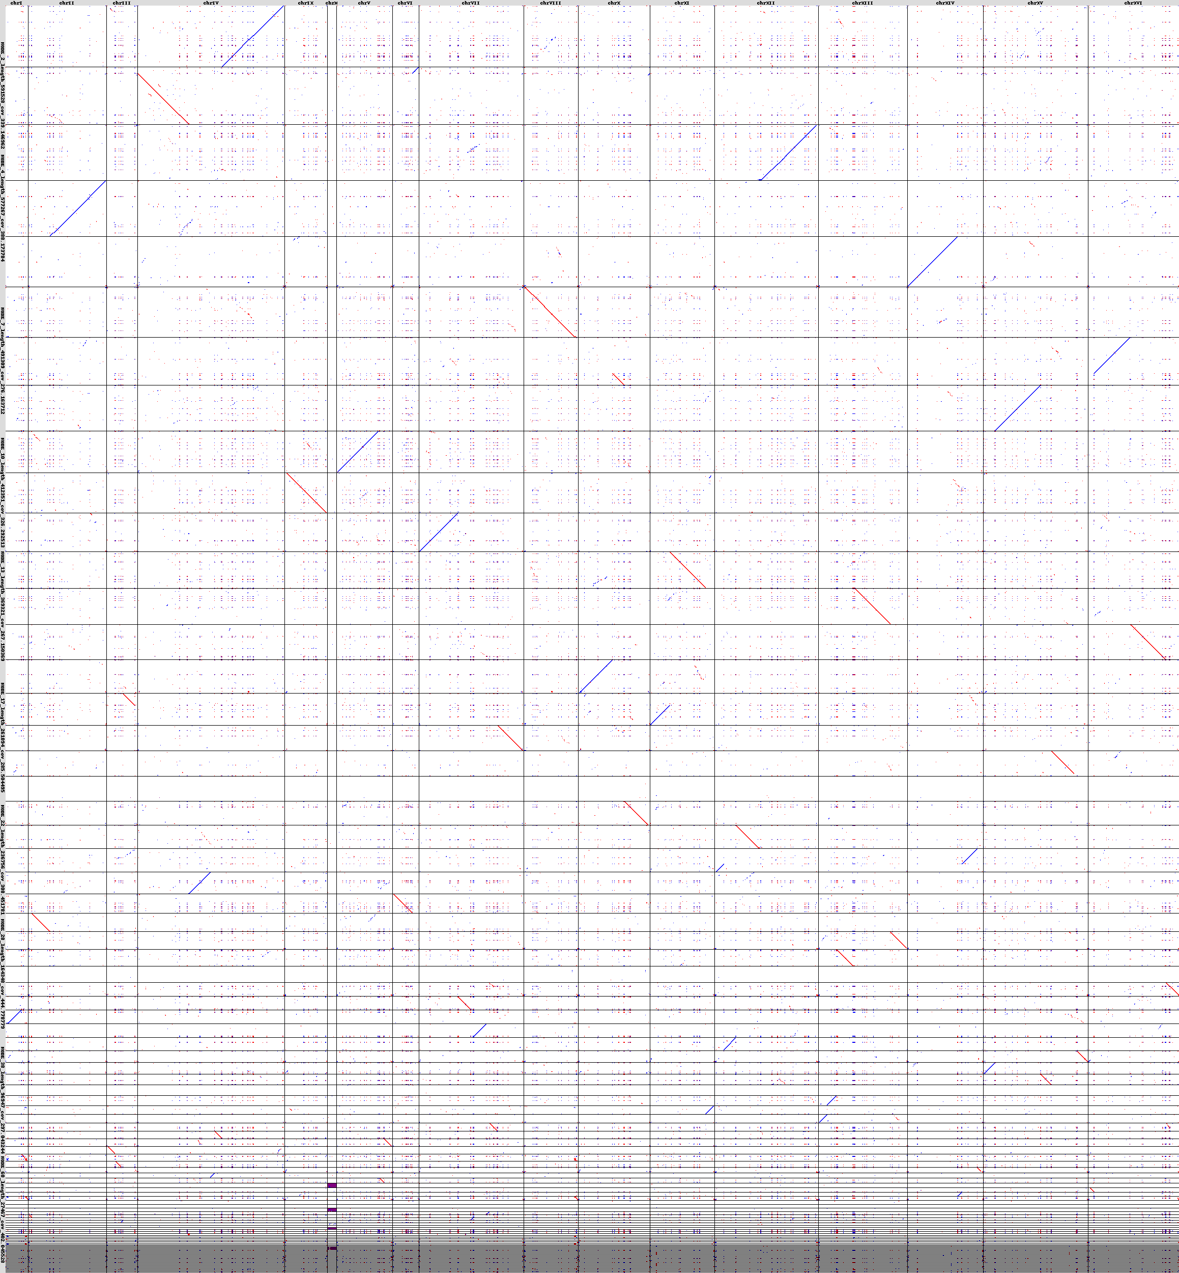
SPAdes assembly Illumina + ONT + NECAT as trusted contigs

