Slide 1
MAPPING STATS

Slide 3
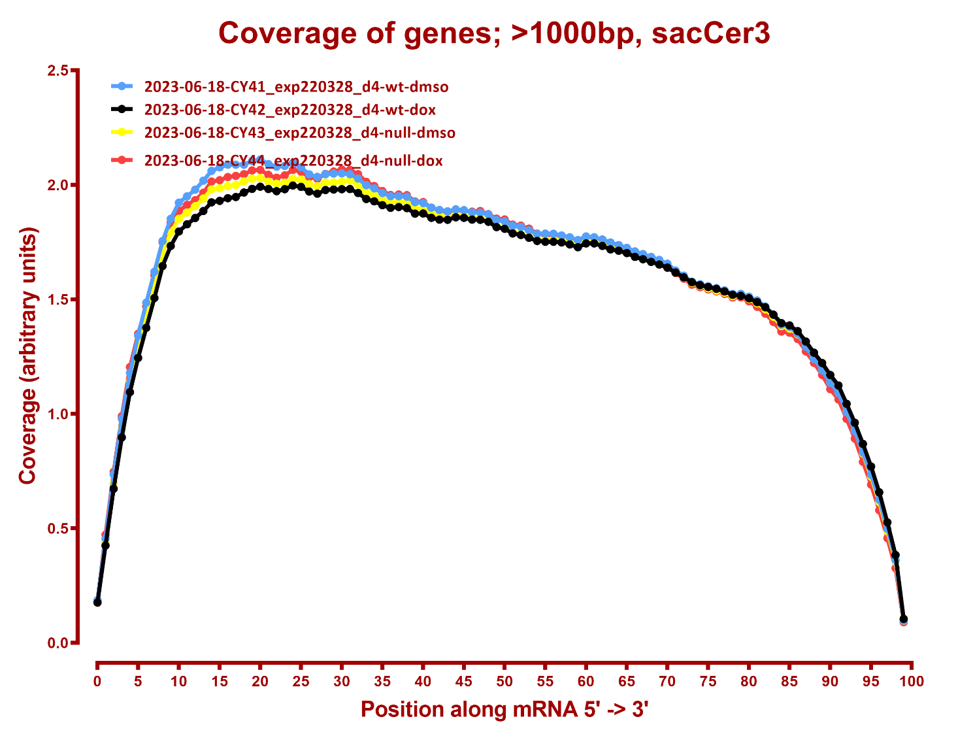
COVERAGE

Slide 4
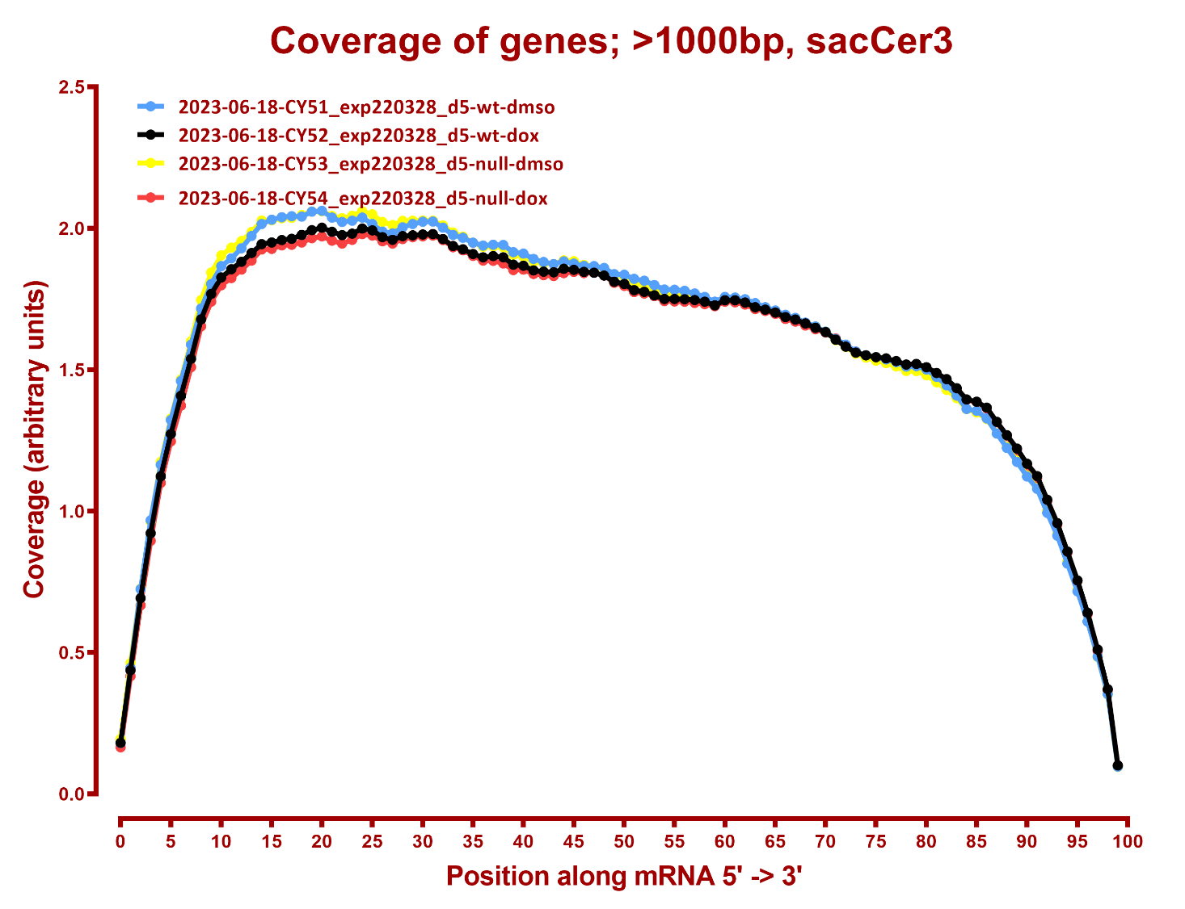

Slide 5
DESEQ SUMMARY
Number differential genes, hg38, 2023-06-18
A | B | p-adj |  | p-val
 |  | up in B vs A | down in B vs A | up in B vs A | down in B vs A
null-dmso | null-dox | 1,124 | 1,271 | 1,926 | 2,054
wt-dmso | null-dmso | 1,410 | 1,270 | 2,228 | 2,169
wt-dmso | null-dox | 2,797 | 2,811 | 3,516 | 3,472
wt-dmso | wt-dox | 1,077 | 964 | 1,899 | 1,867
wt-dox | null-dmso | 30 | 15 | 547 | 476
wt-dox | null-dox | 1,457 | 1,552 | 2,241 | 2,287
Number differential genes, hg38, 2023-06-18+2022-08-27
null-dmso | null-dox | 494 | 572 | 1478 | 1617
wt-dmso | null-dmso | 44 | 19 | 521 | 407
wt-dmso | null-dox | 982 | 1001 | 1946 | 1965
wt-dmso | wt-dox | 51 | 48 | 470 | 509
wt-dox | null-dmso | 141 | 97 | 881 | 780
wt-dox | null-dox | 1238 | 1280 | 2219 | 2293

