Slide 1
MAPPING STATS

Slide 2
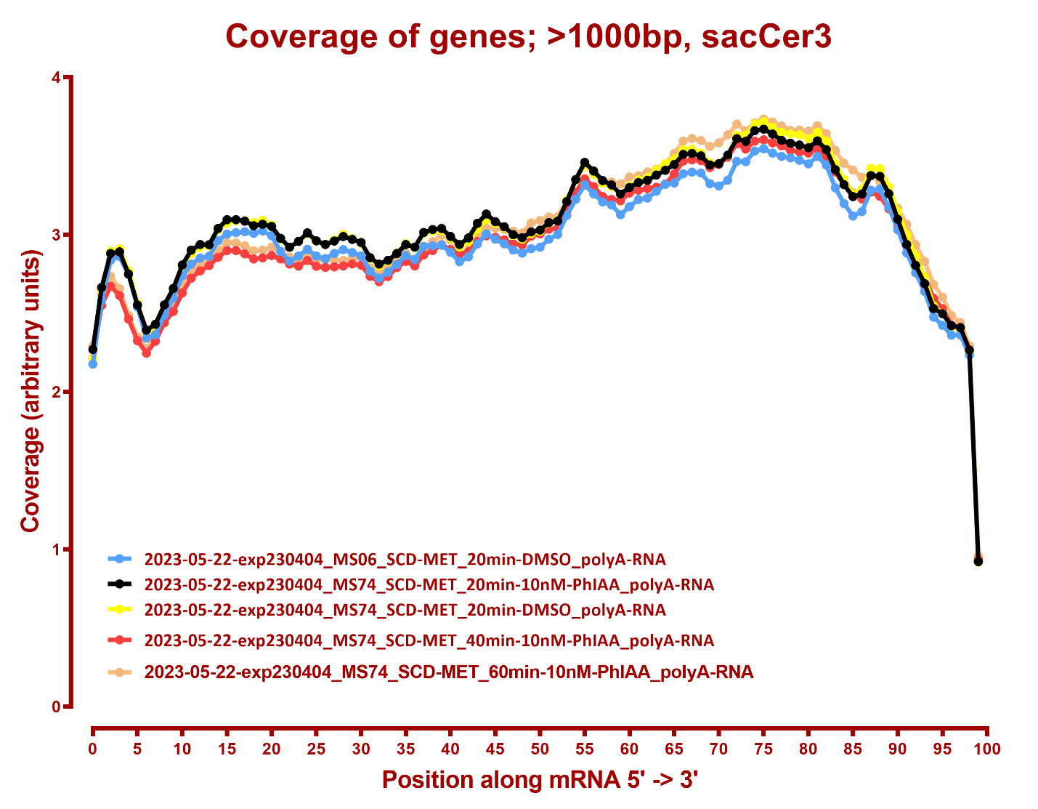
COVERAGE ALL READS

