Slide 1
MAPPING STATS

Slide 2
# | Exonic: | Intergenic: | Intronic:
2022-11-16-MS221107L01_MS95_SCGEuri_00nMBE_1hr-DMSO_input.STAR-2.5.3a.Schizosaccharomyces_pombe.ASM294v2.20 | 0.99 | 0.01 | 0.00
2022-11-16-MS221107L01_MS95_SCGEuri_00nMBE_1hr-DMSO_input.STAR-2.5.3a.sacCer3 | 0.90 | 0.09 | 0.00
2022-11-16-MS221107L02_MS95_SCGEuri_18nMBE_1hr-DMSO_input.STAR-2.5.3a.Schizosaccharomyces_pombe.ASM294v2.20 | 0.99 | 0.01 | 0.00
2022-11-16-MS221107L02_MS95_SCGEuri_18nMBE_1hr-DMSO_input.STAR-2.5.3a.sacCer3 | 0.91 | 0.09 | 0.00
2022-11-16-MS221107L03_MS95_SCGEuri_00nMBE_1hr-0.5uM-EU_input.STAR-2.5.3a.Schizosaccharomyces_pombe.ASM294v2.20 | 0.99 | 0.01 | 0.00
2022-11-16-MS221107L03_MS95_SCGEuri_00nMBE_1hr-0.5uM-EU_input.STAR-2.5.3a.sacCer3 | 0.90 | 0.10 | 0.00
2022-11-16-MS221107L04_MS95_SCGEuri_18nMBE_1hr-0.5uM-EU_input.STAR-2.5.3a.Schizosaccharomyces_pombe.ASM294v2.20 | 0.99 | 0.01 | 0.00
2022-11-16-MS221107L04_MS95_SCGEuri_18nMBE_1hr-0.5uM-EU_input.STAR-2.5.3a.sacCer3 | 0.91 | 0.09 | 0.00
2022-11-16-MS221107L05_MS95_SCGEuri_00nMBE_1hr-2uM-EU_input.STAR-2.5.3a.Schizosaccharomyces_pombe.ASM294v2.20 | 0.99 | 0.01 | 0.00
2022-11-16-MS221107L05_MS95_SCGEuri_00nMBE_1hr-2uM-EU_input.STAR-2.5.3a.sacCer3 | 0.90 | 0.09 | 0.00
2022-11-16-MS221107L06_MS95_SCGEuri_18nMBE_1hr-2uM-EU_input.STAR-2.5.3a.Schizosaccharomyces_pombe.ASM294v2.20 | 0.99 | 0.01 | 0.00
2022-11-16-MS221107L06_MS95_SCGEuri_18nMBE_1hr-2uM-EU_input.STAR-2.5.3a.sacCer3 | 0.91 | 0.09 | 0.00
2022-11-16-MS221107L07_MS95_SCGEuri_00nMBE_1hr-5uM-EU_input.STAR-2.5.3a.Schizosaccharomyces_pombe.ASM294v2.20 | 0.99 | 0.01 | 0.00
2022-11-16-MS221107L07_MS95_SCGEuri_00nMBE_1hr-5uM-EU_input.STAR-2.5.3a.sacCer3 | 0.90 | 0.09 | 0.00
2022-11-16-MS221107L08_MS95_SCGEuri_18nMBE_1hr-5uM-EU_input.STAR-2.5.3a.Schizosaccharomyces_pombe.ASM294v2.20 | 0.99 | 0.01 | 0.00
2022-11-16-MS221107L08_MS95_SCGEuri_18nMBE_1hr-5uM-EU_input.STAR-2.5.3a.sacCer3 | 0.91 | 0.09 | 0.00
2022-11-16-MS221107L09_MS95_SCGEuri_00nMBE_1hr-DMSO_EU-enrich.STAR-2.5.3a.Schizosaccharomyces_pombe.ASM294v2.20 | 0.99 | 0.01 | 0.00
2022-11-16-MS221107L09_MS95_SCGEuri_00nMBE_1hr-DMSO_EU-enrich.STAR-2.5.3a.sacCer3 | 0.88 | 0.12 | 0.00
2022-11-16-MS221107L10_MS95_SCGEuri_18nMBE_1hr-DMSO_EU-enrich.STAR-2.5.3a.Schizosaccharomyces_pombe.ASM294v2.20 | 0.99 | 0.01 | 0.00
2022-11-16-MS221107L10_MS95_SCGEuri_18nMBE_1hr-DMSO_EU-enrich.STAR-2.5.3a.sacCer3 | 0.90 | 0.10 | 0.00
2022-11-16-MS221107L11_MS95_SCGEuri_00nMBE_1hr-0.5uM-EU_EU-enrich.STAR-2.5.3a.Schizosaccharomyces_pombe.ASM294v2.20 | 0.99 | 0.01 | 0.00
2022-11-16-MS221107L11_MS95_SCGEuri_00nMBE_1hr-0.5uM-EU_EU-enrich.STAR-2.5.3a.sacCer3 | 0.92 | 0.08 | 0.00
2022-11-16-MS221107L12_MS95_SCGEuri_18nMBE_1hr-0.5uM-EU_EU-enrich.STAR-2.5.3a.Schizosaccharomyces_pombe.ASM294v2.20 | 0.99 | 0.01 | 0.00
2022-11-16-MS221107L12_MS95_SCGEuri_18nMBE_1hr-0.5uM-EU_EU-enrich.STAR-2.5.3a.sacCer3 | 0.92 | 0.08 | 0.00
2022-11-16-MS221107L13_MS95_SCGEuri_00nMBE_1hr-2uM-EU_EU-enrich.STAR-2.5.3a.Schizosaccharomyces_pombe.ASM294v2.20 | 0.99 | 0.01 | 0.00
2022-11-16-MS221107L13_MS95_SCGEuri_00nMBE_1hr-2uM-EU_EU-enrich.STAR-2.5.3a.sacCer3 | 0.92 | 0.08 | 0.00
2022-11-16-MS221107L14_MS95_SCGEuri_18nMBE_1hr-2uM-EU_EU-enrich.STAR-2.5.3a.Schizosaccharomyces_pombe.ASM294v2.20 | 0.99 | 0.01 | 0.00
2022-11-16-MS221107L14_MS95_SCGEuri_18nMBE_1hr-2uM-EU_EU-enrich.STAR-2.5.3a.sacCer3 | 0.92 | 0.08 | 0.00
2022-11-16-MS221107L15_MS95_SCGEuri_00nMBE_1hr-5uM-EU_EU-enrich.STAR-2.5.3a.Schizosaccharomyces_pombe.ASM294v2.20 | 0.99 | 0.01 | 0.00
2022-11-16-MS221107L15_MS95_SCGEuri_00nMBE_1hr-5uM-EU_EU-enrich.STAR-2.5.3a.sacCer3 | 0.92 | 0.08 | 0.00
2022-11-16-MS221107L16_MS95_SCGEuri_18nMBE_1hr-5uM-EU_EU-enrich.STAR-2.5.3a.Schizosaccharomyces_pombe.ASM294v2.20 | 0.99 | 0.01 | 0.00
2022-11-16-MS221107L16_MS95_SCGEuri_18nMBE_1hr-5uM-EU_EU-enrich.STAR-2.5.3a.sacCer3 | 0.92 | 0.08 | 0.00

Slide 3
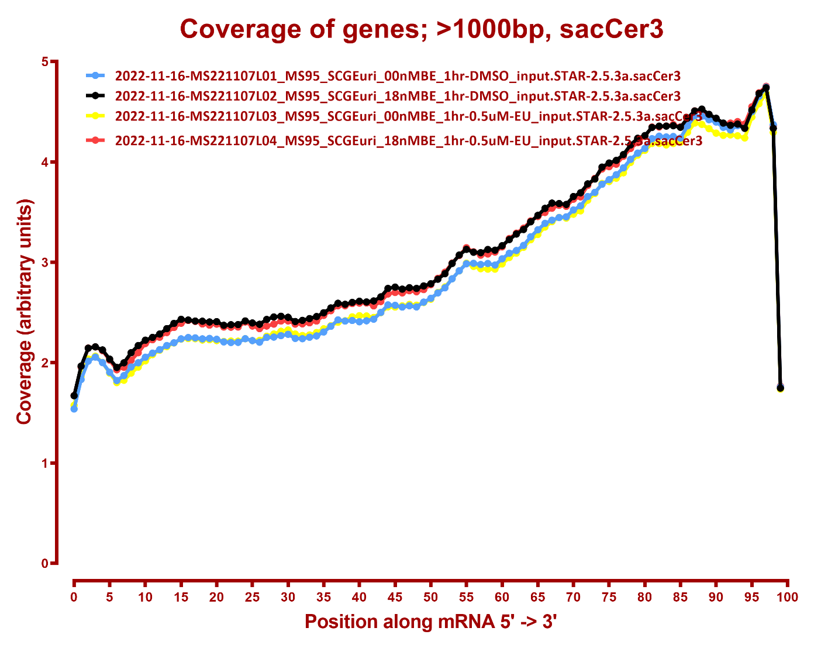
COVERAGE ALL READS

Slide 4
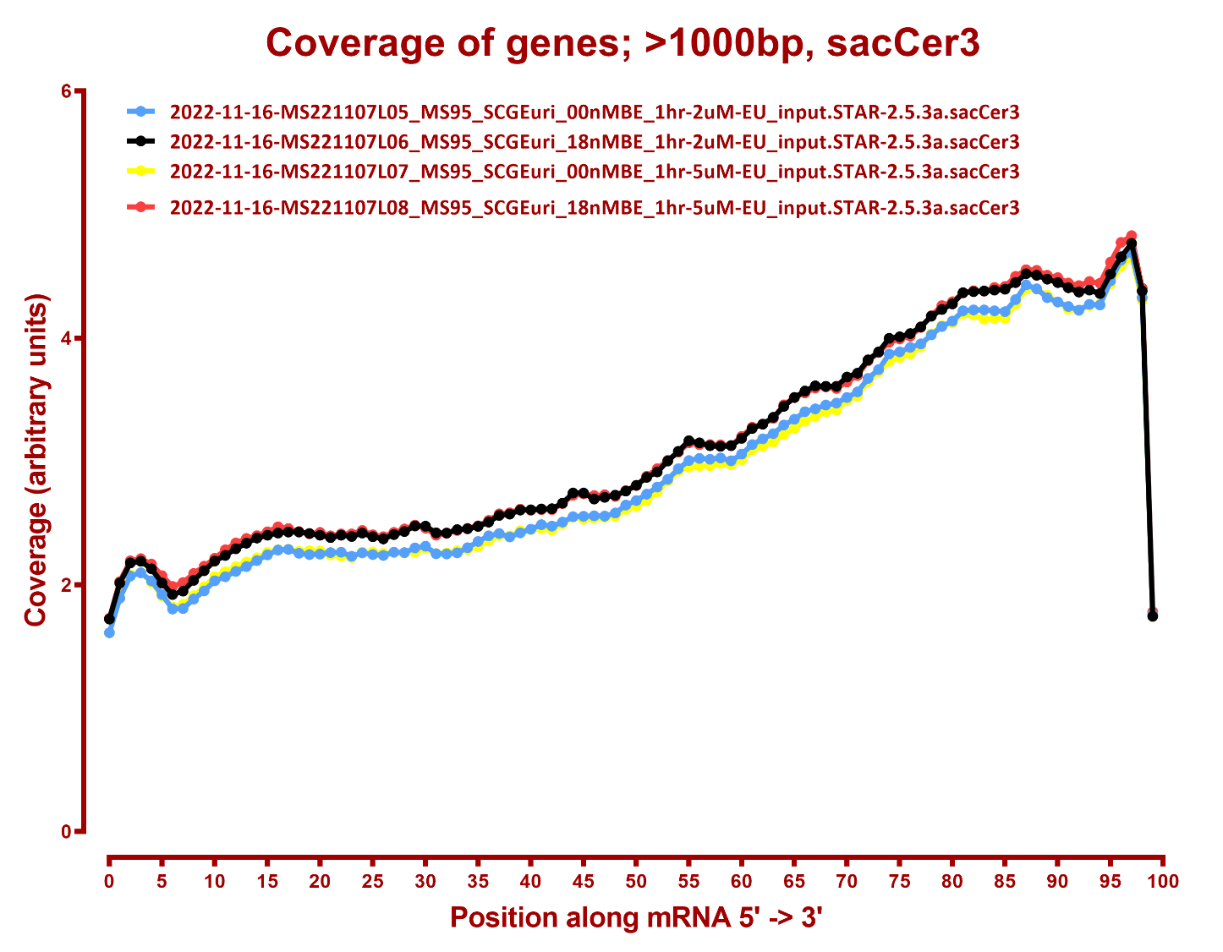

Slide 5
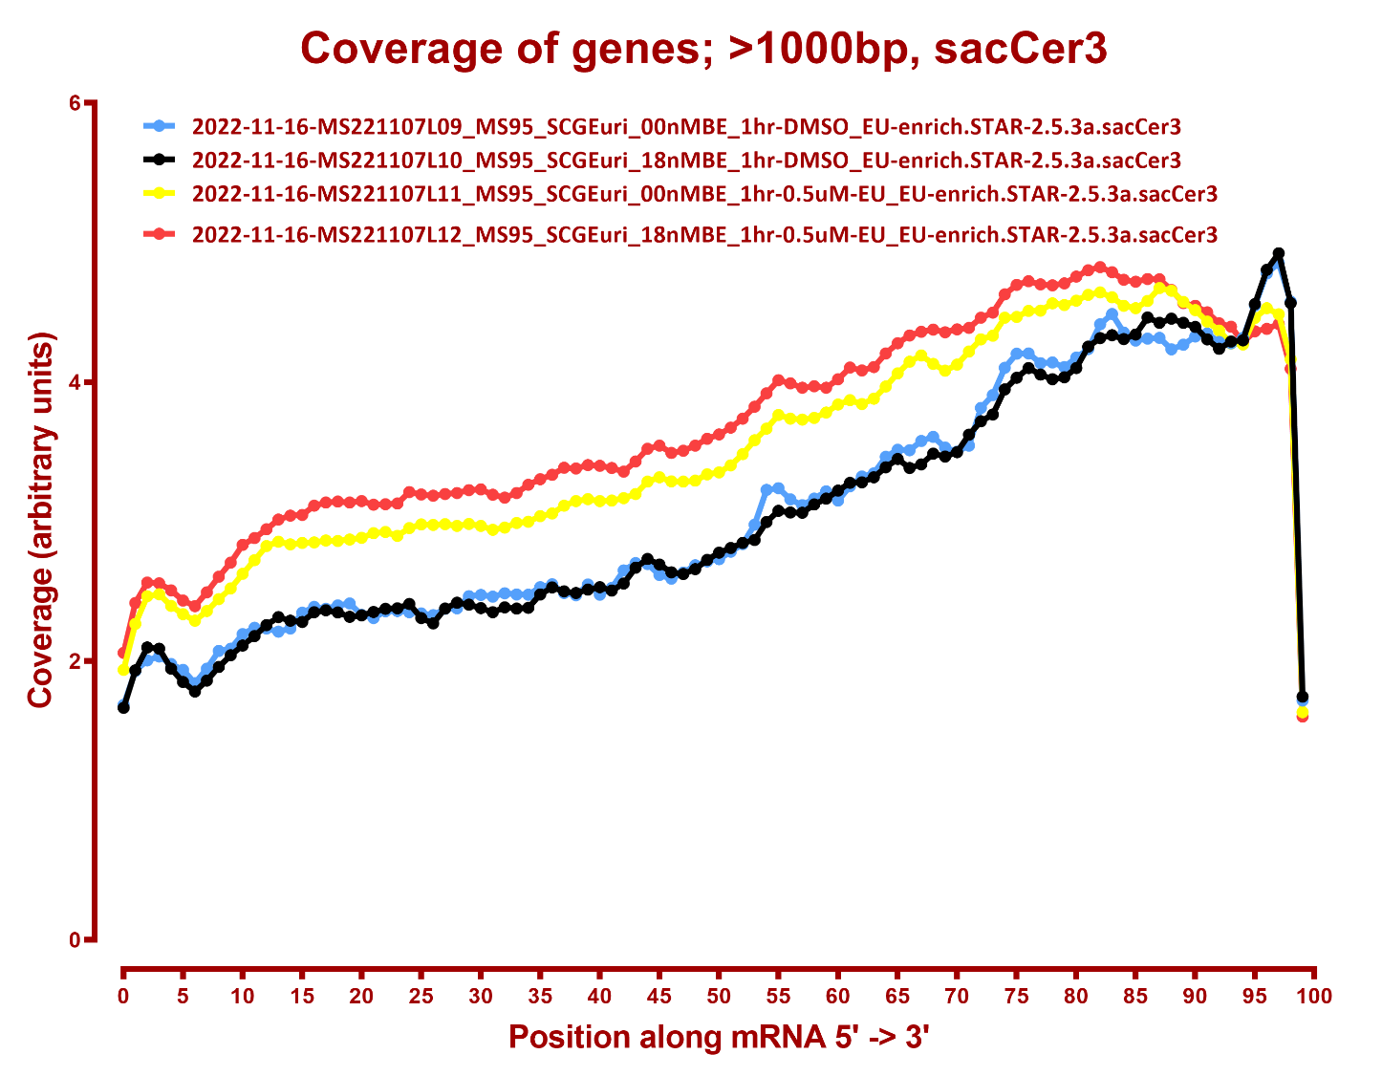

Slide 6
