Slide 1
MAPPING STATS

Slide 2
READ DISTRIBUTION

Slide 3
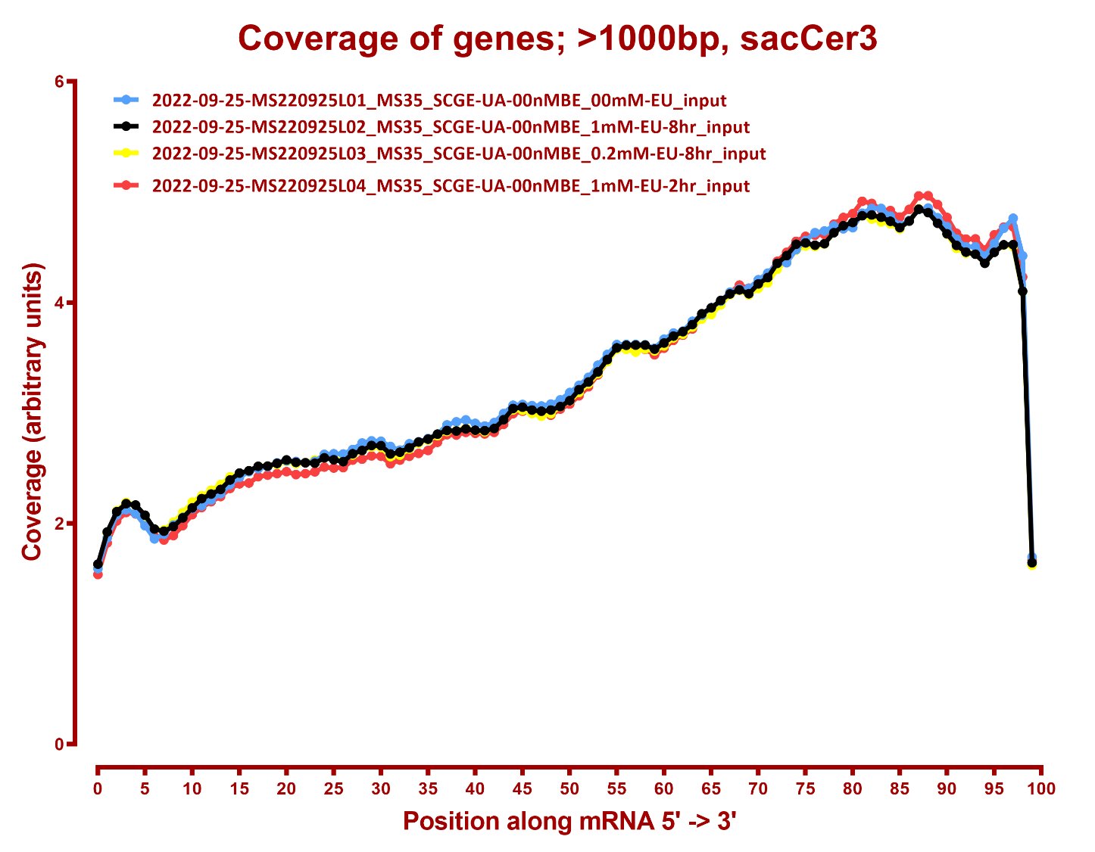
COVERAGE QC

Slide 4
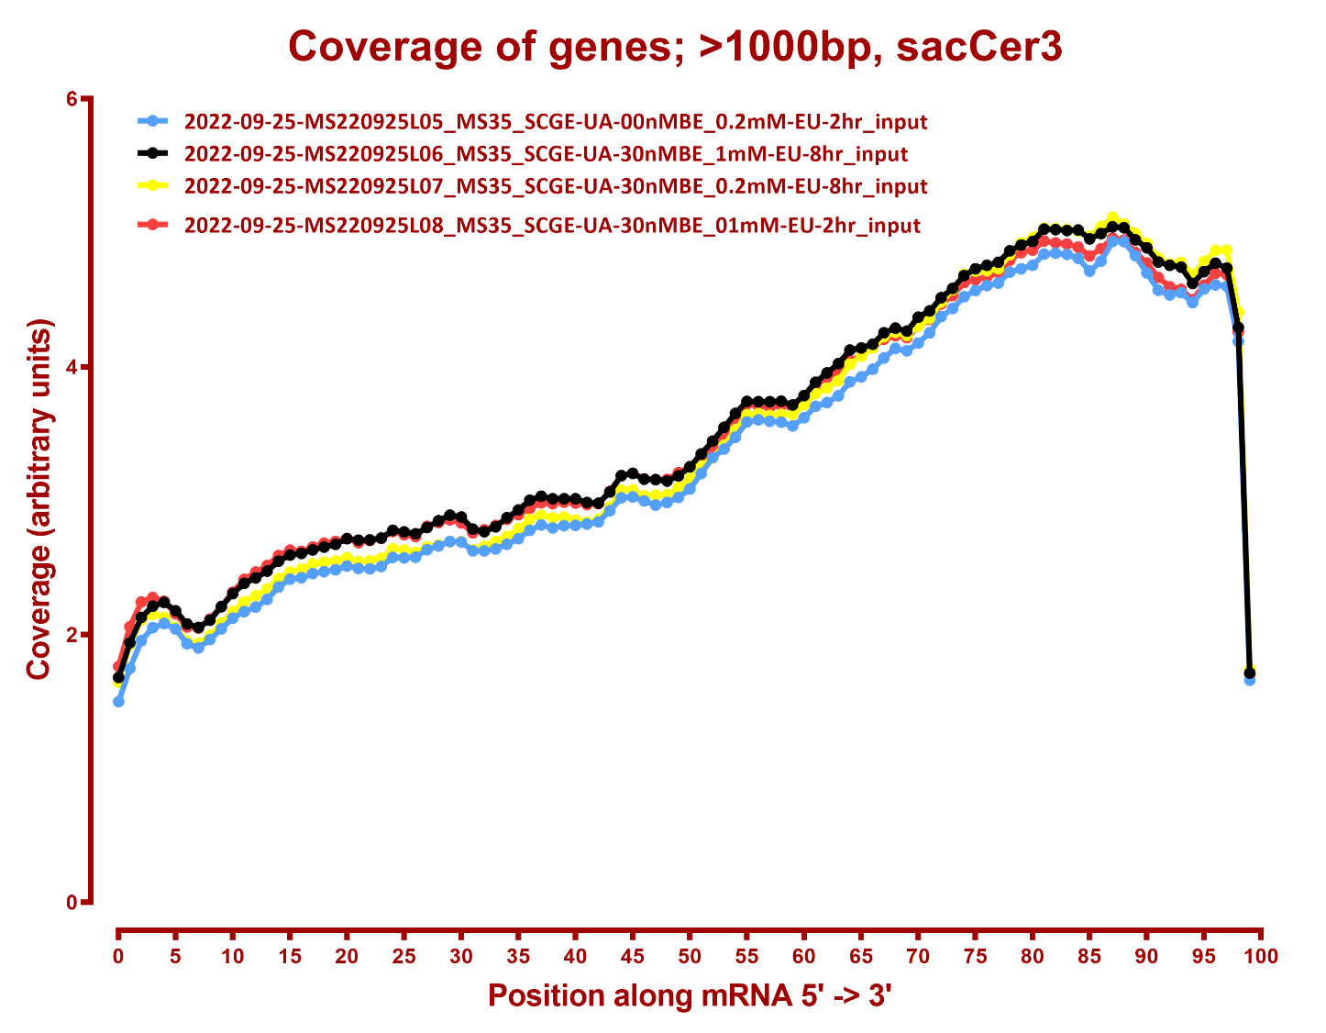

Slide 5
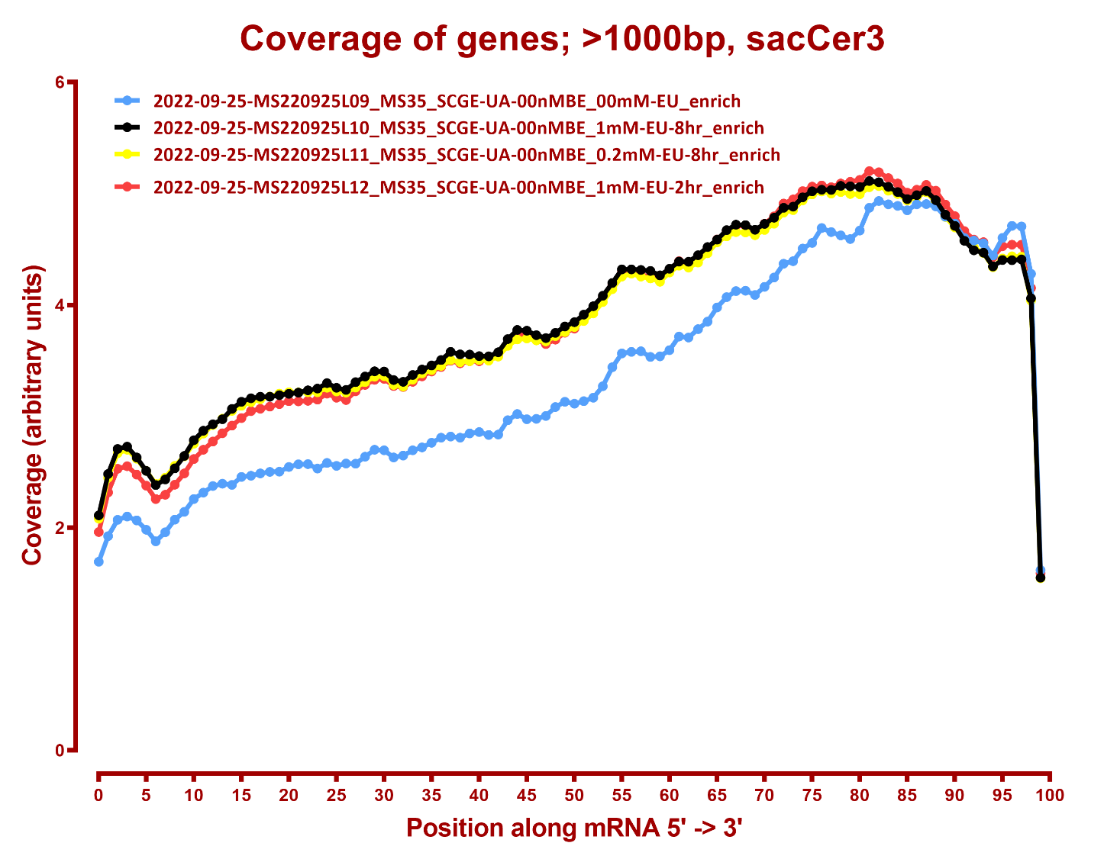

Slide 6
