Slide 1
MAPPING STATS

Slide 2
READ DISTRIBUTION
# | Exonic: | Intergenic: | Intronic:
2022-08-27-CY41_exp220328_d4-wt-dmso | 0.94 | 0.01 | 0.05
2022-08-27-CY42_exp220328_d4-wt-dox | 0.94 | 0.01 | 0.05
2022-08-27-CY43_exp220328_d4-null-dmso | 0.94 | 0.01 | 0.05
2022-08-27-CY44_exp220328_d4-null-dox | 0.95 | 0.01 | 0.04
2022-08-27-CY51_exp220328_d5-wt-dmso | 0.95 | 0.01 | 0.04
2022-08-27-CY52_exp220328_d5-wt-dox | 0.94 | 0.01 | 0.05
2022-08-27-CY53_exp220328_d5-null-dmso | 0.94 | 0.01 | 0.05
2022-08-27-CY54_exp220328_d5-null-dox | 0.95 | 0.01 | 0.04

Slide 3
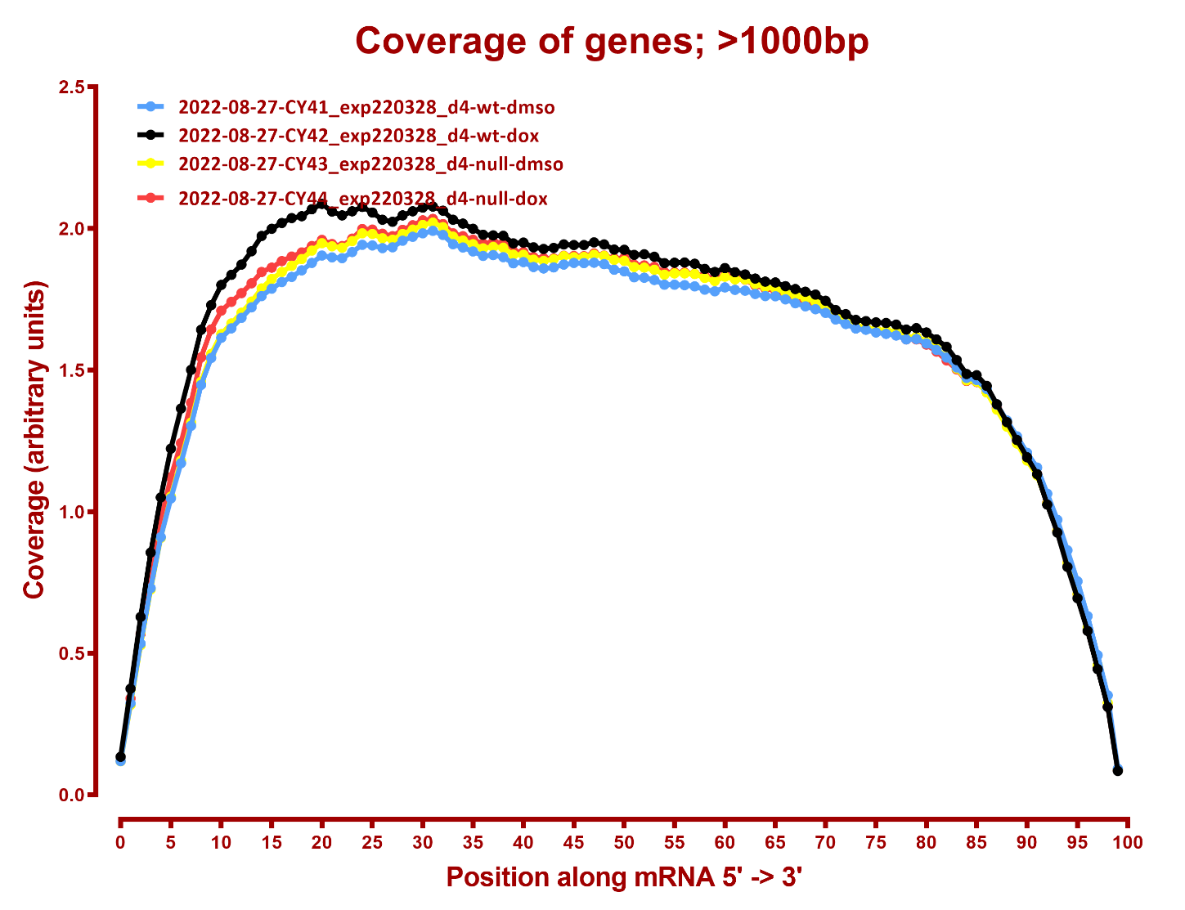
COVERAGE QC

Slide 4
