Slide 1
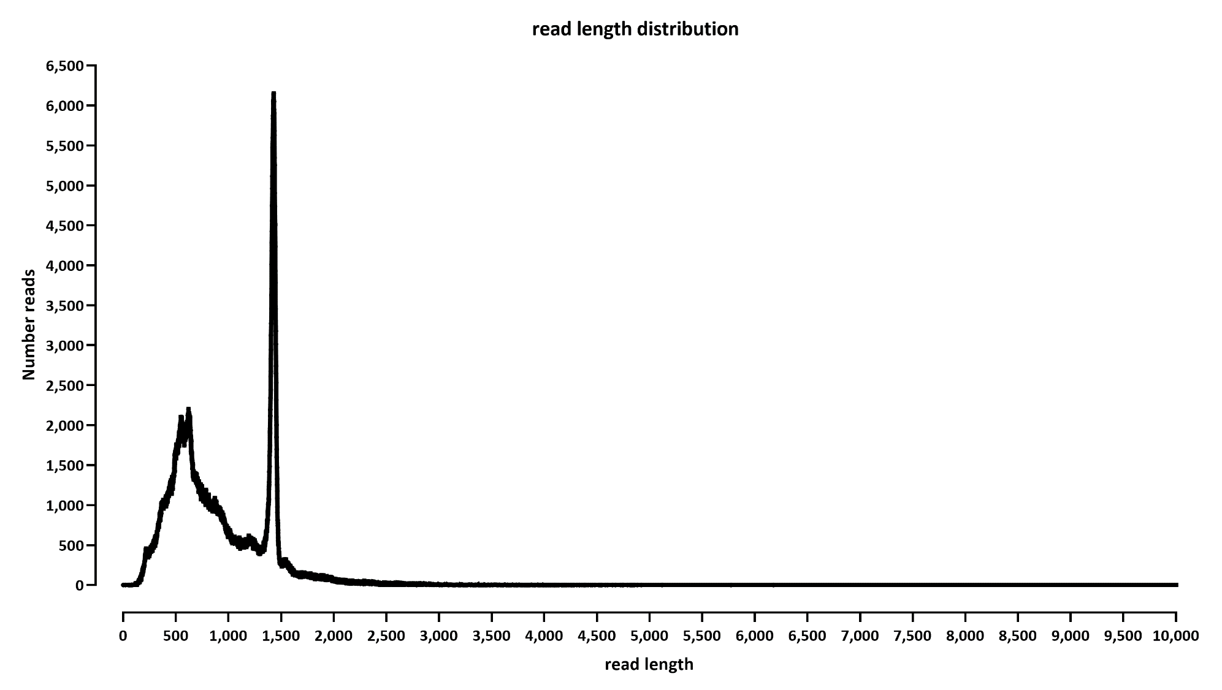
READ LENGTH DISTRIBUTION

Slide 2
PIPELINE:
guppy for rebasecalling
tailfindr on the Guppy FAST5 files
Minimap2 alignment against the transcriptome
tailfindr for annotating tails with transcripts
Post-processing by me to get TPMs.
  Note that TPMs include the reads that aligned, but for which there was no tail length output by tailfindr (that was 1.5% of reads)

Slide 3
Note: when counting transcripts, the ENO2 gene came up at 325,861 TPMs, i.e. a third of the reads
The length of its RNA is 1,447 nt in the annotation, so it matches the peak in the read length distribution

Slide 4
