Slide 1
MAPPING STATS

Slide 2
# | Exonic: | Intergenic: | Intronic:
2021-07-13-210603L01_exp210531_MS207_SCD_ribofree-RNA | 0.93 | 0.07 | 0.00
2021-07-13-210603L02_exp210531_MS208_SCD_ribofree-RNA | 0.93 | 0.07 | 0.00
2021-07-13-210603L03_exp210531_MS294_SCD_ribofree-RNA | 0.93 | 0.07 | 0.00
2021-07-13-210603L04_exp210531_MS207_SCD_RAPA-40min_ribofree-RNA | 0.92 | 0.07 | 0.00
2021-07-13-210603L05_exp210531_MS208_SCD_RAPA-40min_ribofree-RNA | 0.93 | 0.07 | 0.00
2021-07-13-210603L06_exp210531_MS294_SCD_RAPA-40min_ribofree-RNA | 0.93 | 0.07 | 0.00
2021-07-13-210603L07_exp210531_MS207_SCD_RAPA-60min_ribofree-RNA | 0.93 | 0.07 | 0.00
2021-07-13-210603L08_exp210531_MS208_SCD_RAPA-60min_ribofree-RNA | 0.93 | 0.07 | 0.00
2021-07-13-210603L09_exp210531_MS294_SCD_RAPA-60min_ribofree-RNA | 0.92 | 0.07 | 0.00
2021-07-13-210603L10_exp210531_MS207_SCD_RAPA-24hr_ribofree-RNA | 0.93 | 0.07 | 0.00
2021-07-13-210603L11_exp210531_MS208_SCD_RAPA-24hr_ribofree-RNA | 0.93 | 0.07 | 0.00
2021-07-13-210603L12_exp210531_MS295_SCD_RAPA-24hr_ribofree-RNA | 0.93 | 0.07 | 0.00

Slide 3
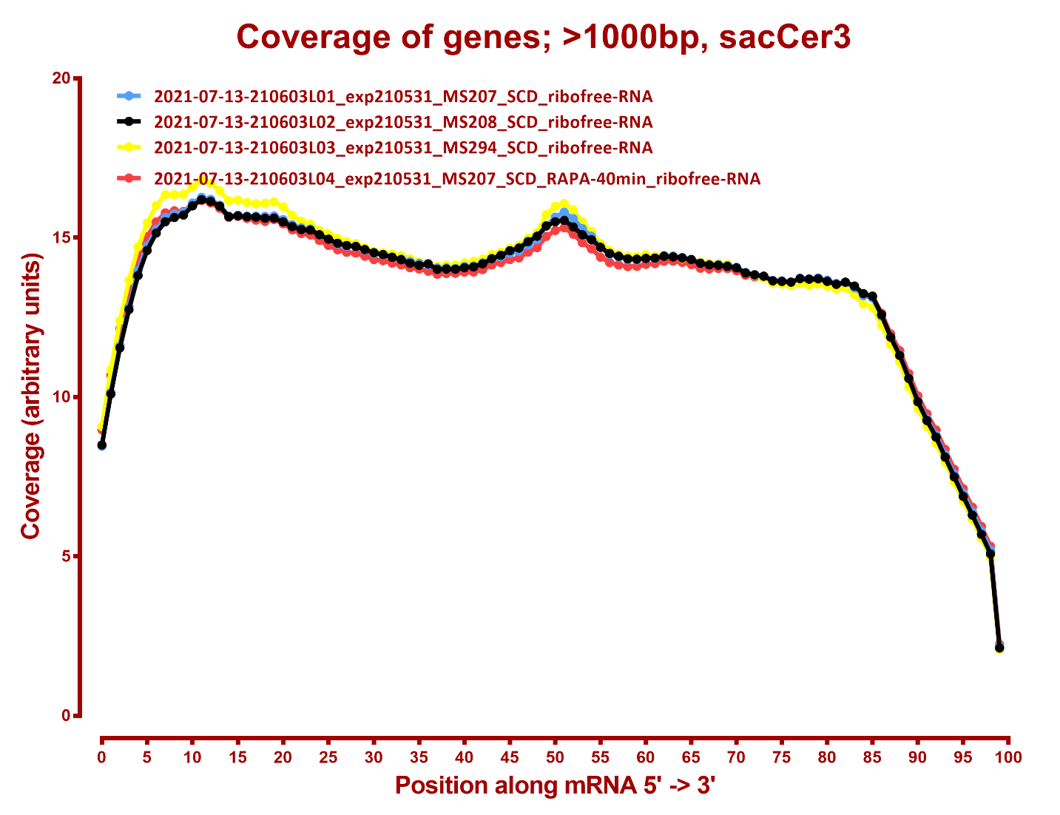
COVERAGE QC

Slide 4
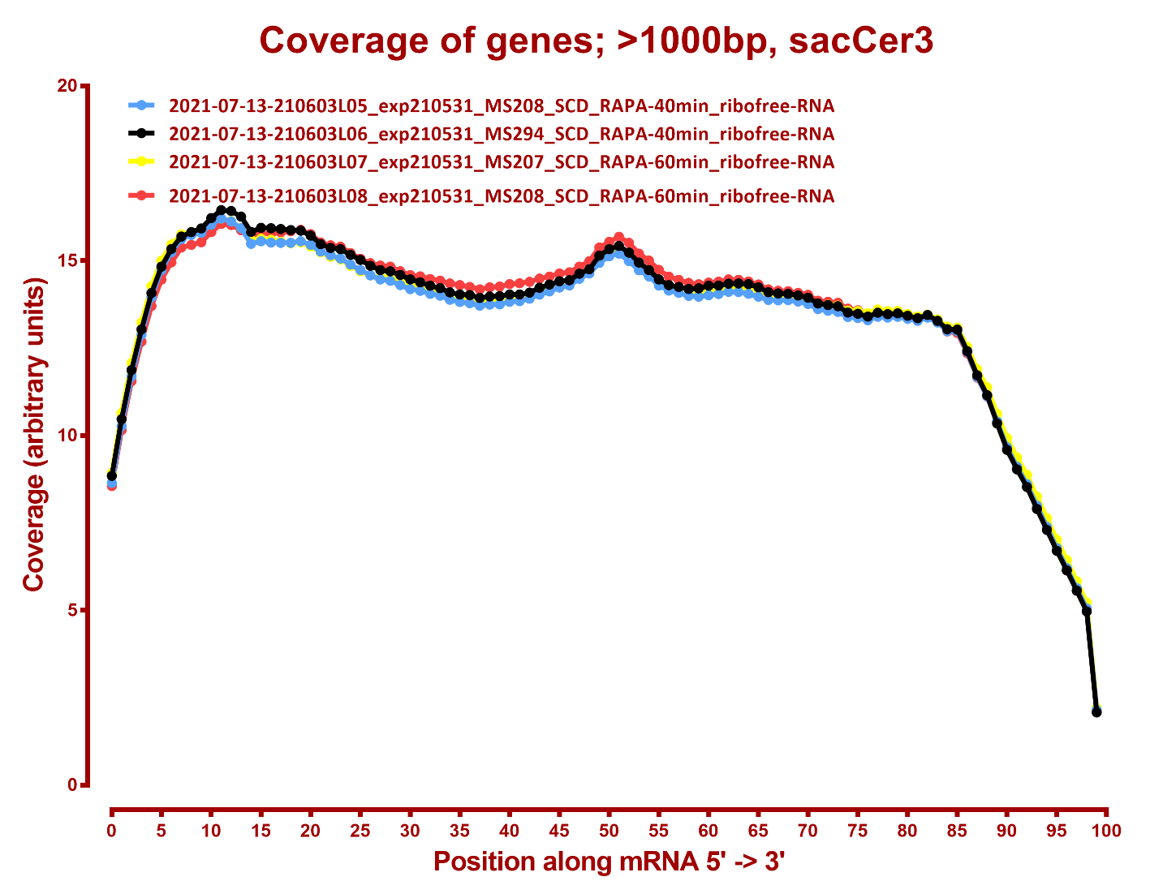

Slide 5
