Slide 1
Mapping stats
Cln3 Whi5 switched!!!

Slide 2
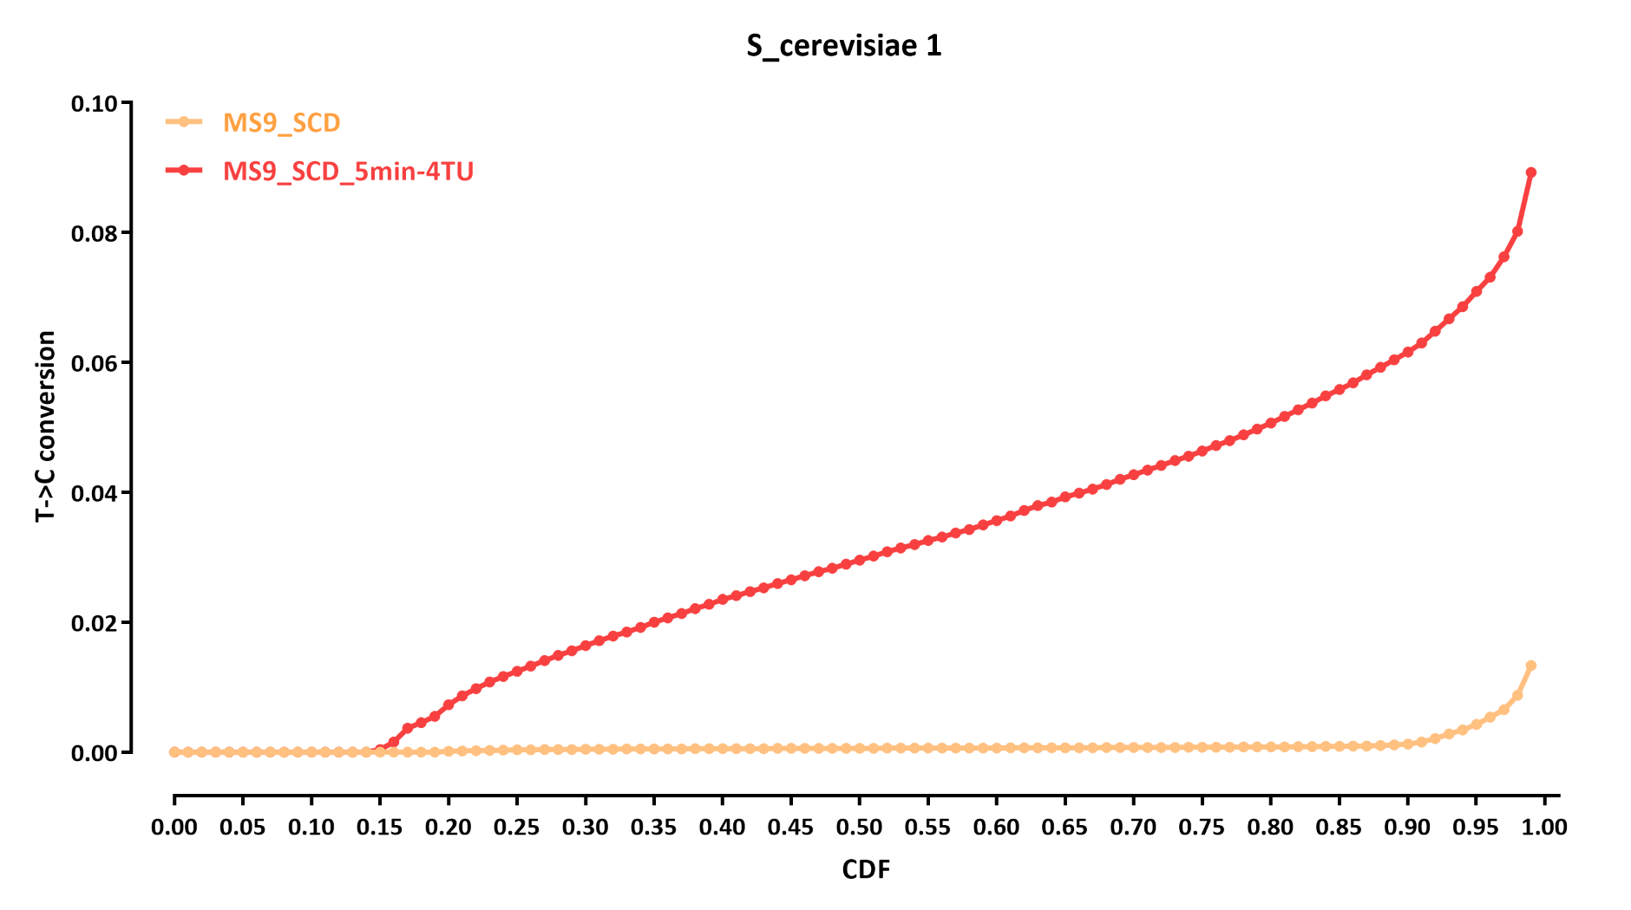
Conversion
Cln3 Whi5 switched!!!

