Slide 1
MAPPING STATS

Slide 2
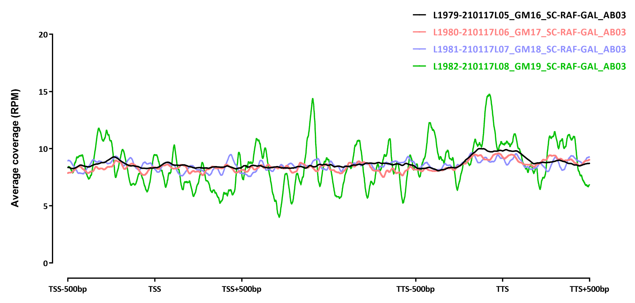

Slide 3
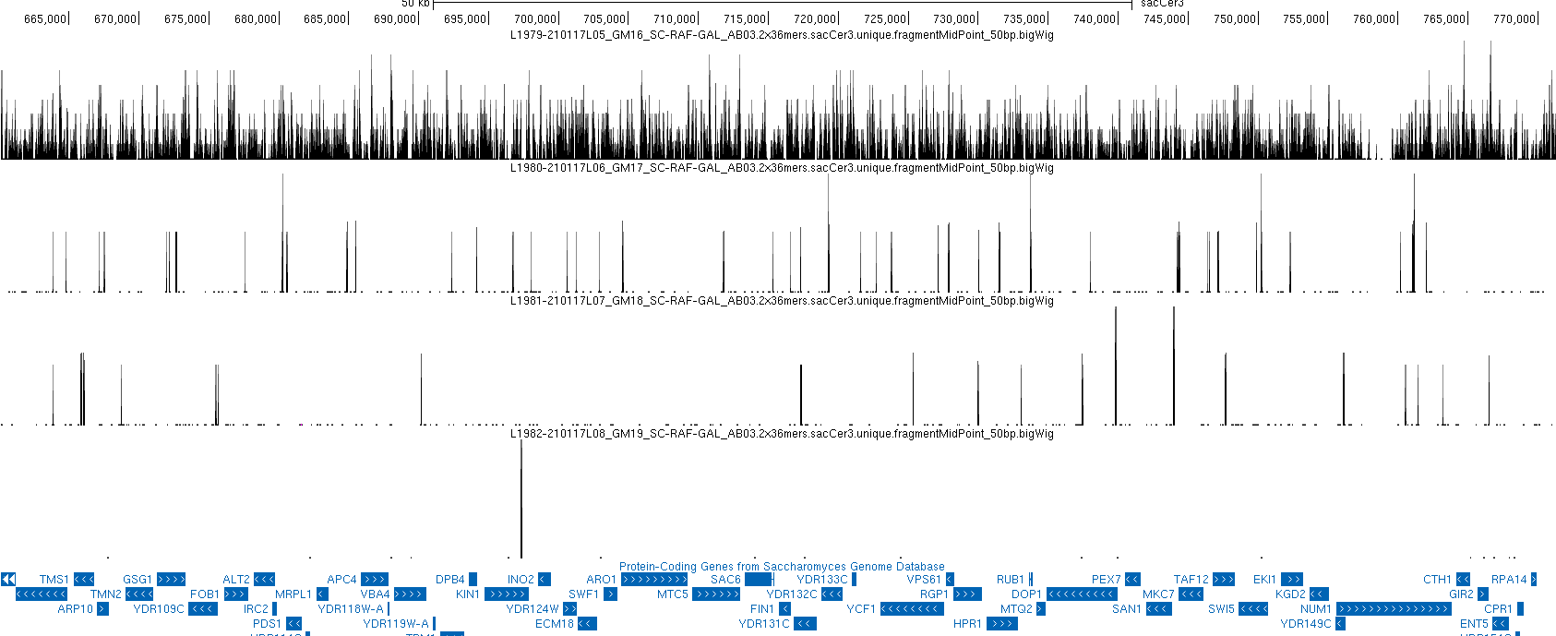
SNAPSHOTS

Slide 4
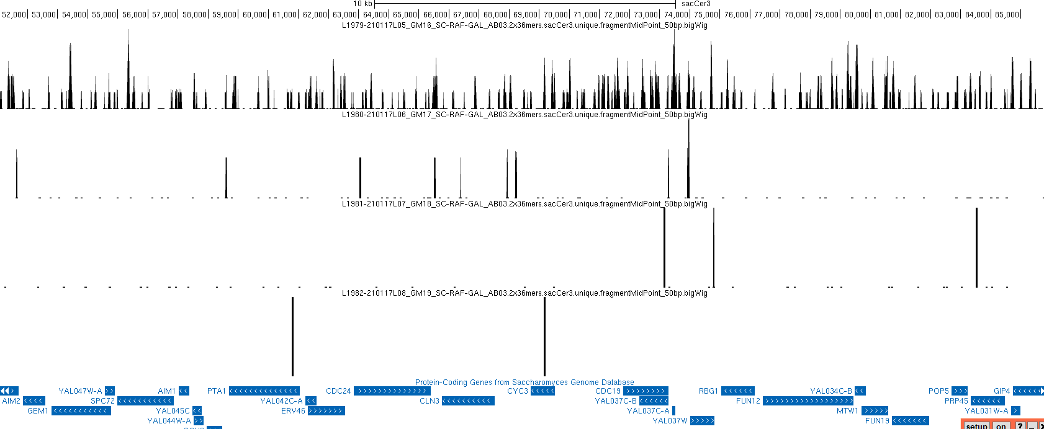
SNAPSHOTS

