Slide 1
MAPPING STATS

Slide 2
READ DISTRIBUTION
# | Exonic: | Intergenic: | Intronic:
2020-11-05-201016L01_MS214_SCGE_RAPA-00min.Schizosaccharomyces_pombe.ASM294v2.20 | 0.99 | 0.01 | 0.00
2020-11-05-201016L01_MS214_SCGE_RAPA-00min.sacCer3 | 0.91 | 0.09 | 0.00
2020-11-05-201016L02_MS214_SCGE_RAPA-10min.Schizosaccharomyces_pombe.ASM294v2.20 | 0.99 | 0.01 | 0.00
2020-11-05-201016L02_MS214_SCGE_RAPA-10min.sacCer3 | 0.91 | 0.09 | 0.00
2020-11-05-201016L03_MS214_SCGE_RAPA-20min.Schizosaccharomyces_pombe.ASM294v2.20 | 0.99 | 0.01 | 0.00
2020-11-05-201016L03_MS214_SCGE_RAPA-20min.sacCer3 | 0.91 | 0.09 | 0.00
2020-11-05-201016L04_MS214_SCGE_RAPA-40min.Schizosaccharomyces_pombe.ASM294v2.20 | 0.99 | 0.01 | 0.00
2020-11-05-201016L04_MS214_SCGE_RAPA-40min.sacCer3 | 0.91 | 0.09 | 0.00
2020-11-05-201016L05_MS214_SCGE_RAPA-60min.Schizosaccharomyces_pombe.ASM294v2.20 | 0.99 | 0.01 | 0.00
2020-11-05-201016L05_MS214_SCGE_RAPA-60min.sacCer3 | 0.90 | 0.10 | 0.00
2020-11-05-201016L06_MS214_SCGE_RAPA-90min.Schizosaccharomyces_pombe.ASM294v2.20 | 0.99 | 0.01 | 0.00
2020-11-05-201016L06_MS214_SCGE_RAPA-90min.sacCer3 | 0.90 | 0.10 | 0.00
2020-11-05-201016L07_MS215_SCGE_RAPA-00min.Schizosaccharomyces_pombe.ASM294v2.20 | 0.99 | 0.01 | 0.00
2020-11-05-201016L07_MS215_SCGE_RAPA-00min.sacCer3 | 0.91 | 0.09 | 0.00
2020-11-05-201016L08_MS215_SCGE_RAPA-10min.Schizosaccharomyces_pombe.ASM294v2.20 | 0.99 | 0.01 | 0.00
2020-11-05-201016L08_MS215_SCGE_RAPA-10min.sacCer3 | 0.91 | 0.09 | 0.00
2020-11-05-201016L09_MS215_SCGE_RAPA-20min.Schizosaccharomyces_pombe.ASM294v2.20 | 0.99 | 0.01 | 0.00
2020-11-05-201016L09_MS215_SCGE_RAPA-20min.sacCer3 | 0.91 | 0.09 | 0.00
2020-11-05-201016L10_MS215_SCGE_RAPA-40min.Schizosaccharomyces_pombe.ASM294v2.20 | 0.99 | 0.01 | 0.00
2020-11-05-201016L10_MS215_SCGE_RAPA-40min.sacCer3 | 0.90 | 0.09 | 0.00
2020-11-05-201016L11_MS215_SCGE_RAPA-60min.Schizosaccharomyces_pombe.ASM294v2.20 | 0.99 | 0.01 | 0.00
2020-11-05-201016L11_MS215_SCGE_RAPA-60min.sacCer3 | 0.90 | 0.10 | 0.00
2020-11-05-201016L12_MS215_SCGE_RAPA-90min.Schizosaccharomyces_pombe.ASM294v2.20 | 0.99 | 0.01 | 0.00
2020-11-05-201016L12_MS215_SCGE_RAPA-90min.sacCer3 | 0.90 | 0.10 | 0.00

Slide 3
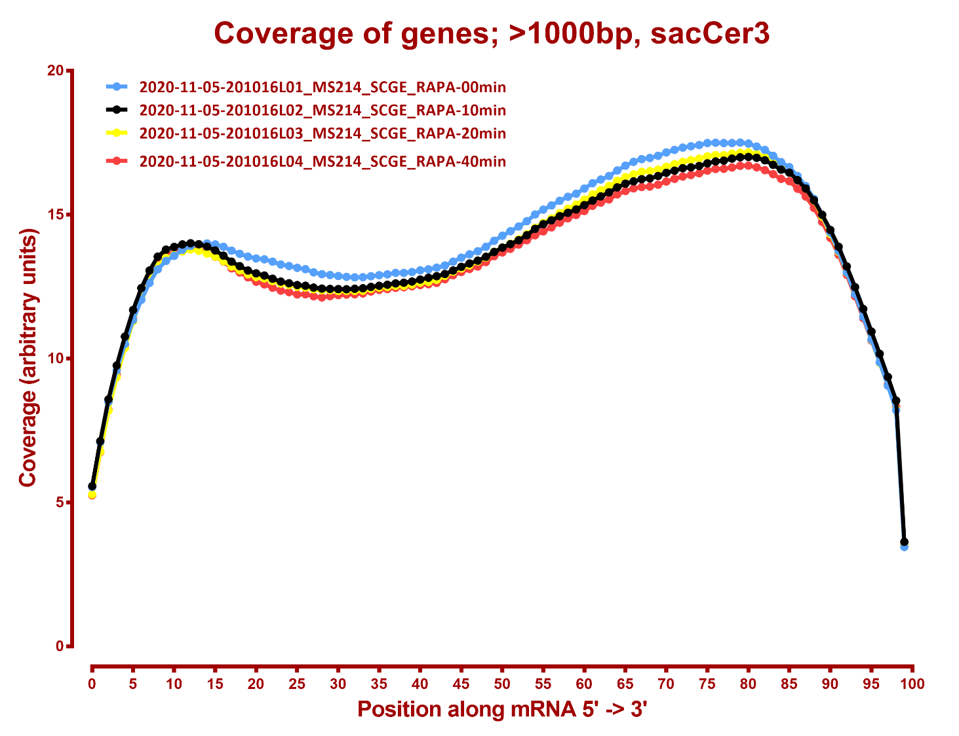
COVERAGE QC

Slide 4
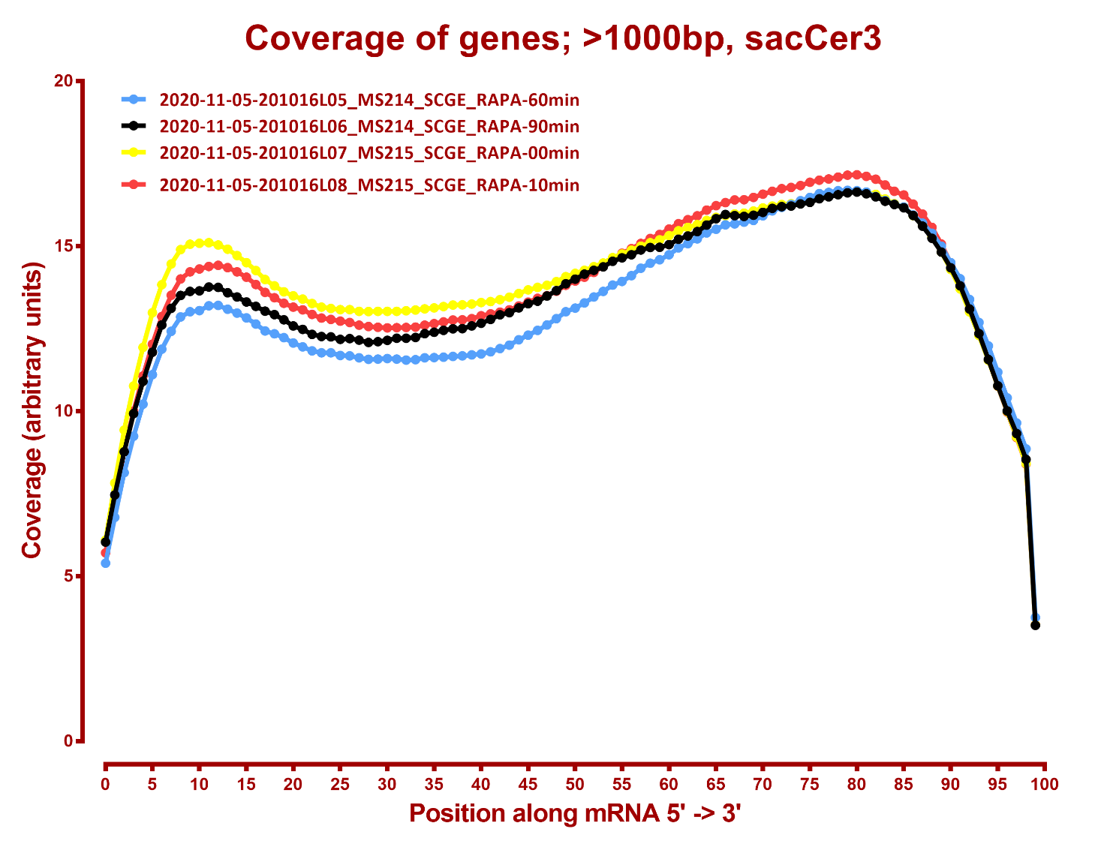

Slide 5
