Slide 1
Mapping stats
Cln3 Whi5 switched!!!

Slide 2
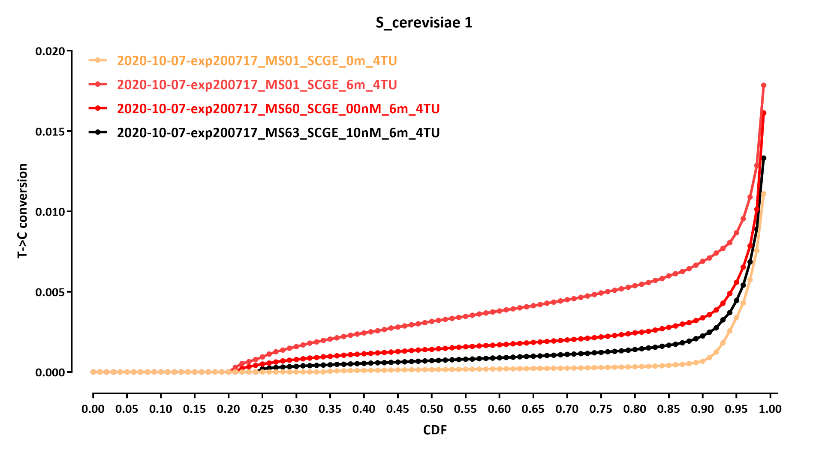
Cln3 Whi5 switched!!!

Slide 3
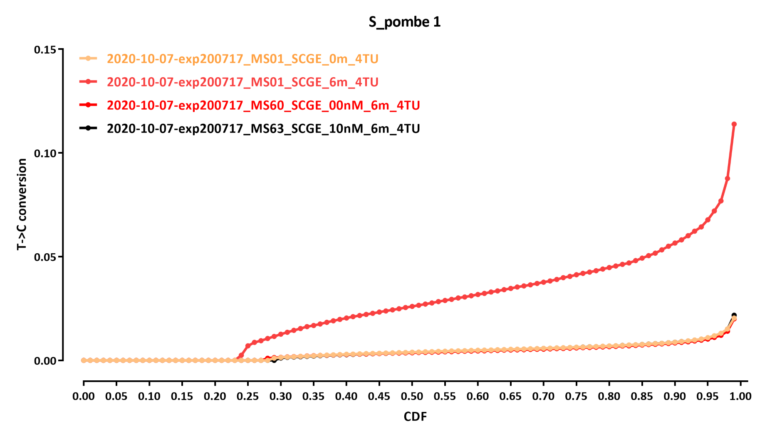
Cln3 Whi5 switched!!!

Slide 4
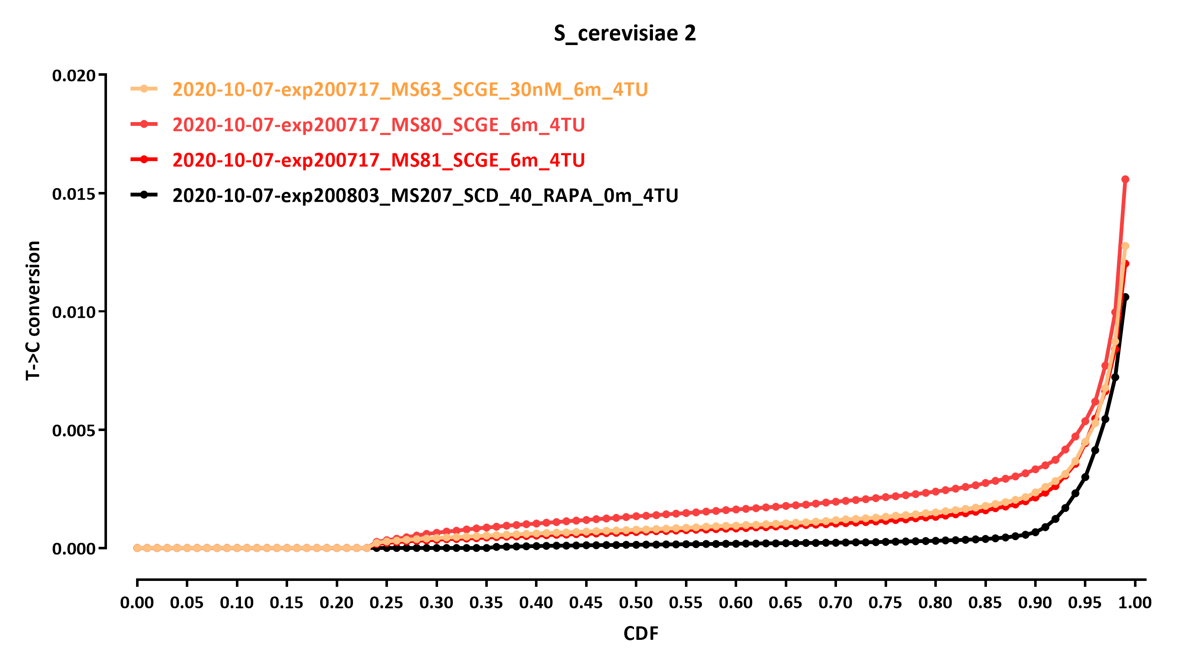
Cln3 Whi5 switched!!!

Slide 5
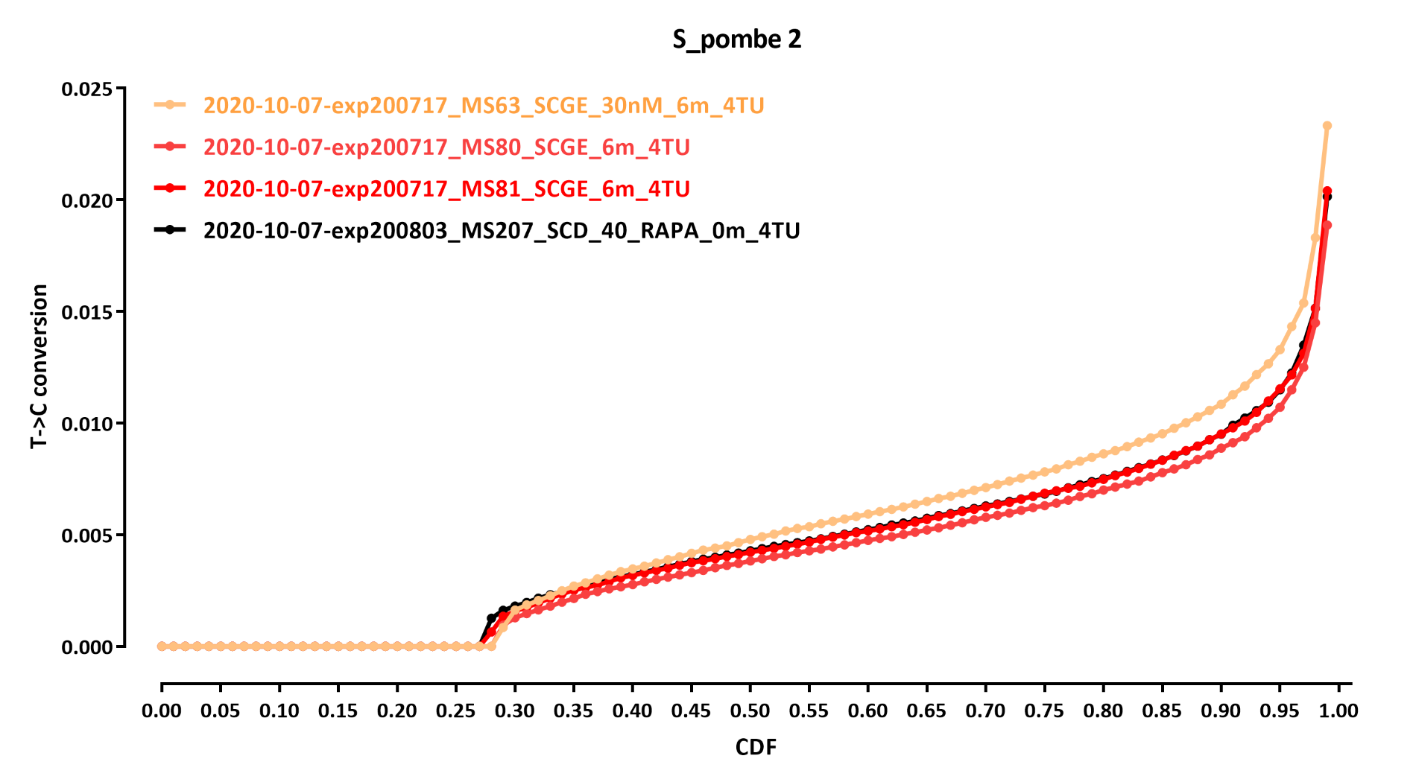
Cln3 Whi5 switched!!!

Slide 6
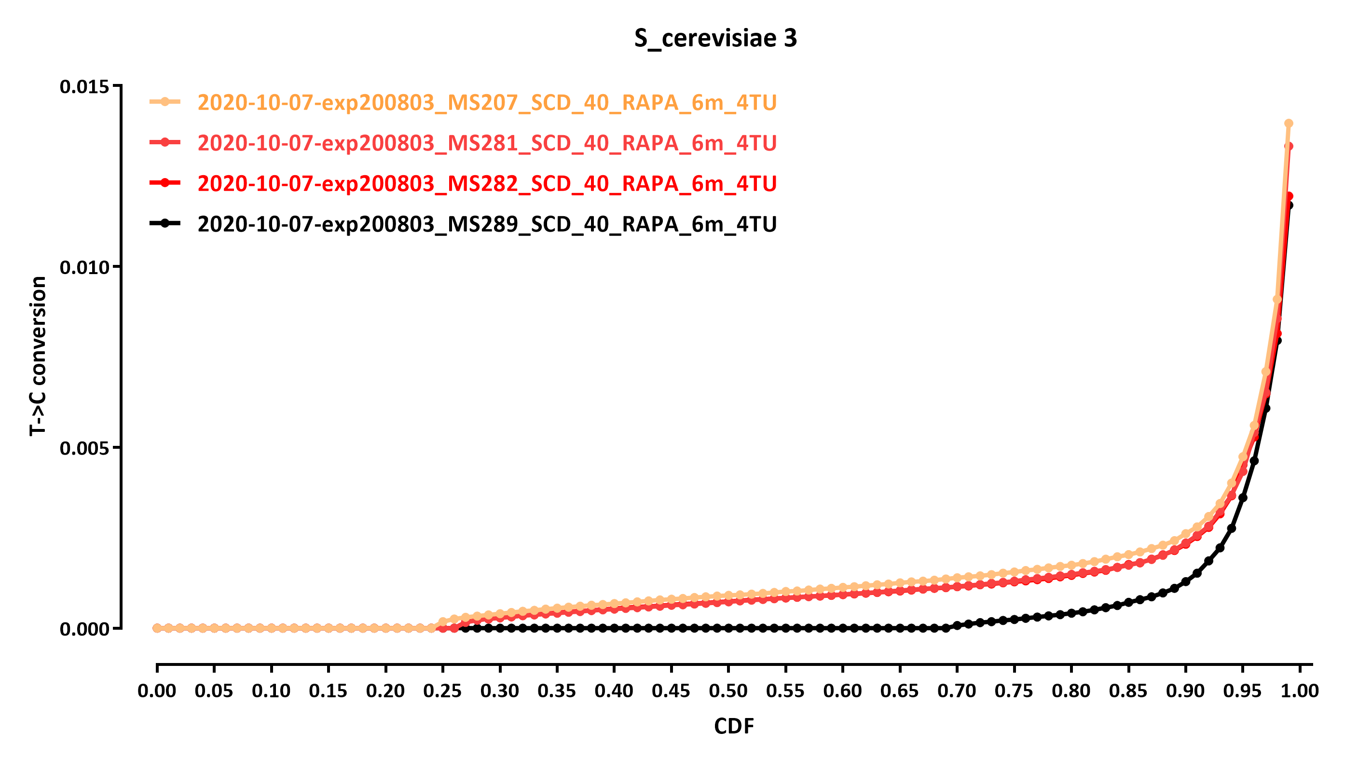
Cln3 Whi5 switched!!!

Slide 7
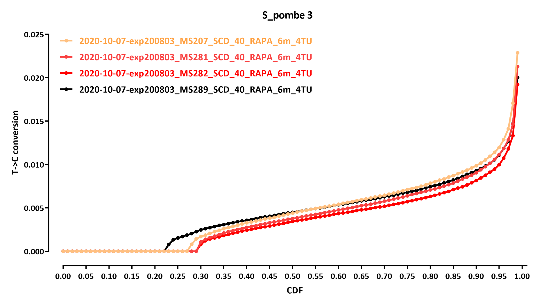
Cln3 Whi5 switched!!!

Slide 8
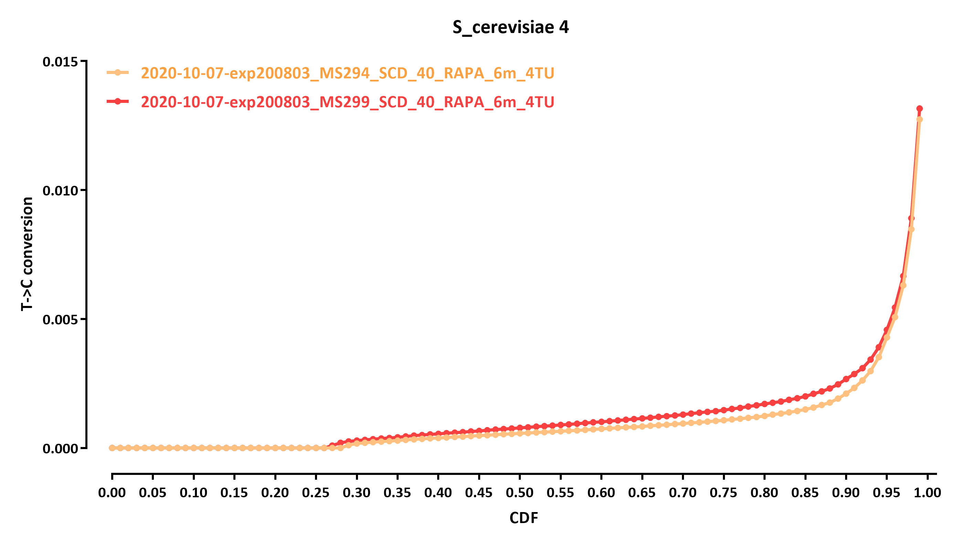
Cln3 Whi5 switched!!!

Slide 9
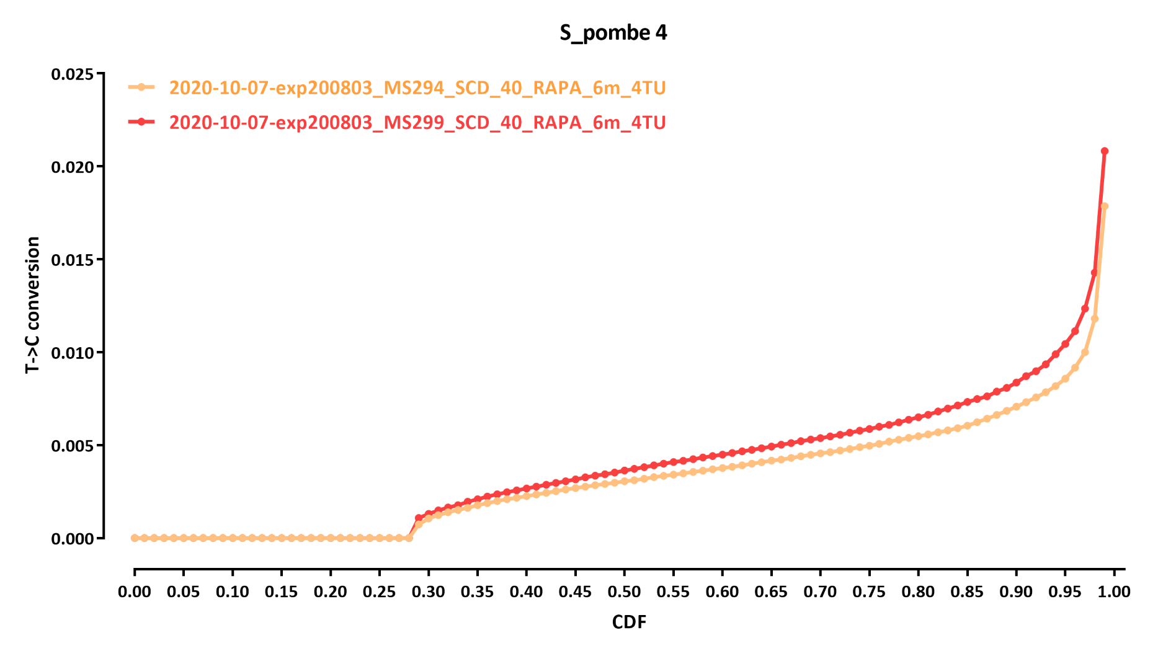
Cln3 Whi5 switched!!!

