Slide 1
Processing notes
Used slamdunk (the only available package for processing SLAM-seq data
Most slamdunk analysis examples use 3’UTRs (which is because QuantSeq is used to make libraries; we do not have UTRs for all genes so I used the whole transcripts and worked in transcriptome space
Cln3 Whi5 switched!!!

Slide 2
Mapping stats
Cln3 Whi5 switched!!!

Slide 3
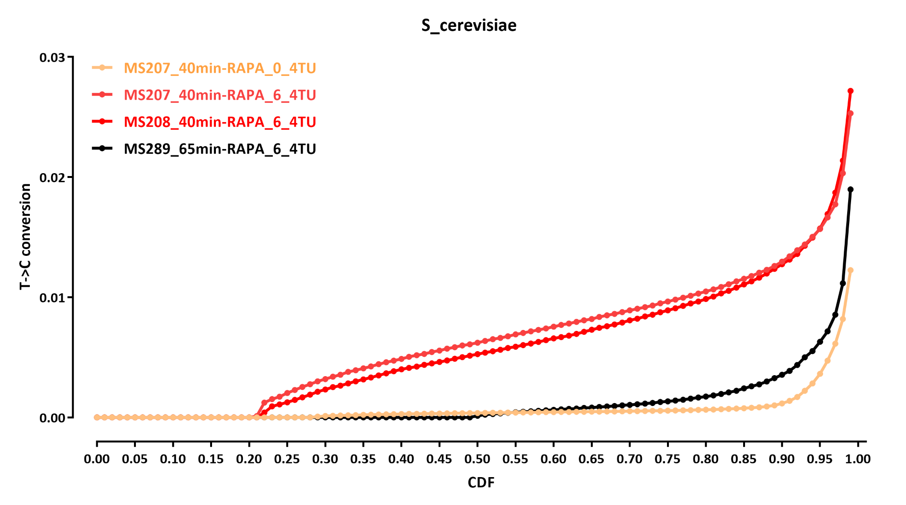
Cln3 Whi5 switched!!!

Slide 4
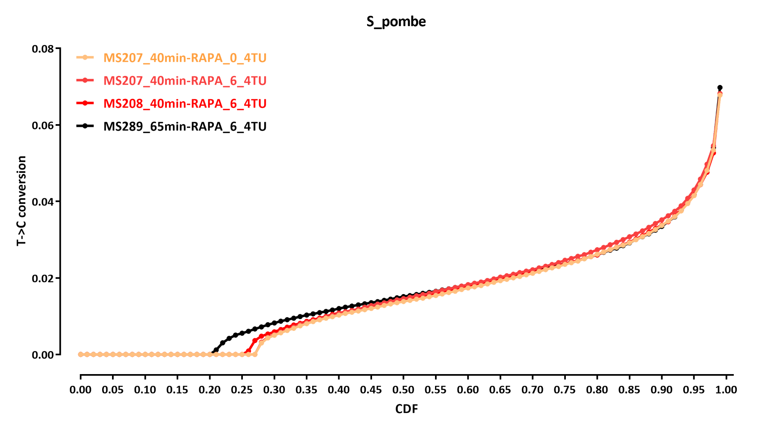
Cln3 Whi5 switched!!!

