Slide 1
General mapping stats
Cln3 Whi5 switched!!!
Note: I could not map the reads with Bismarck
BWAmeth, on the other hand, works.
My guess is that something is not 100% right with the EM-seq adaptor trimming, but I have not been able to figure out what exactly

Slide 2
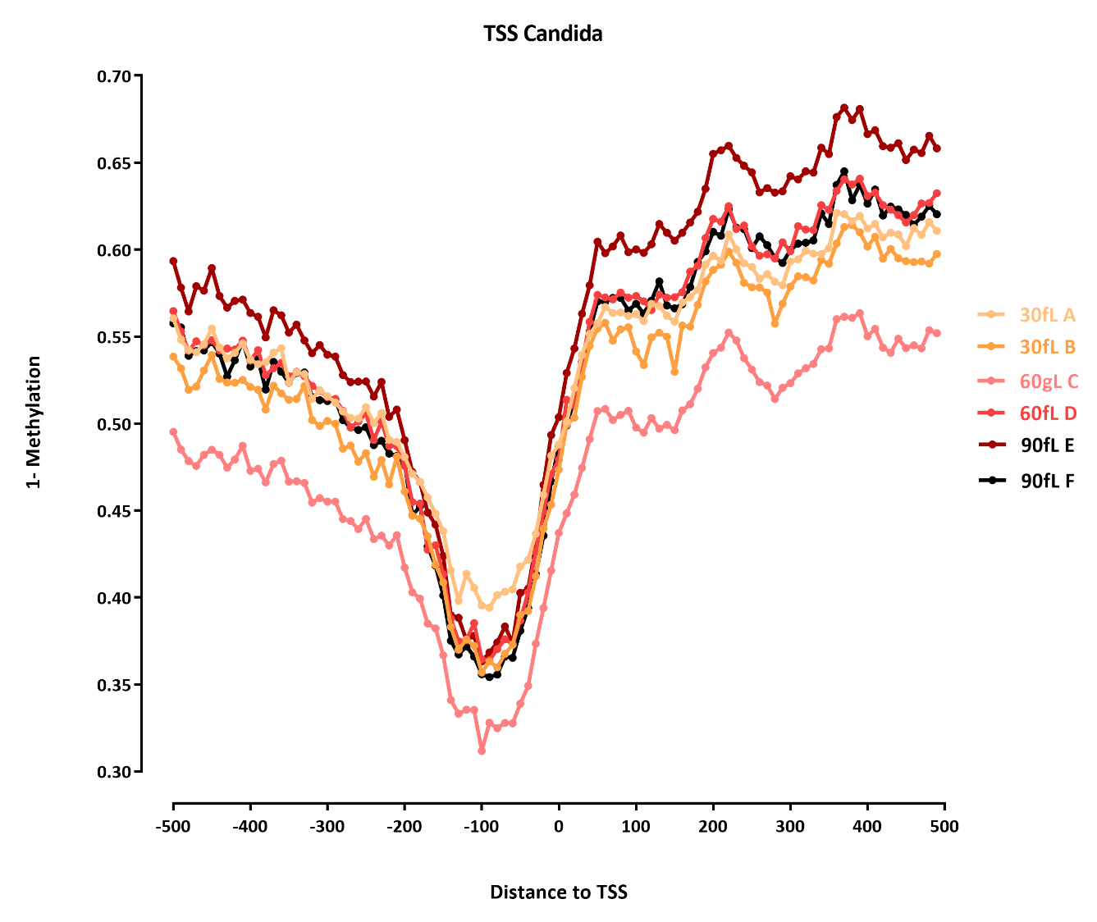

Slide 3
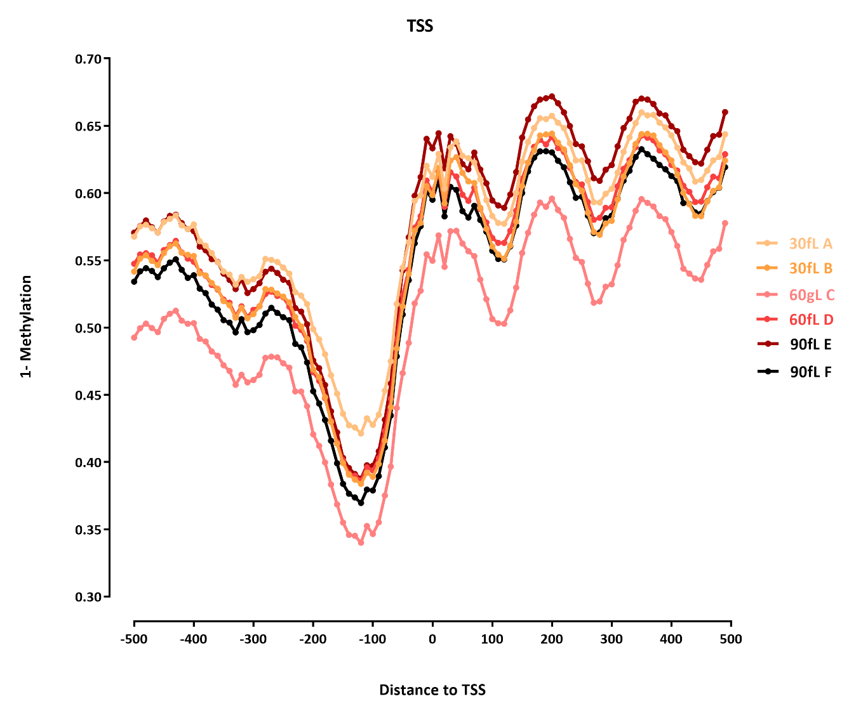

Slide 4
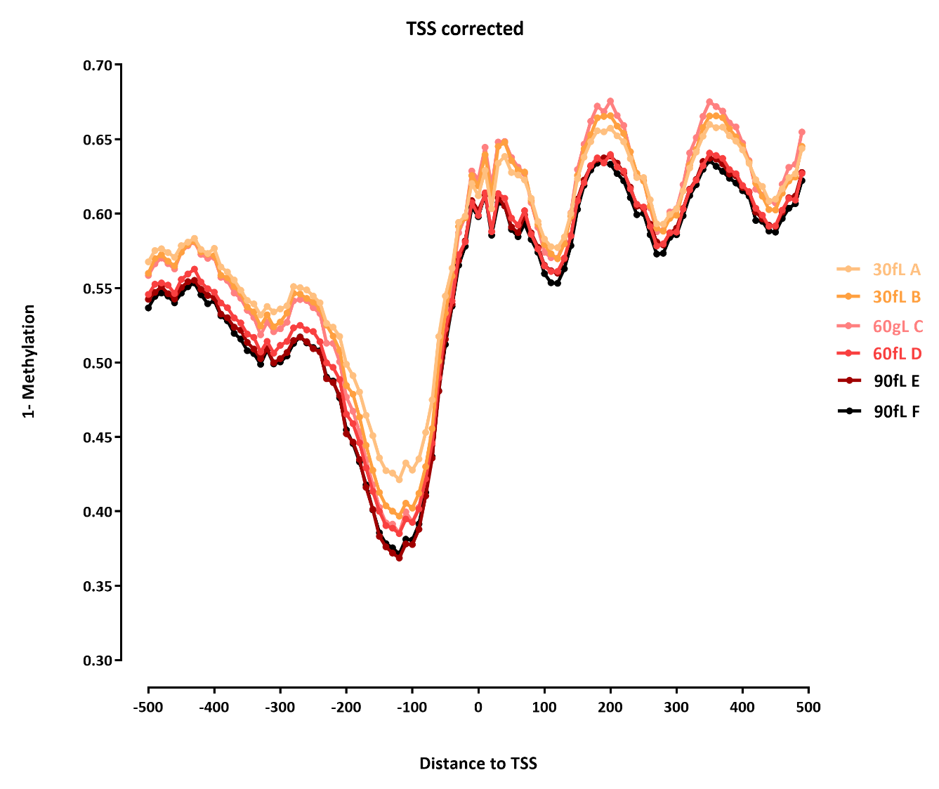

Slide 5
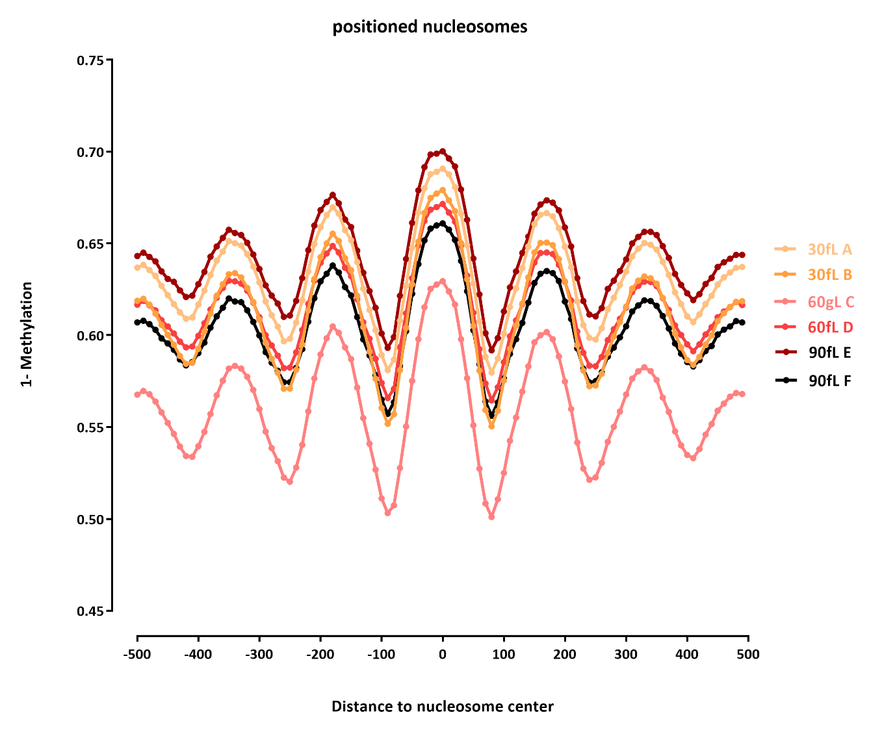

Slide 6
