Slide 1
MAPPING STATS

Slide 2
READ DISTRIBUTION
# | Exonic: | Intergenic: | Intronic:
2019-10-28-RNAseq-exp190911-A050 | 0.93 | 0.07 | 0.00
2019-10-28-RNAseq-exp190911-A060 | 0.93 | 0.07 | 0.00
2019-10-28-RNAseq-exp190911-A070 | 0.93 | 0.07 | 0.00
2019-10-28-RNAseq-exp190911-A080 | 0.92 | 0.08 | 0.00
2019-10-28-RNAseq-exp190911-A090 | 0.92 | 0.07 | 0.00
2019-10-28-RNAseq-exp190911-A100 | 0.92 | 0.07 | 0.00
2019-10-28-RNAseq-exp190911-A110 | 0.93 | 0.07 | 0.00
2019-10-28-RNAseq-exp190911-A120 | 0.93 | 0.07 | 0.00
2019-10-28-RNAseq-exp190911-B010 | 0.92 | 0.07 | 0.00
2019-10-28-RNAseq-exp190911-B020 | 0.92 | 0.07 | 0.00
2019-10-28-RNAseq-exp190911-B030 | 0.93 | 0.07 | 0.00
2019-10-28-RNAseq-exp190911-B040 | 0.93 | 0.07 | 0.00
2019-10-28-RNAseq-exp190911-B050 | 0.93 | 0.07 | 0.00
2019-10-28-RNAseq-exp190911-B060 | 0.93 | 0.07 | 0.00
2019-10-28-RNAseq-exp190911-B070 | 0.93 | 0.07 | 0.00
2019-10-28-RNAseq-exp190911-B080 | 0.93 | 0.07 | 0.00
2019-10-28-RNAseq-exp190911-C0 | 0.92 | 0.08 | 0.00
2019-10-28-RNAseq-exp190911-C010 | 0.92 | 0.08 | 0.00
2019-10-28-RNAseq-exp190911-C020 | 0.93 | 0.07 | 0.00
2019-10-28-RNAseq-exp190911-C030 | 0.93 | 0.07 | 0.00
2019-10-28-RNAseq-exp190911-C040 | 0.92 | 0.07 | 0.00
2019-10-28-RNAseq-exp190911-C050 | 0.93 | 0.07 | 0.00
2019-10-28-RNAseq-exp190911-C060 | 0.93 | 0.07 | 0.00
2019-10-28-RNAseq-exp190911-C070 | 0.93 | 0.07 | 0.00

Slide 3
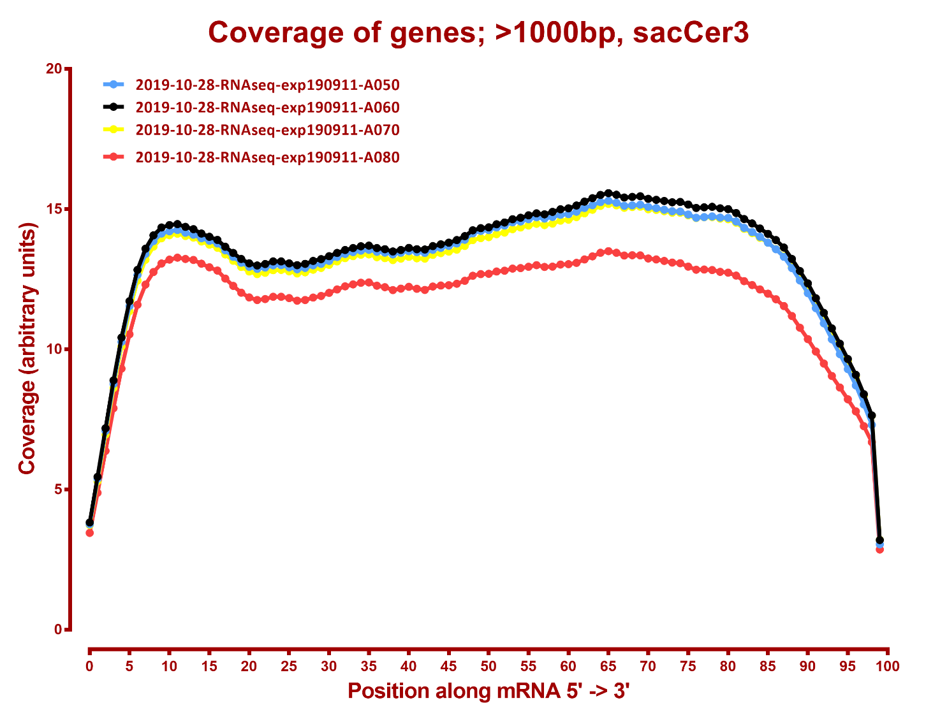

Slide 4
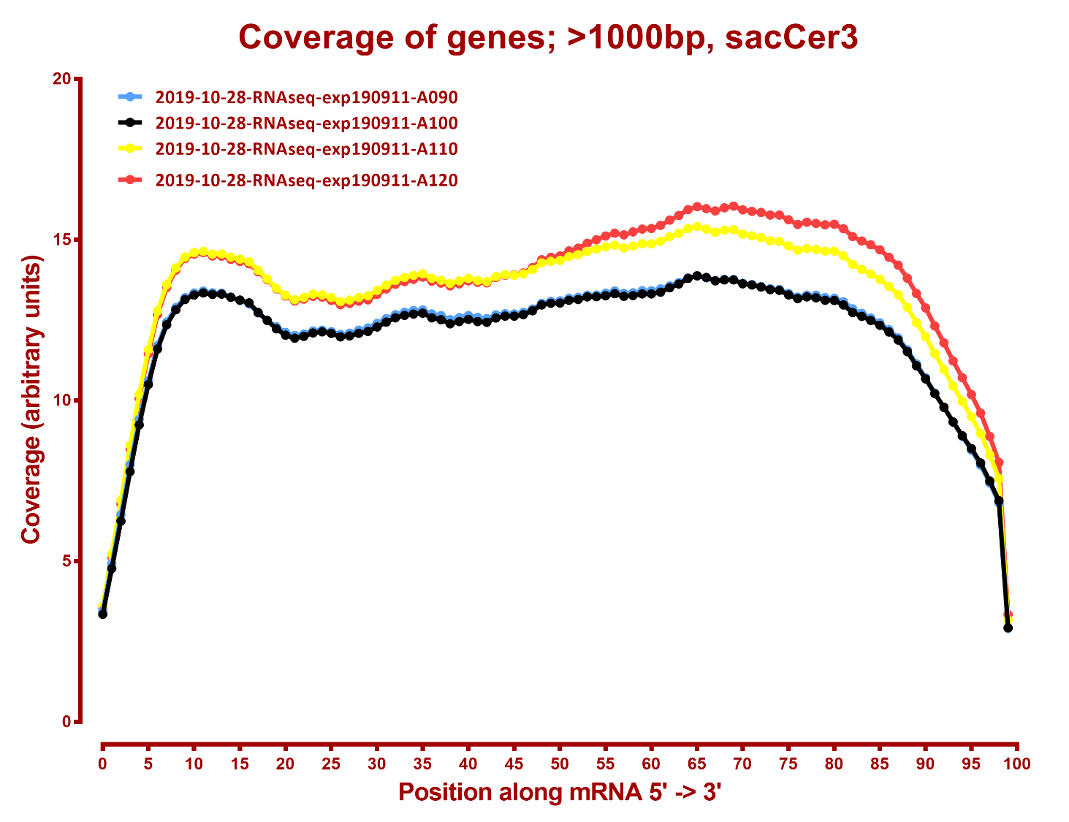

Slide 5
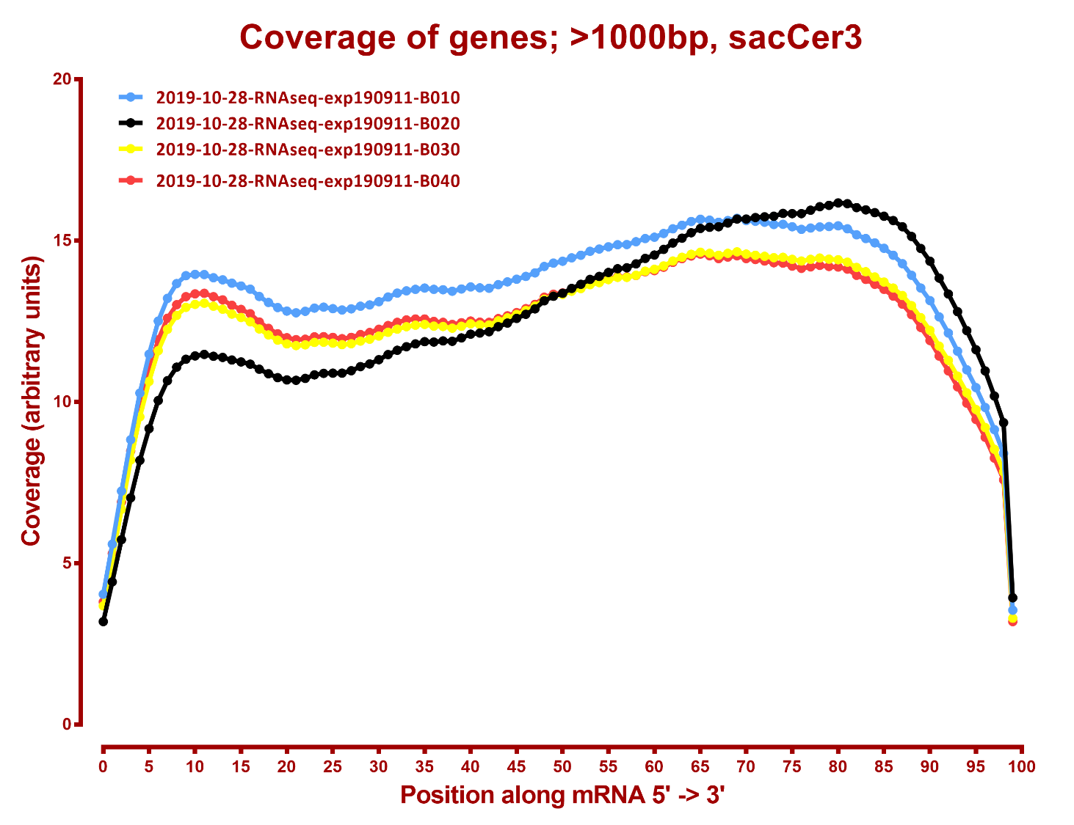

Slide 6
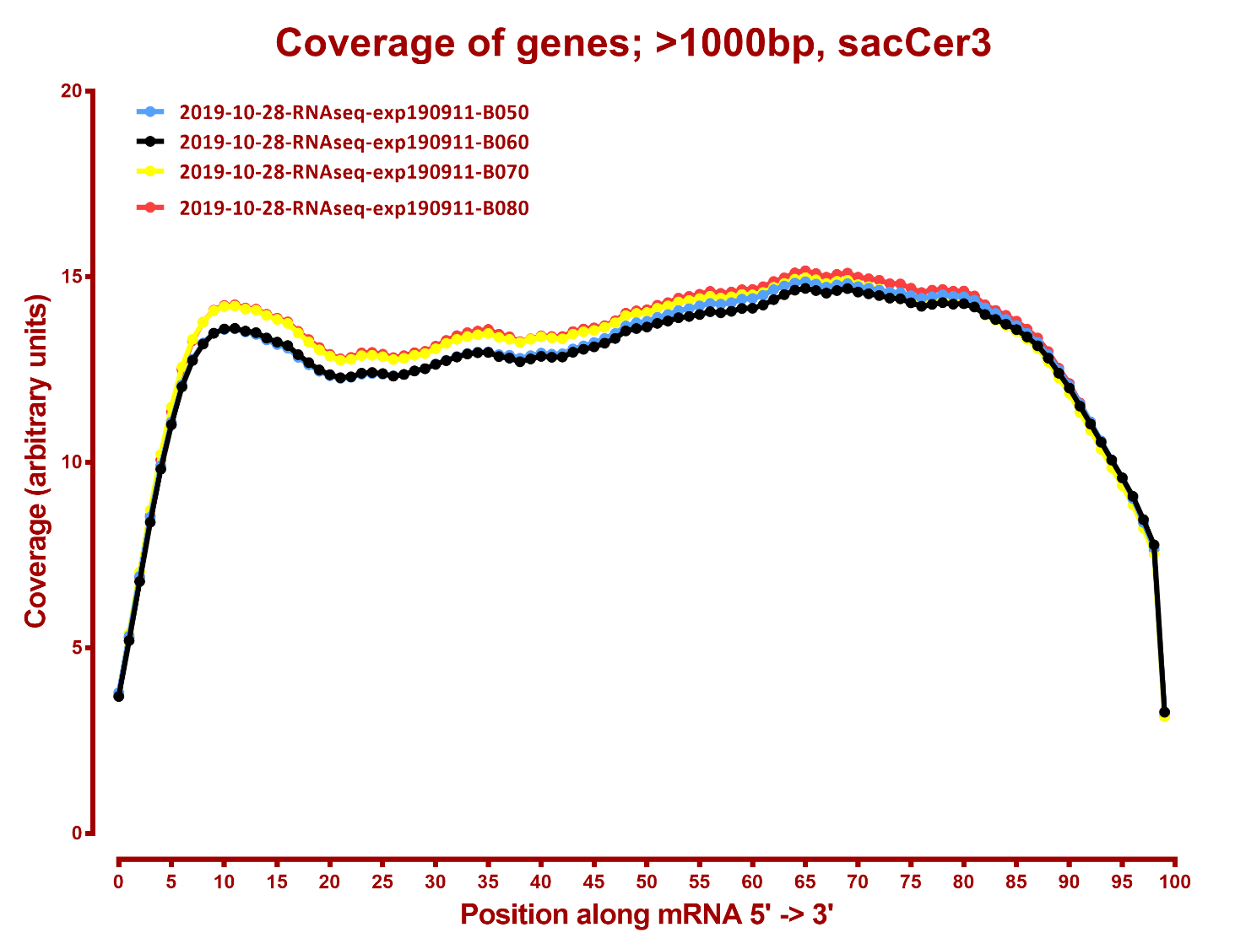

Slide 7
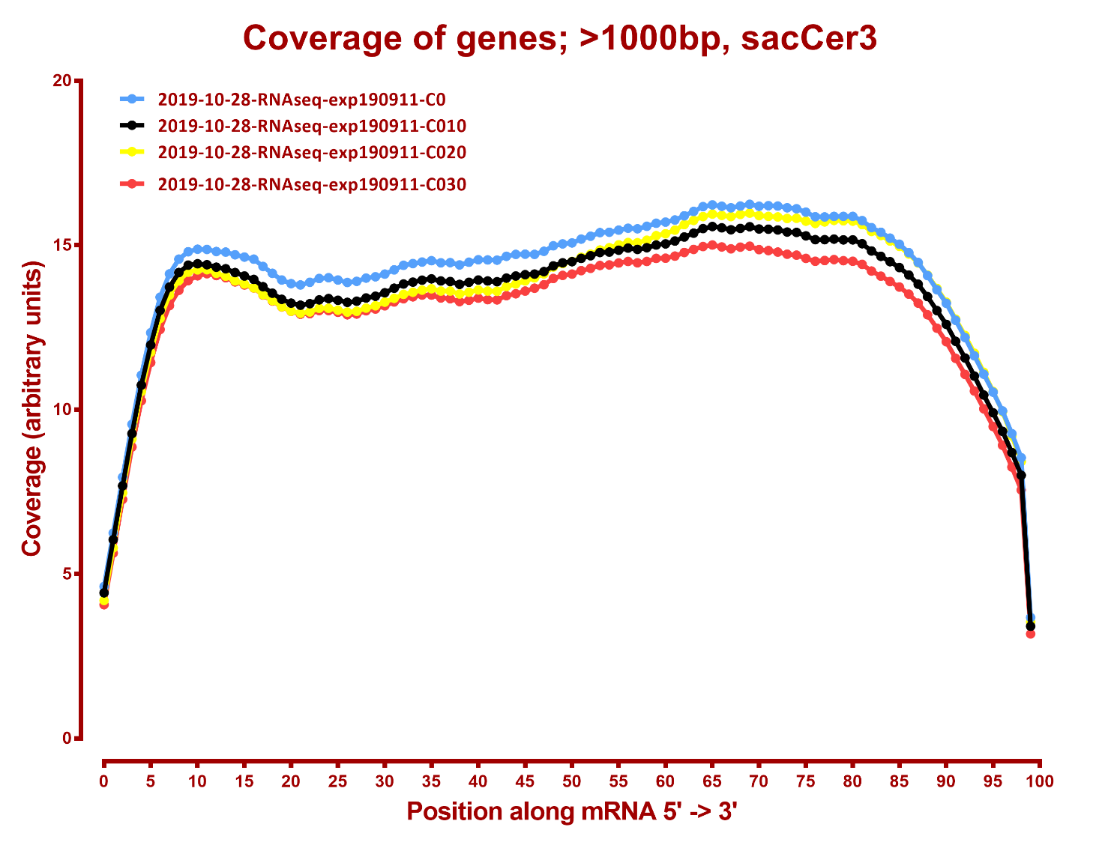

Slide 8
