Slide 1
MAPPING STATS
Library | Read Length | Mapping | Species | Raw fragments | Complexity | Unique | Unique Splices | Multi | Multi Splices | Fraction mapped
A3-G2M_1_rep3 | 2x150 | STAR-2.5.3a | S_pombe | 20,645,522 | 0.39 | 18,294,361 | 1,400,891 | 687,712 | 62,208 | 0.50
A3-G2M_1_rep3 | 2x150 | STAR-2.5.3a | sacCer3 | 20,645,522 | 0.37 | 17,837,669 | 445,645 | 1,312,408 | 36,108 | 0.48
A4-G2M_1_rep4 | 2x150 | STAR-2.5.3a | S_pombe | 23,997,134 | 0.36 | 28,786,499 | 2,191,879 | 868,904 | 121,016 | 0.67
A4-G2M_1_rep4 | 2x150 | STAR-2.5.3a | sacCer3 | 23,997,134 | 0.39 | 13,448,727 | 332,285 | 803,642 | 24,704 | 0.30
B3-G2M_2_rep3 | 2x150 | STAR-2.5.3a | S_pombe | 23,178,118 | 0.38 | 21,251,024 | 1,599,314 | 637,663 | 81,937 | 0.51
B3-G2M_2_rep3 | 2x150 | STAR-2.5.3a | sacCer3 | 23,178,118 | 0.37 | 19,521,932 | 476,820 | 1,185,524 | 39,502 | 0.46
B4-G2M_2_rep4 | 2x150 | STAR-2.5.3a | S_pombe | 25,616,710 | 0.37 | 25,179,892 | 1,990,418 | 1,132,011 | 104,183 | 0.55
B4-G2M_2_rep4 | 2x150 | STAR-2.5.3a | sacCer3 | 25,616,710 | 0.37 | 18,866,978 | 478,722 | 1,512,259 | 38,049 | 0.41
C3-G2M_3_rep3 | 2x150 | STAR-2.5.3a | S_pombe | 20,985,562 | 0.41 | 16,183,734 | 1,276,704 | 582,672 | 53,400 | 0.43
C3-G2M_3_rep3 | 2x150 | STAR-2.5.3a | sacCer3 | 20,985,562 | 0.38 | 20,236,001 | 504,279 | 1,469,083 | 37,003 | 0.53
C4-G2M_3_rep4 | 2x150 | STAR-2.5.3a | S_pombe | 20,505,903 | 0.39 | 18,736,090 | 1,494,362 | 619,400 | 70,028 | 0.51
C4-G2M_3_rep4 | 2x150 | STAR-2.5.3a | sacCer3 | 20,505,903 | 0.38 | 17,183,709 | 436,745 | 1,171,704 | 28,536 | 0.46
D3-G2M_4_rep3 | 2x150 | STAR-2.5.3a | S_pombe | 24,494,003 | 0.39 | 16,109,676 | 1,253,840 | 574,940 | 59,322 | 0.37
D3-G2M_4_rep3 | 2x150 | STAR-2.5.3a | sacCer3 | 24,494,003 | 0.36 | 26,031,540 | 610,526 | 2,106,464 | 51,836 | 0.59
D4-G2M_4_rep4 | 2x150 | STAR-2.5.3a | S_pombe | 19,666,415 | 0.37 | 18,344,599 | 1,531,463 | 605,727 | 75,597 | 0.52
D4-G2M_4_rep4 | 2x150 | STAR-2.5.3a | sacCer3 | 19,666,415 | 0.35 | 15,884,050 | 425,788 | 1,081,076 | 31,262 | 0.44
E3-input_rep3 | 2x150 | STAR-2.5.3a | S_pombe | 20,650,841 | 0.45 | 9,822,901 | 779,481 | 299,996 | 30,274 | 0.26
E3-input_rep3 | 2x150 | STAR-2.5.3a | sacCer3 | 20,650,841 | 0.37 | 26,426,754 | 668,470 | 1,661,261 | 51,051 | 0.70
E4-input_rep4 | 2x150 | STAR-2.5.3a | S_pombe | 19,972,687 | 0.75 | 73 | 9 | 81 | 1 | 0.00
E4-input_rep4 | 2x150 | STAR-2.5.3a | sacCer3 | 19,972,687 | 0.35 | 35,335,012 | 934,818 | 2,002,649 | 78,387 | 0.96
F3-unstained_input_rep3 | 2x150 | STAR-2.5.3a | S_pombe | 21,576,320 | 0.40 | 12,204,541 | 946,213 | 228,915 | 43,529 | 0.31
F3-unstained_input_rep3 | 2x150 | STAR-2.5.3a | sacCer3 | 21,576,320 | 0.34 | 26,059,578 | 705,002 | 1,366,491 | 58,541 | 0.65
F4-unstained_input_rep4 | 2x150 | STAR-2.5.3a | S_pombe | 19,679,198 | 0.54 | 1,499 | 139 | 144 | 0 | 0.00
F4-unstained_input_rep4 | 2x150 | STAR-2.5.3a | sacCer3 | 19,679,198 | 0.31 | 34,720,986 | 898,718 | 1,944,200 | 80,382 | 0.96

Slide 2
READ DISTRIBUTION
# | Exonic: | Intergenic: | Intronic:
2019-10-25-A3-G2M_1_rep3.S_pombe | 0.98 | 0.01 | 0.01
2019-10-25-A3-G2M_1_rep3.sacCer3 | 0.92 | 0.08 | 0.00
2019-10-25-A4-G2M_1_rep4.S_pombe | 0.98 | 0.01 | 0.01
2019-10-25-A4-G2M_1_rep4.sacCer3 | 0.92 | 0.08 | 0.00
2019-10-25-B3-G2M_2_rep3.S_pombe | 0.98 | 0.01 | 0.01
2019-10-25-B3-G2M_2_rep3.sacCer3 | 0.92 | 0.08 | 0.00
2019-10-25-B4-G2M_2_rep4.S_pombe | 0.98 | 0.01 | 0.01
2019-10-25-B4-G2M_2_rep4.sacCer3 | 0.91 | 0.08 | 0.00
2019-10-25-C3-G2M_3_rep3.S_pombe | 0.98 | 0.01 | 0.01
2019-10-25-C3-G2M_3_rep3.sacCer3 | 0.91 | 0.09 | 0.00
2019-10-25-C4-G2M_3_rep4.S_pombe | 0.98 | 0.01 | 0.01
2019-10-25-C4-G2M_3_rep4.sacCer3 | 0.91 | 0.08 | 0.00
2019-10-25-D3-G2M_4_rep3.S_pombe | 0.98 | 0.01 | 0.01
2019-10-25-D3-G2M_4_rep3.sacCer3 | 0.91 | 0.08 | 0.00
2019-10-25-D4-G2M_4_rep4.S_pombe | 0.98 | 0.01 | 0.01
2019-10-25-D4-G2M_4_rep4.sacCer3 | 0.92 | 0.08 | 0.00
2019-10-25-E3-input_rep3.S_pombe | 0.98 | 0.01 | 0.01
2019-10-25-E3-input_rep3.sacCer3 | 0.92 | 0.08 | 0.00
2019-10-25-E4-input_rep4.S_pombe | 1.00 | 0.00 | 0.00
2019-10-25-E4-input_rep4.sacCer3 | 0.91 | 0.08 | 0.00
2019-10-25-F3-unstained_input_rep3.S_pombe | 0.98 | 0.02 | 0.01
2019-10-25-F3-unstained_input_rep3.sacCer3 | 0.91 | 0.09 | 0.00
2019-10-25-F4-unstained_input_rep4.S_pombe | 0.99 | 0.00 | 0.00
2019-10-25-F4-unstained_input_rep4.sacCer3 | 0.91 | 0.08 | 0.00

Slide 3
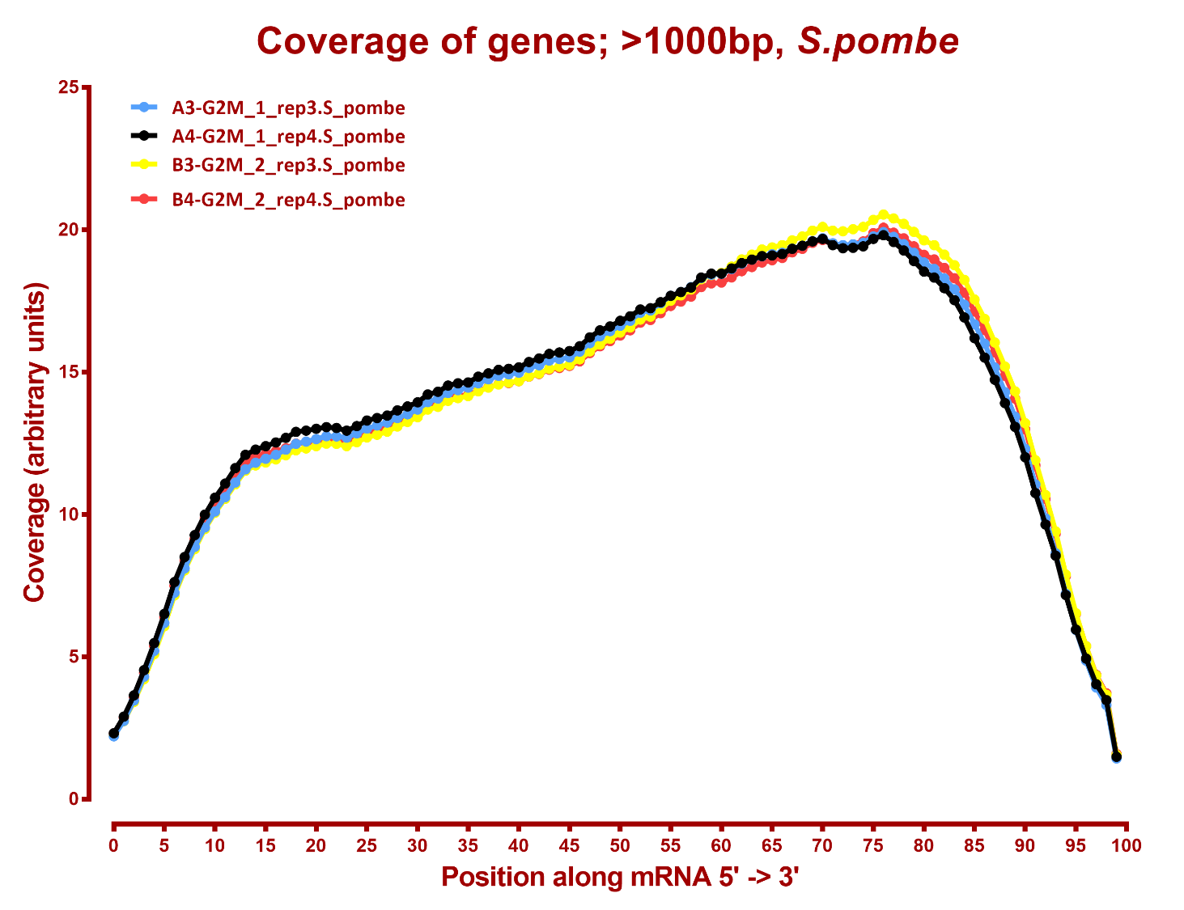

Slide 4
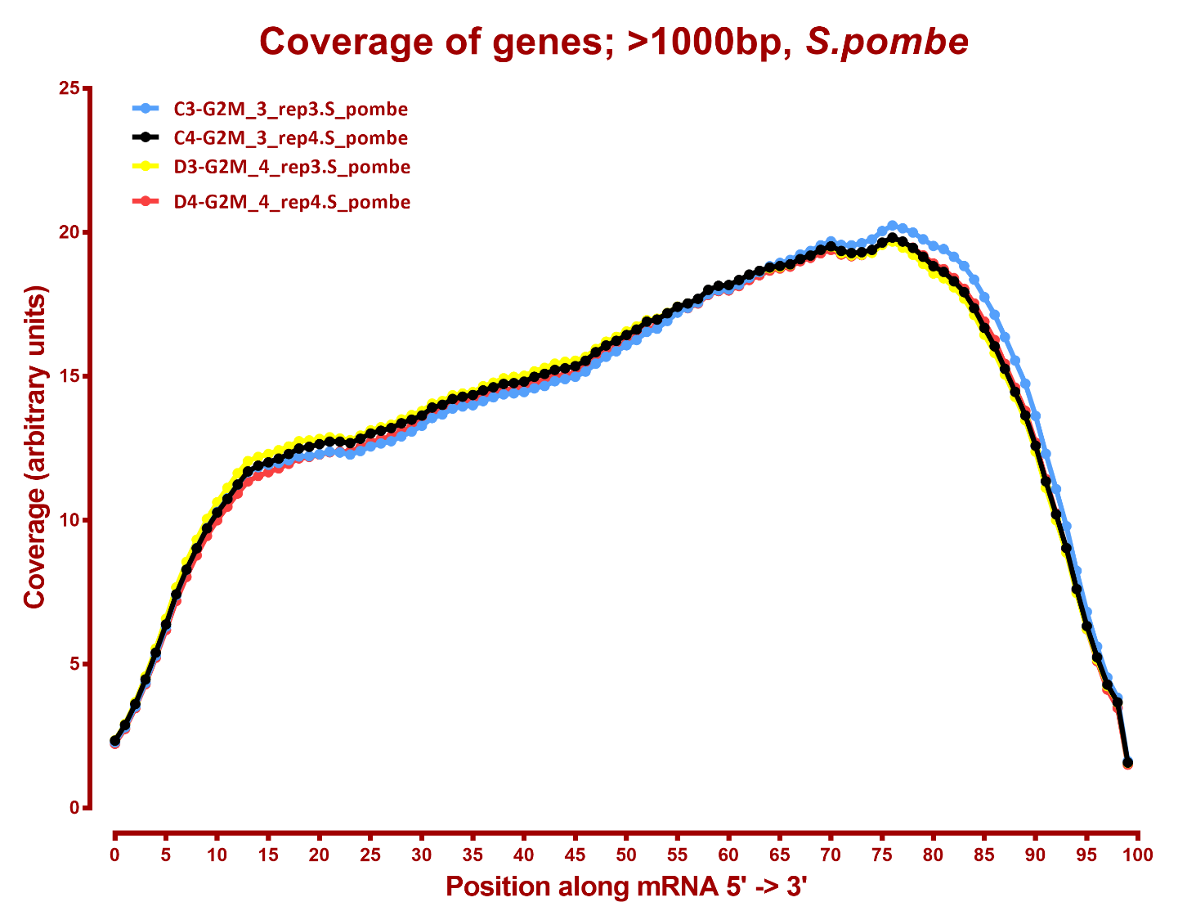

Slide 5
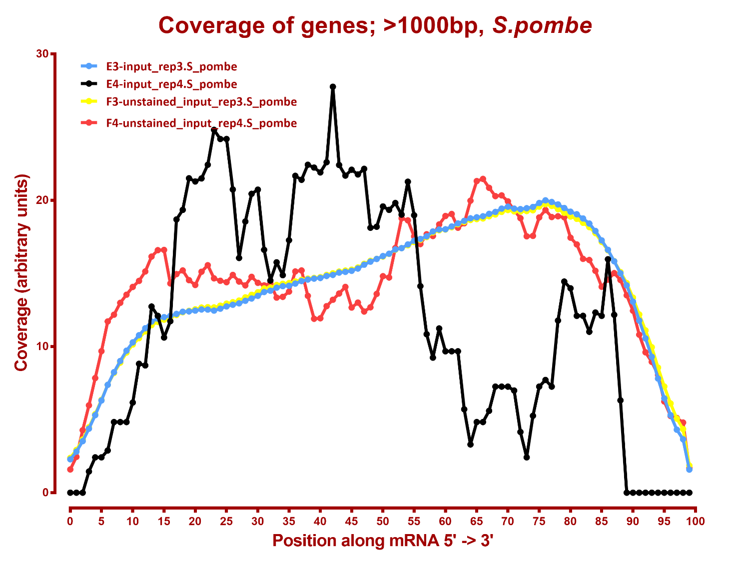

Slide 6
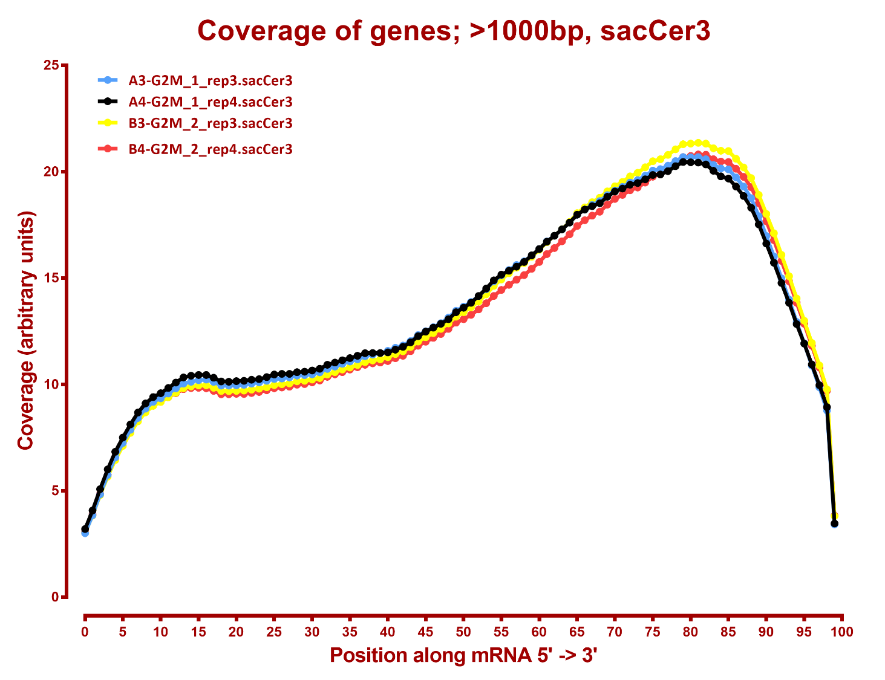

Slide 7
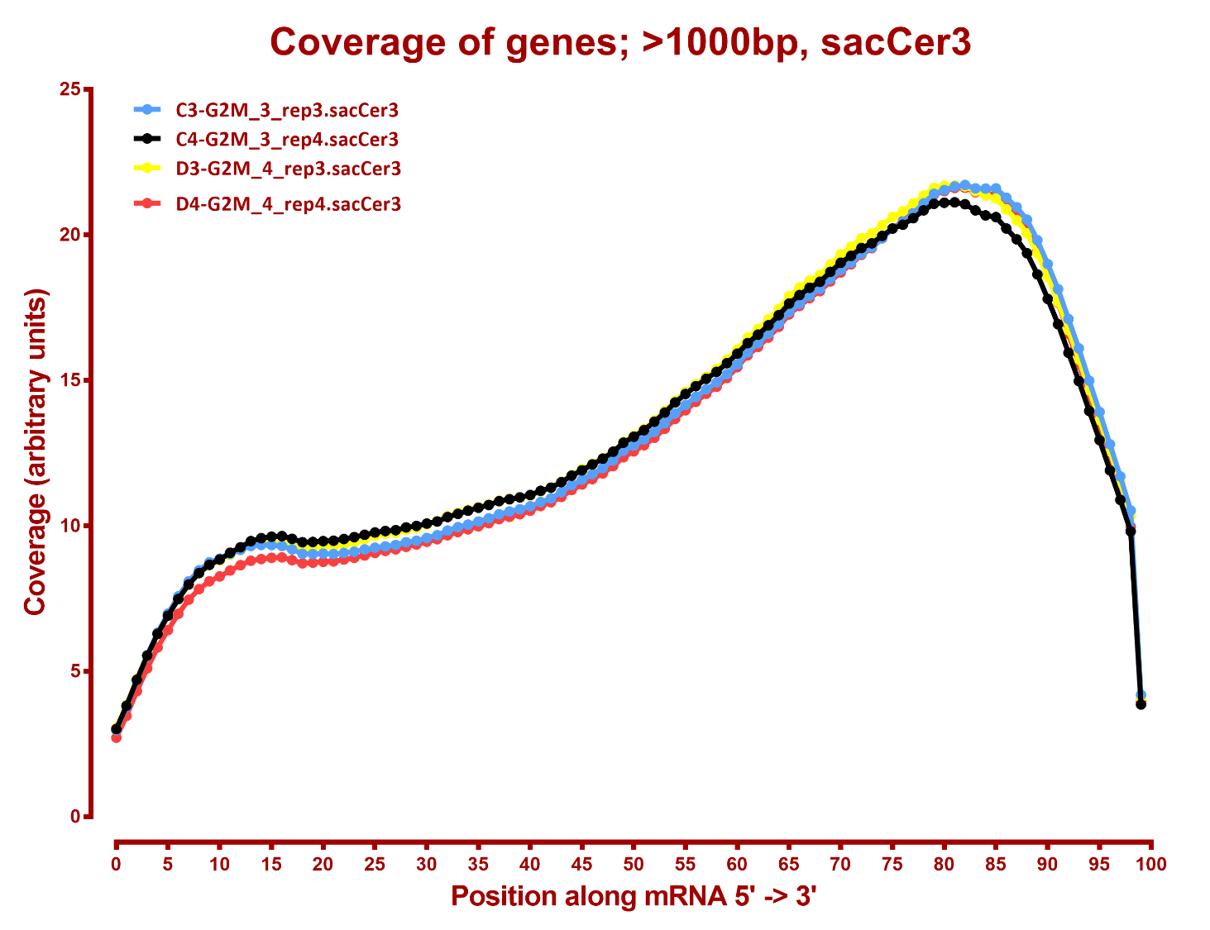

Slide 8
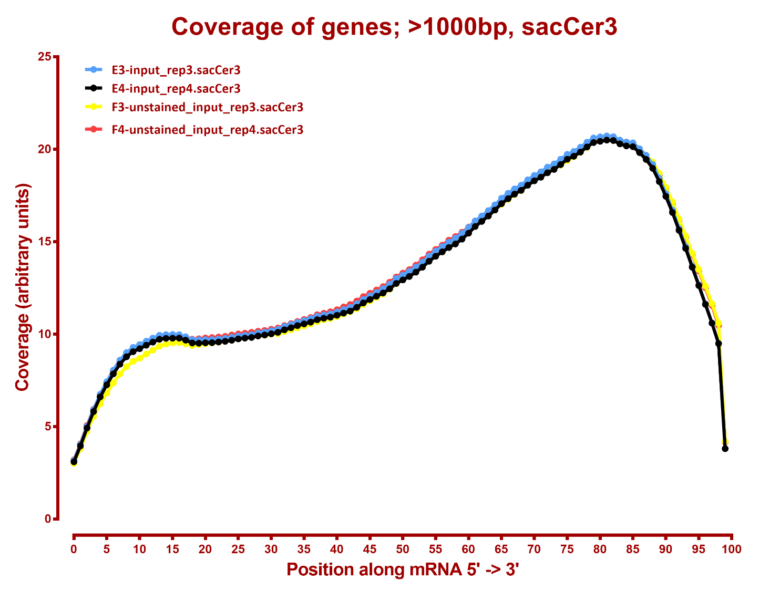

Slide 9
Number differential genes, sacCer3
A | B | p-adj |  | p-val
 |  | up in B vs A | down in B vs A | up in B vs A | down in B vs A
G2M_1 | G2M_2 | 250 | 229 | 624 | 567
G2M_1 | G2M_3 | 749 | 750 | 1,069 | 1,008
G2M_1 | G2M_4 | 1,014 | 1,056 | 1,285 | 1,294
G2M_1 | input | 765 | 677 | 1,042 | 997
G2M_1 | unstained_input | 903 | 785 | 1,135 | 1,098
G2M_2 | G2M_3 | 304 | 243 | 555 | 537
G2M_2 | G2M_4 | 698 | 691 | 971 | 1,001
G2M_2 | input | 456 | 251 | 749 | 591
G2M_2 | unstained_input | 618 | 420 | 925 | 794
G2M_3 | G2M_4 | 189 | 105 | 495 | 461
G2M_3 | input | 277 | 146 | 549 | 428
G2M_3 | unstained_input | 461 | 316 | 838 | 662
G2M_4 | input | 398 | 301 | 712 | 584
G2M_4 | unstained_input | 578 | 445 | 868 | 768
input | unstained_input | 13 | 15 | 275 | 231

Slide 10
Number differential genes, S. pombe
A | B | p-adj |  | p-val
 |  | up in B vs A | down in B vs A | up in B vs A | down in B vs A
G2M_1 | G2M_2 | 0 | 0 | 3 | 10
G2M_1 | G2M_3 | 0 | 0 | 23 | 1
G2M_1 | G2M_4 | 0 | 2 | 3 | 15
G2M_1 | input | 1 | 0 | 181 | 5
G2M_1 | unstained_input | 3,688 | 1 | 3,840 | 1
G2M_2 | G2M_3 | 0 | 0 | 79 | 0
G2M_2 | G2M_4 | 0 | 1 | 11 | 12
G2M_2 | input | 1 | 1 | 360 | 3
G2M_2 | unstained_input | 3795 | 1 | 3927 | 1
G2M_3 | G2M_4 | 0 | 1 | 2 | 140
G2M_3 | input | 0 | 1 | 42 | 4
G2M_3 | unstained_input | 3573 | 1 | 3720 | 2
G2M_4 | input | 4 | 0 | 465 | 4
G2M_4 | unstained_input | 3807 | 1 | 3938 | 1
input | unstained_input | 3297 | 1 | 3505 | 1

Slide 12
MAPPING STATS

Slide 13
READ DISTRIBUTION

Slide 14
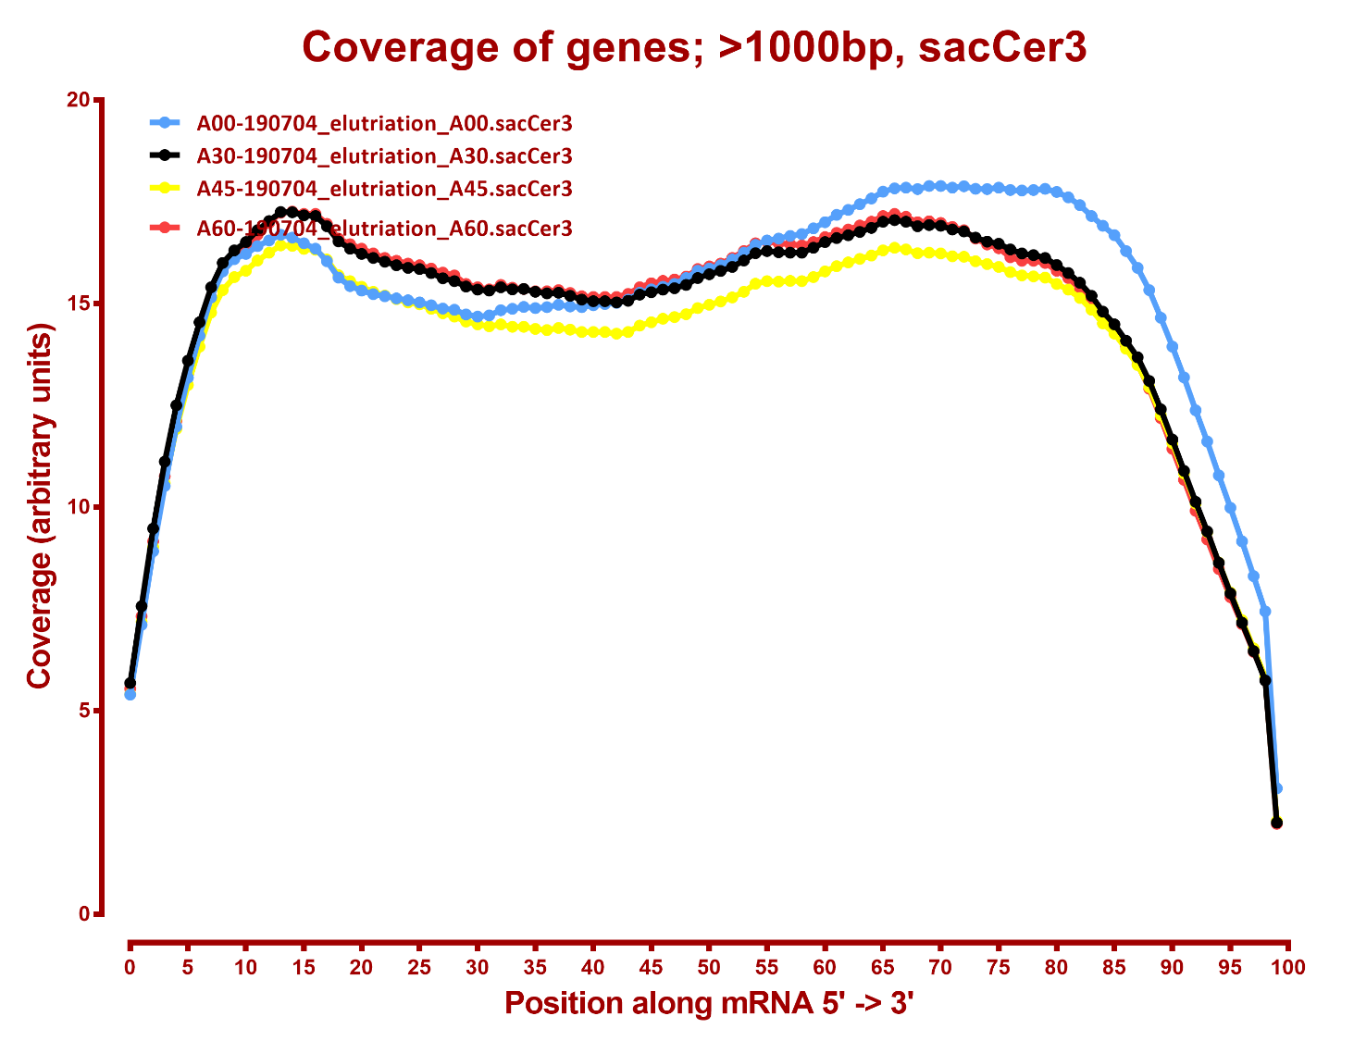

Slide 15
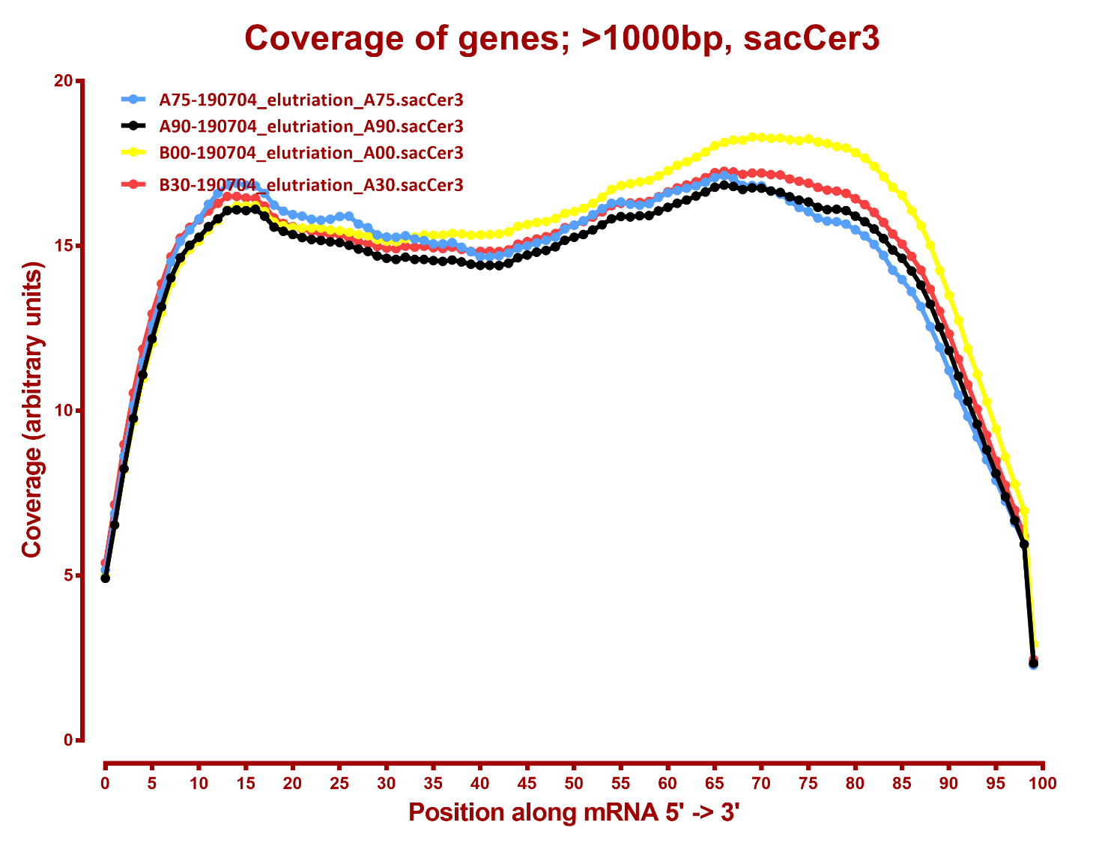

Slide 16
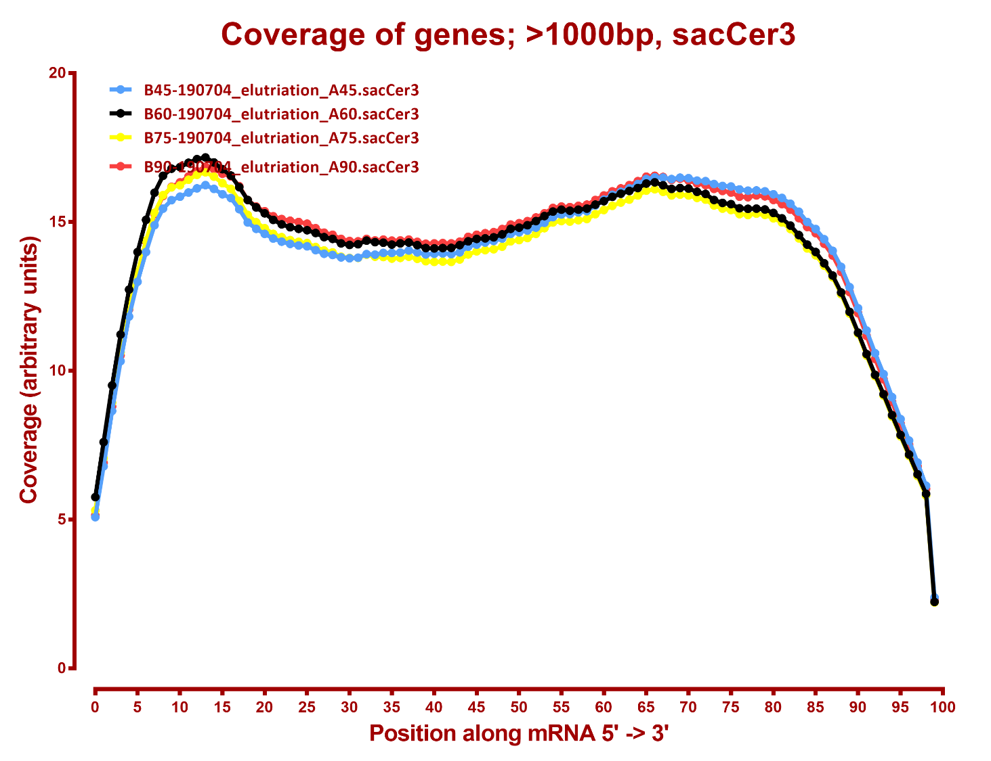

Slide 17
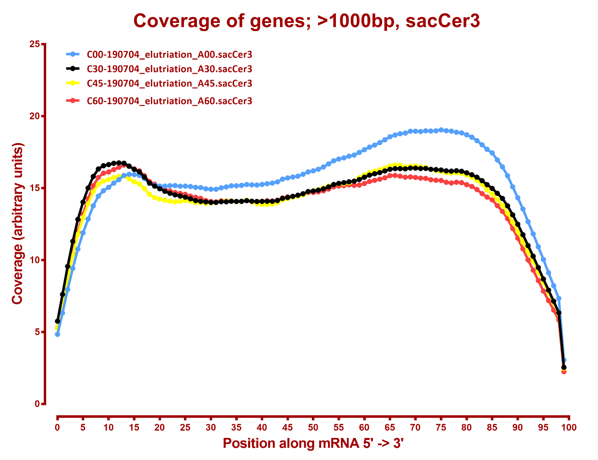

Slide 18
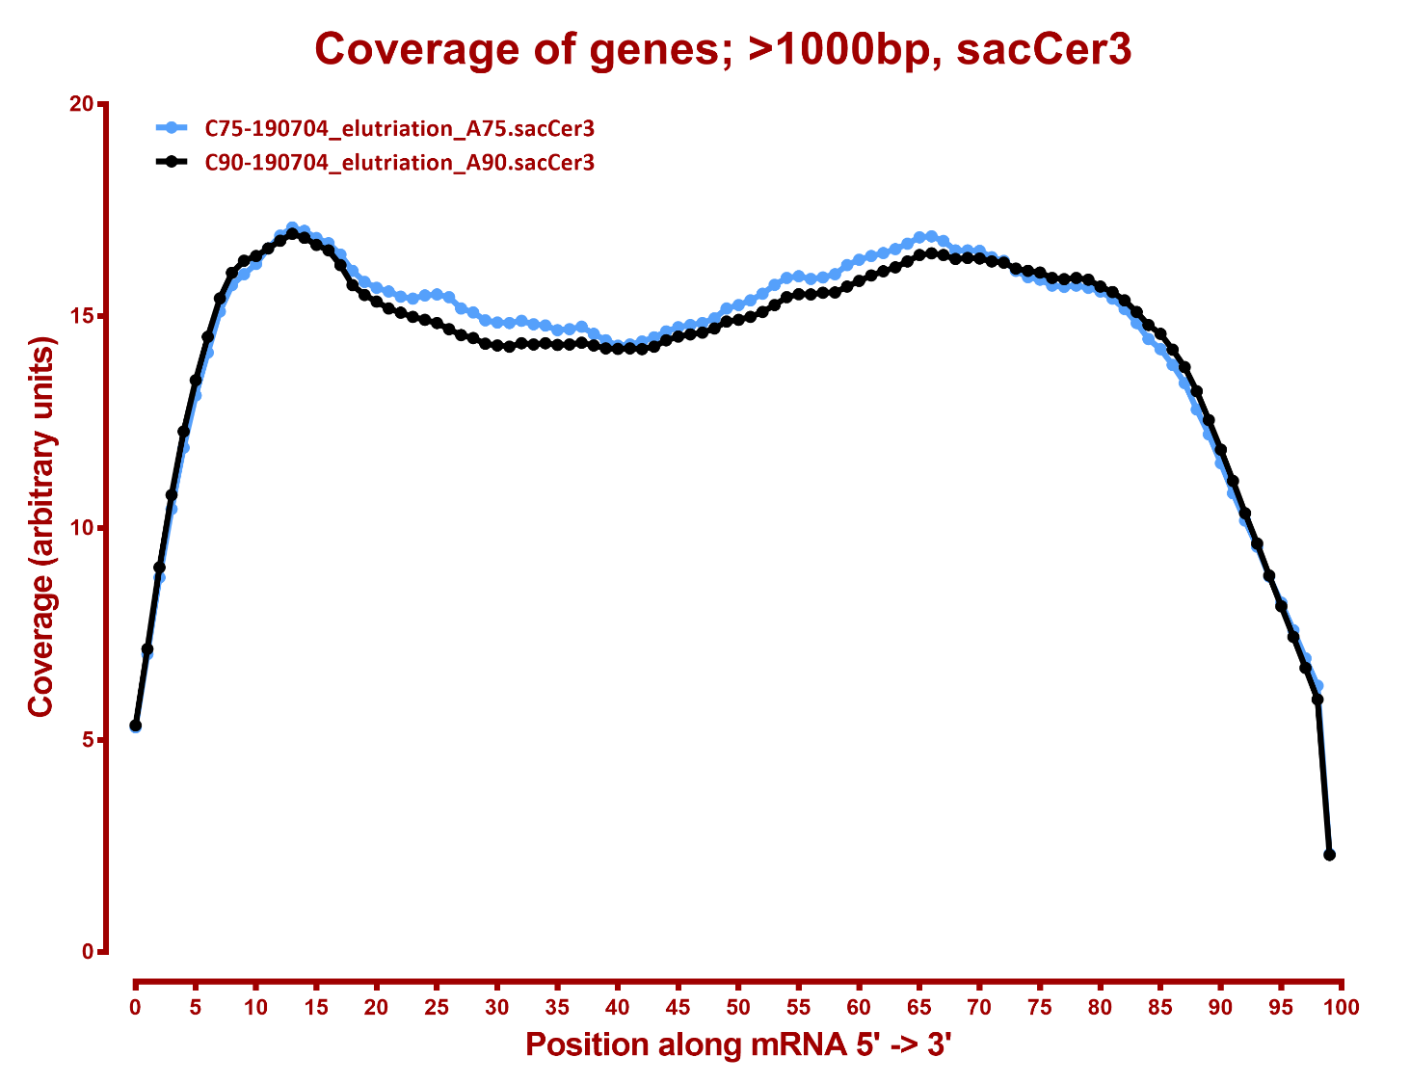

Slide 19
MAPPING STATS

Slide 20
READ DISTRIBUTION
# | Exonic: | Intergenic: | Intronic:
2019-10-25-HLF-1A-HLF_bin1_rep1.dm6 | 0.96 | 0.01 | 0.03
2019-10-25-HLF-1A-HLF_bin1_rep1.hg38 | 0.92 | 0.01 | 0.07
2019-10-25-HLF-1C-HLF_bin1_rep2.dm6 | 0.96 | 0.01 | 0.03
2019-10-25-HLF-1C-HLF_bin1_rep2.hg38 | 0.92 | 0.01 | 0.07
2019-10-25-HLF-2A-HLF_bin2_rep1.dm6 | 0.96 | 0.01 | 0.03
2019-10-25-HLF-2A-HLF_bin2_rep1.hg38 | 0.92 | 0.01 | 0.07
2019-10-25-HLF-2C-HLF_bin2_rep2.dm6 | 0.96 | 0.01 | 0.03
2019-10-25-HLF-2C-HLF_bin2_rep2.hg38 | 0.92 | 0.01 | 0.07
2019-10-25-HLF-3A-HLF_bin3_rep1.dm6 | 0.96 | 0.01 | 0.03
2019-10-25-HLF-3A-HLF_bin3_rep1.hg38 | 0.93 | 0.01 | 0.06
2019-10-25-HLF-3C-HLF_bin3_rep2.dm6 | 0.96 | 0.01 | 0.03
2019-10-25-HLF-3C-HLF_bin3_rep2.hg38 | 0.92 | 0.01 | 0.07
2019-10-25-HLF-4A-HLF_bin4_rep1.dm6 | 0.96 | 0.01 | 0.03
2019-10-25-HLF-4A-HLF_bin4_rep1.hg38 | 0.92 | 0.01 | 0.07
2019-10-25-HLF-4C-HLF_bin4_rep2.dm6 | 0.96 | 0.01 | 0.03
2019-10-25-HLF-4C-HLF_bin4_rep2.hg38 | 0.93 | 0.01 | 0.06
2019-10-25-HLF-SortAll-A-HLF_sort-all_rep1.dm6 | 0.96 | 0.01 | 0.03
2019-10-25-HLF-SortAll-A-HLF_sort-all_rep1.hg38 | 0.92 | 0.01 | 0.07
2019-10-25-HLF-pre-Sort-A-HLF_pre-sort_rep1.dm6 | 0.96 | 0.01 | 0.02
2019-10-25-HLF-pre-Sort-A-HLF_pre-sort_rep1.hg38 | 0.95 | 0.01 | 0.04
2019-10-25-HLF-pre-Sort-C-HLF_pre-sort_rep2.dm6 | 0.98 | 0.01 | 0.02
2019-10-25-HLF-pre-Sort-C-HLF_pre-sort_rep2.hg38 | 0.94 | 0.01 | 0.05

Slide 21
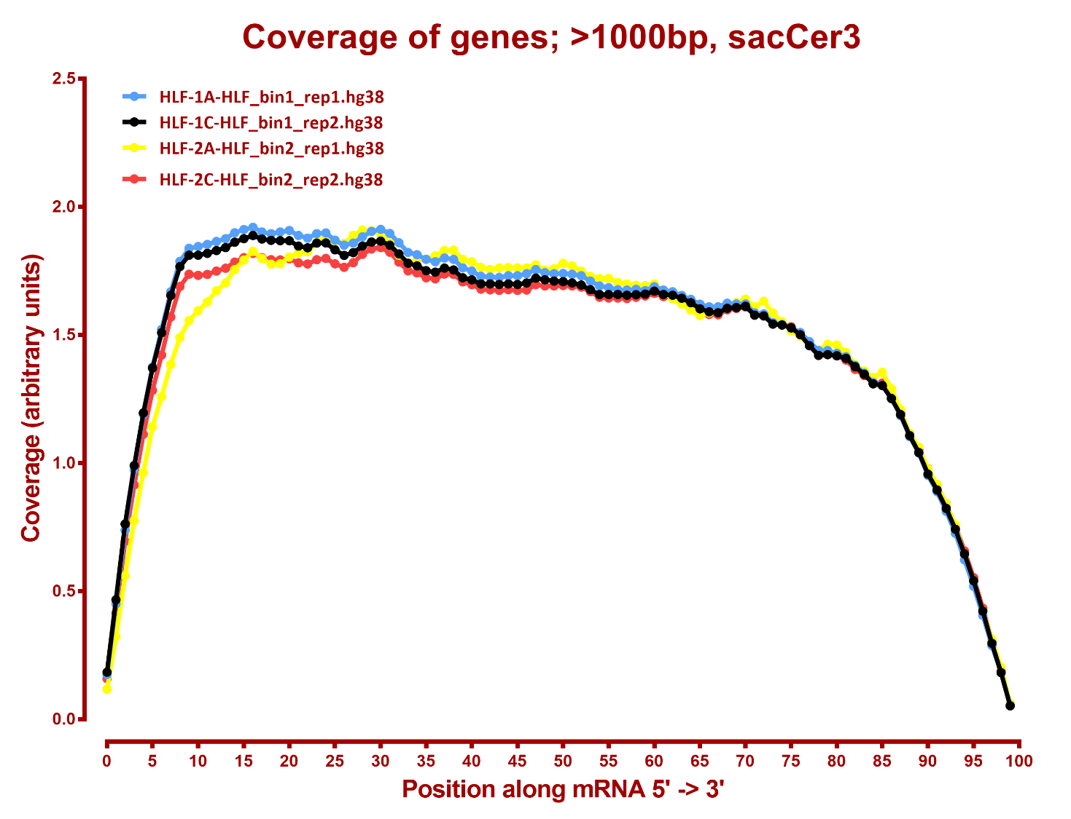

Slide 22
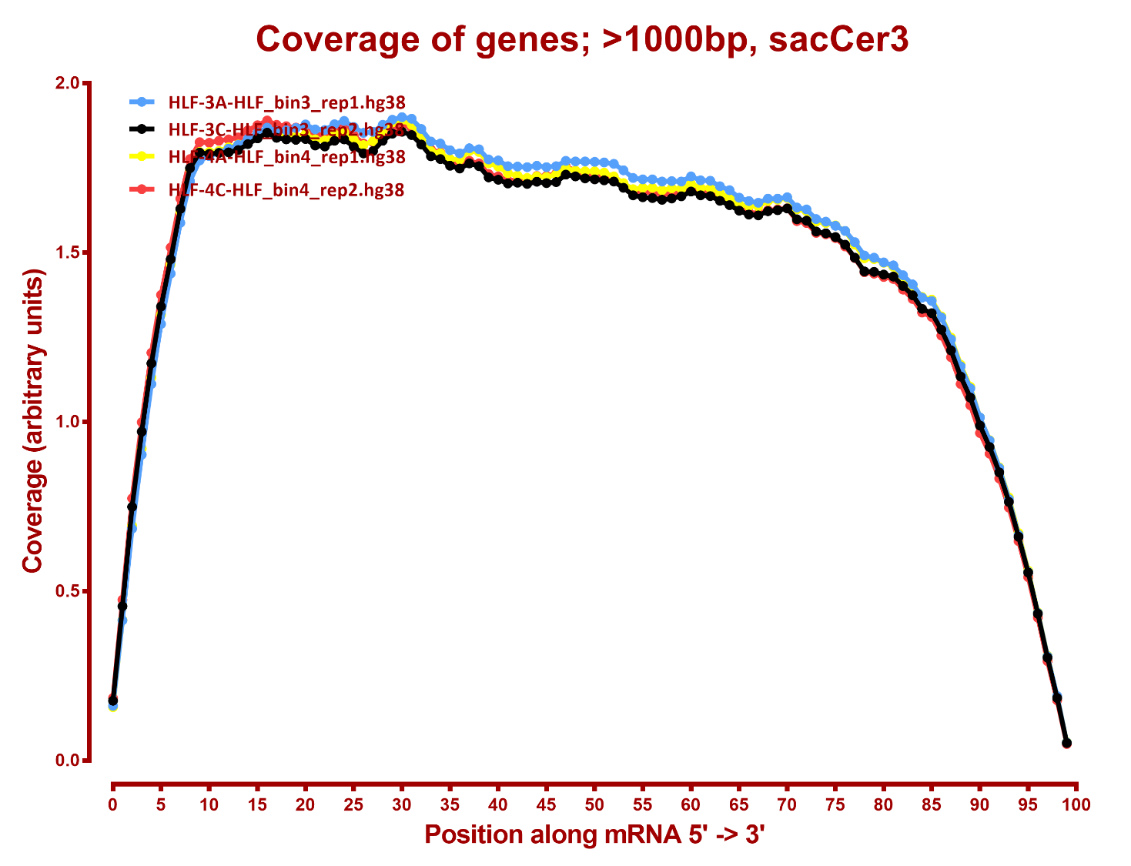

Slide 23
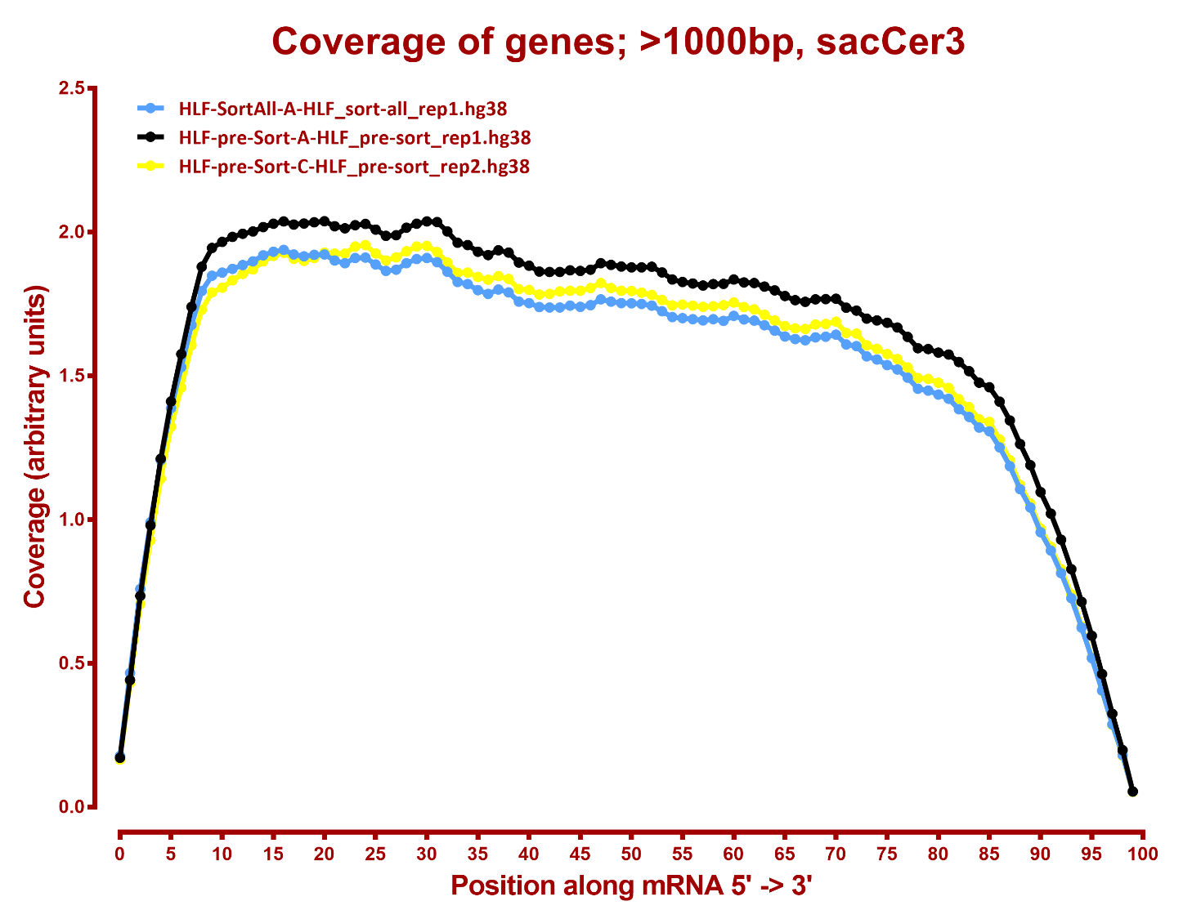

Slide 24
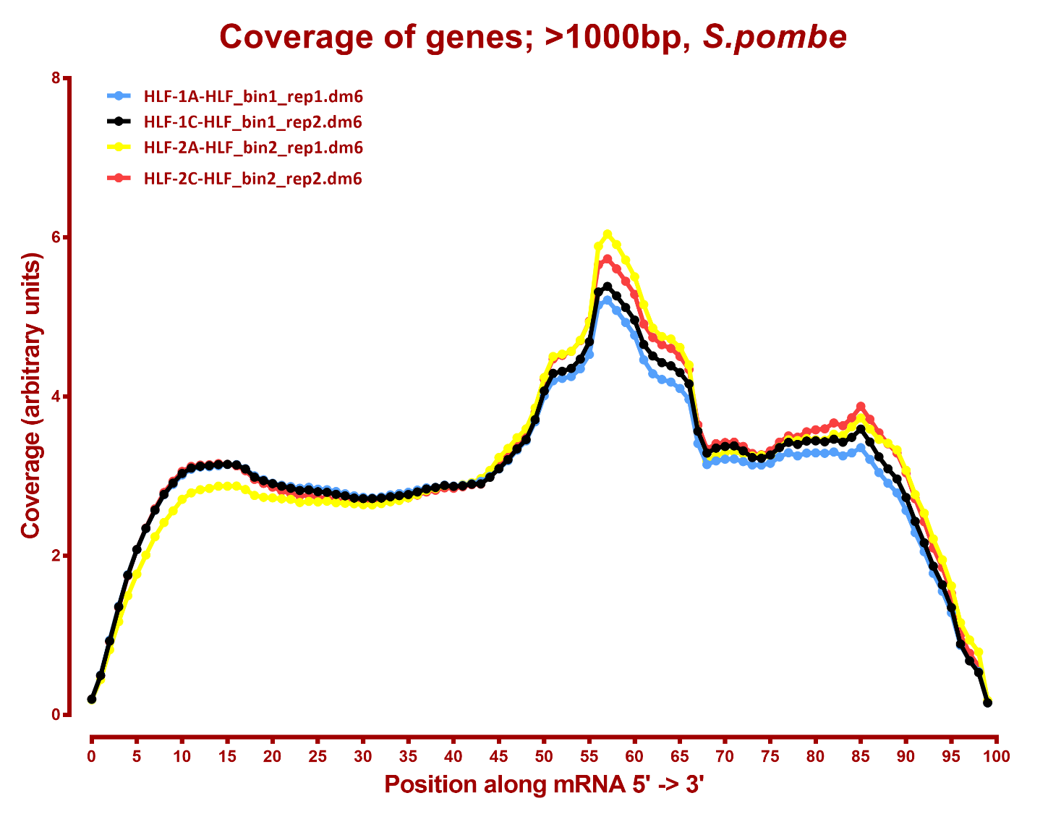

Slide 25
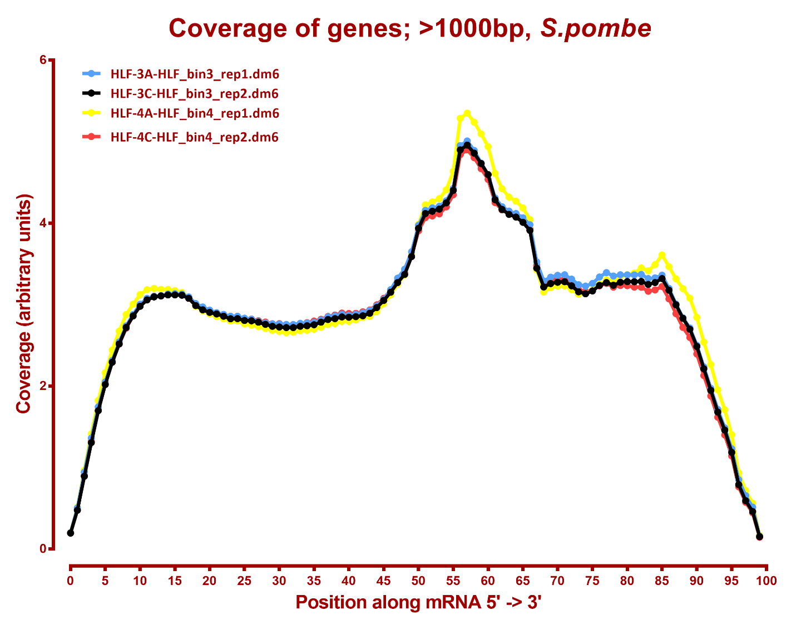

Slide 26
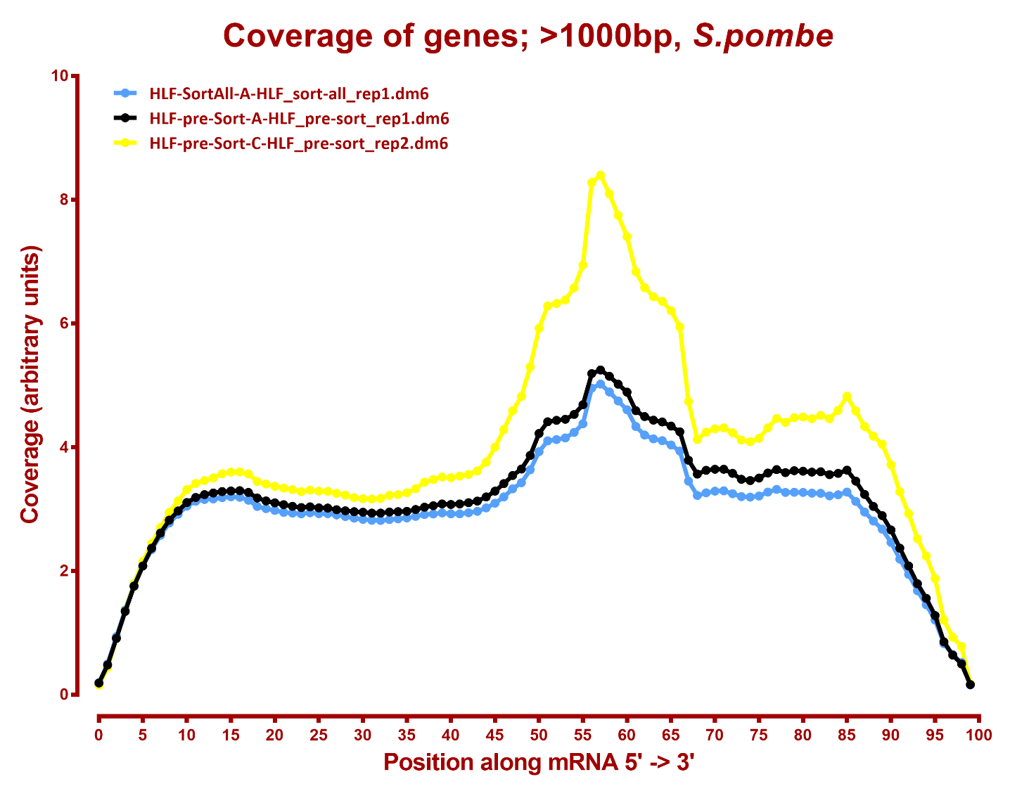

Slide 27
Number differential genes, hg38
A | B | p-adj |  | p-val
 |  | up in B vs A | down in B vs A | up in B vs A | down in B vs A
HLF_bin1 | HLF_bin2 | 10 | 30 | 565 | 552
HLF_bin1 | HLF_bin3 | 74 | 56 | 785 | 655
HLF_bin1 | HLF_bin4 | 237 | 81 | 1,075 | 786
HLF_bin1 | HLF_pre-sort | 97 | 155 | 882 | 1,084
HLF_bin1 | HLF_sort-all | 12 | 11 | 582 | 564
HLF_bin2 | HLF_bin3 | 9 | 3 | 589 | 514
HLF_bin2 | HLF_bin4 | 90 | 9 | 822 | 621
HLF_bin2 | HLF_pre-sort | 93 | 195 | 1,047 | 1,199
HLF_bin2 | HLF_sort-all | 11 | 10 | 597 | 566
HLF_bin3 | HLF_bin4 | 13 | 1 | 313 | 192
HLF_bin3 | HLF_pre-sort | 6 | 62 | 336 | 632
HLF_bin3 | HLF_sort-all | 2 | 1 | 314 | 275
HLF_bin4 | HLF_pre-sort | 2 | 53 | 384 | 736
HLF_bin4 | HLF_sort-all | 2 | 11 | 367 | 475
HLF_sort-all | HLF_pre-sort | 2 | 26 | 322 | 678

Slide 28
Number differential genes, dm6
A | B | p-adj |  | p-val
 |  | up in B vs A | down in B vs A | up in B vs A | down in B vs A
HLF_bin1 | HLF_bin2 | 0 | 1 | 31 | 43
HLF_bin1 | HLF_bin3 | 1 | 1 | 30 | 28
HLF_bin1 | HLF_bin4 | 0 | 1 | 30 | 29
HLF_bin1 | HLF_pre-sort | 128 | 399 | 660 | 854
HLF_bin1 | HLF_sort-all | 1 | 1 | 53 | 42
HLF_bin2 | HLF_bin3 | 2 | 0 | 56 | 35
HLF_bin2 | HLF_bin4 | 0 | 0 | 46 | 37
HLF_bin2 | HLF_pre-sort | 302 | 582 | 846 | 1,020
HLF_bin2 | HLF_sort-all | 4 | 0 | 74 | 60
HLF_bin3 | HLF_bin4 | 0 | 1 | 29 | 29
HLF_bin3 | HLF_pre-sort | 103 | 333 | 600 | 785
HLF_bin3 | HLF_sort-all | 1 | 1 | 44 | 41
HLF_bin4 | HLF_pre-sort | 136 | 373 | 650 | 844
HLF_bin4 | HLF_sort-all | 1 | 0 | 56 | 44
HLF_sort-all | HLF_pre-sort | 8 | 94 | 509 | 601

