Slide 1
MAPPING STATS
Library | Read Length | Mapping | Species | Raw fragments | Complexity | Unique | Unique Splices | Multi | Multi Splices | Fraction mapped
2019-10-01-F1 | 2x150 | STAR-2.5.3a | S_pombe | 4,856,657 | 0.59 | 2,949,702 | 217,172 | 53,807 | 6,795 | 0.33
2019-10-01-F1 | 2x150 | STAR-2.5.3a | sacCer3 | 4,856,657 | 0.53 | 5,622,692 | 152,534 | 286,640 | 6,238 | 0.62
2019-10-01-F2 | 2x150 | STAR-2.5.3a | S_pombe | 4,447,843 | 0.56 | 3,416,193 | 260,675 | 64,091 | 8,933 | 0.42
2019-10-01-F2 | 2x150 | STAR-2.5.3a | sacCer3 | 4,447,843 | 0.53 | 4,304,541 | 120,835 | 220,022 | 4,628 | 0.52
2019-10-01-F3 | 2x150 | STAR-2.5.3a | S_pombe | 4,358,054 | 0.64 | 2,460,013 | 192,335 | 43,804 | 5,524 | 0.31
2019-10-01-F3 | 2x150 | STAR-2.5.3a | sacCer3 | 4,358,054 | 0.56 | 5,239,186 | 140,904 | 270,440 | 6,984 | 0.65
2019-10-01-F4 | 2x150 | STAR-2.5.3a | S_pombe | 3,838,058 | 0.83 | 304 | 26 | 471 | 1 | 0.00
2019-10-01-F4 | 2x150 | STAR-2.5.3a | sacCer3 | 3,838,058 | 0.53 | 6,668,496 | 173,156 | 366,499 | 8,571 | 0.94

Slide 2
READ DISTRIBUTION
# | Exonic: | Intergenic: | Intronic:
2019-10-01-F1-STAR-2.5.3a.Schizosaccharomyces_pombe.ASM294v2.20 | 0.98 | 0.01 | 0.01
2019-10-01-F1-STAR-2.5.3a.sacCer3 | 0.91 | 0.08 | 0.00
2019-10-01-F2-STAR-2.5.3a.Schizosaccharomyces_pombe.ASM294v2.20 | 0.98 | 0.01 | 0.01
2019-10-01-F2-STAR-2.5.3a.sacCer3 | 0.91 | 0.09 | 0.00
2019-10-01-F3-STAR-2.5.3a.Schizosaccharomyces_pombe.ASM294v2.20 | 0.98 | 0.01 | 0.01
2019-10-01-F3-STAR-2.5.3a.sacCer3 | 0.91 | 0.09 | 0.00
2019-10-01-F4-STAR-2.5.3a.Schizosaccharomyces_pombe.ASM294v2.20 | 0.99 | 0.01 | 0.00
2019-10-01-F4-STAR-2.5.3a.sacCer3 | 0.91 | 0.08 | 0.00

Slide 3
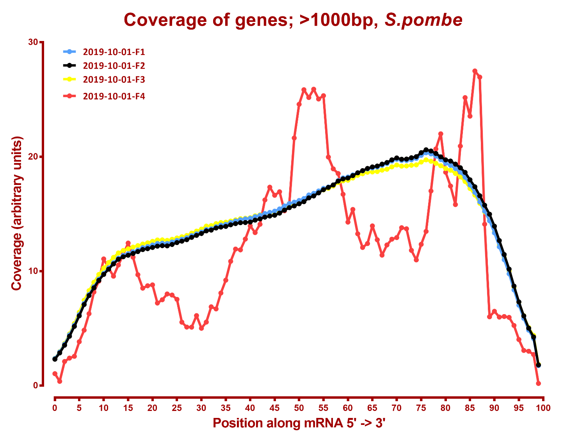

Slide 4
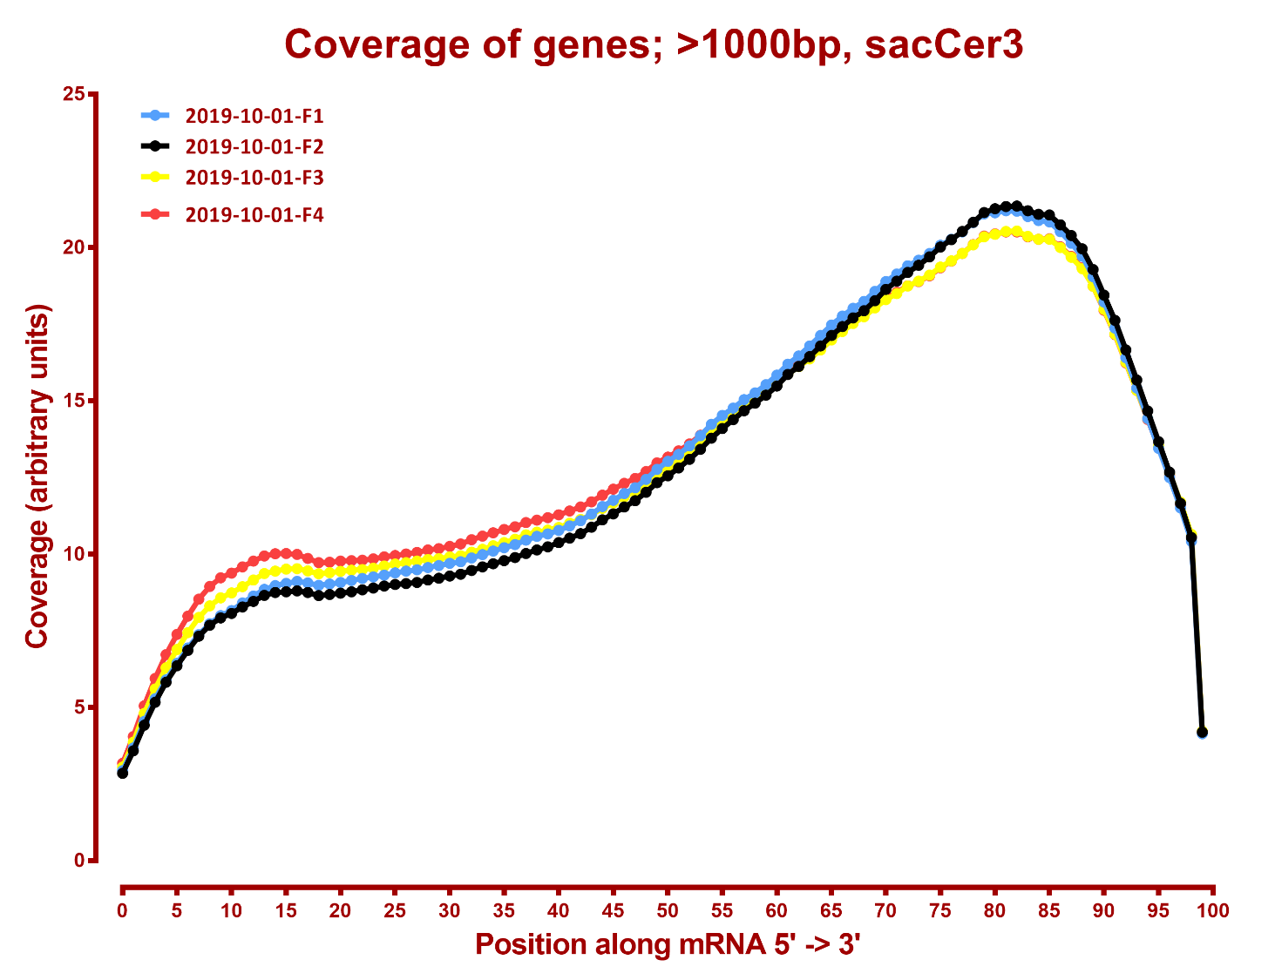

Slide 5
# | 2019-07-06-G2M_1_rep1-A1 | 2019-07-06-G2M_1_rep2-A2 | 2019-07-06-G2M_2_rep1-B1 | 2019-07-06-G2M_2_rep1-B2 | 2019-07-06-G2M_3_rep1-C1 | 2019-07-06-G2M_3_rep2-C2 | 2019-07-06-G2M_4_rep1-D1 | 2019-07-06-G2M_4_rep2-D2 | 2019-07-06-input_rep1-E1 | 2019-07-06-input_rep2-E2 | 2019-07-06-unstained_input_rep1-F1 | 2019-07-06-unstained_input_rep2-F2 | 2019-08-21-A3-G2M_1_rep3 | 2019-08-21-A4-G2M_1_rep4 | 2019-08-21-B3-G2M_2_rep3 | 2019-08-21-B4-G2M_2_rep4 | 2019-08-21-C3-G2M_3_rep3 | 2019-08-21-C4-G2M_3_rep4 | 2019-08-21-D3-G2M_4_rep3 | 2019-08-21-D4-G2M_4_rep4 | 2019-08-21-E3-input_rep3 | 2019-08-21-E4-input_rep4 | 2019-08-21-F3-unstained_input_rep3 | 2019-08-21-F4-unstained_input_rep4 | 2019-10-01-F1 | 2019-10-01-F2 | 2019-10-01-F3 | 2019-10-01-F4
2019-07-06-G2M_1_rep1-A1 | 1.00 | 0.99 | 0.99 | 0.98 | 0.97 | 0.97 | 0.96 | 0.96 | 0.99 | 0.99 | 0.99 | 0.98 | 0.62 | 0.65 | 0.58 | 0.63 | 0.60 | 0.63 | 0.68 | 0.67 | 0.57 | 0.65 | 0.65 | 0.62 | 0.96 | 0.97 | 0.97 | 0.92
2019-07-06-G2M_1_rep2-A2 | 0.99 | 1.00 | 0.98 | 0.99 | 0.98 | 0.98 | 0.97 | 0.97 | 0.97 | 0.98 | 0.98 | 0.99 | 0.64 | 0.66 | 0.59 | 0.64 | 0.61 | 0.64 | 0.70 | 0.68 | 0.57 | 0.66 | 0.66 | 0.63 | 0.96 | 0.96 | 0.96 | 0.91
2019-07-06-G2M_2_rep1-B1 | 0.99 | 0.98 | 1.00 | 0.98 | 0.98 | 0.98 | 0.97 | 0.97 | 0.99 | 0.99 | 0.99 | 0.98 | 0.66 | 0.70 | 0.63 | 0.67 | 0.65 | 0.68 | 0.74 | 0.72 | 0.61 | 0.70 | 0.70 | 0.66 | 0.96 | 0.98 | 0.98 | 0.93
2019-07-06-G2M_2_rep1-B2 | 0.98 | 0.99 | 0.98 | 1.00 | 0.99 | 0.99 | 0.99 | 0.98 | 0.98 | 0.99 | 0.98 | 0.99 | 0.64 | 0.67 | 0.60 | 0.65 | 0.62 | 0.65 | 0.71 | 0.70 | 0.58 | 0.67 | 0.67 | 0.63 | 0.97 | 0.97 | 0.96 | 0.91
2019-07-06-G2M_3_rep1-C1 | 0.97 | 0.98 | 0.98 | 0.99 | 1.00 | 1.00 | 1.00 | 1.00 | 0.98 | 0.98 | 0.98 | 0.99 | 0.68 | 0.71 | 0.65 | 0.69 | 0.67 | 0.70 | 0.77 | 0.75 | 0.63 | 0.72 | 0.72 | 0.68 | 0.97 | 0.97 | 0.96 | 0.91
2019-07-06-G2M_3_rep2-C2 | 0.97 | 0.98 | 0.98 | 0.99 | 1.00 | 1.00 | 1.00 | 1.00 | 0.98 | 0.98 | 0.98 | 0.99 | 0.66 | 0.70 | 0.63 | 0.68 | 0.65 | 0.69 | 0.75 | 0.73 | 0.61 | 0.71 | 0.70 | 0.67 | 0.97 | 0.97 | 0.96 | 0.91
2019-07-06-G2M_4_rep1-D1 | 0.96 | 0.97 | 0.97 | 0.99 | 1.00 | 1.00 | 1.00 | 1.00 | 0.98 | 0.98 | 0.98 | 0.99 | 0.67 | 0.70 | 0.63 | 0.68 | 0.66 | 0.69 | 0.76 | 0.74 | 0.62 | 0.71 | 0.71 | 0.67 | 0.97 | 0.97 | 0.96 | 0.91
2019-07-06-G2M_4_rep2-D2 | 0.96 | 0.97 | 0.97 | 0.98 | 1.00 | 1.00 | 1.00 | 1.00 | 0.98 | 0.98 | 0.98 | 0.99 | 0.68 | 0.71 | 0.64 | 0.69 | 0.67 | 0.70 | 0.76 | 0.75 | 0.63 | 0.72 | 0.72 | 0.68 | 0.97 | 0.96 | 0.96 | 0.91
2019-07-06-input_rep1-E1 | 0.99 | 0.97 | 0.99 | 0.98 | 0.98 | 0.98 | 0.98 | 0.98 | 1.00 | 1.00 | 1.00 | 0.98 | 0.65 | 0.68 | 0.61 | 0.66 | 0.63 | 0.66 | 0.73 | 0.71 | 0.60 | 0.69 | 0.69 | 0.66 | 0.97 | 0.98 | 0.98 | 0.93
2019-07-06-input_rep2-E2 | 0.99 | 0.98 | 0.99 | 0.99 | 0.98 | 0.98 | 0.98 | 0.98 | 1.00 | 1.00 | 1.00 | 0.99 | 0.65 | 0.68 | 0.61 | 0.65 | 0.63 | 0.66 | 0.72 | 0.71 | 0.60 | 0.69 | 0.68 | 0.65 | 0.97 | 0.98 | 0.98 | 0.93
2019-07-06-unstained_input_rep1-F1 | 0.99 | 0.98 | 0.99 | 0.98 | 0.98 | 0.98 | 0.98 | 0.98 | 1.00 | 1.00 | 1.00 | 0.99 | 0.66 | 0.69 | 0.61 | 0.66 | 0.63 | 0.66 | 0.73 | 0.71 | 0.60 | 0.69 | 0.69 | 0.66 | 0.97 | 0.98 | 0.98 | 0.93
2019-07-06-unstained_input_rep2-F2 | 0.98 | 0.99 | 0.98 | 0.99 | 0.99 | 0.99 | 0.99 | 0.99 | 0.98 | 0.99 | 0.99 | 1.00 | 0.68 | 0.71 | 0.64 | 0.68 | 0.66 | 0.69 | 0.75 | 0.74 | 0.63 | 0.72 | 0.72 | 0.68 | 0.98 | 0.97 | 0.97 | 0.92
2019-08-21-A3-G2M_1_rep3 | 0.62 | 0.64 | 0.66 | 0.64 | 0.68 | 0.66 | 0.67 | 0.68 | 0.65 | 0.65 | 0.66 | 0.68 | 1.00 | 0.99 | 0.96 | 0.98 | 0.94 | 0.97 | 0.95 | 0.96 | 0.94 | 0.98 | 0.98 | 0.98 | 0.67 | 0.68 | 0.69 | 0.65
2019-08-21-A4-G2M_1_rep4 | 0.65 | 0.66 | 0.70 | 0.67 | 0.71 | 0.70 | 0.70 | 0.71 | 0.68 | 0.68 | 0.69 | 0.71 | 0.99 | 1.00 | 0.96 | 0.99 | 0.95 | 0.97 | 0.96 | 0.97 | 0.95 | 0.99 | 0.99 | 0.98 | 0.70 | 0.71 | 0.72 | 0.68
2019-08-21-B3-G2M_2_rep3 | 0.58 | 0.59 | 0.63 | 0.60 | 0.65 | 0.63 | 0.63 | 0.64 | 0.61 | 0.61 | 0.61 | 0.64 | 0.96 | 0.96 | 1.00 | 0.99 | 0.99 | 0.97 | 0.93 | 0.95 | 0.98 | 0.95 | 0.96 | 0.97 | 0.62 | 0.63 | 0.64 | 0.60
2019-08-21-B4-G2M_2_rep4 | 0.63 | 0.64 | 0.67 | 0.65 | 0.69 | 0.68 | 0.68 | 0.69 | 0.66 | 0.65 | 0.66 | 0.68 | 0.98 | 0.99 | 0.99 | 1.00 | 0.98 | 0.99 | 0.96 | 0.97 | 0.96 | 0.98 | 0.99 | 0.98 | 0.66 | 0.67 | 0.68 | 0.64
2019-08-21-C3-G2M_3_rep3 | 0.60 | 0.61 | 0.65 | 0.62 | 0.67 | 0.65 | 0.66 | 0.67 | 0.63 | 0.63 | 0.63 | 0.66 | 0.94 | 0.95 | 0.99 | 0.98 | 1.00 | 0.97 | 0.94 | 0.95 | 0.97 | 0.95 | 0.96 | 0.97 | 0.63 | 0.64 | 0.65 | 0.61
2019-08-21-C4-G2M_3_rep4 | 0.63 | 0.64 | 0.68 | 0.65 | 0.70 | 0.69 | 0.69 | 0.70 | 0.66 | 0.66 | 0.66 | 0.69 | 0.97 | 0.97 | 0.97 | 0.99 | 0.97 | 1.00 | 0.98 | 0.99 | 0.94 | 0.98 | 0.99 | 0.98 | 0.67 | 0.68 | 0.69 | 0.65
2019-08-21-D3-G2M_4_rep3 | 0.68 | 0.70 | 0.74 | 0.71 | 0.77 | 0.75 | 0.76 | 0.76 | 0.73 | 0.72 | 0.73 | 0.75 | 0.95 | 0.96 | 0.93 | 0.96 | 0.94 | 0.98 | 1.00 | 1.00 | 0.91 | 0.98 | 0.98 | 0.96 | 0.73 | 0.74 | 0.75 | 0.71
2019-08-21-D4-G2M_4_rep4 | 0.67 | 0.68 | 0.72 | 0.70 | 0.75 | 0.73 | 0.74 | 0.75 | 0.71 | 0.71 | 0.71 | 0.74 | 0.96 | 0.97 | 0.95 | 0.97 | 0.95 | 0.99 | 1.00 | 1.00 | 0.93 | 0.98 | 0.98 | 0.97 | 0.72 | 0.72 | 0.74 | 0.70
2019-08-21-E3-input_rep3 | 0.57 | 0.57 | 0.61 | 0.58 | 0.63 | 0.61 | 0.62 | 0.63 | 0.60 | 0.60 | 0.60 | 0.63 | 0.94 | 0.95 | 0.98 | 0.96 | 0.97 | 0.94 | 0.91 | 0.93 | 1.00 | 0.94 | 0.95 | 0.97 | 0.61 | 0.62 | 0.63 | 0.59
2019-08-21-E4-input_rep4 | 0.65 | 0.66 | 0.70 | 0.67 | 0.72 | 0.71 | 0.71 | 0.72 | 0.69 | 0.69 | 0.69 | 0.72 | 0.98 | 0.99 | 0.95 | 0.98 | 0.95 | 0.98 | 0.98 | 0.98 | 0.94 | 1.00 | 0.99 | 0.99 | 0.70 | 0.71 | 0.72 | 0.68
2019-08-21-F3-unstained_input_rep3 | 0.65 | 0.66 | 0.70 | 0.67 | 0.72 | 0.70 | 0.71 | 0.72 | 0.69 | 0.68 | 0.69 | 0.72 | 0.98 | 0.99 | 0.96 | 0.99 | 0.96 | 0.99 | 0.98 | 0.98 | 0.95 | 0.99 | 1.00 | 0.99 | 0.69 | 0.70 | 0.71 | 0.67
2019-08-21-F4-unstained_input_rep4 | 0.62 | 0.63 | 0.66 | 0.63 | 0.68 | 0.67 | 0.67 | 0.68 | 0.66 | 0.65 | 0.66 | 0.68 | 0.98 | 0.98 | 0.97 | 0.98 | 0.97 | 0.98 | 0.96 | 0.97 | 0.97 | 0.99 | 0.99 | 1.00 | 0.67 | 0.67 | 0.68 | 0.65
2019-10-01-F1 | 0.96 | 0.96 | 0.96 | 0.97 | 0.97 | 0.97 | 0.97 | 0.97 | 0.97 | 0.97 | 0.97 | 0.98 | 0.67 | 0.70 | 0.62 | 0.66 | 0.63 | 0.67 | 0.73 | 0.72 | 0.61 | 0.70 | 0.69 | 0.67 | 1.00 | 0.99 | 0.99 | 0.94
2019-10-01-F2 | 0.97 | 0.96 | 0.98 | 0.97 | 0.97 | 0.97 | 0.97 | 0.96 | 0.98 | 0.98 | 0.98 | 0.97 | 0.68 | 0.71 | 0.63 | 0.67 | 0.64 | 0.68 | 0.74 | 0.72 | 0.62 | 0.71 | 0.70 | 0.67 | 0.99 | 1.00 | 0.99 | 0.95
2019-10-01-F3 | 0.97 | 0.96 | 0.98 | 0.96 | 0.96 | 0.96 | 0.96 | 0.96 | 0.98 | 0.98 | 0.98 | 0.97 | 0.69 | 0.72 | 0.64 | 0.68 | 0.65 | 0.69 | 0.75 | 0.74 | 0.63 | 0.72 | 0.71 | 0.68 | 0.99 | 0.99 | 1.00 | 0.96
2019-10-01-F4 | 0.92 | 0.91 | 0.93 | 0.91 | 0.91 | 0.91 | 0.91 | 0.91 | 0.93 | 0.93 | 0.93 | 0.92 | 0.65 | 0.68 | 0.60 | 0.64 | 0.61 | 0.65 | 0.71 | 0.70 | 0.59 | 0.68 | 0.67 | 0.65 | 0.94 | 0.95 | 0.96 | 1.00
S. cerevisiae protein coding

