Slide 1
MAPPING STATS
Library | Read Length | Mapping | Species | Raw fragments | Complexity | Unique | Unique Splices | Multi | Multi Splices | Fraction mapped
A3-G2M_1_rep3 | 2x150 | STAR-2.5.3a | S_pombe | 40,578,753 | 0.28 | 36,073,151 | 3,170,871 | 645,088 | 152,292 | 0.49
A3-G2M_1_rep3 | 2x150 | STAR-2.5.3a | sacCer3 | 40,578,753 | 0.27 | 36,302,910 | 989,238 | 1,865,029 | 80,345 | 0.48
A4-G2M_1_rep4 | 2x150 | STAR-2.5.3a | S_pombe | 42,423,531 | 0.26 | 49,316,027 | 4,417,741 | 1,047,791 | 253,495 | 0.65
A4-G2M_1_rep4 | 2x150 | STAR-2.5.3a | sacCer3 | 42,423,531 | 0.27 | 25,537,086 | 751,758 | 1,425,701 | 65,509 | 0.33
B3-G2M_2_rep3 | 2x150 | STAR-2.5.3a | S_pombe | 41,568,094 | 0.25 | 38,251,302 | 3,372,154 | 631,962 | 184,154 | 0.51
B3-G2M_2_rep3 | 2x150 | STAR-2.5.3a | sacCer3 | 41,568,094 | 0.25 | 35,700,696 | 812,906 | 1,847,450 | 102,548 | 0.46
B4-G2M_2_rep4 | 2x150 | STAR-2.5.3a | S_pombe | 41,614,983 | 0.25 | 40,117,813 | 3,622,171 | 739,815 | 189,665 | 0.54
B4-G2M_2_rep4 | 2x150 | STAR-2.5.3a | sacCer3 | 41,614,983 | 0.25 | 33,525,605 | 970,979 | 1,841,606 | 77,364 | 0.44
C3-G2M_3_rep3 | 2x150 | STAR-2.5.3a | S_pombe | 42,618,137 | 0.18 | 32,145,296 | 2,856,548 | 523,779 | 132,239 | 0.42
C3-G2M_3_rep3 | 2x150 | STAR-2.5.3a | sacCer3 | 42,618,137 | 0.17 | 43,135,910 | 988,178 | 2,411,361 | 94,523 | 0.55
C4-G2M_3_rep4 | 2x150 | STAR-2.5.3a | S_pombe | 46,341,502 | 0.29 | 41,983,420 | 3,868,282 | 740,299 | 206,131 | 0.50
C4-G2M_3_rep4 | 2x150 | STAR-2.5.3a | sacCer3 | 46,341,502 | 0.27 | 40,790,979 | 1,126,775 | 2,142,002 | 98,562 | 0.48
D3-G2M_4_rep3 | 2x150 | STAR-2.5.3a | S_pombe | 41,674,662 | 0.32 | 26,683,779 | 2,419,169 | 424,890 | 119,634 | 0.36
D3-G2M_4_rep3 | 2x150 | STAR-2.5.3a | sacCer3 | 41,674,662 | 0.27 | 47,449,518 | 1,336,822 | 2,639,507 | 120,679 | 0.62
D4-G2M_4_rep4 | 2x150 | STAR-2.5.3a | S_pombe | 40,642,869 | 0.29 | 35,842,623 | 3,345,305 | 628,582 | 154,648 | 0.49
D4-G2M_4_rep4 | 2x150 | STAR-2.5.3a | sacCer3 | 40,642,869 | 0.27 | 36,119,880 | 1,164,412 | 2,191,363 | 90,989 | 0.49
E3-input_rep3 | 2x150 | STAR-2.5.3a | S_pombe | 40,865,855 | 0.27 | 17,398,727 | 1,621,783 | 303,137 | 78,791 | 0.24
E3-input_rep3 | 2x150 | STAR-2.5.3a | sacCer3 | 40,865,855 | 0.22 | 54,937,099 | 1,384,973 | 3,409,252 | 143,840 | 0.73
E4-input_rep4 | 2x150 | STAR-2.5.3a | S_pombe | 39,236,211 | 0.61 | 132 | 16 | 241 | 7 | 0.00
E4-input_rep4 | 2x150 | STAR-2.5.3a | sacCer3 | 39,236,211 | 0.22 | 69,444,592 | 2,320,210 | 4,517,134 | 240,060 | 0.98
F3-unstained_input_rep3 | 2x150 | STAR-2.5.3a | S_pombe | 42,286,018 | 0.28 | 21,795,416 | 2,032,250 | 397,258 | 84,650 | 0.29
F3-unstained_input_rep3 | 2x150 | STAR-2.5.3a | sacCer3 | 42,286,018 | 0.23 | 53,385,142 | 1,698,254 | 3,142,950 | 170,286 | 0.69
F4-unstained_input_rep4 | 2x150 | STAR-2.5.3a | S_pombe | 40,647,301 | 0.44 | 3,049 | 237 | 270 | 4 | 0.00
F4-unstained_input_rep4 | 2x150 | STAR-2.5.3a | sacCer3 | 40,647,301 | 0.24 | 73,176,020 | 1,934,778 | 3,983,091 | 225,773 | 0.98

Slide 2
READ DISTRIBUTION
2019-08-21-A3-G2M_1_rep3.S_pombe | 0.97 | 0.02 | 0.01
2019-08-21-A3-G2M_1_rep3.sacCer3 | 0.89 | 0.10 | 0.01
2019-08-21-A4-G2M_1_rep4.S_pombe | 0.97 | 0.02 | 0.01
2019-08-21-A4-G2M_1_rep4.sacCer3 | 0.89 | 0.11 | 0.00
2019-08-21-B3-G2M_2_rep3.S_pombe | 0.97 | 0.03 | 0.01
2019-08-21-B3-G2M_2_rep3.sacCer3 | 0.89 | 0.11 | 0.01
2019-08-21-B4-G2M_2_rep4.S_pombe | 0.97 | 0.02 | 0.01
2019-08-21-B4-G2M_2_rep4.sacCer3 | 0.89 | 0.11 | 0.00
2019-08-21-C3-G2M_3_rep3.S_pombe | 0.97 | 0.03 | 0.01
2019-08-21-C3-G2M_3_rep3.sacCer3 | 0.88 | 0.12 | 0.00
2019-08-21-C4-G2M_3_rep4.S_pombe | 0.97 | 0.02 | 0.01
2019-08-21-C4-G2M_3_rep4.sacCer3 | 0.90 | 0.10 | 0.00
2019-08-21-D3-G2M_4_rep3.S_pombe | 0.97 | 0.02 | 0.01
2019-08-21-D3-G2M_4_rep3.sacCer3 | 0.90 | 0.09 | 0.00
2019-08-21-D4-G2M_4_rep4.S_pombe | 0.97 | 0.02 | 0.01
2019-08-21-D4-G2M_4_rep4.sacCer3 | 0.90 | 0.09 | 0.00
2019-08-21-E3-input_rep3.S_pombe | 0.97 | 0.02 | 0.01
2019-08-21-E3-input_rep3.sacCer3 | 0.90 | 0.10 | 0.00
2019-08-21-E4-input_rep4.S_pombe | 0.99 | 0.01 | 0.00
2019-08-21-E4-input_rep4.sacCer3 | 0.89 | 0.10 | 0.00
2019-08-21-F3-unstained_input_rep3.S_pombe | 0.97 | 0.02 | 0.01
2019-08-21-F3-unstained_input_rep3.sacCer3 | 0.89 | 0.11 | 0.00
2019-08-21-F4-unstained_input_rep4.S_pombe | 0.97 | 0.02 | 0.01
2019-08-21-F4-unstained_input_rep4.sacCer3 | 0.89 | 0.10 | 0.00

Slide 3
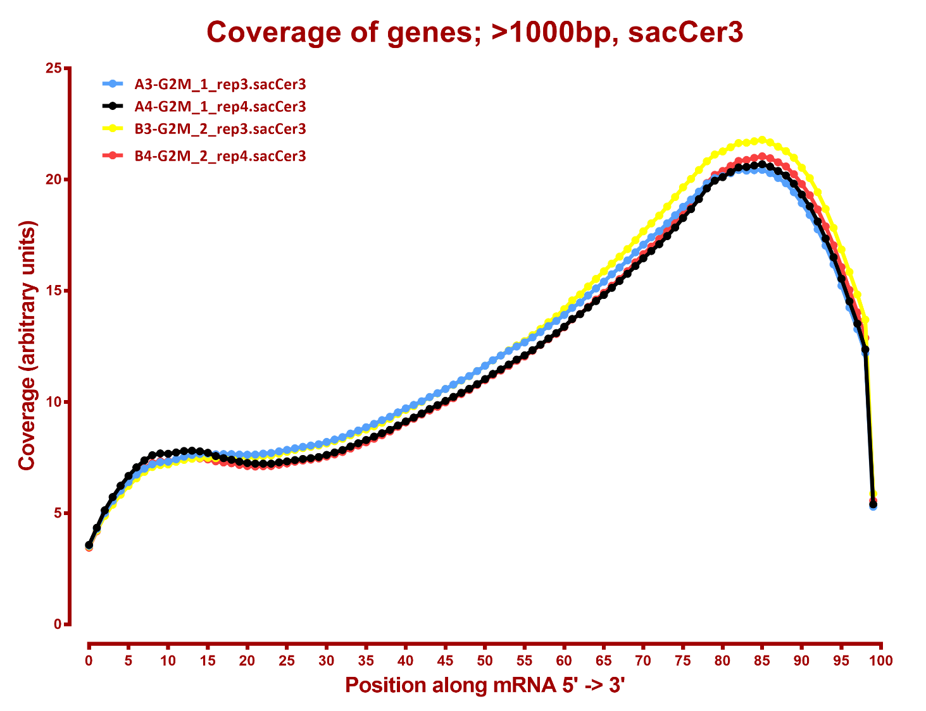

Slide 4
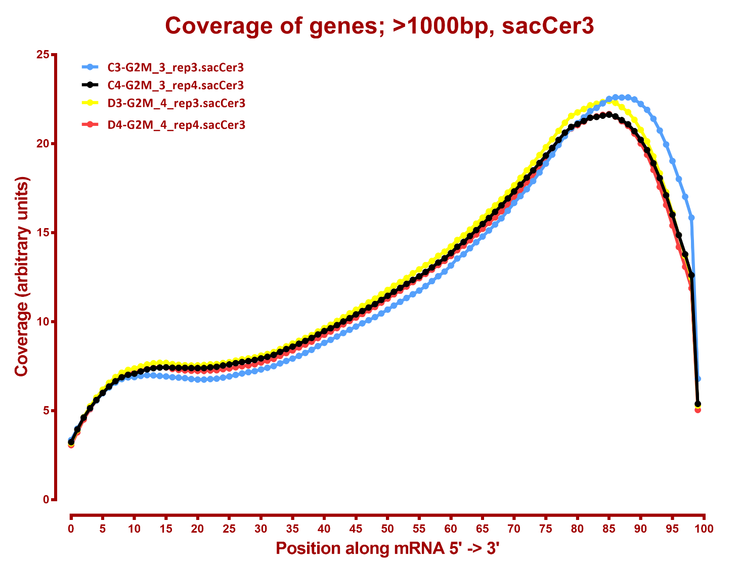

Slide 5
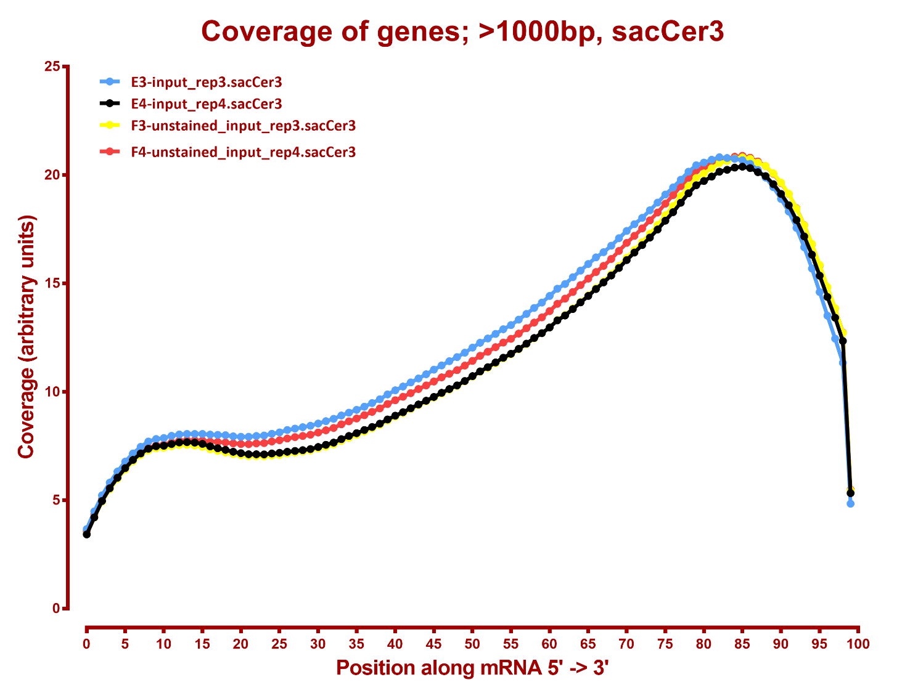

Slide 6
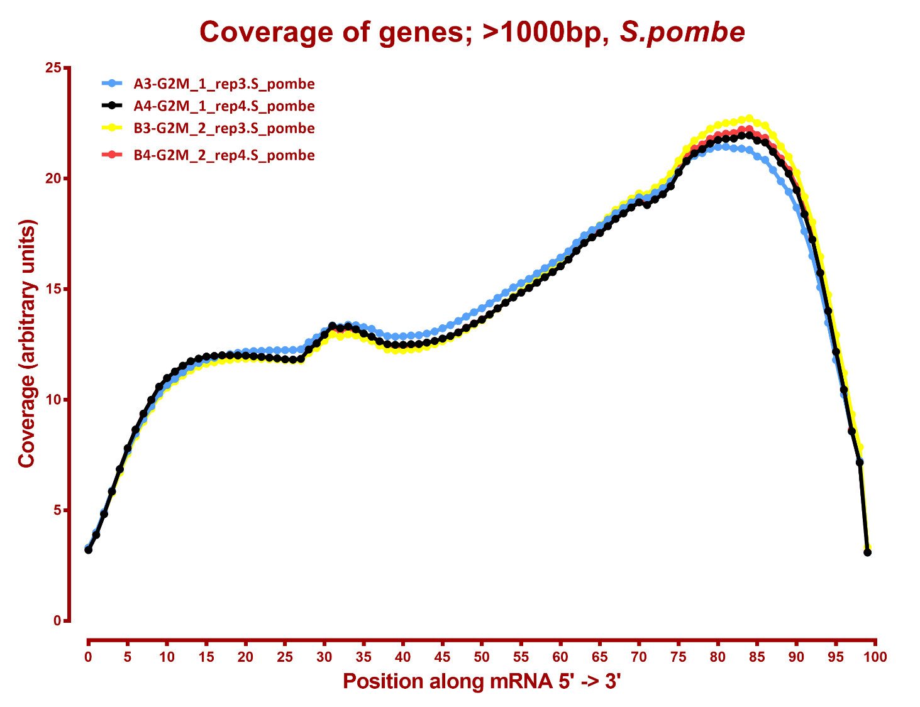

Slide 7
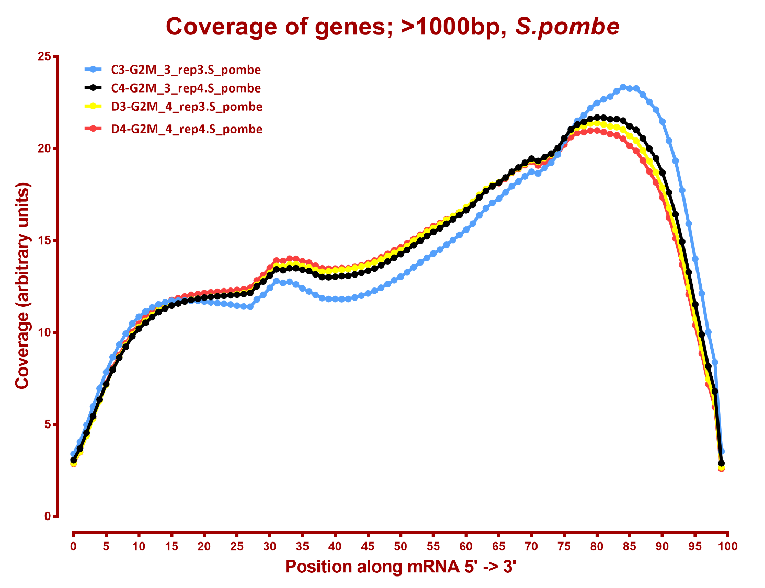

Slide 8
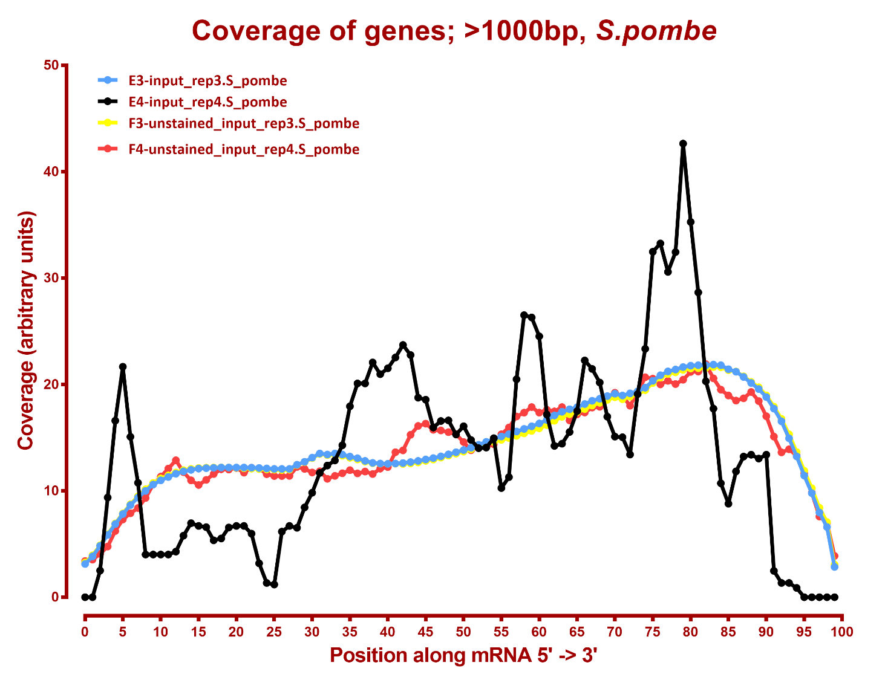

Slide 9
Number differential genes, sacCer3
A | B | p-adj |  | p-val
 |  | up in B vs A | down in B vs A | up in B vs A | down in B vs A
G2M_1 | G2M_2 | 78 | 26 | 339 | 221
G2M_1 | G2M_3 | 318 | 262 | 645 | 521
G2M_1 | G2M_4 | 716 | 558 | 1,072 | 869
G2M_1 | input | 513 | 281 | 839 | 584
G2M_1 | unstained_input | 331 | 163 | 628 | 419
G2M_2 | G2M_3 | 100 | 60 | 295 | 250
G2M_2 | G2M_4 | 720 | 472 | 1,162 | 870
G2M_2 | input | 257 | 119 | 571 | 382
G2M_2 | unstained_input | 176 | 59 | 437 | 273
G2M_3 | G2M_4 | 145 | 40 | 689 | 291
G2M_3 | input | 183 | 88 | 524 | 372
G2M_3 | unstained_input | 70 | 28 | 253 | 164
G2M_4 | input | 362 | 324 | 771 | 810
G2M_4 | unstained_input | 109 | 143 | 394 | 509
input | unstained_input | 0 | 3 | 69 | 124

Slide 10
Number differential genes, S. pombe
A | B | p-adj |  | p-val
 |  | up in B vs A | down in B vs A | up in B vs A | down in B vs A
G2M_1 | G2M_2 | 0 | 0 | 57 | 1
G2M_1 | G2M_3 | 0 | 0 | 110 | 0
G2M_1 | G2M_4 | 95 | 0 | 379 | 3
G2M_1 | input | 66 | 1 | 1,525 | 5
G2M_1 | unstained_input | 0 | 0 | 17 | 1
G2M_2 | G2M_3 | 0 | 0 | 7 | 0
G2M_2 | G2M_4 | 94 | 0 | 213 | 8
G2M_2 | input | 2 | 2 | 173 | 11
G2M_2 | unstained_input | 0 | 0 | 16 | 36
G2M_3 | G2M_4 | 46 | 0 | 138 | 6
G2M_3 | input | 1 | 1 | 144 | 15
G2M_3 | unstained_input | 0 | 0 | 14 | 59
G2M_4 | input | 1 | 37 | 215 | 144
G2M_4 | unstained_input | 1 | 23 | 13 | 181
input | unstained_input | 0 | 0 | 12 | 1092

Slide 11
MAPPING STATS

Slide 12
READ DISTRIBUTION
# | Exonic: | Intergenic: | Intronic:
2019-08-21-A00-190704_elutriation_A00.S_pombe | 1.00 | 0.00 | 0.00
2019-08-21-A00-190704_elutriation_A00.sacCer3 | 0.90 | 0.09 | 0.00
2019-08-21-A30-190704_elutriation_A30.S_pombe | 1.00 | 0.00 | 0.00
2019-08-21-A30-190704_elutriation_A30.sacCer3 | 0.92 | 0.08 | 0.00
2019-08-21-A45-190704_elutriation_A45.S_pombe | 1.00 | 0.00 | 0.00
2019-08-21-A45-190704_elutriation_A45.sacCer3 | 0.90 | 0.10 | 0.00
2019-08-21-A60-190704_elutriation_A60.S_pombe | 1.00 | 0.00 | 0.00
2019-08-21-A60-190704_elutriation_A60.sacCer3 | 0.92 | 0.08 | 0.00
2019-08-21-A75-190704_elutriation_A75.S_pombe | 1.00 | 0.00 | 0.00
2019-08-21-A75-190704_elutriation_A75.sacCer3 | 0.91 | 0.09 | 0.01
2019-08-21-A90-190704_elutriation_A90.S_pombe | 1.00 | 0.00 | 0.00
2019-08-21-A90-190704_elutriation_A90.sacCer3 | 0.91 | 0.09 | 0.01
2019-08-21-B00-190704_elutriation_A00.S_pombe | 0.97 | 0.03 | 0.00
2019-08-21-B00-190704_elutriation_A00.sacCer3 | 0.91 | 0.09 | 0.00
2019-08-21-B30-190704_elutriation_A30.S_pombe | 1.00 | 0.00 | 0.00
2019-08-21-B30-190704_elutriation_A30.sacCer3 | 0.91 | 0.08 | 0.00
2019-08-21-B45-190704_elutriation_A45.S_pombe | 1.00 | 0.00 | 0.00
2019-08-21-B45-190704_elutriation_A45.sacCer3 | 0.91 | 0.08 | 0.00
2019-08-21-B60-190704_elutriation_A60.S_pombe | 0.97 | 0.03 | 0.00
2019-08-21-B60-190704_elutriation_A60.sacCer3 | 0.91 | 0.09 | 0.00
2019-08-21-B75-190704_elutriation_A75.S_pombe | 1.00 | 0.00 | 0.00
2019-08-21-B75-190704_elutriation_A75.sacCer3 | 0.91 | 0.09 | 0.00
2019-08-21-B90-190704_elutriation_A90.S_pombe | 1.00 | 0.00 | 0.00
2019-08-21-B90-190704_elutriation_A90.sacCer3 | 0.91 | 0.08 | 0.00
2019-08-21-C00-190704_elutriation_A00.S_pombe | 0.97 | 0.02 | 0.01
2019-08-21-C00-190704_elutriation_A00.sacCer3 | 0.91 | 0.09 | 0.00
2019-08-21-C30-190704_elutriation_A30.S_pombe | 1.00 | 0.00 | 0.00
2019-08-21-C30-190704_elutriation_A30.sacCer3 | 0.92 | 0.07 | 0.00
2019-08-21-C45-190704_elutriation_A45.S_pombe | 1.00 | 0.00 | 0.00
2019-08-21-C45-190704_elutriation_A45.sacCer3 | 0.90 | 0.10 | 0.00
2019-08-21-C60-190704_elutriation_A60.S_pombe | 1.00 | 0.00 | 0.00
2019-08-21-C60-190704_elutriation_A60.sacCer3 | 0.89 | 0.10 | 0.00
2019-08-21-C75-190704_elutriation_A75.S_pombe | 1.00 | 0.00 | 0.00
2019-08-21-C75-190704_elutriation_A75.sacCer3 | 0.91 | 0.09 | 0.00
2019-08-21-C90-190704_elutriation_A90.S_pombe | 0.95 | 0.02 | 0.02
2019-08-21-C90-190704_elutriation_A90.sacCer3 | 0.90 | 0.10 | 0.00

Slide 13
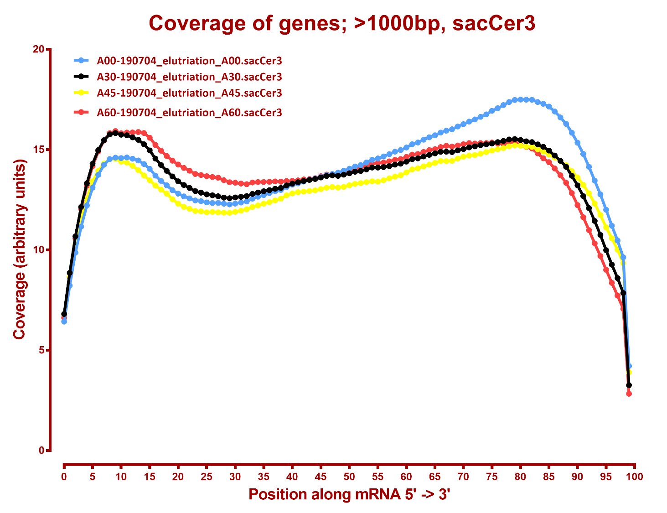

Slide 14
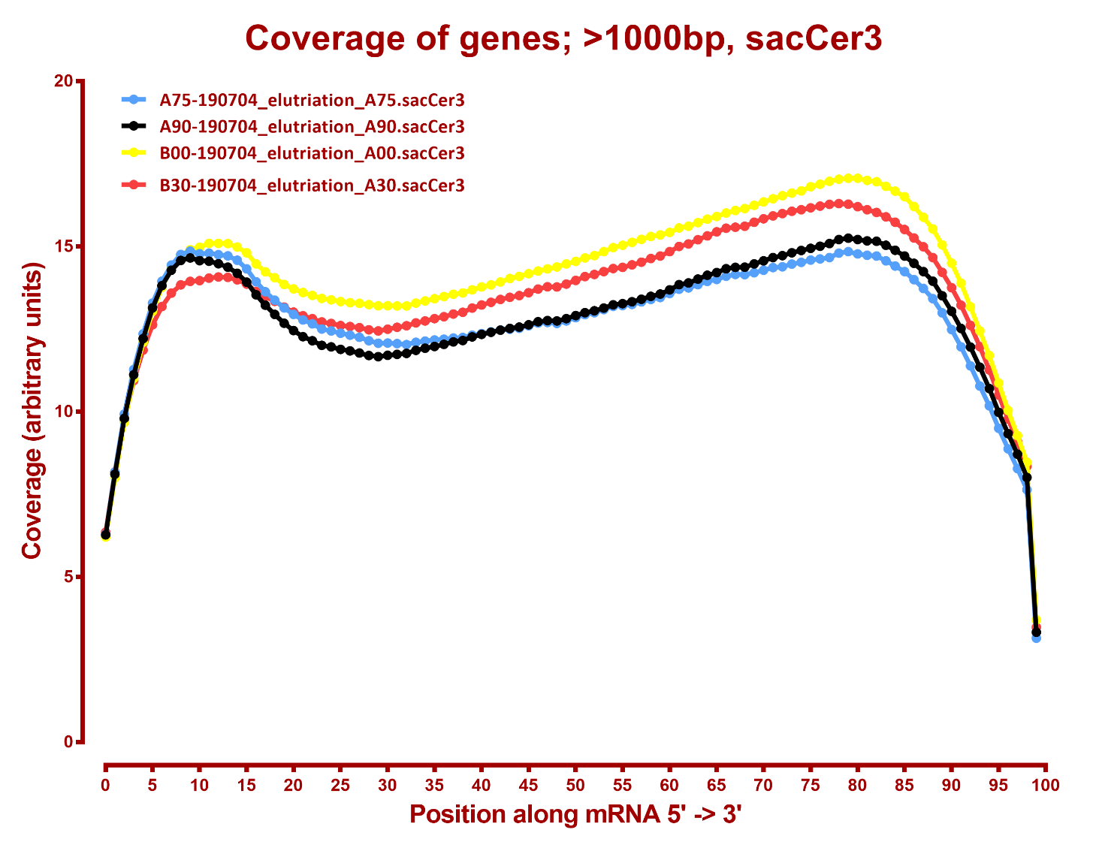

Slide 15
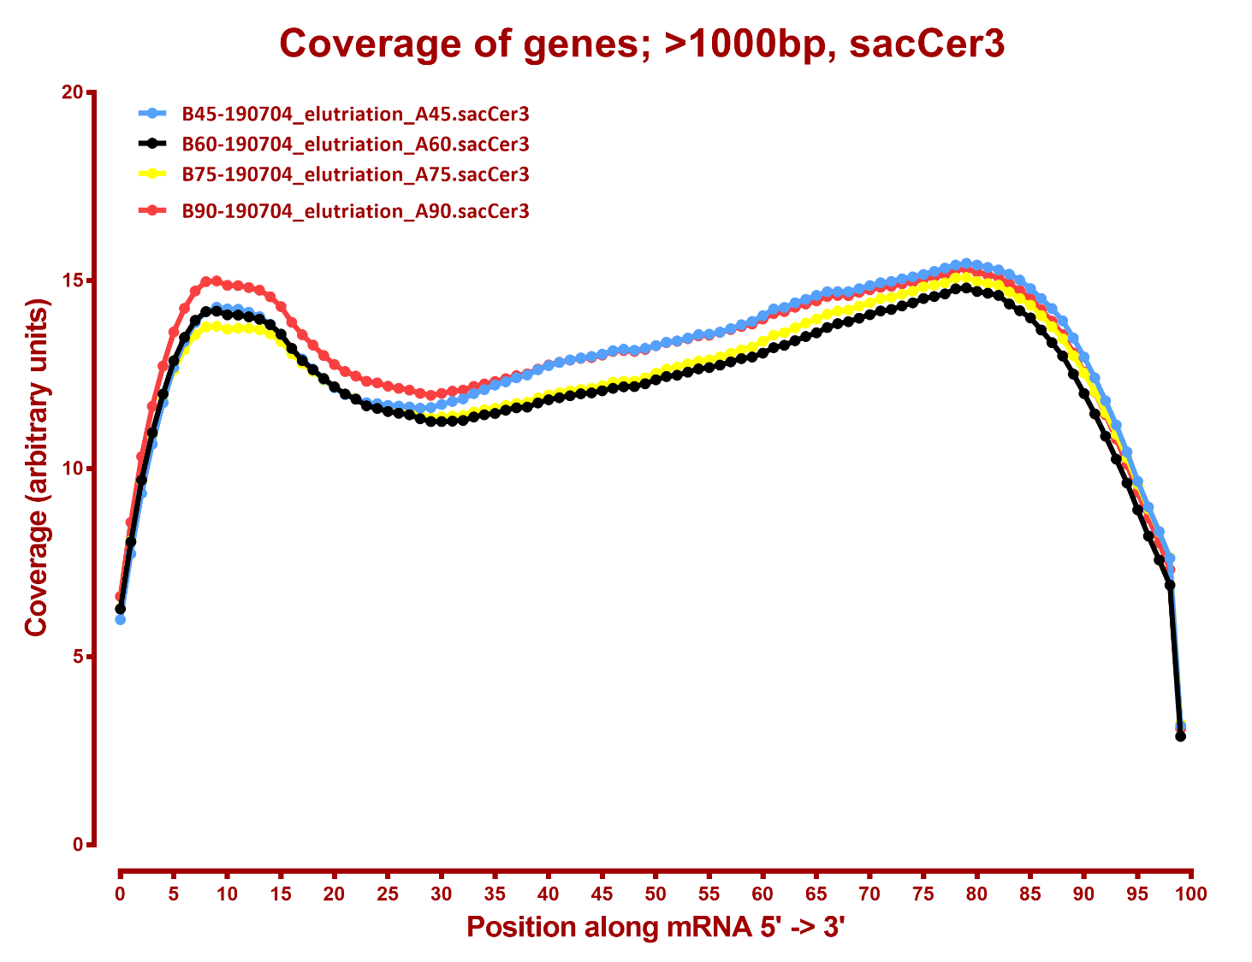

Slide 16
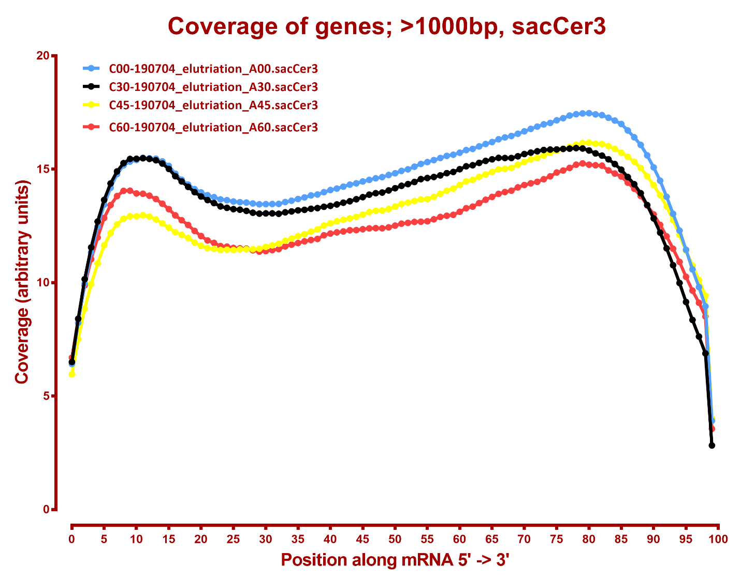

Slide 17
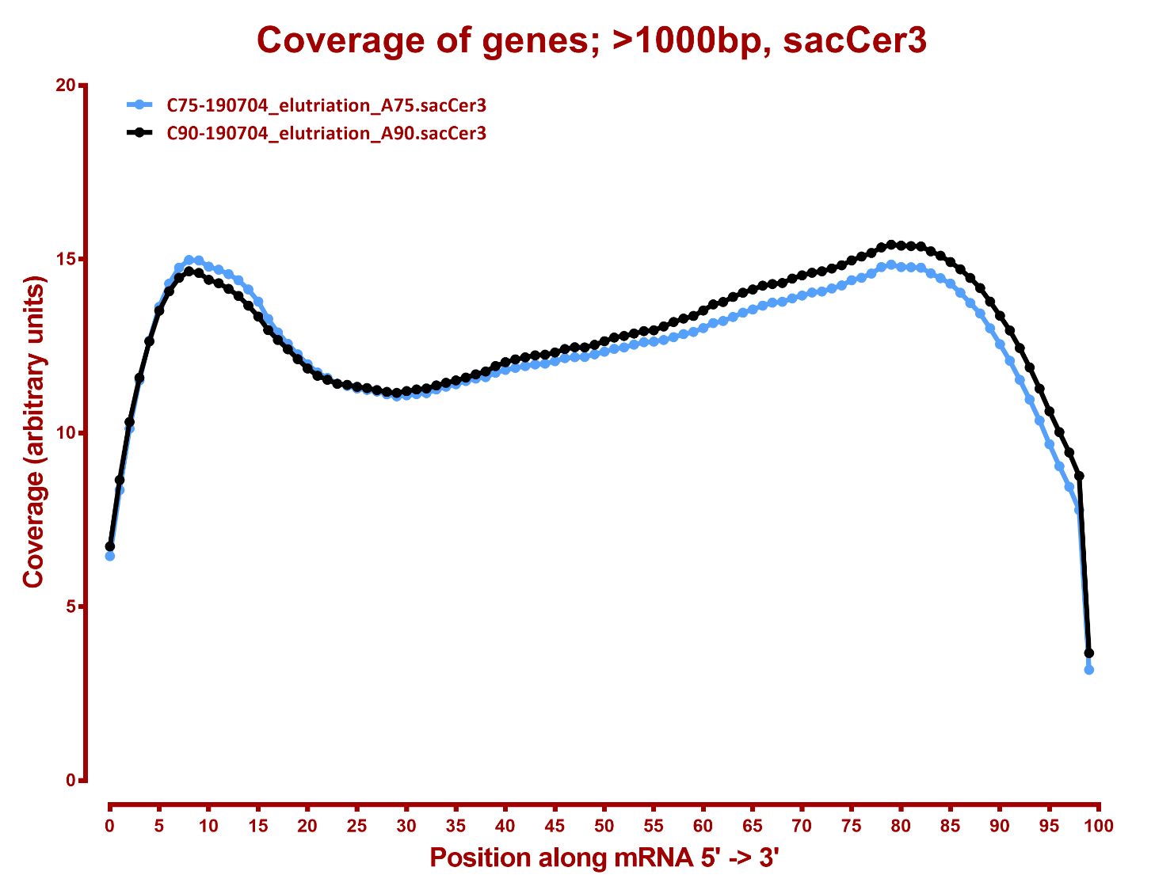

Slide 18
MAPPING STATS

Slide 19
READ DISTRIBUTION
# | Exonic: | Intergenic: | Intronic:
2019-08-21-HLF-1A-HLF_bin1_rep1.dm6 | 0.88 | 0.04 | 0.09
2019-08-21-HLF-1A-HLF_bin1_rep1.hg38 | 0.89 | 0.01 | 0.10
2019-08-21-HLF-1C-HLF_bin1_rep2.dm6 | 0.88 | 0.03 | 0.08
2019-08-21-HLF-1C-HLF_bin1_rep2.hg38 | 0.89 | 0.01 | 0.09
2019-08-21-HLF-2A-HLF_bin2_rep1.dm6 | 0.87 | 0.04 | 0.09
2019-08-21-HLF-2A-HLF_bin2_rep1.hg38 | 0.88 | 0.01 | 0.10
2019-08-21-HLF-2C-HLF_bin2_rep2.dm6 | 0.88 | 0.03 | 0.09
2019-08-21-HLF-2C-HLF_bin2_rep2.hg38 | 0.90 | 0.01 | 0.09
2019-08-21-HLF-3A-HLF_bin3_rep1.dm6 | 0.88 | 0.03 | 0.09
2019-08-21-HLF-3A-HLF_bin3_rep1.hg38 | 0.90 | 0.01 | 0.09
2019-08-21-HLF-3C-HLF_bin3_rep2.dm6 | 0.86 | 0.04 | 0.10
2019-08-21-HLF-3C-HLF_bin3_rep2.hg38 | 0.88 | 0.01 | 0.10
2019-08-21-HLF-4A-HLF_bin4_rep1.dm6 | 0.87 | 0.04 | 0.09
2019-08-21-HLF-4A-HLF_bin4_rep1.hg38 | 0.88 | 0.01 | 0.10
2019-08-21-HLF-4C-HLF_bin4_rep2.dm6 | 0.89 | 0.03 | 0.08
2019-08-21-HLF-4C-HLF_bin4_rep2.hg38 | 0.90 | 0.01 | 0.09
2019-08-21-HLF-SortAll-A-HLF_sort-all_rep1.dm6 | 0.87 | 0.04 | 0.09
2019-08-21-HLF-SortAll-A-HLF_sort-all_rep1.hg38 | 0.89 | 0.01 | 0.09
2019-08-21-HLF-pre-Sort-A-HLF_pre-sort_rep1.dm6 | 0.90 | 0.03 | 0.07
2019-08-21-HLF-pre-Sort-A-HLF_pre-sort_rep1.hg38 | 0.93 | 0.01 | 0.06
2019-08-21-HLF-pre-Sort-C-HLF_pre-sort_rep2.dm6 | 0.93 | 0.02 | 0.05
2019-08-21-HLF-pre-Sort-C-HLF_pre-sort_rep2.hg38 | 0.91 | 0.01 | 0.08

Slide 20
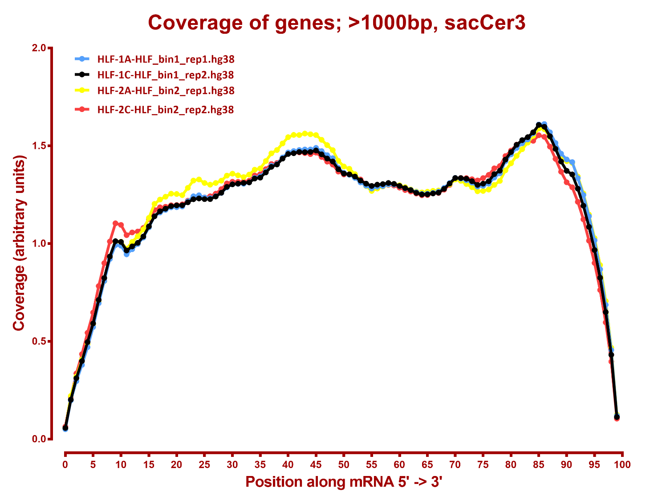

Slide 21
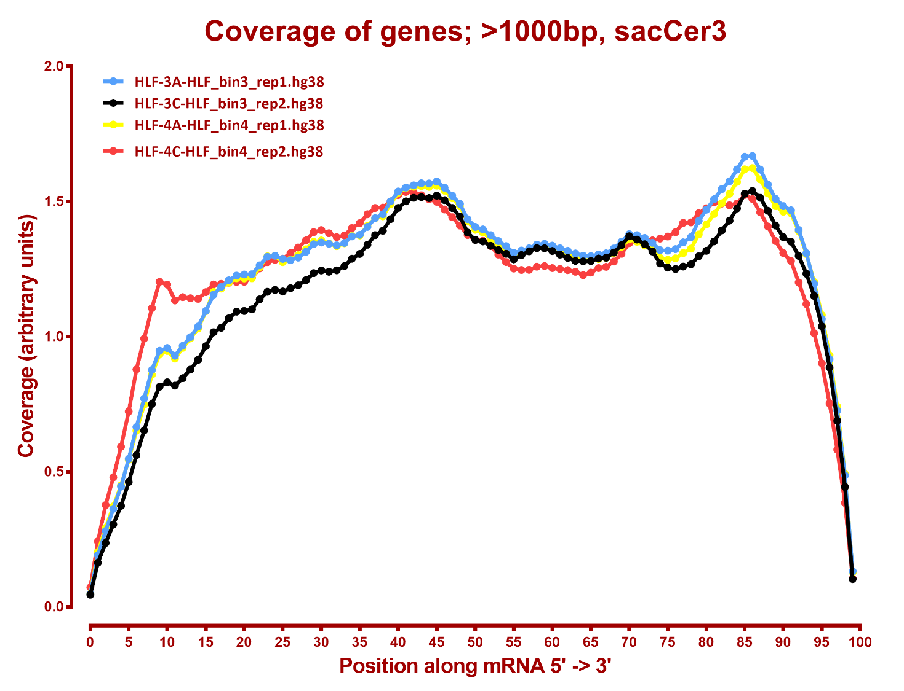

Slide 22
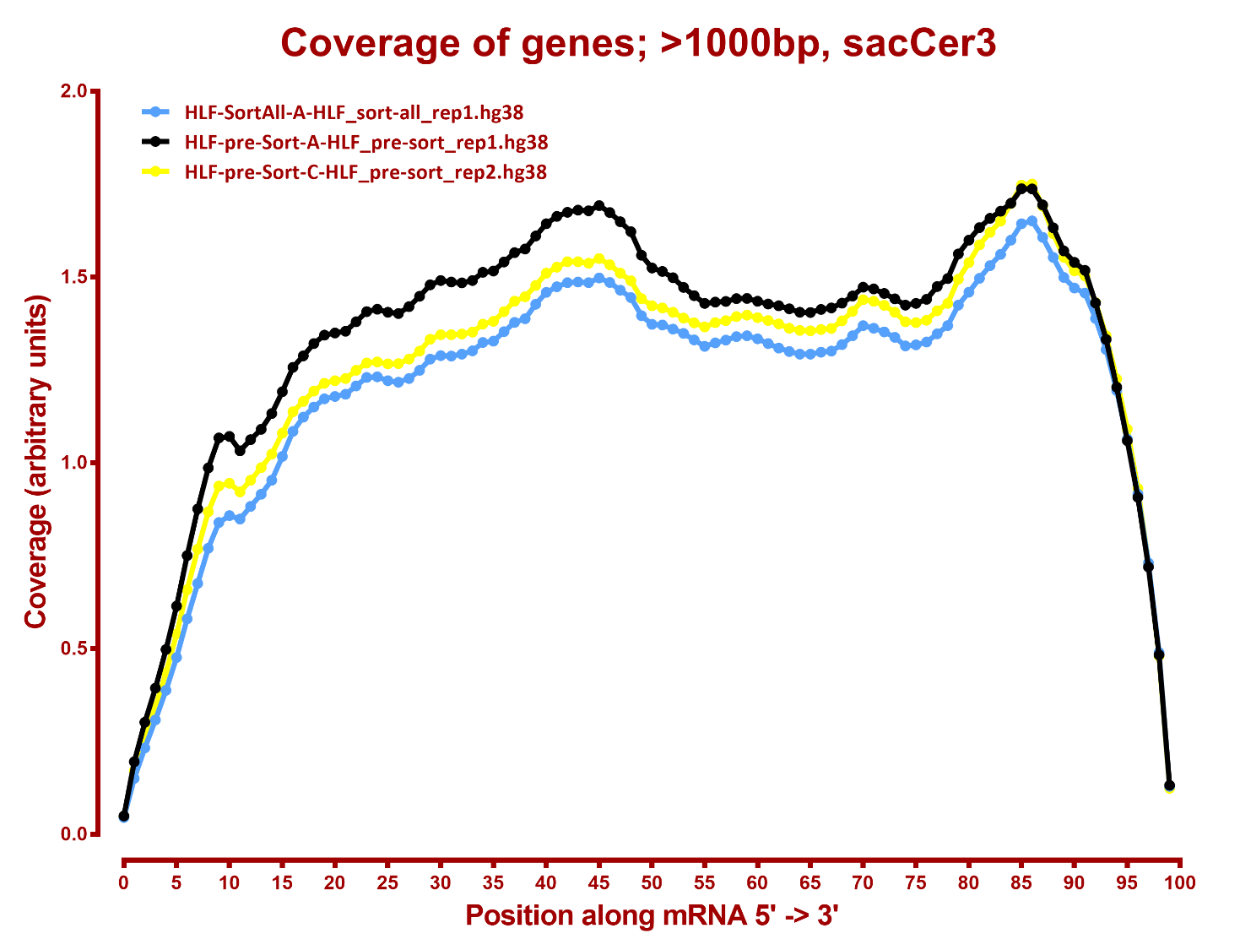

Slide 23
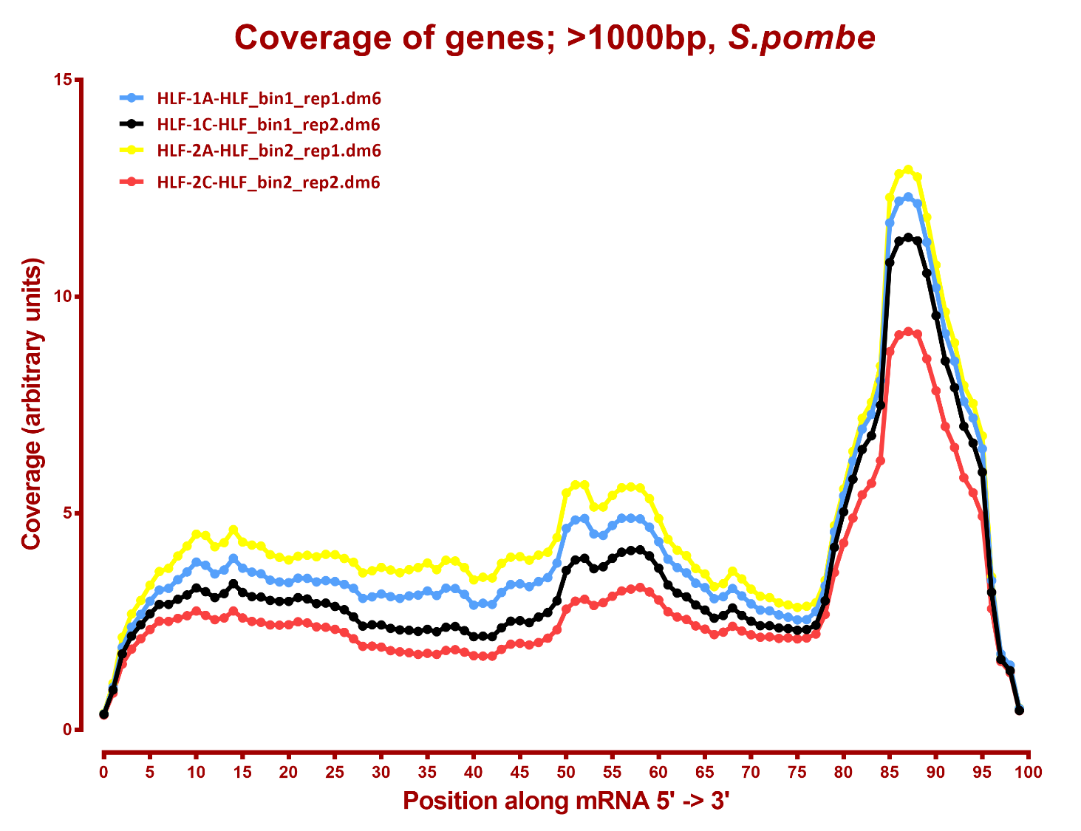

Slide 24
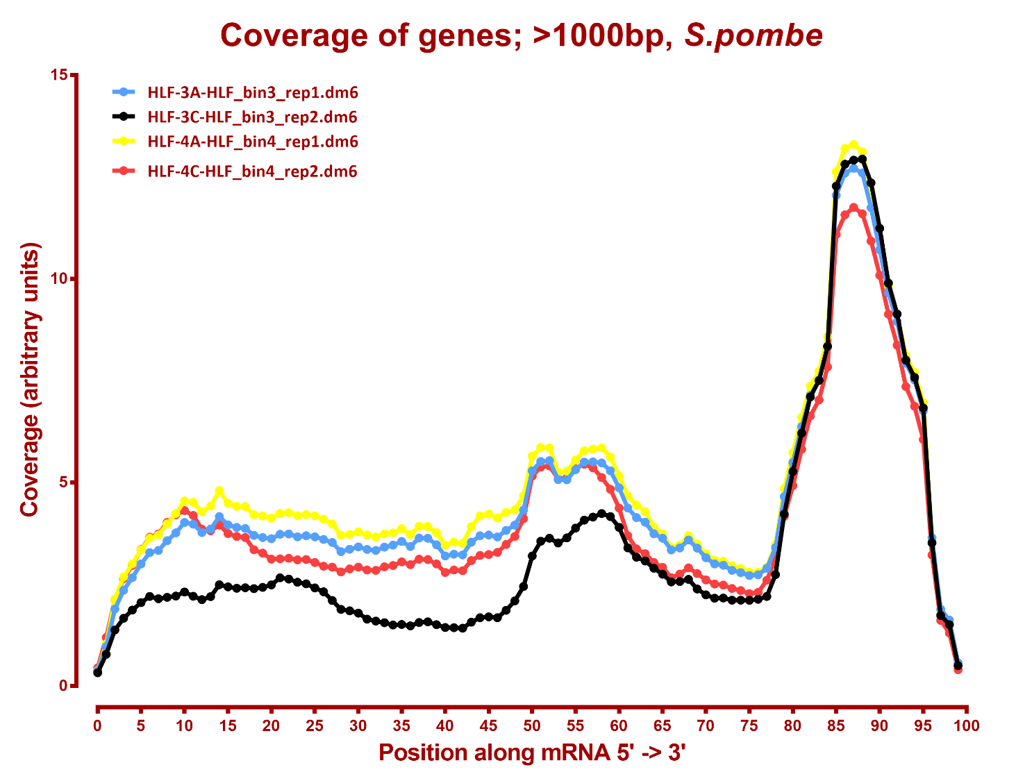

Slide 25
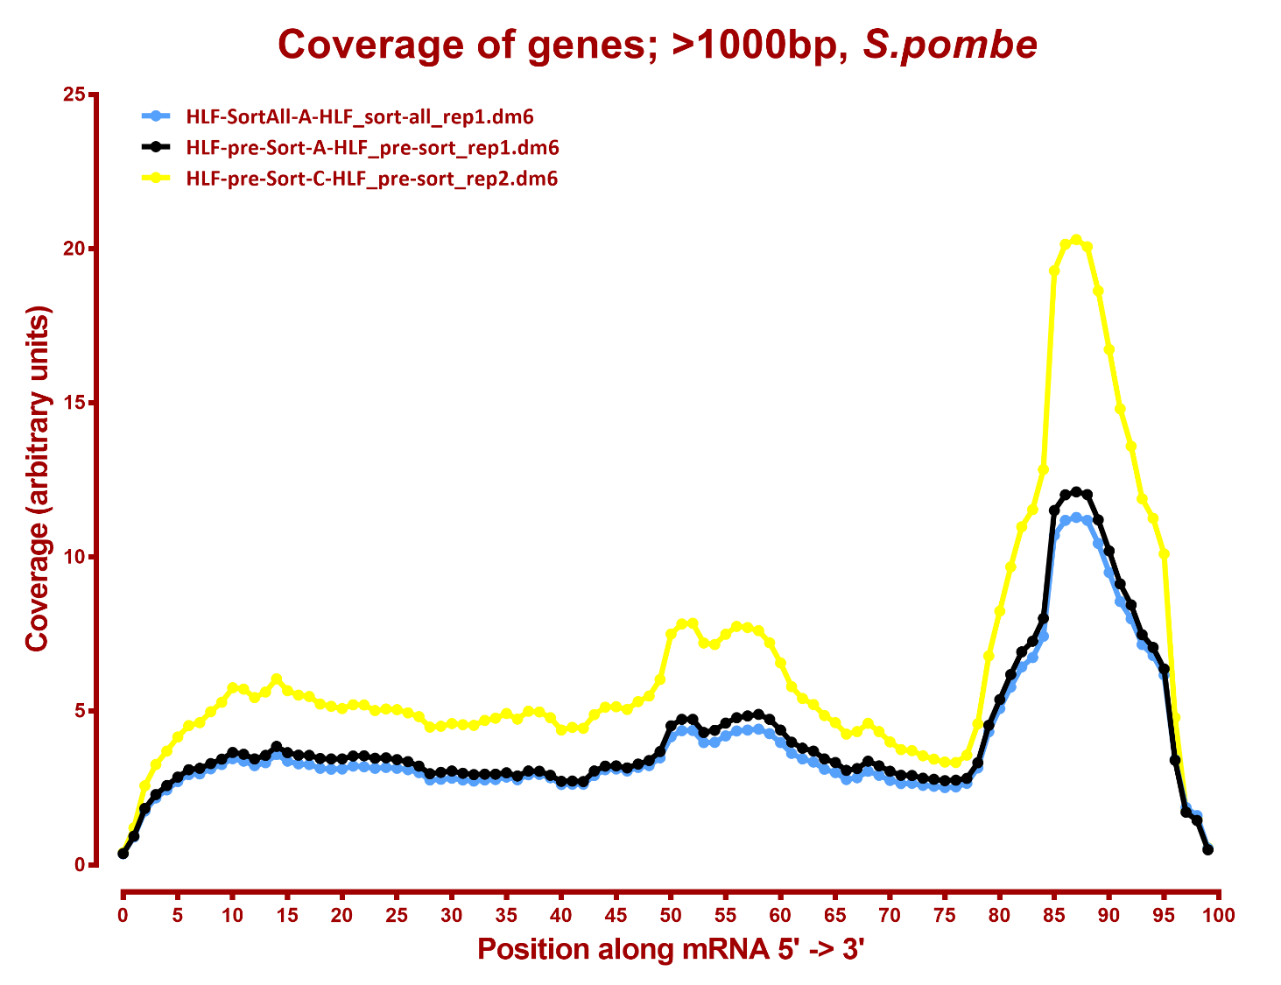

Slide 26
Number differential genes, hg38
A | B | p-adj |  | p-val
 |  | up in B vs A | down in B vs A | up in B vs A | down in B vs A
HLF_bin1 | HLF_bin2 | 0 | 10 | 150 | 138
HLF_bin1 | HLF_bin3 | 20 | 23 | 421 | 431
HLF_bin1 | HLF_bin4 | 25 | 3 | 548 | 245
HLF_bin1 | HLF_pre-sort | 1 | 2 | 173 | 262
HLF_bin1 | HLF_sort-all | 0 | 0 | 187 | 141
HLF_bin2 | HLF_bin3 | 0 | 0 | 164 | 263
HLF_bin2 | HLF_bin4 | 28 | 1 | 356 | 143
HLF_bin2 | HLF_pre-sort | 4 | 4 | 152 | 347
HLF_bin2 | HLF_sort-all | 2 | 0 | 165 | 136
HLF_bin3 | HLF_bin4 | 4 | 0 | 709 | 142
HLF_bin3 | HLF_pre-sort | 1 | 2 | 276 | 453
HLF_bin3 | HLF_sort-all | 1 | 1 | 151 | 95
HLF_bin4 | HLF_pre-sort | 1 | 1 | 183 | 551
HLF_bin4 | HLF_sort-all | 3 | 2 | 179 | 535
HLF_sort-all | HLF_pre-sort | 1 | 2 | 85 | 248

Slide 27
Number differential genes, dm6
A | B | p-adj |  | p-val
 |  | up in B vs A | down in B vs A | up in B vs A | down in B vs A
HLF_bin1 | HLF_bin2 | 0 | 0 | 33 | 15
HLF_bin1 | HLF_bin3 | 1 | 0 | 53 | 77
HLF_bin1 | HLF_bin4 | 0 | 0 | 61 | 34
HLF_bin1 | HLF_pre-sort | 0 | 0 | 116 | 117
HLF_bin1 | HLF_sort-all | 0 | 0 | 35 | 15
HLF_bin2 | HLF_bin3 | 0 | 0 | 77 | 116
HLF_bin2 | HLF_bin4 | 0 | 0 | 86 | 49
HLF_bin2 | HLF_pre-sort | 0 | 1 | 157 | 206
HLF_bin2 | HLF_sort-all | 0 | 0 | 53 | 42
HLF_bin3 | HLF_bin4 | 0 | 1 | 245 | 80
HLF_bin3 | HLF_pre-sort | 12 | 18 | 232 | 340
HLF_bin3 | HLF_sort-all | 0 | 1 | 48 | 30
HLF_bin4 | HLF_pre-sort | 0 | 0 | 201 | 269
HLF_bin4 | HLF_sort-all | 0 | 0 | 57 | 143
HLF_sort-all | HLF_pre-sort | 0 | 0 | 100 | 119

