Slide 1
MAPPING STATS
Library | Read Length | Mapping | Species | Raw fragments | Complexity | Unique | Unique Splices | Multi | Multi Splices | Fraction mapped
2019-05-11-G2-1_180918 | 2x150 | STAR-2.5.3a | S_pombe | 39,181,969 | 0.19 | 15,142,745 | 1,171,441 | 283,926 | 49,030 | 0.21
2019-05-11-G2-1_180918 | 2x150 | STAR-2.5.3a | sacCer3 | 39,181,969 | 0.11 | 54,775,326 | 1,478,490 | 2,553,231 | 152,519 | 0.75
2019-05-11-G2-2_180918 | 2x150 | STAR-2.5.3a | S_pombe | 41,029,542 | 0.23 | 14,505,185 | 1,106,047 | 318,696 | 54,504 | 0.19
2019-05-11-G2-2_180918 | 2x150 | STAR-2.5.3a | sacCer3 | 41,029,542 | 0.13 | 58,401,527 | 1,503,025 | 3,149,043 | 171,735 | 0.77
2019-05-11-G2-3_180918 | 2x150 | STAR-2.5.3a | S_pombe | 40,151,563 | 0.24 | 12,724,183 | 970,809 | 268,524 | 43,162 | 0.17
2019-05-11-G2-3_180918 | 2x150 | STAR-2.5.3a | sacCer3 | 40,151,563 | 0.13 | 58,694,777 | 1,444,187 | 3,380,154 | 175,736 | 0.79
2019-05-11-G2-4_180918 | 2x150 | STAR-2.5.3a | S_pombe | 43,957,042 | 0.23 | 12,213,126 | 954,098 | 253,060 | 40,210 | 0.15
2019-05-11-G2-4_180918 | 2x150 | STAR-2.5.3a | sacCer3 | 43,957,042 | 0.12 | 65,937,322 | 1,752,956 | 3,779,366 | 222,130 | 0.82
2019-05-11-input_180918 | 2x150 | STAR-2.5.3a | S_pombe | 42,278,912 | 0.25 | 10,374,372 | 787,598 | 200,413 | 29,439 | 0.13
2019-05-11-input_180918 | 2x150 | STAR-2.5.3a | sacCer3 | 42,278,912 | 0.12 | 64,884,206 | 1,760,054 | 3,433,700 | 215,180 | 0.83

Slide 2
READ DISTRIBUTION
# | Exonic: | Intergenic: | Intronic:
2019-05-11-G2-1_180918.Schizosaccharomyces_pombe.ASM294v2.20 | 0.98 | 0.02 | 0.00
2019-05-11-G2-1_180918.sacCer3 | 0.90 | 0.10 | 0.00
2019-05-11-G2-2_180918.Schizosaccharomyces_pombe.ASM294v2.20 | 0.98 | 0.02 | 0.00
2019-05-11-G2-2_180918.sacCer3 | 0.90 | 0.10 | 0.00
2019-05-11-G2-3_180918.Schizosaccharomyces_pombe.ASM294v2.20 | 0.98 | 0.02 | 0.00
2019-05-11-G2-3_180918.sacCer3 | 0.90 | 0.10 | 0.00
2019-05-11-G2-4_180918.Schizosaccharomyces_pombe.ASM294v2.20 | 0.98 | 0.02 | 0.00
2019-05-11-G2-4_180918.sacCer3 | 0.89 | 0.10 | 0.00
2019-05-11-input_180918.Schizosaccharomyces_pombe.ASM294v2.20 | 0.98 | 0.02 | 0.00
2019-05-11-input_180918.sacCer3 | 0.90 | 0.10 | 0.00

Slide 3
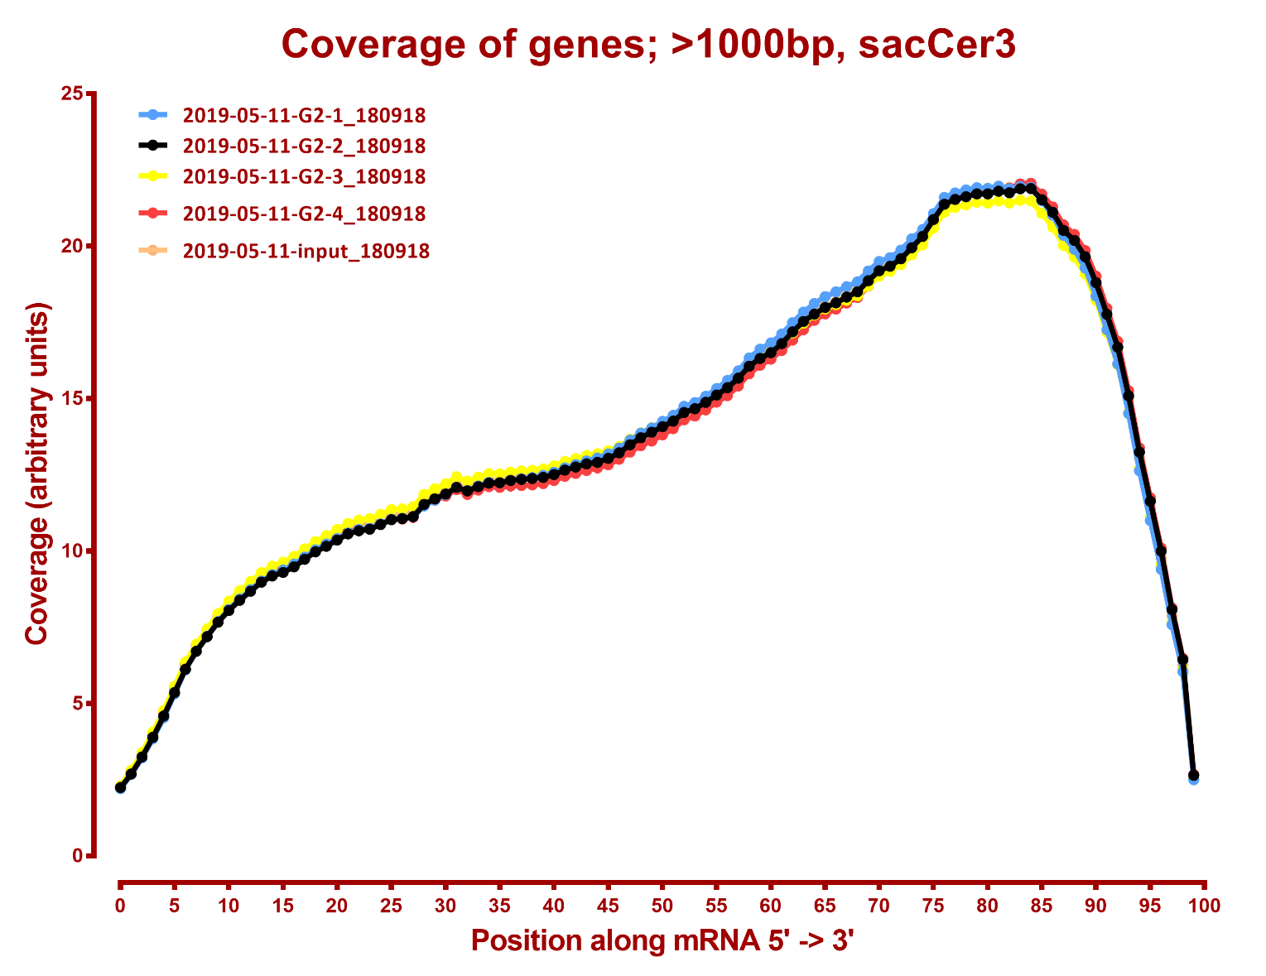

Slide 4
