Slide 1
PIPELINES
For tracks and QC:
Align to combined S. cerevisiae + S. pombe index using STAR 2.5.3a
Mapping stats and QC metrics for each genome individually
For quantification:
Align to combined S. cerevisiae + S. pombe transcriptome index with Bowtie
Quantification in transcriptome space using eXpress (1.5.1)
Note on read lengths: the reads as they came to me were 2x150mers. This appears to be longer than the mean fragment length because the rate of end-to-end alignments falls off precipitously from 2x100mers to 2x150mers. This is what this looks like for the G1 sample:
2x50: 84.59%
2x75: 83.73%
2x100: 78.84%
2x150: 42.20%
I have generated TPMs for all samples in all four formats, and given the depth of sequencing (very high), even the 2x150mers are probably fine, but I would work with the 2x100mers.

Slide 2
MAPPING STATS
Library | Read Length | Mapping | Species | Raw fragments | Complexity | Unique | Unique Splices | Multi | Multi Splices | Fraction mapped
G2-1_fix_180918.s180918_S1 | 2x150 | STAR-2.5.3a | S_pombe | 67,596,723 | 0.36 | 14,412,090 | 746,368 | 1,886,752 | 104,326 | 0.13
G2-1_fix_180918.s180918_S1 | 2x150 | STAR-2.5.3a | sacCer3 | 67,596,723 | 0.22 | 55,344,853 | 1,577,249 | 19,311,706 | 1,399,370 | 0.57
G2-2_fix_180918.s180918_S2 | 2x150 | STAR-2.5.3a | S_pombe | 81,559,408 | 0.34 | 16,599,545 | 858,973 | 2,214,706 | 95,894 | 0.12
G2-2_fix_180918.s180918_S2 | 2x150 | STAR-2.5.3a | sacCer3 | 81,559,408 | 0.19 | 72,991,877 | 1,813,673 | 25,276,739 | 1,560,407 | 0.62
G2-3_fix_180918.s180918_S3 | 2x150 | STAR-2.5.3a | S_pombe | 81,761,577 | 0.33 | 14,962,619 | 774,725 | 1,323,387 | 55,473 | 0.10
G2-3_fix_180918.s180918_S3 | 2x150 | STAR-2.5.3a | sacCer3 | 81,761,577 | 0.18 | 82,555,854 | 1,904,250 | 25,464,500 | 1,510,410 | 0.68
G2-4_fix_180918.s180918_S4 | 2x150 | STAR-2.5.3a | S_pombe | 84,531,291 | 0.34 | 13,292,289 | 705,613 | 1,405,949 | 60,837 | 0.09
G2-4_fix_180918.s180918_S4 | 2x150 | STAR-2.5.3a | sacCer3 | 84,531,291 | 0.17 | 86,203,846 | 1,904,522 | 28,073,462 | 1,710,746 | 0.70
input_fix_180918.s180918_SA | 2x150 | STAR-2.5.3a | S_pombe | 88,299,105 | 0.51 | 2,837 | 47 | 11,415 | 15 | 0.00
input_fix_180918.s180918_SA | 2x150 | STAR-2.5.3a | sacCer3 | 88,299,105 | 0.16 | 105,068,578 | 2,415,786 | 25,393,962 | 1,519,554 | 0.76
input_live_180918.s180918_SB | 2x150 | STAR-2.5.3a | S_pombe | 74,344,565 | 0.36 | 12,946,044 | 668,782 | 915,011 | 48,051 | 0.10
input_live_180918.s180918_SB | 2x150 | STAR-2.5.3a | sacCer3 | 74,344,565 | 0.19 | 74,197,684 | 1,761,880 | 19,212,858 | 1,227,382 | 0.65

Slide 3
READ DISTRIBUTION
# | Exonic: | Intergenic: | Intronic:
G2-1_fix_180918.s180918_S1.Schizosaccharomyces_pombe.ASM294v2.20 | 0.98 | 0.01 | 0.01
G2-2_fix_180918.s180918_S2.Schizosaccharomyces_pombe.ASM294v2.20 | 0.98 | 0.01 | 0.01
G2-3_fix_180918.s180918_S3.Schizosaccharomyces_pombe.ASM294v2.20 | 0.98 | 0.01 | 0.01
G2-4_fix_180918.s180918_S4.Schizosaccharomyces_pombe.ASM294v2.20 | 0.98 | 0.01 | 0.01
input_fix_180918.s180918_SA.Schizosaccharomyces_pombe.ASM294v2.20 | 1.00 | 0.00 | 0.00
input_live_180918.s180918_SB.Schizosaccharomyces_pombe.ASM294v2.20 | 0.98 | 0.01 | 0.01
G2-1_fix_180918.s180918_S1.sacCer3 | 0.94 | 0.06 | 0.00
G2-2_fix_180918.s180918_S2.sacCer3 | 0.94 | 0.06 | 0.00
G2-3_fix_180918.s180918_S3.sacCer3 | 0.94 | 0.06 | 0.00
G2-4_fix_180918.s180918_S4.sacCer3 | 0.94 | 0.06 | 0.00
input_fix_180918.s180918_SA.sacCer3 | 0.93 | 0.07 | 0.00
input_live_180918.s180918_SB.sacCer3 | 0.94 | 0.06 | 0.00

Slide 4
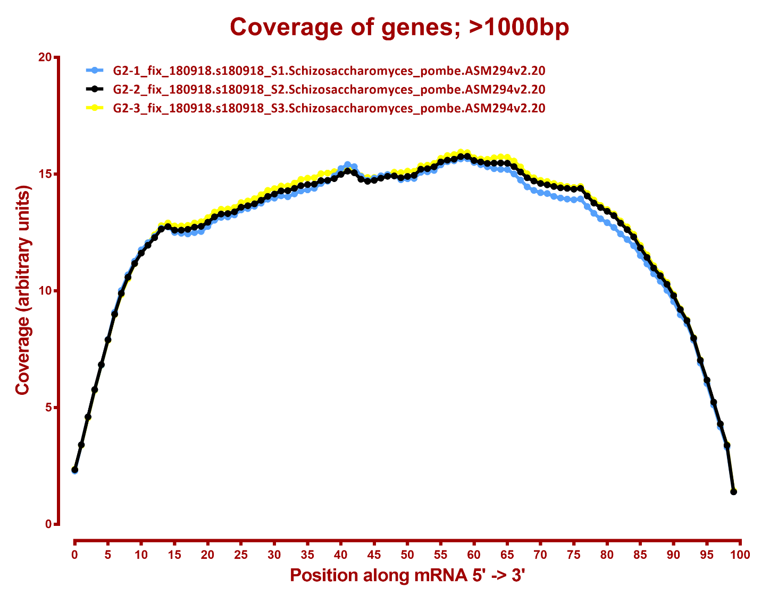

Slide 5
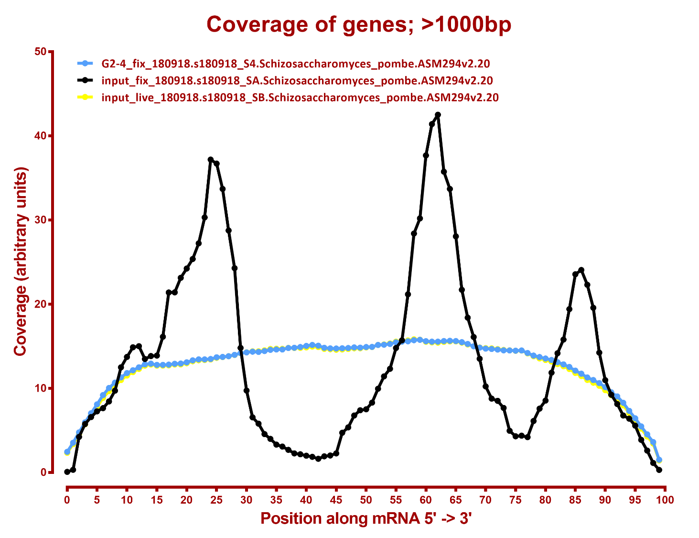

Slide 6
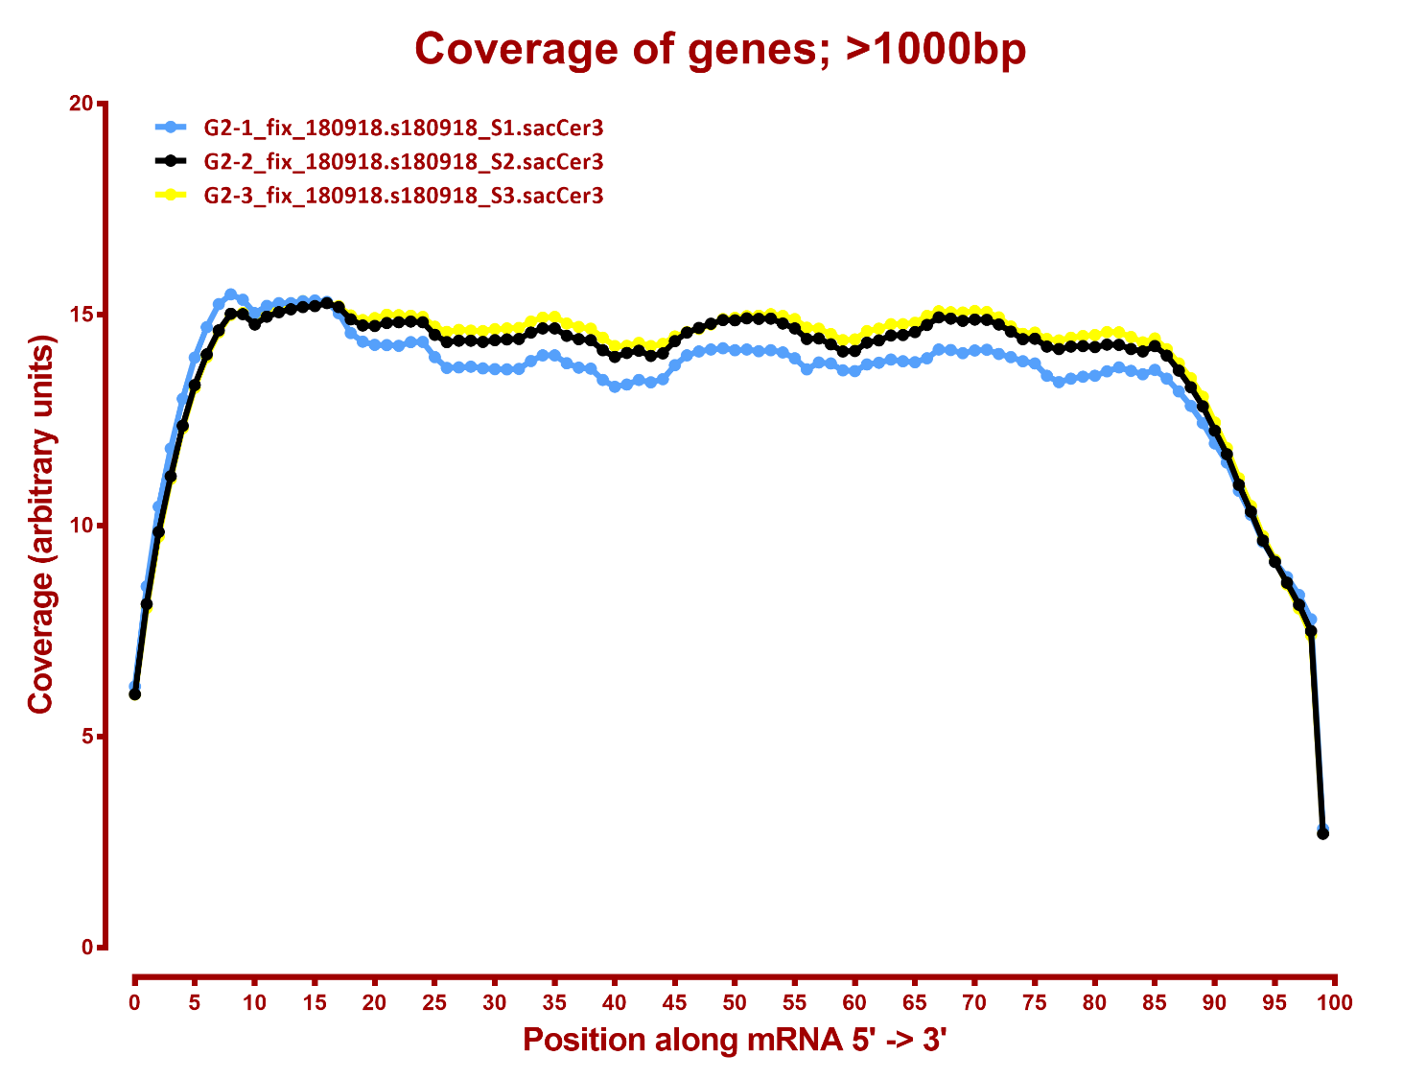

Slide 7
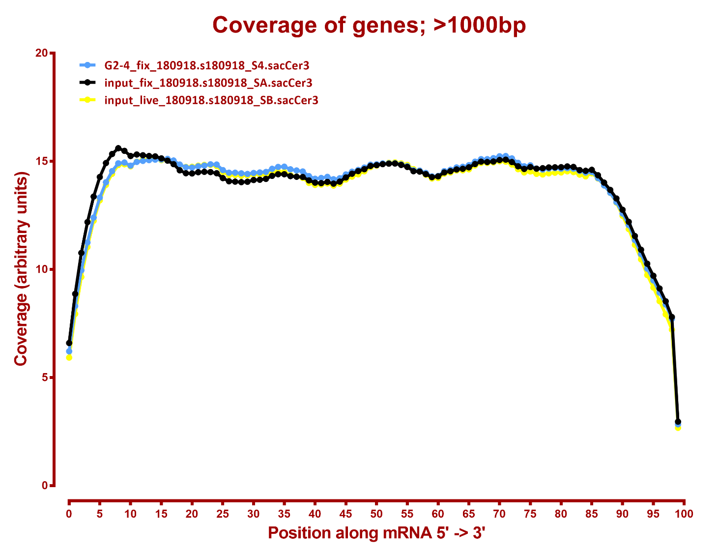

Slide 8
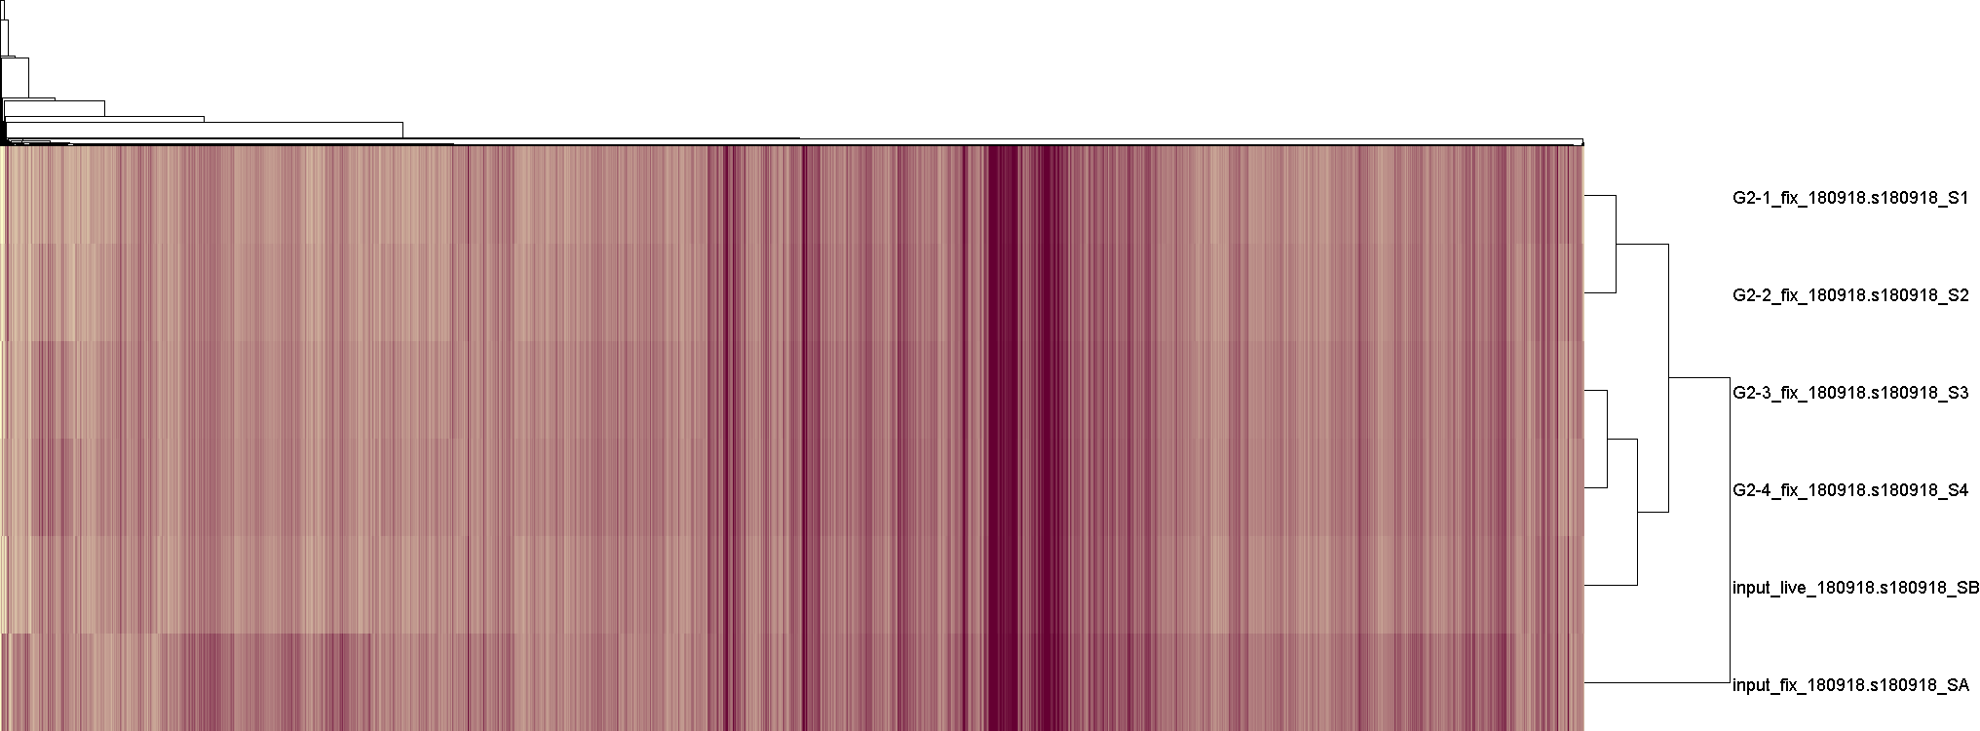
S. cerevisiae genes log2(TPM+1), (TPM > 10 in at least one sample)

Slide 9
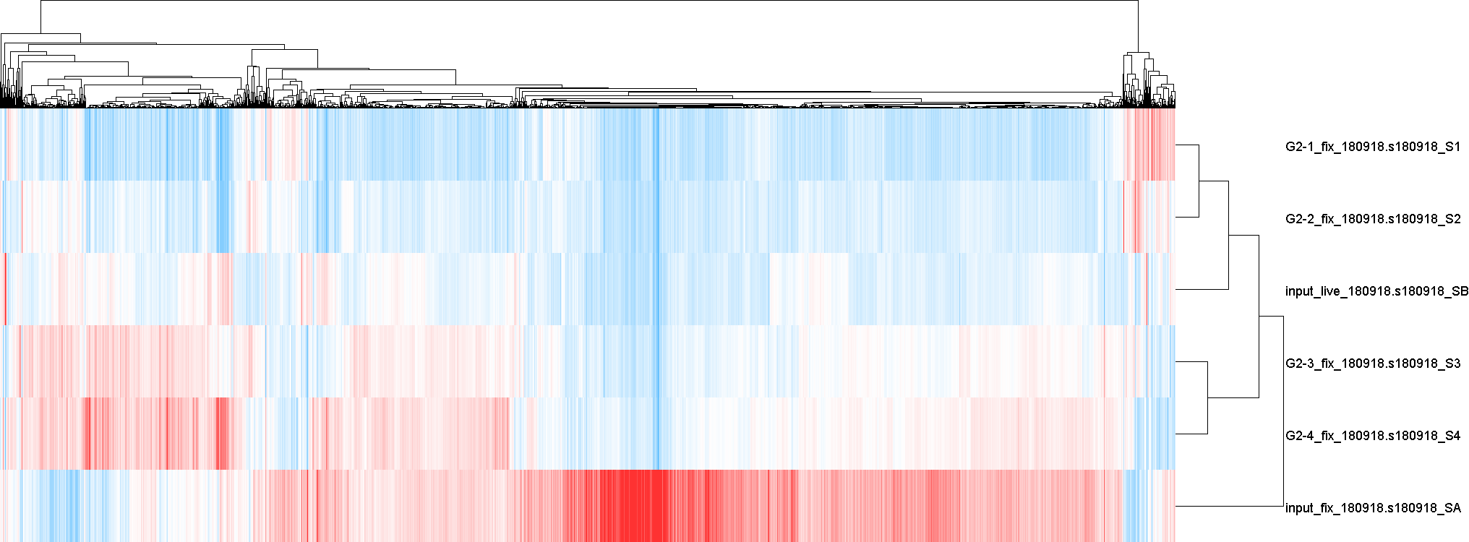
S. cerevisiae genes normalized to mean, (TPM > 10 in at least one sample)

