Slide 1
Dataset stats
Library | Raw fragments | Species | 2x36mers |  | 1x36mers |  | Mappability Corrected RPKM | S.cerevsiae/Candida ratio
 |  |  | Unique non-chrM reads | Complexity | Unique non-chrM reads | Complexity
2018-02-13-A-YPD-input | 603,120 | sacCer3 | 890,262 | 0.98 | 449,717 | 0.98 | 86.97 | 4,851.20
 | 603,120 | Candida | 162 | 1.00 | 98 | 1.00 | 0.02
2018-02-13-B-YPD-Pol2pS2 | 739,280 | sacCer3 | 1,273,346 | 0.95 | 644,537 | 0.94 | 86.97 | 6,251.11
 | 739,280 | Candida | 178 | 1.00 | 109 | 1.00 | 0.01
2018-02-13-C-SCE_input | 780,896 | sacCer3 | 940,824 | 0.98 | 476,336 | 0.98 | 68.08 | 3.81
 | 780,896 | Candida | 260,900 | 0.99 | 132,276 | 0.99 | 17.88
2018-02-13-D-SCE-Pol2pS2 | 842,765 | sacCer3 | 1,225,412 | 0.96 | 619,794 | 0.96 | 74.11 | 6.08
 | 842,765 | Candida | 212,704 | 0.98 | 107,693 | 0.98 | 12.18
2018-02-13-E-SCE-H3 | 778,957 | sacCer3 | 989,158 | 0.98 | 501,680 | 0.98 | 68.38 | 3.88
 | 778,957 | Candida | 269,140 | 0.99 | 136,529 | 0.99 | 17.60
2018-02-13-F-SCE-CTD | 860,877 | sacCer3 | 1,298,016 | 0.96 | 658,411 | 0.95 | 75.85 | 7.20
 | 860,877 | Candida | 190,596 | 0.99 | 96,702 | 0.99 | 10.54
2018-02-13-G-YPD-CTD | 566,772 | sacCer3 | 993,618 | 0.95 | 503,125 | 0.95 | 86.96 | 3,092.31
 | 566,772 | Candida | 296 | 1.00 | 172 | 1.00 | 0.03
2018-02-13-H-SCD_noAA-input | 667,562 | sacCer3 | 645,266 | 0.98 | 326,634 | 0.98 | 52.43 | 1.60
 | 667,562 | Candida | 424,992 | 0.98 | 215,270 | 0.98 | 32.69
2018-02-13-I-SCD_Rpb1_AA-input | 606,366 | sacCer3 | 571,242 | 0.99 | 289,240 | 0.98 | 50.28 | 1.45
 | 606,366 | Candida | 416,914 | 0.98 | 211,192 | 0.98 | 34.72
2018-02-13-J-SCD_TBP-AA-input | 868,003 | sacCer3 | 814,286 | 0.98 | 411,515 | 0.98 | 51.09 | 1.50
 | 868,003 | Candida | 571,646 | 0.98 | 289,140 | 0.98 | 33.96
2018-02-13-K-SCD_noAA-H3 | 589,040 | sacCer3 | 541,558 | 0.98 | 275,845 | 0.98 | 47.57 | 1.28
 | 589,040 | Candida | 447,944 | 0.99 | 228,581 | 0.98 | 37.29
2018-02-13-L-SCD_Rpb1_AA-H3 | 716,259 | sacCer3 | 604,192 | 0.98 | 307,202 | 0.98 | 42.11 | 0.99
 | 716,259 | Candida | 643,024 | 0.98 | 327,346 | 0.98 | 42.45
2018-02-13-M-SCD_TBP-AA-H3 | 561,170 | sacCer3 | 460,992 | 0.98 | 233,911 | 0.98 | 42.46 | 1.01
 | 561,170 | Candida | 482,094 | 0.99 | 245,237 | 0.98 | 42.11
2018-02-13-N-YPD-Rpb3 | 627,400 | sacCer3 | 1,093,878 | 0.95 | 551,792 | 0.94 | 86.93 | 1,611.40
 | 627,400 | Candida | 662 | 1.00 | 362 | 1.00 | 0.05
2018-02-13-O-SCE-Rpb3 | 703,670 | sacCer3 | 1,169,660 | 0.96 | 592,993 | 0.95 | 85.10 | 47.63
 | 703,670 | Candida | 25,890 | 0.99 | 13,162 | 0.99 | 1.79
2018-02-13-P-SCD_noAA-CTD | 1,142,307 | sacCer3 | 1,230,878 | 0.95 | 622,354 | 0.95 | 51.42 | 1.53
 | 1,142,307 | Candida | 851,708 | 0.96 | 430,557 | 0.96 | 33.65
2018-02-13-Q-SCD_Rpb1_AA-CTD | 757,685 | sacCer3 | 149,888 | 0.99 | 75,778 | 0.99 | 9.16 | 0.12
 | 757,685 | Candida | 1,274,360 | 0.95 | 643,900 | 0.94 | 73.62
2018-02-13-R-SCD_TBP-AA-CTD | 556,727 | sacCer3 | 105,842 | 0.99 | 53,696 | 0.99 | 8.96 | 0.12
 | 556,727 | Candida | 923,868 | 0.95 | 467,501 | 0.95 | 73.81
2018-02-13-S-SCD_noAA-Rpb3 | 826,610 | sacCer3 | 1,424,848 | 0.94 | 722,292 | 0.93 | 84.21 | 32.14
 | 826,610 | Candida | 46,910 | 0.99 | 23,761 | 0.99 | 2.62
2018-02-13-T-YPD-Pol2pS5_C | 614,811 | sacCer3 | 1,076,346 | 0.95 | 544,717 | 0.94 | 86.85 | 667.26
 | 614,811 | Candida | 1,652 | 0.99 | 863 | 0.99 | 0.13
2018-02-13-U-YPD-Pol2pS5_D | 635,448 | sacCer3 | 1,103,120 | 0.95 | 557,787 | 0.94 | 86.75 | 389.73
 | 635,448 | Candida | 2,940 | 1.00 | 1,513 | 1.00 | 0.22
2018-02-13-V-YPD-Pol2pS5_E | 491,950 | sacCer3 | 870,774 | 0.95 | 439,526 | 0.95 | 86.86 | 719.26
 | 491,950 | Candida | 1,254 | 0.99 | 646 | 1.00 | 0.12
2018-02-13-W-SCD_Rpb1_AA-Rpb3 | 586,675 | sacCer3 | 879,138 | 0.97 | 443,443 | 0.96 | 74.98 | 6.60
 | 586,675 | Candida | 140,978 | 0.98 | 71,030 | 0.98 | 11.36
2018-02-13-X-SCD_TBP-AA-Rpb3 | 565,781 | sacCer3 | 581,678 | 0.98 | 293,236 | 0.98 | 60.16 | 2.37
 | 565,781 | Candida | 260,278 | 0.97 | 130,775 | 0.96 | 25.38
Cln3 Whi5 switched!!!

Slide 2
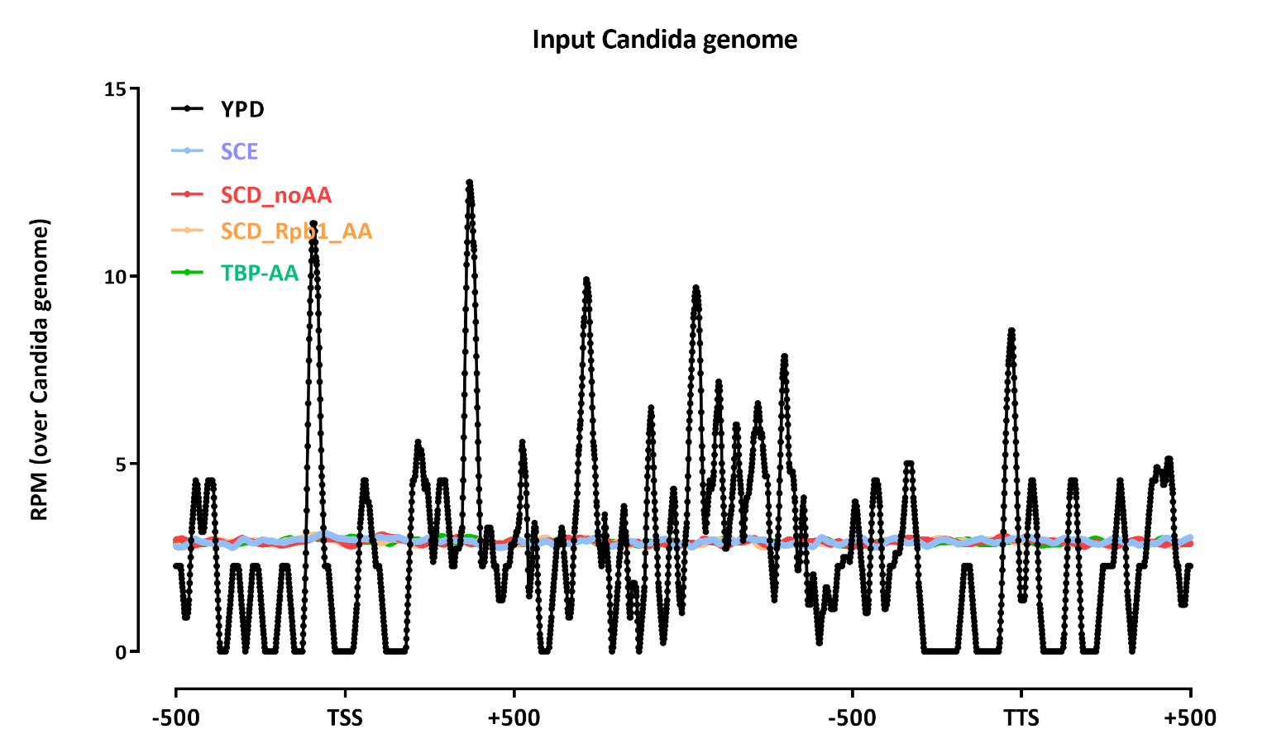
Average gene profiles without renormalization

Slide 3
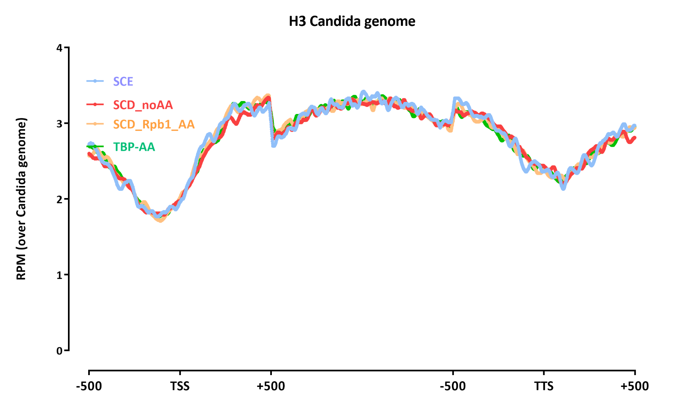

Slide 4
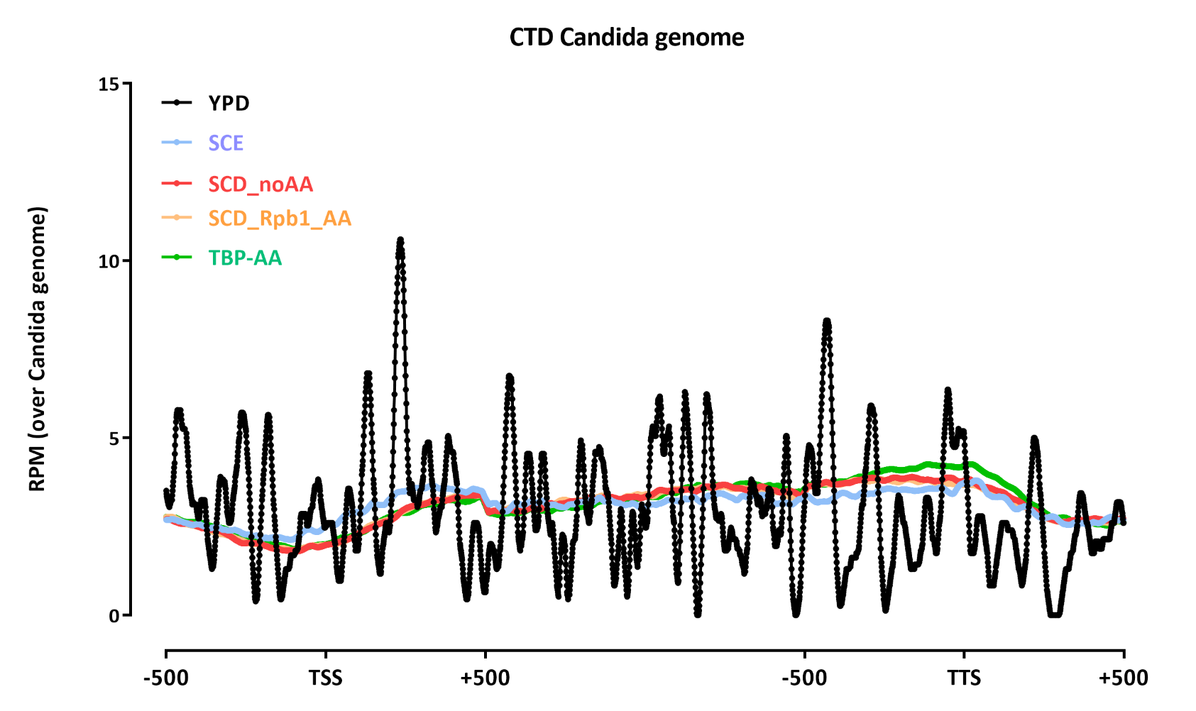

Slide 5
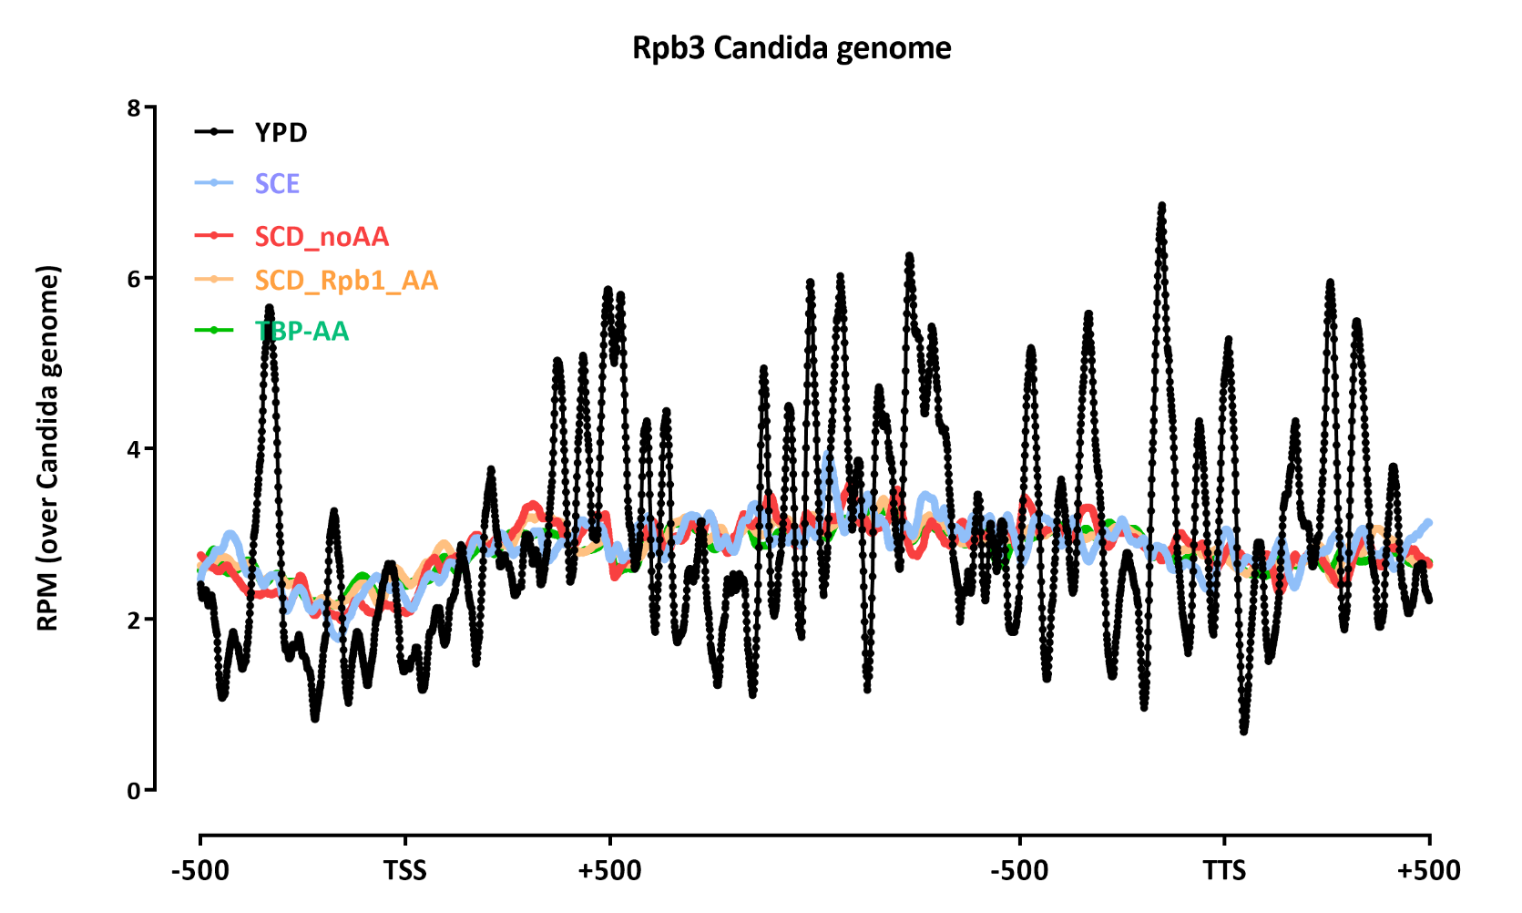

Slide 6
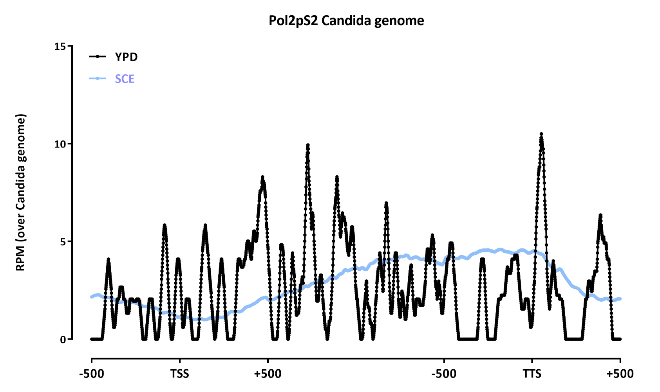

Slide 7
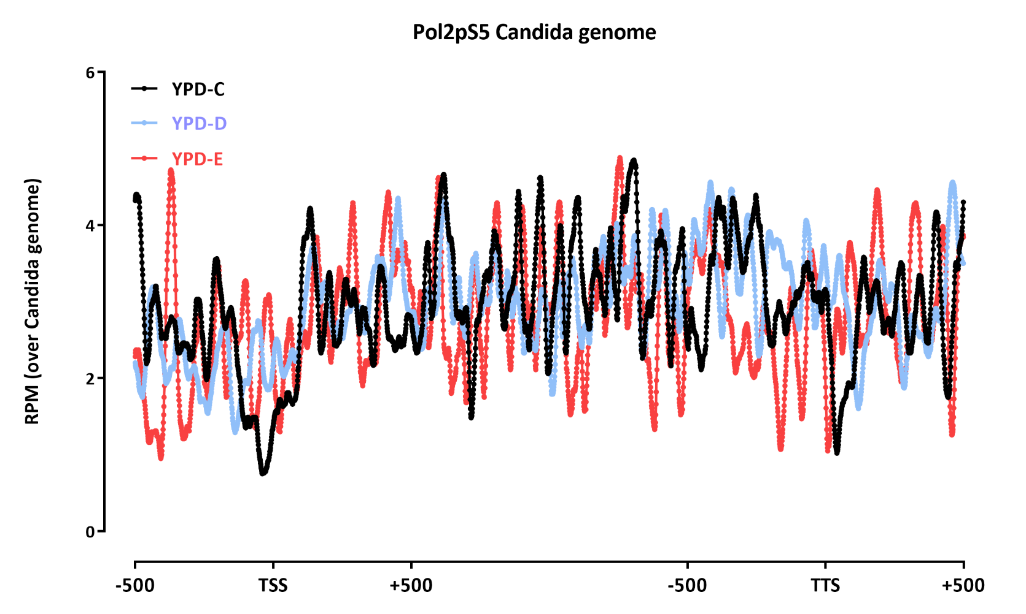

Slide 8
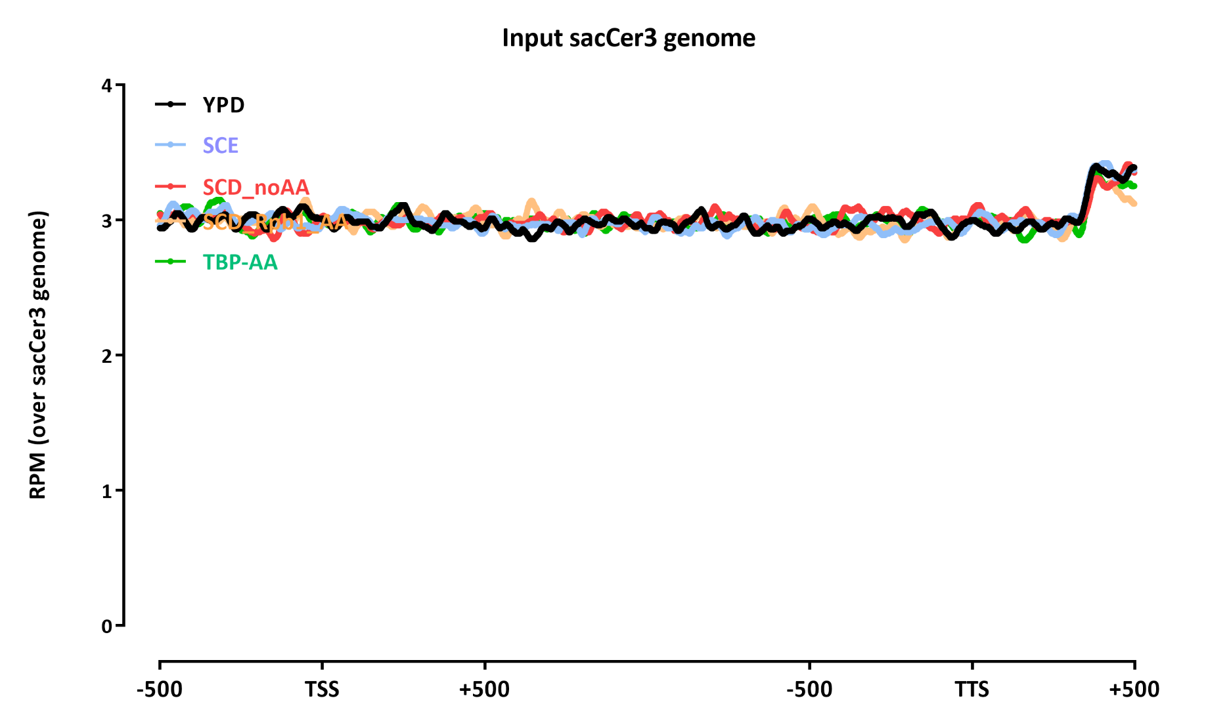

Slide 9
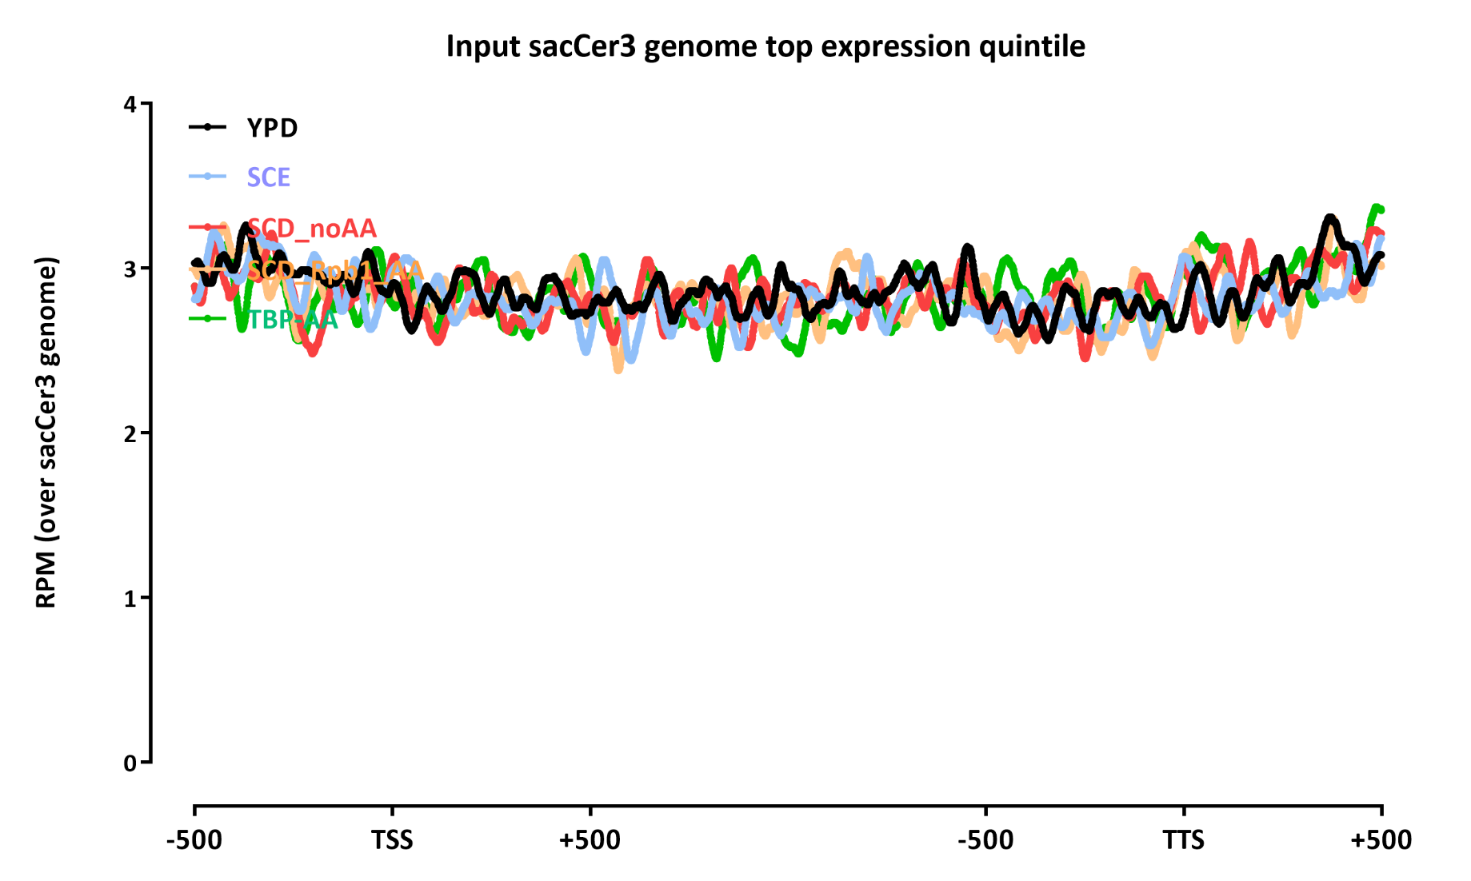

Slide 10
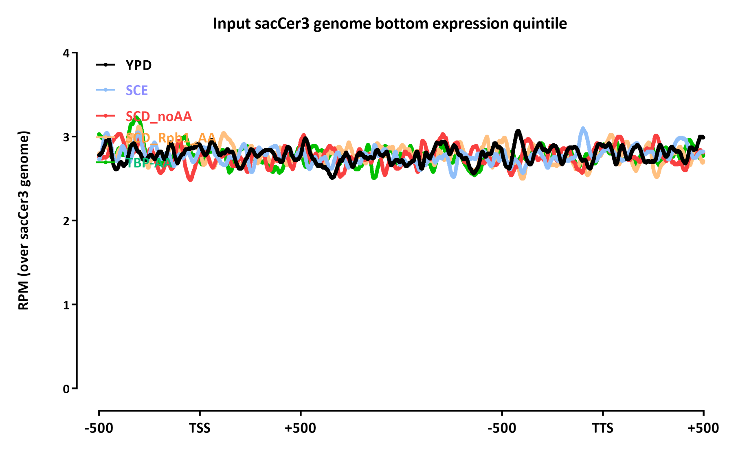

Slide 11
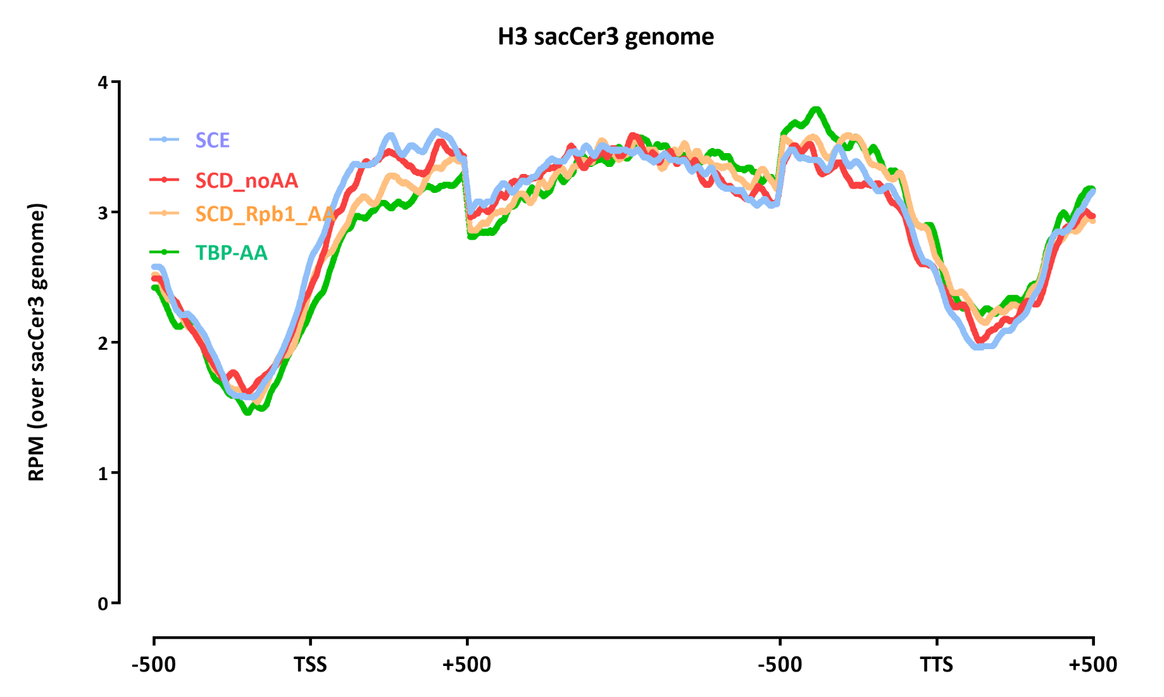

Slide 12
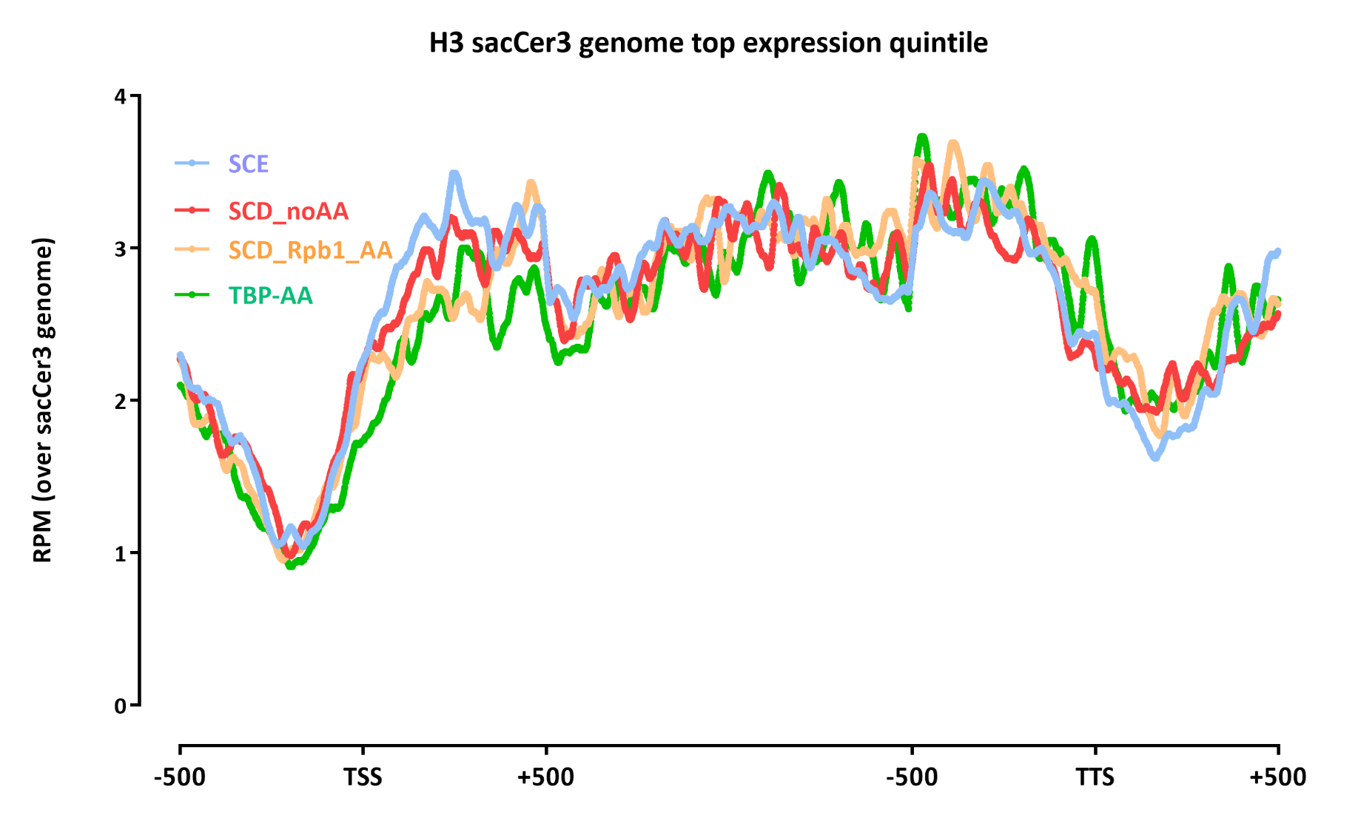

Slide 13
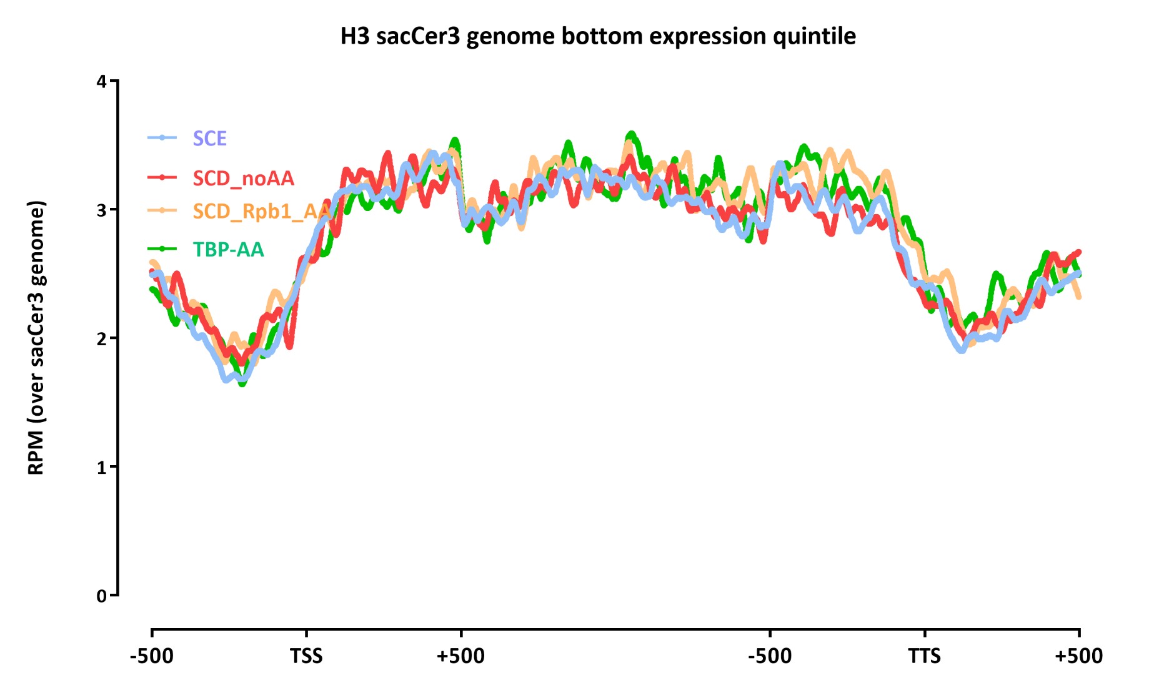

Slide 14
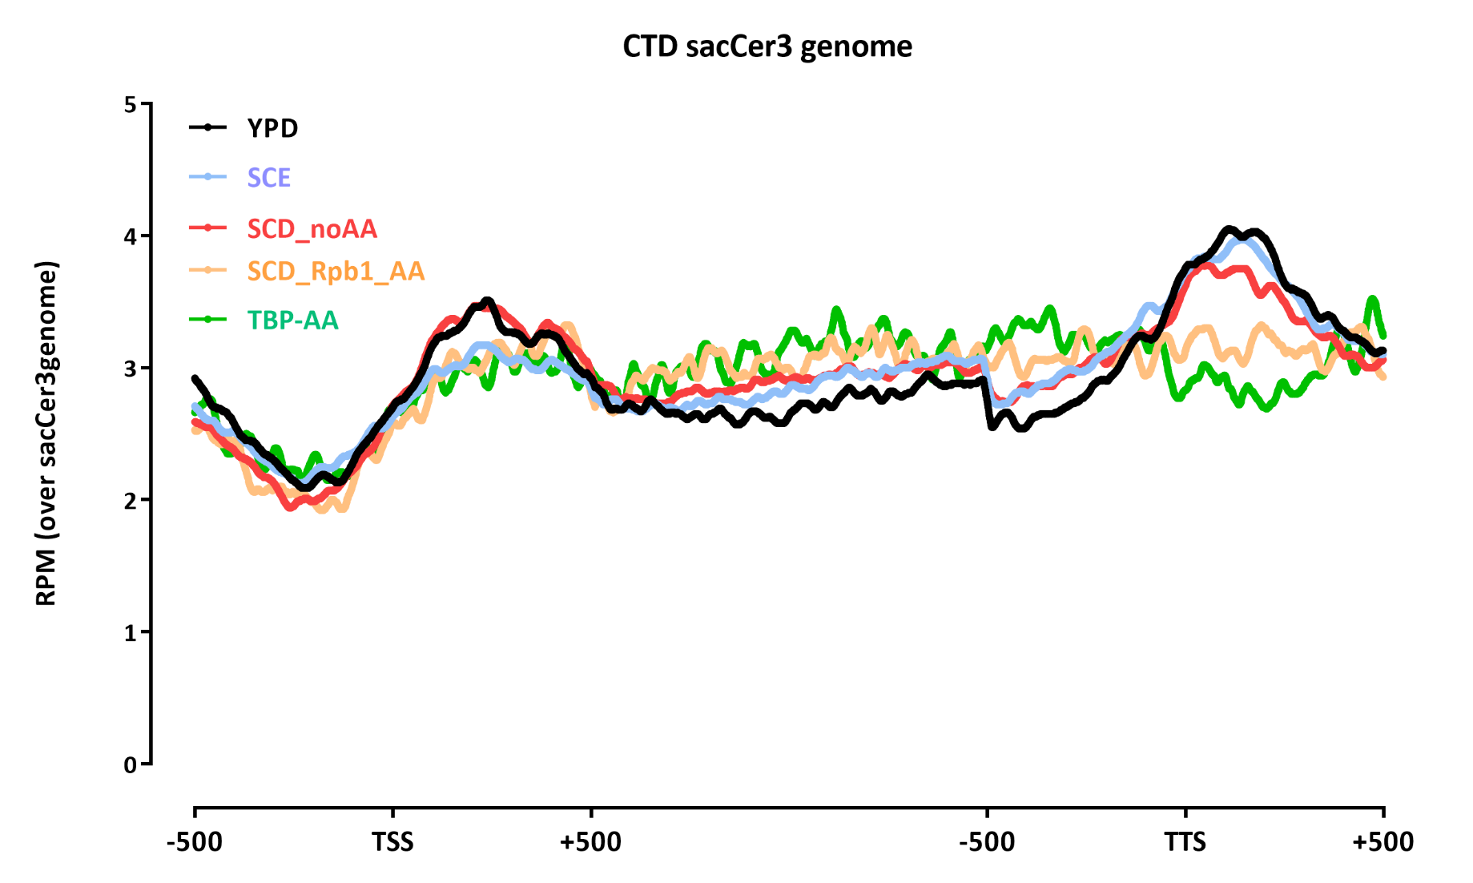

Slide 15
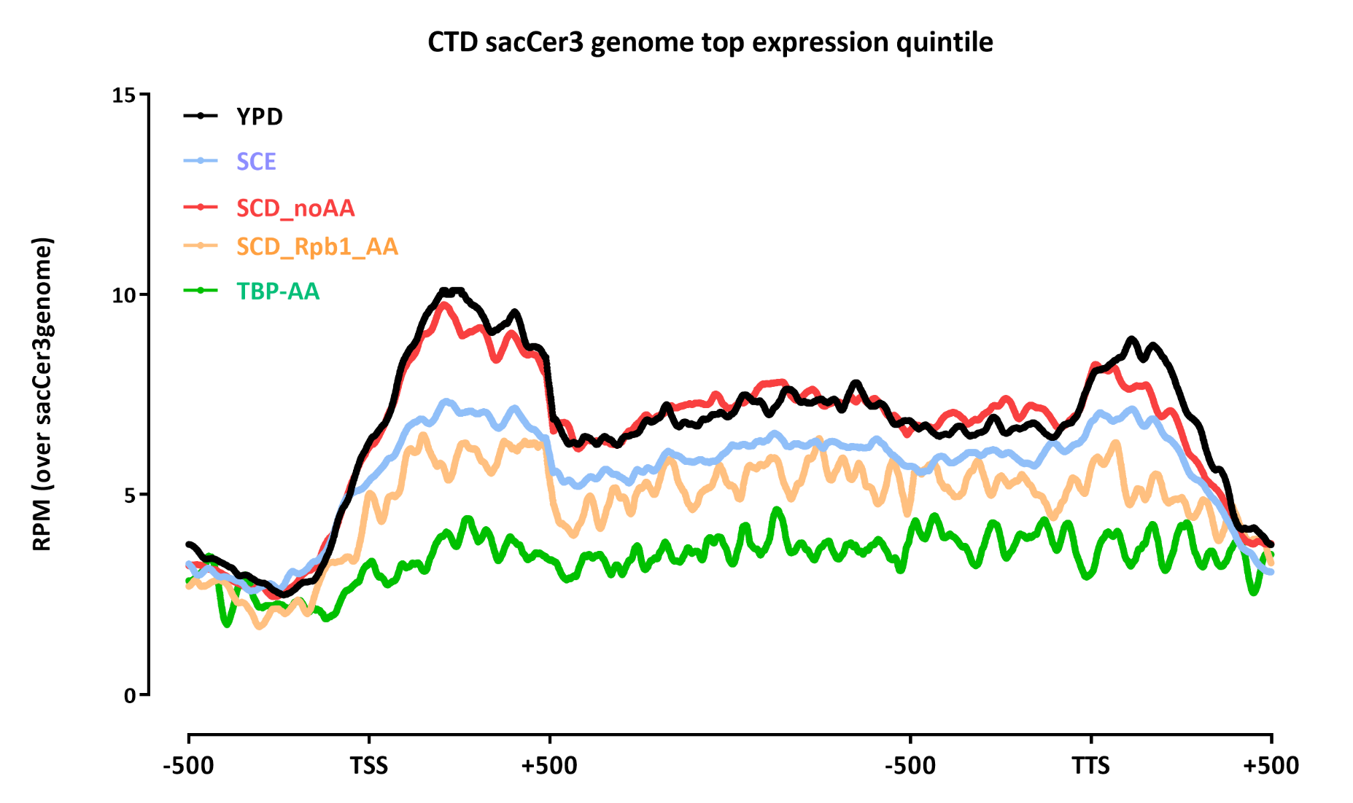

Slide 16
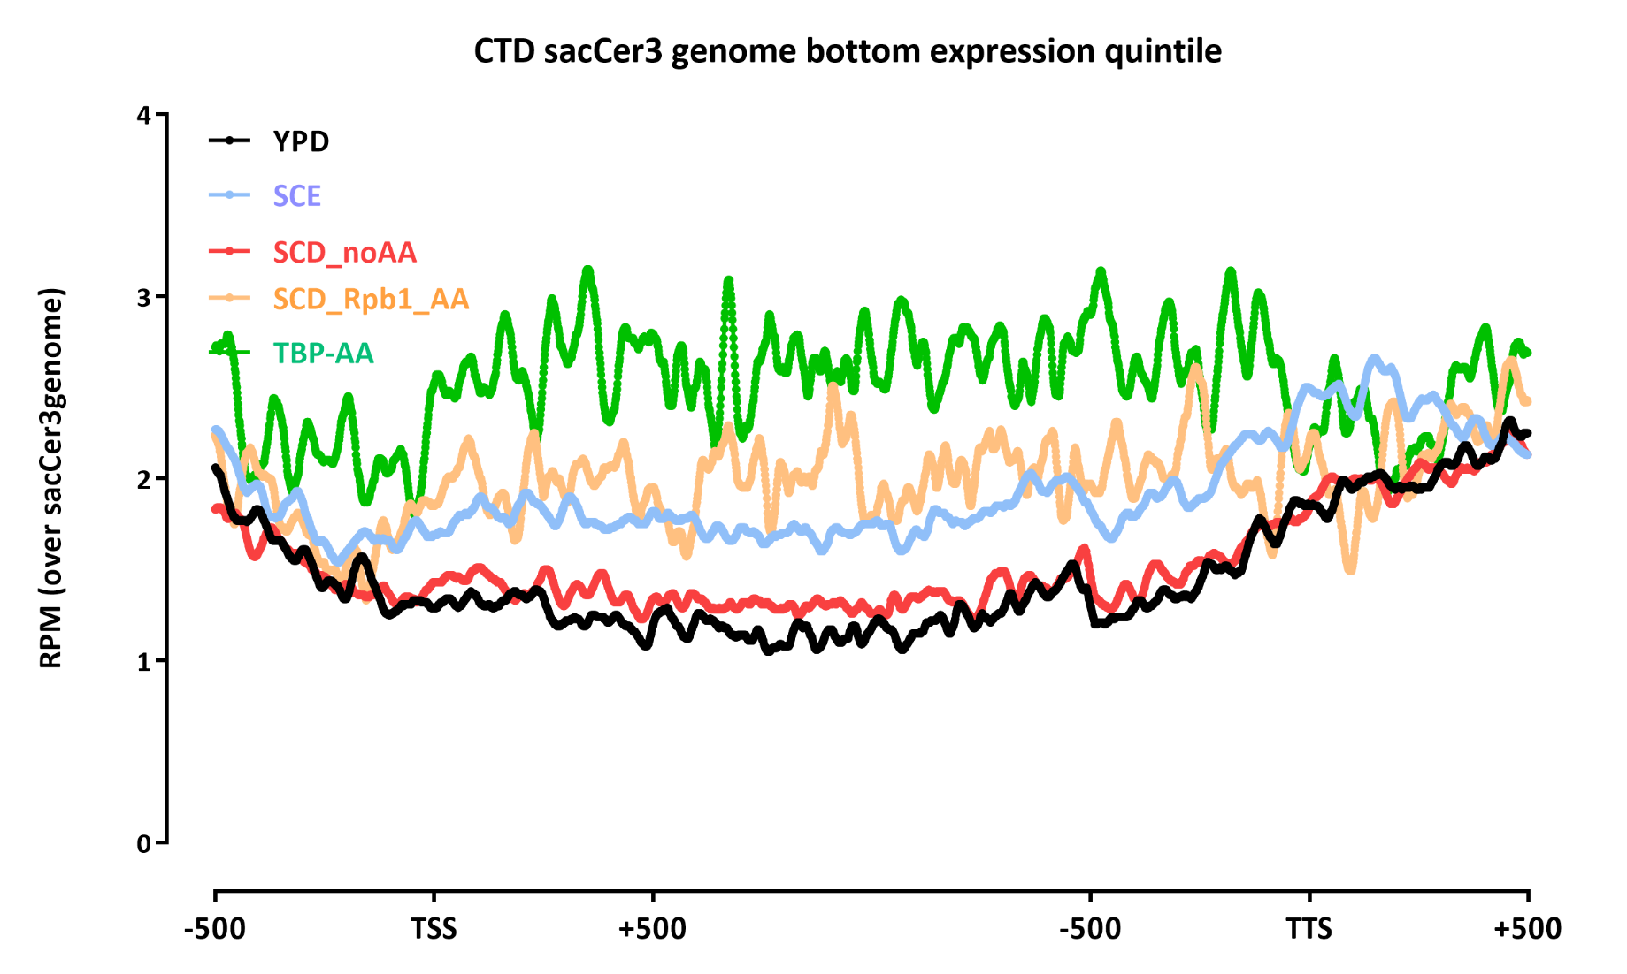

Slide 17
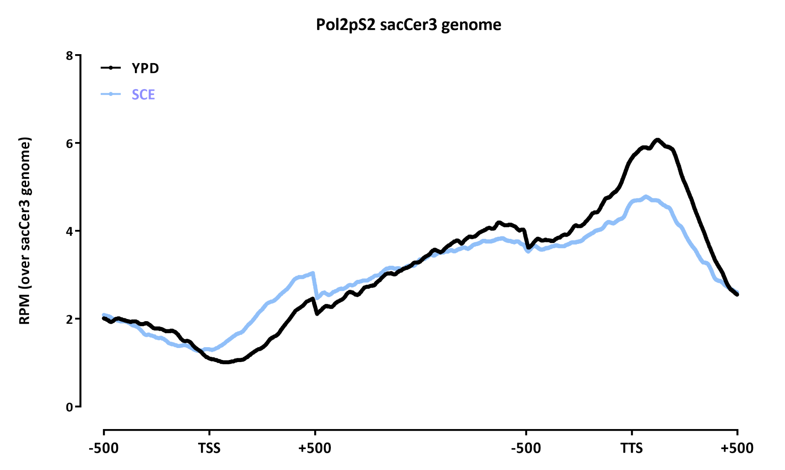

Slide 18
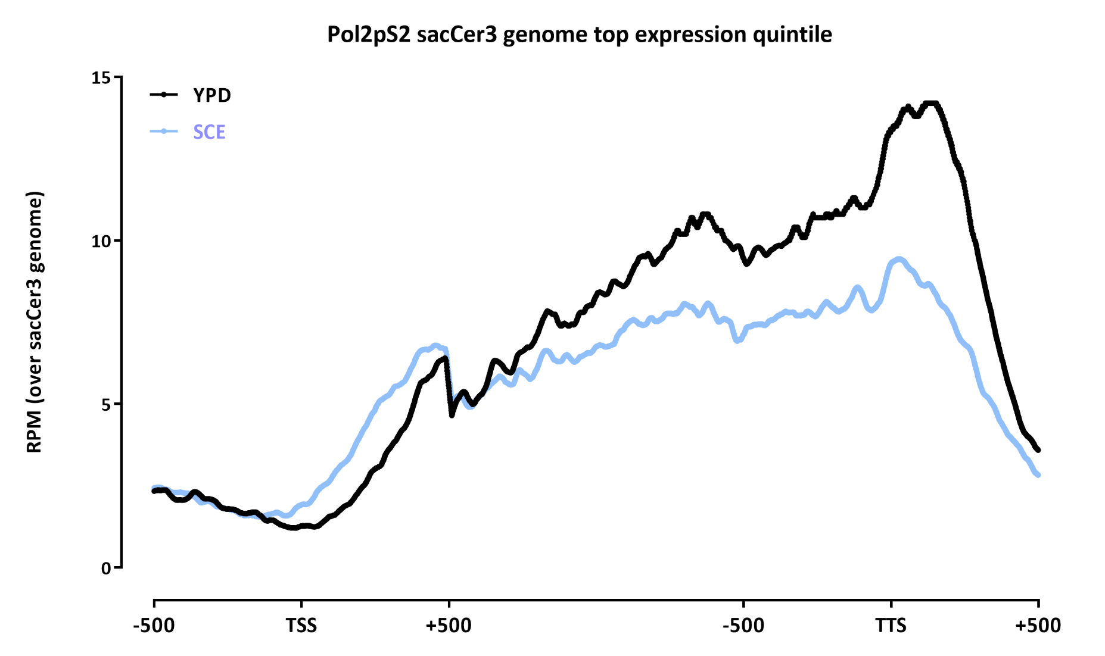

Slide 19
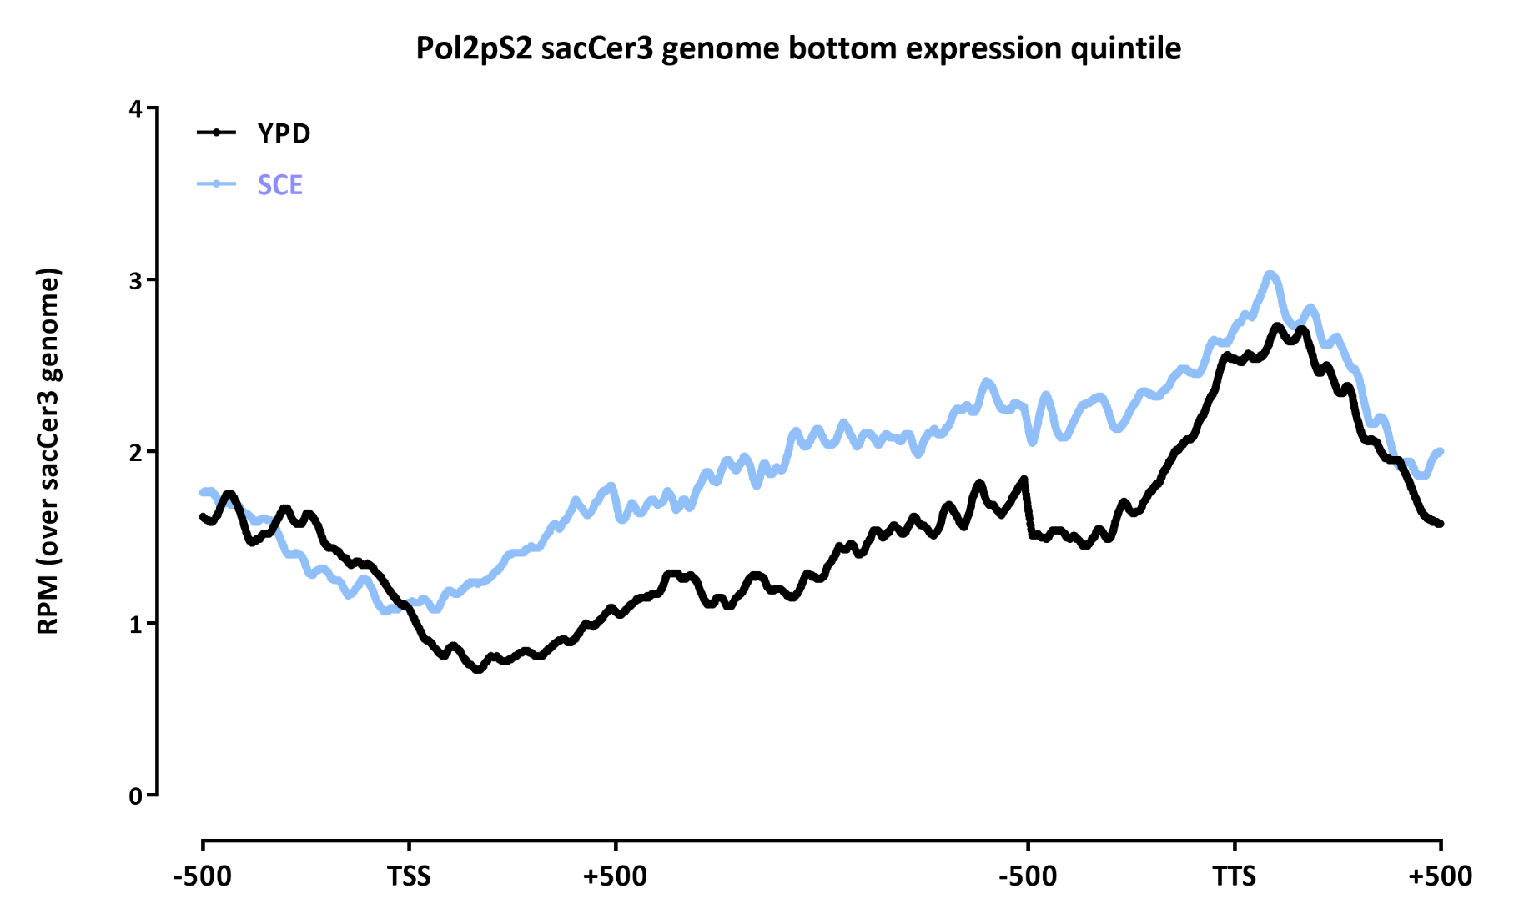

Slide 20
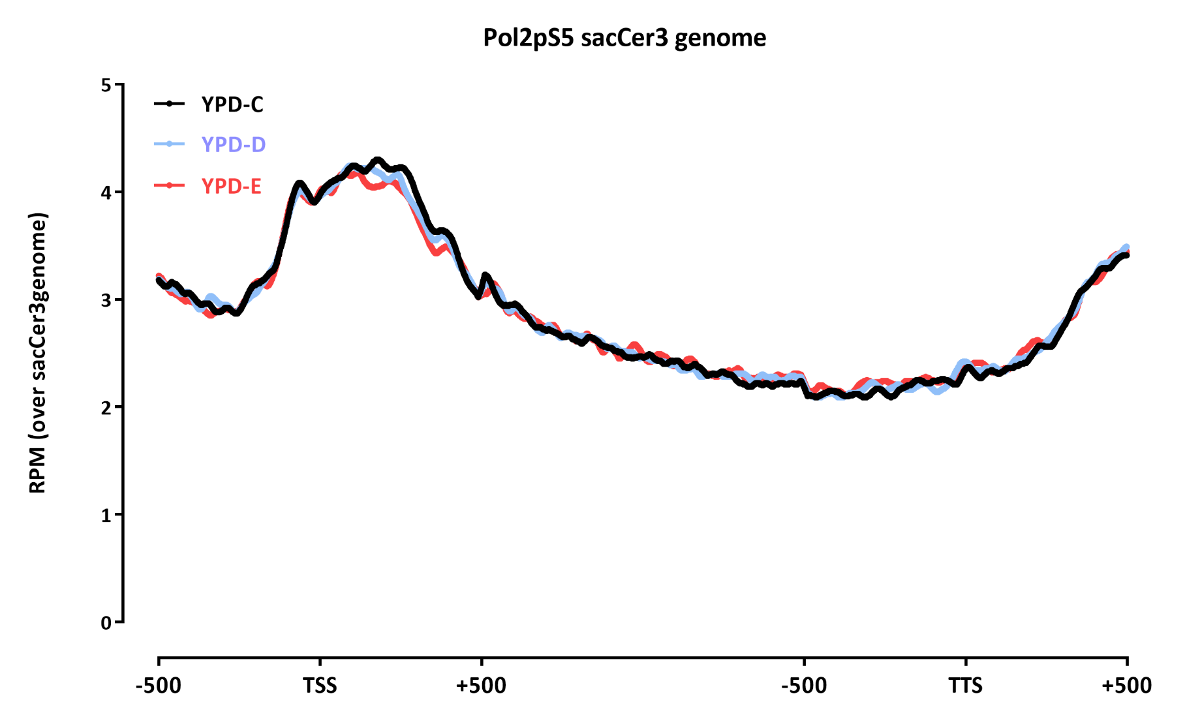

Slide 21
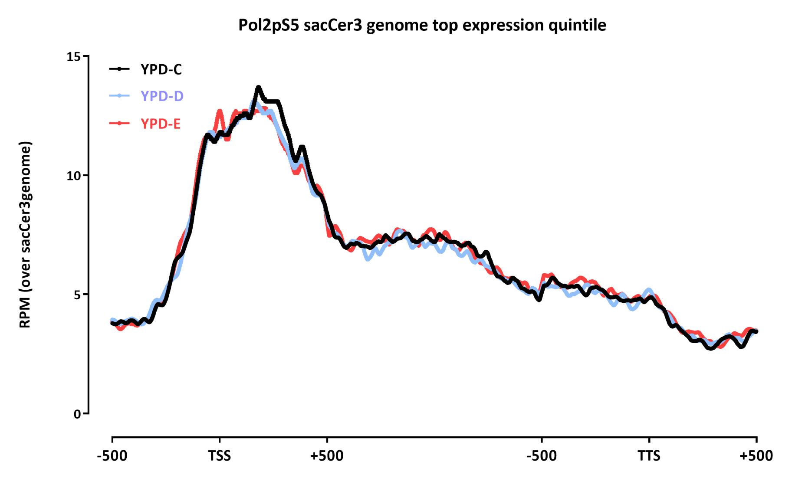

Slide 22
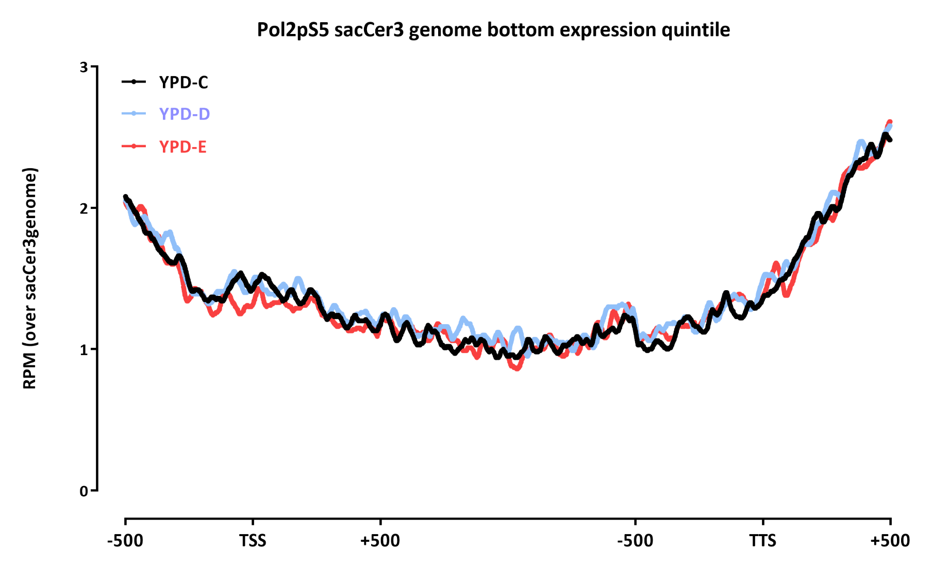

Slide 23
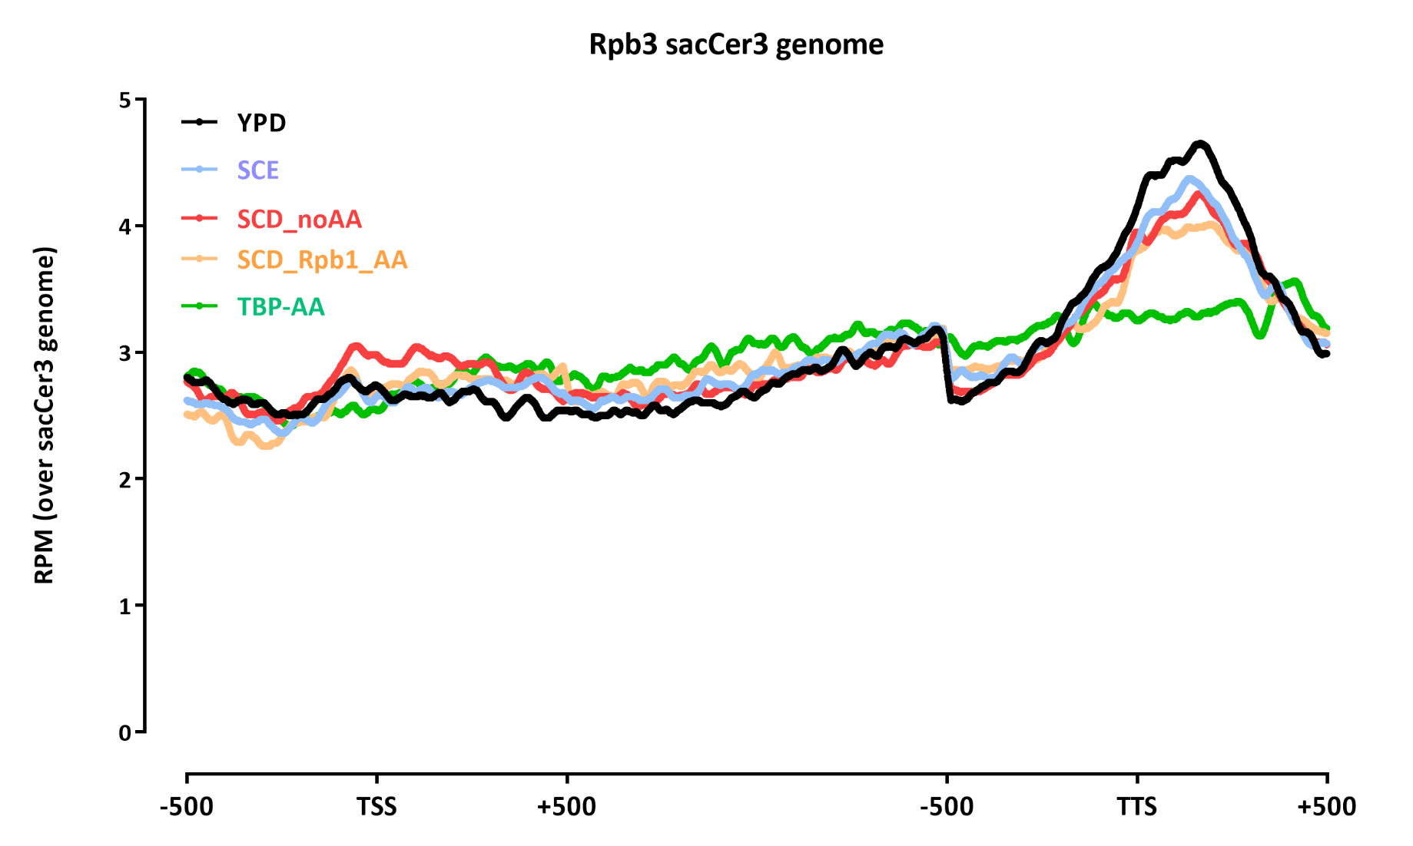

Slide 24
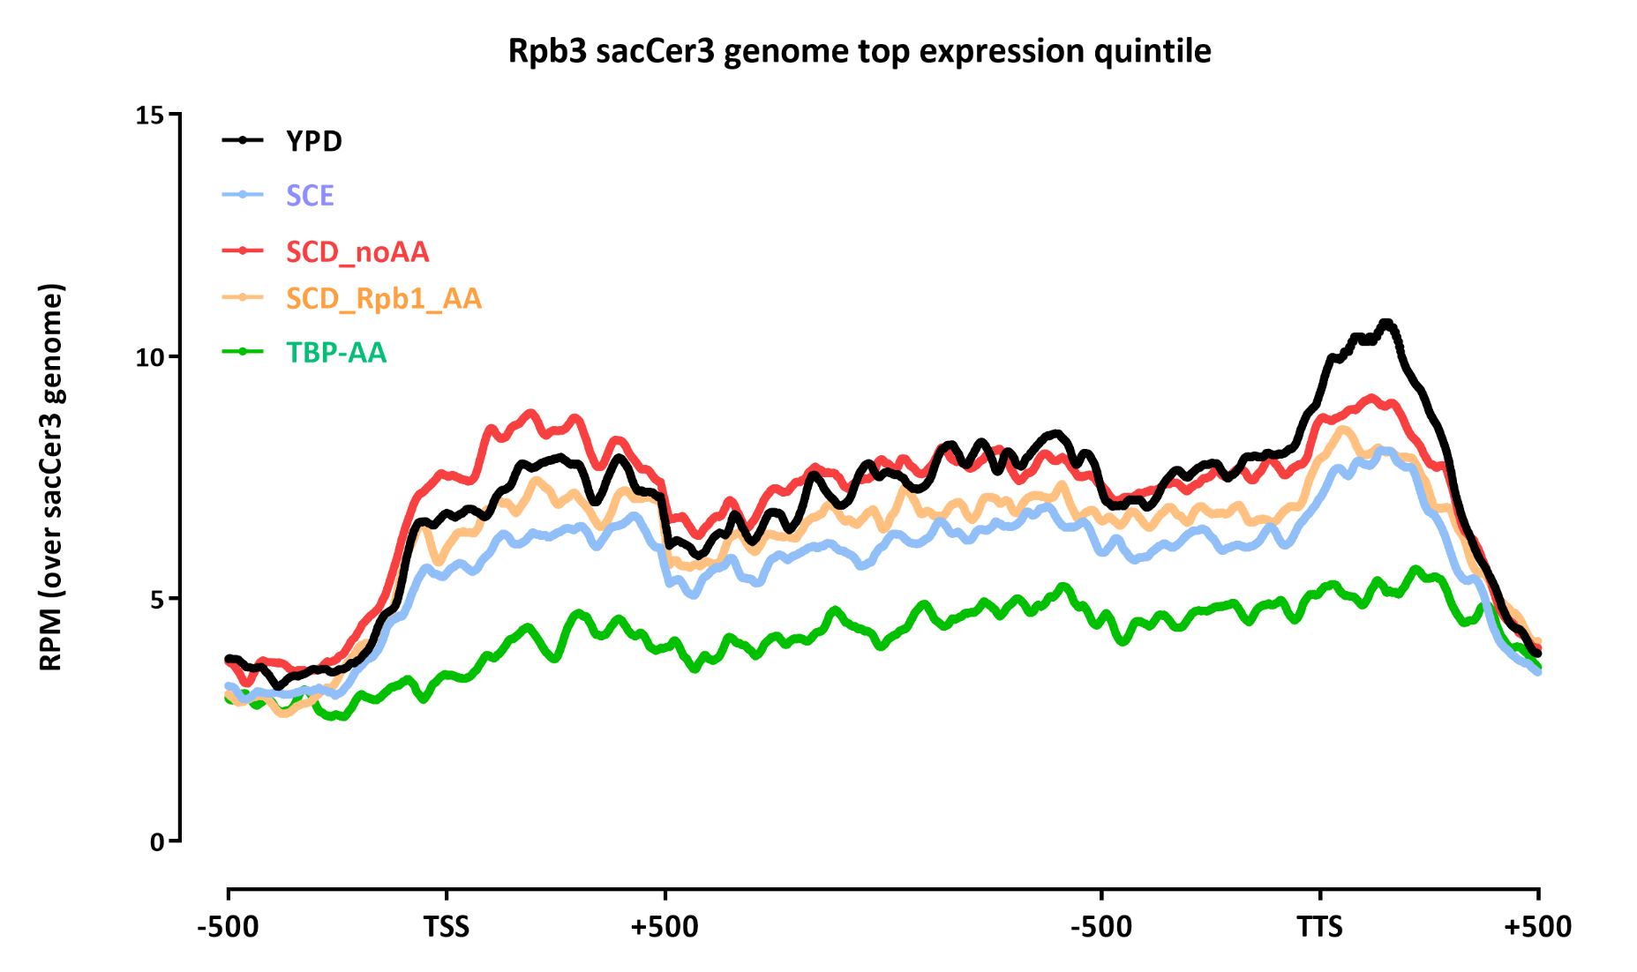

Slide 25
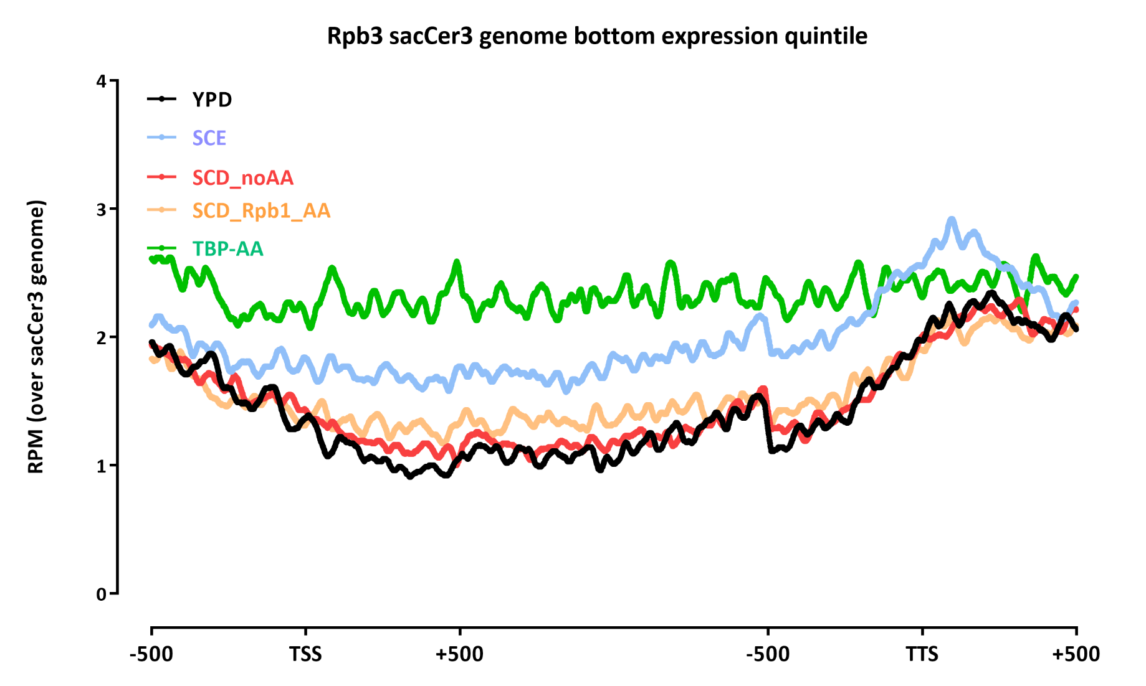

Slide 26
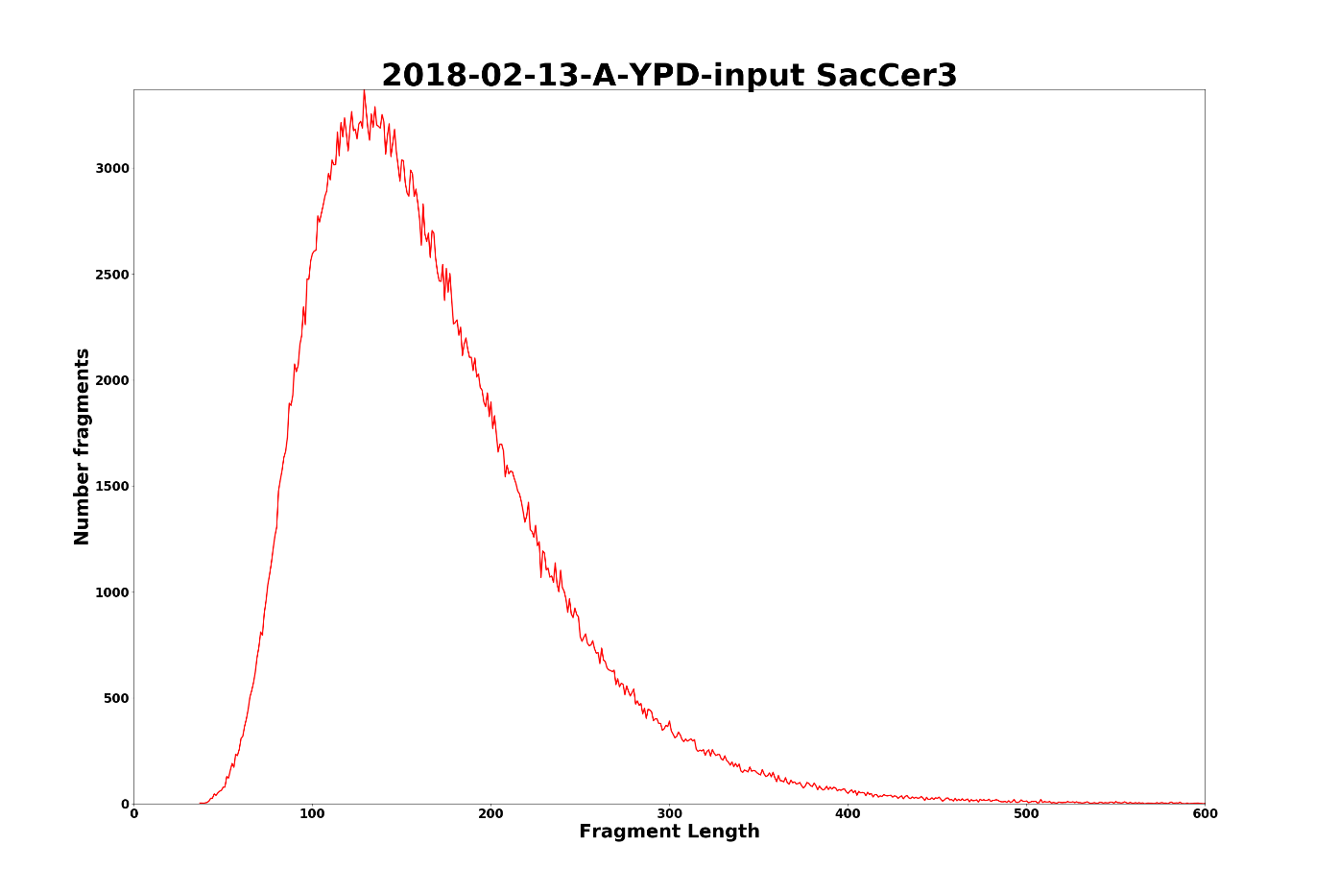
Fragment length distributions

Slide 27
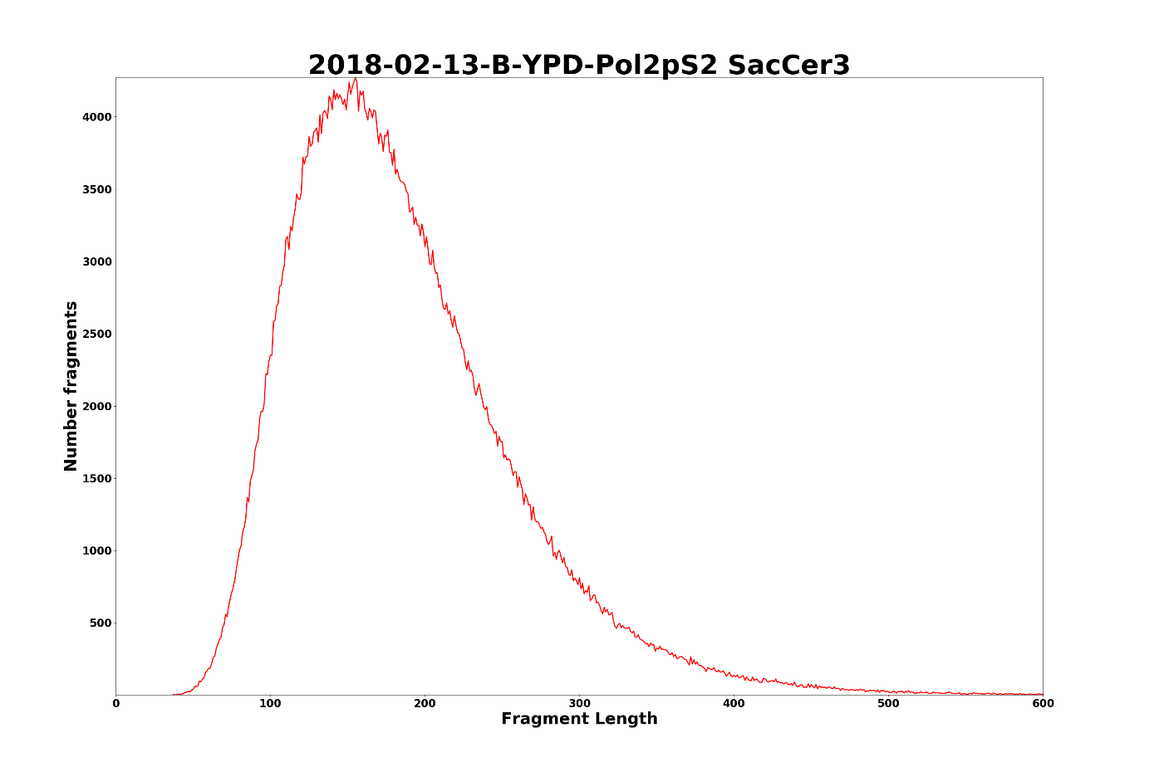

Slide 28
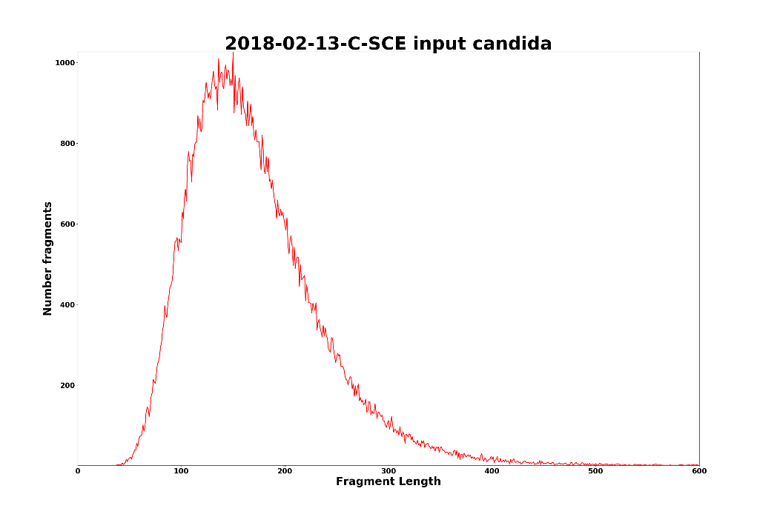
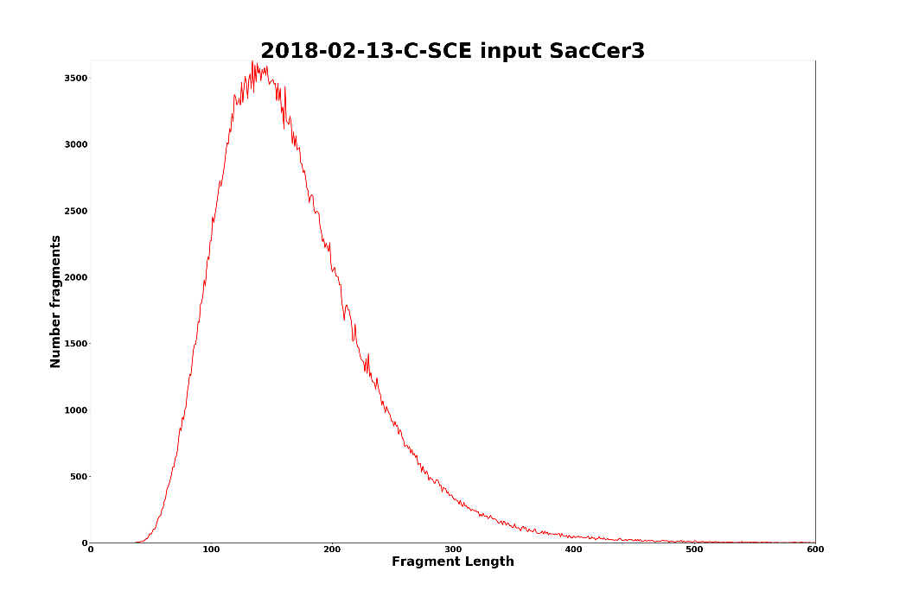

Slide 29
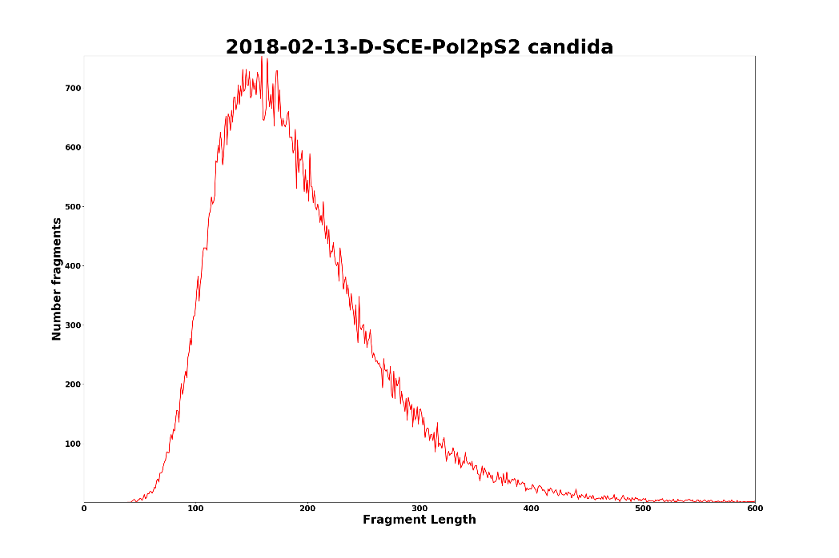
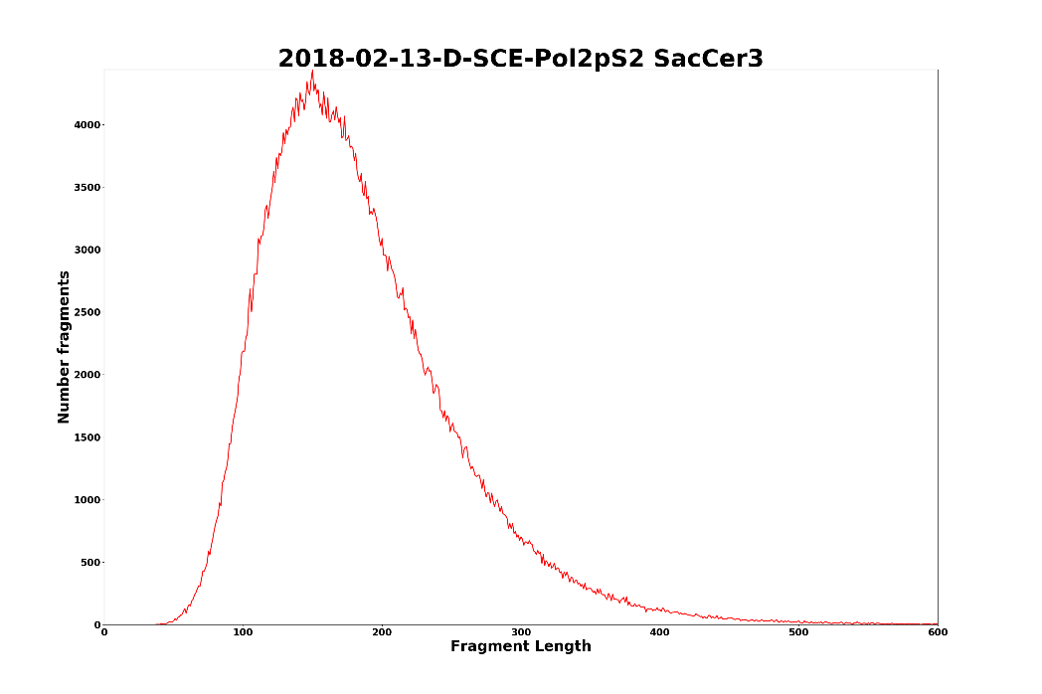

Slide 30
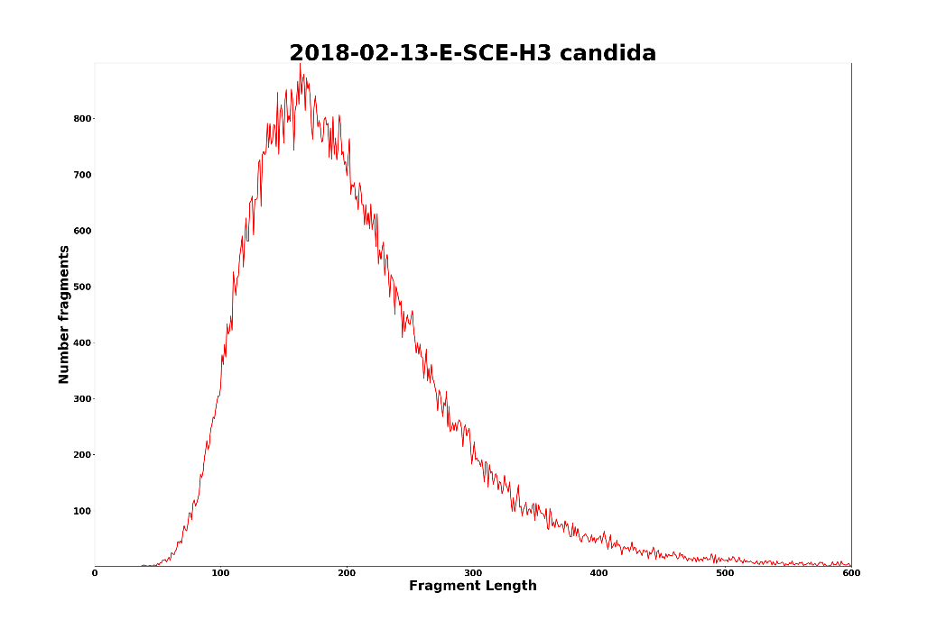

Slide 32
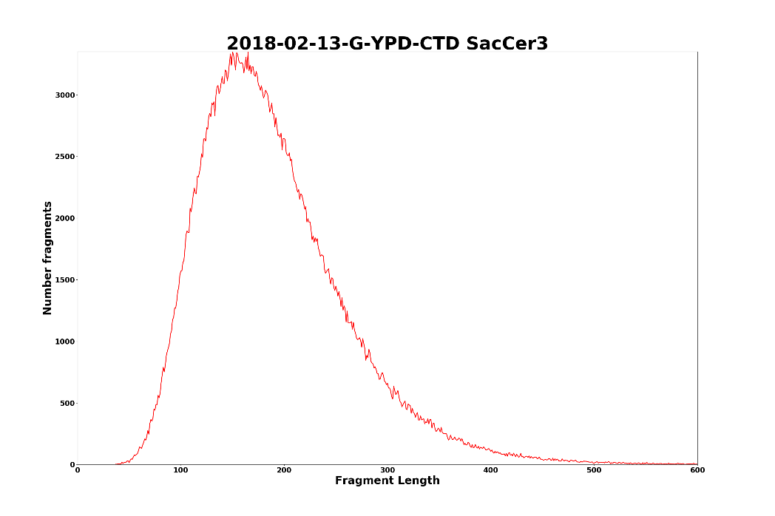

Slide 33
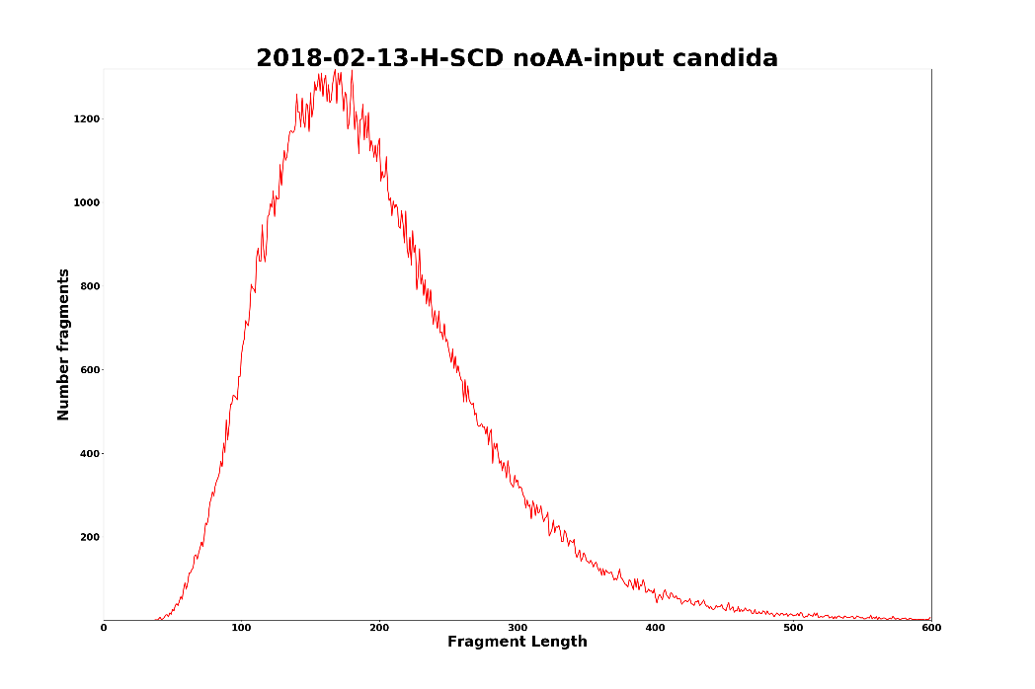
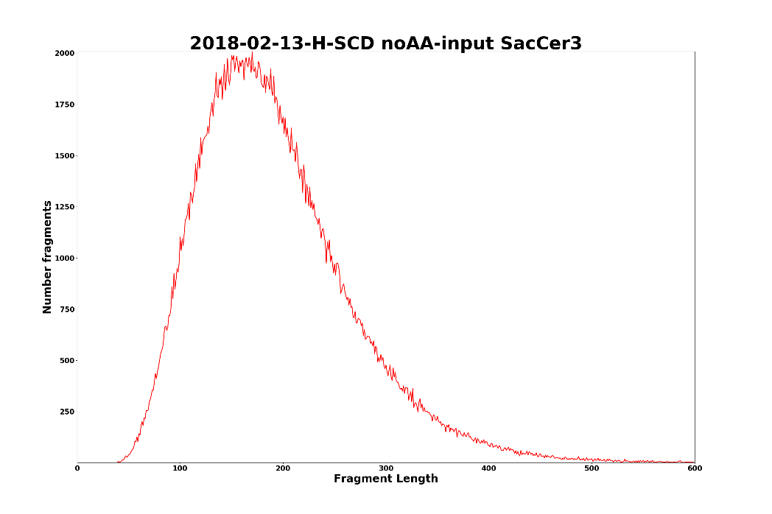

Slide 34
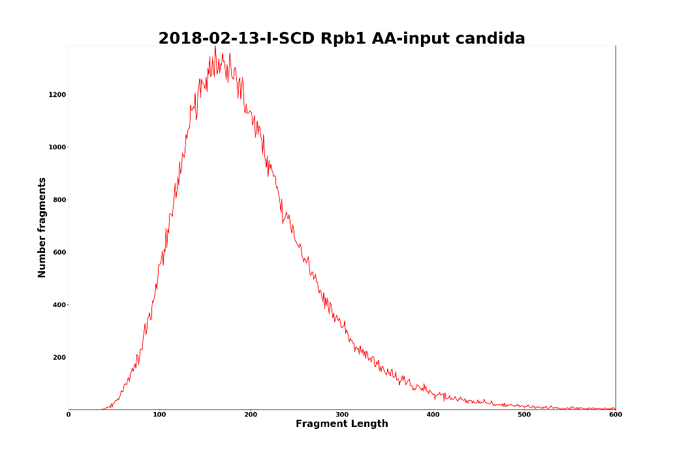
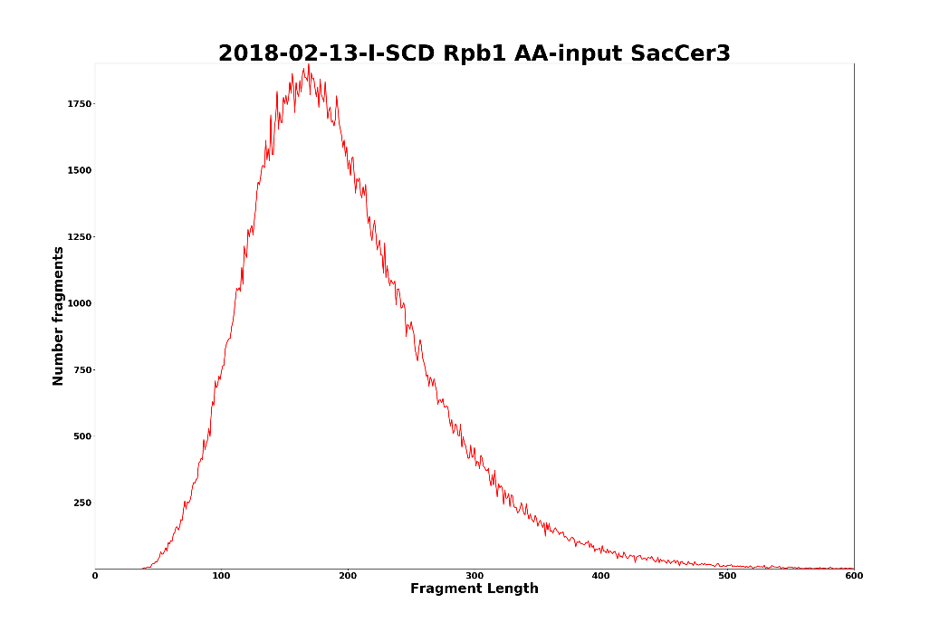

Slide 35
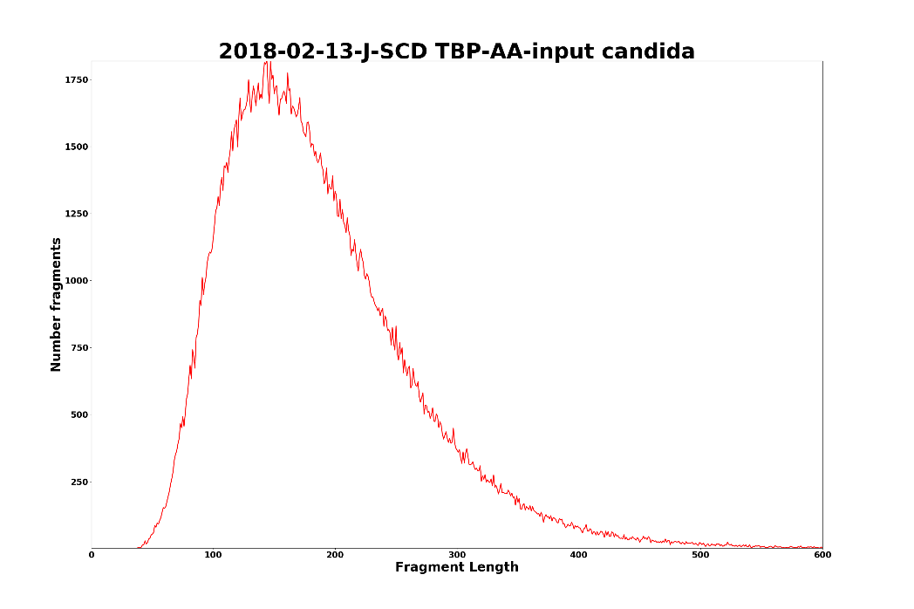
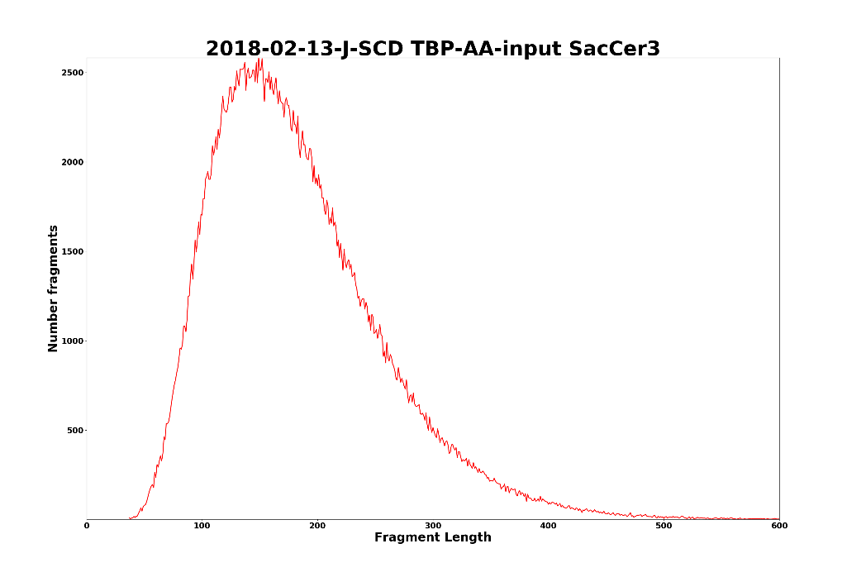

Slide 36
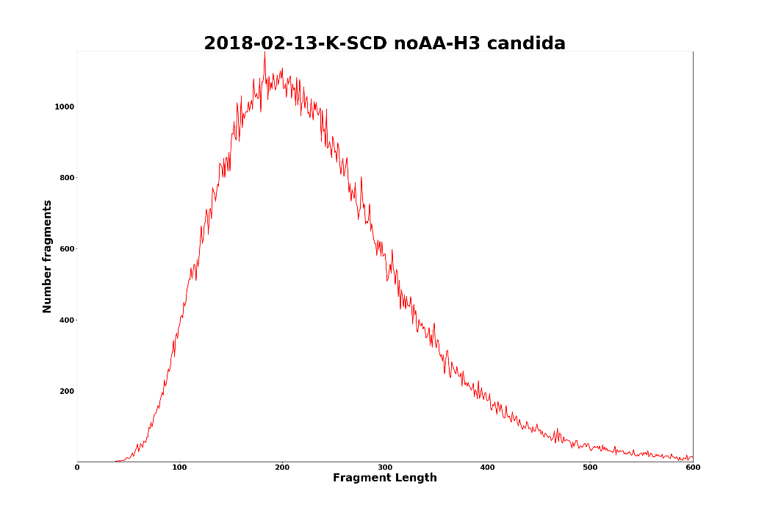
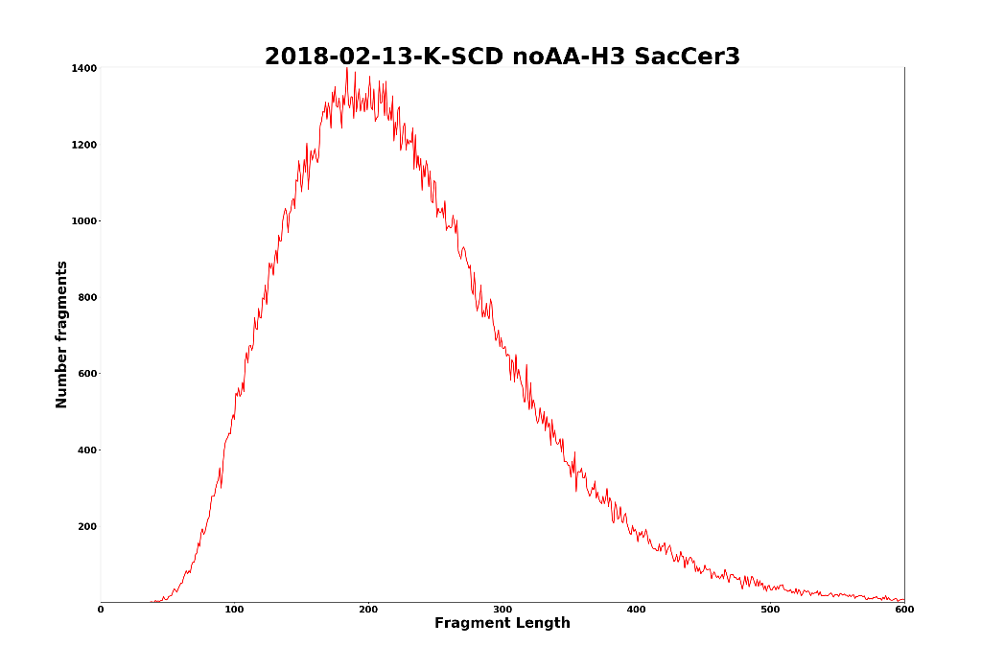

Slide 37
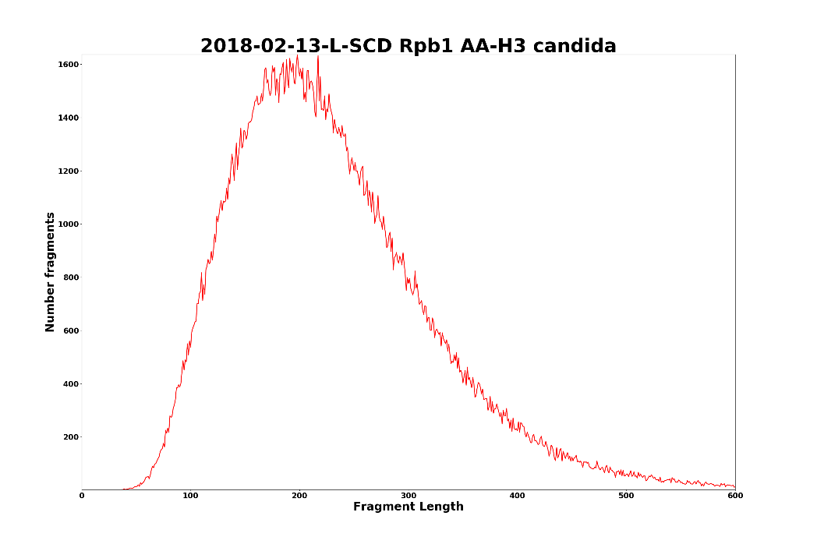
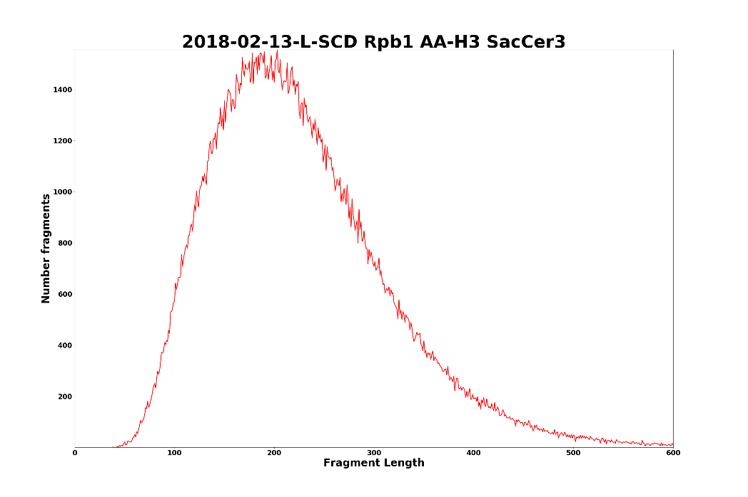

Slide 38
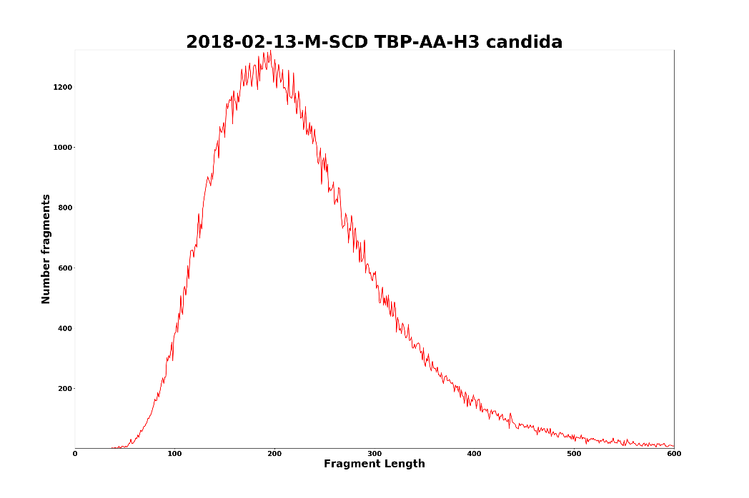
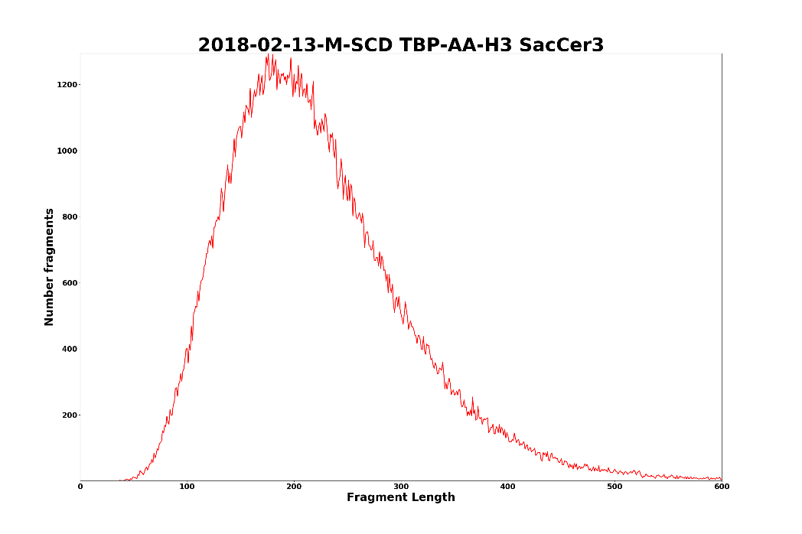

Slide 39
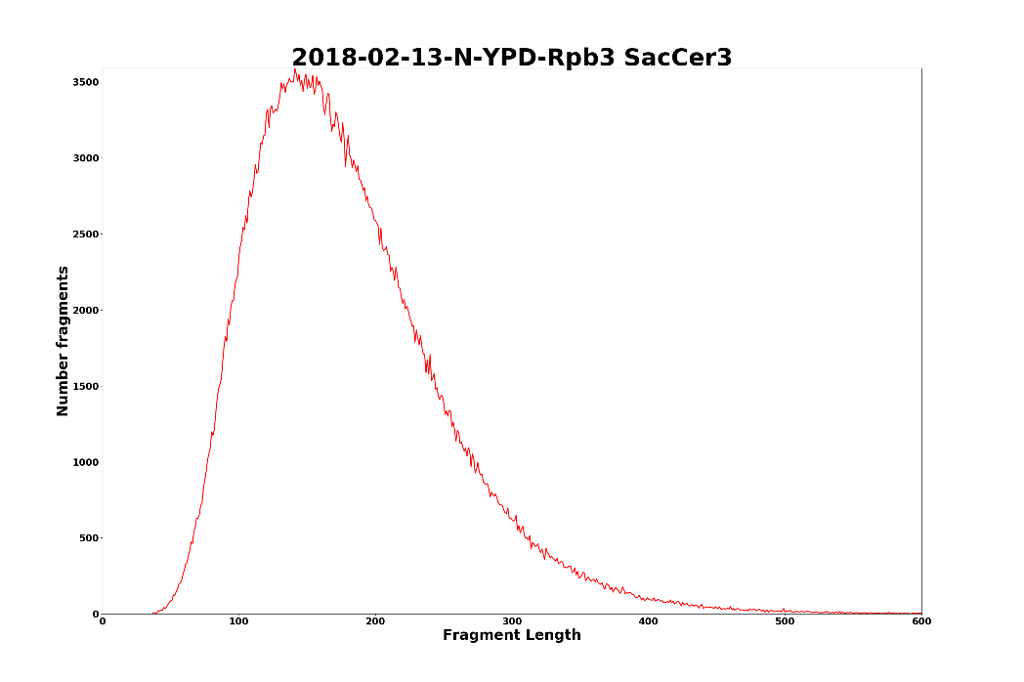

Slide 40
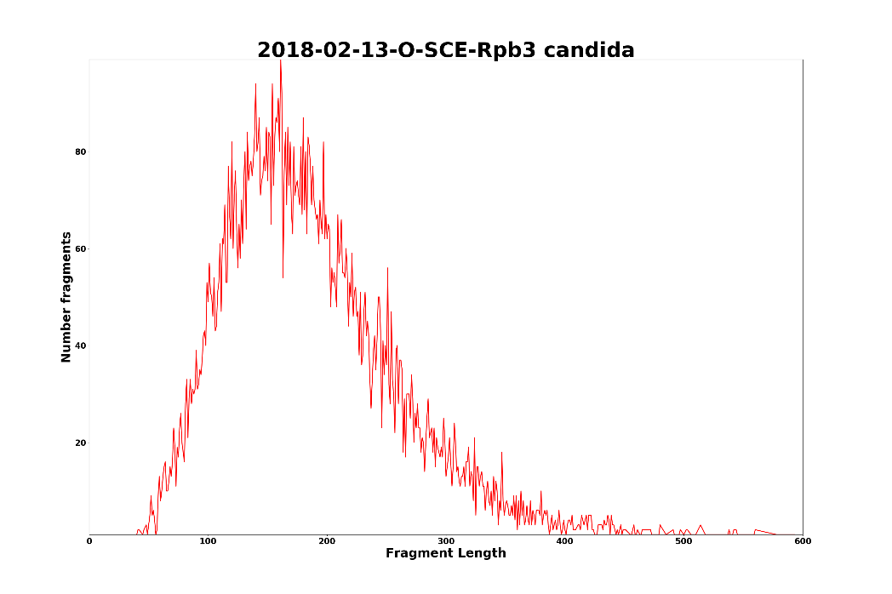
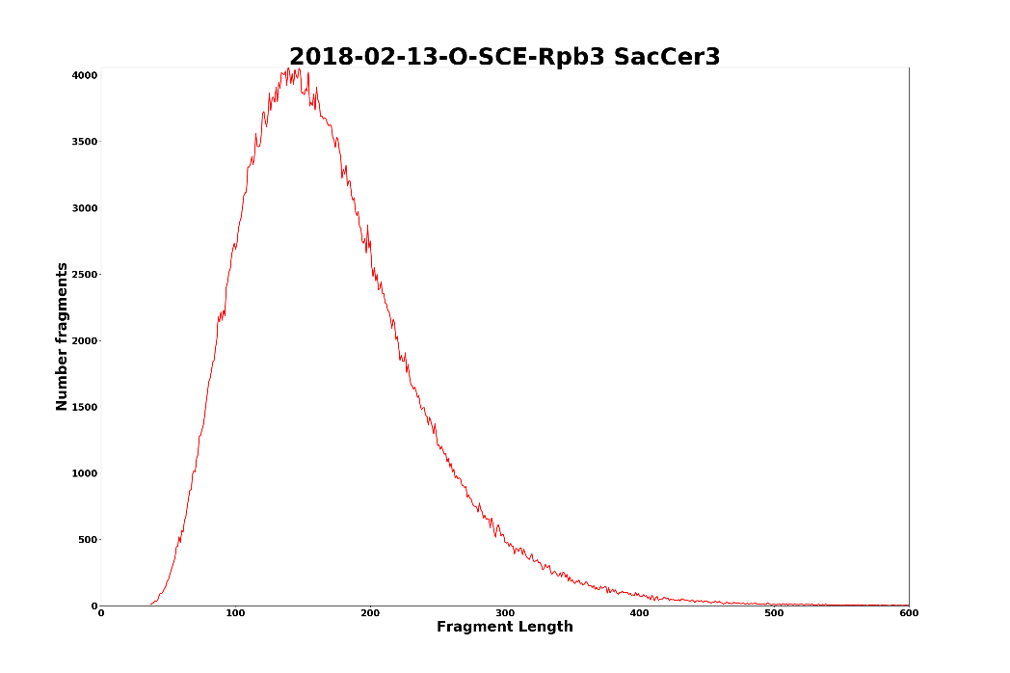

Slide 41
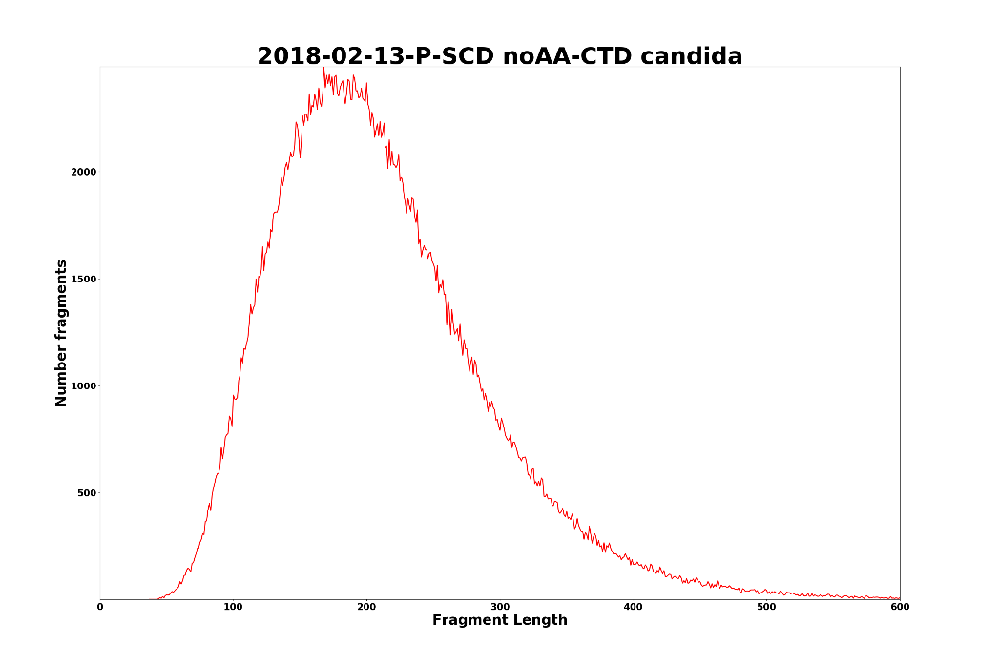

Slide 42
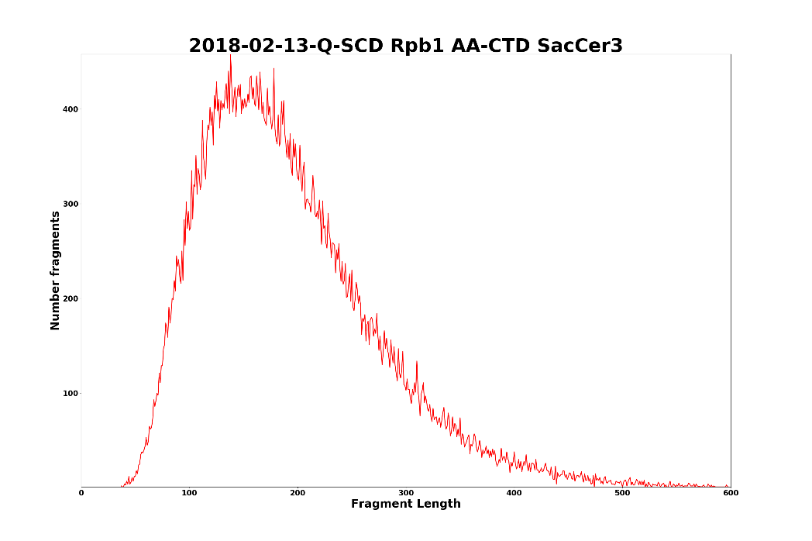

Slide 43
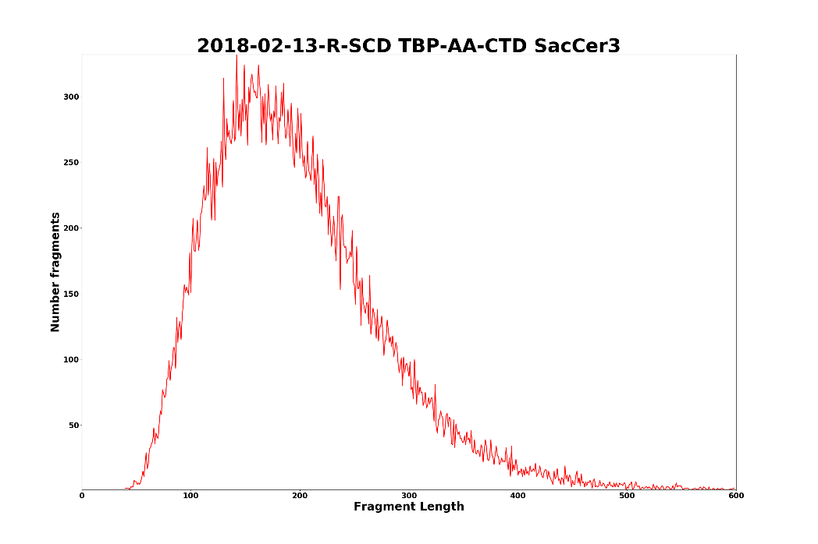

Slide 44



Slide 45


Slide 46


Slide 47


Slide 48



Slide 49



