Slide 1
Dataset stats
Library | Raw fragments | Species | 2x36mers |  | 1x36mers |  | Mappability Corrected RPKM
 |  |  | Unique non-chrM reads | Complexity | Unique non-chrM reads | Complexity
WT-H3 | 1,064,508 | sacCer3 | 1,064,528 | 0.97 | 536,713 | 0.96 | 69.66
 | 1,064,508 | S.pombe | 264,160 | 0.99 | 133,460 | 0.99 | 16.43
WT-Input | 615,834 | sacCer3 | 805,132 | 0.98 | 404,907 | 0.98 | 74.01
 | 615,834 | S.pombe | 141,106 | 0.99 | 70,949 | 0.99 | 12.30
WT-Pol2 | 812,719 | sacCer3 | 772,936 | 0.96 | 390,550 | 0.96 | 69.45
 | 812,719 | S.pombe | 195,266 | 0.98 | 98,571 | 0.98 | 16.63
WT-Pol2pS2 | 724,576 | sacCer3 | 577,786 | 0.96 | 293,261 | 0.96 | 56.75
 | 724,576 | S.pombe | 308,428 | 0.97 | 156,231 | 0.97 | 28.67
WT-Pol2pS25 | 840,788 | sacCer3 | 471,840 | 0.97 | 238,486 | 0.97 | 33.35
 | 840,788 | S.pombe | 760,898 | 0.96 | 383,524 | 0.96 | 50.87
cln3-H3 | 1,436,625 | sacCer3 | 1,509,632 | 0.97 | 760,729 | 0.96 | 71.20
 | 1,436,625 | S.pombe | 334,466 | 0.99 | 168,538 | 0.99 | 14.96
cln3-Input | 1,796,984 | sacCer3 | 1,936,920 | 0.97 | 976,332 | 0.96 | 73.97
 | 1,796,984 | S.pombe | 341,372 | 0.99 | 171,789 | 0.99 | 12.34
cln3-Pol2 | 434,701 | sacCer3 | 482,620 | 0.98 | 243,009 | 0.98 | 68.21
 | 434,701 | S.pombe | 132,890 | 0.99 | 66,860 | 0.99 | 17.80
cln3-Pol2pS2 | 671,364 | sacCer3 | 654,598 | 0.97 | 330,625 | 0.97 | 55.77
 | 671,364 | S.pombe | 366,916 | 0.97 | 184,985 | 0.97 | 29.60
cln3-Pol2pS25 | 610,734 | sacCer3 | 300,588 | 0.98 | 152,613 | 0.98 | 30.12
 | 610,734 | S.pombe | 569,874 | 0.96 | 288,067 | 0.96 | 53.93
whi5-H3 | 1,201,314 | sacCer3 | 1,138,238 | 0.97 | 574,493 | 0.96 | 61.24
 | 1,201,314 | S.pombe | 478,280 | 0.99 | 241,492 | 0.99 | 24.42
whi5-Input | 2,229,447 | sacCer3 | 2,426,126 | 0.96 | 1,224,910 | 0.95 | 72.07
 | 2,229,447 | S.pombe | 502,180 | 0.99 | 253,399 | 0.99 | 14.14
whi5-Pol2 | 918,837 | sacCer3 | 960,044 | 0.95 | 485,651 | 0.95 | 70.70
 | 918,837 | S.pombe | 221,524 | 0.97 | 111,824 | 0.98 | 15.44
whi5-Pol2pS2 | 1,430,630 | sacCer3 | 965,332 | 0.94 | 489,313 | 0.94 | 64.43
 | 1,430,630 | S.pombe | 339,026 | 0.95 | 171,278 | 0.96 | 21.39
whi5-Pol2pS25 | 1,433,030 | sacCer3 | 678,682 | 0.96 | 345,660 | 0.96 | 38.63
 | 1,433,030 | S.pombe | 852,574 | 0.95 | 432,639 | 0.94 | 45.86

Slide 2
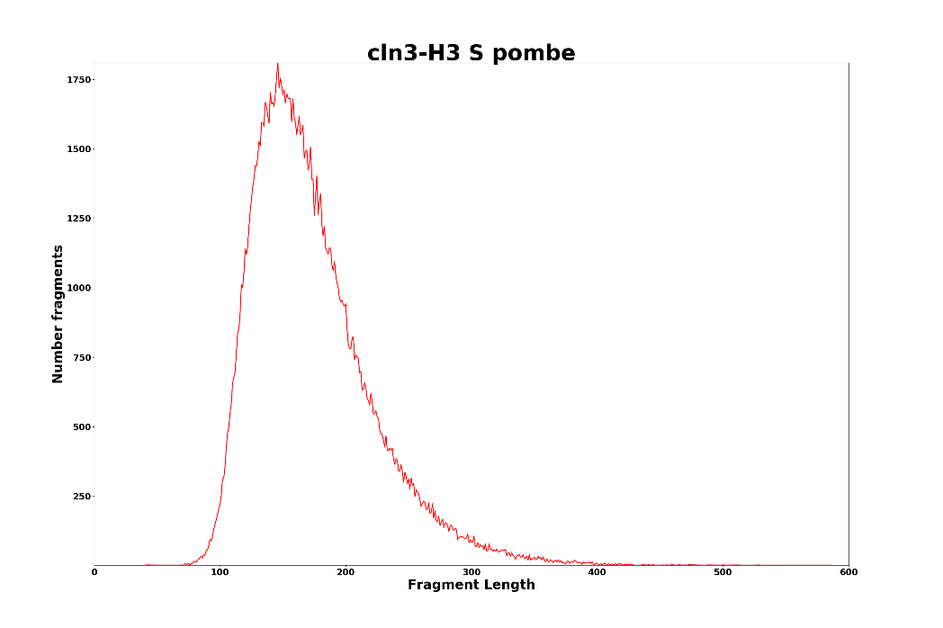
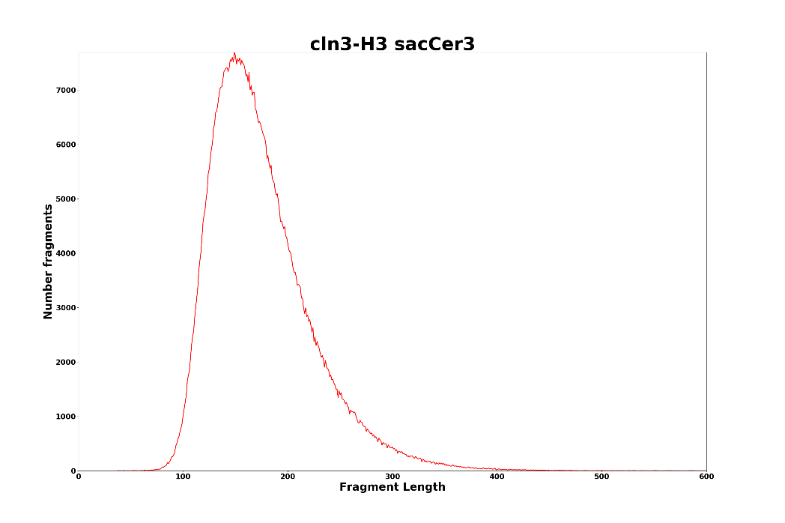

Slide 3
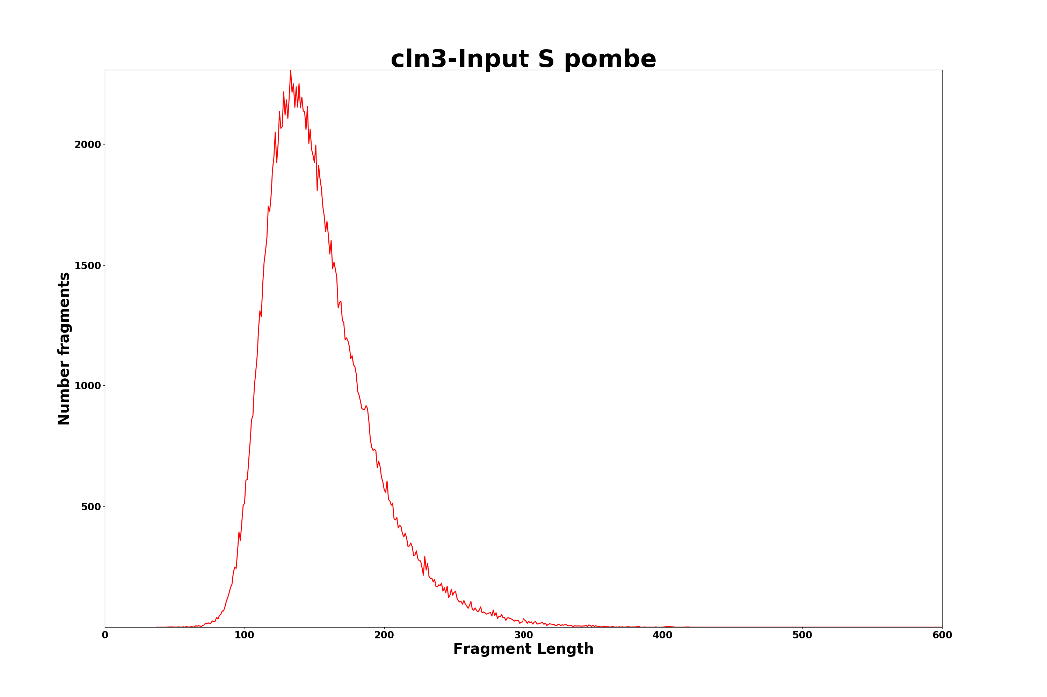
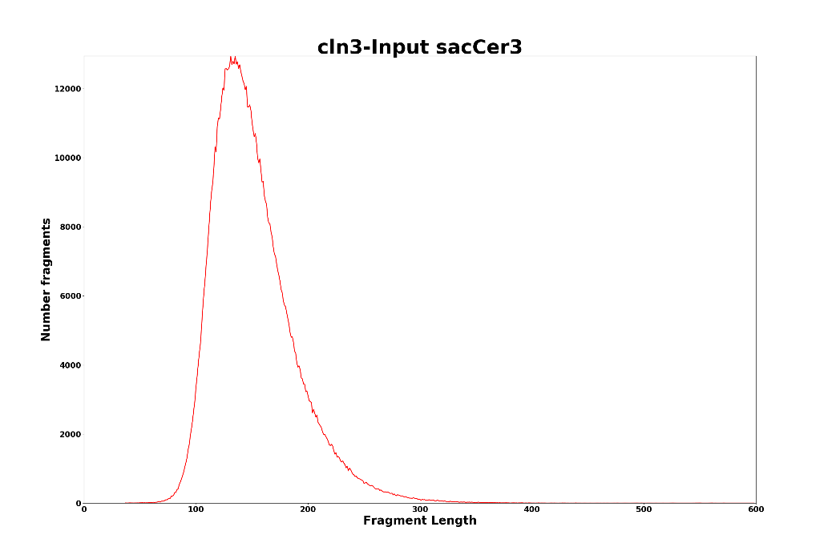

Slide 4
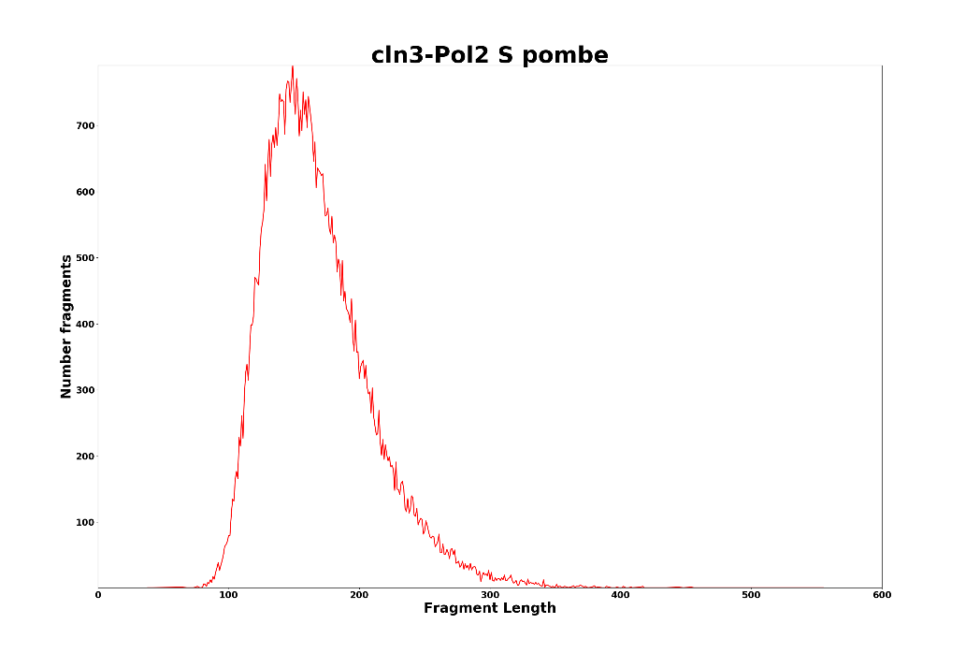
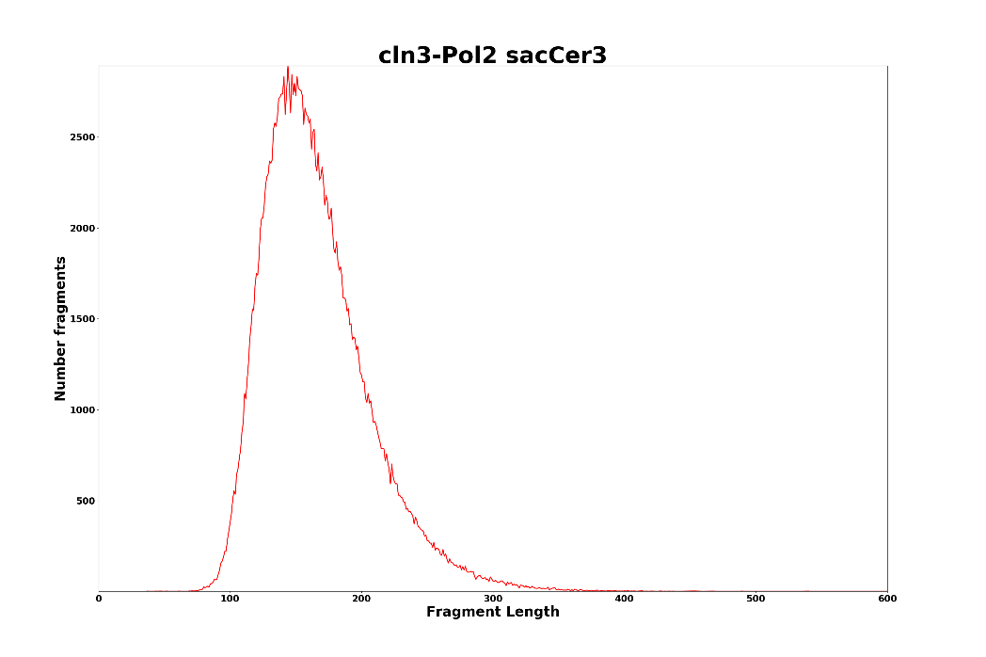

Slide 5
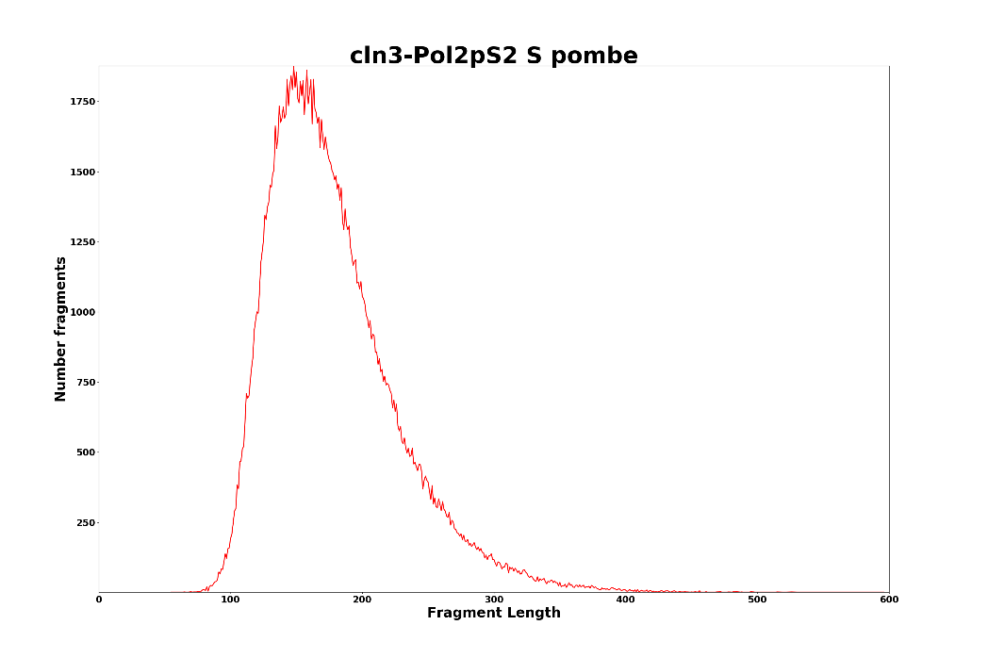
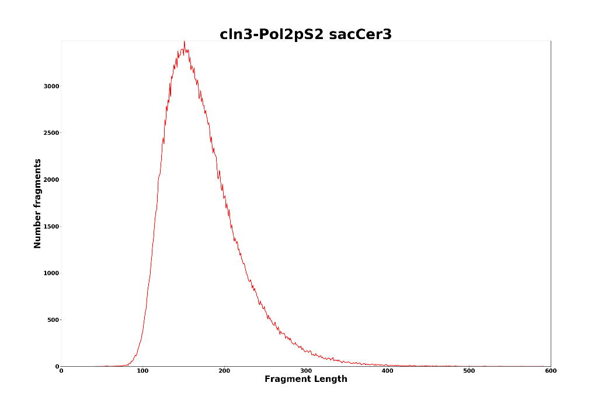

Slide 6
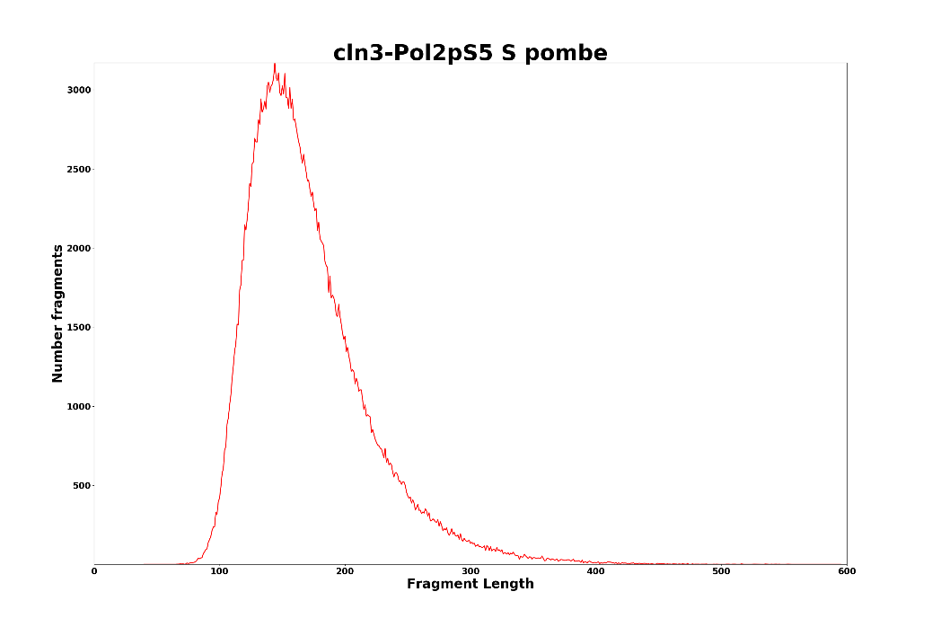
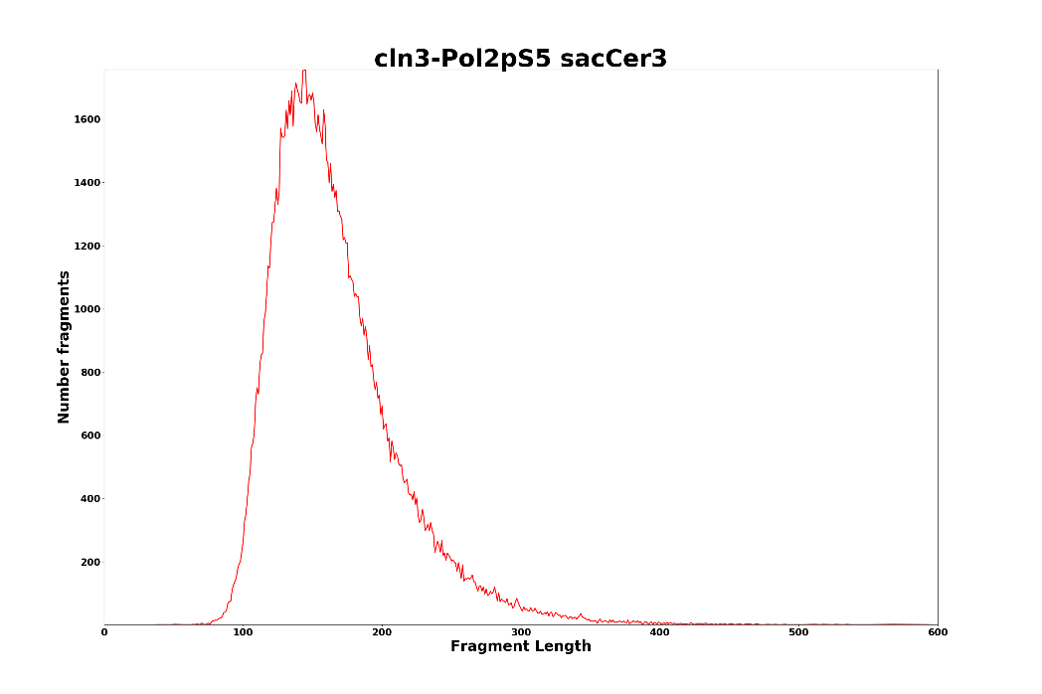

Slide 7
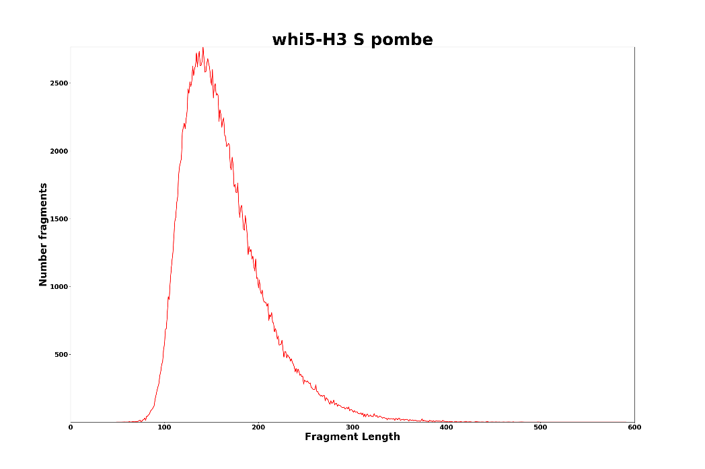
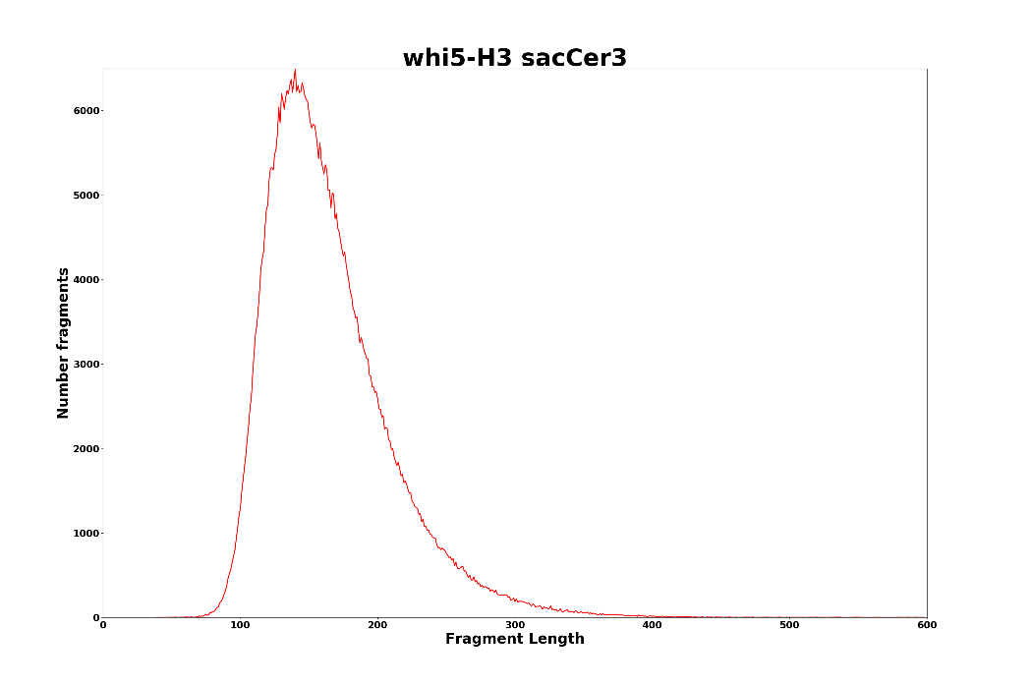

Slide 8
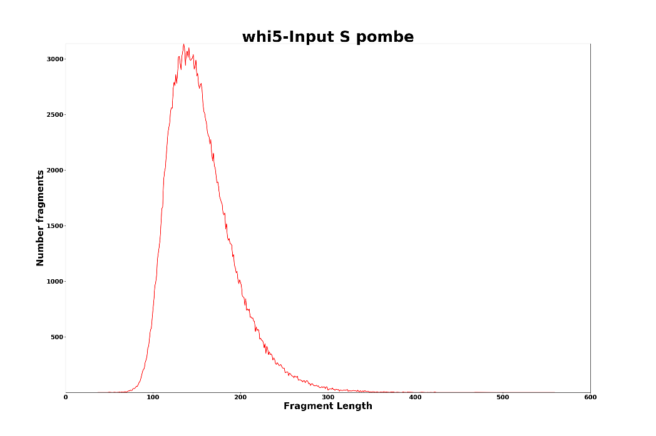
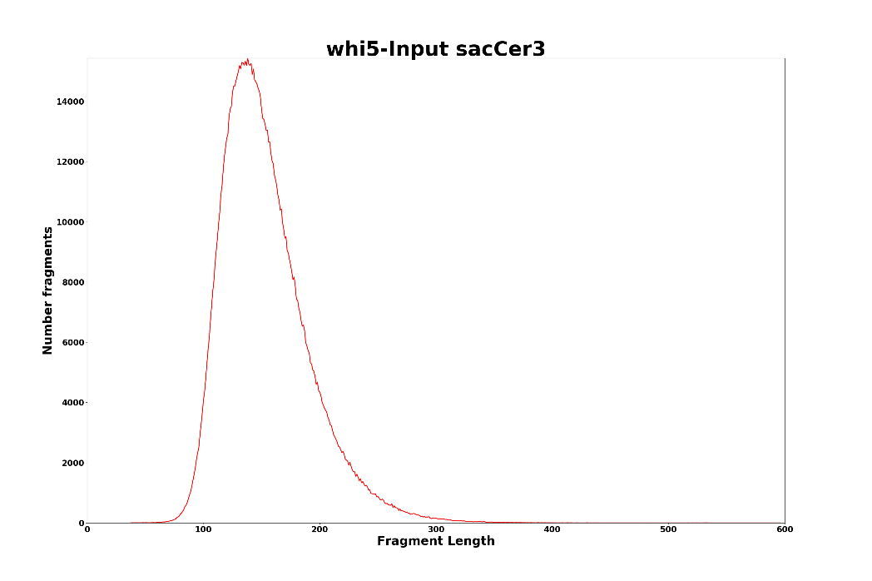

Slide 9
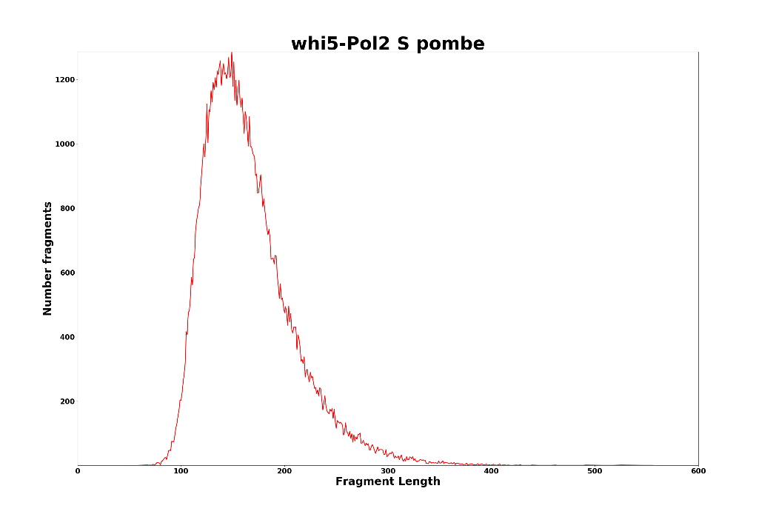
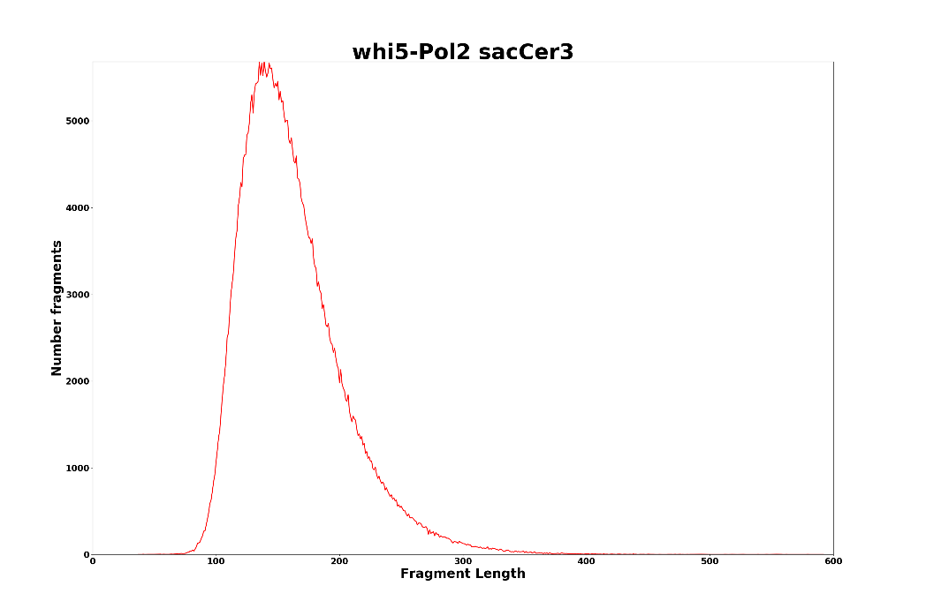

Slide 10
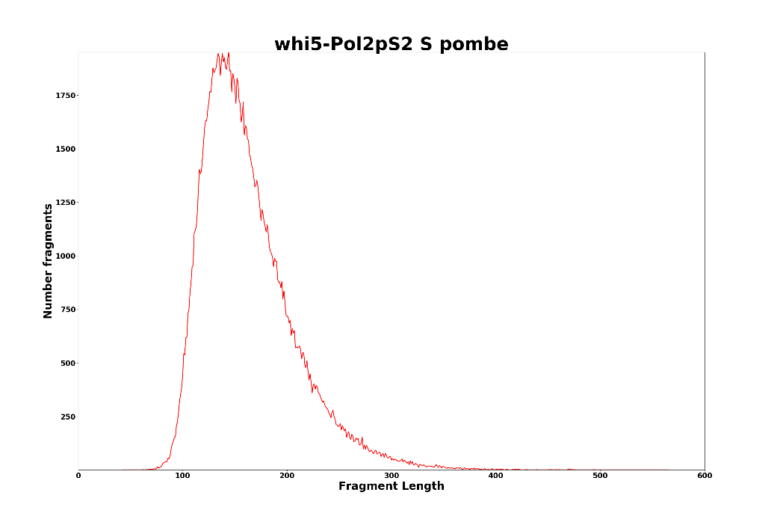


Slide 11
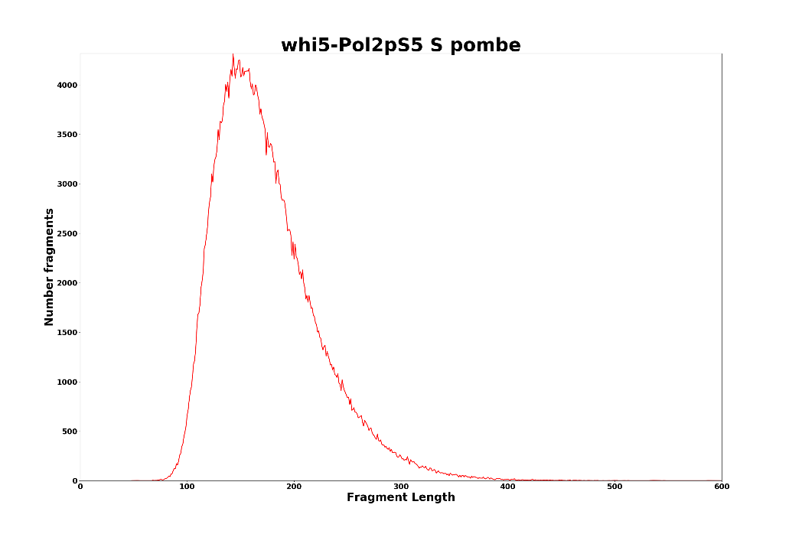
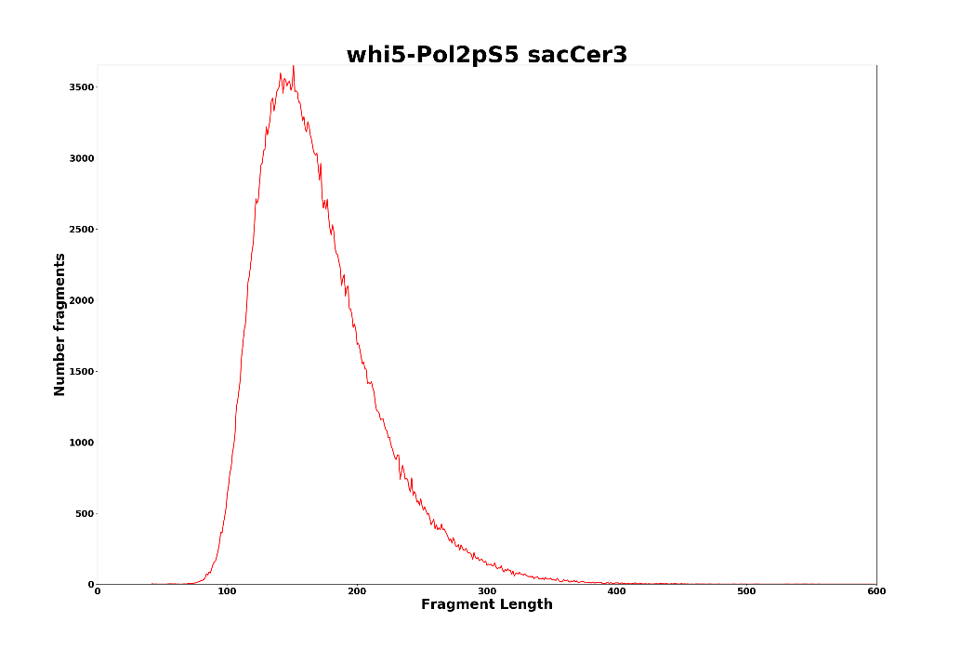

Slide 12
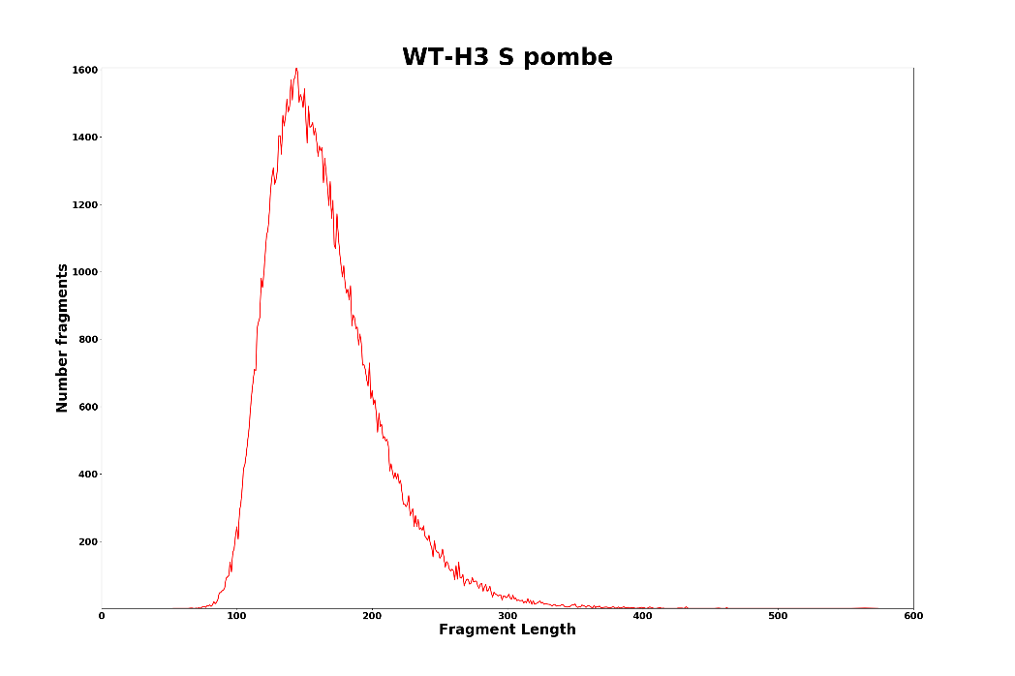
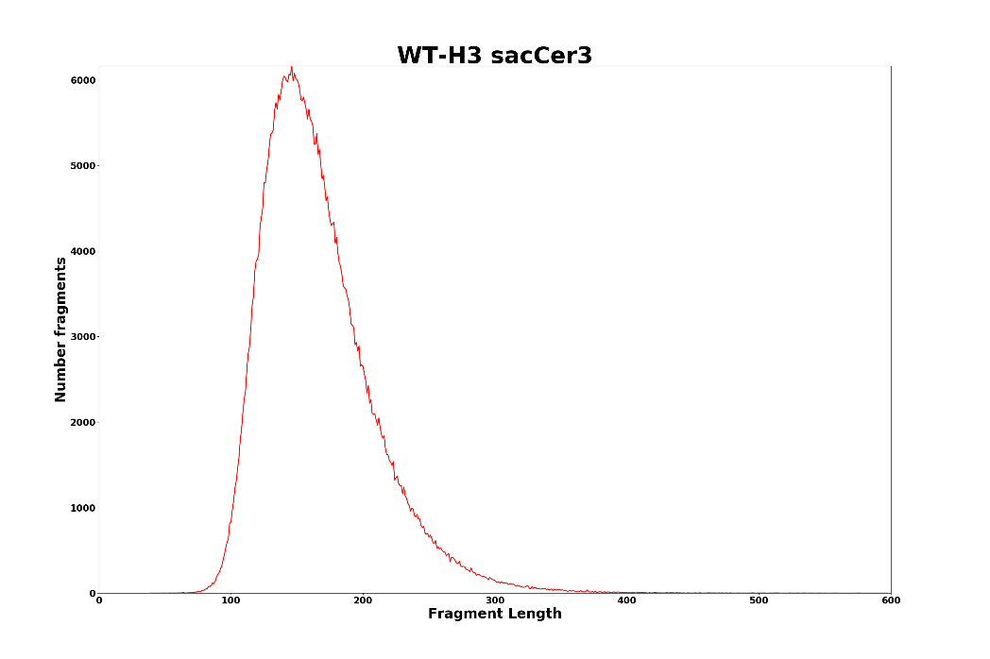

Slide 13
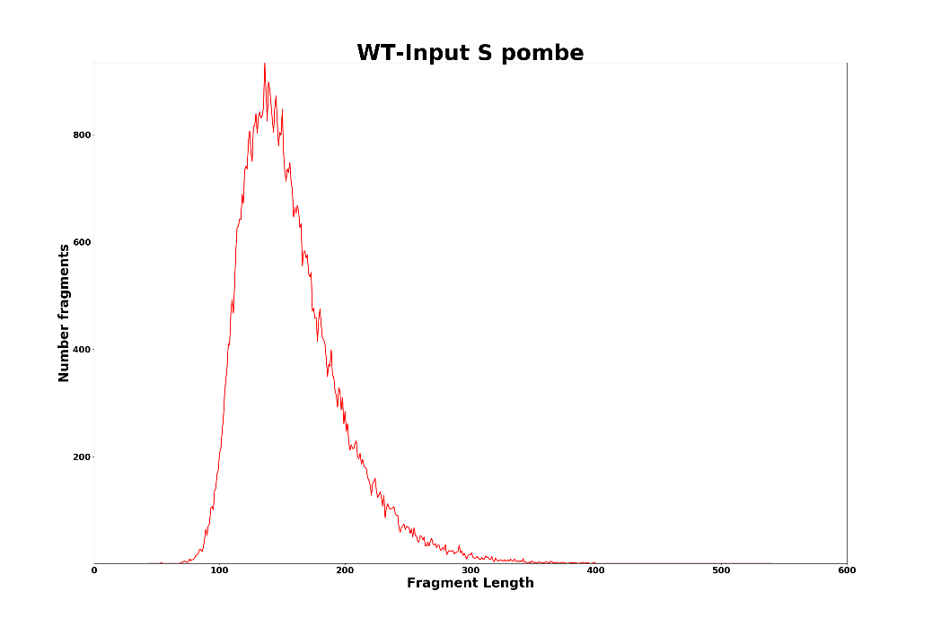
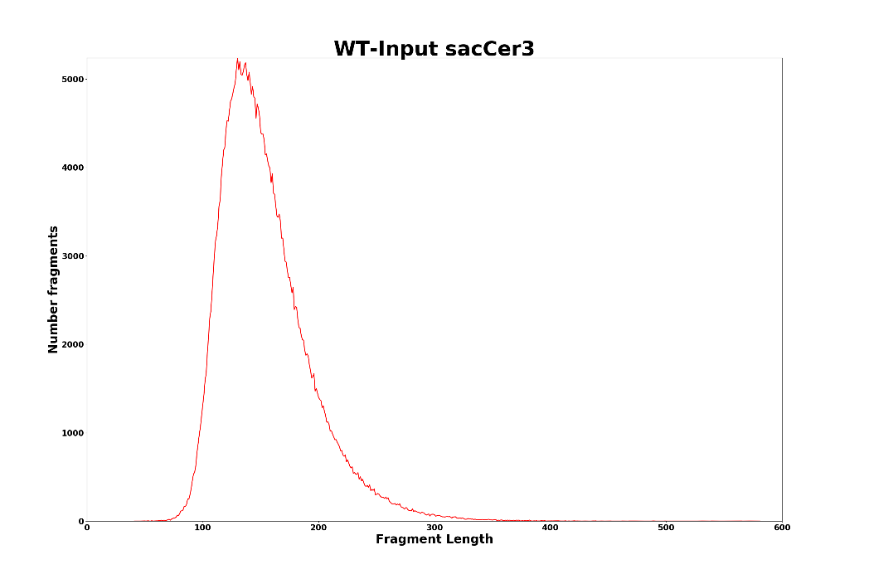

Slide 14
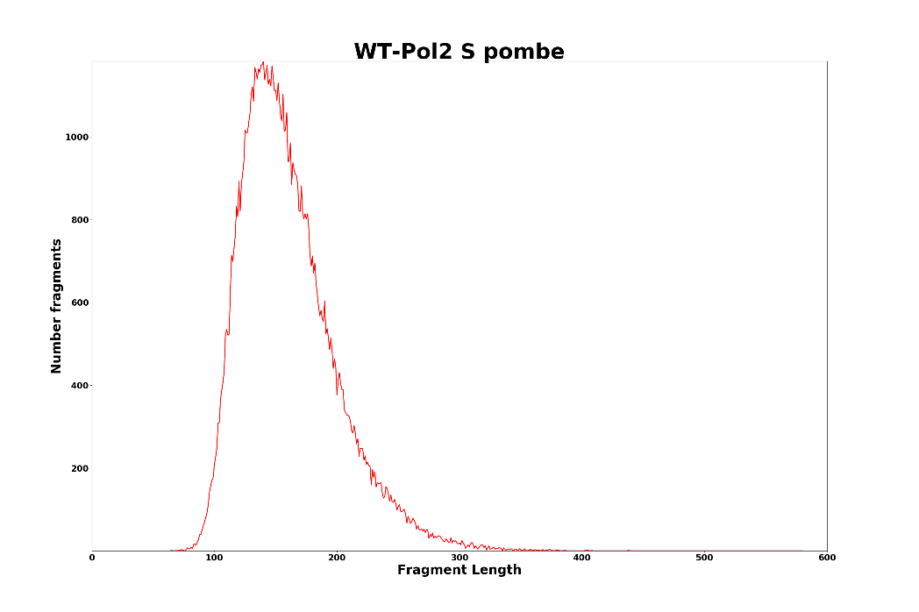
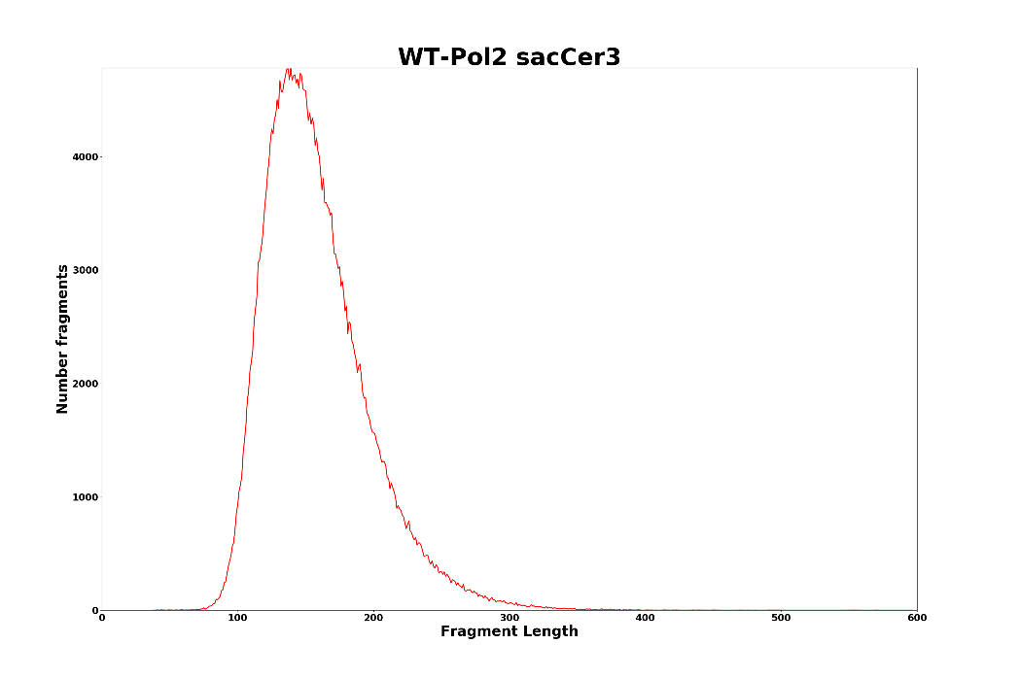

Slide 15
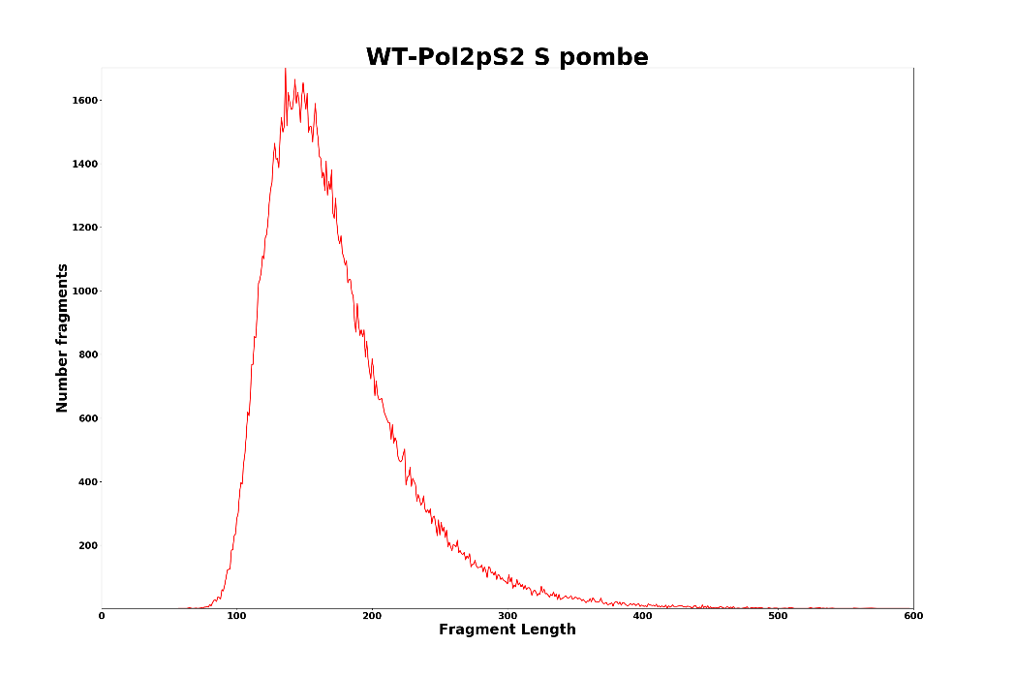
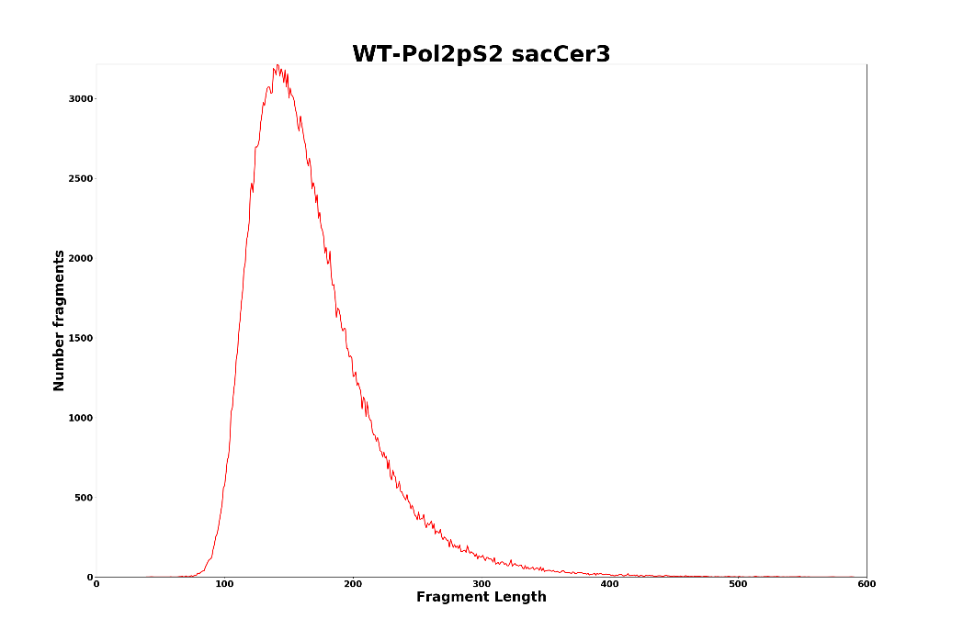

Slide 16
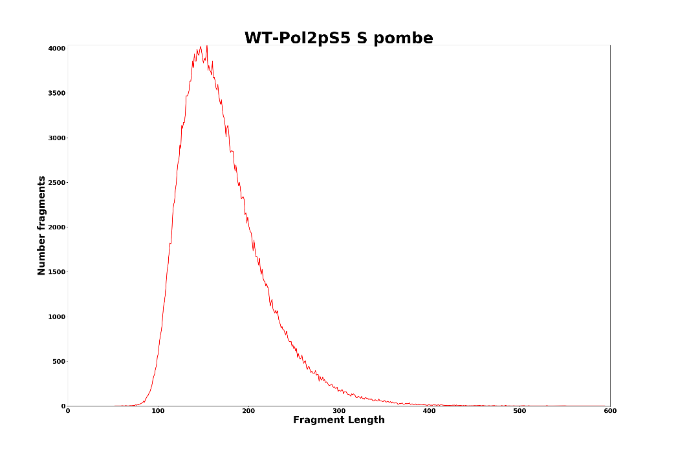
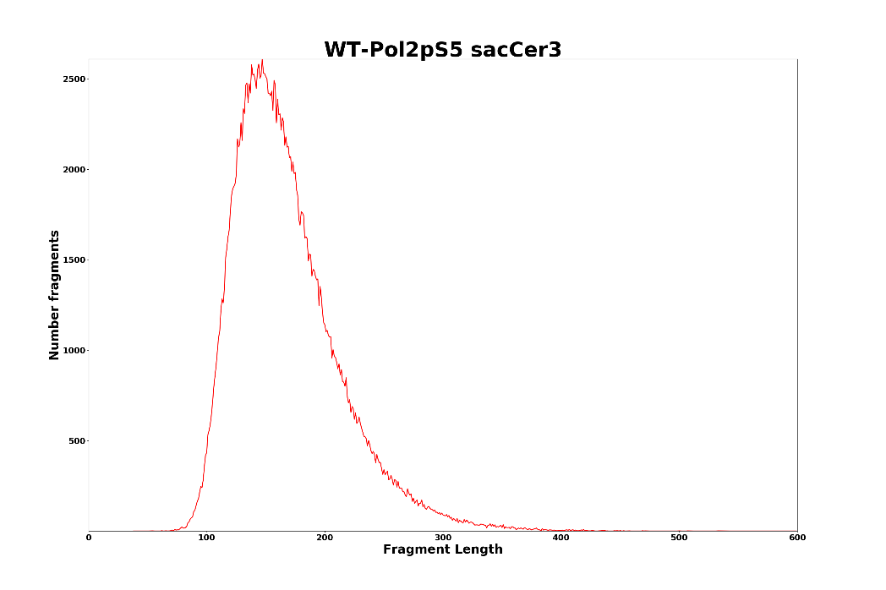

Slide 17
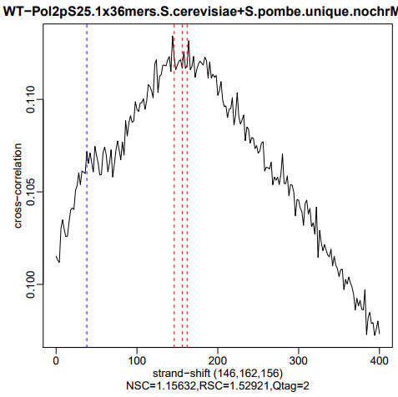
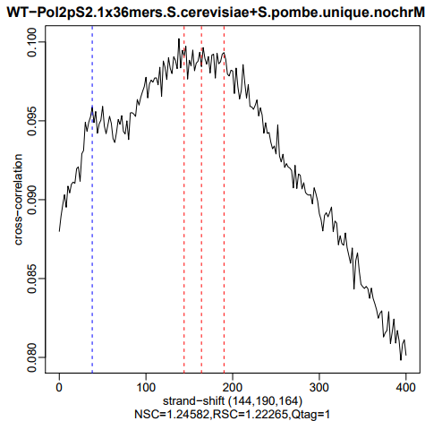
Cross-correlation profiles
Note: these are not very informative in yeast because of the small and compact genome

Slide 18
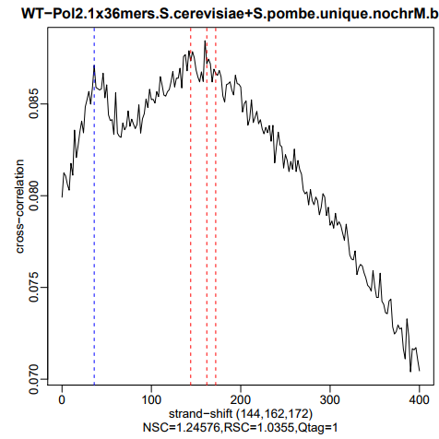
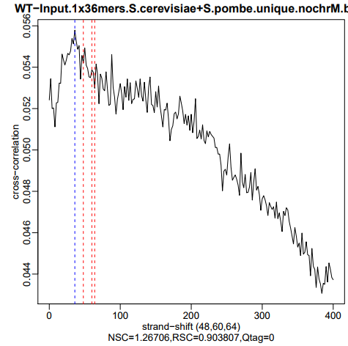

Slide 19
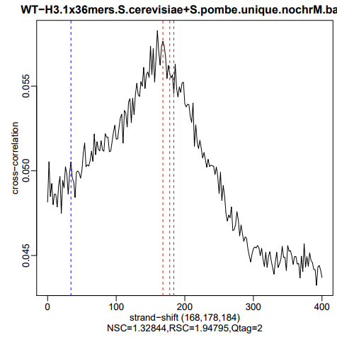
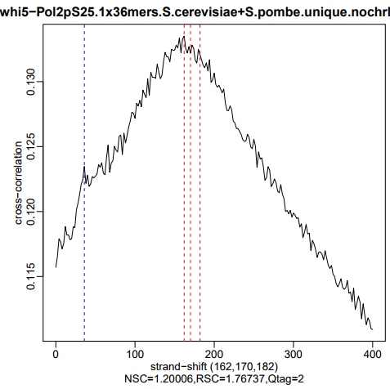

Slide 20
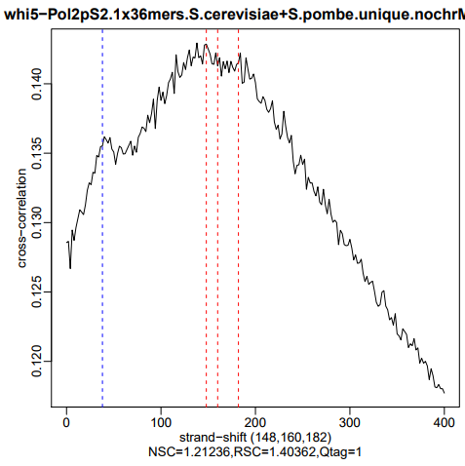
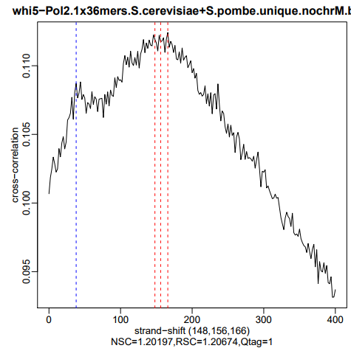

Slide 21
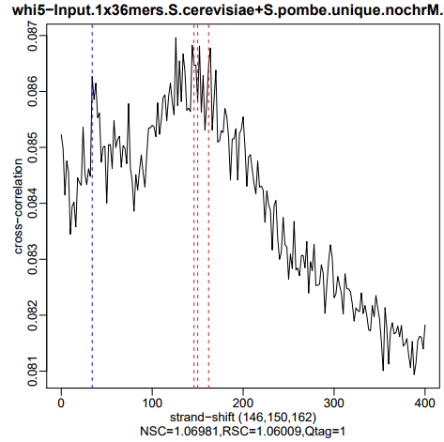
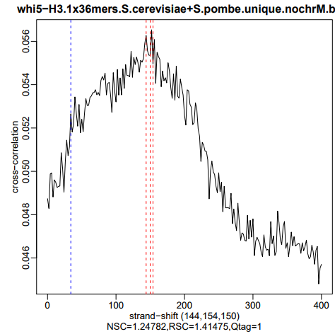

Slide 22
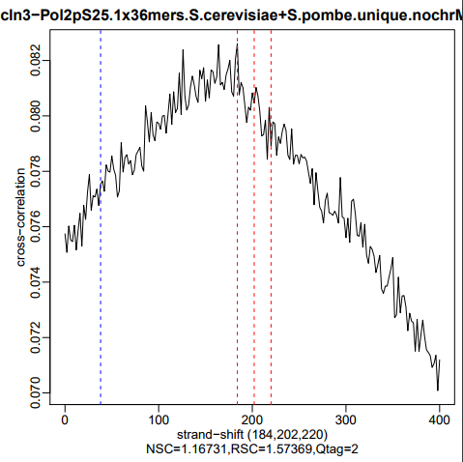
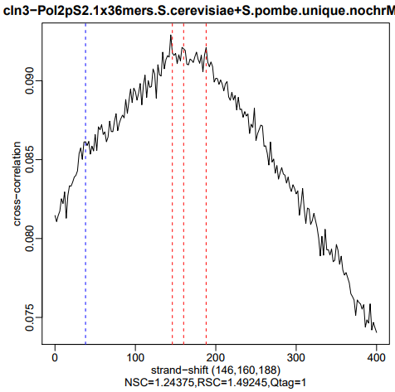

Slide 23
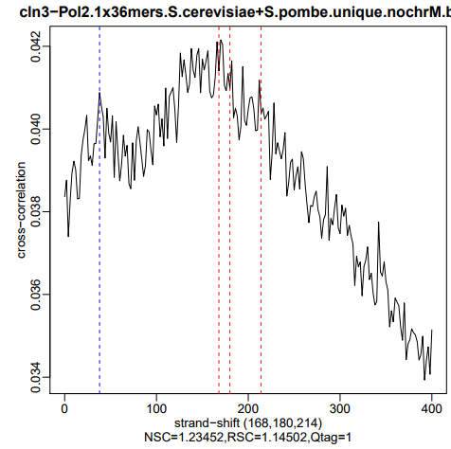
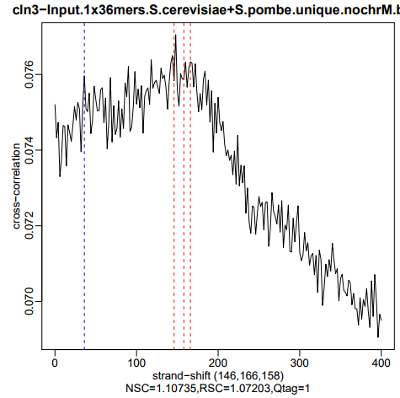

Slide 24
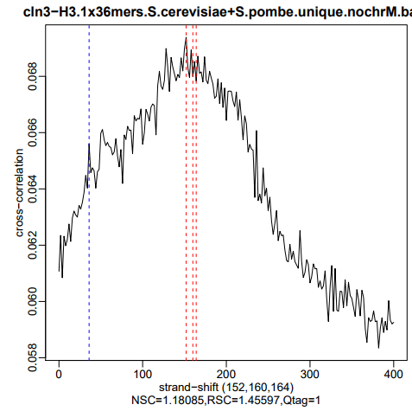

Slide 25
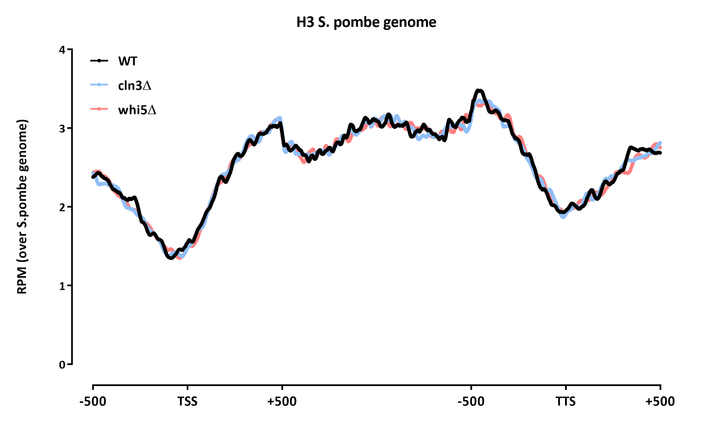
Sanity check on the ChIP itself
Average gene profiles without renormalization, to see if the ChIP-seq behaves as expected

Slide 26
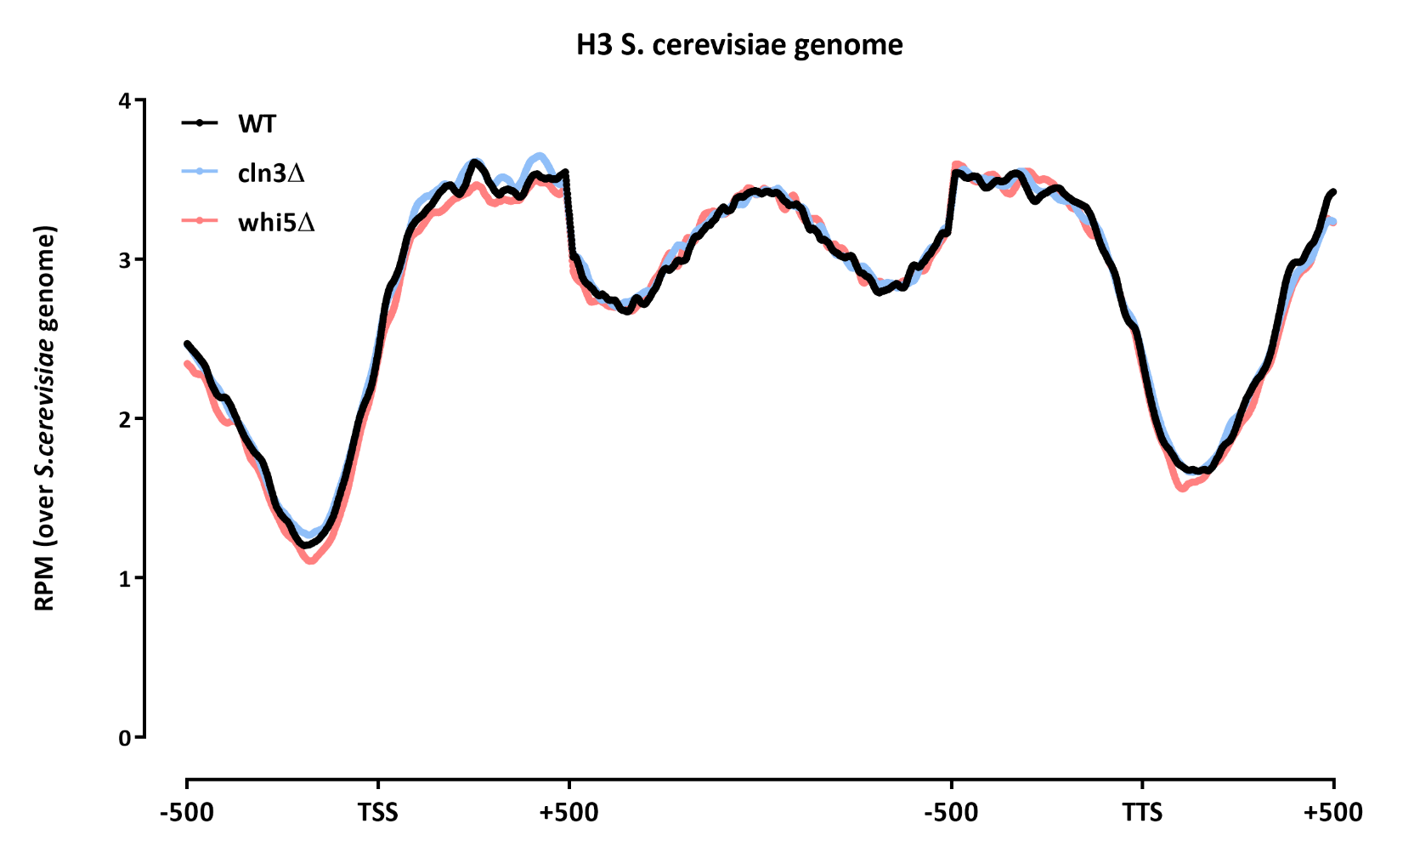

Slide 27
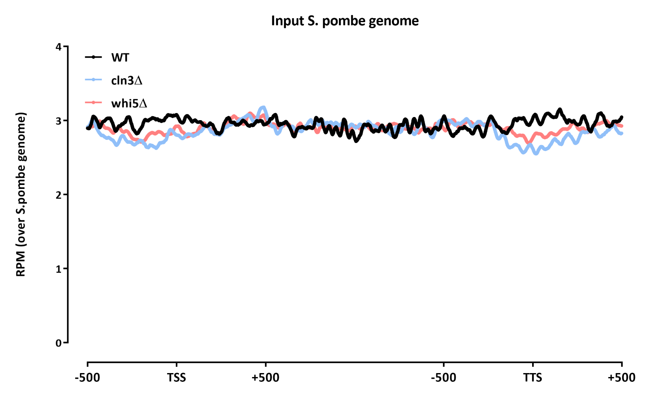

Slide 28
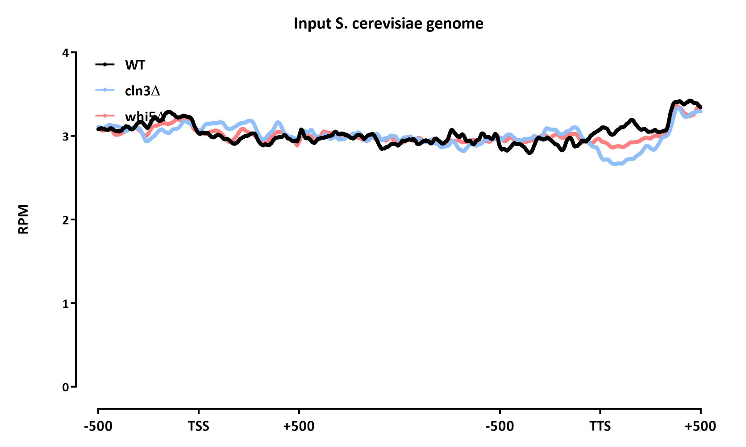

Slide 29
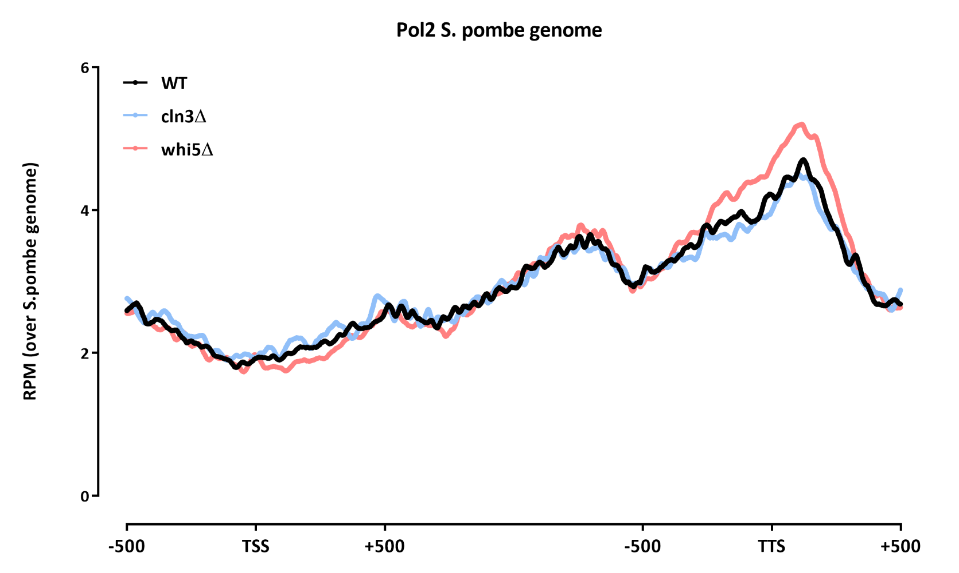

Slide 30
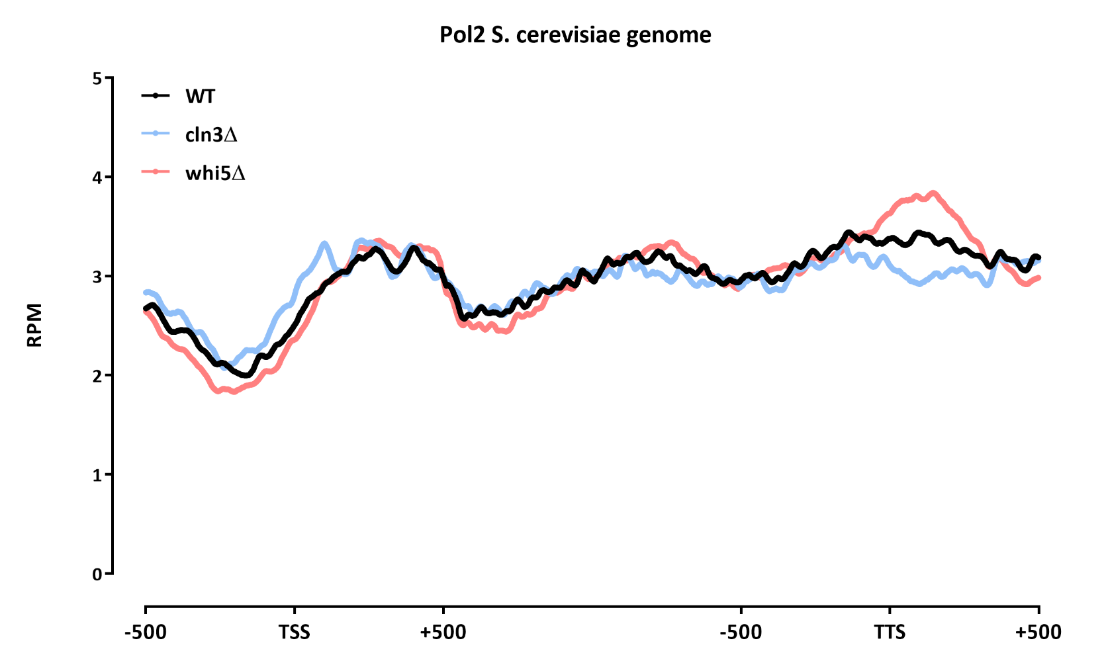

Slide 31


Slide 32


Slide 33


Slide 34


Slide 35

Splitting by expression levels

Slide 36


Slide 37


Slide 38


Slide 39


Slide 40


Slide 41


Slide 42


Slide 43


Slide 44


Slide 45
Normalization
Note: this is much better done for large genomes and/or point-source factors, where we can calculate FRiP values for peaks in the control genome and use that are normalization. The nature of the data here is such that makes it impossible though
Library | Raw fragments | Species | 2x36mers |  | 1x36mers |  | Mappability Corrected RPKM | S.cerevsiae/S.pombe ratio | Correction factor
 |  |  | Unique non-chrM reads | Complexity | Unique non-chrM reads | Complexity
WT-H3 | 1,064,508 | sacCer3 | 1,064,528 | 0.97 | 536,713 | 0.96 | 69.66 | 4.24 | 0.70
 | 1,064,508 | S.pombe | 264,160 | 0.99 | 133,460 | 0.99 | 16.43
WT-Input | 615,834 | sacCer3 | 805,132 | 0.98 | 404,907 | 0.98 | 74.01 | 6.02 | 1.00
 | 615,834 | S.pombe | 141,106 | 0.99 | 70,949 | 0.99 | 12.30
WT-Pol2 | 812,719 | sacCer3 | 772,936 | 0.96 | 390,550 | 0.96 | 69.45 | 4.18 | 0.69
 | 812,719 | S.pombe | 195,266 | 0.98 | 98,571 | 0.98 | 16.63
WT-Pol2pS2 | 724,576 | sacCer3 | 577,786 | 0.96 | 293,261 | 0.96 | 56.75 | 1.98 | 0.33
 | 724,576 | S.pombe | 308,428 | 0.97 | 156,231 | 0.97 | 28.67
WT-Pol2pS25 | 840,788 | sacCer3 | 471,840 | 0.97 | 238,486 | 0.97 | 33.35 | 0.66 | 0.11
 | 840,788 | S.pombe | 760,898 | 0.96 | 383,524 | 0.96 | 50.87
cln3-H3 | 1,436,625 | sacCer3 | 1,509,632 | 0.97 | 760,729 | 0.96 | 71.20 | 4.76 | 0.79
 | 1,436,625 | S.pombe | 334,466 | 0.99 | 168,538 | 0.99 | 14.96
cln3-Input | 1,796,984 | sacCer3 | 1,936,920 | 0.97 | 976,332 | 0.96 | 73.97 | 5.99 | 1.00
 | 1,796,984 | S.pombe | 341,372 | 0.99 | 171,789 | 0.99 | 12.34
cln3-Pol2 | 434,701 | sacCer3 | 482,620 | 0.98 | 243,009 | 0.98 | 68.21 | 3.83 | 0.64
 | 434,701 | S.pombe | 132,890 | 0.99 | 66,860 | 0.99 | 17.80
cln3-Pol2pS2 | 671,364 | sacCer3 | 654,598 | 0.97 | 330,625 | 0.97 | 55.77 | 1.88 | 0.31
 | 671,364 | S.pombe | 366,916 | 0.97 | 184,985 | 0.97 | 29.60
cln3-Pol2pS25 | 610,734 | sacCer3 | 300,588 | 0.98 | 152,613 | 0.98 | 30.12 | 0.56 | 0.09
 | 610,734 | S.pombe | 569,874 | 0.96 | 288,067 | 0.96 | 53.93
whi5-H3 | 1,201,314 | sacCer3 | 1,138,238 | 0.97 | 574,493 | 0.96 | 61.24 | 2.51 | 0.49
 | 1,201,314 | S.pombe | 478,280 | 0.99 | 241,492 | 0.99 | 24.42
whi5-Input | 2,229,447 | sacCer3 | 2,426,126 | 0.96 | 1,224,910 | 0.95 | 72.07 | 5.10 | 1.00
 | 2,229,447 | S.pombe | 502,180 | 0.99 | 253,399 | 0.99 | 14.14
whi5-Pol2 | 918,837 | sacCer3 | 960,044 | 0.95 | 485,651 | 0.95 | 70.70 | 4.58 | 0.90
 | 918,837 | S.pombe | 221,524 | 0.97 | 111,824 | 0.98 | 15.44
whi5-Pol2pS2 | 1,430,630 | sacCer3 | 965,332 | 0.94 | 489,313 | 0.94 | 64.43 | 3.01 | 0.59
 | 1,430,630 | S.pombe | 339,026 | 0.95 | 171,278 | 0.96 | 21.39
whi5-Pol2pS25 | 1,433,030 | sacCer3 | 678,682 | 0.96 | 345,660 | 0.96 | 38.63 | 0.84 | 0.17
 | 1,433,030 | S.pombe | 852,574 | 0.95 | 432,639 | 0.94 | 45.86

Slide 46


Slide 47


Slide 48


Slide 49


Slide 50


Slide 51


Slide 52


Slide 53


Slide 54


Slide 55


Slide 56


Slide 57


Slide 58


Slide 59


Slide 60


