Slide 1
MAPPING STATS

Slide 14
READ DISTRIBUTION

Slide 28
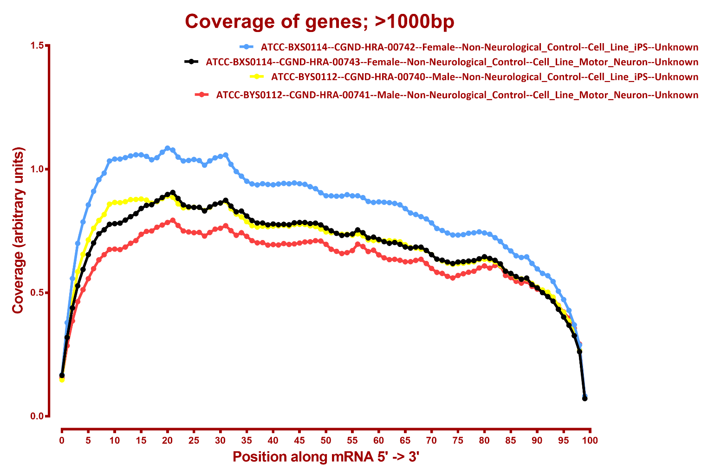
READ COVERAGE (SOME SAMPLES)

Slide 29
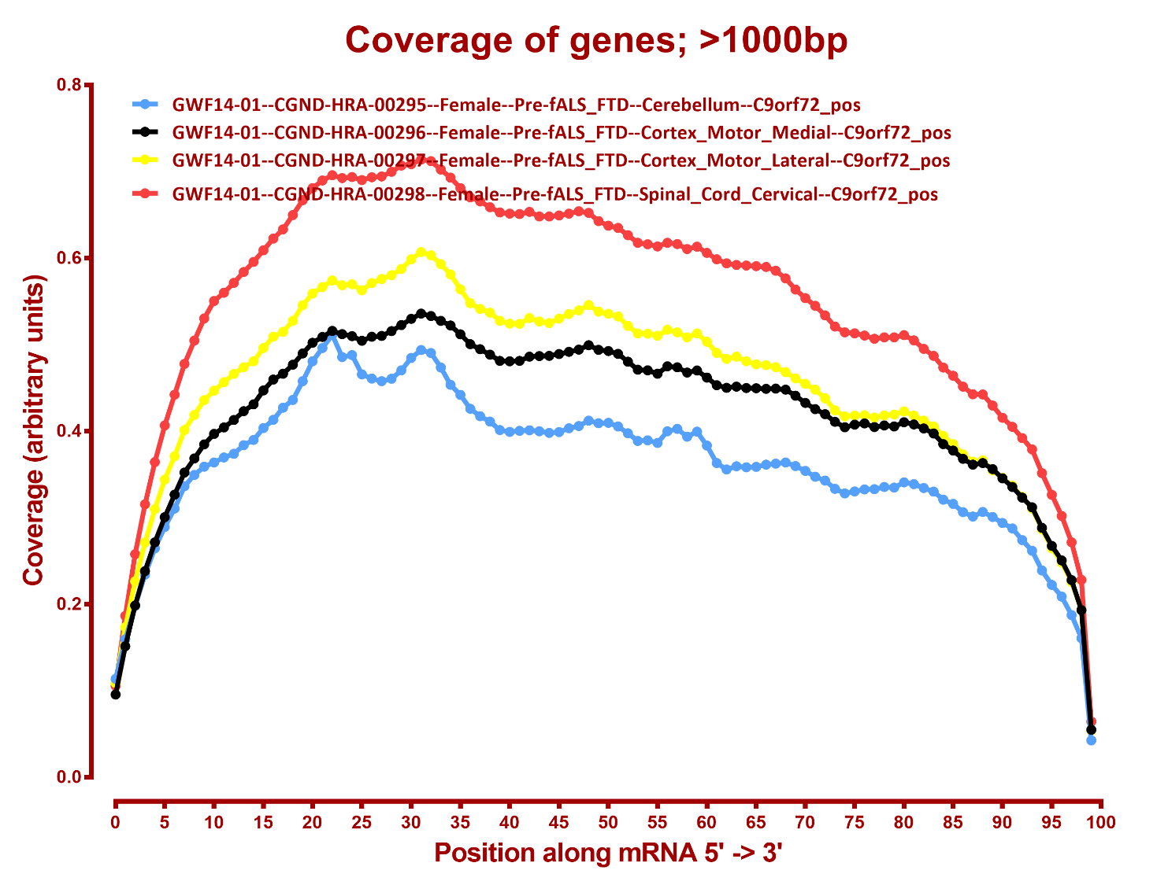

Slide 30
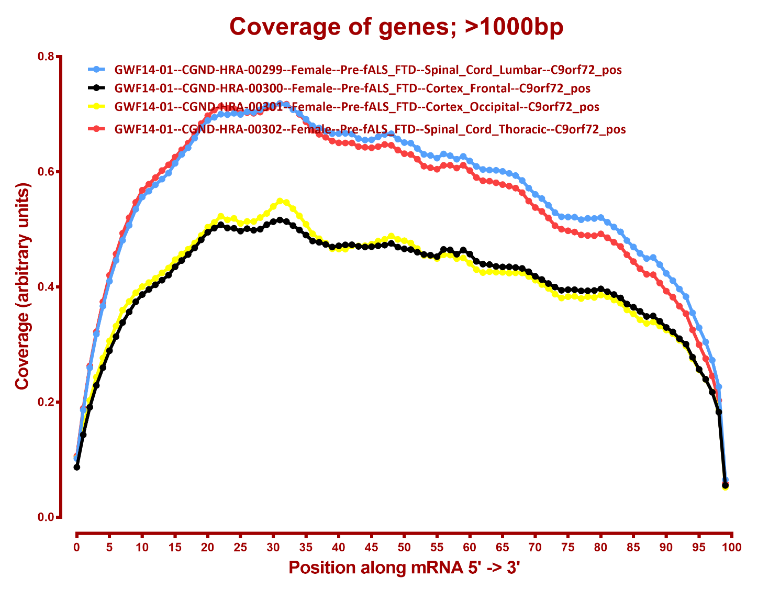

Slide 31
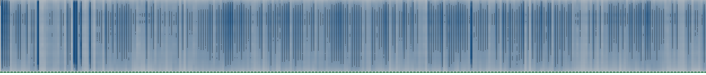
There aren’t really any bad samples, which is good
Here is a heatmap of the whole dataset:
5’
3’

Slide 32
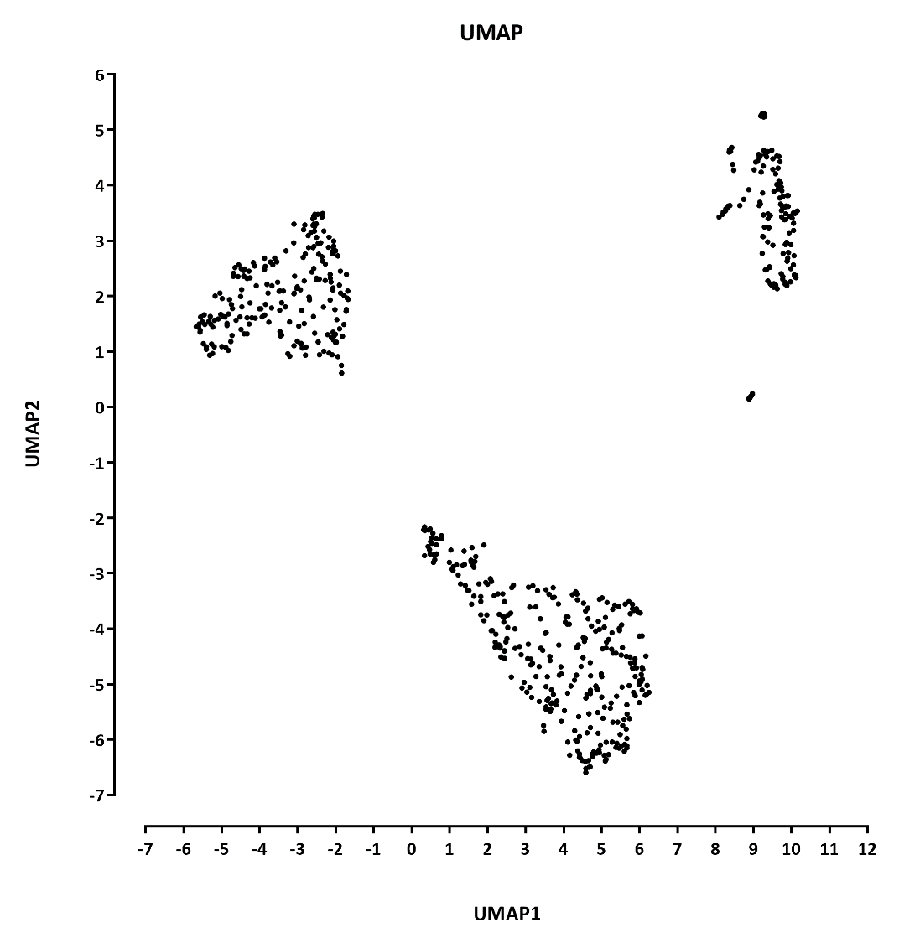
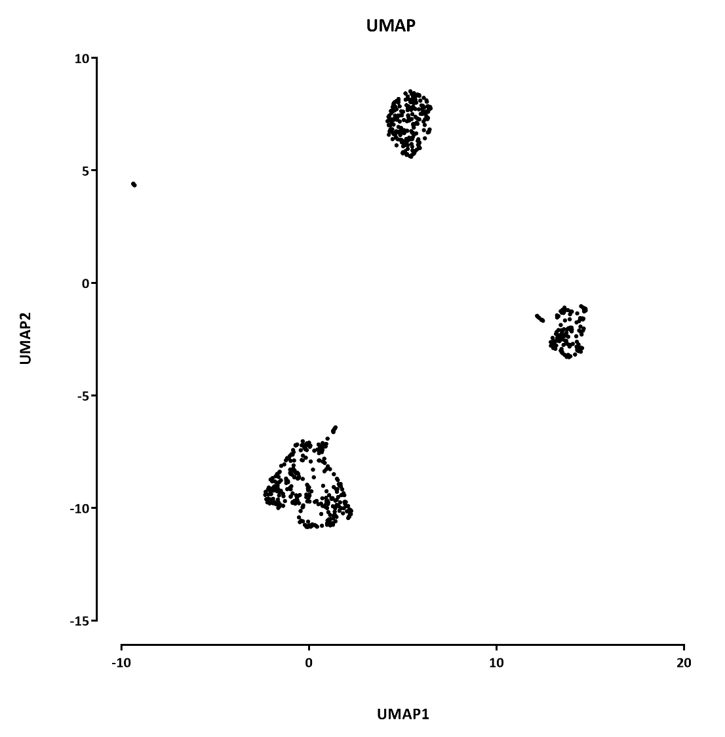

Slide 33
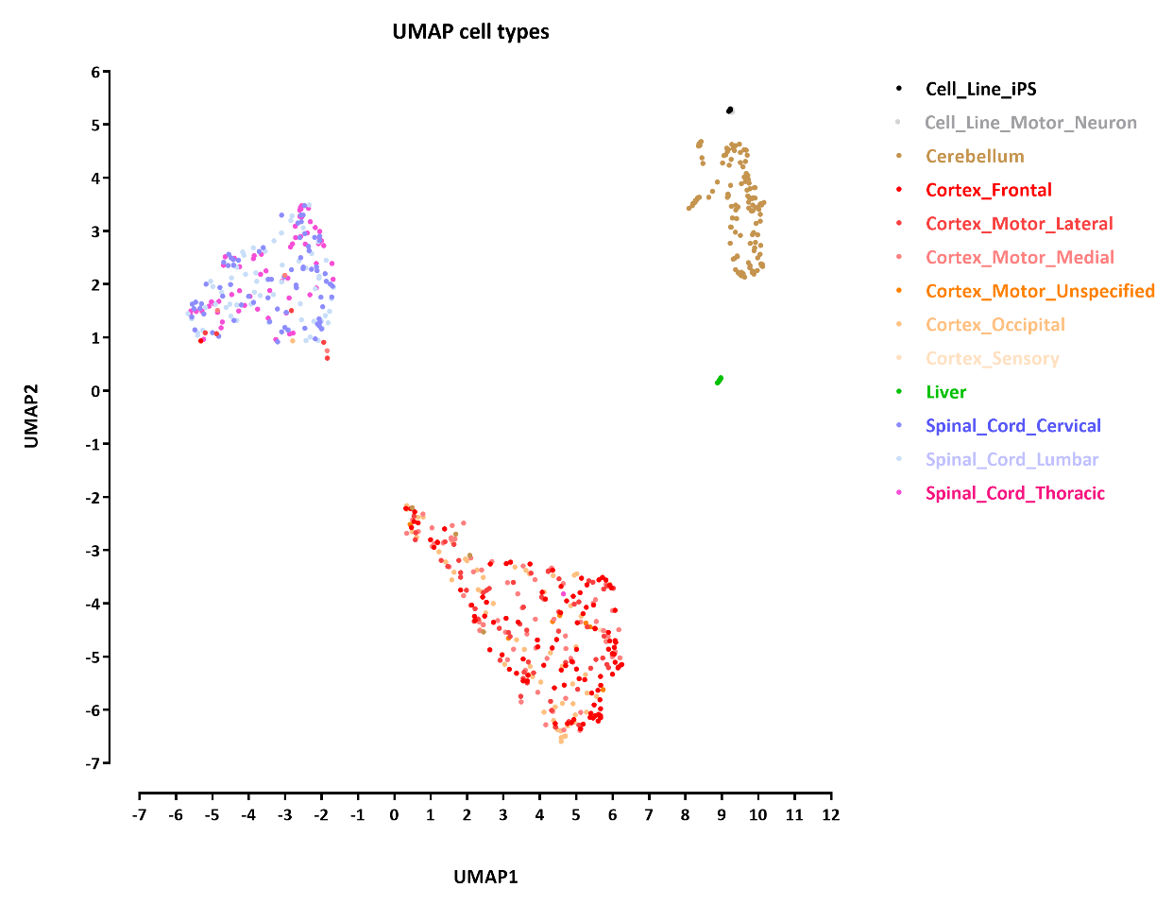
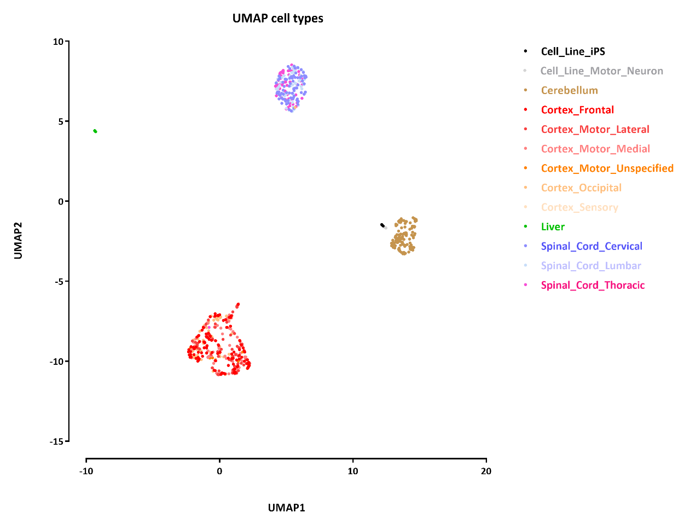

Slide 34
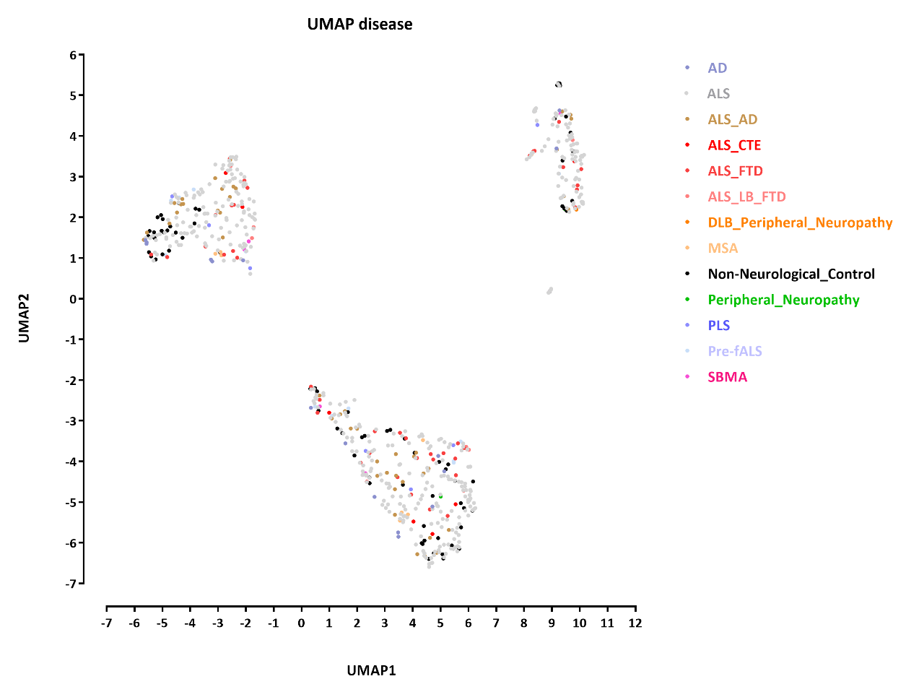
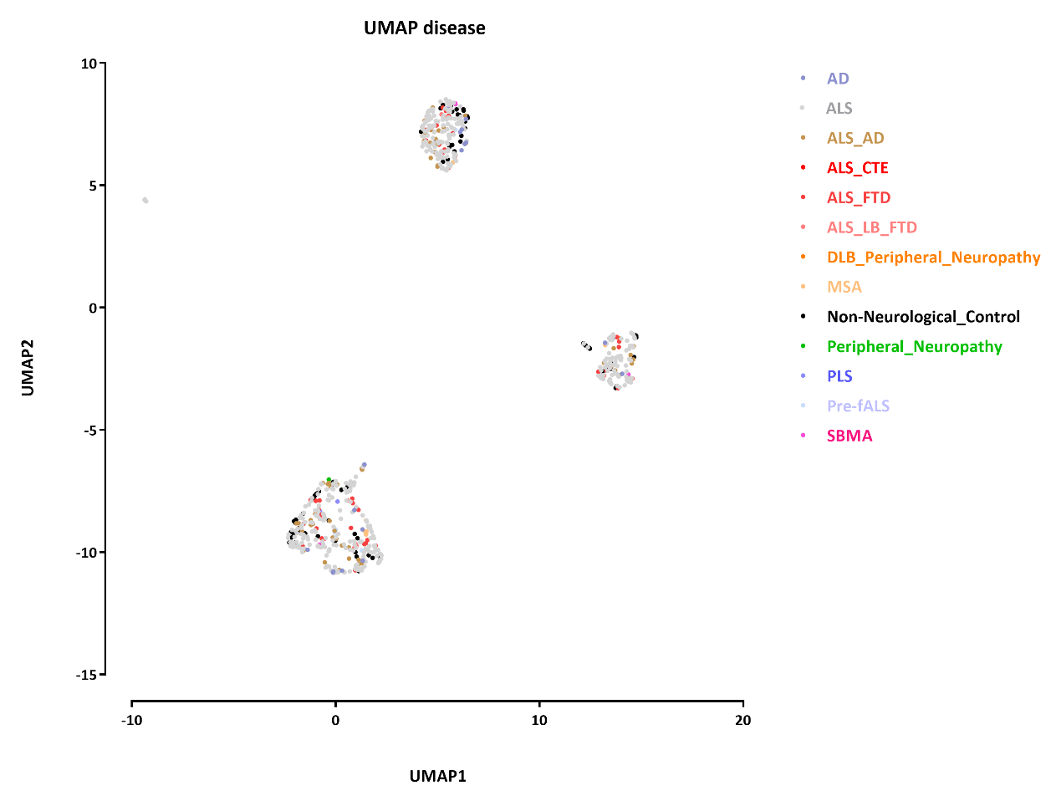

Slide 35
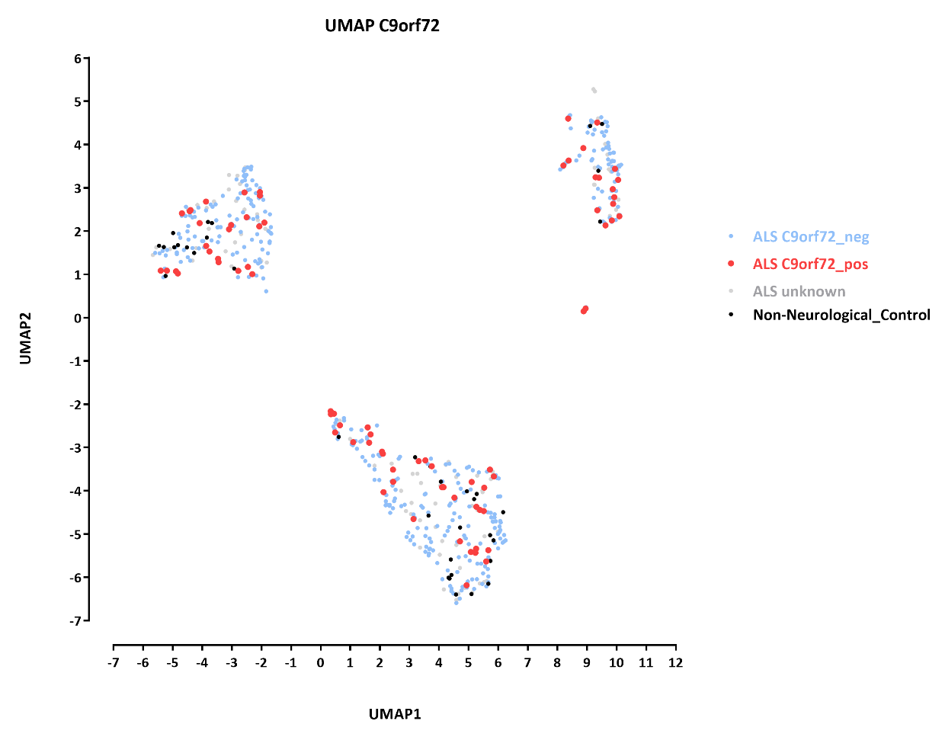
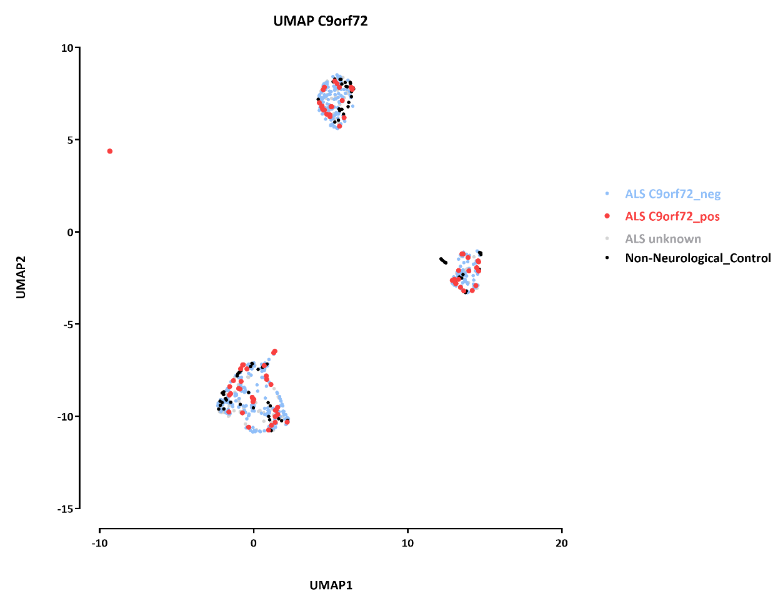

Slide 36
DESEQ RESULTS
Notes:
1. To narrow the conditions space, I have ignored other additional mutations -- SOD1, etc. – but have kept those separate if there was no C9orf72 mutation but a mutation in a different gene. Will redo with a more complex matrix design if necessary and with the additional samples
2. I have not lumped all ALS variations together, but only ran analysis between the pure ALS samples
3. It takes forever to run on the full 653-sample matrix, so I have run it on individual pairwise matrices

Slide 37
all genes
A | B | p-adj
 |  | up in B vs A | down in B vs A
ALS--Cerebellum--C9orf72_neg | ALS--Cerebellum--C9orf72_pos | 16 | 1
ALS--Cortex_Frontal--C9orf72_neg | ALS--Cortex_Frontal--C9orf72_pos | 5 | 1
ALS--Cortex_Motor_Lateral--C9orf72_neg | ALS--Cortex_Motor_Lateral--C9orf72_pos | 0 | 0
ALS--Cortex_Motor_Medial--C9orf72_neg | ALS--Cortex_Motor_Medial--C9orf72_pos | 89 | 68
ALS--Cortex_Occipital--C9orf72_neg | ALS--Cortex_Occipital--C9orf72_pos | 988 | 1,180
ALS--Liver--C9orf72_neg | ALS--Liver--C9orf72_pos | 1 | 2
ALS--Spinal_Cord_Cervical--C9orf72_neg | ALS--Spinal_Cord_Cervical--C9orf72_pos | 3 | 0
ALS--Spinal_Cord_Lumbar--C9orf72_neg | ALS--Spinal_Cord_Lumbar--C9orf72_pos | 122 | 33
ALS--Spinal_Cord_Thoracic--C9orf72_neg | ALS--Spinal_Cord_Thoracic--C9orf72_pos | 0 | 0

Slide 38
BBC3
# | baseMean | log2FoldChange | lfcSE | stat | pvalue | padj
Cerebellum | 148.68 | -0.06 | 0.126746 | -0.50678 | 6.12E-01 | 0.925915
Cortex_Frontal | 118.73 | 0.03 | 0.13778 | 0.223127 | 8.23E-01 | 0.982128
Cortex_Motor_Lateral | 85.85 | 0.26 | 0.183971 | 1.400862 | 1.61E-01 | 0.937896
Cortex_Motor_Medial | 88.12 | 0.30 | 0.235441 | 1.273976 | 2.03E-01 | 0.482623
Cortex_Occipital | 95.96 | 0.04 | 0.233426 | 0.151465 | 8.80E-01 | 9.48E-01
Liver | 72.34 | -0.33 | 0.331889 | -0.9807 | 3.27E-01 | 0.999968
Spinal_Cord_Cervical | 94.73 | -0.05 | 0.167597 | -0.27071 | 7.87E-01 | 0.997691
Spinal_Cord_Lumbar | 99.38 | -0.38 | 0.272373 | -1.40225 | 1.61E-01 | 0.619453
Spinal_Cord_Thoracic | 113.33 | -0.04 | 0.202335 | -0.19584 | 8.45E-01 | 0.997226
TP53
# | baseMean | log2FoldChange | lfcSE | stat | pvalue | padj
Cerebellum | 75.52 | -0.21 | 0.150164 | -1.38355 | 1.66E-01 | 0.649791
Cortex_Frontal | 160.40 | 0.00 | 0.167319 | 0.007656 | 9.94E-01 | 0.998027
Cortex_Motor_Lateral | 171.36 | -0.03 | 0.22611 | -0.14263 | 8.87E-01 | 0.99571
Cortex_Motor_Medial | 177.16 | -0.09 | 0.273906 | -0.3247 | 7.45E-01 | 0.884541
Cortex_Occipital | 140.33 | 0.11 | 0.271219 | 0.398877 | 6.90E-01 | 0.848963
Liver | 393.12 | 0.26 | 0.314987 | 0.838385 | 4.02E-01 | 0.999968
Spinal_Cord_Cervical | 404.30 | 0.14 | 0.157239 | 0.899172 | 3.69E-01 | 0.997691
Spinal_Cord_Lumbar | 421.47 | 0.09 | 0.215076 | 0.418959 | 6.75E-01 | 0.910393
Spinal_Cord_Thoracic | 424.04 | 0.02 | 0.189932 | 0.09651 | 9.23E-01 | 0.997226

Slide 39
ALS--Cerebellum
# | baseMean | log2FoldChange | lfcSE | stat | pvalue | padj
C9orf72 | 1995.43 | 0.70 | 0.1261 | 5.590735 | 2.26E-08 | 0.000227
BOK | 490.74 | -0.54 | 0.132225 | -4.1063 | 4.02E-05 | 0.047552
DLX6 | 0.23 | -0.24 | 0.04845 | -4.99983 | 5.74E-07 | 0.002308
DPYSL5 | 666.36 | -0.50 | 0.108765 | -4.59446 | 4.34E-06 | 0.012463
HOXA4 | 1.38 | -0.75 | 0.093147 | -8.05427 | 8.00E-16 | 1.61E-11
IL10 | 6.36 | -0.61 | 0.139653 | -4.34042 | 1.42E-05 | 0.021996
LOC100129917 | 258.38 | -0.71 | 0.156854 | -4.54492 | 5.50E-06 | 0.013813
LOC100130557 | 161.74 | -0.52 | 0.12406 | -4.15142 | 3.30E-05 | 0.044291
LOC154860 | 2.51 | -0.80 | 0.144473 | -5.5047 | 3.70E-08 | 0.000248
MTRNR2L3 | 0.87 | -0.39 | 0.072616 | -5.43254 | 5.56E-08 | 0.000279
PITX2 | 0.41 | -0.28 | 0.057847 | -4.76413 | 1.90E-06 | 0.006356
SHOX2 | 2.24 | -0.53 | 0.118274 | -4.50223 | 6.72E-06 | 0.015023
SIM2 | 7.95 | -0.71 | 0.159667 | -4.4598 | 8.20E-06 | 0.016495
SLC6A14 | 1.61 | -0.44 | 0.101297 | -4.34139 | 1.42E-05 | 0.021996
SPATA18 | 6.59 | -0.69 | 0.158392 | -4.34102 | 1.42E-05 | 0.021996
ZNF323 | 274.87 | -0.63 | 0.151247 | -4.13527 | 3.55E-05 | 0.044554
ZNF514 | 431.61 | -0.62 | 0.144061 | -4.3155 | 1.59E-05 | 0.02287
down
up

Slide 40
ALS--Cortex_Frontal
# | baseMean | log2FoldChange | lfcSE | stat | pvalue | padj
C9orf72 | 1031.49 | 0.55 | 0.112857 | 4.912508 | 8.99E-07 | 0.003981
LOC100130954 | 6.96 | -0.82 | 0.167347 | -4.89465 | 9.85E-07 | 0.003981
NCRUPAR | 3.39 | -0.81 | 0.15308 | -5.29637 | 1.18E-07 | 0.001194
PDE6A | 27.58 | -0.90 | 0.17541 | -5.10499 | 3.31E-07 | 0.002229
TFAP2B | 0.76 | -0.72 | 0.116629 | -6.18546 | 6.19E-10 | 1.25E-05
TRAF3 | 484.80 | -0.37 | 0.081281 | -4.56845 | 4.91E-06 | 0.016553
down
up

Slide 41
ALS--Liver
# | baseMean | log2FoldChange | lfcSE | stat | pvalue | padj
CLRN3 | 476.86 | 1.40 | 0.307833 | 4.547495 | 5.43E-06 | 0.033885 |  | down
ITLN1 | 614.84 | 1.59 | 0.341703 | 4.646913 | 3.37E-06 | 0.031546 |  | up
IL2RA | 33.16 | -1.82 | 0.342085 | -5.31553 | 1.06E-07 | 0.001991

Slide 42
ALS--Spinal_Cord_Cervical
# | baseMean | log2FoldChange | lfcSE | stat | pvalue | padj
CA9 | 2.91 | -0.58 | 0.123557 | -4.69325 | 2.69E-06 | 0.026689 |  | down
FER1L6 | 15.29 | -0.73 | 0.155504 | -4.69862 | 2.62E-06 | 0.026689 |  | up
LOC100335030 | 24.01 | -0.81 | 0.17804 | -4.52507 | 6.04E-06 | 0.039951

Slide 43
ALS--Spinal_Cord_Lumbar, down genes: no GO enrichment
ALS--Spinal_Cord_Lumbar, up genes:

Slide 44
ALS--Cortex_Occipital, up genes:

Slide 45
ALS--Cortex_Occipital, down genes:

Slide 54
ALS--Cortex_Motor_Medial, down genes
ALS--Cortex_Motor_Medial, no enrichment

Slide 55
all genes
A | B | p-adj
 |  | up in B vs A | down in B vs A
ALS--Cerebellum--C9orf72_neg | ALS--Cerebellum--C9orf72_pos | 16 | 1
ALS--Cerebellum--C9orf72_neg | Non-Neurological_Control--Cerebellum | 2,841 | 2,146
ALS--Cerebellum--C9orf72_pos | Non-Neurological_Control--Cerebellum | 8 | 8
ALS--Cortex_Frontal--C9orf72_neg | ALS--Cortex_Frontal--C9orf72_pos | 5 | 1
ALS--Cortex_Frontal--C9orf72_neg | Non-Neurological_Control--Cortex_Frontal | 593 | 639
ALS--Cortex_Frontal--C9orf72_pos | Non-Neurological_Control--Cortex_Frontal | 1 | 0
ALS--Cortex_Motor_Lateral--C9orf72_neg | ALS--Cortex_Motor_Lateral--C9orf72_pos | 0 | 0
ALS--Cortex_Motor_Lateral--C9orf72_neg | Non-Neurological_Control--Cortex_Motor_Lateral | 1 | 0
ALS--Cortex_Motor_Lateral--C9orf72_pos | Non-Neurological_Control--Cortex_Motor_Lateral | 11 | 38
ALS--Cortex_Motor_Medial--C9orf72_neg | ALS--Cortex_Motor_Medial--C9orf72_pos | 89 | 68
ALS--Cortex_Motor_Medial--C9orf72_neg | Non-Neurological_Control--Cortex_Motor_Medial | 2 | 0
ALS--Cortex_Motor_Medial--C9orf72_pos | Non-Neurological_Control--Cortex_Motor_Medial | 4 | 12
ALS--Cortex_Occipital--C9orf72_neg | ALS--Cortex_Occipital--C9orf72_pos | 988 | 1,180
ALS--Cortex_Occipital--C9orf72_neg | Non-Neurological_Control--Cortex_Occipital | 1 | 0
ALS--Cortex_Occipital--C9orf72_pos | Non-Neurological_Control--Cortex_Occipital | 268 | 220
ALS--Liver--C9orf72_neg | ALS--Liver--C9orf72_pos | 1 | 2
ALS--Liver--C9orf72_neg | Non-Neurological_Control--Liver | 34 | 36
ALS--Liver--C9orf72_pos | Non-Neurological_Control--Liver | 34 | 30
ALS--Spinal_Cord_Cervical--C9orf72_neg | ALS--Spinal_Cord_Cervical--C9orf72_pos | 3 | 0
ALS--Spinal_Cord_Cervical--C9orf72_neg | Non-Neurological_Control--Spinal_Cord_Cervical | 1,557 | 1,937
ALS--Spinal_Cord_Cervical--C9orf72_pos | Non-Neurological_Control--Spinal_Cord_Cervical | 871 | 1,201
ALS--Spinal_Cord_Lumbar--C9orf72_neg | ALS--Spinal_Cord_Lumbar--C9orf72_pos | 122 | 33
ALS--Spinal_Cord_Lumbar--C9orf72_neg | Non-Neurological_Control--Spinal_Cord_Lumbar | 88 | 495
ALS--Spinal_Cord_Lumbar--C9orf72_pos | Non-Neurological_Control--Spinal_Cord_Lumbar | 454 | 692
ALS--Spinal_Cord_Thoracic--C9orf72_neg | ALS--Spinal_Cord_Thoracic--C9orf72_pos | 0 | 0
ALS--Spinal_Cord_Thoracic--C9orf72_neg | Non-Neurological_Control--Spinal_Cord_Thoracic | 3 | 32
ALS--Spinal_Cord_Thoracic--C9orf72_pos | Non-Neurological_Control--Spinal_Cord_Thoracic | 44 | 36

Slide 56
GO enrichment, Cerebellum C9orf72_neg vs Non-Neurological_Control down genes

Slide 59
GO enrichment, Cerebellum C9orf72_neg vs Non-Neurological_Control up genes

Slide 60
GO enrichment, Cortex Frontal C9orf72_neg vs Non-Neurological_Control down genes

Slide 62
GO enrichment, Cortex Frontal C9orf72_neg vs Non-Neurological_Control up genes

Slide 63
GO enrichment, Cortex Occipital C9orf72_pos vs Non-Neurological_Control down genes
- no enrichment
GO enrichment, Cortex Occipital C9orf72_pos vs Non-Neurological_Control up genes

Slide 67
GO enrichment, liver C9orf72_pos vs Non-Neurological_Control down genes
GO enrichment, liver C9orf72_pos vs Non-Neurological_Control down genes

Slide 68
GO enrichment, Spinal Cord Cervical C9orf72_neg vs Non-Neurological_Control down genes

Slide 72
GO enrichment, Spinal Cord Cervical C9orf72_neg vs Non-Neurological_Control up genes

Slide 73
GO enrichment, Spinal Cord Cervical C9orf72_pos vs Non-Neurological_Control down genes

Slide 77
GO enrichment, Spinal Cord Cervical C9orf72_pos vs Non-Neurological_Control up genes

Slide 78
GO enrichment, Spinal Cord Lumbar C9orf72_neg vs Non-Neurological_Control down genes

Slide 82
GO enrichment, Spinal Cord Lumbar C9orf72_neg vs Non-Neurological_Control up genes
-- no enrichment

Slide 83
GO enrichment, Spinal Cord Lumbar C9orf72_pos vs Non-Neurological_Control down genes

Slide 84
etc..

Slide 85
GO enrichment, Spinal Cord Lumbar C9orf72_pos vs Non-Neurological_Control up genes

Slide 86
GO enrichment, Spinal Cord Thoracic C9orf72_neg vs Non-Neurological_Control down genes
GO enrichment, Spinal Cord Thoracic C9orf72_neg vs Non-Neurological_Control up genes
- no enrichment

Slide 87
GO enrichment, Spinal Cord Thoracic C9orf72_pos vs Non-Neurological_Control down genes
- no enrichment
GO enrichment, Spinal Cord Thoracic C9orf72_pos vs Non-Neurological_Control up genes

