Slide 1
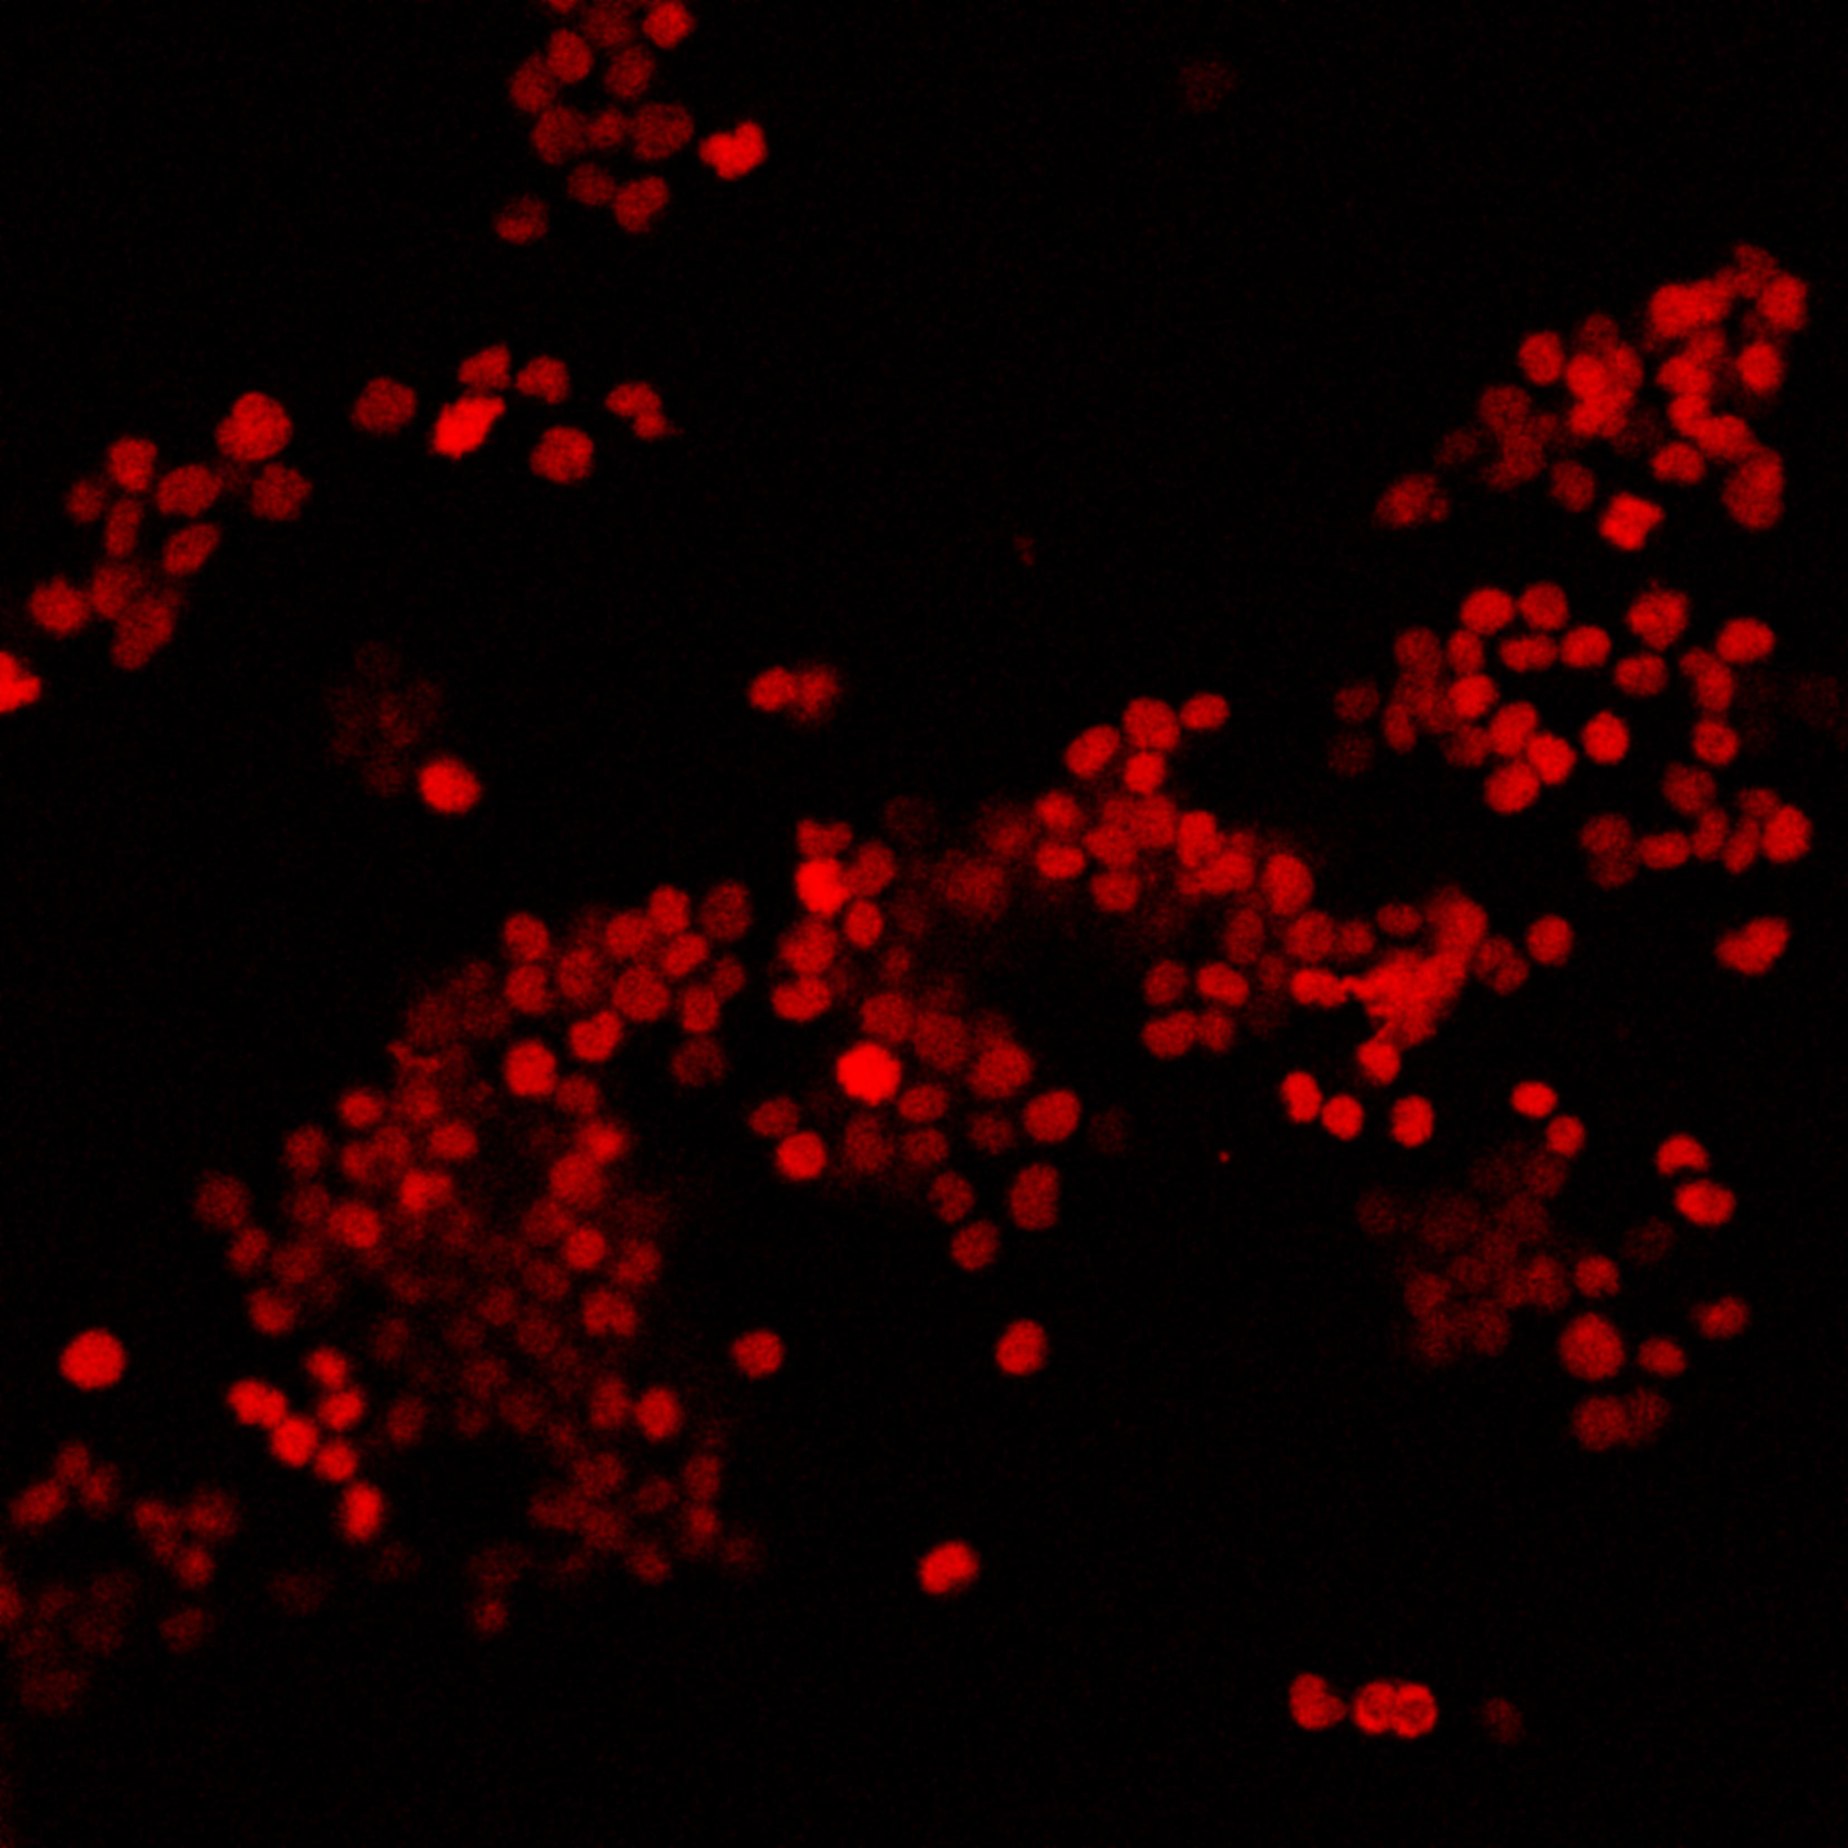
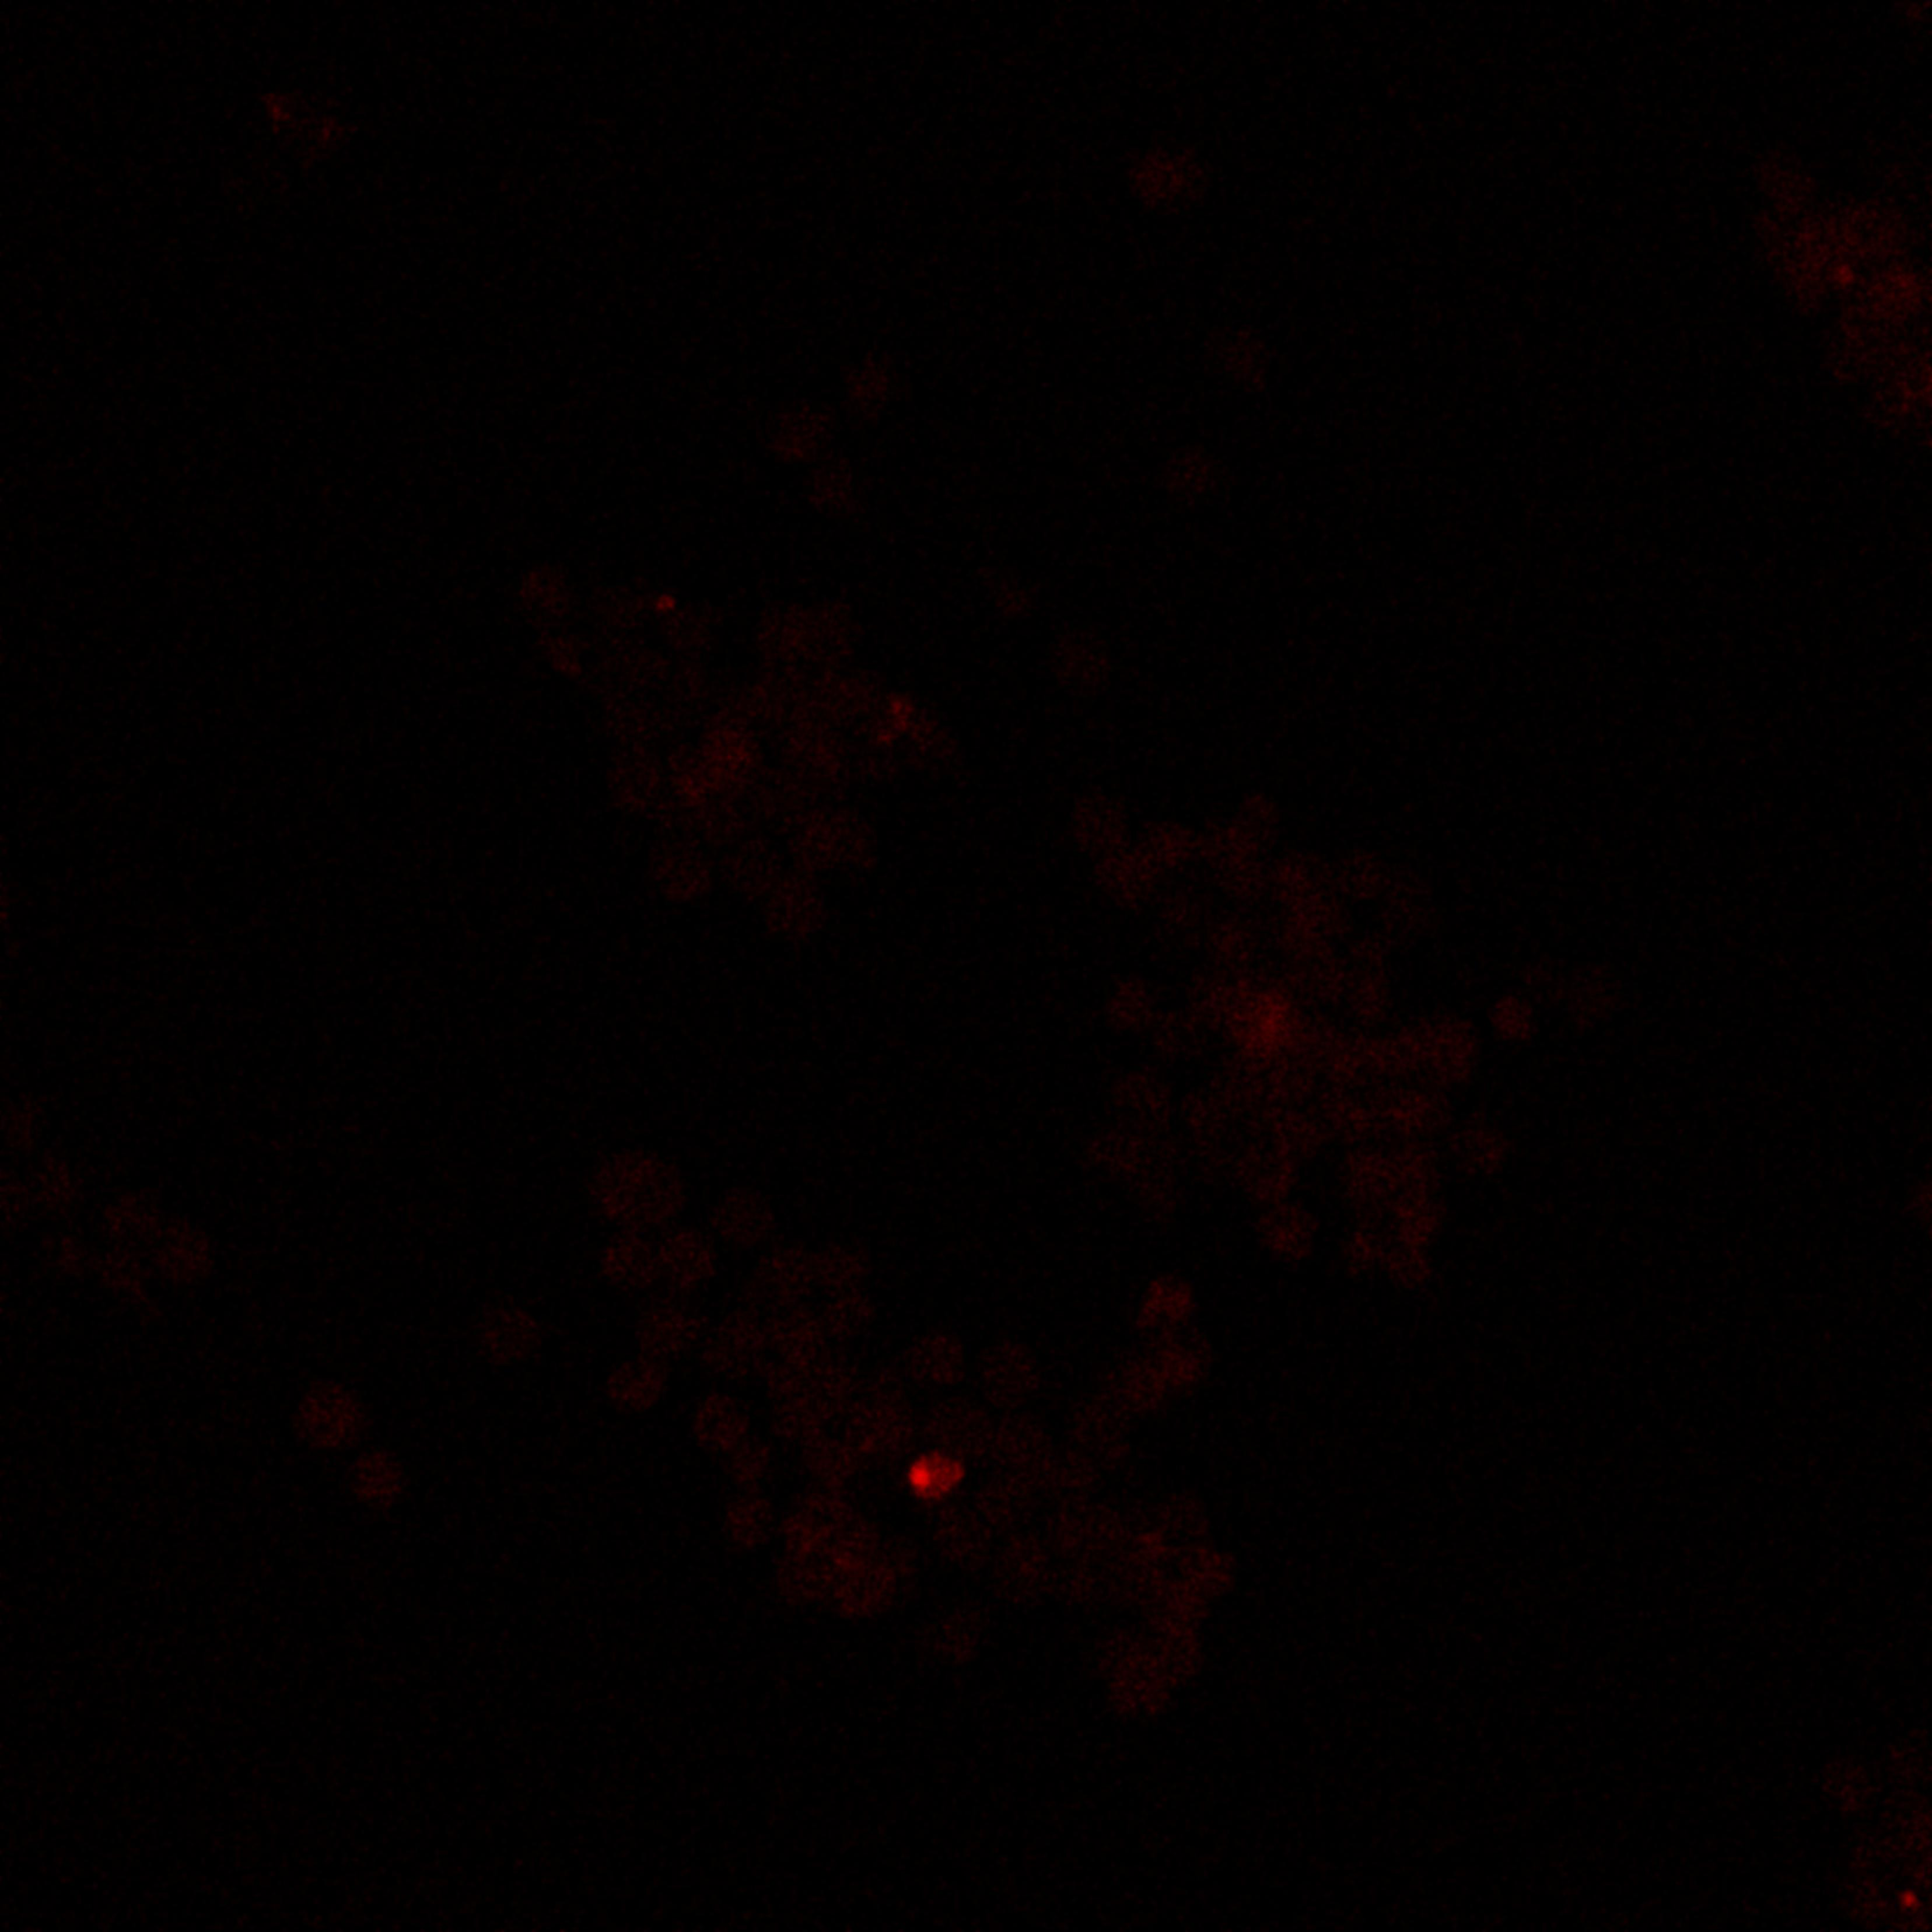
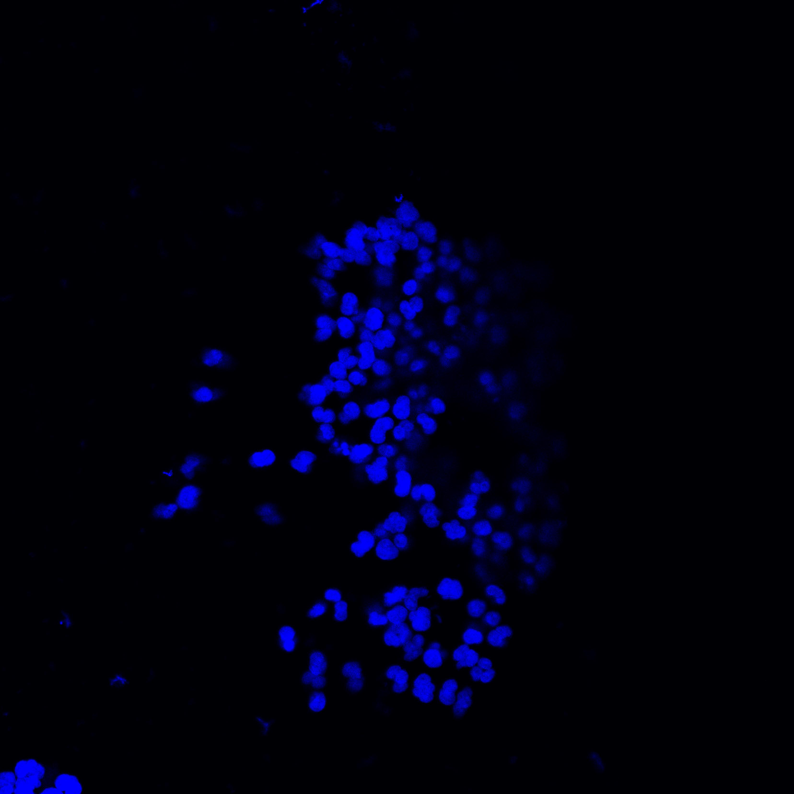
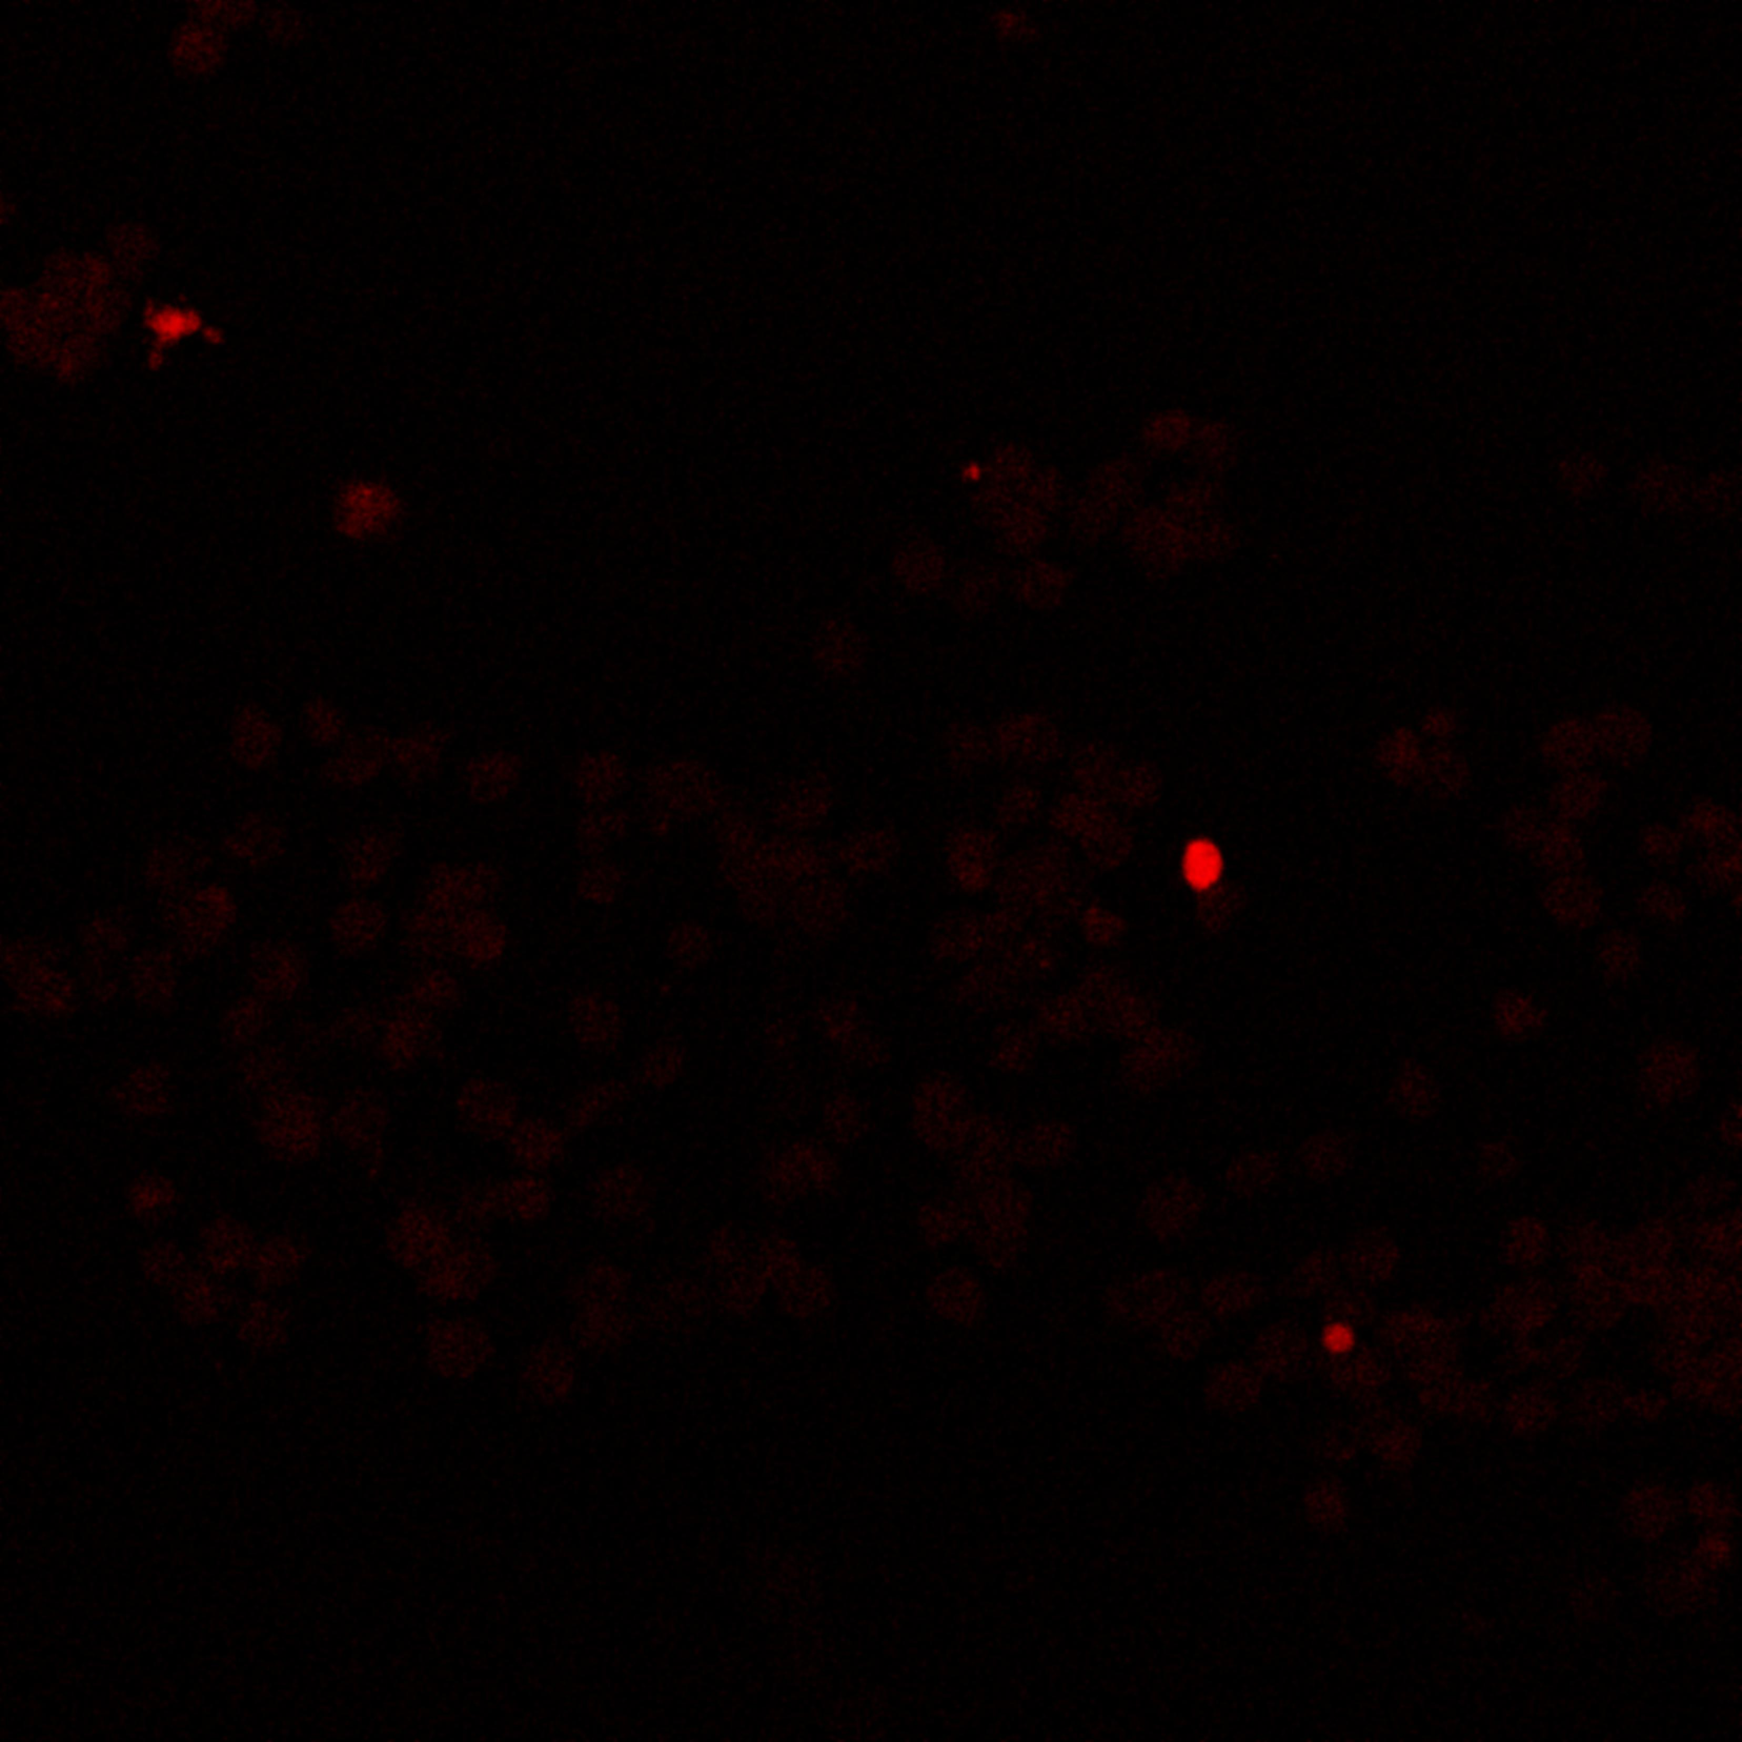
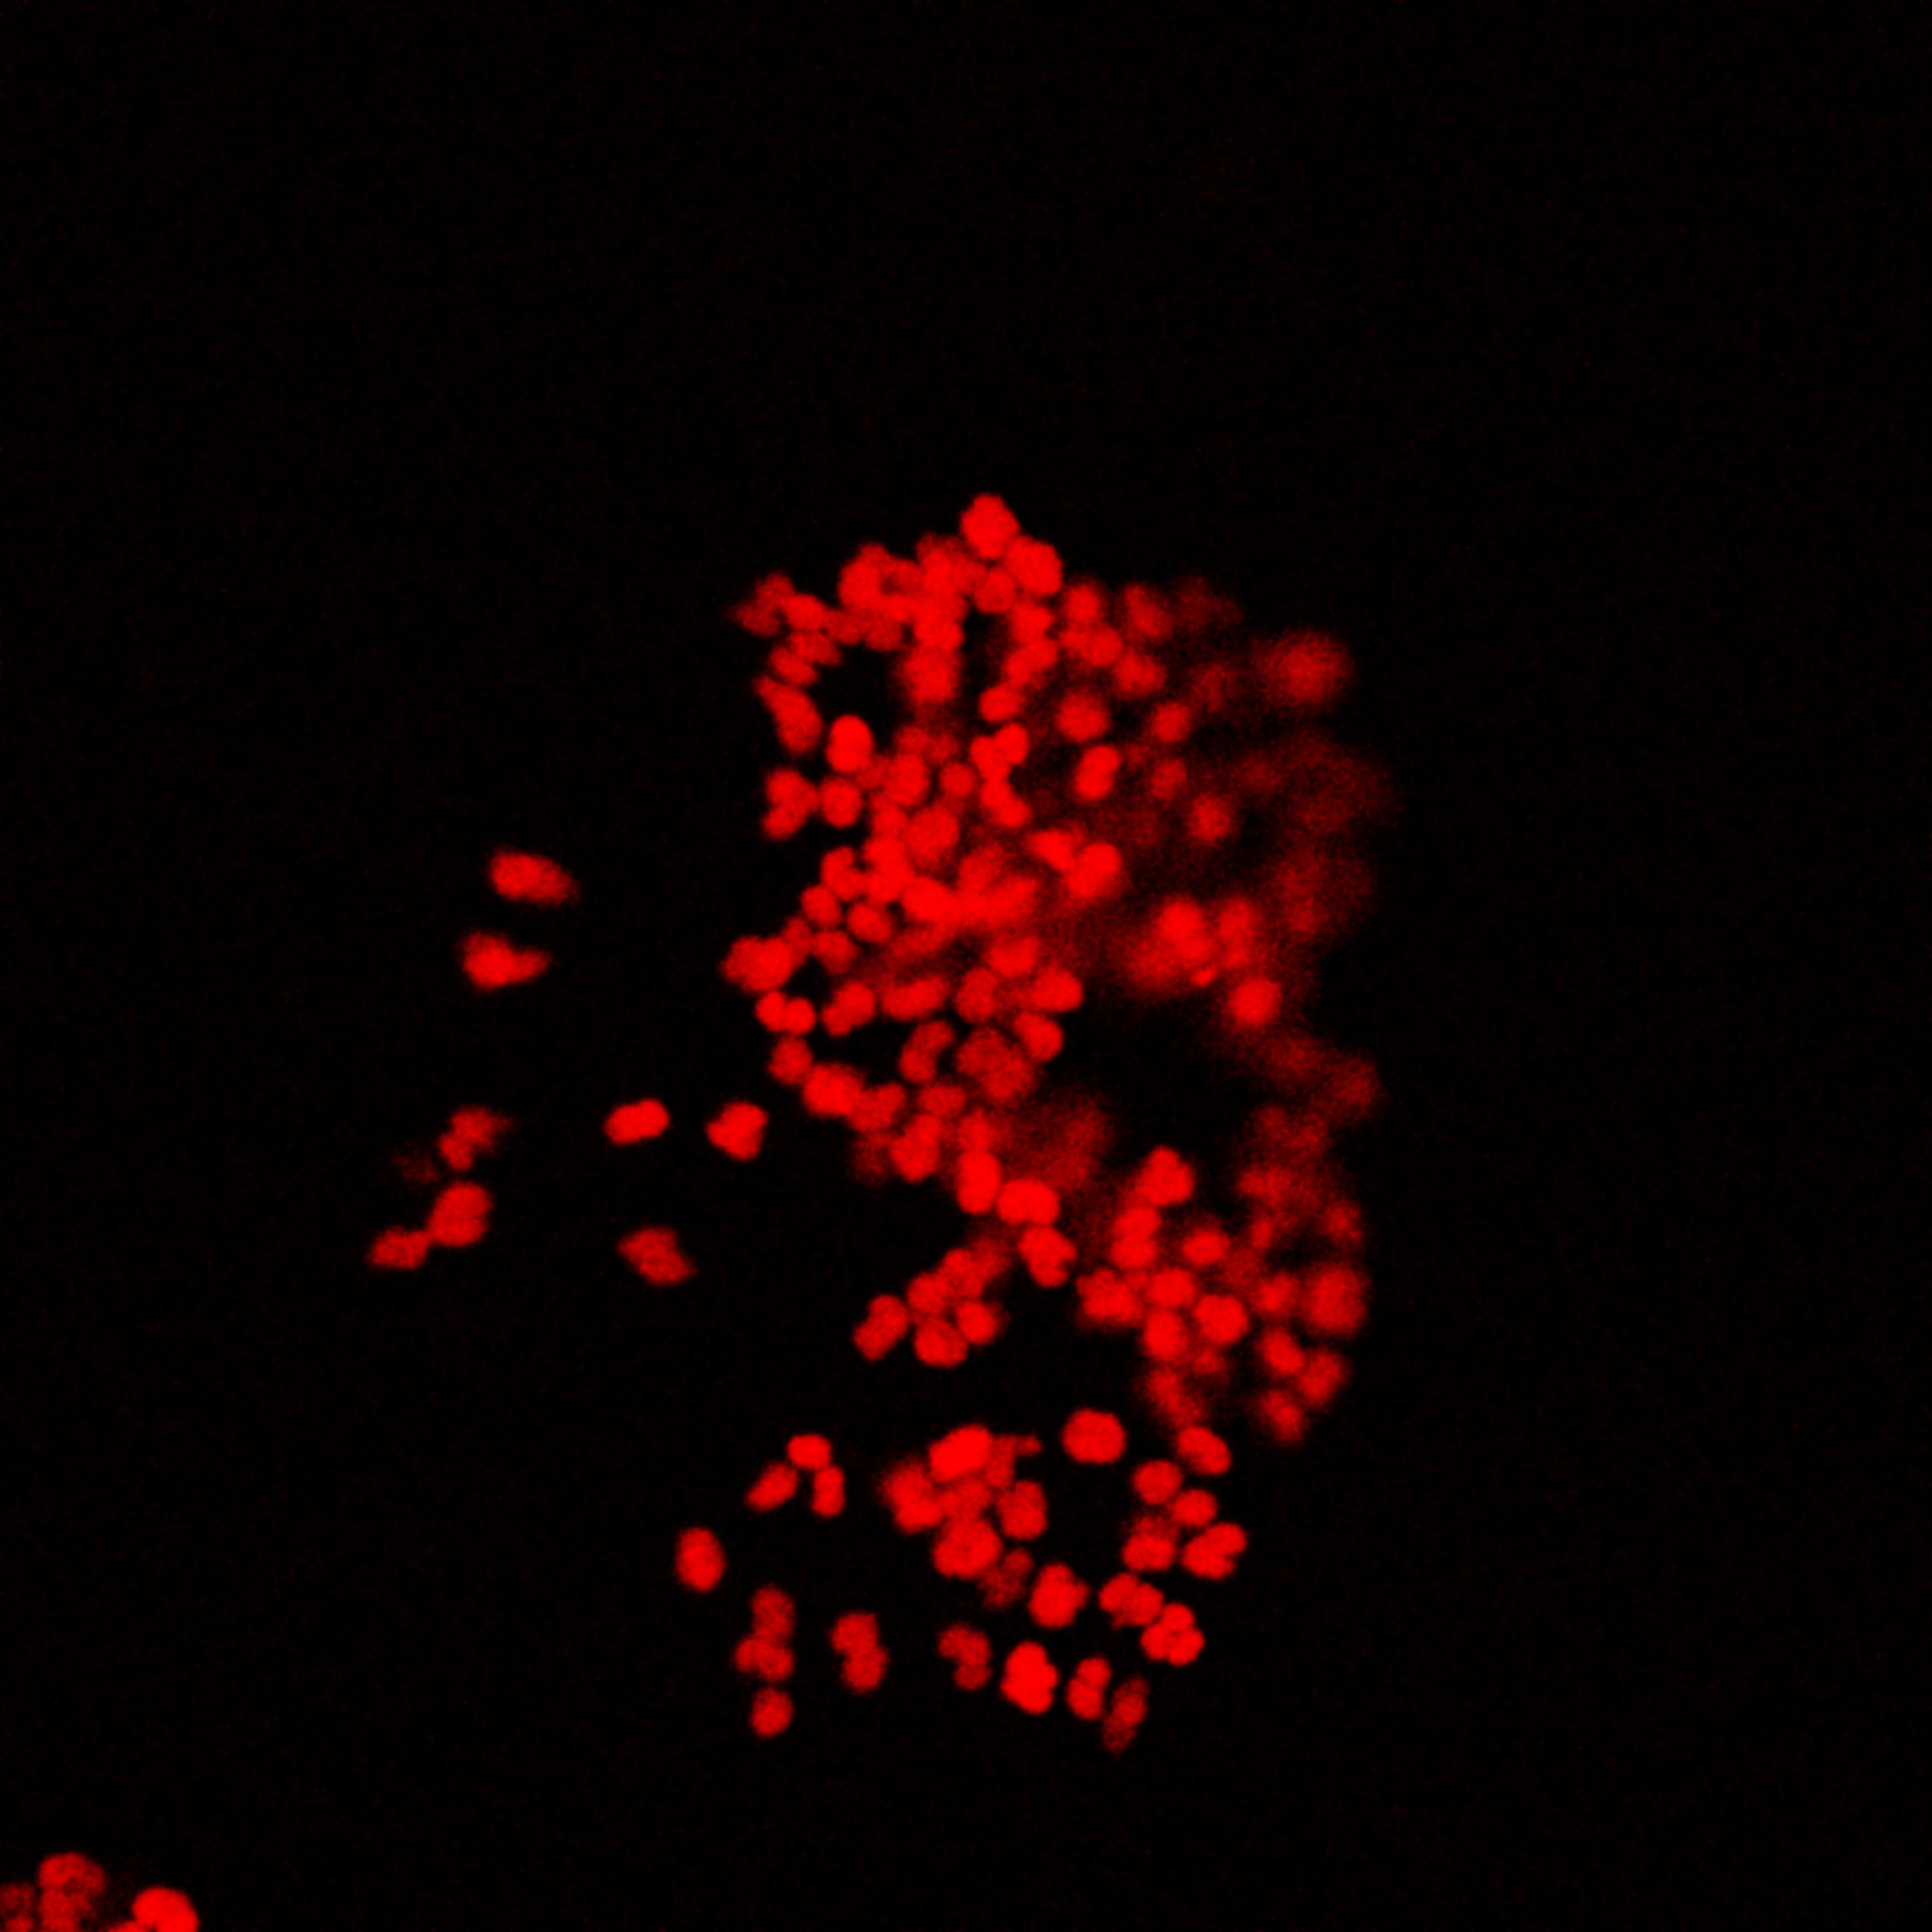
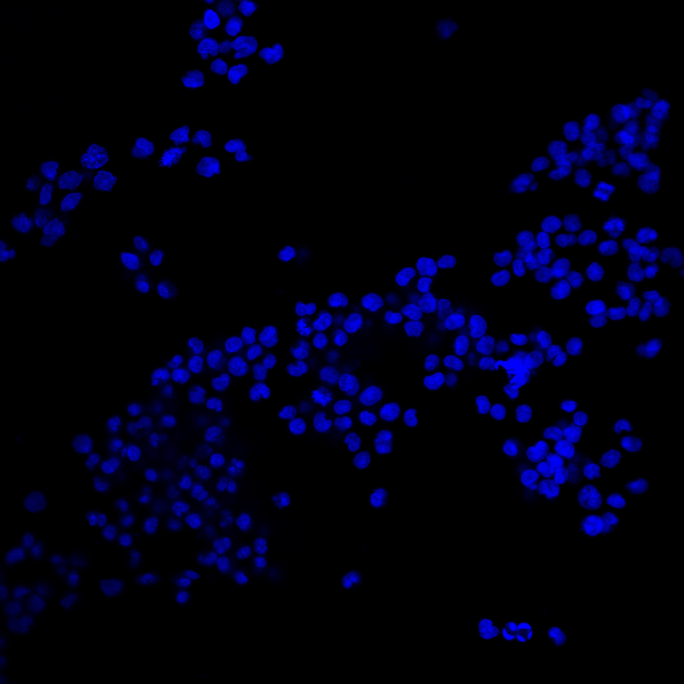
Nice-view with TexasRed-dATP (HUT 78 cells)
Fig.1a
Fig.1b
DAPI - + Nt.CviPII
DMSO
Romidepsin
OCI Index
Fig.1: Nice-view of HUT 78 cells treated or not with 1μM of HDAC inhibitor (Romidepsin) for 6 h at 37 °C. Fig.1a shows the visualization of Texas Red-5-dATP (red) with or without Nt.CviPII.
Nuclei are shown using DAPI staining (blue). Fig.1b represents the open chromatin index (quantification of fluorescence incorporation).

Slide 2
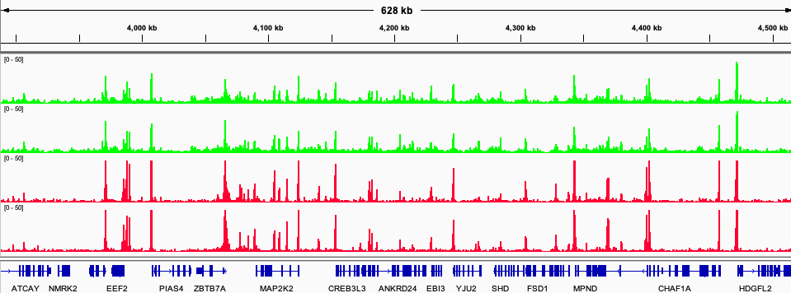
Chr 19: 3,887,591-4,516,290
HUT 78_ control_1
HUT 78_ control_2
HUT 78_ Romidepsin_1
HUT 78_ Romidepsin_2
Fig.2. Representative IGV tracks of HUT 78 control and Romidepsin treated cells

