Slide 1
GREENLEAF LAB ssDNA SEQEUNCING SUMMARY
GEORGI K. MARINOV, ALEX TREVINO, ZOHAR SHIPONY
2019/12/23

Slide 2
1. TESTING KAS-SEQ

Slide 3
EXPERIMENT SUMMARY
We did our first test in Drosophila S2 cells (we needed to work with small genome, see further below why)
We changed the protocol a little bit after the biotin capture step, adapting the procedure we have been using for Hi-C instead, which uses amplification directly on beads
We also tried tagmentation on beads as a potentially more efficient (and adaptable to high-throughput formats) library building strategy

Slide 4
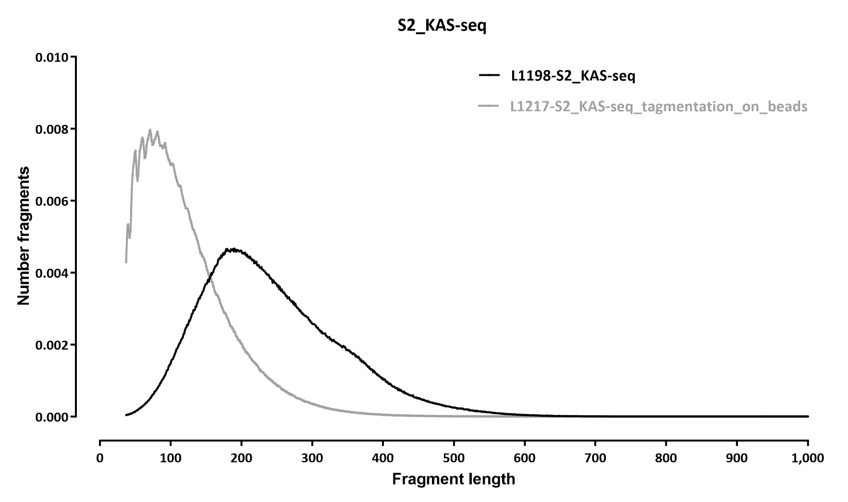
FRAGMENT LENGTH DISTRIBUTION

Slide 5
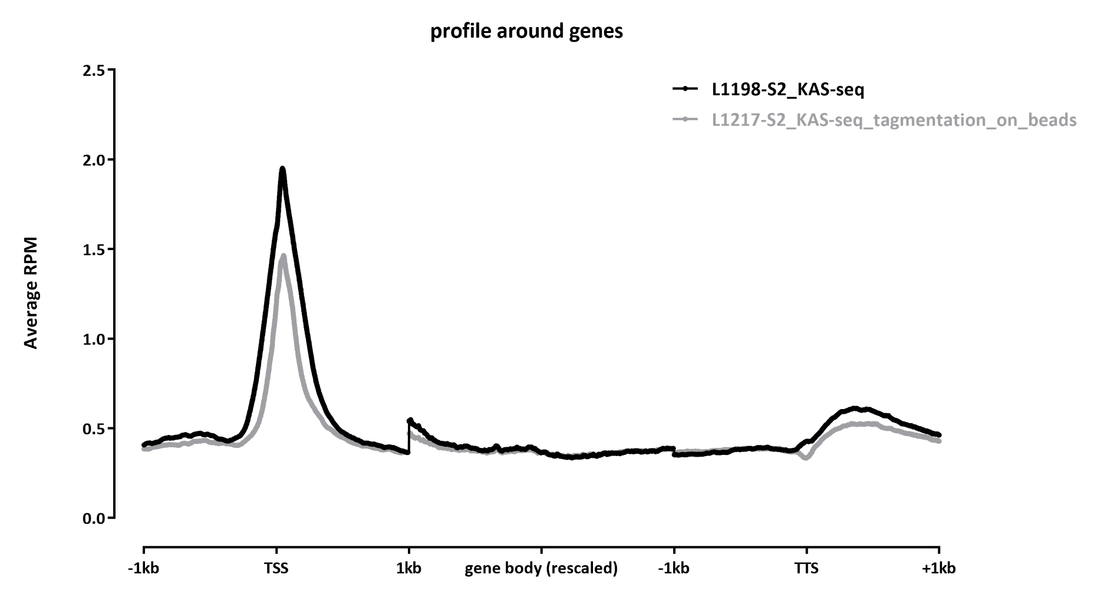

Slide 6
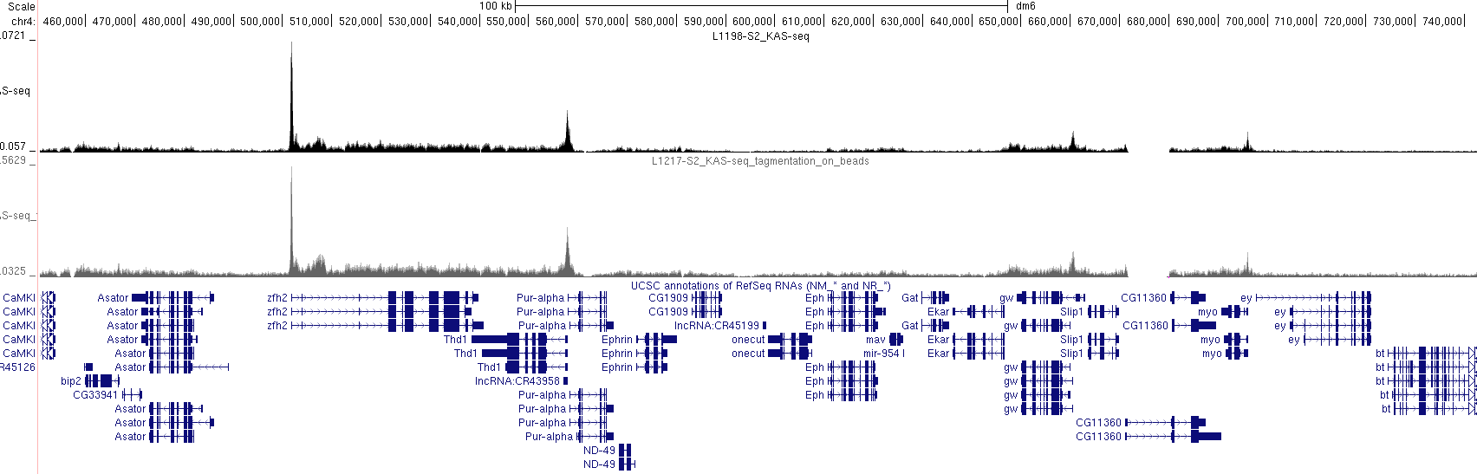
SNAPSHOTS

Slide 7
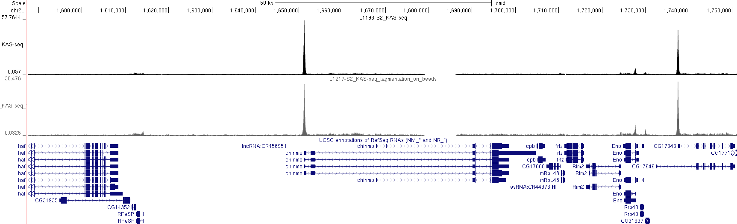
SNAPSHOTS

Slide 8
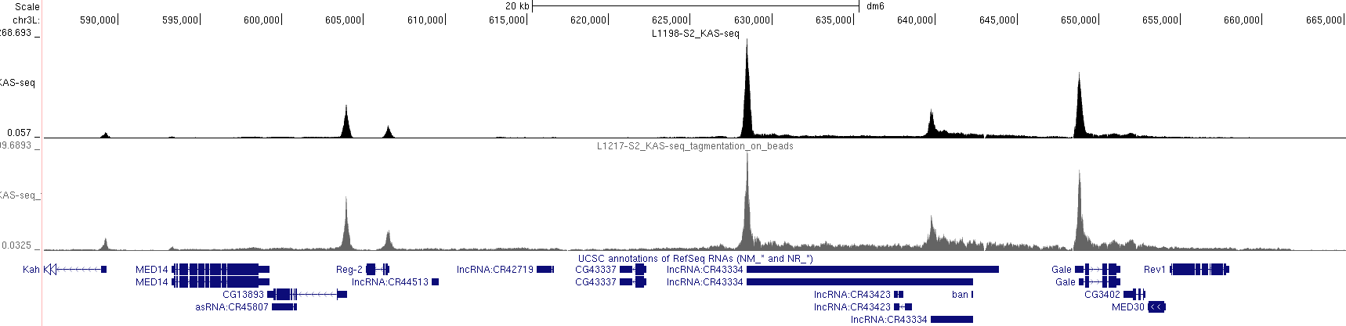
SNAPSHOTS

Slide 9
PROTOCOL TEST SUMMARY
KAS-seq works successfully in our hands
Both ligation-based and tagmentation-based on-beads protocols work fine, though, at least in this test, the ligation resulted in a slightly better signal-to-noise ratio

Slide 10
2. SINGLE-MOLECULE READOUT (nanoKAS)

Slide 11
POSSIBILITIES AND ADVANTAGES
Ketoxal is a bulky modification
Should be detectable very well using nanopore sequencing
Would provide base-pair readout of ssDNA
Would provide linked long-range single-molecule readout of ssDNA
We sequenced one MinION flowcell of HMW DNA from the same S2 experiment (prior to the click reaction)
Note: this is why we tested in S2 cells – we were aiming at obtain sufficiently deep coverage to try some single-molecule analysis, thus a small genome being beneficial

Slide 12
RESULTS FROM THE FIRST 800K NANOPORE READS:

Slide 13
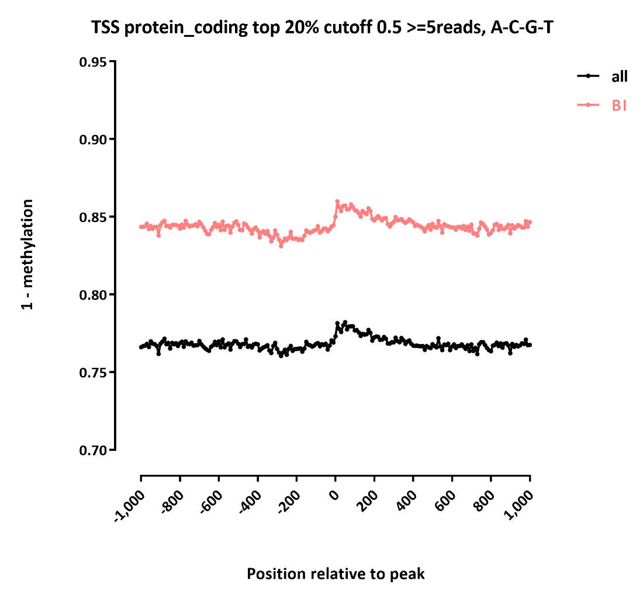
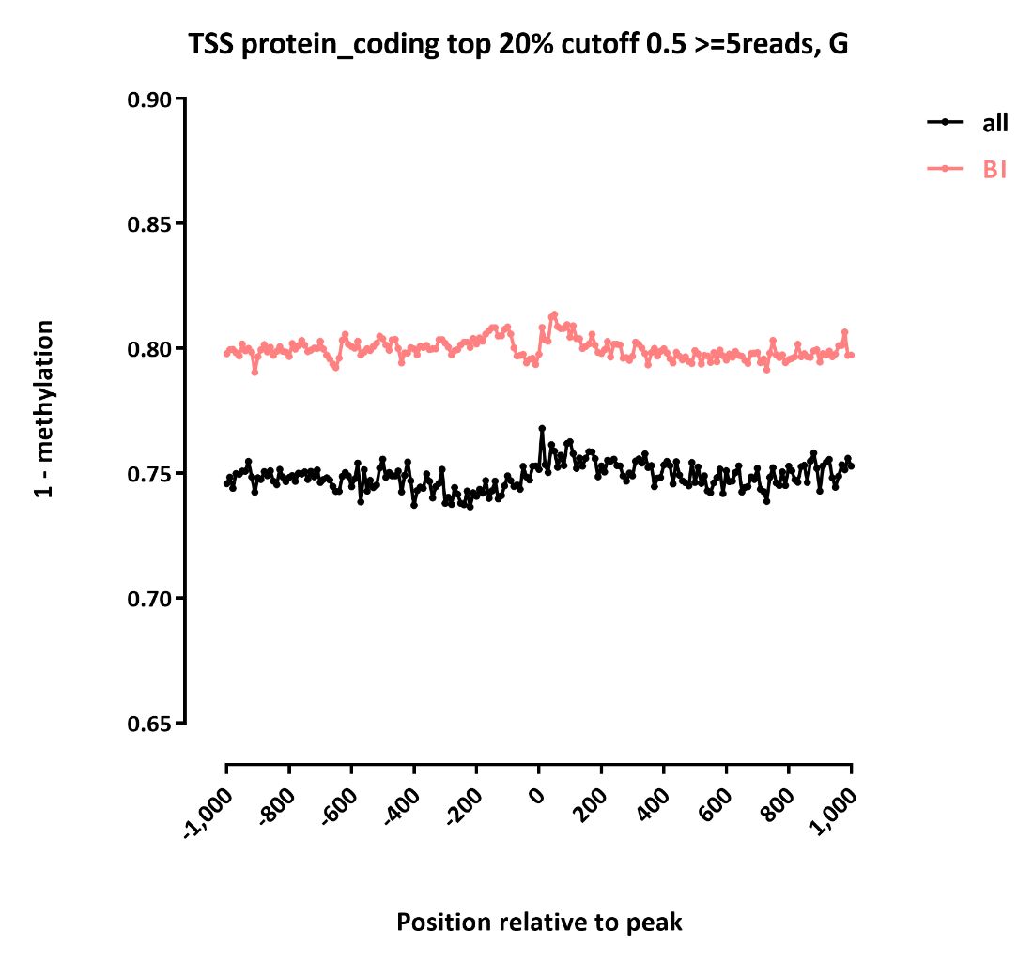
DETECTED MODIFICATION LEVELS AROUND HIGHLY EXPRESSED TSSs

Slide 14
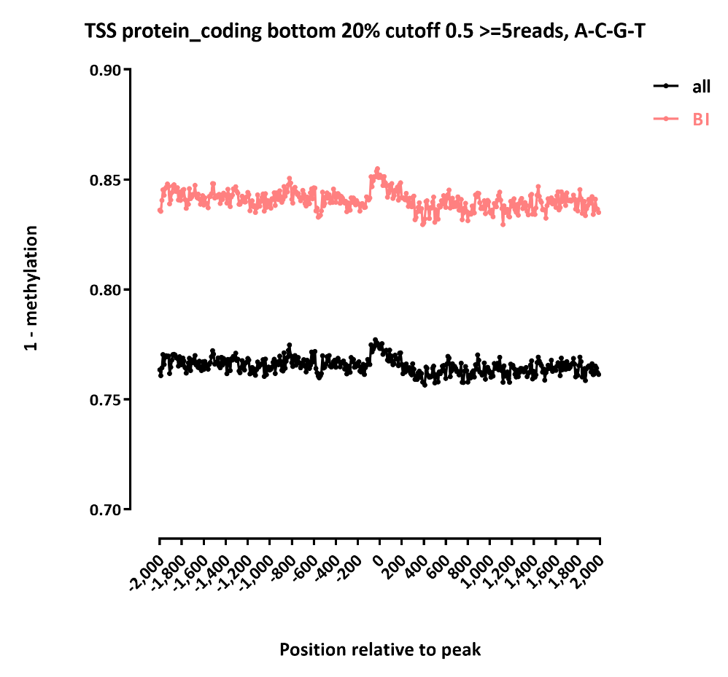
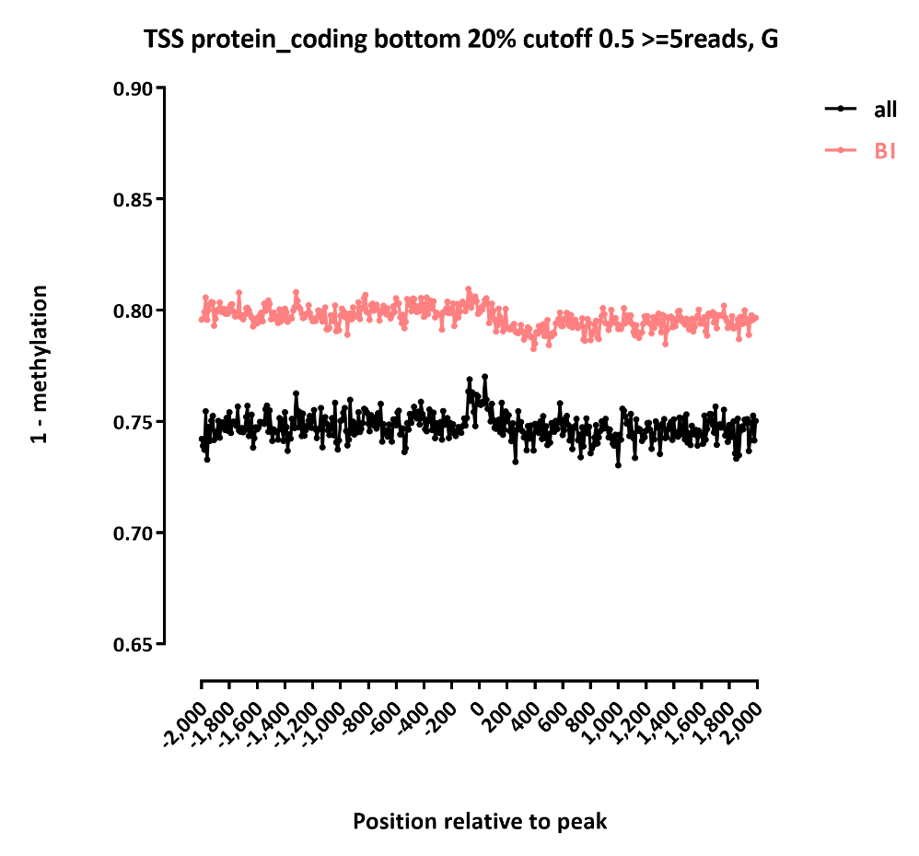
DETECTED MODIFICATION LEVELS AROUND SILENT TSSs

Slide 15
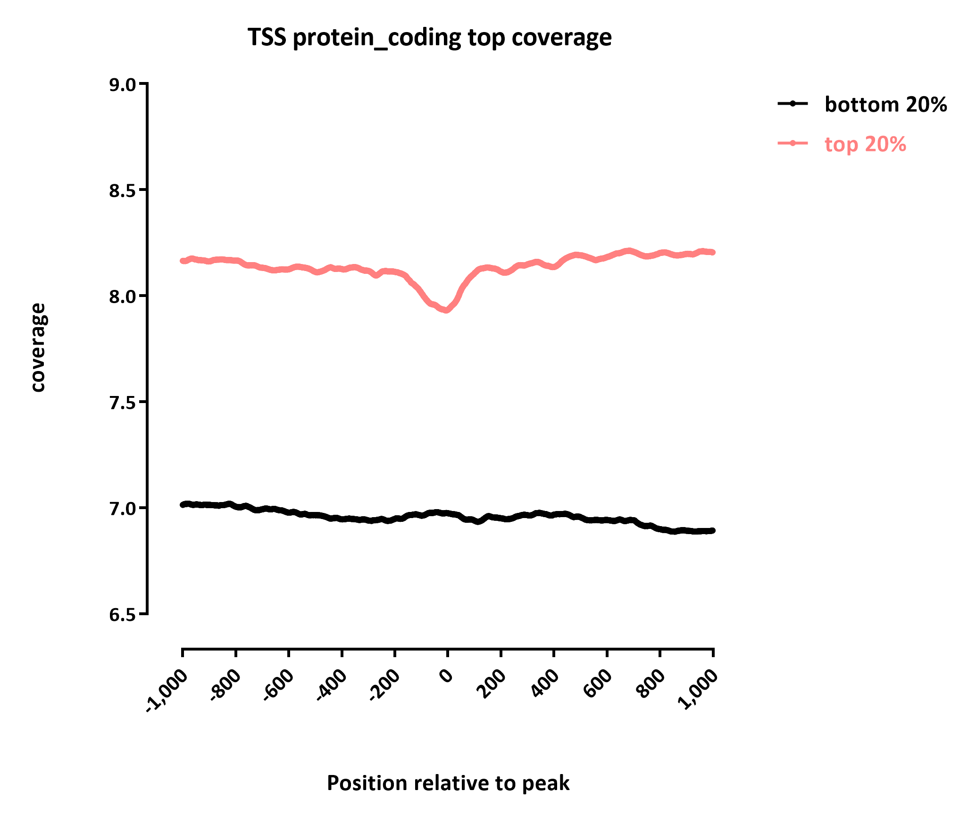
RAW READ COVERAGE

Slide 16
nanoKAS SUMMARY
We were not able to obtain strong enrichment signal around TSS
However, this is not for failure of the kethoxal modification to induce a current change through the pore
The problem appears instead to be that kethoxal is causing the software to throw away modified reads once the modification is encountered (thus the dip in coverage around the TSS at highly expressed genes), which is because it is inducing very strong current changes
We are in discussion with ONT about how to resolve these issues (we are having the same problem on several other projects right now). It is a purely algorithmic problem, not a physical one at the pore

Slide 17
3. EXPERIMENTS WITH CAS9

Slide 18
KAS-SEQ TEST IN PROKARYOTES
In addition to S2 cells, we tested the protocol on a prokaryotic genome, using a Haloferax volcanii culture we had growing in the lab
Haloferax is a species of halophilic archaea
It has a main chromosome and 5 plasmids
The experiment was done on a dormant room-temperature culture (Haloferax normally grows at 45C)

Slide 19
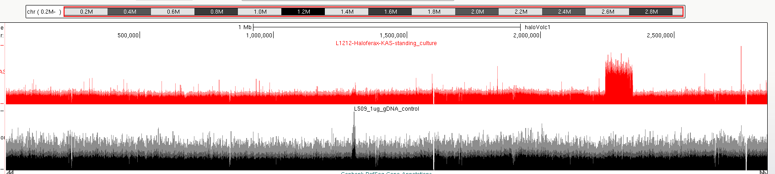
MAIN CHROMOSOME

Slide 20
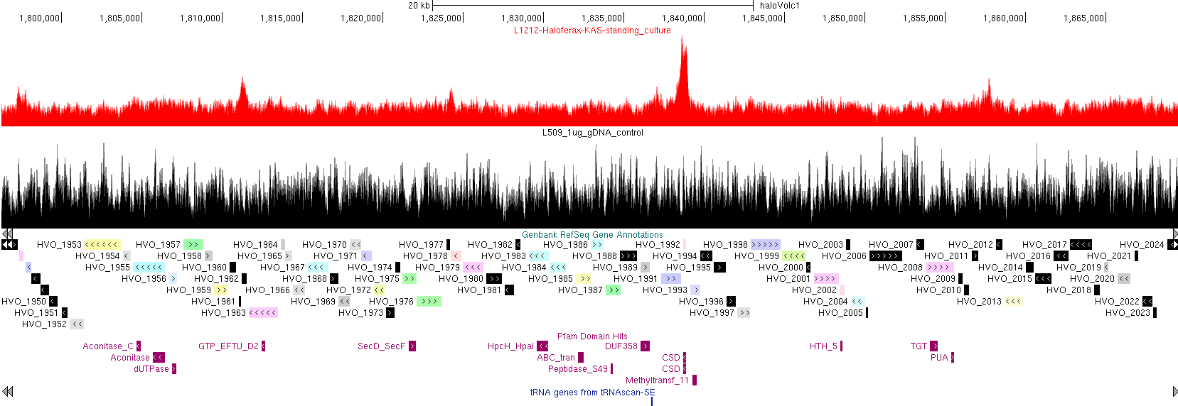
MAIN CHROMOSOME, ZOOM IN
We observe only modest enrichment at TSSs, consistent with the source material being a dormant culture

Slide 21
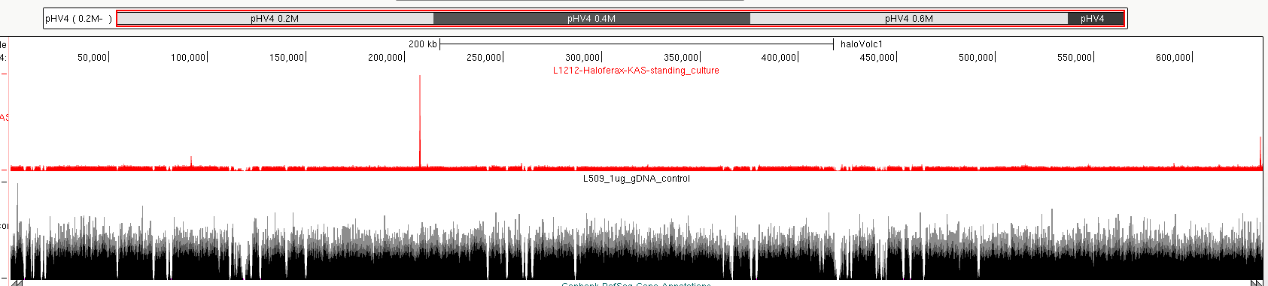
HOWEVER:
A huge peak is observed on one of the plasmids!

Slide 22
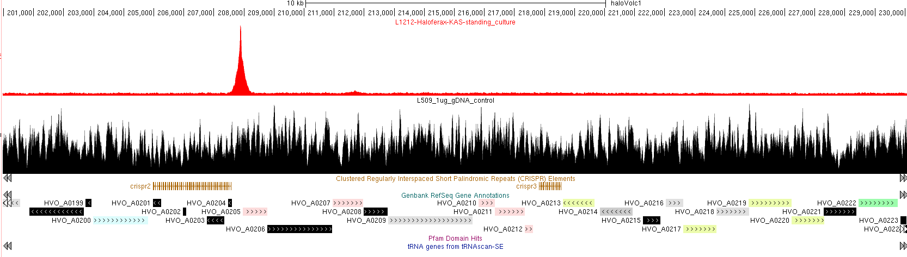
ZOOM IN
this is Cas6
There are 3 CRISPR arrays in Haloferax, the other one is on the main chromosome. Only this one shows a KAS peak
We do not know right now why the CRISPR array beginning is so strongly enriched for ssDNA, but it made us think about CRISPRs (of coyrse, this clearly has implications about basic CRISPR biology that could be followed on at some point)

Slide 23
dCAS9/CAS9 TARGET MAPPING
We do not know right now why the CRISPR array beginning is so strongly enriched for ssDNA, but it made us think about CRISPRs
We have done quite a bit of work on studying Cas9 specificity in recent years, and there are many unresolved problems in the field
Existing methods for mapping off-target sites are all very complicated and difficult to carry out
In addition, there is no good method for mapping dCas9 off-target sites, as existing methods all rely on mapping actual cuts and use the catalyitically active Cas9 version. ChIP-seq is too noisy, plus it does not distinct actual strand invasion from other types of binding
We reasoned kethoxal should be able to label sites of strand invasion
We carried out a test using two sgRNAs targeting the mouse HOXA locus, by carrying out a ketoxal reaction on an in vitro sample of a dCas9 sgRNA RNP that was incubated with mouse gDNA

Slide 24
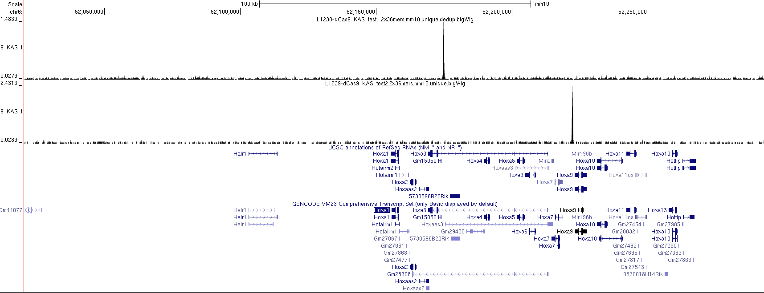
RESULTS

Slide 25
dCAS9/CAS9 TARGET MAPPING SUMMARY
Kethoxal seems to be an extremely promising way of mapping Cas9 targets (“CasKAS”)
Easier and quicker than anything currently existing
Mapping strand invasion rather than binding
Could in principle be adapted to a high-throughput format in plates to profile numerous guides in parallel

Slide 26
4. STRAND-SPECIFIC KAS (ssKAS)

Slide 27
SUMMARY
We have reasons to think that kethoxal labeling is not equal on both strands of the DNA, at least in some contexts
Thus a strand-specific version of the protocol could reveal interesting new biology
Nanopore sequencing will readily provide that information, once the readout issue is resolved, but there are Illumina-based approaches too, plus Illumina is much easier to work with in general
We have not gotten around to sequencing either of them, but we are testing two approaches to convert denatured post-click DNA that has been captured into libraries
The first one is an adaptation of the PBAT protocol for carrying out whole-genome bisulfite sequencing, which uses random priming to carry out a first/second strand synthesis off a template (thus preserving the strand specificity)
The second one is to ligate adapters with random-sequence overhangs onto the 3’ end of the captured DNA on beats and carry out a first/second strand synthesis
We will report on the success of these approaches after the break

Slide 28
5. SINGLE-CELL KAS (scKAS)

Slide 29
SUMMARY:
We have debated a lot internally on how to approach the single-cell problem
The challenge is that we need to simultaneously:
carry out the click reaction
enrich for modified DNA
index cells
These three goals do not fit directly into any of the existing single-cell protocols
We are testing two main strategies right now, on the success of which we will report after the break

Slide 30
APPROACH 1:
This approach uses the 10X platform
Kethoxal labeling is carried out in cells
Cells are then fixed (we need to do this in order to “freeze” things in place and stop DNA repair reactions from eliminating the kethoxal)
The click reaction is the carried out in situ
Cells are then denatured in SDS (this approach has been used in multiple single-cell studies, and it preserves the cells as long as they are fixed)
Then we feed the cells into the standard 10X scATAC protocol, where tagmentation and indexing happen in droplets (this is why we need to denature, in order to not convolve the KAS signal with the accessible chromatin signal)
Then once GEMs are broken up, we do a biotin pull-down and library amplification

Slide 31
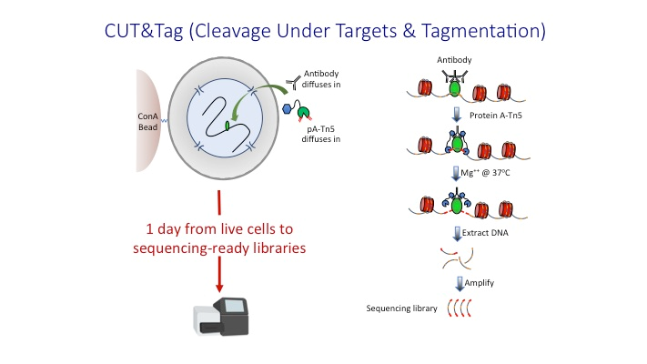
APPROACH 2:
This approach adapts the CUT&Tag protocol for mapping protein-DNA interactions
CUT&Tag uses a proteinA-Tn5 fusion to direct Tn5 to the sites where the protein of interest (labelled by a primary antibody) is located in the genome
The advantage is that Tn5 directly adds primer landing sites to DNA fragments, which can then be amplified

Slide 32
APPROACH 2:
This approach adapts the CUT&Tag protocol for mapping protein-DNA interactions
Kethoxal labeling is carried out in cells
Cells are then fixed (we need to do this in order to “freeze” things in place and stop DNA repair reactions from eliminating the kethoxal)
The click reaction is then carried out in situ
We may or may not have to denature in this case, in principle we think it could work without denaturing
We are trying two strategies to bring Tn5 to kethoxal sites:
- Use an anti-biotin antibody to bring the pA-Tn5 to ssDNA sites
- Incubate with streptavidin, then use an anti-streptavidin antibody to bring pA-Tn5
We expect the second strategy to work better
The CUT&Tag approach also has the advantage of being scalable, as it can be directly adapted to a combinatorial indexing format, thus greatly increasing throughput

