Slide 1
ULTIMA PERTURB-SHARE FIRST PRODUCTION RUN

Slide 2
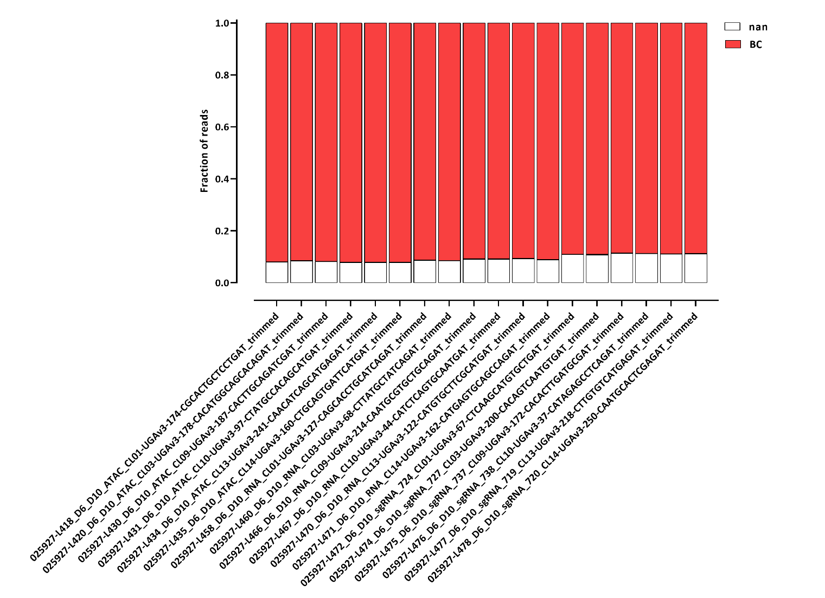
Barcode assignment

Slide 3
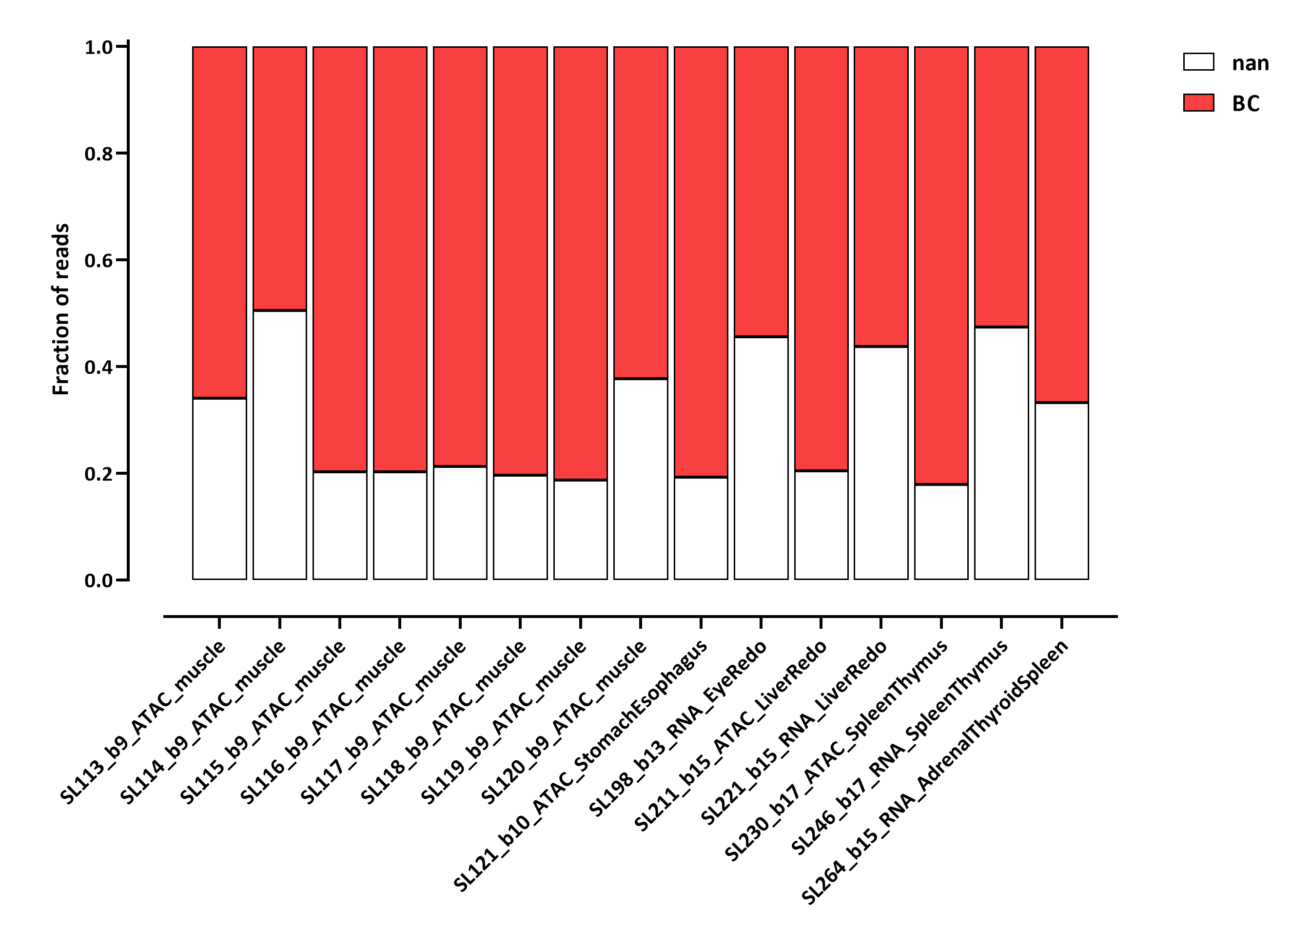
Typical Illumina for comparison:

Slide 4
Mapping stats RNA

Slide 5
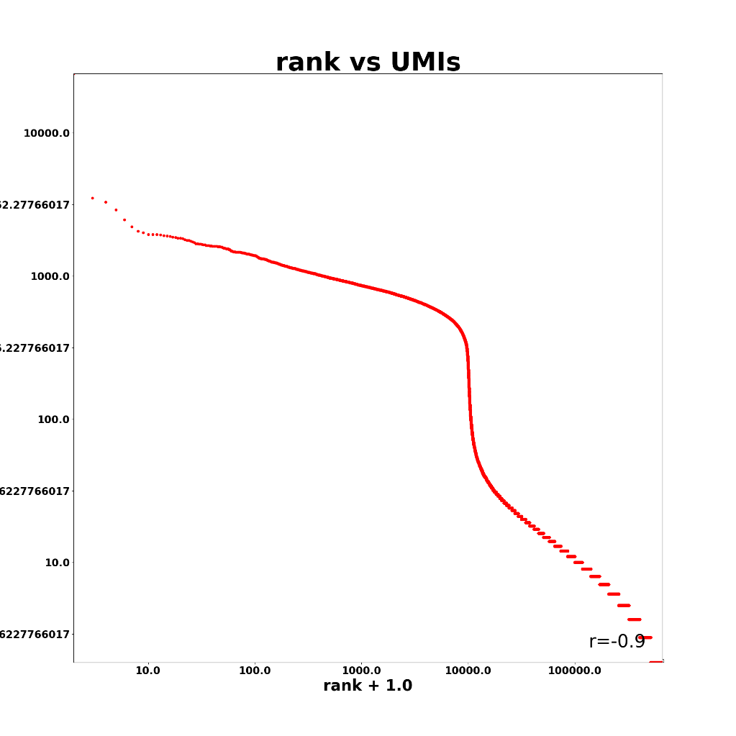
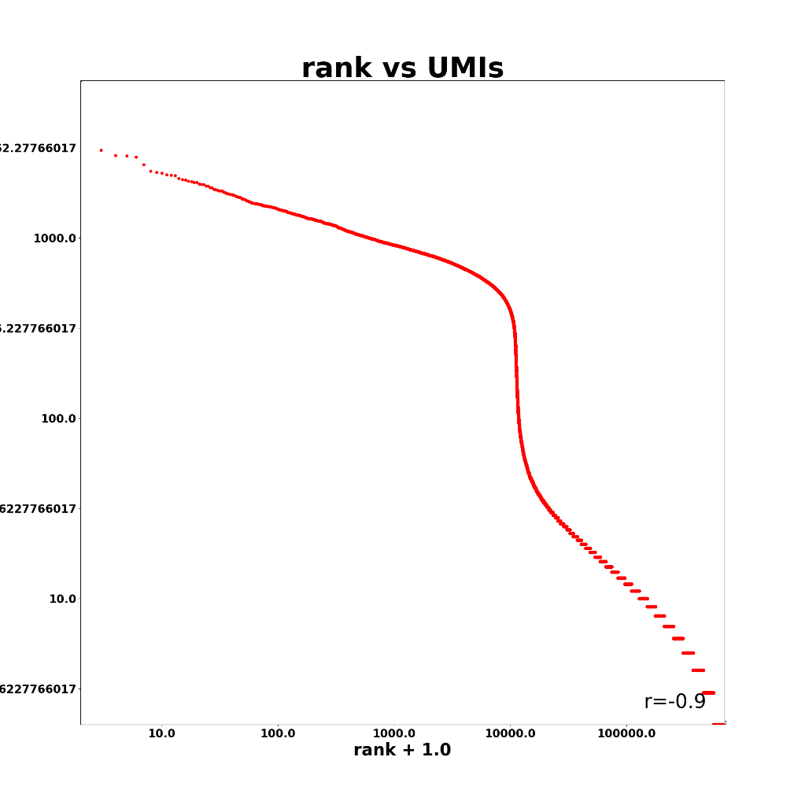

Slide 6
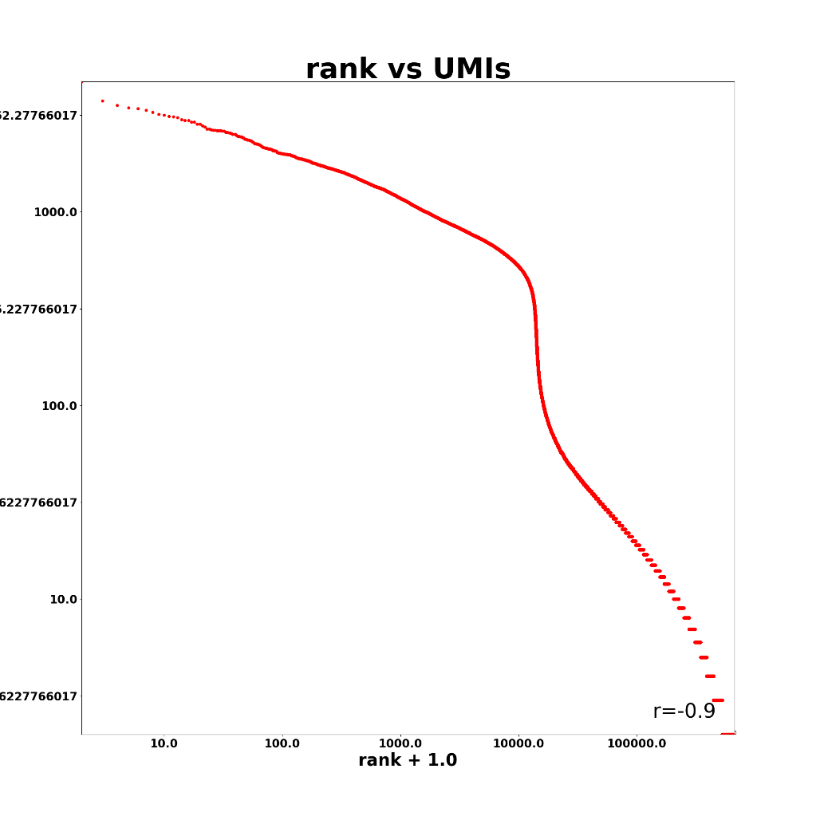
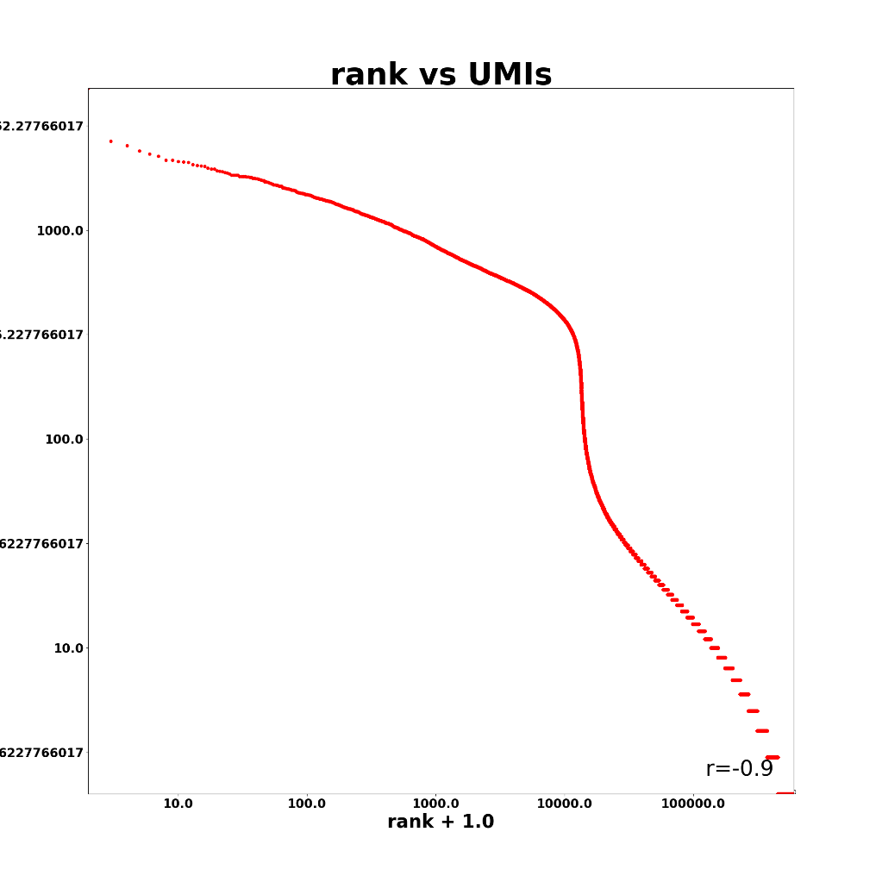

Slide 7
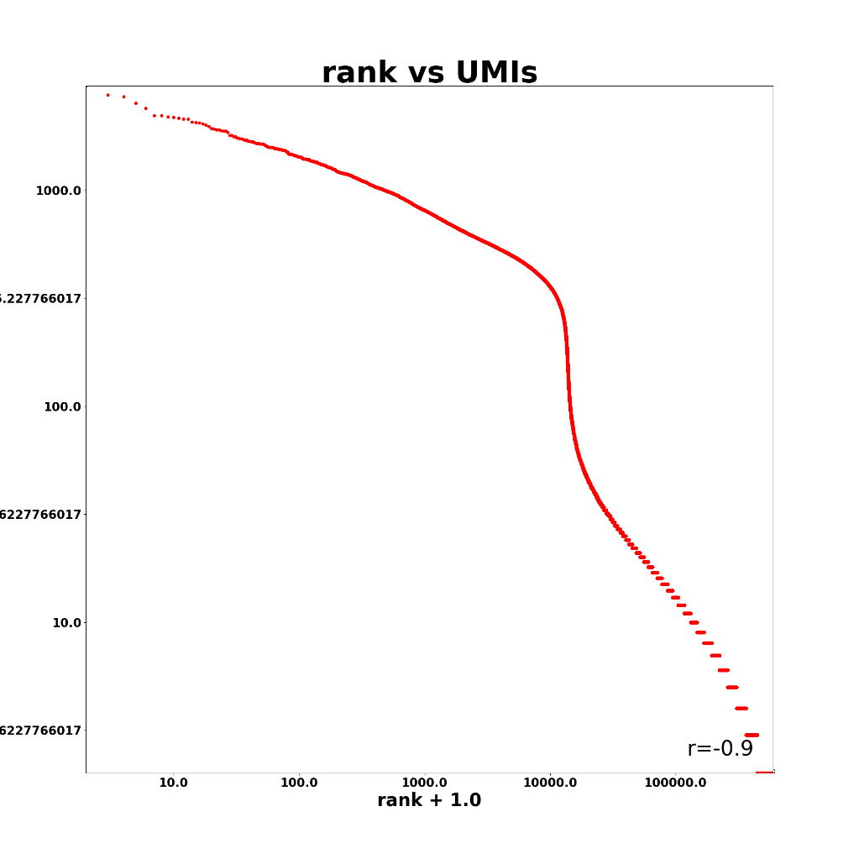
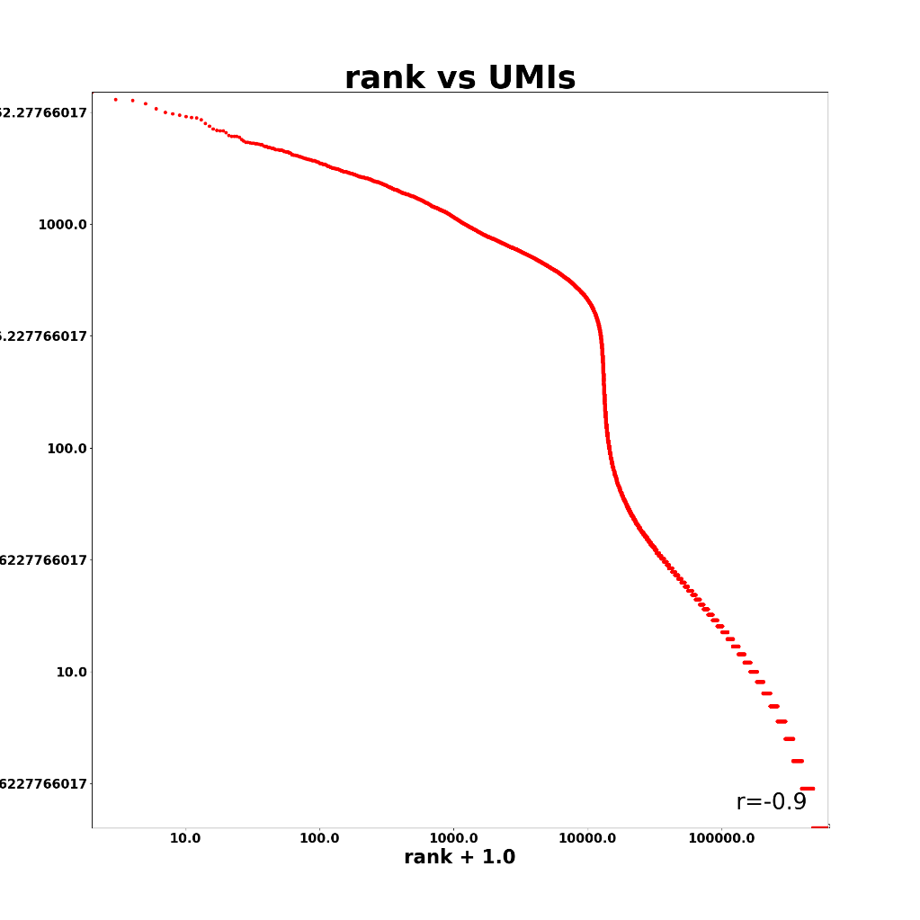

Slide 8
Mapping stats ATAC
Note: cutoff should be higher than 500 in this case, but doing it on the RNA side will do the job fine

Slide 9
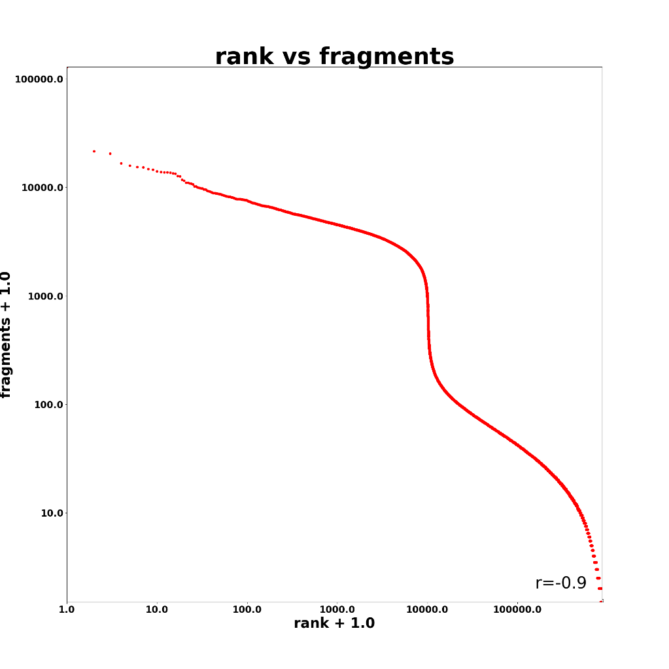
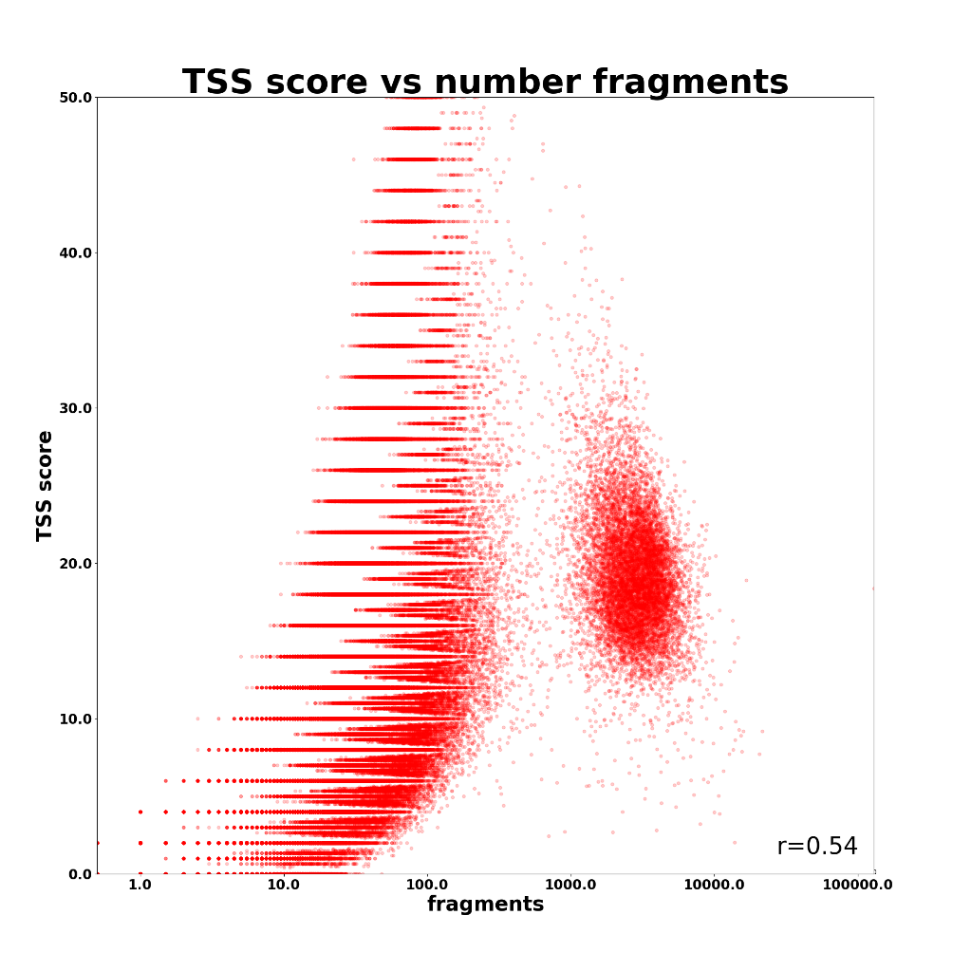

Slide 10
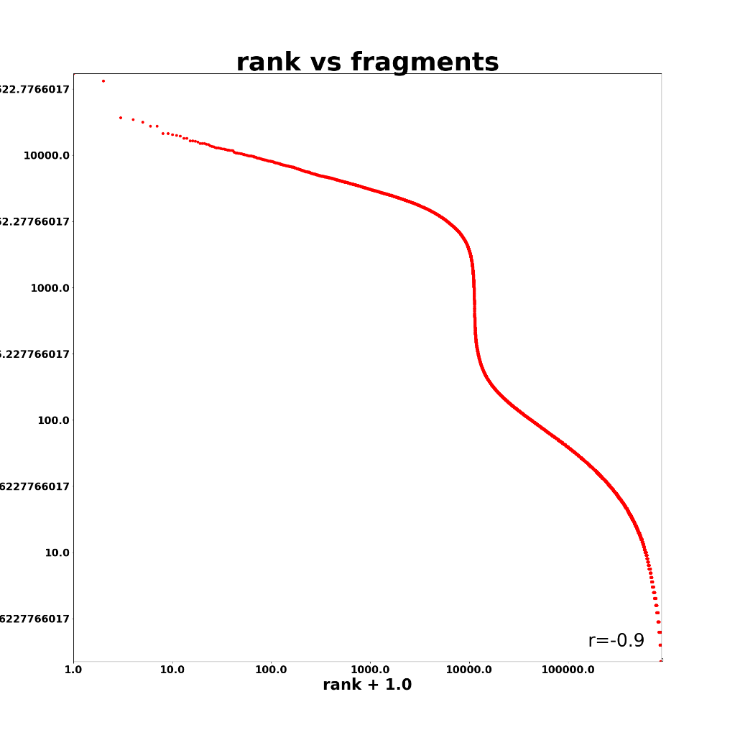
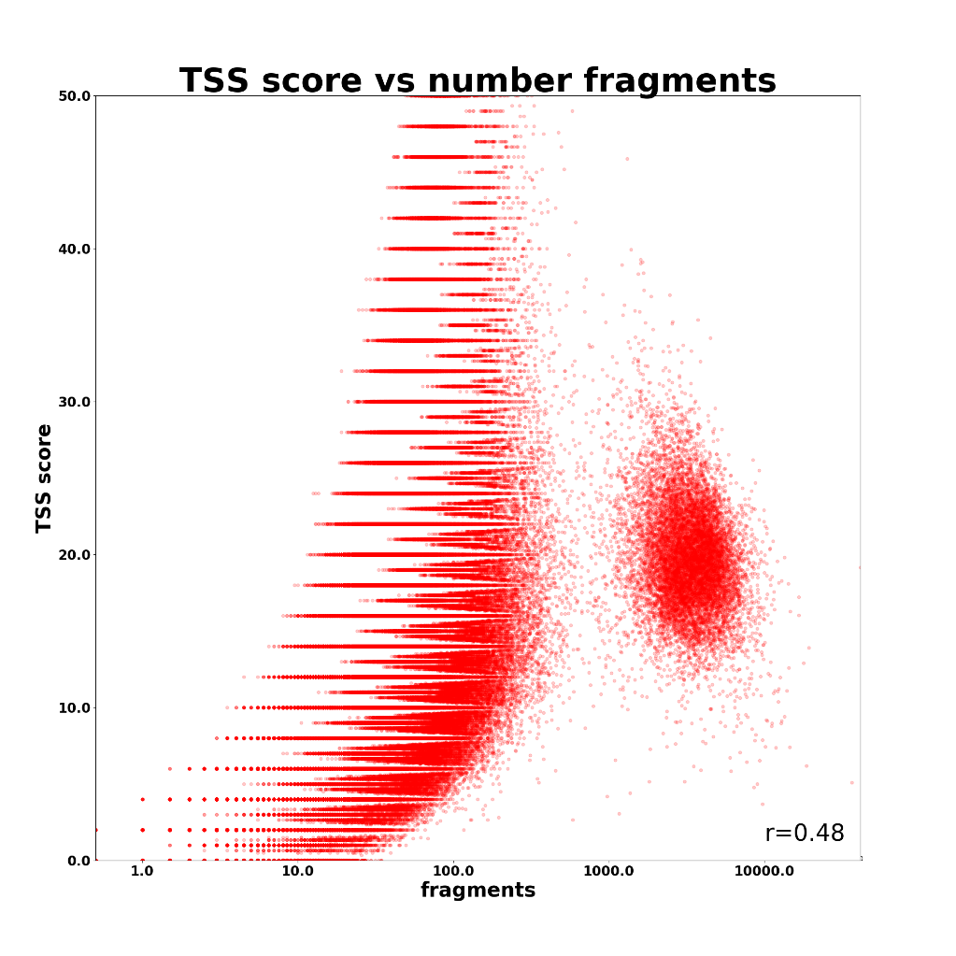

Slide 11
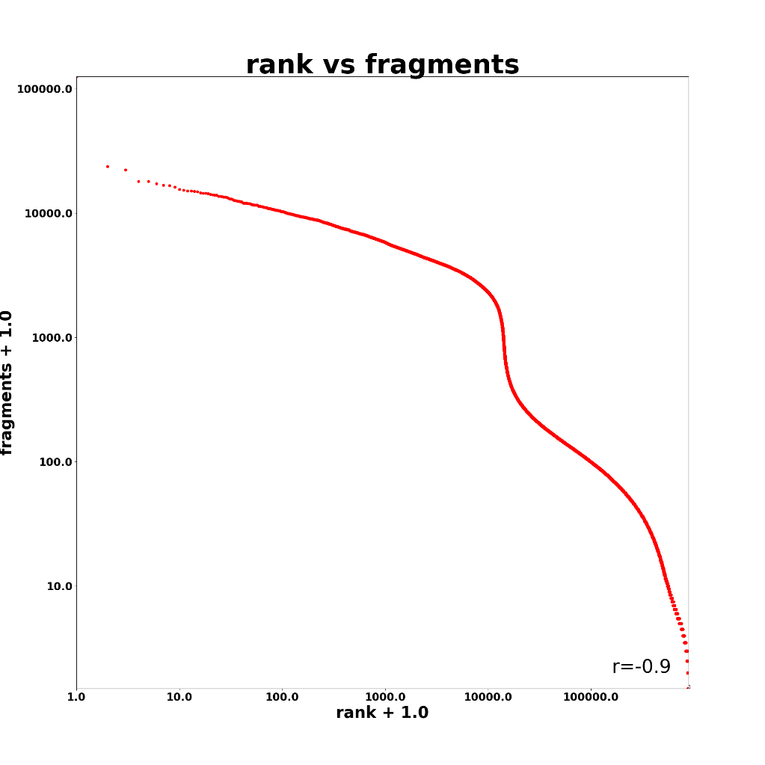
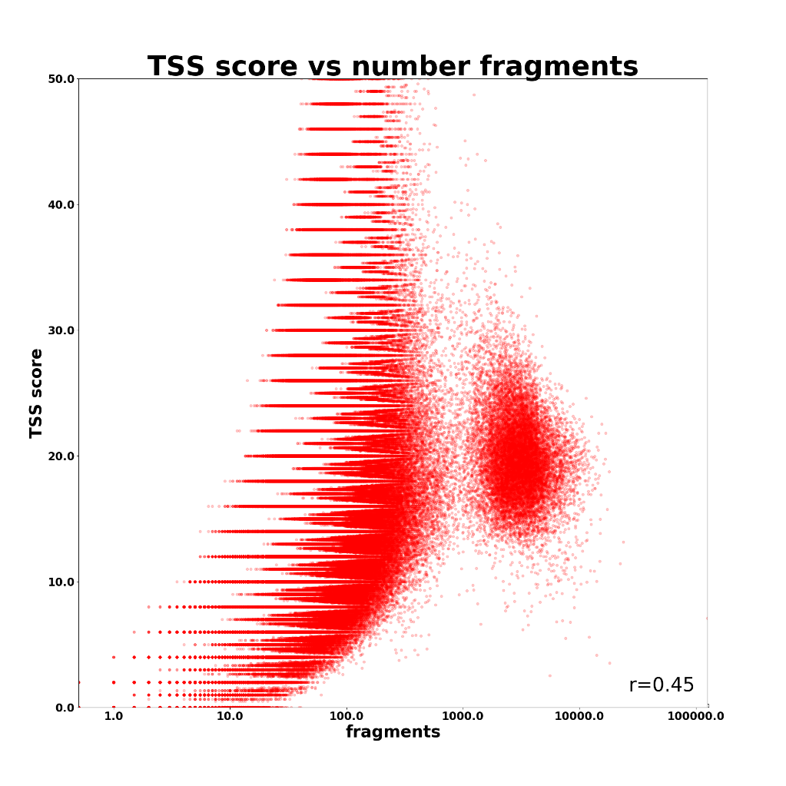

Slide 12
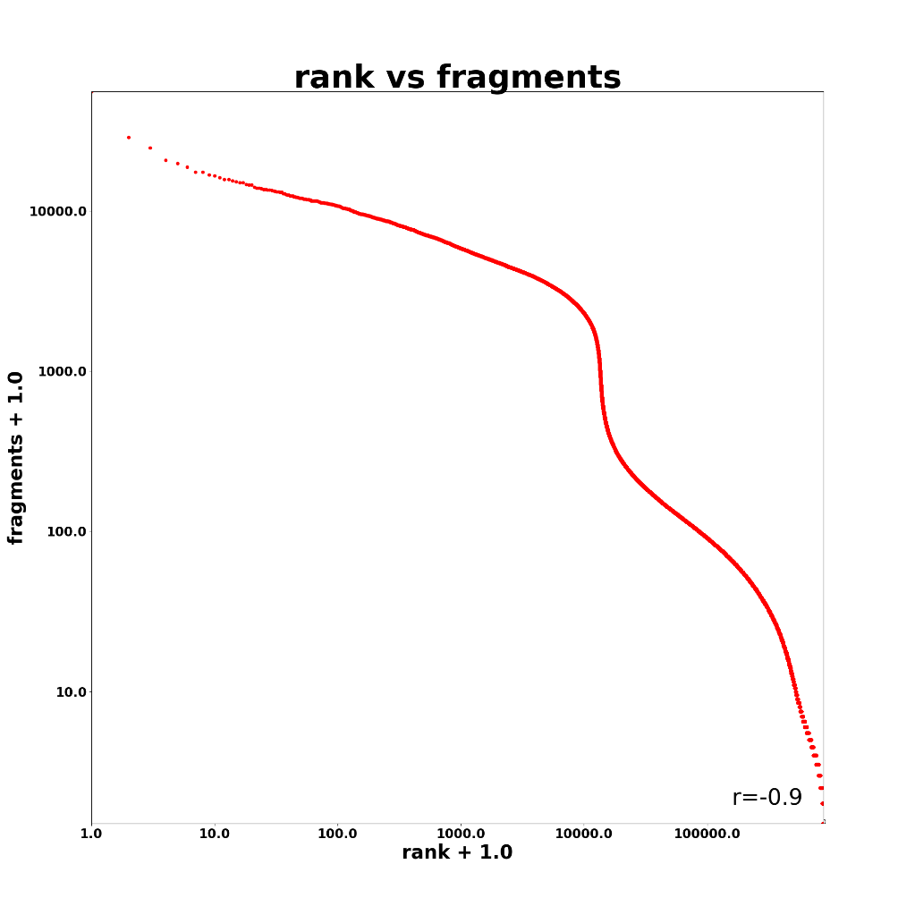
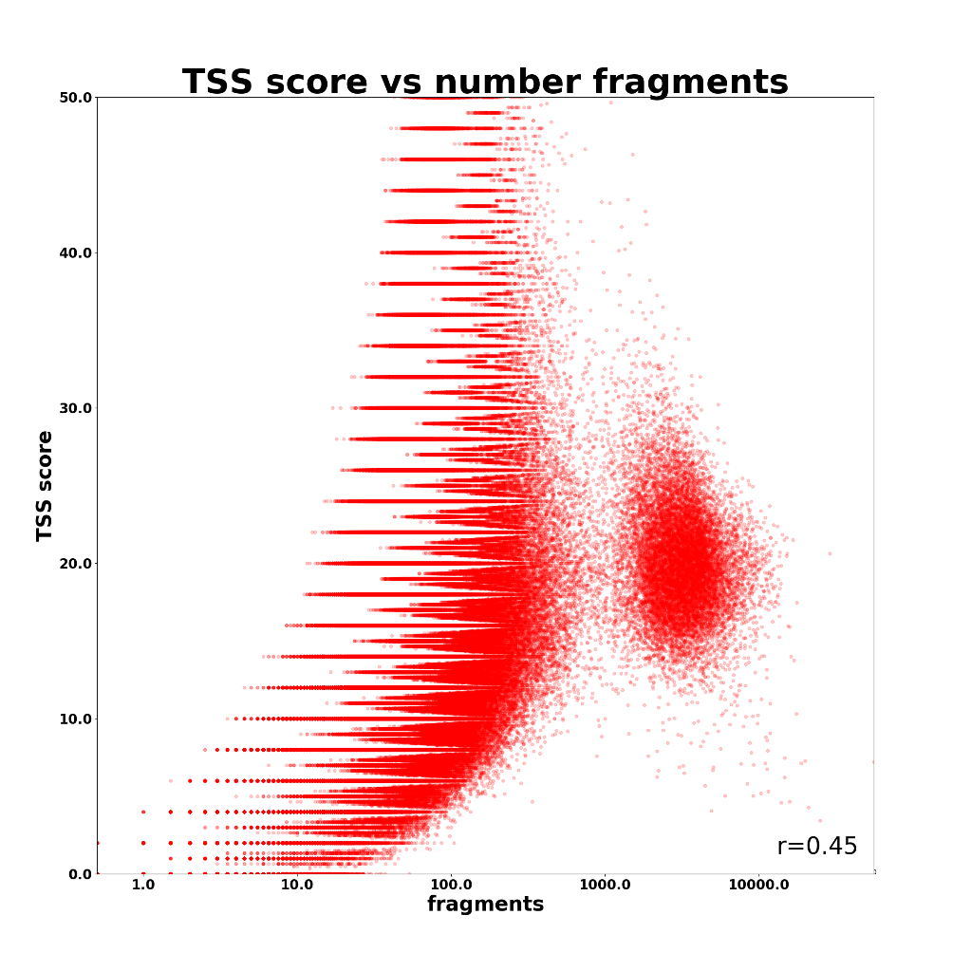

Slide 13
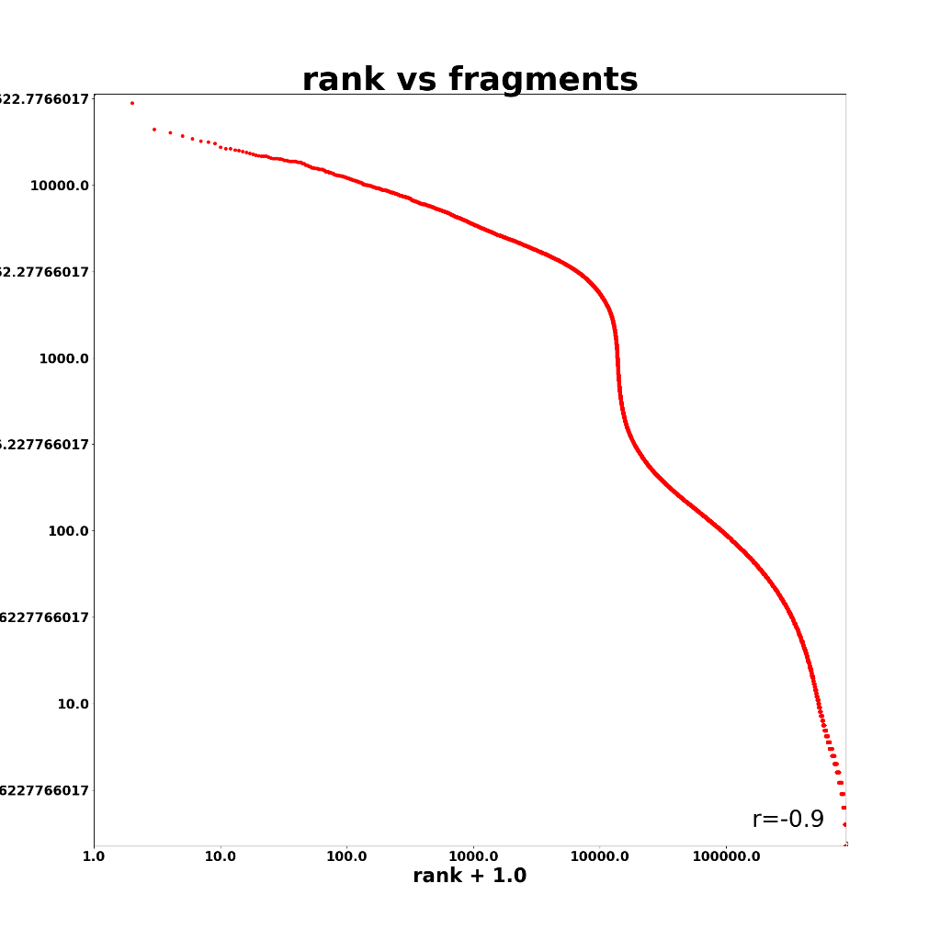
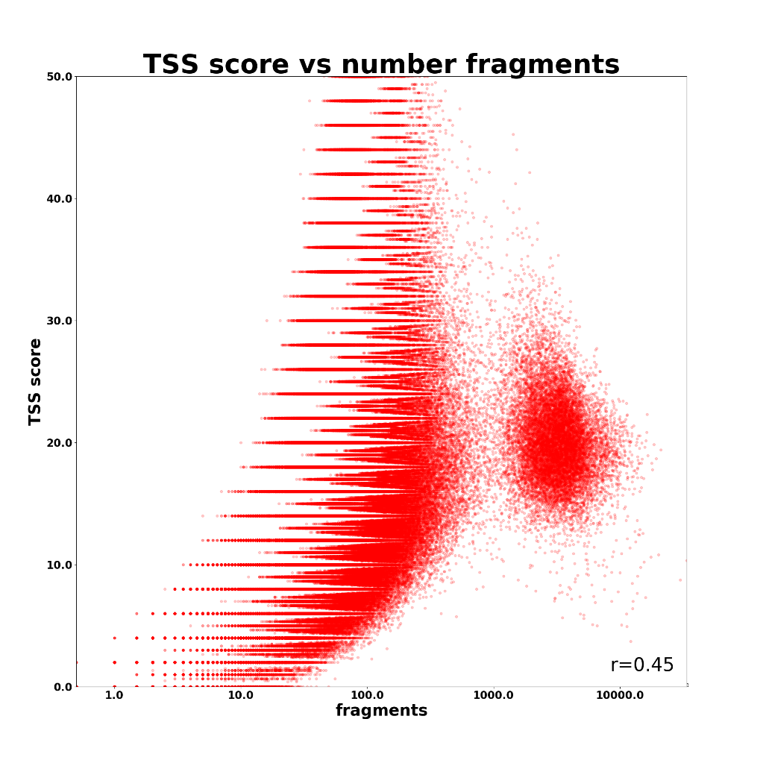

Slide 14
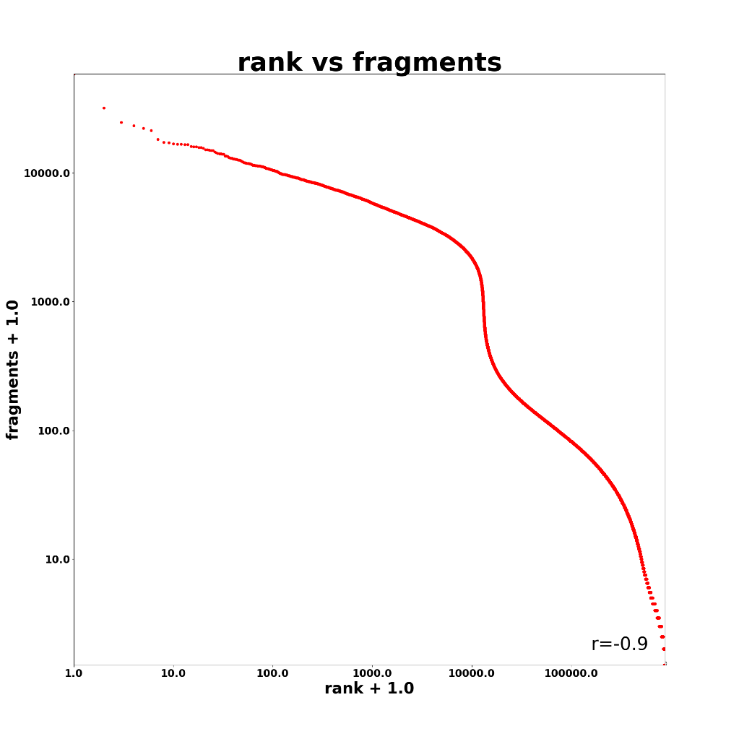


Slide 15
sgRNA reads
#library | raw reads | reads assigned to sgRNA | fraction | barcodes >10 reads | barcodes >5 reads
025927-L472_D6_D10_sgRNA_724_CL01-UGAv3-67-CTCAAGCATGTGCTGAT_trimmed | 49,244,850 | 26,476,962 | 0.54 | 51,601 | 56,521
025927-L474_D6_D10_sgRNA_727_CL03-UGAv3-200-CACAGTCAATGTGAT_trimmed | 29,309,339 | 16,607,662 | 0.57 | 70,577 | 74,241
025927-L475_D6_D10_sgRNA_737_CL09-UGAv3-172-CACACTTGATGCGAT_trimmed | 25,862,530 | 13,758,687 | 0.53 | 118,619 | 140,456
025927-L476_D6_D10_sgRNA_738_CL10-UGAv3-37-CATAGAGCCTCAGAT_trimmed | 21,395,424 | 11,637,254 | 0.54 | 95,563 | 109,678
025927-L477_D6_D10_sgRNA_719_CL13-UGAv3-218-CTTGTGTCATGAGAT_trimmed | 37,991,352 | 20,917,201 | 0.55 | 123,819 | 135,451
025927-L478_D6_D10_sgRNA_720_CL14-UGAv3-250-CAATGCACTCGAGAT_trimmed | 18,307,722 | 9,858,059 | 0.54 | 72,458 | 124,585

Slide 16
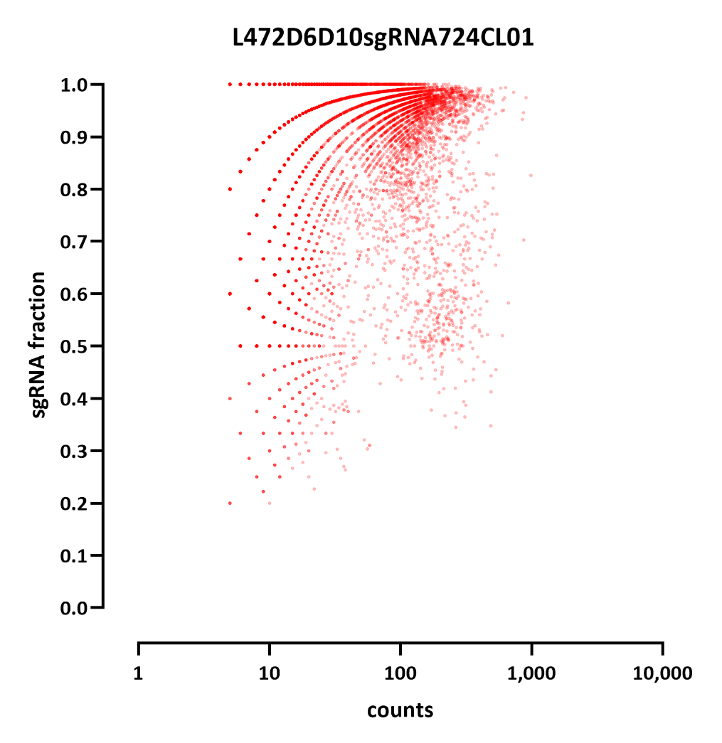
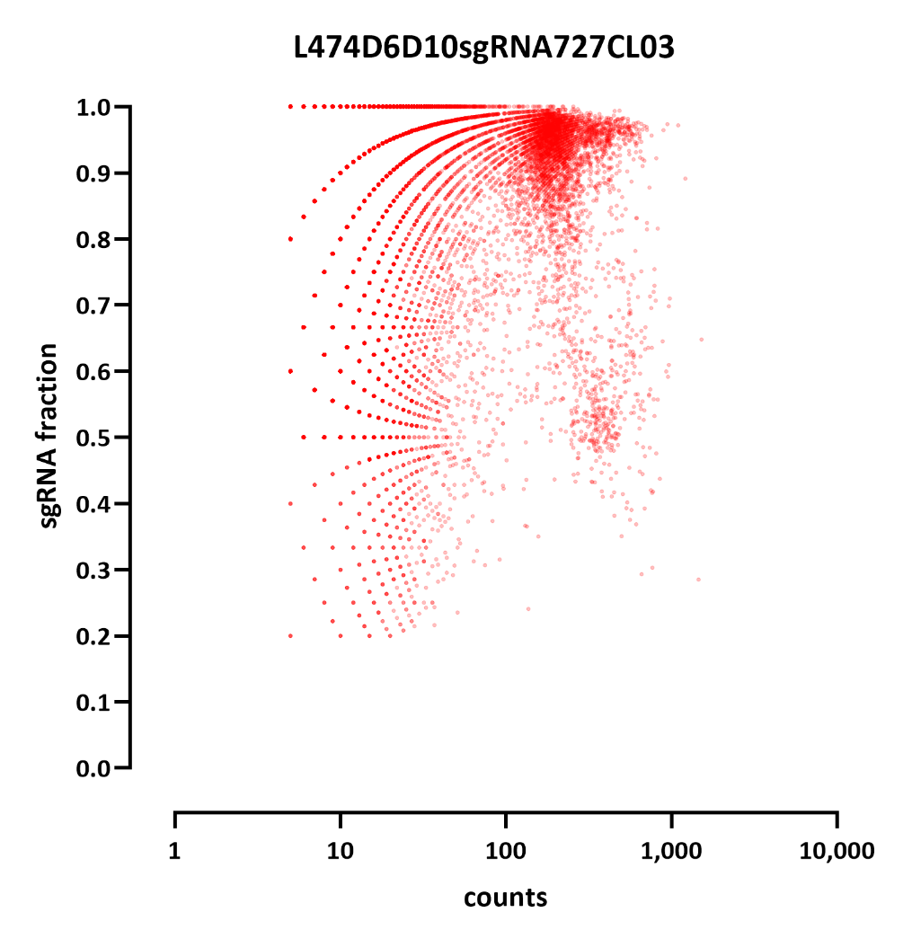

Slide 17
sgRNA assignment intersect with ATAC
Asking for:
- >= 10 sgRNA reads
>= 75% of reads assigned to a single sgRNA
sgRNAs assigned to at least one cell:
3,937 cells in CL01
4,074 cells in CL03
4,994 cells in CL09
4,785 cells in CL10
4,778 cells in CL13
4,179 cells in CL14
CL01 836
CL03 848
CL09 843
CL10 846
CL13 841
CL14 836
Note:
I am ignoring time points for this analysis, but these libraries were a mix of two time points in fact
From these we get ~25 cells per sgRNA across both time points

Slide 18
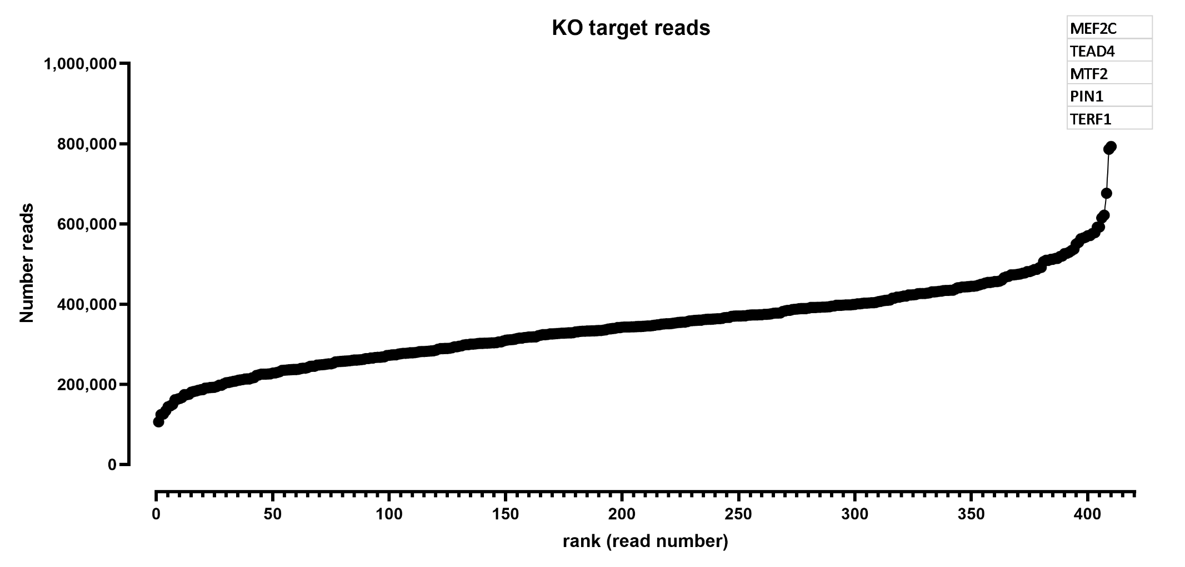
ATAC

Slide 19
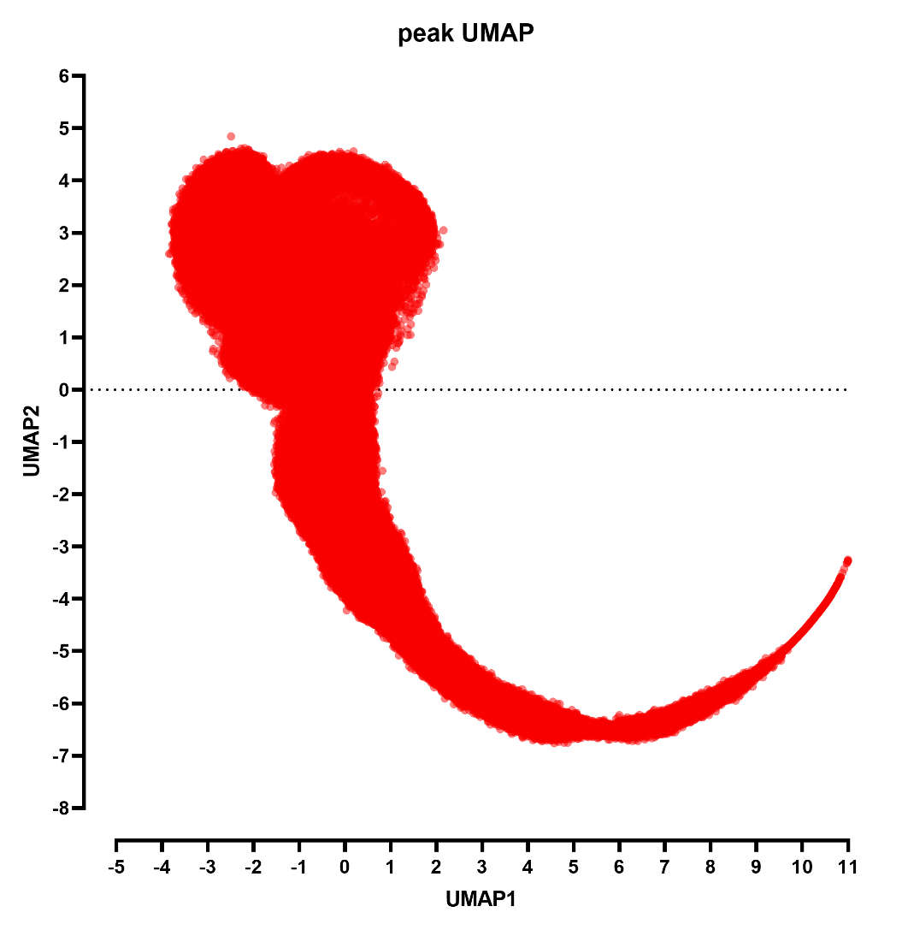
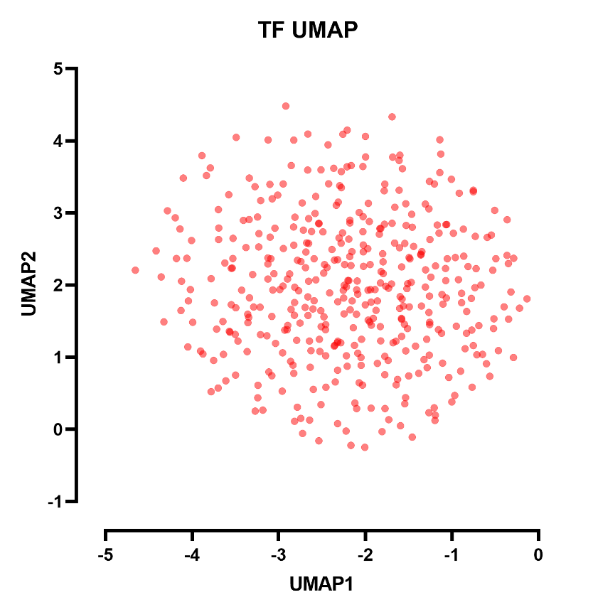
ATAC

Slide 20
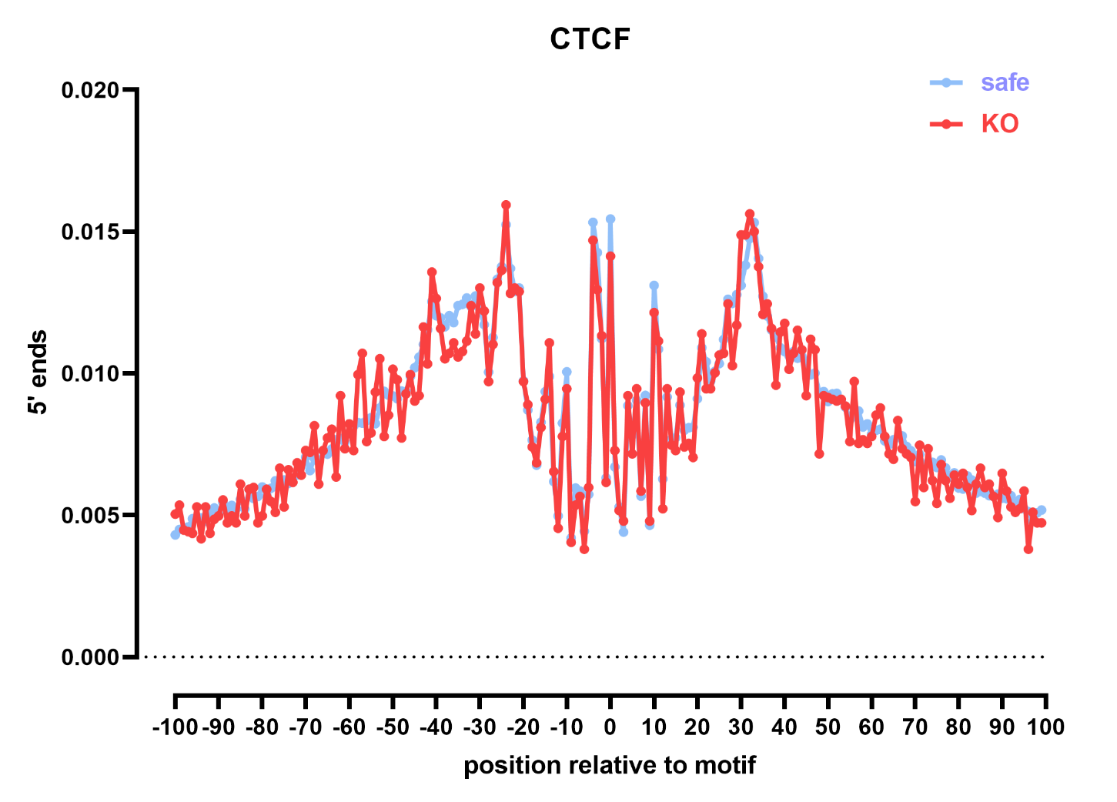
MOTIF ACCESSIBILITY

Slide 21
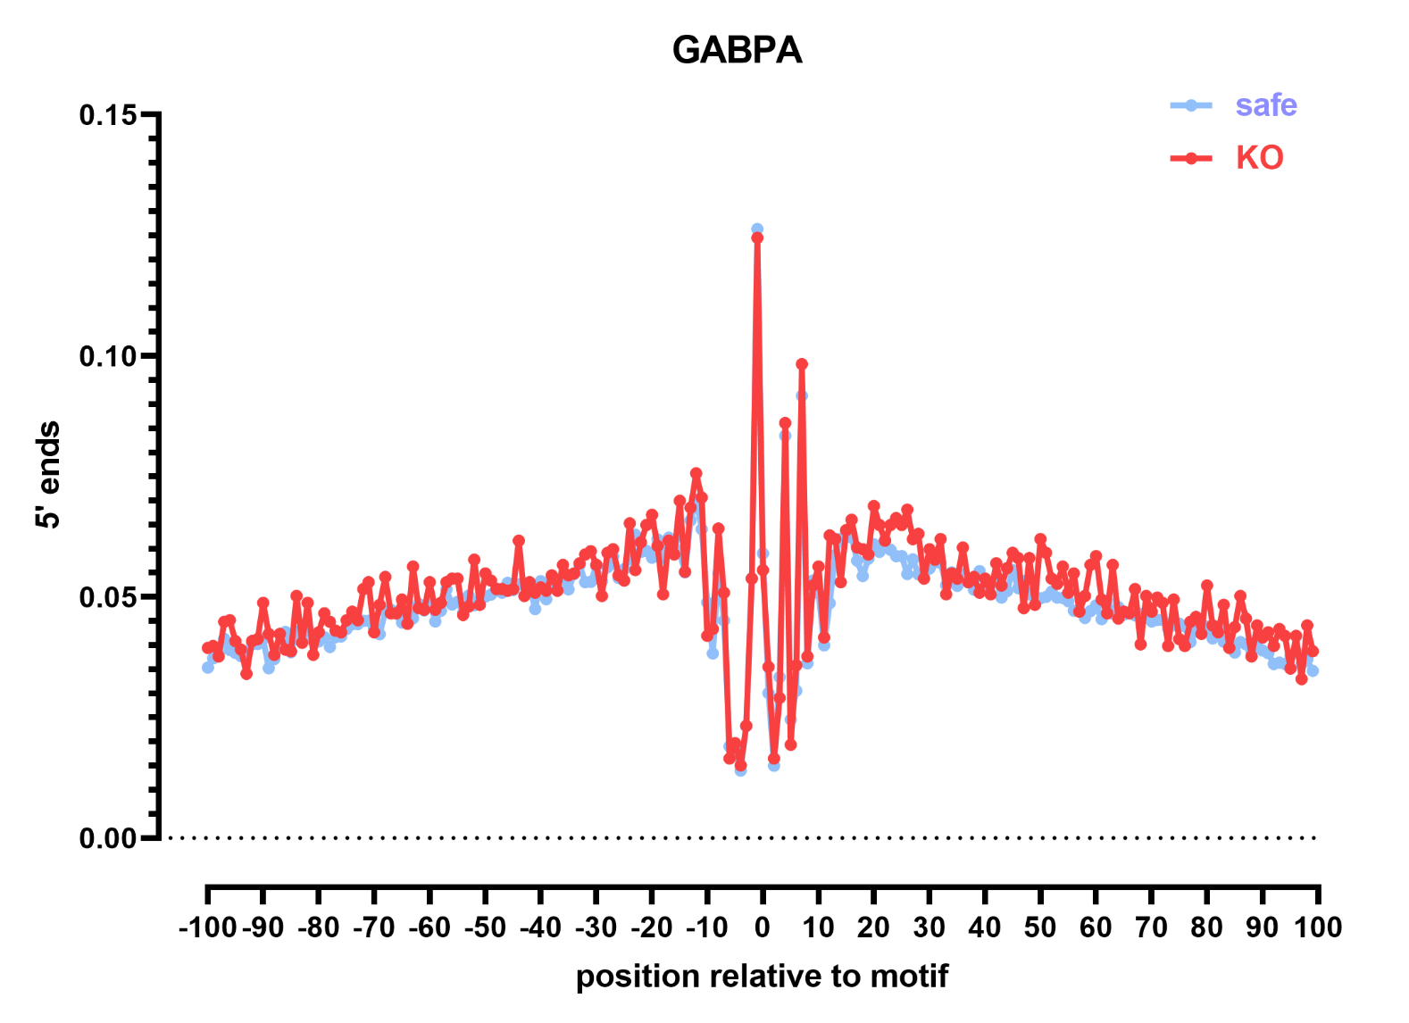

Slide 22
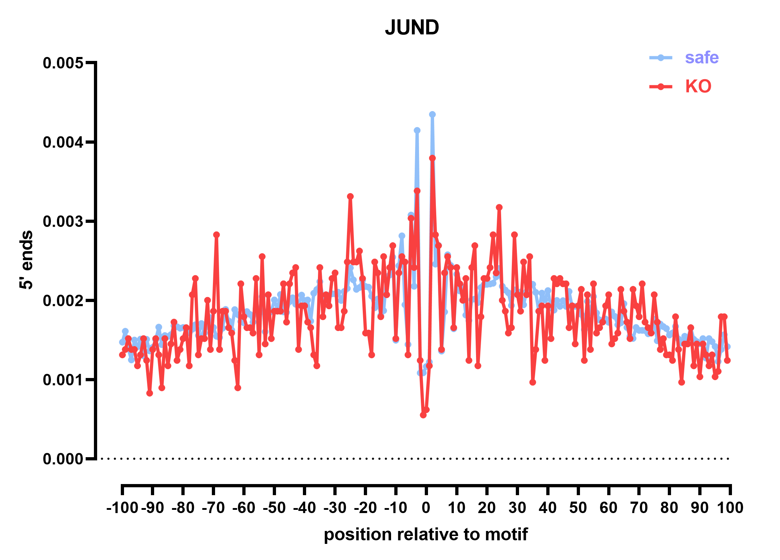

Slide 23
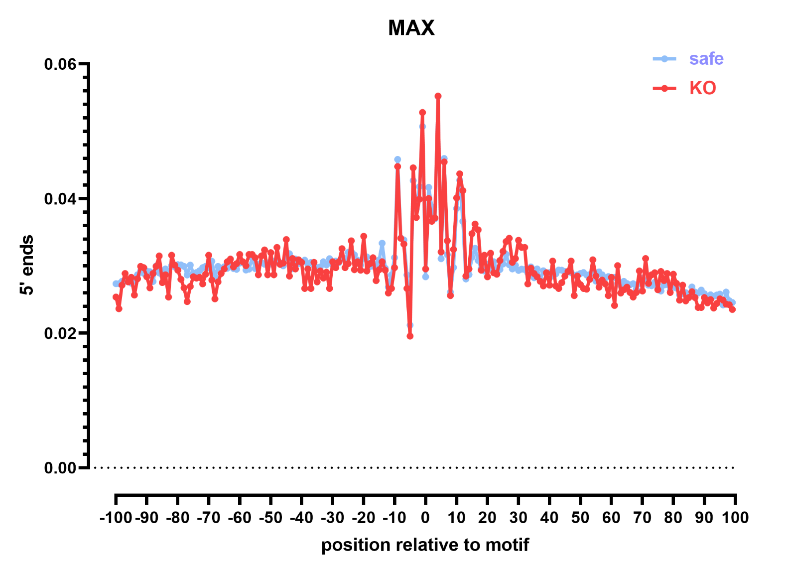

Slide 24
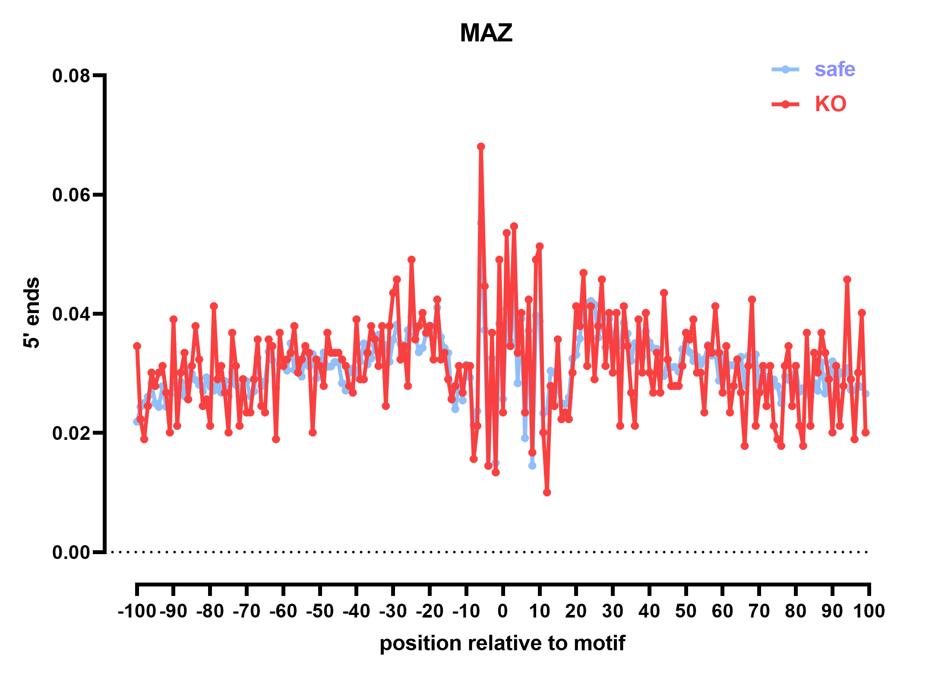

Slide 25
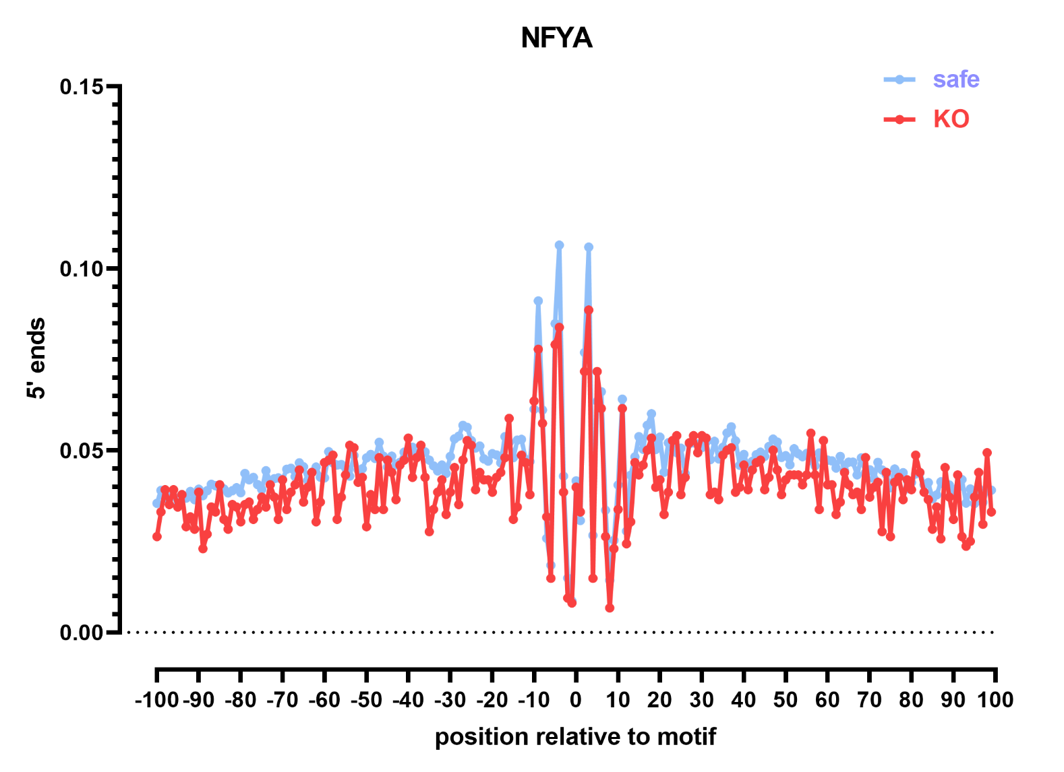

Slide 26
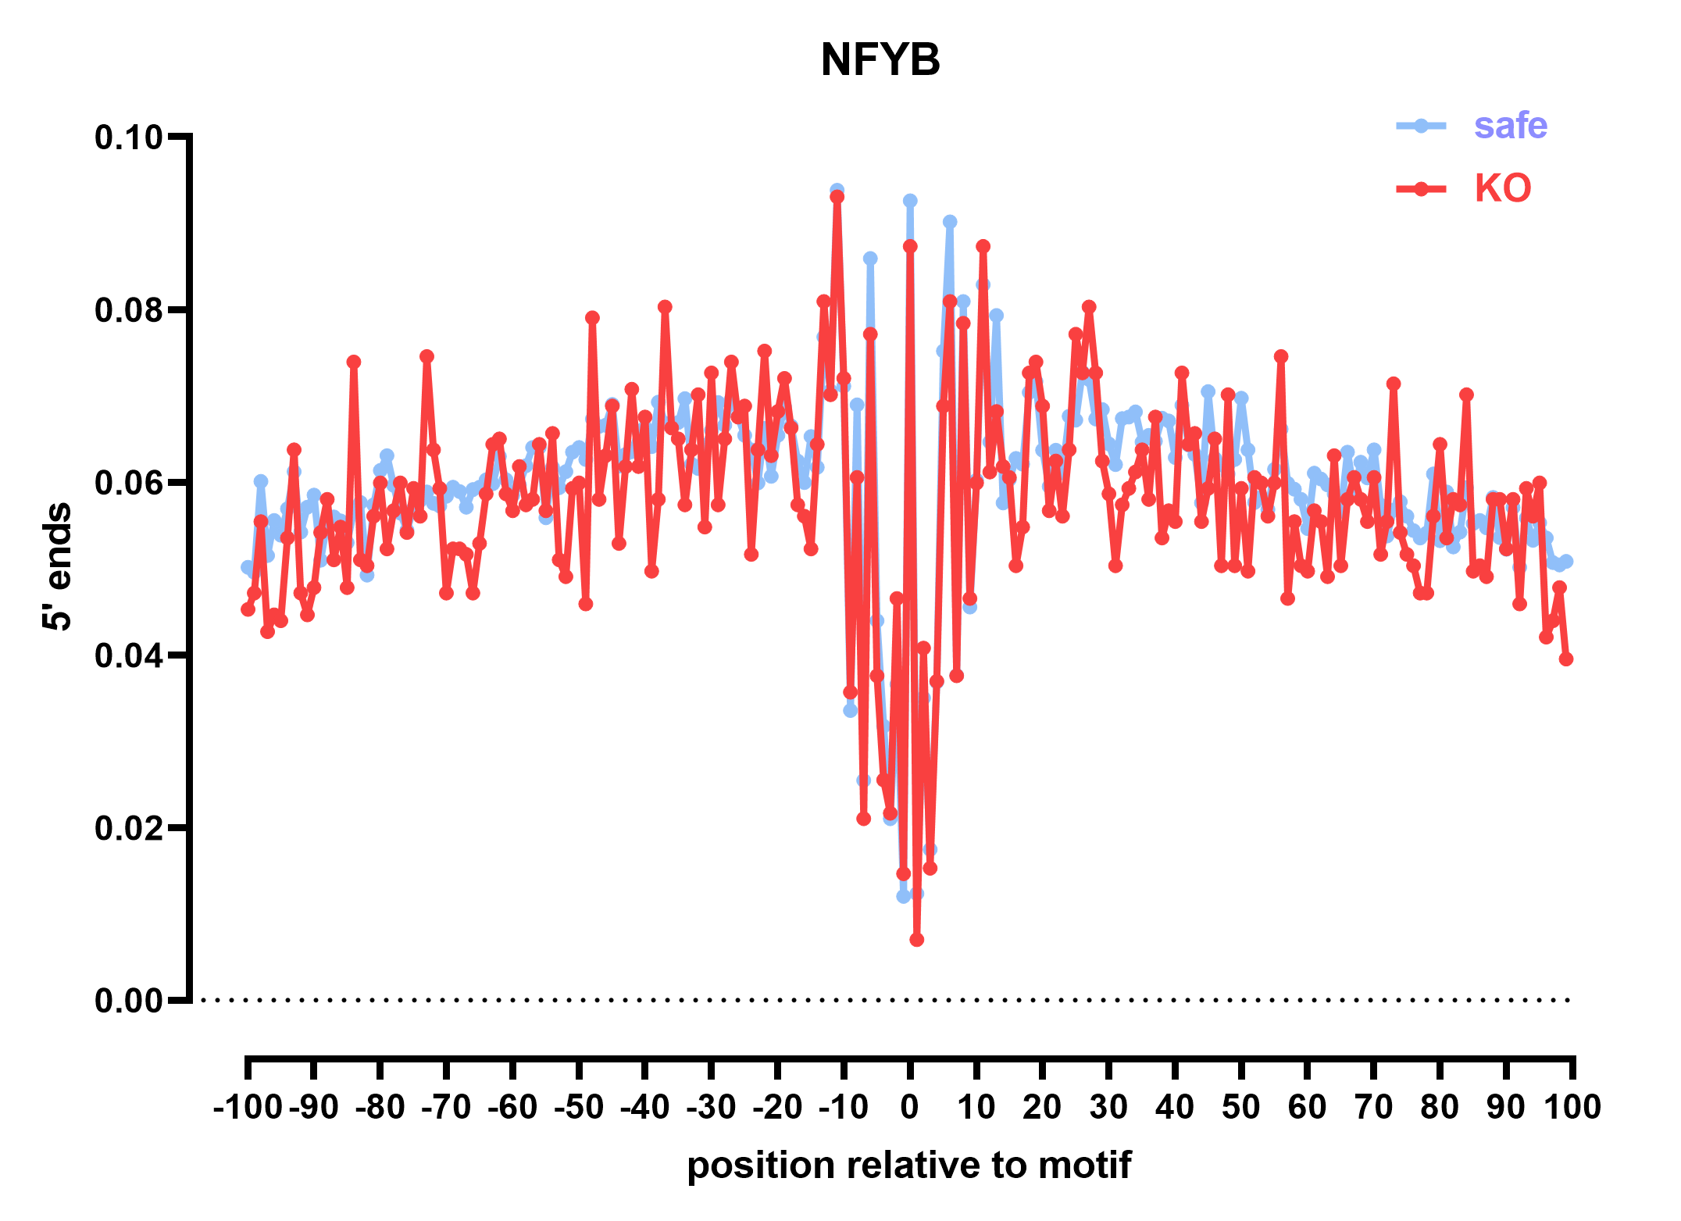

Slide 27
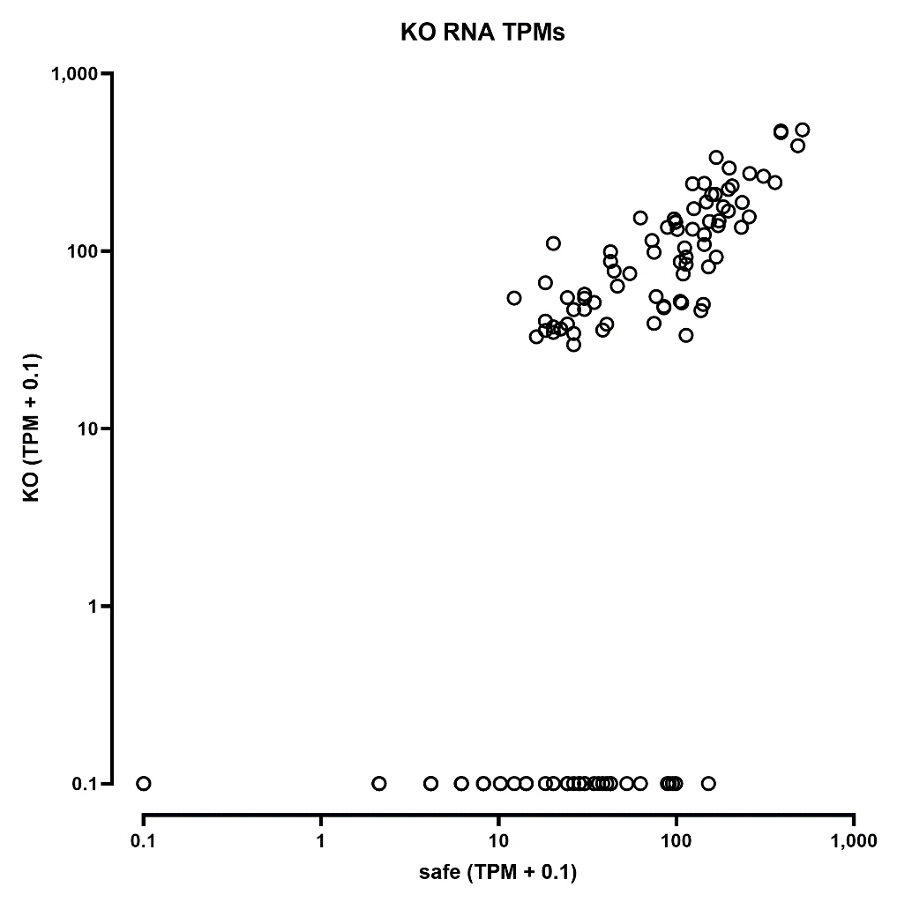
RNA
Note that:
The “safes” have higher coverage because there are 40 safe sgRNA vs. 2 KO sgRNA per gene
We are still at only a few cells per sgRNA
These libraries are a mixture of D2 and D7, and at D2 we do not expect a full KO yet

Slide 28
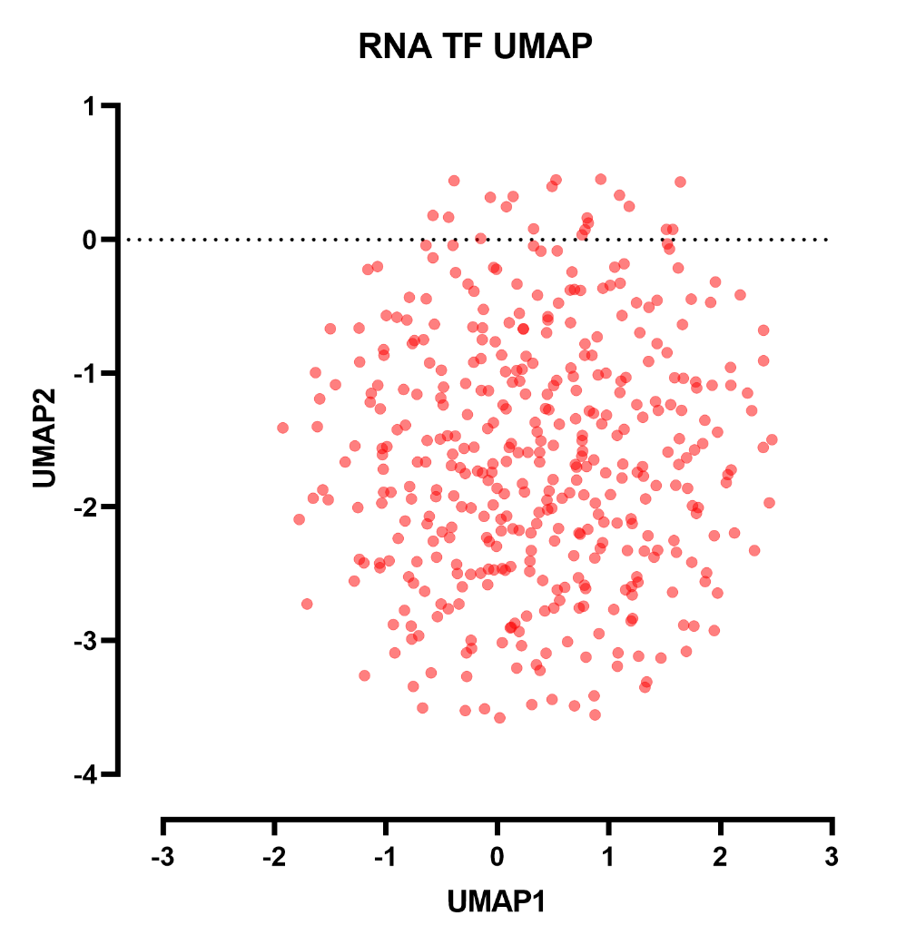
RNA

Slide 29
ATAC INDIVIDUAL PETRUBATIONS

Slide 30
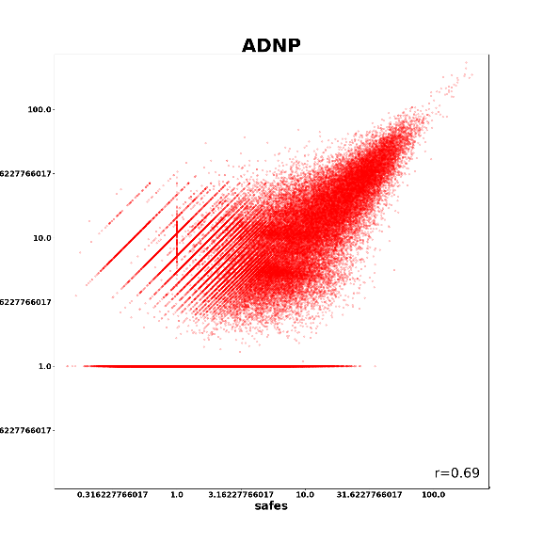
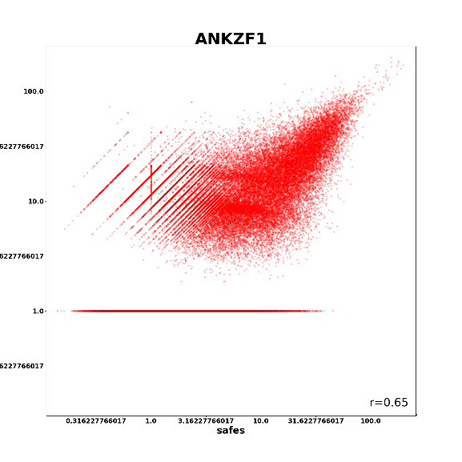
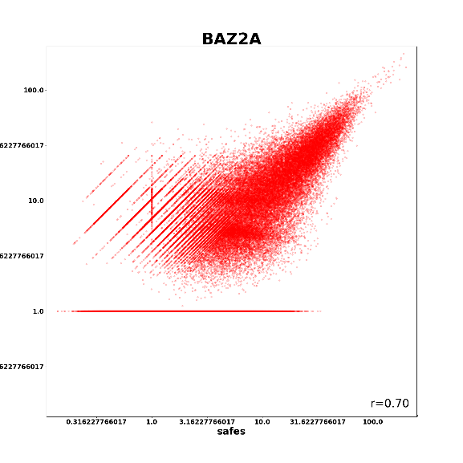
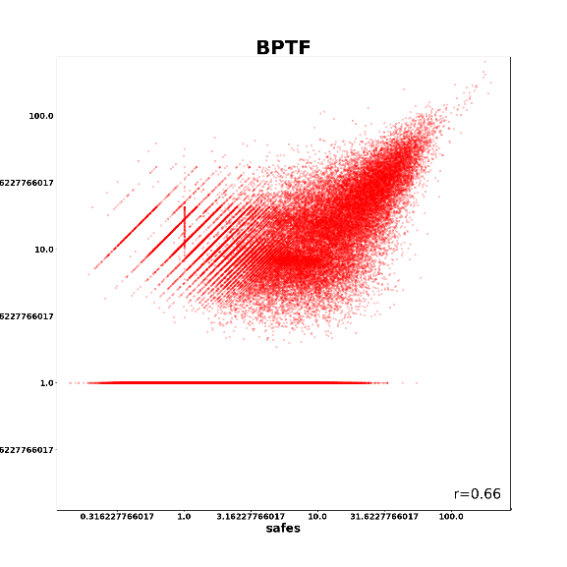



Slide 31



Slide 32
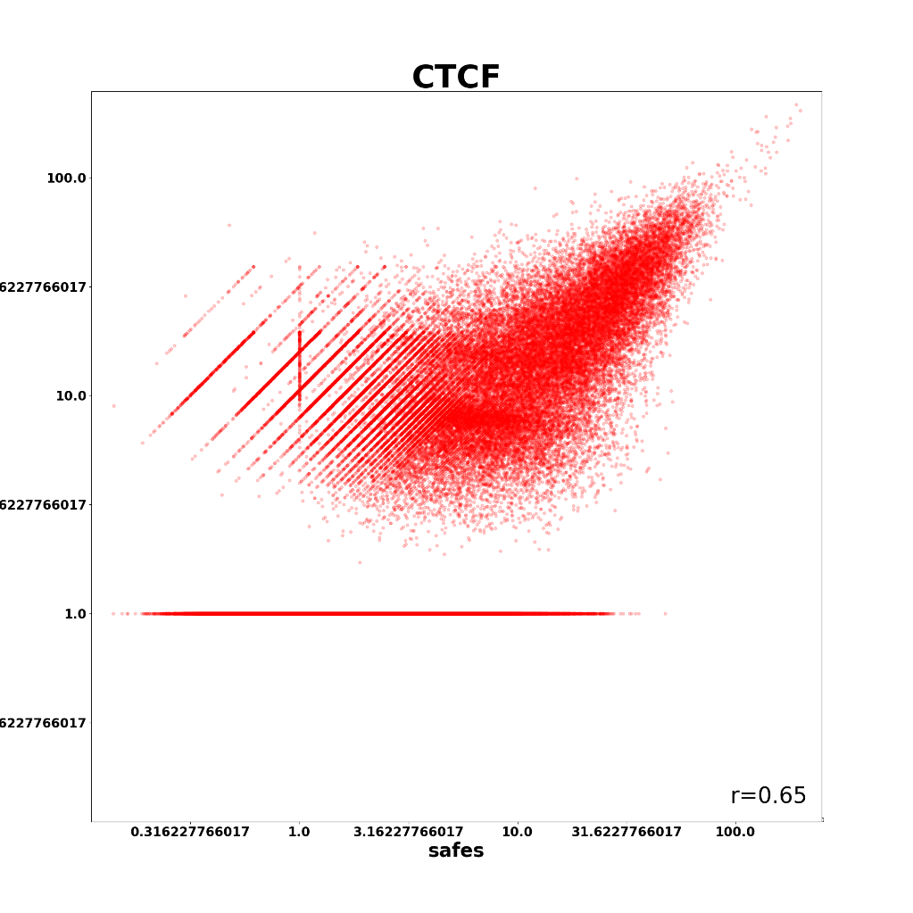


Slide 33
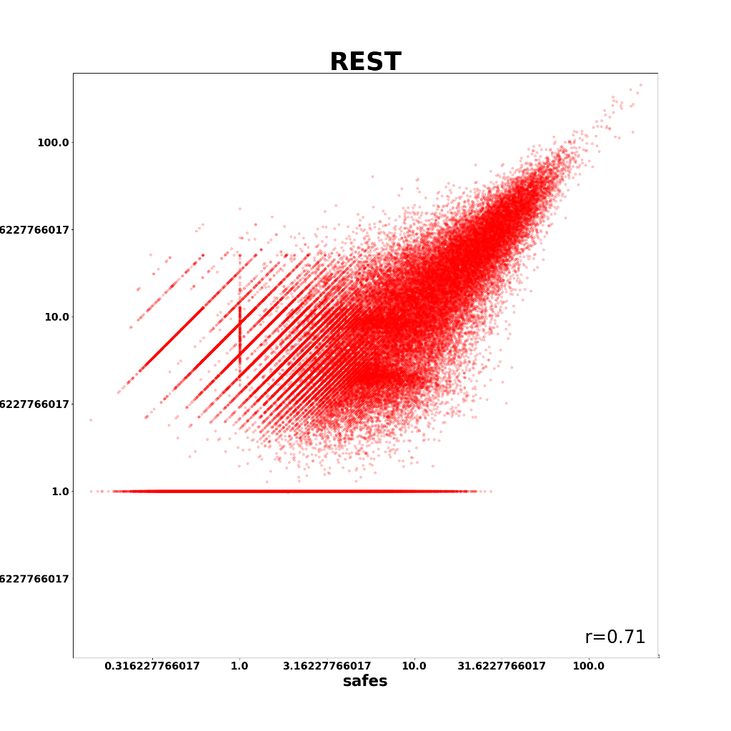


Slide 34
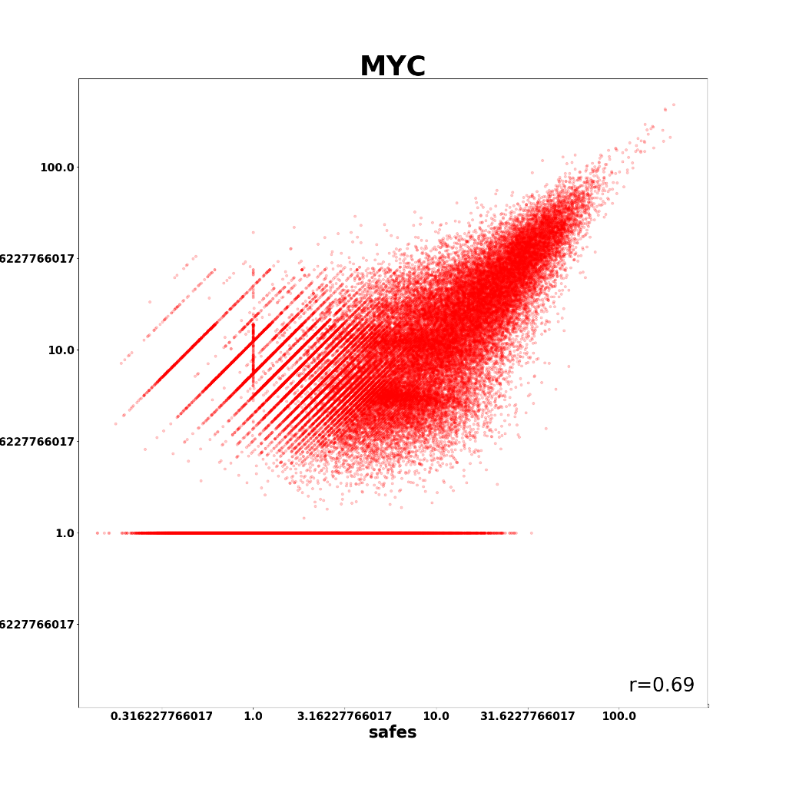
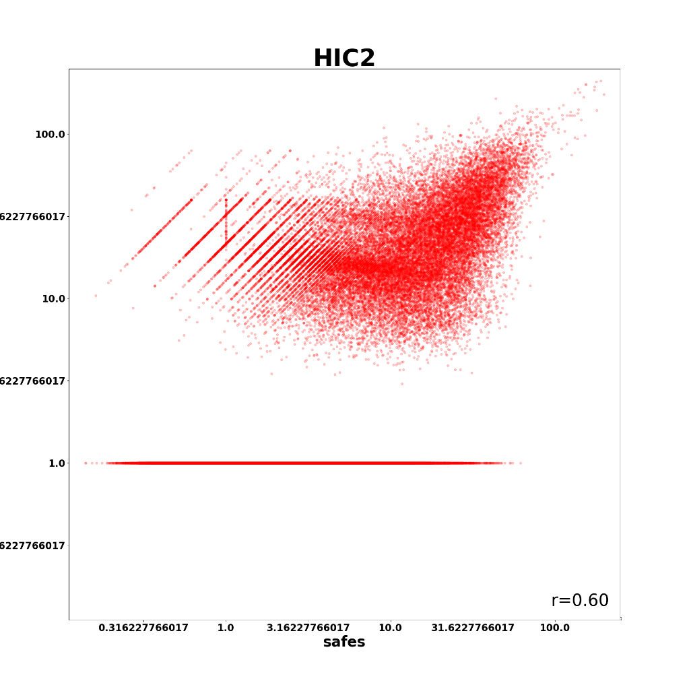

Slide 35
Full set:
https://mitra.stanford.edu/kundaje/marinovg/oak/ENCODE4/single-cell/2023-07-11-UG-data/subbam_MACS_RPM-png/

